Slide 1
Transcatheter versus medical treatment of symptomatic severe tricuspid regurgitation: a propensity score matched analysis
Maurizio Taramasso MD, PhD
from a TriValve – Mayo Clinic – Leiden University collaboration
University Hospital of Zurich, University of Zurich, Switzerland

Slide 2
Disclosure Statement of Financial Interest
Within the past 12 months, I or my spouse/partner have had a financial
interest/arrangement or affiliation with the organization(s) listed below:
Affiliation/Financial Relationship | Company
Consulting Fees/Honoraria | Abbott Boston Scientific Edwards Lifesciences 4tech CoreMedic

Slide 3
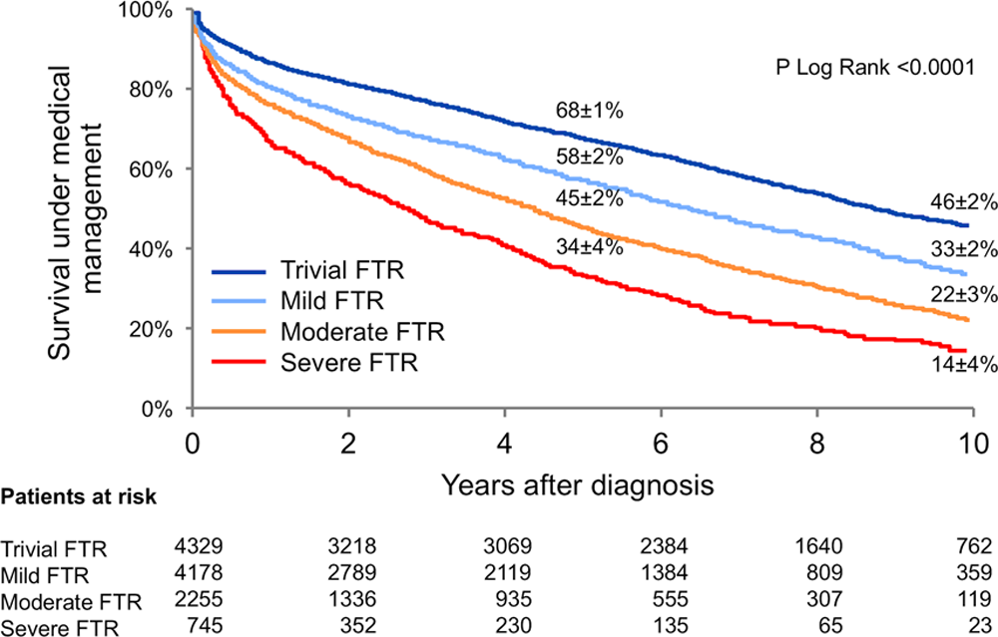
Background
High prevalence of TR in the cardiological population (concomitant left-side heart disease, chronic atrial fibrillation, or pulmonary hypertension setting)
For long considered a benign valve disease, but highly impact the survival
Uncertainty in regard to the clinical efficacy of TR therapies
Benfari G. et al. Circulation. 2019 Jul 16;140(3):196-206

Slide 4
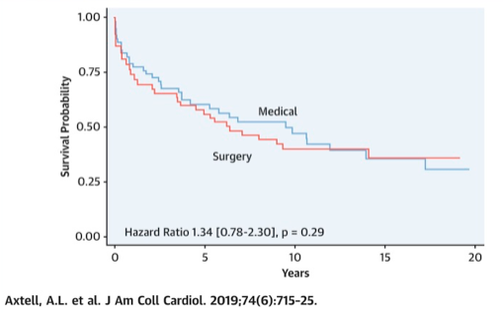
Background
TR surgical treatment is associated to high operative mortality, suboptimal long-term survival, and frequent TR recurrence after repair.
Uncertainty in regard to the clinical efficacy of TR therapies (currently transcatheter therapies are not included in the guidelines).
Lacking RCTs

Slide 5
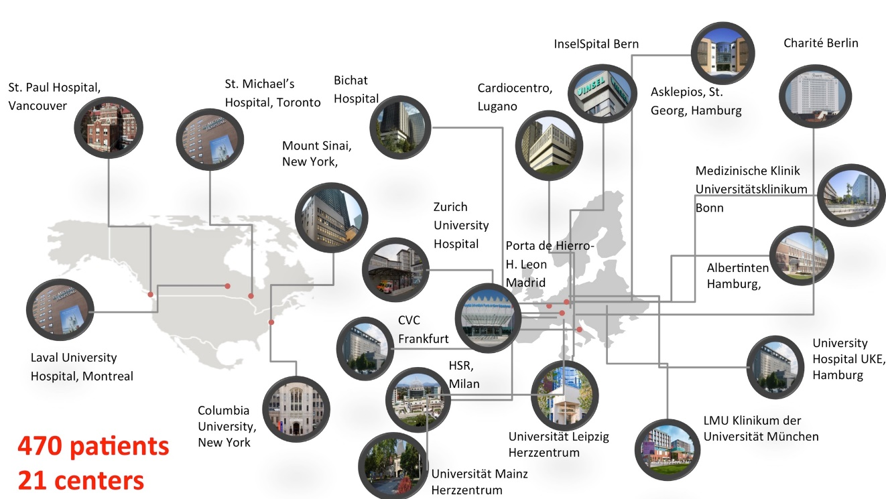
TriValve Registry
The TriValve International Registry represents so far the largest multicenter, multi-devices series of patients with symptomatic severe TR who underwent transcatheter tricuspid valve interventions (TTVI)

Slide 6
Aim
Comparing outcomes of TTVI in high-risk patients (TriValve registry) to a control group of similar patients under conservative treatment with GDMT

Slide 7
Methods
The control cohort of patients with severe TR was formed by consecutive patients evaluated at Mayo Clinic, Rochester, Mn, USA and Leiden University Medical Center, The Netherlands
Exclusion criteria were previous tricuspid valve surgery or intervention, and iatrogenic (pacemaker lead related) TR
Patients in the TTVI cohort (TriValve registry) were matched with controls using propensity scores (distance ± 0.2 SD). The variable adopted to calculate propensity score were age, Euroscore II, and pulmonary pressure level

Slide 8
Methods
Primary endpoint was mortality from any cause or rehospitalization for heart failure (HF)
Secondary endpoint was overall mortality. Follow-up data were collected for patients up to 12 month
TTVI procedural success was defined as patient alive at the end of the procedure, with device successfully implanted, delivery system retrieved and residual TR <3+

Slide 9
Results
 | Overall population N=1652 |  |  | Propensity matched cohort N=536
 | TTVI N=472 | Controls N=1179 | P-value | TTVI N=268 | Controls N=268 | P-value
Age, y±SD | 77±8 | 76 ±13 | 0.07 | 77±8 | 76 ±13 | 0.2
Women, % | 55% | 63% | 0.007 | 56% | 59% | 0.4
TR of functional etiology | 90% | 96% | 0.0004 | 90% | 95% | 0.1
Left ventricular EF, % | 50 ±13 | 49 ±17 | 0.2 | 49±15 | 50 ±15 | 0.2
Left ventricular EF <35%, % | 18% | 26% | 0.0006 | 22% | 21% | 0.7
Euroscore II, (%) | 10.5±11.2 | 17.9±11.7 | <0.0001 | 12±11 | 13±9 | 0.6
Right ventricular dysfunction | 34% | 20% | <0.0001 | 37% | 29% | <0.0001
S-PAP, mmHg | 40±15 | 52±15 | <0.0001 | 44±14 | 43±14 | 0.3
Pulmonary hypertension, % | 27% | 50% | <0.0001 | 34% | 29% | 0.2
NYHA III-IV, % | 93% | 39% | <0.0001 | 93% | 23% | <0.0001
Mitral regurgitation > 2+ | 33% | 18% | <0.0001 | 40% | 17% | <0.0001
Atrial Fibrillation, % | 83% | 57% | <0.0001 | 82% | 50% | <0.0001
Pacemaker or defibrillator, % | 26% | 5% | <0.0001 | 29% | 12% | <0.0001

Slide 10
Results: Primary and secondary endpoint

Slide 11
Results: Primary and secondary endpoint

Slide 12
Results: Primary and secondary endpoint
77±3%
68±4%
64±3%
51±3%

Slide 13
Results: Multivariable adjusted models
Model for control group | HR for death or heart failure hosp (primary endpoint) | P-value | HR for mortality (secondary endpoint) | P-value
1) Unadjusted | 0.60 (0.46-0.79) | 0.003 | 0.56 (0.39-0.79) | 0.001

Slide 14
Results: Multivariable adjusted models
Model for control group | HR for death or heart failure hosp. (primary endpoint) | P-value | HR for mortality (secondary endpoint) | P-value
1) Unadjusted | 0.60 (0.46-0.79) | 0.003 | 0.56 (0.39-0.79) | 0.001
2) Adj. for sex and NYHA | 0.46 (0.31-0.68) | 0.0001 | 0.49 (0.31-0.79) | 0.003

Slide 15
Results: Multivariable adjusted models
Model for control group | HR for death or heart failure hosp. (primary endpoint) | P-value | HR for mortality (secondary endpoint) | P-value
1) Unadjusted | 0.60 (0.46-0.79) | 0.003 | 0.56 (0.39-0.79) | 0.001
2) Adj. for sex and NYHA | 0.46 (0.31-0.68) | 0.0001 | 0.49 (0.31-0.79) | 0.003
3) Adj. for sex and NYHA, Afib, and RV dysf. | 0.39 (0.26-0.59) | <0.0001 | 0.41 (0.26-0.67) | 0.0004

Slide 16
Results: Multivariable adjusted models
Model for control group | HR for death or heart failure hosp. (primary endpoint) | P-value | HR for mortality (secondary endpoint) | P-value
1) Unadjusted | 0.60 (0.46-0.79) | 0.003 | 0.56 (0.39-0.79) | 0.001
2) Adj. for sex and NYHA | 0.46 (0.31-0.68) | 0.0001 | 0.49 (0.31-0.79) | 0.003
3) Adj. for sex and NYHA, Afib, and RV dysf. | 0.39 (0.26-0.59) | <0.0001 | 0.41 (0.26-0.67) | 0.0004
4) Adj for sex and NYHA, Afib, and RV dysf, MR>2+, PM/ICD | 0.35 (0.23-0.54) | <0.0001 | 0.38 (0.23-0.63) | 0.002

Slide 17
Results: subgroup analysis

Slide 18
Results: TTVI device type
Total matched TTVI: 268

Slide 19
Results: Procedural success vs. residual TR

Slide 20
Results: impact of concomitant MR

Slide 21
Conclusions
TTVI in high-risk patients with symptomatic severe TR as compared to medical treatment alone is associated to lower incidence of composite endpoint as well as lower all-cause mortality, at 1 year follow-up
A significant difference was observed between patients undergoing TTVI with procedural success compared to those in whom procedural success was not achieved
TTVI patients without a significant reduction in TR presented similar outcomes vs. control group, confirming the prognostic role of TR reduction in improving outcomes

