Slide 1

COMPLETE TRIAL
A randomized, comparative effectiveness study of
complete versus culprit-only revascularization strategies
to treat multivessel disease after early percutaneous coronary
intervention for ST-segment elevation myocardial infarction
Shamir R. Mehta MD, MSc
Population Health Research Institute, McMaster University and Hamilton Health Sciences
on behalf of the COMPLETE Trial Executive & Steering Committees and Investigators

Slide 2
Disclosures
The COMPLETE Trial was funded by the
Canadian Institutes of Health Research
and the Population Health Research Institute
with additional unrestricted grants from AstraZeneca and Boston Scientific.
Coordinated by the Population Health Research Institute
Hamilton, Canada

Slide 3
Background
Patients undergoing primary PCI to the culprit lesion for STEMI are often found to have multivessel CAD, with 1 or more angiographically significant non-culprit lesions.
There is uncertainty on how best to manage these non-culprit lesions:
    Routinely revascularize them with PCI?
    Manage them conservatively with guideline-directed medical therapy alone?
Prior RCT’s have shown non-culprit lesion PCI reduces revascularization but none were powered to detect moderate reductions in hard clinical outcomes such as CV death or MI. ¹⁻⁴
Meta-analyses have suggested a possible reduction in CV death or MI, but this result is fragile and no single RCT has been adequately powered to confirm this.⁵
The COMPLETE trial was designed to address this evidence gap.
Wald et al. N Engl J Med 2013;369:1115-23.
Gershlick et al. J Am Coll Cardiol 2015;65:963-72.
Engstrom et al. Lancet 2015;386:665-71.
Smits et al. N Engl J Med 2017;376:1234-44.
Bainey et al. Can J Cardiol 2016;32:1542-51.

Slide 4
Primary Objective
In patients presenting with STEMI and multi-vessel coronary artery disease who have undergone culprit-lesion PCI, the objective is:
To determine whether a strategy of routine, staged non-culprit lesion PCI with the goal of complete revascularization is superior to a strategy of culprit lesion-only PCI in reducing the composite of CV death or new MI.

Slide 5

COMPLETE
Trial Design
STEMI with Multivessel CAD and successful PCI to the Culprit Lesion
MVD defined as at least one additional non-culprit lesion ≥ 2.5 mm diameter
and ≥70% stenosis or 50-69% with FFR ≤0.80
Exclusion Criteria: Intent to revascularize NCL,
planned surgical revascularization, prior CABG
RANDOMIZATION
Stratified for intended timing of NCL PCI:
During initial hospitalization or after discharge (max 45 d)
Actual Time to study NCL PCI in Complete Group (median)
During initial hospitalization: 1 day (IQR 1-3)
After hospital discharge: 23 days (IQR 12.5-33.5)
Complete Revascularization
Routine staged PCI* of all suitable non-culprit lesions
with the goal of complete revascularization
N=2016
Culprit-Lesion-Only Revascularization
No further revascularization of non-culprit lesions,
guideline-directed medical therapy alone
N=2025
*Everolimus-eluting stents
strongly recommended
Guideline-Directed Medical Therapy
ASA, P2Y12 inhibitor (Ticagrelor strongly recommended), Statin, BB, ACE/ARB + Risk Factor Modification
Median Follow-up: 3 years
Co-primary Outcomes: 1. Composite of CV death or new MI
2. Composite of CV death, new MI or IDR
Key Secondary Outcome: CV death, new MI, IDR, unstable angina, NYHA class IV heart failure
Mehta SR et al. Am Heart J 2019; 215:157-166.

Slide 6
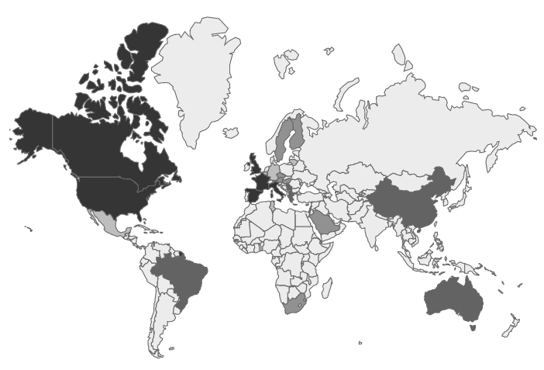
Global Recruitment
140 centers, 31 countries
Australia | Lithuania
Austria | Macedonia
Belgium | Mexico
Brazil | Poland
Canada | Portugal
China | Romania
Colombia | Saudi Arabia
Czech Republic | Serbia
Finland | South Africa
France | Spain
Germany | Sweden
Greece | Switzerland
Hungary | Tunisia
Israel | United Kingdom
Italy | USA
Kuwait
Europe
1907
North America
1778
Asia-Pacific
149
Africa
47
Middle East
55
South America
105

Slide 7
Study Power and Follow-up
Study Power: 80% power for CVD/MI and 89% power for CVD/MI/IDR to detect a 22% HRR.
To preserve the overall type I error rate of 5% for the testing of both co-primary outcomes, the first co-primary outcome was tested at a P value of 0.045 and the second at a P value of 0.0119*
Recruitment Period: February 1, 2013 – March 6, 2017
Angiographic Core Lab: Central review of all coronary angiograms in the trial
Analysis: Intention-to-treat, Cox proportional hazards model, stratified by intended timing of revascularization, stratified log rank test
Follow-up (vital status): 99.1% in Complete group and 99.3% Culprit-Lesion-only group
Crossover in first 45 days: From Complete Revasc to Culprit-Lesion-only = 3.9% From Culprit-Lesion-only to Complete Revasc = 4.7%
*Mehta SR et al. Am Heart J 2019; 215:157-166.

Slide 8
Baseline Characteristics
 | Complete N=2016 | Culprit-only N=2025
Age (yrs) | 61.6 | 62.4
Gender (% male) | 80.5 | 79.1
Diabetes (%) | 19.1 | 19.9
Chronic renal insuff. (%) | 2.0 | 2.3
Prior MI (%) | 7.3 | 7.6
Current smoker (%) | 40.6 | 38.9
Hypertension (%) | 48.7 | 50.7
Dyslipidemia (%) | 37.9 | 39.4
Prior PCI (%) | 7.0 | 7.0
Prior stroke (%) | 3.2 | 3.1
Hemoglobin A1C | 6.3 | 6.3
LDL (mmol/L) | 3.1 | 3.1
Creatinine (µmol/L) | 84.7 | 85.2
 | Complete N=2016 | Culprit-only N=2025
Sx onset to Culprit PCI (%)
<6 hours | 69.4 | 67.1
6~12 hours | 16.1 | 17.7
>12 hours | 14.5 | 15.3
Discharge Meds (%)
ASA | 99.8 | 99.5
P2Y12 Inhibitor | 99.4 | 99.7
Ticagrelor | 64.4 | 63.3
Prasugrel | 9.6 | 8.3
Clopidogrel | 25.6 | 28.2
Beta blocker | 88.1 | 89.1
ACEi/ARB | 85.5 | 84.6
Statin | 98.2 | 97.2

Slide 9
Procedural Characteristics
 | Complete N=2016 | Culprit-only N=2025
Index PCI for STEMI
Primary | 91.9% | 93.1%
Pharmaco-invasive | 3.2% | 3.0%
Rescue | 4.9% | 3.9%
Radial access | 80.8% | 80.7%
Residual diseased vessels
1 | 76.1% | 77.1%
≥2 | 23.9% | 22.9%
NCL location
Left main | 0.4% | 0.1%
LAD | 38.0% | 41.2%
Proximal LAD | 9.8% | 10.4%
Mid LAD | 21.7% | 23.7%
Circumflex | 36.4% | 35.6%
RCA | 25.3% | 23.2%
 | Complete N=2016 | Culprit-only N=2025
NCL diameter | 2.8 mm | 2.9 mm
Mean NCL stenosis (visual) | 79.3% | 78.7%
NCL stenosis (visual)
50-69% and FFR<0.80 | 0.8% | 0.6%
70-79% | 41.3% | 45.1%
80-89% | 33.5% | 32.6%
90-99% | 22.3% | 19.7%
100% | 2.1% | 2.0%
SYNTAX score (Core Lab)
Baseline | 16.3 | 16.0
Culprit lesion specific | 8.8 | 8.6
Non-culprit lesion specific | 4.5 | 4.5
Residual (after index PCI) | 7.2 | 7.0

Slide 10
Procedural Characteristics
 | Complete N=2016 | Culprit-only N=2025
Index PCI for STEMI
Primary | 91.9% | 93.1%
Pharmaco-invasive | 3.2% | 3.0%
Rescue | 4.9% | 3.9%
Radial access | 80.8% | 80.7%
Residual diseased vessels
1 | 76.1% | 77.1%
≥2 | 23.9% | 22.9%
NCL location
Left main | 0.4% | 0.1%
LAD | 38.0% | 41.2%
Proximal LAD | 9.8% | 10.4%
Mid LAD | 21.7% | 23.7%
Circumflex | 36.4% | 35.6%
RCA | 25.3% | 23.2%
 | Complete N=2016 | Culprit-only N=2025
NCL diameter | 2.8 mm | 2.9 mm
Mean NCL stenosis (visual) | 79.3% | 78.7%
NCL stenosis (visual)
50-69% and FFR<0.80 | 0.8% | 0.6%
70-79% | 41.3% | 45.1%
80-89% | 33.5% | 32.6%
90-99% | 22.3% | 19.7%
100% | 2.1% | 2.0%
SYNTAX score (Core Lab)
Baseline | 16.3 | 16.0
Culprit lesion specific | 8.8 | 8.6
Non-culprit lesion specific | 4.5 | 4.5
Residual (after index PCI) | 7.2 | 7.0
Complete revascularization was achieved in 90.1% after NCL PCI (SYNTAX score = 0)

Slide 11
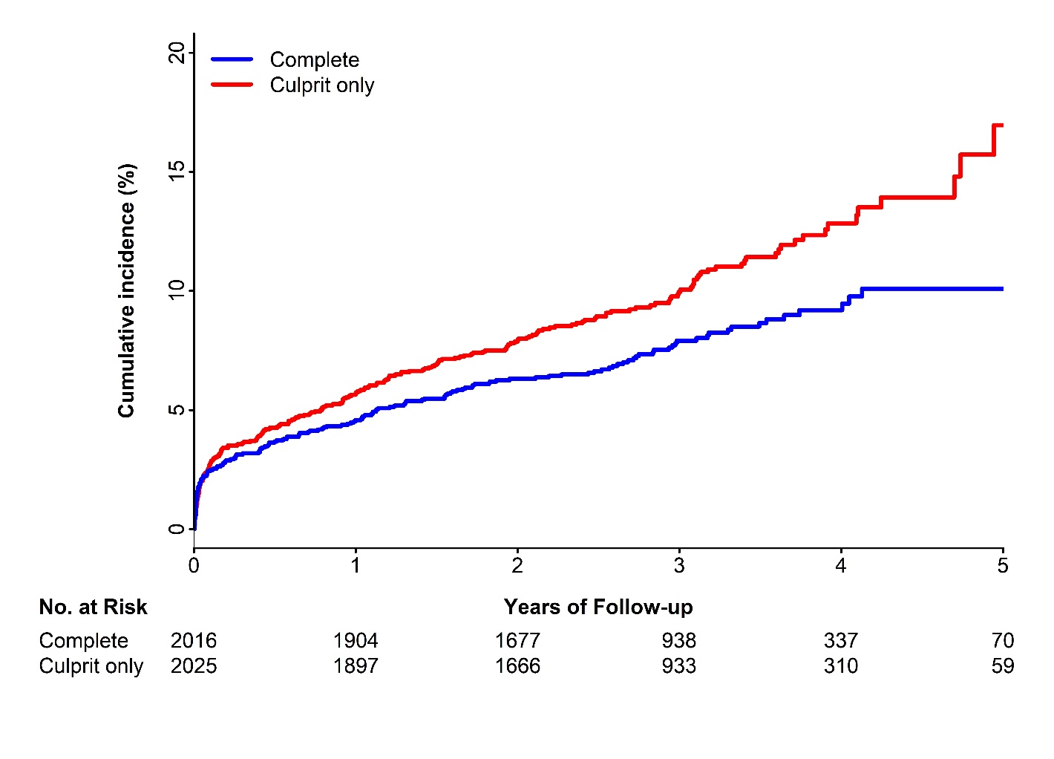
First Co-Primary Outcome:
CV Death or New MI
Hazard Ratio 0.74
95% CI 0.60-0.91
P=0.004
NNT (median 3 years) = 37

Slide 12
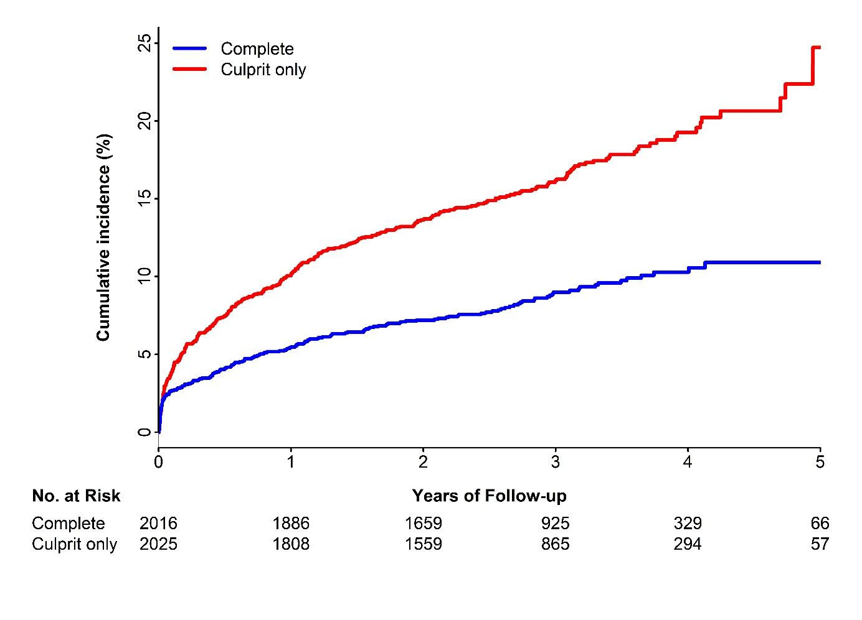
2nd Co-Primary Outcome:
CV Death, New MI, or IDR
Hazard Ratio 0.51
95% CI 0.43-0.61
P < 0.001
NNT (median 3 years) = 13

Slide 13
Efficacy Outcomes
 | Complete Revasc. N=2016 |  | Culprit Lesion Only N=2025 |  | HR (95% CI) | P value
 | N (%) | %/year | N (%) | %/year
Co-Primary Outcomes
CV death or MI | 158 (7.8) | 2.7 | 213 (10.5) | 3.7 | 0.74 (0.60-0.91) | 0.004
CV death, MI or IDR | 179 (8.9) | 3.1 | 339 (16.7) | 6.2 | 0.51 (0.43-0.61) | <0.001
Key Secondary Outcome
CV death, MI, IDR, unstable angina or class IV HF | 272 (13.5) | 4.9 | 426 (21.0) | 8.1 | 0.62 (0.53-0.72) | <0.001
Other Secondary Outcomes
MI | 109 (5.4) | 1.9 | 160 (7.9) | 2.8 | 0.68 (0.53-0.86) | 0.002
IDR | 29 (1.4) | 0.5 | 160 (7.9) | 2.8 | 0.18 (0.12-0.26) | <0.001
Unstable Angina | 70 (3.5) | 1.2 | 130 (6.4) | 2.2 | 0.53 (0.40-0.71) | <0.001
CV death | 59 (2.9) | 1.0 | 64 (3.2) | 1.0 | 0.93 (0.65-1.32) | 0.68
All-cause Death | 96 (4.8) | 1.6 | 106 (5.2) | 1.7 | 0.91 (0.69-1.20) | 0.51

Slide 14
Sub-types of MI
 | Complete Revasc. N=2016 |  | Culprit Lesion Only N=2025 |  | HR (95% CI)
 | N (%) | %/year | N (%) | %/year
Subtype of MI
NSTEMI | 66 (3.27) | 1.11 | 105 (5.19) | 1.78 | 0.63 (0.46-0.85)
STEMI | 43 (2.13) | 0.72 | 53 (2.62) | 0.88 | 0.81 (0.54-1.22)
Universal MI Definition
Type 1 | 63 (3.13) | 1.05 | 128 (6.32) | 2.17 | 0.49 (0.36-0.66)
Type 2 | 16 (0.79) | 0.26 | 13 (0.64) | 0.21 | 1.24 (0.60-2.58)
Type 3 | 4 (0.20) | 0.07 | 1 (0.05) | 0.02 | 4.04 (0.45-36.17)
Type 4a | 16 (0.79) | 0.27 | 8 (0.40) | 0.13 | 2.01 (0.86-4.70)
Type 4b | 8 (0.40) | 0.13 | 13 (0.64) | 0.21 | 0.62 (0.26-1.49)
Type 5 | 1 (0.05) | 0.02 | 1 (0.05) | 0.02 | 1.00 (0.06-15.92)

Slide 15
Timing of Non-Culprit Lesion PCI:
During or After Index Hospitalization
Actual Median Time to study NCL PCI in Complete Group
During initial hospitalization: 1 day (IQR 1-3); After Hospital Discharge: 23 days (IQR 12.5-33.5)
CV death or New MI
Complete Culprit Only HR (95% CI) Interaction P
no. of events/total no. (%/yr)
CV death, New MI, or IDR
Complete Culprit Only HR (95% CI) Interaction P
no. of events/total no. (%/yr)

Slide 16
Main Pre-Defined Subgroup Analyses

Slide 17
Safety and Other Outcomes
 | Complete Revasc. N=2016 |  | Culprit Lesion Only N=2025 |  | HR (95% CI) | P value
 | N (%) | %/year | N (%) | %/year
Stroke | 38 (1.9) | 0.6 | 29 (1.4) | 0.5 | 1.31 (0.81-2.13) | 0.27
Stent thrombosis | 26 (1.3) | 0.4 | 19 (0.9) | 0.3 | 1.38 (0.76-2.49) | 0.28
All cause death or new MI | 194 (9.6) | 3.3 | 251 (12.4) | 4.3 | 0.77 (0.64-0.93) | 0.006
Major bleeding | 58 (2.9) | 1.0 | 44 (2.2) | 0.7 | 1.33 (0.90-1.97) | 0.15
Contrast-associated acute kidney injury* | 30 (1.5) | - | 19 (0.9) | - | 1.59 (0.89-2.84) | 0.11
NYHA class IV heart failure | 58 (2.9) | 1.0 | 56 (2.8) | 0.9 | 1.04 (0.72-1.50) | 0.83
Clinically non-significant bleeding | 32 (1.6) | 0.5 | 27 (1.3) | 0.4 | 1.19 (0.71-1.99) | 0.50
* There were 7 vs 0 patients with AKI associated with complete revasc during index hospitalization

Slide 18
Conclusions
In patients with STEMI and multi-vessel coronary artery disease:
Compared with culprit-lesion-only PCI, routine non-culprit lesion PCI with the goal of complete revascularization:
  Reduced CV death or new MI by 26% (P=0.004), NNT = 37
  Reduced CV death, new MI or IDR by 49% (P<0.001), NNT = 13
The benefit of complete revascularization was similar in those undergoing non-culprit lesion PCI during the index hospitalization (median 1 day) and several weeks after hospital discharge (median 3 weeks)
There were no significant differences in bleeding, stent thrombosis, AKI or stroke

Slide 19
Acknowledgments
Executive Committee
S.R. Mehta (Study PI) D.A. Wood (Study Co-PI) J.A. Cairns (SC Chair) R. Mehran R.F. Storey
Data Monitoring Committee
C.B. Granger (Chair) D.L. Bhatt J.W. Eikelboom K.A.A. Fox S. Pocock
Adjudication Committee
K.R. Bainey (Chair), M. Rokoss, M. Bossard, D. Topic, D. Halon, F. Moccetti, L. De Luca, N. Pinilla-Echeverri, M. Sibbald, J. Sanchis Forés, G. Oliveira, V. Zeniou, G.J. Fodor, P.K. Cheung, G. Helft, G. Gyenes, D.H. Kim, A. Bagai, I. Sanchez Perez, T. Lai, D. Mancevski, P. Domsik, T.W. Hruczkowski, P. Buderova, P. Lamelas
International Steering Committee Executive Committee and:
K.F. Alhabib A. Avezum D.P. Faxon O. Hlinomaz M. Keltai J. Lopez-Sendon C. Naber S.V. Rao R.C. Welsh | J. Amerena G. Di Pasquale L. Feldman S. James B.S. Lewis L. Mauri K. Niemela P.G. Steg Y. Yang
Canadian Steering Committee
J.A. Cairns D.A. Wood W.J. Cantor S. Jolly S. Lavi R. Whitlock R.C. Welsh | S.R. Mehta K.R. Bainey V. Dzavik A. Lamy J.F. Tanguay T. Sheth
Angiographic Core Lab
N. Pinilla-Echeverri, T. Sheth (Director), S.R. Mehta, M. Stanton, R. Moxham, C. Panton, L. Sandham, N. Sahami, P. Lamelas, S. Chandran, J. Winter, S. Khouj, A. Alazzoni, M. Bossard, A. Alshehri, S. Al-Maashani, J. Paikin, A. Al-Saleh
PHRI Central Coordinating Centre
Study Team: B. Meeks (Program Manager) Helen Nguyen (Coordinator) E. Makaji R. Manojlovic L. Whalen C. Agrippa | Statisticians: J. Wang J. Nakamya P. Gao H. Jung S.I. Bangdiwala
Senior Scientific Advisor
S. Yusuf
We thank all investigators,
study coordinators and participants

Slide 20
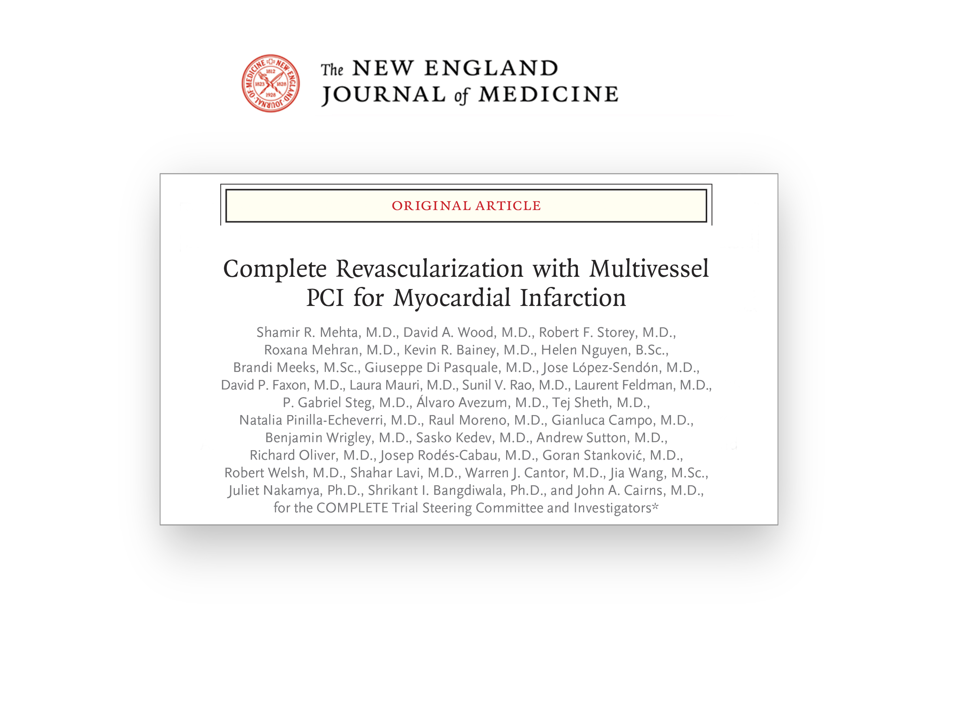
Available online at NEJM.org

