Slide 1
Ticagrelor With AspIrin or ALone In HiGH-Risk Patients After Coronary InTervention
Roxana Mehran, MD
on behalf of the TWILIGHT Investigators
Icahn School of Medicine at Mount Sinai, New York, NY
ClinicalTrials.gov Number: NCT02270242

Slide 2
Declaration of Interest
The TWILIGHT Trial
Sponsoring organization: Icahn School of Medicine at Mount Sinai, NY
Funded by AstraZeneca
Coordinated by Icahn School of Medicine at Mount Sinai, NY

Slide 3
Disclosures
Affiliation/Financial Relationship | Company
Consultant/ Exec committee/Advisory board/personal fees | Abbott Laboratories, Boston Scientific, Medscape, Siemens Medical Solutions, Phillips (Spectranetics), PLx Pharma, Roivant Sciences Inc, Volcano Corporation, Sanofi, Janssen,
Research Funding to Institution | Abbott Laboratories, Astra Zeneca, Bayer, Beth Israel Deaconess, BMS, CSL Behring, DSI, Medtronic, Boston Scientific, Novartis, OrbusNeich
Equity, <1% | Claret Medical, Elixir Medical
DSMB membership paid to the institution | Watermark Research Partners

Slide 4
Background
Balancing ischemic and bleeding complications post PCI is an important dilemma for clinicians.¹⁻³
Addressing the clinical imperatives of lowering bleeding while preserving ischemic benefit requires therapeutic strategies that decouple thrombotic from hemorrhagic risk.
Reducing the duration of aspirin after PCI may allow for more prolonged use of potent P2Y₁₂ inhibitors while avoiding aspirin-related bleeding risk.⁴
Baber et al. JACC Cardiovasc Interv 2016;9:1349-57.
Genereux et al. J Am Coll Cardiol 2015;66:1036-45.
Valgimigli et al. Eur Heart J 2017;38:804-10.
Capodanno et al. Nat Rev Cardiol 2018;15:480-96.

Slide 5
Trial Hypothesis
In patients undergoing PCI who are at high risk for ischemic or hemorrhagic complications and who have completed a 3-month course of dual antiplatelet therapy with ticagrelor plus aspirin, continued treatment with ticagrelor monotherapy would be superior to ticagrelor plus aspirin with respect to clinically relevant bleeding and would not lead to ischemic harm.

Slide 6
Trial Objectives
Primary Objective:
To determine the impact of SAPT (ticagrelor monotherapy) versus DAPT (ticagrelor plus aspirin) for 12 months in reducing clinically relevant bleeding (BARC 2, 3 or 5) among high-risk patients who have undergone successful PCI.
Secondary Objective:
To determine the impact of SAPT (ticagrelor monotherapy) versus DAPT (ticagrelor plus aspirin) for 12 months on major ischemic adverse events (all-cause death, non-fatal MI or stroke) among high-risk patients who have undergone successful PCI.

Slide 7
Methods
TWILIGHT was a randomized, double-blinded, placebo-controlled trial conducted in 187 sites across 11 countries.
From July 2015- December 2017, patients undergoing successful PCI with at least 1 locally-approved DES whom the treating clinician intended to discharge on ticagrelor plus aspirin were eligible to participate.
Trial inclusion required the presence of at least 1 additional clinical and angiographic feature associated with a high risk of ischemic or bleeding events.

Slide 8
TWILIGHT Inclusion Criteria
Clinical criteria
Age ≥65 years
Female gender
Troponin positive ACS
Established vascular disease (previous MI, documented PAD or CAD/PAD revasc)
DM treated with medications or insulin
CKD (eGFR <60ml/min/1.73m² or CrCl <60ml/min)
Angiographic criteria
Multivessel CAD
Target lesion requiring total stent length >30mm
Thrombotic target lesion
Bifurcation lesion(s) with Medina X,1,1 classification requiring ≥2 stents
Left main (≥50%) or proximal LAD (≥70%) lesions
Calcified target lesion(s) requiring atherectomy

Slide 9
TWILIGHT Exclusion Criteria
Under 18 years of age
Contraindication to aspirin or ticagrelor
Planned surgery within 90 days
Planned coronary revascularization (surgical or percutaneous) within 90 days
Need for chronic oral anticoagulation
Prior stroke
Dialysis-dependent renal failure
Active bleeding or extreme-risk for major bleeding
Salvage PCI or STEMI presentation
Liver cirrhosis
Life expectancy <1 year
Unable or unwilling to provide informed consent
Women of child bearing potential
Fibrinolytic therapy within 24 hours of index PCI
Concomitant therapy with a strong cytochrome P-450 3A inhibitor or inducer
Platelet count <100,000 mm³
Requiring ongoing treatment with aspirin ≥325 mg daily

Slide 10
Study Organization
Executive Committee
Roxana Mehran
Usman Baber
Dominick J. Angiolillo
David Cohen
George D. Dangas
Shamir Mehta
C. Michael Gibson
Adnan Kastrati
Mitchel Krucoff
E. Magnus Ohman
Philippe Gabriel Steg
Data Coordinating Center
Center for Interventional Cardiovascular Research and Clinical Trials at Mount Sinai, New York
Country Leaders
Austria Kurt Huber
Israel Giora Weisz, Ran Kornowski
UK Vijay Kunadian, Keith Oldroyd
China Han Yaling
India Upendra Kaul
Germany Berhard Witzenbichler
Canada Vladimir Dzavik
Poland Robert Gil, Dariuz Dudek
Italy Gennaro Sardella
Spain Javier Escaned
Trial Leadership
Roxana Mehran Global PI
Usman Baber Chair, Clinical Coordinating Center
Theresa Franklin-Bond Pharmacovigilance & Safety
Jerusa Altema Project Manager
Samantha Sartori Statistician
CEC
Jin Y. Cha (Manager)
Steven O. Marx (Chair) Stroke adjudication:
Bruce Darrow Jesse Weinberger
Douglas DiStefano David Kaufman
Newsha Ghodsi Mark Milstein
Jose Meller
Nicola Corvaia
S. Chiu Wong
DSMB
Bernard J. Gersh (Chair)
Spencer King
Stuart Pocock
David Faxon
James Tcheng
Tim Collier (Statistician)
Steering Committee
Paul Gurbel
Christian Hamm
Timothy D. Henry
David J. Moliterno
Samin K. Sharma
Sponsor: Icahn School of Medicine at Mount Sinai
Funding: AstraZeneca

Slide 11
Study Design
Enrollment Period
3 Months
Randomization Period
12 Months
Observation Period
3 Months
High-Risk PCI Patients
(N=9006)
Ticagrelor + Aspirin
Standard of Care
N = 7119
Not Randomized
(N=1887)
Ticagrelor + Placebo
Standard of Care
Ticagrelor + Aspirin
(Open label)
0 M
3 M
4 M
9 M
15 M
18 M

Slide 12
Study Endpoint
Primary Endpoint (Bleeding): Superiority Hypothesis
BARC 2, 3 or 5 bleeding between 0 - 12 months after randomization
Key Secondary Endpoint (Ischemic): Non-inferiority Hypothesis
Non-fatal MI, stroke or all-cause death between 0 - 12 months after randomization

Slide 13
Sample Size and Power Calculations
Assuming a one-year rate of BARC 2, 3 or 5 bleeding of 4.5% among patients receiving DAPT, a sample size of 8200 was chosen to detect a relative reduction of at least 28% with ticagrelor monotherapy and a type I error of 0.05.
Assuming a one-year rate of 8.0% for the key secondary endpoint, a sample size of 8200 provided 80% power to exclude an absolute non-inferiority margin of 1.6% with type I error 0.025.
An enrolled cohort of 9000 was chosen to accommodate an approximate 10% rate of randomization ineligibility.

Slide 14
Statistical Analysis
The cumulative incidences of the primary and key secondary endpoints were expressed as Kaplan-Meier estimates by treatment group. Hazard ratios (HR) and 95% confidence intervals (CI) were generated using Cox proportional hazards models with treatment allocation as a single covariate.
Treatment effects were also expressed as absolute risk differences using the one-year Kaplan-Meier estimates and Greenwood standard errors.
Superiority testing using a log-rank p-value was performed for the primary endpoint. For the key secondary endpoint a one-sided non-inferiority test was performed using the upper limit of the 95% CI for the absolute risk difference.
The primary endpoint was evaluated in the intention to treat (ITT) cohort while the key secondary endpoint was assessed in the per protocol cohort.

Slide 15
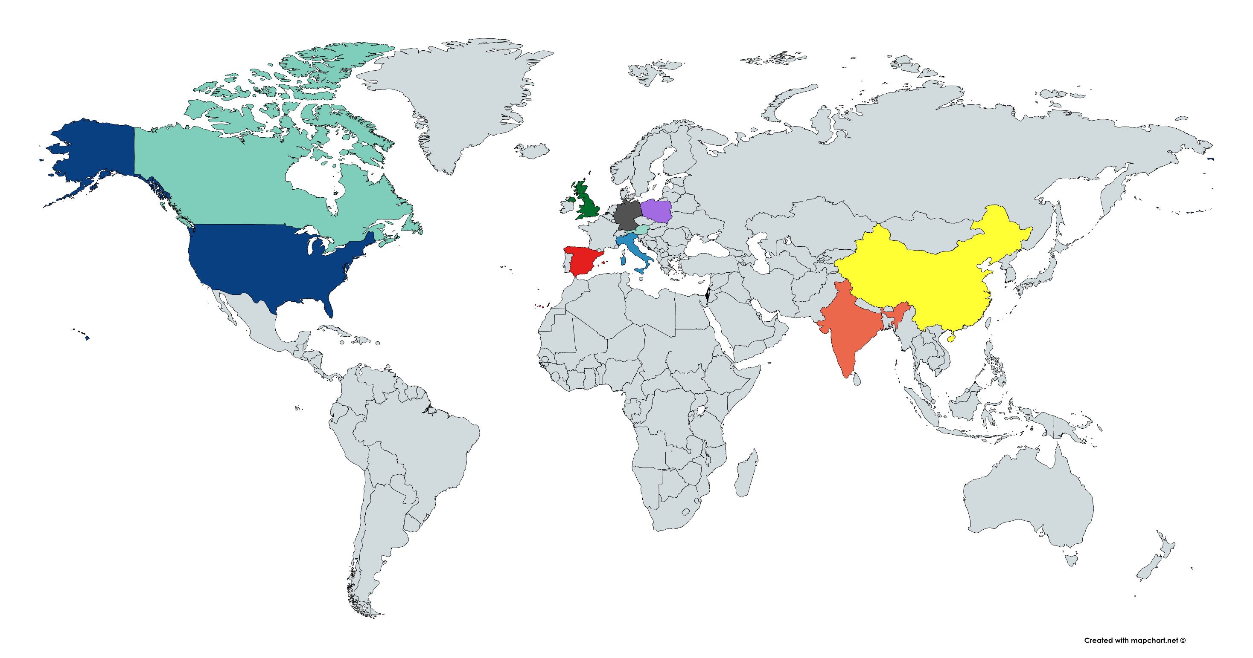
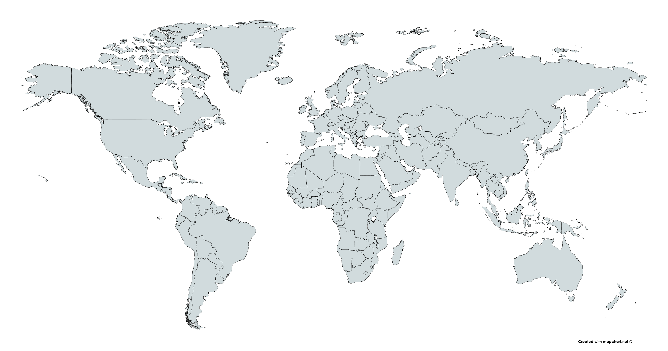
TWILIGHT Enrolled Population
POLAND
(N=750, 8.3%)
INDIA
(N=697, 7.7%)
GERMANY
(N=261, 2.9%)
CHINA
(N=1169, 13.0%)
UK
(N=437, 4.9%)
CANADA
(N=815, 9.1%)
SPAIN
(N=166, 1.8%)
USA
(N=3271, 36.3%)
ITALY
(N=779, 8.7%)
AUSTRIA
(N=360, 4.0%)
ISRAEL
(N=295, 3.3%)
Total Enrolled 9006
187 sites across 11 countries in North America, Europe and Asia

Slide 16
TWILIGHT Randomized Population
POLAND
(N=672, 9.4%)
INDIA
(N=610, 8.6%)
GERMANY
(N=189, 2.7%)
CHINA
(N=1028, 14.4%)
UK
(N=349, 4.9%)
CANADA
(N=634, 8.9%)
SPAIN
(N=131, 1.8%)
USA
(N=2338, 32.8%)
ITALY
(N=665, 9.3%)
AUSTRIA
(N=276, 3.9%)
ISRAEL
(N=227, 3.2%)
Total Randomized 7119
187 sites across 11 countries in North America, Europe and Asia

Slide 17
Top 10 Performing Sites
Site | Principal Investigator | Enrolled | Randomized | Follow-Up
1. General Hospital of Shenyang Military, China | Prof. Han Yaling | 249 | 240 | 100%
2. Clinica Mediterranea, Italy | Prof. Carlo Briguori | 250 | 220 | 100%
3. St. Francis Hospital, USA | Dr. Richard Shlofmitz | 251 | 158 | 98%
4. Polsko-Amerykanskie Kliniki Serca II, Poland | Dr. Wojciech Fil | 170 | 152 | 100%
5. Rex-UNC Hospital, USA | Dr. Deepak Pasi | 196 | 145 | 98%
6. LeBauer-Cone Health, USA | Dr. Christopher McAlhany | 159 | 128 | 98%
7. Clearwater Cardiovascular, USA | Dr. Douglas Spriggs | 177 | 126 | 100%
8. Hamilton General Hospital, Canada | Dr. Shamir Mehta | 182 | 117 | 99%
9. York PCI, Canada | Dr. Warren Cantor | 149 | 117 | 98%
10. South Oklahoma Heart, USA | Dr. Naeem Tahirkheli | 140 | 113 | 100%

Slide 18
Enrolled
(N = 9006)
Not randomized (n = 1887)
Lost to follow-up (106)
Adverse events (243)
Death, MI or stroke (111)
Any revascularization (134)
BARC 3B or higher bleed (52)
DAPT non-adherence (1148)
Consent withdrawal/refusal (267)
Other reasons (123)
1:1 Randomized
(N = 7119)
Ticagrelor + Placebo
(N = 3555)
Ticagrelor + Aspirin
(N = 3564)
18 withdrew consent
41 lost to follow-up
25 withdrew consent
27 lost to follow-up
1 physician withdrew
15 Month Follow-up
(N = 3496; 98.3%)
15 Month Follow-up
(N = 3511; 98.5%)
Includes 34 deaths
Includes 48 deaths
15 M Vital status
(N = 3546; 99.7%)
15 M Vital status
(N = 3554; 99.7%)

Slide 19
Adherence to Study Medications
93.9%
92.8%
90.5%
89.6%
87.1%
85.9%
82.9%
82.2%
Adherence to medication (%)
Adherence to medication (%)

Slide 20
Patient Characteristics
Baseline Demographics
Variable | Tica + Placebo (N = 3555) | Tica + Aspirin (N = 3564)
Age, years [Mean ± SD] | 65.2 ± 10.3 | 65.1 ± 10.4
Female sex | 23.8% | 23.9%
Nonwhite race | 31.2% | 30.5%
BMI, kg/m² | 28.6 ± 5.5 | 28.5 ± 5.6
Diabetes Mellitus | 37.1% | 36.5%
Insulin requiring | 9.4% | 10.5%
Chronic Kidney Disease | 16.8% | 16.8%
Anemia | 19.8% | 19.1%
ACS presentation | 64.0% | 65.7%
Current Smoker | 20.4% | 23.1%
Previous MI | 28.7% | 28.6%
Previous PCI | 42.3% | 42.0%
Previous CABG | 10.2% | 9.8%
Previous major bleed | 0.9% | 0.9%

Slide 21
Patient Characteristics
Baseline Procedural Details
Variable | Tica + Placebo (N = 3555) | Tica + Aspirin (N = 3564)
Radial access | 73.1% | 72.6%
Multivessel CAD | 63.9% | 61.6%
Target vessel
LAD | 75.1% | 74.3%
RCA | 53.5% | 52.5%
LCX | 46.8% | 46.2%
Left Main Disease ≥50% | 7.9% | 8.6%
Number of lesions treated | 1.5 ± 0.7 | 1.5 ± 0.7
Lesion morphology
Thrombus | 10.4% | 10.7%
Calcification, moderate/severe | 14.0% | 13.7%
Any bifurcation | 12.2% | 12.1%
Chronic total occlusion | 6.2% | 6.3%
Total stent length | 40.1 ± 24.2 | 39.7 ± 24.3

Slide 22
Primary Endpoint: BARC 2, 3 or 5 Bleeding
ITT Cohort
10
Ticagrelor + Aspirin
Ticagrelor + Placebo
8
7.1%
Placebo vs Aspirin
HR (95%CI): 0.56 (0.45 to 0.68)
P <0.001
6
Cumulative incidence (%)
4.0%
4
ARD = -3.08% (-4.15% to -2.01%)
NNT = 33
2
0
0
3
6
9
12
Months since randomization
No. at risk
Ticagrelor + Aspirin
3564
3454
3357
3277
3213
Ticagrelor + Placebo
3555
3474
3424
3366
3321

Slide 23
BARC 3 or 5 Bleeding
ITT Cohort
10
Ticagrelor + Aspirin
Ticagrelor + Placebo
8
Placebo vs Aspirin
HR (95%CI): 0.49 (0.33 to 0.74)
P = 0.0006
6
Cumulative incidence (%)
4
ARD = -0.99% (-1.55% to -0.43%)
2
2.0%
1.0%
0
0
3
6
9
12
Months since randomization
No. at risk
Ticagrelor + Aspirin
3564
3516
3470
3426
3390
Ticagrelor + Placebo
3555
3504
3475
3440
3423

Slide 24
Prespecified Bleeding Endpoints (ITT Cohort)
HR [95%CI]:
0.49 [0.33 - 0.74]
p = 0.0006
HR [95%CI]:
0.54 [0.37 - 0.80]
p = 0.002
HR [95%CI]:
0.53 [0.33 - 0.85]
p = 0.008
HR [95%CI]:
0.50 [0.28 - 0.90]
p = 0.02

Slide 25
Prespecified Bleeding Endpoints (ITT Cohort)
Variable | Ticagrelor + Placebo (N = 3555) | Ticagrelor + Aspirin (N = 3564) | HR [95% CI] | p-value
BARC 3 or 5 | 34 (1.0%) | 69 (2.0%) | 0.49 [0.33 - 0.74] | 0.0006
TIMI minor or major | 141 (4.0%) | 250 (7.1%) | 0.56 [0.45 - 0.68] | <0.0001
TIMI major | 17 (0.5%) | 34 (1.0%) | 0.50 [0.28 - 0.90] | 0.02
GUSTO moderate or severe | 26 (0.7%) | 49 (1.4%) | 0.53 [0.33 - 0.85] | 0.008
ISTH major | 39 (1.1%) | 72 (2.1%) | 0.54 [0.37 - 0.80] | 0.002

Slide 26
Key Secondary Endpoint: Death, MI or Stroke
PP Cohort
10
Ticagrelor + ASA
8
Ticagrelor + Placebo
6
Placebo vs Aspirin
HR (95%CI): 0.99 (0.78 to 1.25)
P_{non-inferiority} <0.001
Cumulative incidence (%)
3.9%
4
3.9%
2
ARD = -0.06% (-0.97% to 0.84%)
0
0
3
6
9
12
Months since randomization
No. at risk
Ticagrelor + Aspirin
3515
3466
3415
3361
3320
Ticagrelor + Placebo
3524
3457
3412
3365
3330

Slide 27
Prespecified Ischemic Endpoints (PP Cohort)
HR [95%CI]:
0.97 [0.76 - 1.24]
p = 0.80
HR [95%CI]:
1.00 [0.75 - 1.33]
p = 0.99
HR [95%CI]:
0.75 [0.48 - 1.18]
p = 0.21
HR [95%CI]:
1.80 [0.83 - 3.90]
p = 0.13
HR [95%CI]:
0.74 [0.37 – 1.47]
p = 0.38

Slide 28
Prespecified Ischemic Endpoints (PP Cohort)
Variable | Ticagrelor + Placebo (N = 3524) | Ticagrelor + Aspirin (N = 3515) | HR [95% CI] | p-value
CV Death, MI or Ischemic Stroke | 126 (3.6%) | 130 (3.7%) | 0.97 [0.76 - 1.24] | 0.80
All-cause death | 34 (1.0%) | 45 (1.3%) | 0.75 [0.48 - 1.18] | 0.21
CV Death | 26 (0.8%) | 37 (1.1%) | 0.70 [0.43 - 1.16] | 0.17
MI, any | 95 (2.7%) | 95 (2.7%) | 1.00 [0.75 - 1.33] | 0.99
Stroke, any | 18 (0.5%) | 10 (0.3%) | 1.80 [0.83 - 3.90] | 0.13
Ischemic | 16 (0.5%) | 8 (0.2%) | 2.00 [0.86 - 4.67] | 0.10
Stent thrombosis (definite/probable) | 14 (0.4%) | 19 (0.6%) | 0.74 [0.37 – 1.47] | 0.38
Clinically driven revascularization | 246 (7.1%) | 227 (6.6%) | 1.09 [0.91 - 1.30] | 0.36
Any hospitalization | 601 (17.2%) | 618 (17.8%) | 0.97 [0.87 - 1.09] | 0.60

Slide 29
Subgroup Analysis for Primary Endpoint (ITT)
Subgroups
No. of
patients
Tica + Placebo
Tica + Aspirin
HR
[95% CI]
P Value for
Interaction
no. of events (% of patients)
Age (years)
0.67
<65
3400
59 (3.5%)
100 (6.0%)
0.59 [0.42 – 0.81]
≥65
3719
82 (4.5%)
150 (8.2%)
0.54 [0.41 – 0.70]
Sex
0.89
Male
5421
99 (3.7%)
178 (6.7%)
0.55 [0.43 – 0.70]
Female
1698
42 (5.0%)
72 (8.6%)
0.57 [0.39 – 0.83]
Diabetes Mellitus
0.23
No
4499
83 (3.8%)
164 (7.3%)
0.50 [0.39 – 0.66]
Yes
2620
58 (4.5%)
86 (6.6%)
0.65 [0.47 – 0.91]
Region of Enrollment
0.16
North America
2972
83 (5.7%)
126 (8.7%)
0.65 [0.49 – 0.85]
Europe
2509
32 (2.6%)
79 (6.3%)
0.40 [0.27 – 0.61]
Asia
1638
26 (3.2%)
45 (5.5%)
0.57 [0.35 – 0.92]
Indication for PCI
0.03
Stable
2503
60 (4.8%)
75 (6.2%)
0.76 [0.54 – 1.06]
ACS
4614
81 (3.6%)
175 (7.6%)
0.47 [0.36 – 0.61]
Total stent length (mm)
0.06
<30
3036
64 (4.4%)
93 (6.1%)
0.70 [0.51 – 0.97]
≥30
4082
77 (3.8%)
157 (7.9%)
0.47 [0.36 – 0.62]
Multivessel Disease
0.74
No
2422
47 (4.1%)
94 (7.6%)
0.53 [0.37 – 0.75]
Yes
4697
94 (4.0%)
156 (6.9%)
0.57 [0.44 – 0.74]
Tica + Placebo Better
Tica + Aspirin Better

Slide 30
Subgroup Analysis for Key Secondary Endpoint (PP)
Subgroups
No. of
patients
Tica + Placebo
Tica + Aspirin
HR
[95% CI]
P Value for
Interaction
no. of events (% of patients)
Age (years)
0.72
<65
3362
56 (3.4%)
60 (3.6%)
0.94 [0.65 – 1.35]
≥65
3677
79 (4.3%)
77 (4.2%)
1.02 [0.75 – 1.40]
Sex
0.97
Male
5363
106 (4.0%)
108 (4.1%)
0.98 [0.75 – 1.29]
Female
1676
29 (3.5%)
29 (3.5%)
0.99 [0.59 – 1.66]
Diabetes Mellitus
0.05
No
4446
76 (3.5%)
62 (2.8%)
1.24 [0.89 – 1.73]
Yes
2593
59 (4.6%)
75 (5.9%)
0.77 [0.55 – 1.09]
Region of Enrollment
0.38
North America
2939
62 (4.3%)
62 (4.3%)
1.00 [0.70 – 1.42]
Europe
2487
61 (5.0%)
56 (4.5%)
1.10 [0.77 – 1.59]
Asia
1613
12 (1.5%)
19 (2.4%)
0.62 [0.30 – 1.29]
Indication for PCI
0.75
Stable
2472
39 (3.1%)
35 (2.9%)
1.06 [0.67 – 1.67]
ACS
4565
96 (4.3%)
102 (4.5%)
0.97 [0.73 – 1.28]
Total stent length (mm)
0.44
<30
3003
59 (4.0%)
56 (3.7%)
1.10 [0.76 – 1.58]
≥30
4036
76 (3.8%)
81 (4.1%)
0.91 [0.67 – 1.24]
Multivessel Disease
0.10
No
2392
23 (2.0%)
37 (3.0%)
0.67 [0.40 – 1.12]
Yes
4647
112 (4.8%)
100 (4.4%)
1.08 [0.83 – 1.42]
Tica + Placebo Better
Tica + Aspirin Better

Slide 31
Landmark Analysis for Primary Endpoint
BARC 2, 3 or 5 Bleeding
10%
Ticagrelor + Aspirin
Ticagrelor + Placebo
8%
7.1%
6%
Cumulative incidence (%)
4.0%
4%
Placebo vs Aspirin
HR (95%CI): 1.24 (0.64 to 2.40)
2%
0.7%
0.5%
0%
0
3
6
9
12
15
Months since randomization

Slide 32
Landmark Analysis for Key Secondary Endpoint
Death, MI or Stroke
10%
Ticagrelor + Aspirin
Ticagrelor + Placebo
8%
6%
Cumulative incidence (%)
3.9%
4%
3.9%
Placebo vs Aspirin
HR (95%CI): 0.84 (0.51 to 1.40)
2%
1.1%
0.9%
0%
0
3
6
9
12
15
Months since randomization

Slide 33
Limitations
These results may not be generalizable to
all patients undergoing PCI, given the requirement in our trial for both high-risk (clinical and angiographic) features, and
patients receiving background therapy with other P2Y₁₂ inhibitors.
Observed treatment effects do not apply to all enrolled participants but rather to those patients who were able to take 3 months of dual antiplatelet therapy without any major adverse events.
A lower-than expected incidence of the composite end point of death, MI, or stroke may have biased our results for this key secondary end point toward the null.
Lack of power to detect differences in the risk of important yet rare clinical events, such as stent thrombosis and stroke.

Slide 34
Conclusions
In high-risk patients who underwent PCI and were treated with ticagrelor and aspirin for 3 months without any major adverse (bleeding or ischemic) events, an antiplatelet strategy of continuing ticagrelor monotherapy resulted in:
substantially less bleeding than ticagrelor plus aspirin
without increasing ischemic events over a period of 1 year

Slide 35
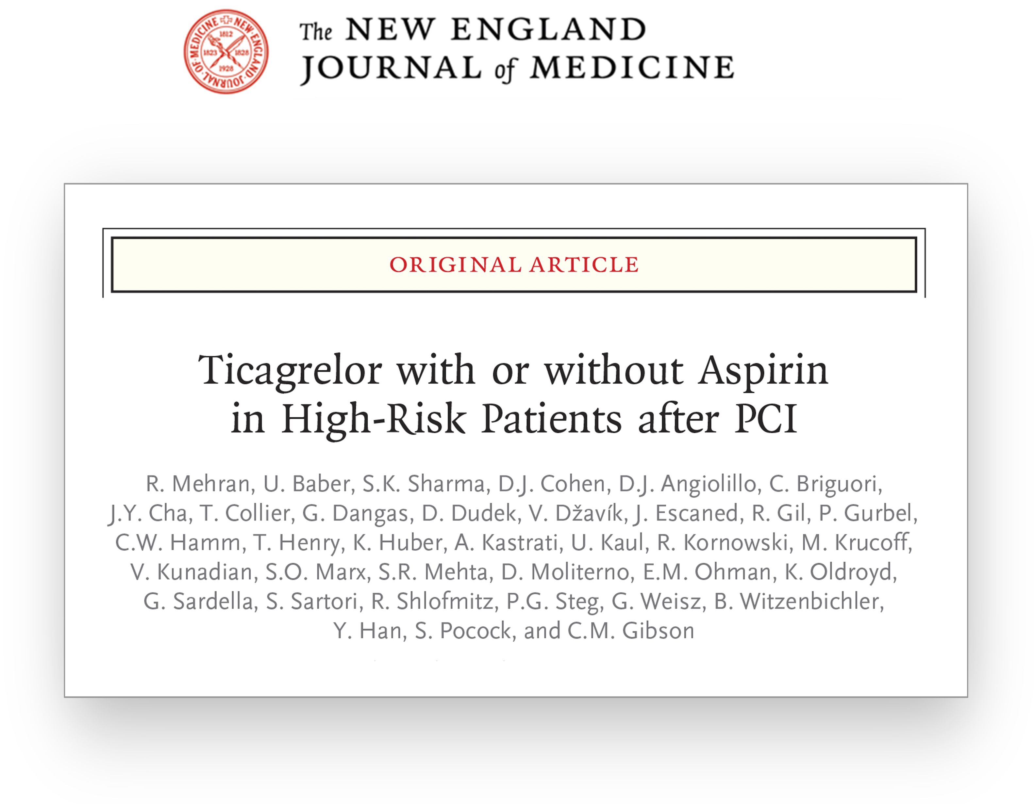

Slide 36
Acknowledgement
We thank all country leaders, investigators, coordinators and study participants who made TWILIGHT possible!

Slide 37
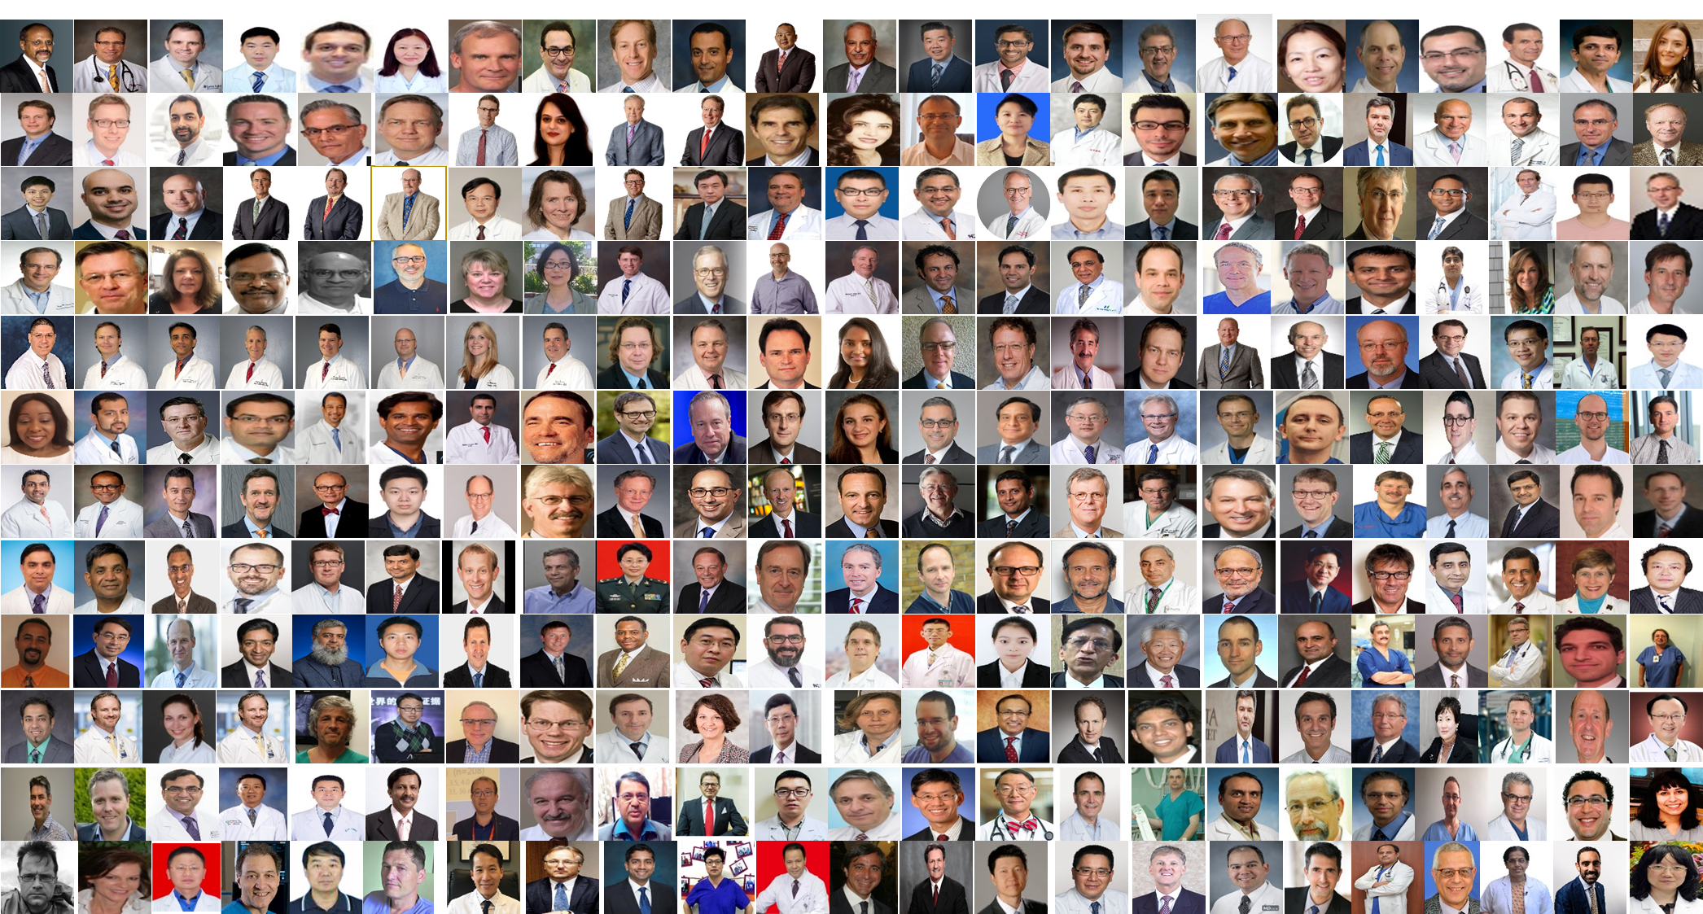

Slide 38
COLLABORATORS
Scientific Oversight: Executive Committee
Roxana Mehran MD (Study Chair, Global Principal Investigator)
Usman Baber MD, MS (Chair of Clinical Data Coordinating Center)
Dominick J. Angiolillo MD, PhD
David J. Cohen MD, MSc
George Dangas MD, PhD
C. Michael Gibson MD, MS
Adnan Kastrati MD
Mitchell Krucoff MD
Shamir Mehta MD, MSc
E. Magnus Ohman MD
Philippe Gabriel Steg MD
Scientific Oversight: Steering Committee
Paul Gurbel MD
Christian Hamm MD
Timothy D. Henry MD
David J. Moliterno MD
Samin Sharma MD
Scientific Oversight: Country Leaders
Prof. Bernhard Witzenbichler MD (Germany)
Vladimir Dzavik MD (Canada)
Prof. Javier Escaned MD (Spain)
Prof. Robert Gil MD, Prof. Dariusz Dudek MD, PhD (Poland)
Prof. Kurt Huber MD (Austria)
Upendra Kaul MD (India)
Vijay Kunadian MD, Prof. Keith Oldroyd MD (United Kingdom)
Prof. Gennaro Sardella MD (Italy)
Giora Weisz MD, Ran Kornowski MD (Israel)
Prof. Han Ya-Ling MD (China)
Data Monitoring Committee
Bernard J. Gersh MB, ChB, DPhil (Chair, Data Safety Monitoring Board)
Timothy Collier MSc (Independent Statistician)
David P. Faxon MD (Member, Data Safety Monitoring Board)
Spencer B. King MD (Member, Data Safety Monitoring Board)
Stuart Pocock PhD (Member, Data Safety Monitoring Board)
James E. Tcheng MD (Member, Data Safety Monitoring Board)
Clinical Events Committee
Steven Marx MD (Chair, Clinical Events Committee)
Shing Chiu Wong MD (Member, Clinical Events Committee)
Nicola Corvaja MD (Member, Clinical Events Committee)
Bruce Darrow MD, PhD (Member, Clinical Events Committee)
Douglas DiStefano MD (Member, Clinical Events Committee)
Newsha Ghodsi MD (Member, Clinical Events Committee)
David Kaufman MD (Member, Clinical Events Committee)
Jose Meller MD (Member, Clinical Events Committee)
Mark Milstein MD (Member, Clinical Events Committee)
Jesse Weinberger MD (Member, Clinical Events Committee)
Dhrubajyoti Bandyopadhyay MD; Anton Camaj MD; Rishi Chandiramani MD; Qinzhong Chen MD, PhD; Sherif Elsayed MD; Rafael Harari MD; Yuqi Liu MD; David Power MB, ChB; Anastasios Roumeliotis MD; Kleanthis Theodoropoulus MD
Academic Research Center
Leadership
Roxana Mehran MD (Director of the Center for Interventional Cardiovascular Research & Clinical Trials);
Usman Baber MD, MS (Director of Clinical Biometrics); Theresa Franklin-Bond PA, MS (Director of Research Operations, Quality Outcomes & Event Adjudication); Katharine Idrissi (Director of Research Administration); Rebecca Ortega (Director of Business Development)
Project Management
Jerusa Altema (Clinical Research Manager); Precious Akinsanya (Clinical Research Manager); Kristin Falciglia (Project Manager); Johnston Grier (Project Manager); Pamela Kivitz (Project Manager); Carlos Bazan MD (Senior Clinical Research Associate); Lauren Joyce (Senior Clinical Research Associate); Elvira Oseledchyk MD (Senior Clinical Research Associate); Clayton Snyder (Senior Clinical Research Associate); Julia Carpenedo (Clinical Research Associate); Stefan Dabic (Clinical Research Associate); Lauren Lopez (Clinical Research Associate); Sarah Mirza (Clinical Research Associate); Alyssa Ramkissoon (Clinical Research Associate); Shireen Wellington (Clinical Research Associate); Tiffany Moore (Publications and Fellowship Coordinator); Sulman Arshad (Volunteer)
Medical Oversight
Davide Cao MD (Senior Post-Doctoral Research Fellow); Bimmer Claessen MD, PhD (Senior Post-Doctoral Research Fellow); Jaya Chandrasekhar MD, MS (Publications Manager, Senior Post-Doctoral Research Fellow); Michela Faggioni MD (Post-Doctoral Research Fellow); Serdar Farhan MD (Post-Doctoral Research Fellow); Gennaro Giustino MD (Post-Doctoral Research Fellow); Sabato Sorrentino MD, PhD (Post-Doctoral Research Fellow); Birgit Vogel MD (Post-Doctoral Research Fellow); Rishi Chandiramani MD (Post-Doctoral Research Scholar); Sherif Elsayed MD (Post-Doctoral Research Scholar); Zhen Ge MD (Post-Doctoral Research Scholar); Ridhima Goel MD (Post-Doctoral Research Scholar); Paul Guedeney MD (Post-Doctoral Research Scholar); Yuqi Liu MD (Post-Doctoral Research Scholar); Anastasios Roumeliotis MD (Post-Doctoral Research Scholar); Moritz Blum BS (Research Scholar)
Biostatistics
Samantha Sartori PhD (Biostatistician); Melissa Aquino MS (Data Science Analyst III); Rachel Singleton MS (Data Science Analyst I); Sonny Sayseng MS (Database Administrator); Michele Sarin MS (Programmer Analyst I)
Pharmacovigilance & Safety
Theresa Franklin-Bond PA, MS
Clinical Events Committee Management
Jin Young Cha (Clinical Events Project Manager II); Rashi Bedekar (Clinical Events Associate); Raza Hijazi (Clinical Events Associate); Mike Koh (Clinical Events Associate); Kamilia Moalem (Clinical Events Associate); Amika Purushotham (Clinical Events Associate); Zaha Waseem (Clinical Events Associate); Emma Woodoff-Leith (Clinical Events Associate); Jayden Abraham (Volunteer); Sulman Arshad (Volunteer); Kayla Bedel-Franklin (Volunteer); Caroline Dannacher (Volunteer); Shayan Ghodsi (Volunteer); Maya Jeremias (Volunteer); Jessica Johnstone (Volunteer); Deepika Nambiar (Volunteer); Divya Nambiar (Volunteer); Timothy Rudolph-Math (Volunteer); Alden Weiner (Volunteer); George Danias (Volunteer); Sahil Dave (Volunteer); Antonia Demopoulous (Volunteer); Saaman Ghodsi (Volunteer); Amrita Gill (Volunteer); Daniel Greenberg (Volunteer); Andrey Mychajlyszyn (Volunteer);
Daniel Mychajlyszyn (Volunteer); Kiana Saghri (Volunteer); Andrew Spana (Volunteer); Carl Spana (Volunteer); Alex Sudyn (Volunteer); Kirsten Von Rosenvinge (Volunteer)
Finance
Jennifer Garcia (Finance Director); Patricia Knipper (Finance Director); Yvonne Mei (Finance Manager); Katherine Areche (Financial Analyst); Nodar Kipshidze (Financial Analyst); Farhan Sohail (Financial Analyst)
IRB Submissions
Mary Ann Kiernan MPA (Senior Director, Regulatory and Compliance); Jody Campbell (Regulatory Compliance Associate)
Global Partners
ACORN Regulatory
Gemma Robinson PhD (Managing Director); Danica Cvetkovic MD, PhD (Medical Manager); John McEntyre PhD (Senior Regulatory Affairs Advisor)
AstraZeneca
Eva Turgonyi MD (Executive Director of Global Medical Affairs, Brilinta Team Leader); Chris Hewitt MD (Global Medical Affairs Leader Cardiovascular); Jonathan Lu MD, PhD (Medical Director); Gunnar Brandrup-Wognsen MD, PhD (Brilinta Medical Director Global); Narinder Bhalla MD (Head of US Medical Affairs Cardiovascular); Barry Reicher MD, MBA (Medical Director of Clinical Research, CVMD); James Ferguson MD (Vice President, CVMD and Scientific External Relations); Rodrigo Gribble MS, MBA (Vice President of Brilinta & Epanova); Naeem Khan MD (Vice President- CVMD); Lois Walker BSN, MPH (External Scientific Research Manager); Vitalina Rozenfeld Pharm.D. (Medical Science Liaison)
Bay Area Health Trust (or Bay Area Research Logistics (BARL)
Paul McCracken CPA (Business Unit Director); Gina Howley (Production Coordinator); Marlena Nagorski (Clinical Trial Coordinator);
Cardinal Health Pharmaceutical Co., Ltd.
Ying Meng (Clinical Trial Associate); Yueyue Zhang (Clinical Trial Associate)
FOJP Service Corporation
Charles Ferguson (Vice President of Client Services); Duane Perricelli (Vice President of Risk Management Advisory Services); Andrea Rienzo (Mount Sinai Representative)
Helios Amper-Klinikum, Dachau
Prof. Bernhard Witzenbichler MD (Germany Country Leader, Site Principal Investigator); Marion Senegewald (Site Coordinator) Marlene Swoboda (Site Coordinator)
iProcess Global Research Inc.
Asker Ahmed (Director); Mohammed Saleem (Clinical Operations Manager); Deepa Ganesh (Senior Clinical Research Associate); Abhinaya Bhatta MD (Clinical Research Associate); Karthik Ramasamy MD (Clinical Monitor);Pratiksha Sharma (Clinical Research Associate); Hemalatha Siddaramu (Clinical Research Associate);
International Center for Health Outcomes and Innovation Research (InCHOIR), at Mount Sinai
Ron Levitan (Director of Information System); Rami Habas, MS (Associate IT Director)
KCRI
Lukasz Partyka (CEO); Beata Checinska-Tokarz MSc (Chief Clinical Operations Officer);
Angieszka Cwiek PhD (Clinical Project Manager); Lukasz Sapala MSc, MBA (Associate Clinical Project Manager); Anna Cieslicka MSc (Junior Clinical Research Associate)
London School of Hygiene & Tropical Medicine
Timothy Collier MSc (Statistician)
MARSH
Sarah Goodman (Vice President of Life Sciences –Casualty)
Medical Devices Consultancy Ltd.
Lynn Vandertie (Director); Emma Whittaker (Senior Clinical Research Associate); Kate Allen (Data Analyst)
Medmarc
Jeff Stroud (Life Sciences Underwriting Executive)
PharmaScience
Sharon Keays (Clinical Study Manager, Clinical Operations)
RUNDO International Pharmaceutical Research and Development Co., Ltd.
Bo Qin (Project Manager); Yoyo Wang (Project Manager); Dan Zheng (Project Manager)
Salud Madrid, Hospital Universitario Clinical San Carlos
Prof. Javier Escaned MD (Spain Country Leader, Site Principal Investigator); Sarah Fernandez (Site Coordinator); Maria Aranzazu Ortega Pozzi (Site Coordinator)
Shaare Zedek
Dmitry Dratva MD (Site Principal Investigator); Astrid Rojansky (Site Coordinator)
SHARP Clinical Devices
Peter Tomlinson (Logistics Project Manager); Hannah Williams (Logistics Project Manager)
The Newcastle Upon Tyne Hospitals, NHS Hospital Trust
Vijay Kunadian MD (United Kingdom Country Leader, Site Principal Investigator); Natasha Bridgeman (REC Manager); Lesley Hall PhD (Senior Trial Manager); Phil Mawson (R & D Study Manager)
Trialog Clinical Trials, Ltd.
Tamar Itzhaky (Senior Returns and Destruction Specialist); Jean Ossad (Senior Import Coordinator); Revital Aksakalov (Pharmacist); Tally Levin (Import Coordinator)
WellSpring Pharma Services
Charles Chee (Director of Quality and Regulatory Affairs)
Wilhelminen Hospital
Prof. Kurt Huber MD (Austria Country Leader, Site Principal Investigator); Claudia Wegmayr MSc (Primary Study Coordinator); Irena Vujasin (Study Coordinator)
World Courier
Pradeep Kumar (Depot Manager); Rama Chandran (Pharmacist Operating Assistant); Greg Murray (Clinical Supply Consultant); Venkata Ramaiah (Pharmacist Operating Assistant); Olimpia Scott (Credit Controller, AR Assistant); Russell Smith (Clinical Supply Consultant)
WuXi App Tec
Ge Li, PhD (Chairman, CEO)

Slide 39
SITE LIST and INVESTIGATORS
Dr. Piotr Palinski | Poland | Centrum Kardiologii Allenort Scanmed - Tomaszów Mazowiecki
Dr. Krzysztof Milewski | Poland | X Oddzial Kardiologii Tychy
Prof. Robert Gil | Poland | Centrum Szpital Kliniczny MSW
Dr. Aleksander Żurakowski | Poland | Malopolskie Centrum Sercowo-Naczyniowe-
Dr. Maciej Maliszewski | Poland | Centrum Kardiologii Inwazyjnej- Ostrowiec
Dr. Witold Żmuda | Poland | Centrum Kardiologii Inwazyjnej-Oświęcim
Prof. Dariusz Dudek | Poland | Szpital Uniwersytecki Krakow
Dr. Jacek Godlewski | Poland | Centrum Kardiologii Inwazynej Pinczow
Dr. Małgorzata Głowaty | Poland | Centrum Kardiologii Allenort Scanmed, Kutno
Dr. Adam Kern | Poland | Wojewodzki Szpital Specjalistyczny, Olsztyn
Dr. Janusz Szczupak | Poland | Centrum Kardiologii Inwazyjnej, Krosno,
Dr. Marek Kondys | Poland | III Oddzial Kardiologii Inwazyjnej, Dabrowa Gornicza
Dr. Wojciech Fil | Poland | Polsko-Amerykańskie Kliniki Serca II, Bielsko-Biala
Dr. Jakub Foryś | Poland | Zgierskie Centrum Kardiologii,
Dr. Janusz Prokopczuk | Poland | IV Oddzial Kardiologii Inwazyjnej
Dr. Nader Elmasri | Poland | Gdańskie Centrum Sercowo-Naczyniowe
Prof. Javier Escaned | Spain | Hospital Clinico San Carlos
Dr. Josepa Mauri & Dr. Omar Abdul | Spain | Hospital German Trias i Pujol
Dr. Rafael Romaguera | Spain | Hospital Universitari de Bellvitge
Dr. Manuel Sabate Tenas | Spain | Hospital Clinic Barcelona
Dr. Jose Maria de la Torre Hernandez | Spain | Hospital Universitario Marques De Valdecilla
Prof. Keith Oldroyd | United Kingdom | Golden Jubilee National Hospital
Dr. John Irving | United Kingdom | Ninewells Hospital (NHS Tayside)
Dr. Nicholas Cruden | United Kingdom | Royal Infirmary of Edinburgh (NHS Lothian)
Dr. Vijay Kunadian | United Kingdom | Freeman Hospital
Dr. Simon Hetherington | United Kingdom | Kettering General Hospital
Dr. David Hildick-Smith | United Kingdom | Brighton and Sussex University Hospitals
Dr. Peter O’Kane | United Kingdom | Royal Bournemouth Hospital
Dr. Ross McGeoch | United Kingdom | Hairmyres Hospital (NHS Lanarkshire)
Dr. Scot Garg | United Kingdom | Royal Blackburn Hospital
Dr. Peter Ludman | United Kingdom | Queen Elizabeth Hospital
Dr. Jonathan Watt | United Kingdom | Raigmore Hospital (NHS Highland)
Dr. Robert Butler | United Kingdom | Royal Stoke University Hospital
Dr. Andrew Wragg | United Kingdom | St. Bartholomew's Hospital
Dr. Simon Walsh | United Kingdom | Belfast Health & Social Care Trust
Dr. Magdi El-Omar | United Kingdom | Central Manchester University Hospital
Dr. Marcus Flather | United Kingdom | Norfolk & Norwich University Hospital
Dr. Samin Sharma | United States | Mount Sinai Hospital
Dr. Anthony J. Spaedy | United States | Missouri Heart Center
Dr. William Dixon | United States | Tallahassee Research Institute
Dr. Mitchell Rashid | United States | CAMC Clinical Trials Center
Dr. Thom Dahle | United States | CentraCare Heart and Vascular Center
Dr. Michael Foster | United States | South Carolina Heart Center (Providence Cardiology, LLC)
Dr. Rohit Amin | United States | Penisacola Research Consultants, Inc.
Dr. Magdi Ghali | United States | Iowa Heart Center
Dr. Michael Kim | United States | Lenox Hill
Dr. Puneet Gandtora | United States | Southside Hospital
Dr. Barry Kaplan | United States | North Shore
Principal Investigator | Country | Hospital
Prof. Kurt Huber | Austria | Wilhelminen Hospital
Dr. Clemens Steinwender | Austria | Kepler University Hospital Linz
Dr. Christian Ebner | Austria | Krankenhaus der Elisabethinen Linz GmbH
Dr. Hubert Wallner | Austria | KH Schwarzach
Dr. Anna Rab | Austria | Landeskrankenhaus Villach
Prof. Stefan Harb | Austria | LKH Graz Sud-West
Dr. David Zweiker | Austria | LKH-Univ. Klinikum Graz
Dr. Matthias Frick | Austria | Landeskrankenhaus Feldkirch
Dr. Franz Weidinger | Austria | Krankenanstalt Rudolfstiftung
Dr. Payam Dehghani | Canada | Prairie Vascular Research Inc.
Dr. Shamir Mehta | Canada | Hamilton Health Sciences McMaster
Dr. Warren Cantor | Canada | Southlake Regional Health Centre
Dr. Mina Madan | Canada | Sunnybrook Research Institute
Dr. Anthony Della Siega | Canada | Victoria Heart Institute Foundation
Dr. Shahar Lavi | Canada | Lawson Health Research Institute
Dr. Asim Cheema | Canada | Dixie Medical Group
Dr. Vladimir Dzavik | Canada | University of Toronto
Dr. Albert Chan | Canada | Royal Columbian Hospital, Fraser Clinical Trials
Dr. Han Ya-Ling | China | The General Hospital of Shenyang Military
Dr. Lin Hailong | China | Dalian Municipal Center Hospital
Dr. Ruiyan Zhang | China | Rui Jin Hospital Shanghai Jiaotong University School of Medicine
Dr. Qiu Chunguang | China | The First Affiliated Hospital of Zhengzhou University
Dr. Jianan Wang | China | The Second Affiliated Hospital Zhejiang University
Dr. Xianghua Fu | China | The Second Hospital of Hebei University (5th Ward)
Dr. Yongjun Li | China | The 2nd Hospital of Hebei Medical University (4th Ward)
Dr. Jiyan Chen | China | Guangdong General Hospital
Dr. Cuilian Dai | China | Xiamen Cardiovascular Hospital Xiamen University
Dr. Shaoliang Chen | China | Nanjing First Hospital Jiangsu
Dr. Xi Su | China | WuHan Asia Heart Hospital
Dr. Qiang Wu | China | Guizhou Province People’s Hospital
Dr. Ying Huang & Dr. Yitong Ma | China | The 1st Affiliated Hospital of Xinjiang Medical University
Dr. Shuyang Zhang | China | Peking Union Medical College Hospital
Dr. Jianhong Tao | China | People’s Hospital of Sichuan Province
Dr. Suxin Luo | China | The 1st Affiliated Hospital of Chongqing Medical University
Dr. Yujie Zhou | China | Beijing Anzhen Hospital
Dr. Xianxian Zhao | China | Shanghai Changhai Hospital
Dr. Yawei Xu | China | Shanghai Tenth Peoples Hospital
Dr. Xiang Cheng | China | Wuhan Union Hospital
Dr. Yingxian Sun | China | The First Hospital of China Medical University
Dr. Ming Cui | China | Peking University Third Hospital
Dr. Jianhua Zhu | China | The First Affiliated Hospital Zhejiang University
Dr. Zaixin Yu | China | Xiangya Hospital Central South University
Dr. Xiaoyong Qi | China | Hebei General Hospital
Dr. Shouli Wang | China | The 306th Hospital of PLA
Dr. Lianqun Cui | China | Shandong Provincial Hospital
Principal Investigator | Country | Hospital
Prof. Bernhard Witzenbichler | Germany | Helios Amper-Klinikum Dachau
Dr. Carsten Schwencke | Germany | MVZ Hamburg
Dr. Alexander Bufe | Germany | Helios Klinikum Krefeld
Dr. Tobias Geisler | Germany | Universitaetsklinikum Tubingen
Dr. Stephan Achenbach | Germany | Universitaetsklinikum Erlangen
Dr. Carsten Skurk | Germany | Charite Berlin
Dr. Volker Schaechinger | Germany | Klinikum Fulda
Dr. Christoph Liebetrau | Germany | Kerckhoff-Klinik Forschungsgesellschaft mbH
Dr. Ingo Voigt & Dr. Christoph Jensen | Germany | Elisabeth Krankenhaus
Dr. Daniel Duerschmied & Dr. Ingo Ahrens | Germany | Universitäts-Herzzentrum Freiburg
Dr. Adnan Kastrati | Germany | Deutsches Herzzentrum Muenchen
Dr. Johannes Brachmann | Germany | Klinikum Coburg
Dr. Milind Gadkari | India | KEM Hospital Research Center
Dr. Patel Tejas Madhusudan | India | Apex Heart Institute
Dr. Sanjeev K Sharma | India | Eternal Heart Care & Research Institute
Dr. Tapan Ghose & Dr. Ripen Gupta | India | Fortis Flt Lt Rajan Dhall Hospital
Dr. Atul Mathur & Prof. Upendra Kaul | India | Fortis Escort Heart Institute
Dr. Satya Gupta | India | Care Institute of Medical Sciences
Dr. Prabhavathi | India | Sri Jayadeva Institute of Cardiovascular Sciences and Research
Dr. Keshava R | India | Fortis Bangalore
Dr. Neeraj Pandit | India | Ram Manohar Lohia Hospital
Dr. Dmitry Dratva & Dr. Giora Weisz | Israel | Shaare Zedek Medical Center
Prof. Abid Assali & Prof. Morris Mosseri | Israel | Meir Medical Center
Dr. Shaul Atar | Israel | Galilee Medical Center
Dr. Majdi Halabi | Israel | Ziv Medical Center
Dr. Carlos Cafri | Israel | Soroka Medical Center
Dr. Gabriel Greenberg & Dr. Eli Lev | Israel | Hasharon Medical Center
Prof. Ran Kornowski & Prof. Abid Assali | Israel | Belinson Medical Center
Dr. Sa’ar Minha | Israel | Assaf Harofeh Medical Center
Dr. Robert Zukerman & Prof. Eugenia Nikolsky | Israel | Rambam Health Corporation
Prof. Yosef Rozenman | Israel | Edith Wolfson Medical Center
Prof. Yaron Arbel | Israel | Tel Aviv Medical Center
Dr. Giulio Stefanini | Italy | Humanitas Mirasole
Dr. Alaide Chieffo | Italy | San Raffaele
Dr. Ciro Indolfi | Italy | Magna Graecia University
Dr. Gennaro Sardella | Italy | Policlinico Umberto I
Dr. Paolo Canova & Dr. Giuseppe Musumeci | Italy | ASST-Papa Giovanni XXIII
Dr. Roberto Adriano Latini & Dr. Bernardo Cortese | Italy | Ospedale Fatebenefratelli
Dr. Alfonso Ielasi | Italy | Ospedale Bolognini
Dr. Carlo Briguori | Italy | Clinica Mediterranea
Dr. Ferdinando Varbella | Italy | Infermi Rivoli Hospital
Dr. Enrico Cerrato | Italy | San Luigi Gonzaga
Dr. Marco Ferlini | Italy | Policlinico San Matteo
Dr. Sergio Berti | Italy | Gabriele Monasterio
Dr. Lara Frediani | Italy | Azienda Usl Toscana Nord Ovest
Dr. Paolo Calabria & Dr. Giuseppe Guerrieri | Italy | Ospedale della Misericordia
Dr. Barry Bertolet | United States | Cardiology Associates of North Mississippi
Dr. Richard Shlofmitz | United States | Saint Francis Hospital
Dr. Paul Seigel | United States | South Florida Research Group
Dr. Jonathan Roberts | United States | Memorial Healthcare System
Dr. Zeshan A. Rana | United States | Cardiology Associates of Fredericksburg
Dr. Naeem Tahirkheli | United States | South Oklahoma Heart Research
Dr. Christopher Metzger | United States | Wellmont CVA Heart Institute
Dr. Habib Samady | United States | Emory University
Dr. Michael Rosenberg | United States | Holy Family Memorial
Dr. Sorin Brener | United States | New York Presbyterian Brooklyn Methodist
Dr. Denes Korpas | United States | Nebraska Heart Institute
Dr. Virender Sethi | United States | Hackensack University Medical Center
Dr. Jason B. Lindsey | United States | Saint Luke's Cardiovascular Consultants
Dr. Aron Schwarcz | United States | Englewood Cardiovascular Associates of North Jersey
Dr. Chao-Wei Hwang | United States | Frederick Memorial Hospital
Dr. Mansoor A. Qureshi | United States | Michigan Heart
Dr. Enrique Rivera | United States | Sarah Cannon Blake Medical Center
Dr. Maria Bartlett | United States | Sarah Cannon Coliseum Medical Center
Dr. Larry Van-Thomas Crisco | United States | Sarah Cannon Memorial Jackson Hospital
Dr. Samuel Durr | United States | Black Hills Cardiovascular Research
Dr. Alpesh Shah | United States | Houston Methodist Research Insitute
Dr. Ziad Abbud | United States | Meridian Health
Dr. John Fox | United States | Mount Sinai Beth Israel
Dr. Dominick Angiolillo | United States | University of Florida
Dr. Matthew Bilodeau | United States | Lutheran Hospital of Indiana
Dr. Gregory Giugliano | United States | Baystate Medical Center
Dr. Arash Arshi | United States | Ohio Health Research Institute
Dr. Deepak Pasi | United States | Rex-UNC Hospital, Inc
Dr. David Moliterno | United States | University of Kentucky Research Foundation
Dr. Abbas Shehadeh | United States | Saint Michael's Medical Center
Dr. Zafir A. Hawa | United States | North Kansas City Hospital
Dr. Ronald Caputo | United States | St. Joseph’s Hospital Health Center
Dr. David Rizik | United States | HonorHealth Research Institute
Dr. Christopher McAlhany | United States | LeBauer Cardiovascular Research Foundation
Dr. Guillermo Pineda | United States | Palmetto Health
Dr. Louis Kantaros | United States | Hudson Valley Heart Center
Dr. Robert Iwaoka | United States | Novant Health
Dr. Syed Gilani | United States | University of Texas System
Dr. Douglas Spriggs | United States | Clearwater Cardiovascular
Dr. Thomas Wang | United States | Washington Adventist Hospital
Dr. David Bohle | United States | Novant Forsyth Memorial Hospital
Dr. Vamsi Krishna | United States | Seton Heart Institute Hays
Dr. Herbert Aronow | United States | The Miriam Hospital
Dr. George Kichura | United States | Saint Louis Heart and Vascular
Dr. Tommy C. Lee | United States | Bakersfield Memorial Hospital
Dr. Charles O'Shaughnessy | United States | North Ohio Heart Center
Dr. Kreton Mavromatis | United States | Atlantic VA Medical Center
Dr. Robert Iowaka | United States | Novant Heart and Vascular Institute

Slide 40
Patient Characteristics of Enrolled Population
Baseline Demographics
Variable | Overall (N = 9006)
Age, years (Mean ± SD) | 65.7 ± 10.4
Female sex | 2235 (24.8%)
Race/Ethnicity
White | 6369 (70.7%)
Black | 367 (4.1%)
Asian | 2059 (22.9%)
Other | 211 (2.3%)
Region
North America | 4092 (45.4%)
Europe | 3048 (33.8%)
Asia | 1866 (20.7%)
BMI, kg/m² (Mean ± SD) | 28.7 ± 5.7
Diabetes Mellitus | 3395 (37.7%)
Insulin requiring | 978 (10.9%)
Current Smoker | 1899 (21.1%)
Variable | Overall (N = 9006)
Country by Region
North America
United States | 3277 (36.4%)
Canada | 815 (9.0%)
Europe
UK | 437 (4.9%)
Spain | 166 (1.8%)
Italy | 779 (8.6%)
Poland | 750 (8.3%)
Germany | 261 (2.9%)
Austria | 360 (4.0%)
Israel | 295 (3.3%)
Asia
China | 1169 (13.0%)
India | 697 (7.7%)

Slide 41
Patient Characteristics of Enrolled Cohort
Baseline Medical History
Baseline Procedural Details
Variable | Overall (N = 9006)
Hypercholesterolemia | 5630 (62.5%)
Hypertension | 6607 (73.4%)
Family history of CAD | 3407 (37.9%)
CHF | 530 (5.9%)
Renal failure on dialysis | 29 (0.3%)
Liver disease | 36 (0.4%)
Peripheral artery disease | 708 (7.9%)
Previous TIA | 176 (2.0%)
Previous MI | 2593 (28.8%)
Previous PCI | 3927 (43.6%)
Previous CABG | 1019 (11.3%)
Prior major bleed | 89 (1.0%)
Atrial fibrillation | 144 (1.6%)
Variable | Overall (N = 9006)
Diseased vessels (≥70%)
LAD CAD ≥70% | 6719 (74.6%)
RCA CAD ≥70% | 4807 (53.4%)
LCX CAD ≥70% | 4216 (46.8%)
Multivessel CAD* | 5685 (63.1%)
Left Main Disease ≥50% | 735 (8.2%)
Mitral regurgitation ≥1 | 1701 (63.4%)
Total contrast, ml (Mean ± SD) | 173.0 ± 79.1

Slide 42
Patient Characteristics (Not Randomized vs Randomized)
Baseline Demographics
Variable | Not Randomized (N = 1887) | Randomized (N = 7119)
Age, years (Mean ± SD) | 67.7 ± 10.4 | 65.1 ± 10.3
Female sex | 537 (28.5%) | 1698 (23.9%)
Race/Ethnicity
White | 1446 (76.6%) | 4923 (69.2%)
Black | 98 (5.2%) | 269 (3.8%)
Asian | 275 (14.6%) | 1784 (25.1%)
Other | 68 (3.6%) | 143 (2.0%)
Region
North America | 1120 (59.4%) | 2972 (41.7%)
Europe | 539 (28.6%) | 2509 (35.2%)
Asia | 228 (12.1%) | 1638 (23.0%)
BMI, kg/m² (Mean ± SD) | 29.3 ± 6.1 | 28.6 ± 5.6
Diabetes Mellitus | 775 (41.1%) | 2620 (36.8%)
Insulin requiring | 269 (14.3%) | 709 (10.0%)
Current Smoker | 351 (18.7%) | 1548 (21.8%)
Variable | Not Randomized (N = 1887) | Randomized (N = 7119)
Country by Region
North America
United States | 939 (49.8%) | 2338 (32.8%)
Canada | 181 (9.6%) | 634/7119 (8.9%)
Europe
UK | 88 (4.7%) | 349 (4.9%)
Spain | 35 (1.9%) | 131 (1.8%)
Italy | 114 (6.0%) | 665 (9.3%)
Poland | 78 (4.1%) | 672 (9.4%)
Germany | 72 (3.8%) | 189 (2.7%)
Austria | 84 (4.5%) | 276 (3.9%)
Israel | 68 (3.6%) | 227 (3.2%)
Asia
China | 141 (7.5%) | 1028 (14.4%)
India | 87 (4.6%) | 610 (8.6%)

Slide 43
Patient Characteristics (Not Randomized vs Randomized)
Baseline Medical History
Baseline Procedural Details
Variable | Not Randomized (N = 1887) | Randomized (N = 7119)
Hypercholesterolemia | 1327 (70.3%) | 4303 (60.4%)
Hypertension | 1453 (77.0%) | 5154 (72.4%)
Family history of CAD | 810 (43.2%) | 2597 (36.5%)
CHF | 164 (8.7%) | 366 (5.1%)
Renal failure on dialysis | 11 (0.6%) | 18 (0.3%)
Liver disease | 9 (0.5%) | 27 (0.4%)
Peripheral artery disease | 219 (11.6%) | 489 (6.9%)
Previous TIA | 54 (2.9%) | 122 (1.7%)
Previous MI | 553 (29.3%) | 2040 (28.7%)
Previous PCI | 929 (49.2%) | 2998 (42.1%)
Previous CABG | 309 (16.4%) | 710 (10.0%)
Prior major bleed | 26 (1.4%) | 63 (0.9%)
Atrial fibrillation | 45 (2.4%) | 99 (1.4%)
Variable | Not Randomized (N = 1887) | Randomized (N = 7119)
Diseased vessels (≥70%)
LAD CAD ≥70% | 1401 (74.2%) | 5318 (74.7%)
RCA CAD ≥70% | 1033 (54.7%) | 3774 (53.0%)
LCX CAD ≥70% | 906 (48.0%) | 3310 (46.5%)
Multivessel CAD* | 1219 (64.6%) | 4466 (62.7%)
Left Main Disease ≥50% | 153 (8.1%) | 582 (8.2%)
Mitral regurgitation ≥1 | 474 (70.5%) | 1227 (61.0%)
Total contrast, ml (Mean ± SD) | 172.8 ± 82.7 | 173.1 ± 78.2

Slide 44
All-cause Death
PP Cohort
10
Ticagrelor + Aspirin
Ticagrelor + Placebo
8
6
Cumulative incidence (%)
Placebo vs Aspirin
HR (95%CI): 0.75 (0.48 to 1.18)
P = 0.21
4
2
1.3%
1.0%
0
0
3
6
9
12
Months since randomization
No. at risk
Ticagrelor + Aspirin
3564
3556
3538
3520
3496
Ticagrelor + Placebo
3555
3540
3531
3517
3506

Slide 45
CV Death, MI or Ischemic Stroke
PP Cohort
10
Ticagrelor + Aspirin
Ticagrelor + Placebo
8
Placebo vs Aspirin
HR (95%CI): 0.97 (0.76 to 1.24)
P = 0.80
6
Cumulative incidence (%)
3.7%
4
3.6%
2
0
0
3
6
9
12
Months since randomization
No. at risk
Ticagrelor + Aspirin
3515
3466
3416
3362
3321
Ticagrelor + Placebo
3524
3458
3413
3366
3331

Slide 46
Stent Thrombosis (Definite/Probable)
PP Cohort
5
Ticagrelor + Aspirin
4
Ticagrelor + Placebo
3
Cumulative incidence (%)
2
Placebo vs Aspirin
HR (95%CI): 0.74 (0.37 to 1.47)
P = 0.38
1
0.6%
0.4%
0
0
3
6
9
12
Months since randomization
No. at risk
Ticagrelor + Aspirin
3515
3487
3459
3425
3393
Ticagrelor + Placebo
3524
3482
3462
3432
3417

Slide 47
Ischemic Stroke
PP Cohort
5
Ticagrelor + Aspirin
4
Ticagrelor + Placebo
3
Cumulative incidence (%)
2
Placebo vs Aspirin
HR (95%CI): 2.00 (0.86 to 4.67)
P = 0.10
1
0.5%
0.2%
0
0
3
6
9
12
Months since randomization
No. at risk
Ticagrelor + Aspirin
3515
3489
3460
3427
3402
Ticagrelor + Placebo
3524
3482
3456
3429
3413

