Slide 1
3-month discontinuation of dual antiplatelet therapy after bioresorbable polymer sirolimus-eluting stent implantation: MODEL U-SES study
Ken Kozuma, MD
Teikyo University Hospital
On behalf of the MODEL U-SES Investigators

Slide 2
Disclosure Statement of Financial Interest
I, (Ken Kozuma) have a financial interest/arrangement that could be perceived as a real or apparent conflict of interest in the context of the subject of this presentation as follows.
Scientific advisory boards for and honoraria from Terumo, Abbott Vascular Japan, Boston Scientific Japan, Daiichi-Sankyo, Sanofi, Bayer, Behringer Ingerheim and Bristol-Meyers Squibb.
Sponsor of the Study Terumo

Slide 3
Background
Risk of stent thrombosis has been dramatically decreased by the use of dual antiplatelet therapy (DAPT) and newer generation DES. However, severe bleeding complications caused by DAPT, even rare, are linked to increased mortality.
Recent guidelines recommend short DAPT up to 3 months, only in HBR patients. However, short DAPT may be beneficial for any patients.
Aspirin may be more associated with bleeding complication than P2Y12 receptor inhibitors.
Notes:
2

Slide 4
Objectives
MODEL U-SES is a prospective study designed to evaluate a safety of 3-month DAPT after implantation of Ultimaster bioresorbable polymer sirolimus-eluting stent (BP-SES).
Secondary objective is to investigate the appropriateness of P2Y12 receptor inhibitor monotherapy comparing with aspirin monotherapy after 3 months.

Slide 5
Ultimaster bioresorbable polymer Sirolimus-eluting stent (BP-SES)
Ultimaster DES
Design | Open cell design
Platform | Cobalt chromium
Strut thickness | 80 µm
Drug Carrier | PDLLA-PCL copolymer [poly (D,L-lactic acid)-poly caprolactone]
Coating | Abluminal gradient coating technology
Drug | Sirolimus (3.9 µg/mm stent length)
Polymer degradation time and drug release | 3-4 months
Notes:
We used an Ultimaster stent for this trial. Ultimaster is a modern DES which has the following features. Strut thickness is 80μm, polymer degrades after 3-4 months. Abluminal coating with Sirolimus.

Slide 6
Study Design
Prospective multicenter single-arm registry, Investigators initiated study with 65 sites from Japan
Patients treated with U-SES and considered appropriate to 3-month DAPT after implantation. (n=1,500)
Enrollment after IC
Patient level propensity adjusted
Historical control
Discontinuation of Aspirin or P2Y12 inhibitor at 3 months
CENTURY II
(Longer DAPT)
Primary endpoint
Ischemic and bleeding event at 12 months
Clinicaltrials.gov
NCT02837003
Primary Endpoint: A composite of all cause death, myocardial infarction (MI), stroke, definite/probable stent thrombosis (ST), BARC type 3 or 5 bleeding at 1 year
Notes:
This trial is a single-arm multicenter prospective registry by comparing the safety and efficacy of 3-month DAPT after Ultimaster stent implantation to Century II Ultimaster arm.

Slide 7
Study Organization
Steering Committee:
Ken Kozuma (PI)
Junya Ako
Atsushi Hirohata
Kiyoshi Hibi
Yoshiaki Ito
Yuji Ikari
Yoshihisa Kinoshita
Yoshihiro Morino
Mamoru Nanasato
Yoshihisa Nakagawa
Nobuo Shiode
Shinjo Sonoda
Kengo Tanabe
Junichi Yamaguchi
Clinical Event Committee:
Hideki Ishii
Takashi Muramatsu
Katsuhisa Waseda
Data Monitoring Committee:
Masato Nakamura
Tetsu Yamaguchi
Executive Adviser:
Shigeru Saito
Statistical analysis:
Toshihito Furukawa, Biostatistical Research Corporation
Angiographic core lab: Cardio Core Japan, Tokyo, Japan
Data Center:
Medical Edge Co., Ltd.
Administrative Office:
Meditrix Co., Ltd.
Funded by:
Terumo Corporation
Notes:
6

Slide 8
Inclusion Criteria
Study population
Patients with ACS or Stable coronary artery disease requiring PCI, and considered suitable for short DAPT to 3 months by the physician’s discretion.
Exclusion Criteria
Patients ≥20 years-old
Coronary artery lesion(s) treated with U-SES
Patients with written consent
Patients with previous stent thrombosis
Patients with predisposition to thrombosis
Unable to comply with follow up
Participate in other clinical trials
Notes:
7

Slide 9
Primary Endpoint
Composite endpoint of all-cause death, myocardial infarction(MI), stroke (ischemic and hemorrhagic), ARC definite/probable stent thrombosis, and serious bleeding (BARC 3 or 5) during the 12 months after stent implantation
Major Secondary Endpoints
Comparison of the incidence of each event for each continued antiplatelet drug
Notes:
8

Slide 10
Other Secondary Endpoints
MACE: Composite of cardiac death, MI, and clinically driven target lesion revascularization (TLR)
Incidence of safety and efficacy events during the 3 months and 12 months after stent implantation
All-cause death
Cardiac death
MI
Stroke [ischemic and hemorrhagic]
Revascularization (TVR and TLR)
Rehospitalization due to angina pectoris
TIA
Stent thrombosis
Notes:
9

Slide 11
Sample Size Calculation and Statistics
In the CENTURY II trial, the incidence of the primary endpoint of the BP-SES arm was 6.5% in the total cohort.
To prove the non-inferiority of shorter DAPT with the margin of 3.5% and power of 0.80, 1,350 evaluable subjects would be needed. To accommodate for lost to follow-up the sample size in the current study was set at 1,500 subjects.
Propensity score subclassification adjustment analysis was applied for the comparison with historical control.
Notes:
10

Slide 12
Patient Flow
Patients treated with BP-SES
(n=1,711)
Enrollment from 65 Japanese centers
between October 2016 and March 2018
4 = DES implantation other than BP-SES
3 = Withdraw consent, 6 = Exclusion criteria
3 = Found to be double registration
Enrolled
(n=1,695)
3-month Clinical Follow-up (n=1,686; 99.5%)
)
Aspirin continuation
(n=846)
P2Y12 Inhibitors
(n=674)
1-Year Clinical Follow-up (n=1,616; 95.3%)
26 patients continued DAPT for 12 months
22 = lost to follow-up, 25 death
Notes:
We enrolled 1695 patients and 95% were followed at 1 year.
SAPT whether aspirin or P2Y12 inhibitor was decided based on the sites. Each center declared the medication for SAPT.

Slide 13
Baseline Patient Characteristics in MODEL U-SES
 | MODEL U-SES (n=1,695)
Age, years | 69.7 ± 10.6
Age ≥75 years | 36.2%
Male gender | 76.8%
Body mass Index, kg/m² | 24.3 ± 3.5
Diabetes | 39.3%
Hypertension | 79.9%
Dyslipidemia | 80.8%
Current smoker | 21.7%
Severe CKD | 13.0%
Hemodialysis | 5.3%
Prior stroke | 10.4%
Heart failure | 27.2%
Atrial fibrillation | 8.2%
Peripheral vascular disease | 6.7%
Clinical diagnosis
Acute myocardial infarction | 15.3%
STEMI | 11.7%
NSTEMI | 3.7%
Unstable angina | 13.1%
Stable coronary artery disease | 46.6%
Silent ischemia | 22.2%
Old myocardial infarction | 5.7%
Previous GI bleeding | 2.3%
Previous peptic ulceration | 2.2%
Previous carotid artery disease | 3.8%
Malignancy | 8.8%
Anemia, Hb <11.0 g/dL | 9.8%
Prior PCI | 38.9%
Prior CABG | 2.8%
Family history of CV disease | 15.5%
Notes:
There were many high-risk features for bleeding in this study. More than 1/3 of patients were elderly. Severe CKD and hemodialysis were 13.0% and 5.3%, respectively. 8.2% of the patients have Afib. ACS were 30%, which is standard ratio in Japan. Considerble numbers of patients have malignancy and anemia.

Slide 14
Medication at Discharge in MODEL U-SES
Aspirin | 100%
P2Y12 inhibitor | 100%
Clopidogrel | 42.6%
Prasugrel (3.75mg) | 57.4%
Oral anticoagulation | 9.4%
Proton pump inhibitor | 84.6%
Statin | 82.1%
Insulin | 7.5%
ARB | 37.0%
ACE inhibitor | 20.7%
Calcium blocker | 40.2%
β blocker | 32.4%
NSAIDS | 4.3%
Steroid | 3.1%
Notes:
This is a list of medication at discharge. DAPT was prescribed in all patients. 9% of patients receive oral anticoagulant. More than 8% of patients have NSAIDs and steroid as one of the bleeding risk medication.

Slide 15
Baseline Patient Characteristics Comparison with historical control
 | MODEL U-SES (n=1,695) | CENTURY II (n=549) | p-Value
Age, years | 69.7 ± 10.6 | 65.3 ± 10.5 | <.0001
Age ≥75 years | 36.2% | 19.7% | <.0001
Male gender | 76.8% | 78.5% | 0.41
Body mass Index, kg/m² | 24.3 ± 3.5 | 27.0 ± 4.1 | <.0001
Diabetes | 39.3% | 32.2% | 0.003
Hypertension | 79.9% | 73.4% | 0.002
Current smoker | 21.7% | 22.4% | 0.72
Severe CKD | 13.0% | 4.0% | <.0001
Hemodialysis | 5.3% | 2.0% | 0.001
Prior stroke | 10.4% | 3.8% | <.0001
Heart failure | 27.2% | 29.3% | 0.35
Peripheral vascular disease | 6.7% | 9.7% | 0.03
（
Notes:
14
This slide shows a comparison between the current study and historical control. There are many differences in the patient background. MODEL U-SES has higher risks. More elderly, more diabetes and hypertension, more kidney disease, more history of stroke.

Slide 16
DAPT Adherence
At discharge, % | 1,695 / 1,695 | 100.0%
3-4 months, % | 315 / 1,681 | 18.7%
12 months, % | 60 / 1,674 | 3.6%
Continuation of each APTx after 3 months
Declaration Not fulfilled
Aspirin 945 63
P2Y12 750 63
CENTURY II trial
At discharge | 98.9%
3-4 months | 97.3%
12 Months | 66.2%
Notes:
DAPT was maintained up to 3 months. More than 80% of the patients switched to single antiplatelet therapy. However, there were some delay in the discontinuation. Most of the patients continued declared medication as SAPT.

Slide 17
12-month Clinical Outcomes

Slide 18
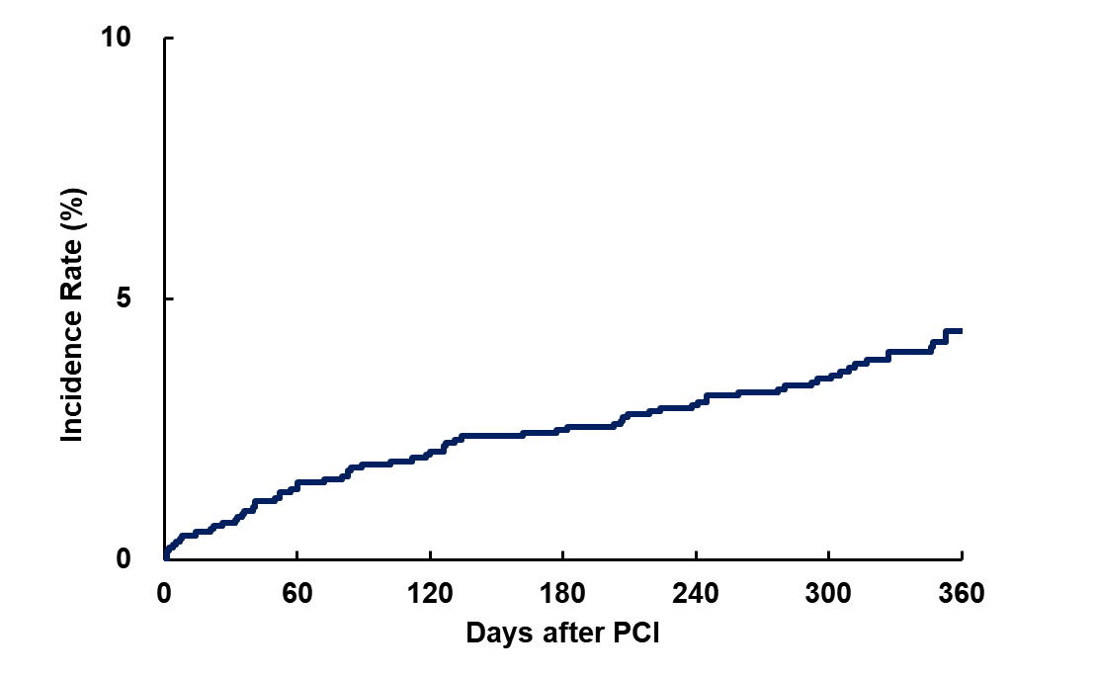
All cause death, MI, Stroke, ST, and Bleeding (BARC 3 or 5) - Primary endpoint -
4.4%
Notes:
This is a primary endpoint of this study. Composite endpoint of all cause death, MI, stroke, stent thrombosis, and severe bleeding at 1 year occurred in 4.4% of the patients.

Slide 19
Primary Endpoint
All cause death, MI, Stroke, ST, and Bleeding (BARC 3 or 5)
Propensity score subclassification adjustment analysis
MODEL U-SES (N= 1,616) | CENTURY II BP-SES (N= 542) | Difference | One Sided 95% Upper Confidence Bound | Delta | P non-inferiority
4.3% (69 /1,616 ) | 5.7% (31 /542 ) | -3.17% | -0.86% | 3.50% | <.0001
Notes:
After propensity score adjustment, estimated difference was 3.17% which was lower than one side of 95% confidence interval. Therefore non-inferiority was proved.
Propensityスコアを使い、同じPropensityスコアをもつ症例は被検者背景は同じだと仮定します。
そのままのPropensityスコアでは、Model USESとCentury2のすべてのデータがマッチングできないため、
Model USESとCentury2の症例を合わせてPropensityスコアの値を順番にならべ、5層に分けます。
層の中ではPropensityスコアはほぼ同じ、つまり、Model USESとCentury2の比較が可能だと仮定し、層の中でModel USESとCentury2のPE率の差を求めます。すると5つの層から5つのModel USESとCentury2のPE発現率の差がもとまります。あとはこの差を適切にまとめて1つの差として求めれば良いことになります
具体的な数値としては、下記は単純なModel USESとCentury2のPE発現率と95%信頼区間になります
Model U-Ses
CENTURY 2 BP-SES
(N= 1616 Patients)
(N= 542 Patients)
4.3% (69 /1616 )
5.7% (31 /542 )
この差はおおよそ-1.4%ですが、単純にこの差は背景が違うので、比較には使えません（単純なKaplan mierer曲線も同じ意味で比較は不可ですが）
そこで5つの層の比較可能な差をまとめたものが
Difference
-3.17%
となります。この3.17%は、単純差-1.4%よりも大きくなっています。これはおそらくPE発生に関して、Model USESはCentury2にくらべて高リスク手段であり、同じPE発生リスクで比較すれば、Model USESはCentury2よりもよりPE発生率が低いことが推測されます。
One Sided 95% Upper Confidence Bound
-0.86%
は、-3.17%ｍの片側2.5%の上側信頼区間になります。これが非劣性マージン3.5%よりも小さければ非劣性は証明されたことになります。
P-Value
<.0001
は非劣性の検定p値で、0.05以下なら非劣性が証明される=上記上側信頼区間が3.5%よりも小さい
ことを意味します
これがプロトコールに書いてある非劣性の定義、検定と結果の解釈です

Slide 20
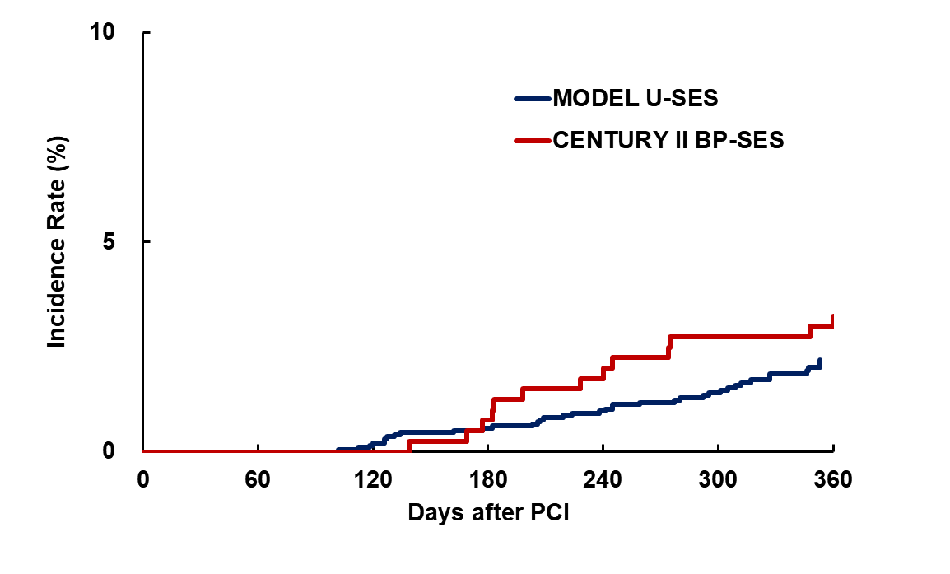
Landmark Analysis at 90 Days: All cause death, MI, Stroke, ST, and Bleeding (BARC 3 or 5) with Propensity Score Adjustment
HR (95%CI): 0.59 (0.27-1.30), P=0.19
3.7%
2.2%
Notes:
As you can appreciate from the graphics, periprocedural MI was higher in Century II study. Universal definition Type 4a MI may not be fully monitored in this study, although other type 4 MI was adjudicated by CEC. Therefore, we performed landmark analysis from 3 months. As you can see, landmark analysis demonstrated same trend of MODEL U-SES group as Century II in the composite endpoint.

Slide 21
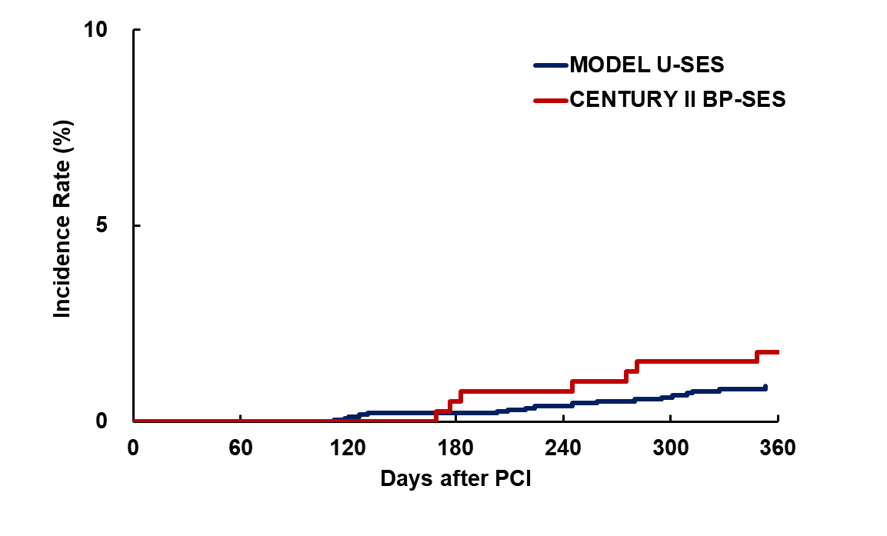
Landmark Analysis at 90 Days: Cardiovascular death, MI, Stroke and ST with Propensity Score Adjustment
HR (95%CI): 0.46 (0.14-1.44), P=0.18
2.0%
0.9%
Notes:
When looking at thrombotic events, results were similar.

Slide 22
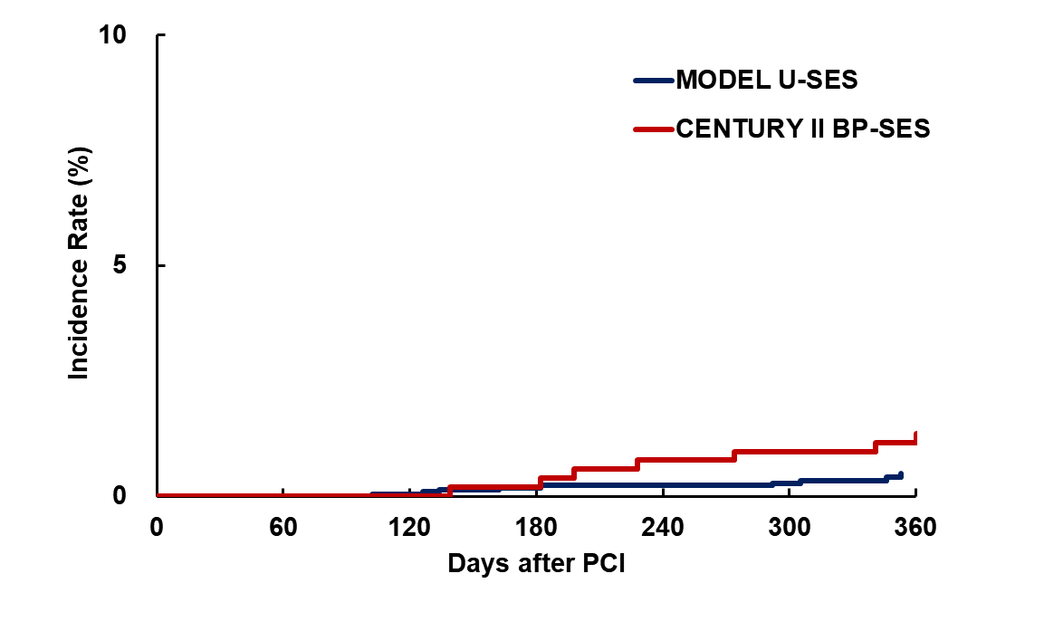
Landmark Analysis at 90 Days: Bleeding (BARC 3 or 5) with Propensity Score Adjustment
HR (95%CI): 0.33 (0.10-1.08), P=0.07
1.6%
0.5%
Notes:
Bleeding events of this study group tended to be lower than control group.

Slide 23
12-month Clinical Outcomes
Primary Endpoint: All cause death, MI, Stroke, ST, and Bleeding (BARC 3 or 5)
Notes:
This is a list of each event. Stent thrombosis was only 0.2%, whereas severe bleeding was 1.2%, even in this short DAPT study.

Slide 24
Comparison of Single Antiplatelet Therapy: Aspirin and P2Y12 receptor inhibitors
Notes:
Then I will present the second but major objective of this study.

Slide 25
Baseline Patient Characteristics
 | Aspirin (n=846) | P2Y12 (n=674) | p-Value
Age, years | 69.3 ± 10.8 | 69.8 ± 10.3 | 0.39
Age≥75 years | 35.6% | 35.6% | 1.00
Male gender | 78.7% | 74.5% | 0.06
Body mass Index, kg/m² | 24.1 ± 3.4 | 24.4 ± 3.4 | 0.07
Diabetes | 37.2% | 39.8% | 0.34
Hypertension | 79.4% | 79.5% | 1.00
Current smoker | 22.9% | 18.0% | 0.03
Severe CKD | 13.9% | 12.3% | 0.36
Hemodialysis | 4.7% | 4.5% | 0.90
Prior stroke | 8.8% | 12.0% | 0.04
Heart failure | 25.6% | 30.0% | 0.06
Peripheral vascular disease | 6.9% | 5.4% | 0.24
（
Notes:
24
This slide demonstrates baseline characteristics according to the continued medications. Current smoker is higher and prior stroke is lower in aspirin monotherapy group. The difference in the 2 groups was not so unbalanced.

Slide 26
Baseline Lesion Characteristics
 | Aspirin (n=846) | P2Y12 (n=674) | p-Value
Number of treated lesions | 1.1 ± 0.4 | 1.2 ± 0.5 | 0.12
Multi-vessel treatment | 4.8% | 7.2% | 0.06
Target vessel location
LMCA | 1.2% | 1.7% | 0.51
LAD | 55.2% | 53.7% | 0.57
LCx | 20.7% | 24.5% | 0.08
RCA | 28.1% | 27.5% | 0.82
Thrombus | 11.4% | 6.8% | 0.002
Chronic total occlusion | 0.8% | 2.0% | 0.07
In-stent restenosis | 1.2% | 2.2% | 0.15
Bifurcation | 40.7% | 42.9% | 0.43
Moderate or heavy calcification | 17.8% | 14.1% | 0.07
Small vessel (<= 2.75mm) | 58.6% | 64.7% | 0.02
Long lesion ( > 18mm) | 41.6% | 40.5% | 0.70
SYNTAX score | 9.1 ± 6.0 | 9.1 ± 6.4 | 0.99
Notes:
25
With regards to lesion characteristics, rates of small vessel and thrombus containing lesions are higher in P2Y12 group. Other demographic were balanced.

Slide 27
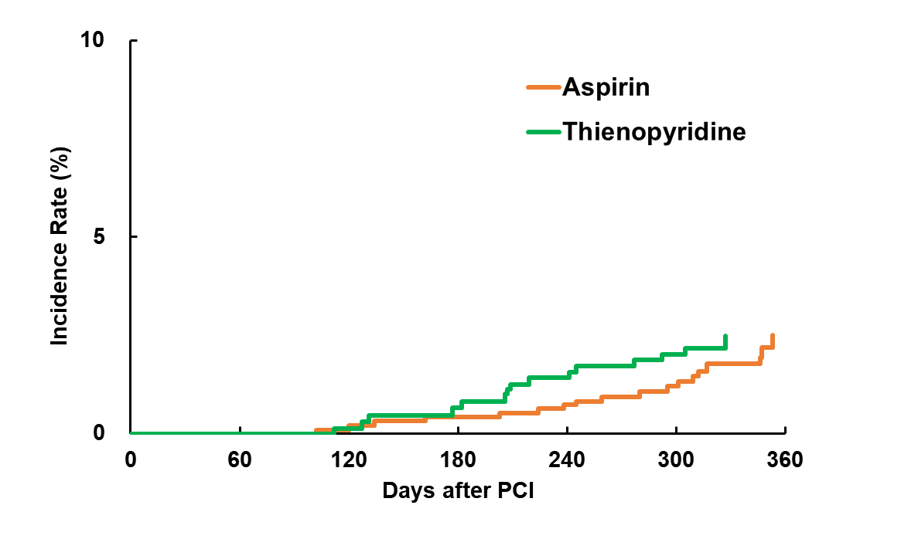
Landmark Analysis at the 90 Days All cause death, MI, Stroke, ST, and Bleeding (BARC 3 or 5)
P2Y12 inhibitor
Propensity score IPTW Analysis (Inverse Probability of Treatment Weighted)
HR (95%CI): 1.14 (0.58-2.22), P=0.71
2.5%
2.5%
Notes:
This is the net adverse composite endpoint. Unbalance of 2 medications were adjusted by propensity IPTW analysis. Both 2 monotherapy were identical.

Slide 28
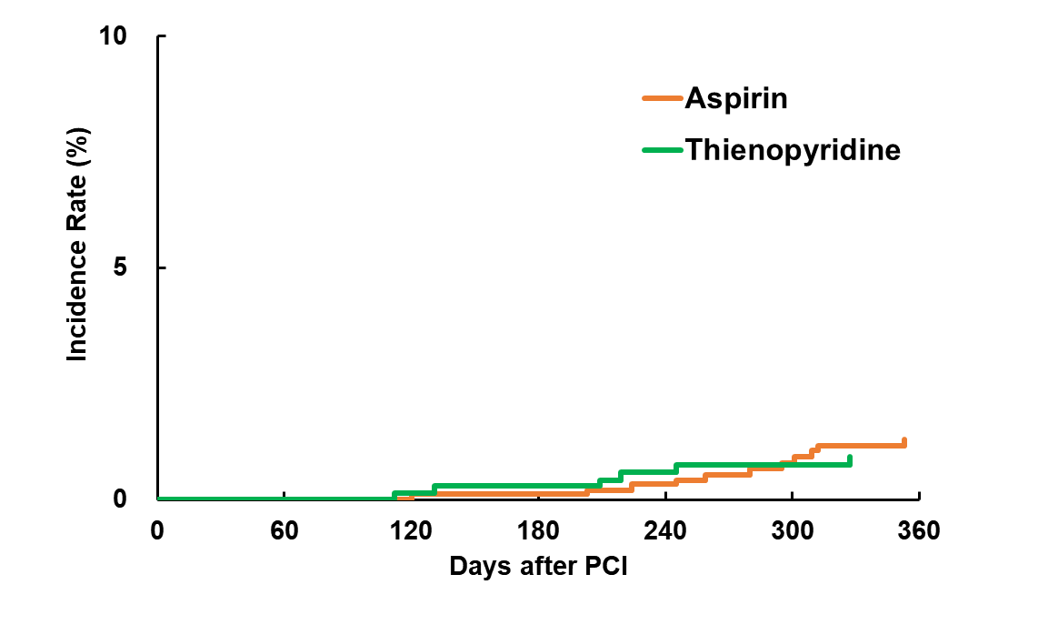
Landmark Analysis at the 90 Days Cardiovascular death, MI, Stroke and ST with IPTW Analysis
P2Y12 inhibitor
HR (95%CI): 0.76 (0.28-2.07), P=0.60
1.3%
0.9%
Notes:
This is the ischemic endpoint. Two groups were not different.

Slide 29
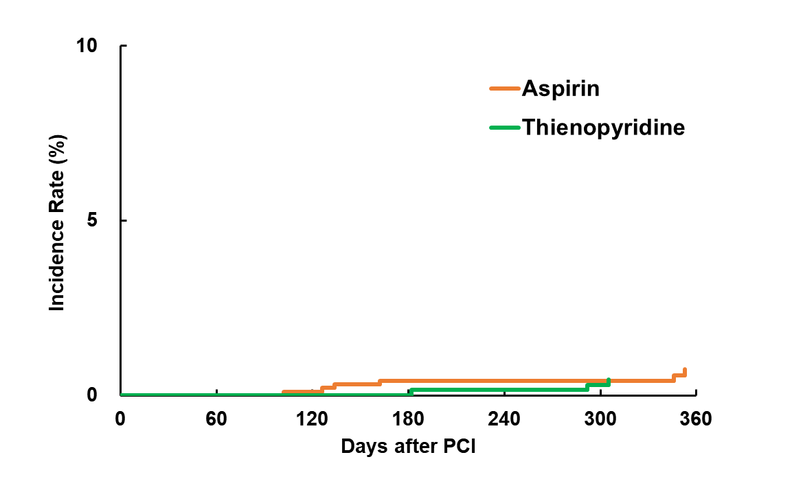
Landmark Analysis at the 90 Days Bleeding (BARC 3 or 5) with IPTW Analysis
P2Y12 inhibitor
HR (95%CI): 0.68 (0.17-2.76), P=0.59
0.7%
0.5%
Notes:
Bleeding was also not different.

Slide 30
Limitations
This study was not a randomized controlled trial but used patients level propensity score adjusted historical control group.
Propensity score adjusted analysis may not compensate the selection bias of this study sufficiently, since considerable baseline difference was observed.
Comparison between aspirin and P2Y12 receptor inhibitors was not randomized so that the safety and efficacy of each antiplatelet monotherapy cannot be conclusive.
Notes:
29

Slide 31
Conclusions
This study demonstrated that 3-month DAPT was non-inferiority to adjusted cohort of longer DAPT after BP-SES implantation in net adverse clinical events.
P2Y12 inhibitor monotherapy was almost equivalent to Aspirin monotherapy after 3 months in terms of both bleeding and thrombotic events.
Direct comparison between P2Y12 inhibitor and aspirin would be necessary to confirm the efficacy and safety of P2Y12 inhibitor monotherapy in a randomized fashion.
Notes:
30

Slide 32
Thank you

