Slide 1
Prospective Study of Biomarkers, Symptom Improvement and Ventricular Remodeling During Entresto Therapy for Heart Failure
(PROVE-HF; NCT02887183)
James L. Januzzi MD^{1,2}, Margaret F. Prescott PhD³, Javed Butler MD MPH MBA⁴, G. Michael Felker MD MHS⁵, Alan S. Maisel MD⁶, Kevin McCague MA³, Alexander Camacho PhD¹, Ileana L. Piña MD MPH⁷, Ricardo A. Rocha MD³, Amil M. Shah MD MPH⁸, Kristin M. Williamson PharmD³, and Scott D. Solomon MD⁸ on behalf of the PROVE-HF Investigators
¹Massachusetts General Hospital, ²Baim Institute for Clinical Research, Boston, MA, USA; ³Novartis Pharmaceuticals, East Hanover, NJ, USA; ⁴University of Mississippi Medical Center, Jackson, MS, USA; ⁵Duke University Medical Center and Duke Clinical Research Institute, Durham, NC, USA; ⁶University of California, San Diego School of Medicine, San Diego, CA, USA; ⁷Detroit Medical Center, Detroit, MI, USA; ⁸Brigham and Women’s Hospital, Boston, MA, USA

Slide 2
Disclosures
The PROVE-HF Study was Sponsored by Novartis Pharmaceuticals, Inc.
Dr. Januzzi is a Trustee of the American College of Cardiology, has received grant support from Novartis, Roche Diagnostics, Abbott, Singulex and Prevencio, and consulting income from Abbott, Janssen, Novartis, Pfizer, Merck, and Roche Diagnostics.
Dr. Prescott, Mr. McCague, Dr. Rocha and Dr. Williamson are employees of Novartis Pharmaceuticals, Inc.
Dr. Butler has received research support from the NIH, PCORI, and the European Union. He serves as a consultant for Abbott, Adrenomed, Amgen, Array, Astra Zeneca, Bayer, Boehringer Ingelheim, Bristol Myers Squib, CVRx, G3 Pharmaceutical, Innolife, Janssen, LinaNova, Luitpold, Medtronic, Merck, Novartis, NovoNordisk, Relypsa, Roche, Sanofi, V-Wave Limited, and Vifor.
Dr. Felker has received research grants from NHLBI, American Heart Association, Amgen, Merck, Cytokinetics, and Roche Diagnostics; he has acted as a consultant to Novartis, Amgen, BMS, Medtronic, Cardionomic, Relypsa, V-Wave, Myokardia, Innolife, EBR Systems, Arena, Abbott, Sphingotec, Roche Diagnostics, Alnylam, LivaNova, and SC Pharma.
Dr. Maisel has received consulting income from Abbott Vascular, Ortho Clinical Diagnostics and Novartis.
Dr. Pina reports consulting income from Relypsa and Novartis.
Dr. Shah has received research support from Novartis through Brigham and Women’s Hospital, and consulting fees from Philips Ultrasound and Bellerophon Therapeutics.
Dr. Solomon has received research grants from Alnylam, Amgen, AstraZeneca, Bellerophon, Bayer, BMS, Celladon, Cytokinetics, Eidos, Gilead, GSK, Ionis, Lone Star Heart, Mesoblast, MyoKardia, NIH/NHLBI, Novartis, Sanofi Pasteur, Theracos, and has consulted for Akros, Alnylam, Amgen, AstraZeneca, Bayer, BMS, Cardior, Corvia, Cytokinetics, Gilead, GSK, Ironwood, Merck, Myokardia, Novartis, Roche, Takeda, Theracos, Quantum Genetics, Cardurion, AoBiome, Janssen, Cardiac Dimensions, and Tenaya.

Slide 3
Introduction
In the PARADIGM-HF study, sacubitril/valsartan (S/V) improved outcomes¹
Remodeling of the myocardium is central to the progression of HF with reduced ejection fraction (HFrEF) and is associated with risk for cardiovascular events²
Effect of S/V on cardiac remodeling is not known
In PARADIGM-HF, benefits of S/V were associated with a reduction in amino-terminal pro-B type natriuretic peptide (NT-proBNP) concentrations³
Reduction in NT-proBNP during GDMT for HFrEF is associated with reverse cardiac remodeling⁴
We therefore examined the association of the change in NT-proBNP after initiation of S/V with long-term changes in measures of cardiac remodeling
¹McMurray JJ, Packer M, Desai AS, et al, N Engl J Med. 2014 Sep 11;371(11):993-1004; ²Kramer DG, Trikalinos TA, Kent DM et al, J Am Coll Cardiol. 2010 Jul 27;56(5):392-406; ³Zile MR, Claggett BL, Prescott MF, et al, J Am Coll Cardiol. 2016 Dec 6;68(22):2425-2436; ⁴Daubert MA, Adams K, Yow E, et al, JACC Heart Fail. 2019 Feb;7(2):158-168

Slide 4
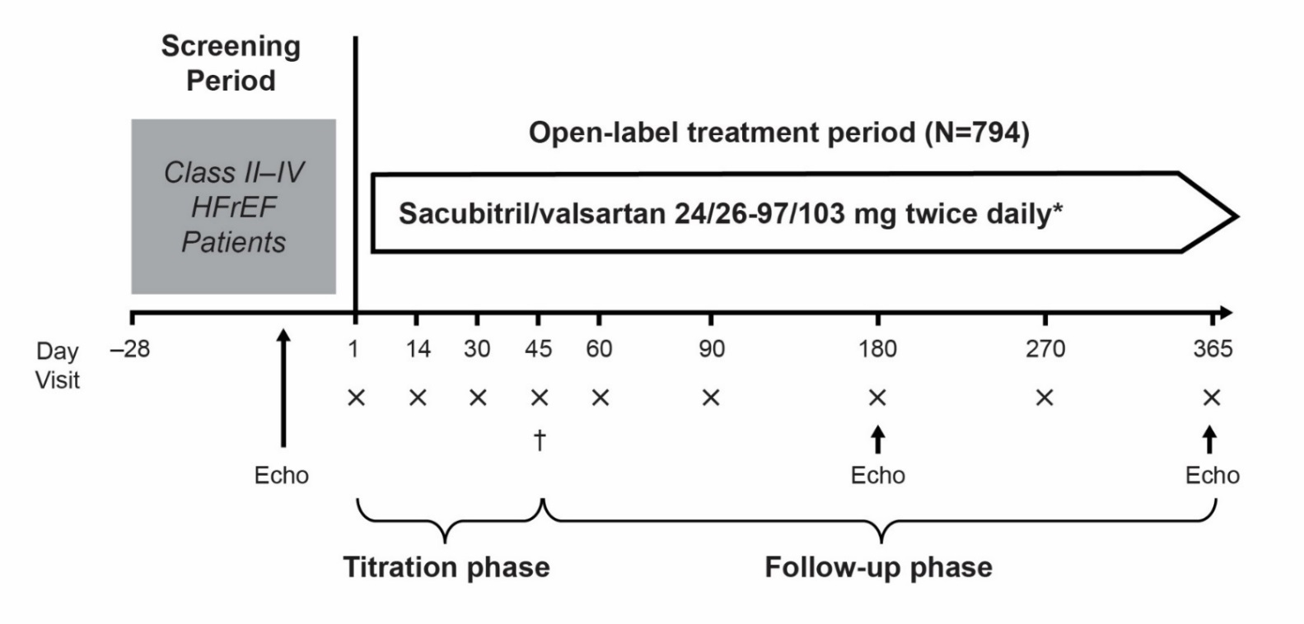
Methods
Adult patients with symptomatic HFrEF (LVEF ≤40%) eligible for on-label treatment with S/V were enrolled
Following discontinuation of ACEI/ARB, S/V was initiated and titrated
Blood samples (x) were obtained at each study visit for NT-proBNP measurement
An echocardiogram was performed at baseline, 6- and 12-months, and interpreted by a core lab in a clinically and temporally blinded fashion
Key Inclusion Criteria | Key Exclusion Criteria
Aged ≥18 years Patients with HFrEF who are candidates for on-label sacubitril/valsartan treatment per the standard of care NYHA functional class II, III, or IV LVEF ≤40% within the preceding 6 months according to any local measurement, and no subsequent documentation of EF >40% Stable dose of loop diuretic for the 2 weeks preceding study start | History of hypersensitivity/allergy or suspected contraindication to ACEI, ARB, or ARNI Any angioedema history Concomitant use of ACEI therapy, nesiritide, aliskiren, or drugs that may affect absorption of the study medication Current or previous treatment with sacubitril/valsartan Inadequate washout of other investigational drugs before study initiation Enrollment in another clinical trial within 30 days of screening Potassium >5.2 mEq/L at screening History of malignancy within 1 year Pregnancy, lactation, or use of any method of contraception that is not highly effective Implantation of CRT/D within 6 months Prior or planned heart transplant or LVAD
X = Vital status/events (CV death, HF hospitalization, worsening HF), physical examination, blood samples for safety chemistry and biomarkers, urine sampling, HF symptom assessment, KCCQ-23.
* Standard HF therapy was continued throughout the study with the exception of ACEI/ARB; †At Day 45, KCCQ-23 was not administered.
CV denotes: cardiovascular; HF denotes: heart failure; KCCQ-23 denotes: Kansas City Cardiomyopathy Questionnaire-23.
Januzzi JL, Butler J, Fombu E, et al; Am Heart J, 2018;199:130-136.

Slide 5
Goals of the study
Primary endpoint:
Correlation between change in NT-proBNP and remodeling at 12 months:
Left ventricular ejection fraction (LVEF)
LV end-diastolic volume index (LVEDVi)
LV end-systolic volume index (LVESVi)
Left atrial volume index (LAVi)
Ratio of early mitral diastolic filling velocity/early diastolic mitral annular velocity (E/e')
Secondary endpoints:
Association between change in NT-proBNP and remodeling at 6 months
Effect of S/V on cardiac remodeling in specific patient subgroups not represented in the PARADIGM-HF trial:
New-onset HF and/or ACEI/ARB naïve
Those with BNP or NT-proBNP concentrations below PARADIGM-HF inclusion criteria
Patients not reaching target doses of S/V (97/103 mg twice daily)
Januzzi JL, Butler J, Fombu E, et al; Am Heart J, 2018;199:130-136.

Slide 6
Baseline characteristics (N=794)
Cardiac measurements, median (interquartile range):
LVEF = 28.2 (24.5, 32.7) %
LVEDVi = 86.93 (76.17, 100.43) mL/m²
LVESVi = 61.68 (51.95, 75.00) mL/m²
LAVi = 37.76 (31.63, 46.09) mL/m²
E/e' =11.70 (8.80, 16.00)
Parameter | N=794
Age, years; mean (SD) | 65.1 (12.4)
Male sex; n (%) | 568 (71.5)
NYHA Class II or III; n (%) | 780 (98.2)
Race; n (%) White Black | 581 (73.4) 180 (22.7)
Body-mass index, kg/m², mean (SD) | 31.3 (6.9)
Past Medical History; n (%) Hypertension Diabetes mellitus Myocardial infarction Atrial fibrillation/flutter | 699 (88.0) 361 (45.5) 329 (41.4) 280 (35.3)
Guideline-directed HFrEF therapy; n (%) Beta blocker ACEI/ARB MRA CRT/CRT-ICD ICD-alone | 757 (95.3) 602 (75.8) 281 (35.4) 122 (15.4) 226 (28.5)
Subgroups of interest:
New-onset HF and/or ACEI/ARB naïve: N = 118 (14.9%)
BNP or NT-proBNP concentrations below PARADIGM-HF inclusion criteria: N = 292 (36.8%)
Following titration, 278 (35.0%) did not receive target dose
N (%) unless otherwise noted; SD, standard deviation; NYHA, New York Heart Association; ACEI, ACE inhibitor; ARB, angiotensin II receptor blocker; MRA, mineralocorticoid receptor antagonist; CRT, cardiac resynchronization therapy; ICD, implantable cardioverter-defibrillator

Slide 7
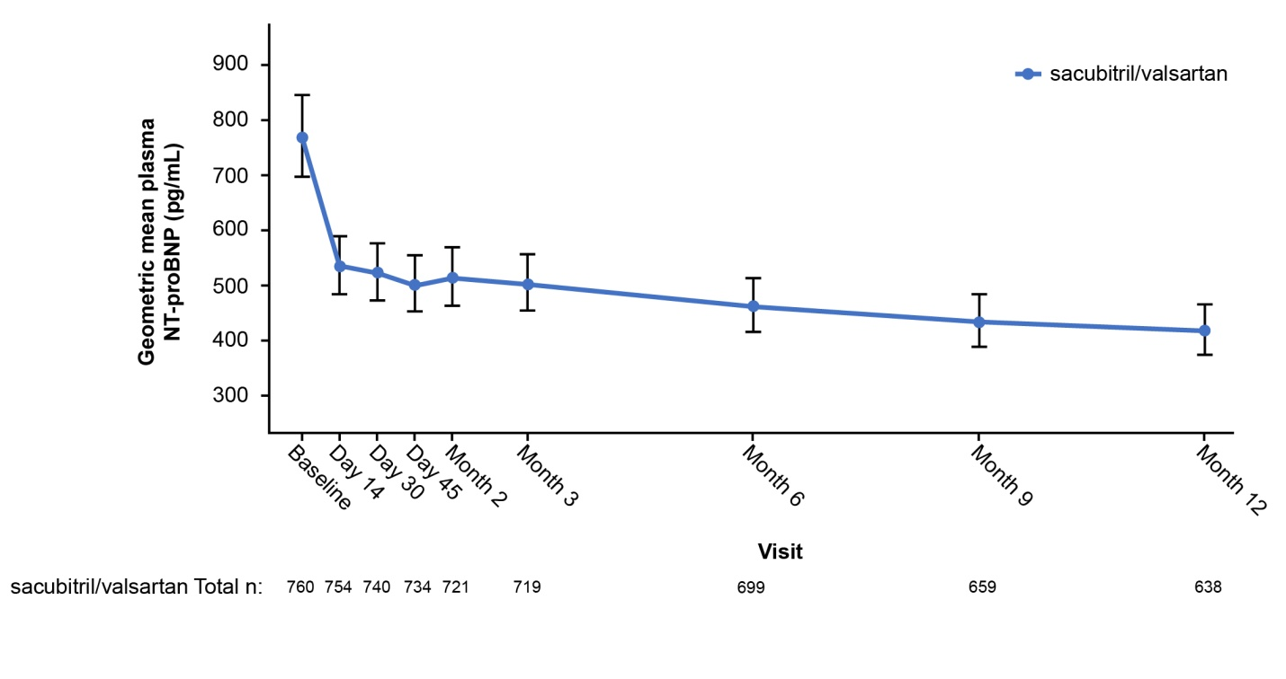
NT-proBNP concentrations
Rapid and significant reduction of NT-proBNP was observed, with majority of reduction within the first 2 weeks
Time point | N | Median NT-proBNP (25th, 75th percentile), pg/mL
Baseline | 760 | 816 (332, 1822)
Day 14 | 754 | 528 (226, 1378)
Day 30 | 740 | 546 (211, 1321)
Day 45 | 734 | 514 (192, 1297)
Month 2 | 721 | 535 (210, 1299)
Month 3 | 719 | 488 (211, 1315)
Month 6 | 699 | 473 (179, 1163)
Month 9 | 659 | 444 (170, 1153)
Month 12 | 638 | 455 (153, 1090)

Slide 8
Primary endpoint
From baseline to 12 months, significant correlations were observed between the change in NT-proBNP concentration and cardiac remodeling parameters.
Parallel latent growth curve analyses demonstrated strong association between early NT-proBNP change and subsequent reverse cardiac remodeling.
Parameter | Pearson r (IQR) | P value
NT-proBNP (pg/mL) / LVEF (%) | -0.381 (-0.448, -0.310) | <.0001
NT-proBNP (pg/mL) / LVEDVi (mL/m²) | 0.320 (0.246, 0.391) | <.0001
NT-proBNP (pg/mL) / LVESVi (mL/m²) | 0.405 (0.335, 0.470) | <.0001
NT-proBNP (pg/mL) / LAVi (mL/m²) | 0.263 (0.186, 0.338) | <.0001
NT-proBNP (pg/mL) / E/E’ | 0.269 (0.182, 0.353) | <.0001
IQR, interquartile range; LVEF, left ventricular ejection fraction; LVEDVi, left ventricular end-diastolic volume index; mL, milliliter; LAVi, left atrial volume index; E/E’, ratio of early diastolic filling velocity and early diastolic mitral annular velocity

Slide 9
Reverse cardiac remodeling (1)
Baseline to 12 months: all P <.001
+9.4%
+5.2%
86.93
-6.65
-12.25
LVEF (%)
28.2
-8.67
61.68
-15.29
LV volume (mL/m²)
25% of subjects experienced an LVEF increase of ≥13% at 12 months
BL
6M
12M
BL
6M
12M
BL
6M
12M
BL, baseline; LVEF, left ventricular ejection fraction; LVEDVi, left ventricular end-diastolic volume index; LVESVi, left ventricular end-systolic volume index

Slide 10
Reverse cardiac remodeling (2)
Baseline to 12 months: all P <.001
37.76
-4.36
-7.57
11.70
-1.23
-1.30
LVMi fell from
124.77 to 107.82 g/m²
(mean -16.00 g/m²; P <.001)
LA volume (mL/m²)
E/e’ ratio
BL
6M
12M
BL
6M
12M
BL, baseline; mL, milliliter; LA, left atrial; LAVi, left atrial volume index; E/e’, ratio of early diastolic filling velocity and early diastolic mitral annular velocity; LVMi, left ventricular mass index.

Slide 11
Subgroups of interest
Reverse cardiac remodeling was comparable in each subgroup of interest
All P <0.001 except where noted
New-onset HF/ACEI-ARB naïve (N=118)
Parameter | LS Mean change, BL to 12 months (95% CI)
LVEF (%) | +12.8 (+11.05, +14.5)
LVEDVi (mL/m²) | -13.81 (-15.78, -11.83)
LVESVi (mL/m²) | -17.88 (-20.07, -15.68)
LAVi (mL/m²) | -8.44 (-9.73, -7.15)
E/e’ | -2.60 (-3.83, -1.37)
NP < PARADIGM incl criteria* (N=292)
Parameter | LS Mean change, BL to 12 months (95% CI)
LVEF (%) | +9.4 (+8.6, +10.3)
LVEDVi (mL/m²) | -11.32 (-12.24, -10.40)
LVESVi (mL/m²) | -14.15 (-15.15, -13.15)
LAVi (mL/m²) | -7.06 (-7.54, -6.58)
E/e’ | -0.93 (-1.43, -0.43)
Not reaching target dose (N=278)
Parameter | LS Mean change, BL to 12 months (95% CI)
LVEF (%) | +9.4 (+8.4, +10.3)
LVEDVi (mL/m²) | -10.99 (-12.21, -9.77)
LVESVi (mL/m²) | -14.32 (-15.67, -12.97)
LAVi (mL/m²) | -7.23 (-7.97, -6.50)
E/e’ | -0.46 (-1.32, +0.40); P =NS
*NT-proBNP < 600 pg/mL if not hospitalized or < 400 pg/mL if hospitalized within the past 12 months; BNP < 150 pg/mL if not hospitalized or < 100 pg/mL if hospitalized for HF within the past 12 months; BL, baseline; LS, least-square; LVEF, left ventricular ejection fraction; LVEDVi, left ventricular end-diastolic volume index; mL, milliliter; LAVi, left atrial volume index; E/E’, ratio of early diastolic filling velocity and early diastolic mitral annular velocity; NP, natriuretic peptide.

Slide 12
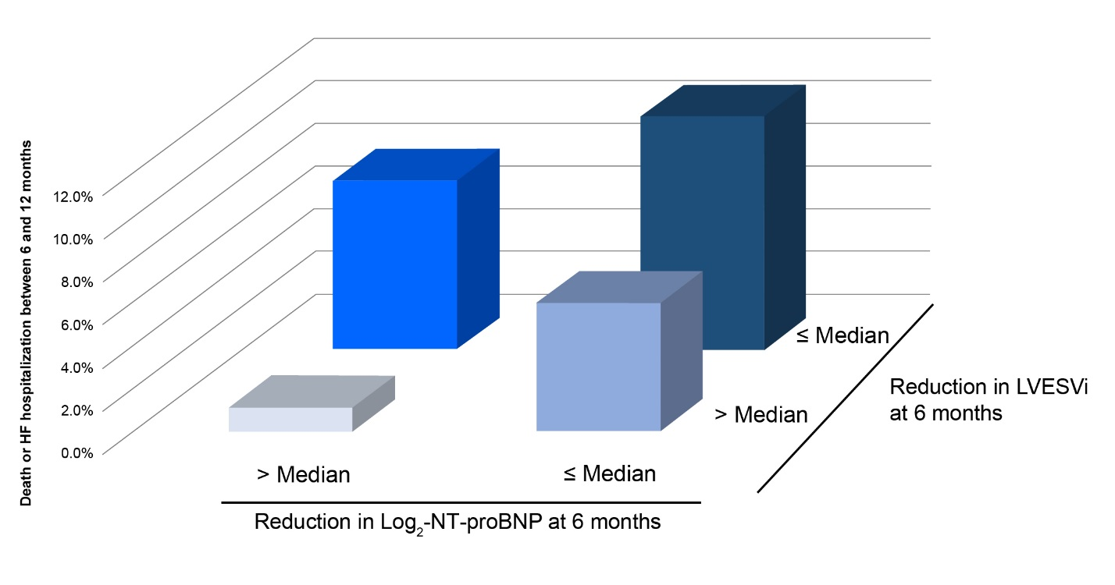
Death or HF hospitalization by 12 months
Patients with largest reduction in NT-proBNP and LVESVi by 6 months had lowest rates of subsequent death or HF hospitalization by 12 months

Slide 13
Adverse events by 12 months
Adverse events rates were similar to the PARADIGM-HF study, with the exception of dizziness
Positively-adjudicated angioedema occurred in only 2 patients (0.3%), of whom 1 was Black (0.56%)
Both cases of angioedema were mild, resolving with antihistamines or no therapy
Event | N = 794; n (%)
Hypotension (systolic blood pressure <90 mm mercury) | 140 (17.6)
Dizziness | 133 (16.8)
Hyperkalemia (potassium > 5.3 milliequivalents/liter) | 105 (13.2)
Worsening kidney function* | 98 (12.3)
Angioedema No treatment or antihistamines only without hospitalization | 2 (0.3)
*Worsening (decrease) in estimated glomerular filtration rate of ≥ 35% from baseline, or an increase in creatinine of ≥ 0.5 mg/dL from baseline and a worsening (decrease) in estimated glomerular filtration rate of ≥ 25% from baseline at a given visit.

Slide 14
Limitations
Single-group, open-label design
Availability of S/V following regulatory approval plus its Class I guideline recommendation made a comparison group unethical for a 12-month study
Echocardiograms were interpreted in a temporally-blinded manner and primary endpoint was based on objective measures
Multiple comparisons may have increased risk of Type 1 error
Not all echo measurements were available at each time point

Slide 15
Conclusions
In this study of patients with HFrEF treated with sacubitril/valsartan, reduction in NT-proBNP was significantly associated with reverse cardiac remodeling
The degree of reverse remodeling demonstrated may help to explain how sacubitril/valsartan reduces morbidity and mortality in patients with HFrEF
Analyses examining impact of sacubitril/valsartan on quality of life, symptoms, and a broad range of mechanistic biomarkers are underway

Slide 16
James L. Januzzi Jr, MD; Margaret F. Prescott, PhD; Javed Butler, MD, MPH, MBA; G. Michael Felker, MD, MHS; Alan S. Maisel, MD; Kevin McCague, MA; Alexander Camacho, PhD; Ileana L. Piña, MD, MPH; Ricardo A. Rocha, MD; Amil M. Shah, MD, MPH; Kristin M. Williamson, PharmD; Scott D. Solomon, MD; PROVE-HF Investigators
Association of Change in N-Terminal Pro–B-Type Natriuretic Peptide Following Initiation of Sacubitril-Valsartan Treatment With Cardiac Structure and Function in Patients With Heart Failure With Reduced Ejection Fraction
Published September 2, 2019

