Slide 1
IVUS-XPL: Five-Year Outcomes From a Randomized Trial of Intravascular Ultrasound-Guided vs Angiography-Guided PCI of Long Coronary Lesions
Myeong-Ki Hong, MD. PhD
on behalf of the IVUS-XPL trial investigators
Severance Cardiovascular Hospital,
Yonsei University College of Medicine, Seoul, Korea

Slide 2
Disclosure
Conflict of Interest Disclosures:
There are no conflict of interest disclosures.
Funding/Support:
This study was supported by the Cardiovascular Research Center, Seoul, Korea.
Role of the funder/sponsor:
No funder/sponsor had any role in the design and conduct of the study; collection, management, analysis, and interpretation of the data.

Slide 3
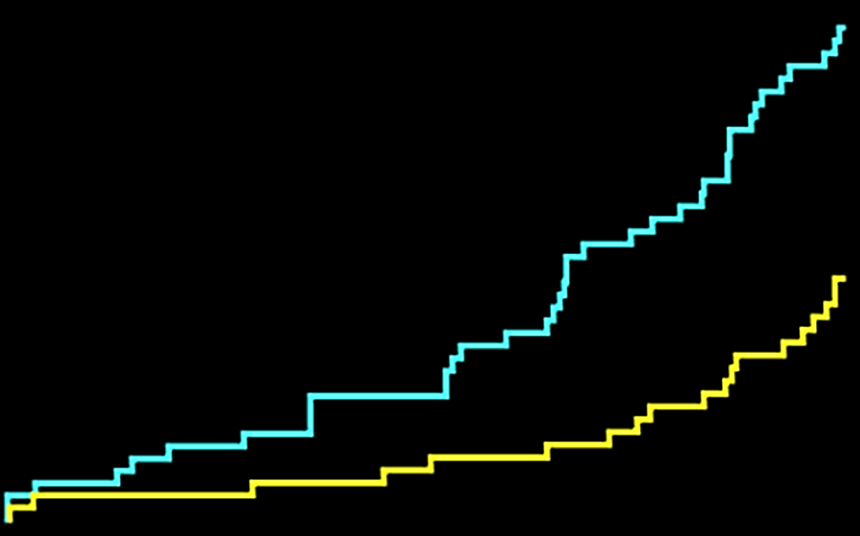
IVUS-XPL Trial: 1-year Clinical Outcome
6
5.8%
HR, 0.48 (95% CI, 0.28-0.83)
Log-rank P = .007
Patients with long coronary lesions
(Implanted stent ≥28 mm in length)
N = 1400
4
Angiography-guidance
Patients with Primary
End Point Event, %
2.9%
DES implantation with
IVUS guidance
n = 700
DES implantation with
angiography guidance
n = 700
2
Clinical follow-up at 12 months
Primary end point: MACE
Cardiac death, target-lesion related MI, and ischemia-driven TLR
IVUS-guidance
0
0
3
6
9
12
Time Since Randomization, mo
No. at risk
Angiography arm
IVUS arm
700
700
673
671
660
665
643
654
624
641
Hong et al. JAMA 2015;314:2155-2163

Slide 4
Usefulness of IVUS beyond 1 year
Background
Limitation of the IVUS-XPL trial
Short-term follow-up, while the TLR still has been continued to occur beyond 1 year even in the era of new-generation DES.
There is no randomized trial evidence evaluating the long-term effect of IVUS guidance beyond 2 years.
IVUS usage
during PCI
Is the beneficial effect sustained up to 5 years?

Slide 5
Objective
We report the 5 year clinical outcomes of the randomized IVUS-XPL trial in order to determine whether the beneficial 1-year effect of IVUS guidance is sustained up to 5 years when patients are treated with contemporary DES.

Slide 6
Study Design
IVUS-XPL trial:
A prospective, randomized, multi-center trial at 20 centers in Korea
Enrollment period: Oct 2010 and July 2014
Key inclusion criteria
Age 20 years or older
Patients with typical chest pain or evidence of myocardial ischemia
Non-emergent conditions
Stent length ≥ 28 mm based on angiographic estimation
Significant coronary artery stenosis (>50% based on visual estimate) considered for coronary revascularization with stent implantation
Hong et al. JAMA 2015;314:2155-2163

Slide 7
Study Design
Extended 5-year Follow-up of IVUS-XPL trial:
Clinical assessment, including the evaluation of cardiac symptoms and compliance with medications, was performed at the physician office visit every 3-6 months during the 5 year follow-up period.
Therefore, follow-up data were collected from medical records by the dedicated clinical research coordinators from each of the participating centers.

Slide 8
Statistical Analysis
Primary analysis
Intention-to-treat analysis with cumulative incidences of MACE at 5 year using the Kaplan-Meier estimates.
Comparison using the log-rank test.
Land-mark analyses between 1 and 5 year
Subgroup analyses for 5-year MACE

Slide 9
Study Flow
13372 | Patients underwent coronary angiography during the study inclusion period
11972 Excluded
1400 Randomized
700 | Randomized to receive IVUS-guidance PCI
700 | Randomized to receive angiography- guidance PCI
4 36 3 | Withdrew consent Lost to follow-up Died
3 34 5 | Withdrew consent Lost to follow-up Died
At 1 year
657 | Completed 1-year follow-up
658 | Completed 1-year follow-up
28 40 | Died Lost to follow-up
23 41 | Died Lost to follow-up
At 5 year
589 | Completed 5-year follow-up
594 | Completed 5-year follow-up
700 | Included in primary analysis
700 | Included in primary analysis

Slide 10
Baseline Clinical Characteristics
 | End of trial at 1 year
 | IVUS-guidance | Angiography-guidance | P-value
No. of patients | 657 | 658
Age, y | 63±9 | 64±9 | 0.413
Male sex | 452 (69) | 455 (69) | 0.890
Body mass index, kg/m² | 24.6±2.9 | 24.7±3.1 | 0.537
Hypertension | 425 (65) | 419 (64) | 0.702
Diabetes mellitus | 211 (32) | 235 (36) | 0.168
Dyslipidemia | 445 (68) | 434(66) | 0.494
Current smoker | 144 (22) | 168 (26) | 0.123
Prior myocardial infarction | 33 (5) | 29 (4) | 0.599
Prior percutaneous coronary intervention | 73 (11) | 68 (10) | 0.649
Prior coronary artery bypass graft | 18 (3) | 16 (2) | 0.725
Left ventricular ejection fraction, % | 63.0±9.8 | 62.3±10.2 | 0.244
Clinical presentation |  |  | 0.252
Stable angina | 335 (51) | 340 (52)
Unstable angina | 231 (35) | 209 (32)
Acute myocardial infarction | 91 (14) | 109 (17)
No. of treated lesions per patients | 1.31±0.55 | 1.36±0.56 | 0.128
Duration of dual antiplatelet treatment, days | 365 (180, 365) | 365 (180, 365) | 0.864

Slide 11
Angiographic and Procedural Characteristics
 | IVUS-guidance | Angiography-guidance | P-value
No. of lesions | 657 | 658
Coronary arteries |  |  | 0.109
Left anterior descending artery | 431 (66) | 395 (60)
Left circumflex artery | 85 (13) | 102 (16)
Right coronary artery | 141 (22) | 161 (25)
Baseline quantitative coronary angiographic data
Reference vessel diameter, mm | 2.89±0.46 | 2.84±0.45 | 0.105
Minimum lumen diameter, mm | 0.83±0.43 | 0.82±0.43 | 0.563
Diameter stenosis, % | 71.2±14.4 | 71.4±14.4 | 0.859
Lesion length, mm | 34.9±10.8 | 35.2±10.5 | 0.562
Adjunct post-dilatation | 498 (76) | 375 (57) | <0.001
Final balloon size, mm | 3.15±0.43 | 3.05±0.42 | <0.001
Maximal inflation pressure, atmosphere | 16.5±4.1 | 15.9±4.1 | 0.048
Post-intervention quantitative coronary angiographic data
Total stented length, mm | 39.3±10.8 | 35.2±10.5 | 0.738
Reference vessel diameter, mm | 3.04±0.44 | 2.97±0.44 | 0.003
Minimum lumen diameter, mm | 2.64±0.42 | 2.56±0.40 | 0.001
Diameter stenosis, % | 12.9±8.6 | 13.5±8.1 | 0.216

Slide 12
Clinical outcomes at 5 years
 | IVUS- guidance (n=700) | Angiography- guidance (n=700) | Hazard ratio (95% CI) | Log-Rank P value
Primary End Point
MACE | 36 (5.6%) | 70 (10.7%) | 0.50 (0.34−0.75) | 0.001
Secondary End Point
Cardiac death | 6 (0.9%) | 14 (2.2%) | 0.43 (0.17−1.12) | 0.074
Target lesion related MI | 4 (0.6%) | 6 (0.9%) | 0.67 (0.19−2.36) | 0.525
Ischemia-driven TLR | 31 (4.8%) | 55 (8.4%) | 0.54 (0.33−0.89) | 0.007
Stent thrombosis | 2 (0.3%) | 2 (0.3%) | 1.00 (0.14−7.10) | 1.000
Acute | 1 (0.1%) | 1 (0.1%)
Sub-acute | 1 (0.1%) | 0
Late | 0 | 1 (0.1%)

Slide 13
Clinical outcomes between 1 and 5 years
 | IVUS- guidance (n=700) | Angiography- guidance (n=700) | Hazard ratio (95% CI) | Log-Rank P value
Primary End Point
MACE | 17 (2.8%) | 31 (5.2%) | 0.53 (0.29−0.95) | 0.031
Secondary End Point
Cardiac death | 3 (0.5%) | 9 (1.4%) | 0.33 (0.90−1.23) | 0.083
Target lesion related MI | 4 (0.6%) | 5 (0.8%) | 0.80 (0.21−2.97) | 0.736
Ischemia-driven TLR | 14 (2.3%) | 22 (3.7%) | 0.61 (0.31−1.20) | 0.150
Stent thrombosis | 0 | 0 | − | −

Slide 14
Primary End Point
At 5 years
Between 1 and 5 years
15
15
HR = 0.50 (95% CI = 0.34−0.75)
Log-rank P = 0.001
10
Angiography-guidance
10
Patients with Primary End Point Event, %
Patients with Primary End Point Event, %
HR = 0.53 (95% CI = 0.29−0.95)
Log-rank P = 0.031
5
5
Angiography-guidance
IVUS-guidance
0
0
IVUS-guidance
0
1
2
3
4
5
0
1
2
3
4
5
No. at risk
Time Since Randomization, y
No. at risk
Time Since Randomization, y
Angiography IVUS
700
700
624
641
603
624
586
609
562
591
543
562
Angiography
IVUS
700
700
624
641
603
624
586
609
562
591
543
562

Slide 15
Subgroup
analyses
of 5-year rates of MACE

Slide 16
Conclusion
Compared with angiography-guided stent implantation, IVUS-guided stent implantation resulted in a significantly lower rate of major adverse cardiac events up to 5 years.
Sustained 5-year clinical benefits resulted from both within 1 year and from 1 to 5 years post-implantation even in the current DES implantation era.

Slide 17
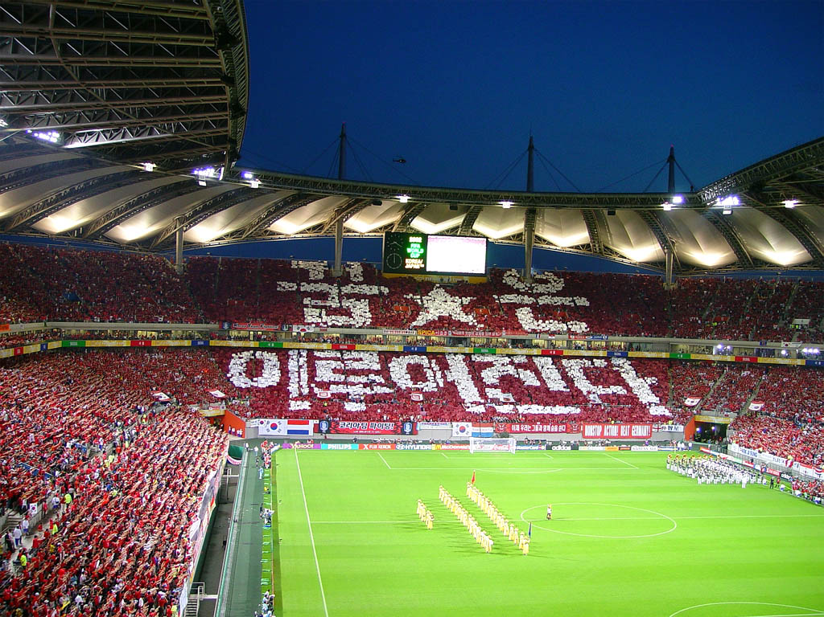
Dreams will
come true

Slide 18
Primary End Point
At 5 years
Between 1 and 5 years
15
15
HR = 0.48 (95% CI = 0.28−0.83)
Log-rank P = 0.048
10
10
Patients not meeting the IVUS-criteria
for stent optimization
Patients with Primary End Point Event, %
Patients with Primary End Point Event, %
HR = 0.85 (95% CI = 0.32−2.27)
Log-rank P =0.749
5
5
Patients meeting the IVUS-criteria
for stent optimization
Patients not meeting the IVUS-criteria
for stent optimization
0
0
Patients meeting the IVUS-criteria
for stent optimization
0
1
2
3
4
5
0
1
2
3
4
5
No. at risk
Time Since Randomization, y
No. at risk
Time Since Randomization, y
Not meeting
Meeting
315
363
285
334
276
326
270
320
261
313
253
292
Not meeting
Meeting
315
363
285
334
276
326
270
320
261
313
253
292

