Slide 1

Rivaroxaban Monotherapy versus Combination
Therapy in Patients with Atrial Fibrillation and Stable Coronary Artery Disease
Atrial Fibrillation and Ischemic events with Rivaroxaban
in patiEnts with stable coronary artery disease
Satoshi Yasuda, Koichi Kaikita, Masaharu Akao, Junya Ako, Tetsuya Matoba, Masato Nakamura, Katsumi Miyauchi, Nobuhisa Hagiwara, Kazuo Kimura, Atsushi Hirayama, Kunihiko Matsui, Hisao Ogawa,
on behalf of the AFIRE (Atrial Fibrillation and Ischemic events with Rivaroxaban in patiEnts with stable coronary artery disease) Investigators
Notes:
Thank you, chairpersons, ladies and gentlemen. It’s my great pleasure to present the primary result of the AFIRE trial in Hot Line Session.

Slide 2
A Reduced Antithrombotic Regimen Recommended by Current Guidelines
Algorithm for dual antiplatelet therapy (DAPT) in patients with an indication for oral anticoagulation undergoing percutaneous coronary intervention (PCI). ¹⁾
The selection of the most effective antithrombotic treatment for patients with atrial fibrillation (AF) and coronary artery disease (CAD) is a clinical challenge.
A reduced antithrombotic regimen of patients with AF within the first 12 months after PCI was studied in PIONEER AF-PCI ²⁾, RE-DUAL PCI ³⁾, and AUGUSTUS ⁴⁾.
  Triple therapy (an oral anticoagulant plus aspirin and a P2Y₁₂ inhibitor): for as short a duration as possible
  Combination therapy (an anticoagulant plus a P2Y₁₂ inhibitor.): up to 12 mo. in selected patients
1) Valgimigli M, et al., Eur Heart J, 2018 2) Gibson CM, et al. N Engl J Med 2016
3) Cannon CP, et al. N Engl J Med 2017 4) Lopes RD, et al. N Engl J Med 2019
Notes:
The selection of the most effective antithrombotic treatment for patients with atrial fibrillation (AF) and coronary artery disease (CAD) is a clinical challenge.
A reduced antithrombotic regimen of patients with AF within the first 12 months after PCI was studied in PIONEER AF-PCI ²⁾, RE-DUAL PCI ³⁾, and AUGUSTUS ⁴⁾.
On the basis of these studies, current guidelines recommend triple therapy (an oral anticoagulant plus aspirin and a P2Y12 inhibitor) for as short a duration as possible.
Such treatment is followed by combination therapy with an oral anticoagulant plus a P2Y₁₂ inhibitor up to 12 months in selected patients.

Slide 3
After 1 year following PCI, Current Guidelines Recommend Oral Anticoagulant Monotherapy
Algorithm for dual antiplatelet therapy (DAPT) in patients with an indication for oral anticoagulation undergoing percutaneous coronary intervention (PCI). ¹⁾
After 12 months of combination therapy, or in patients with AF and stable CAD not requiring intervention, current guidelines recommend monotherapy with
an oral anticoagulant.
However, this approach has yet to be supported
by evidence from randomized, controlled trials.
Furthermore, substantial numbers of patients in this situation continue to be treated with combination therapy, which indicates a gap between guidelines and clinical practice.²⁾
1) Valgimigli M, et al., Eur Heart J, 2018 2) Ancedy Y, et al., Int J Cardiol 2016
Notes:
After 12 months of combination therapy, or in patients with atrial fibrillation and stable coronary artery disease not requiring intervention, current guidelines recommend monotherapy with oral anticoagulant.^{9,10}
However, this approach has yet to be supported by evidence from randomized, controlled trials.
Furthermore, substantial numbers of patients in this situation continue to be treated with combination therapy, which indicates a gap between guidelines and clinical practice.¹¹

Slide 4
Atrial Fibrillation and Ischemic events with Rivaroxaban in patiEnts with stable coronary artery disease: AFIRE Study
In the AFIRE study, we aimed to investigate whether rivaroxaban monotherapy is noninferior to combination therapy (rivaroxaban plus an antiplatelet agent) in patients with AF and stable CAD more than 1 year after revascularization or
in those with angiographically confirmed CAD not requiring revascularization.
Notes:
In the AFIRE study, we aimed to investigate whether rivaroxaban monotherapy is noninferior to combination therapy (rivaroxaban plus an antiplatelet agent) in patients with AF and stable CAD more than 1 year after revascularization or in those with angiographically confirmed CAD not requiring revascularization.

Slide 5
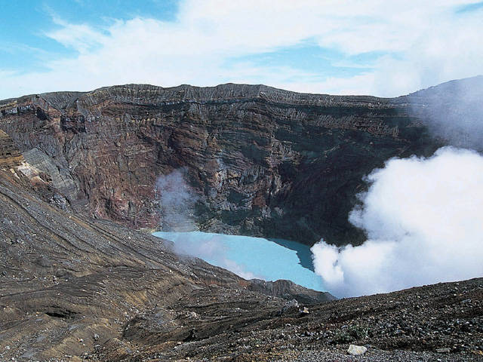

Trial Organization
Satoshi Yasuda
Hisao Ogawa (Deputy Principal Investigator),
Kazuo Kimura, Nobuhisa Hagiwara, Atsushi Hirayama,
Masato Nakamura, Katsumi Miyauchi
Junya Ako (Chair), Masaharu Akao, Koichi Kaikita, Tetsuya Matoba ,
Tetsuya Sumiyoshi, Yukihiro Koretsune, Takafumi Hiro
Yoichiro Hashimoto, Kazumi Kimura, Teruyuki Hirano
Hiroyuki Daida (Chair), Yasushi Okada, Tsutomu Yamazaki
Kunihiko Matsui
Japan Cardiovascular Research Foundation
Principal Investigator
Steering Committee
Protocol Committee
Clinical Events Committee
Cardiac Region:
Brain Region:
Data Safety and Monitoring Committee
Principal Statistician
Funding
Notes:
Here is the trial organization.
This trial was funded by Japan Cardiovascular Research Foundation.

Slide 6

Atrial Fibrillation and Ischemic events with Rivaroxaban in patiEnts with stable coronary artery disease: AFIRE Study
A multicenter, prospective, randomized, open-label, parallel-group trial ¹⁾
R
A
N
D
O
M
I
Z
E
Rivaroxaban Monotherapy
2200 patients with AF (CHADS₂$≥$1) and stable CAD
Key inclusion criteria
Underwent PCI or CABG
more than 1 year earlier
Angiographically confirmed CAD (with stenosis of ≥50%) not requiring revascularization
Key exclusion criteria
A history of stent thrombosis
Coexisting active tumor
Poorly controlled hypertension
Rivaroxaban 10 or 15 mg/day ^{2)*}
*The level of rivaroxaban in blood samples obtained from Japanese patients who were taking rivaroxaban at the 15-mg dose was similar to the level in white patients who were taking the 20-mg dose.
Combination Therapy
Rivaroxaban 10 or 15 mg/day
Single antiplatelet
Aspirin 81 or 100 mg/day,
Clopidogrel 50 or 75 mg/day, Prasugrel 2.5 or 3.75 mg/day
UMIN Clinical Trials Registry number, UMIN000016612. ClinicalTrials.gov number, NCT02642419.
1) Yasuda S, et al. Int J Cardiol. 2018. 2) Tanigawa T, et al. Drug Metab Pharmacokinet. 2013.
Notes:
AFIRE was a multicenter, prospective, randomized, open-label, parallel-group trial.
We randomly assigned patients with AF who had undergone percutaneous coronary intervention (PCI) or coronary-artery bypass grafting (CABG) more than 1 year earlier or who had angiographically confirmed CAD (with stenosis of ≥50%) not requiring revascularization to receive monotherapy with rivaroxaban or combination therapy with rivaroxaban plus a single antiplatelet agent.

Slide 7
Primary End Points
Primary efficacy end point ¹⁾ ;
The composite of stroke, systemic embolism, myocardial infarction, unstable angina requiring revascularization, or death from any cause
Assessed noninferiority of rivaroxaban monotherapy, as compared with combination therapy
(noninferiority margin: 1.46 for the 95% CI, with a power of 80%)
Performed in the modified ITT population
Primary safety end point ¹⁾ ;
A closed testing procedure was conducted after assessment of primary efficacy endpoint
To determine superiority of rivaroxaban monotherapy, as compared with combination therapy
Major bleeding, as defined according to the criteria of the ISTH*
Performed in the safety population
Sample size; Estimated that the enrollment of 2200 patients and the occurrence of at least 219 primary efficacy end points were required. ¹⁾
Yasuda S, et al. Int J Cardiol. 2018. *ISTH: the International Society on Thrombosis and Hemostasis
Notes:
The primary efficacy end point was the composite of stroke, systemic embolism, myocardial infarction, unstable angina requiring revascularization, or death from any cause.
The trial assessed the noninferiority of rivaroxaban monotherapy, as compared with combination therapy, with non-inferiority margin of 1.46 for the 95% CI with a power of 80%.
A closed testing procedure was conducted after assessment of primary efficacy endpoint to determine superiority of rivaroxaban monotherapy, as compared with combination therapy.
Primary safety end point was major bleeding, as defined according to the criteria of the ISTH.
We estimated that the enrollment of 2200 patients and the occurrence of at least 219 primary efficacy end points were required.

Slide 8
Study Flow: Randomization and Follow-up
Enrollment Period: From February 23, 2015 to September 30, 2017
2236 underwent randomization
Monotherapy Group
Combination-therapy Group
R
1118 were assigned
1118 were assigned
1107 were included
modified ITT population
N=2215
1108 were included
1099 were included
Safety population
n=2198
1099 were included
1084 were included
Per protocol population
n=2159
1075 were included
1005 completed
Completed follow-up
n=1973
968 completed
Notes:
From February 23, 2015 to September 30, 2017, patients were enrolled.
2236 underwent randomization, and 2215 patients (1107 in the monotherapy group and 1108 in the combination-therapy group) were included in the modified intention-to-treat population

Slide 9
Characteristics of Patients at Baseline
modified ITT population
 | Rivaroxaban Monotherapy (N=1107) | Combination Therapy (N=1108)
Age – (yr) mean ± SD | 74.3±8.3 | 74.4±8.2
Male sex – no. (%) | 875 (79.0) | 876 (79.1)
BMI – (kg/m²) mean ± SD | 24.5±3.7 | 24.5±3.7
CrCl – (ml/min) mean ± SD | 62.8±25.7 | 61.7±24.0
Current smoker – no. (%) | 146 (13.2) | 146 (13.2)
Diabetes – no. (%) | 461 (41.6) | 466 (42.1)
Previous stroke – no. (%) | 148 (13.4) | 175 (15.8)
Previous MI – no. (%) | 384 (34.7) | 393 (35.5)
Previous PCI – no. (%) | 781 (70.6) | 783 (70.7)
Previous CABG – no. (%) | 125 (11.3) | 127 (11.5)
 | Rivaroxaban Monotherapy (N=1107) | Combination Therapy (N=1108)
Type of stent – no. /total no. (%) DES BMS DES and BMS Unknown | 500/723 (69.2) 171/723 (23.7) 19/723 ( 2.6) 33/723 ( 4.6) | 477/721 (66.2) 171/721 (23.7) 36/721 ( 5.0) 37/721 ( 5.1)
Type of AF – no. (%) Paroxysmal Persistent Permanent | 596 (53.8) 164 (14.8) 347 (31.3) | 580 (52.3) 175 (15.8) 353 (31.9)
CHADS₂ score - median | 2 | 2
CHA₂DS₂ -VASc score - median | 4 | 4
HAS-BLED score - median | 2 | 2
Received Aspirin - no. (%) | 8 ( 0.7) | 778 (70.2)
Received P2Y₁₂ inhibitor- no. (%) | 4 ( 0.4) | 297 (26.8)
Notes:
At baseline, the characteristics of the patients were similar in the two treatment group.
The mean age was 74 years, and 79% of patients were men. 70.6% had undergone previous PCI, and 11.4% had undergone previous CABG.
The median CHADS2 score was 2, the median CHA2DS2-VASc score was 4, and the median HAS-BLED score was 2.
Among patients in the combination therapy, 70.2% received aspirin, and 26.8% received a P2Y12 inhibitor.

Slide 10
Early Termination of the Trial
The evaluation of the patients was planned to continue until September 2018.
Because of a higher risk of death from any cause in the combination-therapy group, the independent data and safety monitoring committee recommended
early termination of the trial in July 2018.
The median treatment duration was 23.0 months (interquartile range, 15.8 to 31.0)
The median follow-up period was 24.1 months (interquartile range, 17.3 to 31.5).
Notes:
The evaluation of the patients was planned to continue until September 2018.
Because of a higher risk of death from any cause in the combination-therapy group, the independent data and safety monitoring committee recommended early termination of the trial in July 2018.
The median treatment duration was 23.0 months (interquartile range, 15.8 to 31.0)
The median follow-up period was 24.1 months (interquartile range, 17.3 to 31.5).

Slide 11
Primary Efficacy End Point
The composite of stroke, systemic embolism, myocardial infarction, unstable angina requiring revascularization, or death from any cause
Notes:
Primary Efficacy End Point is as follows;

Slide 12
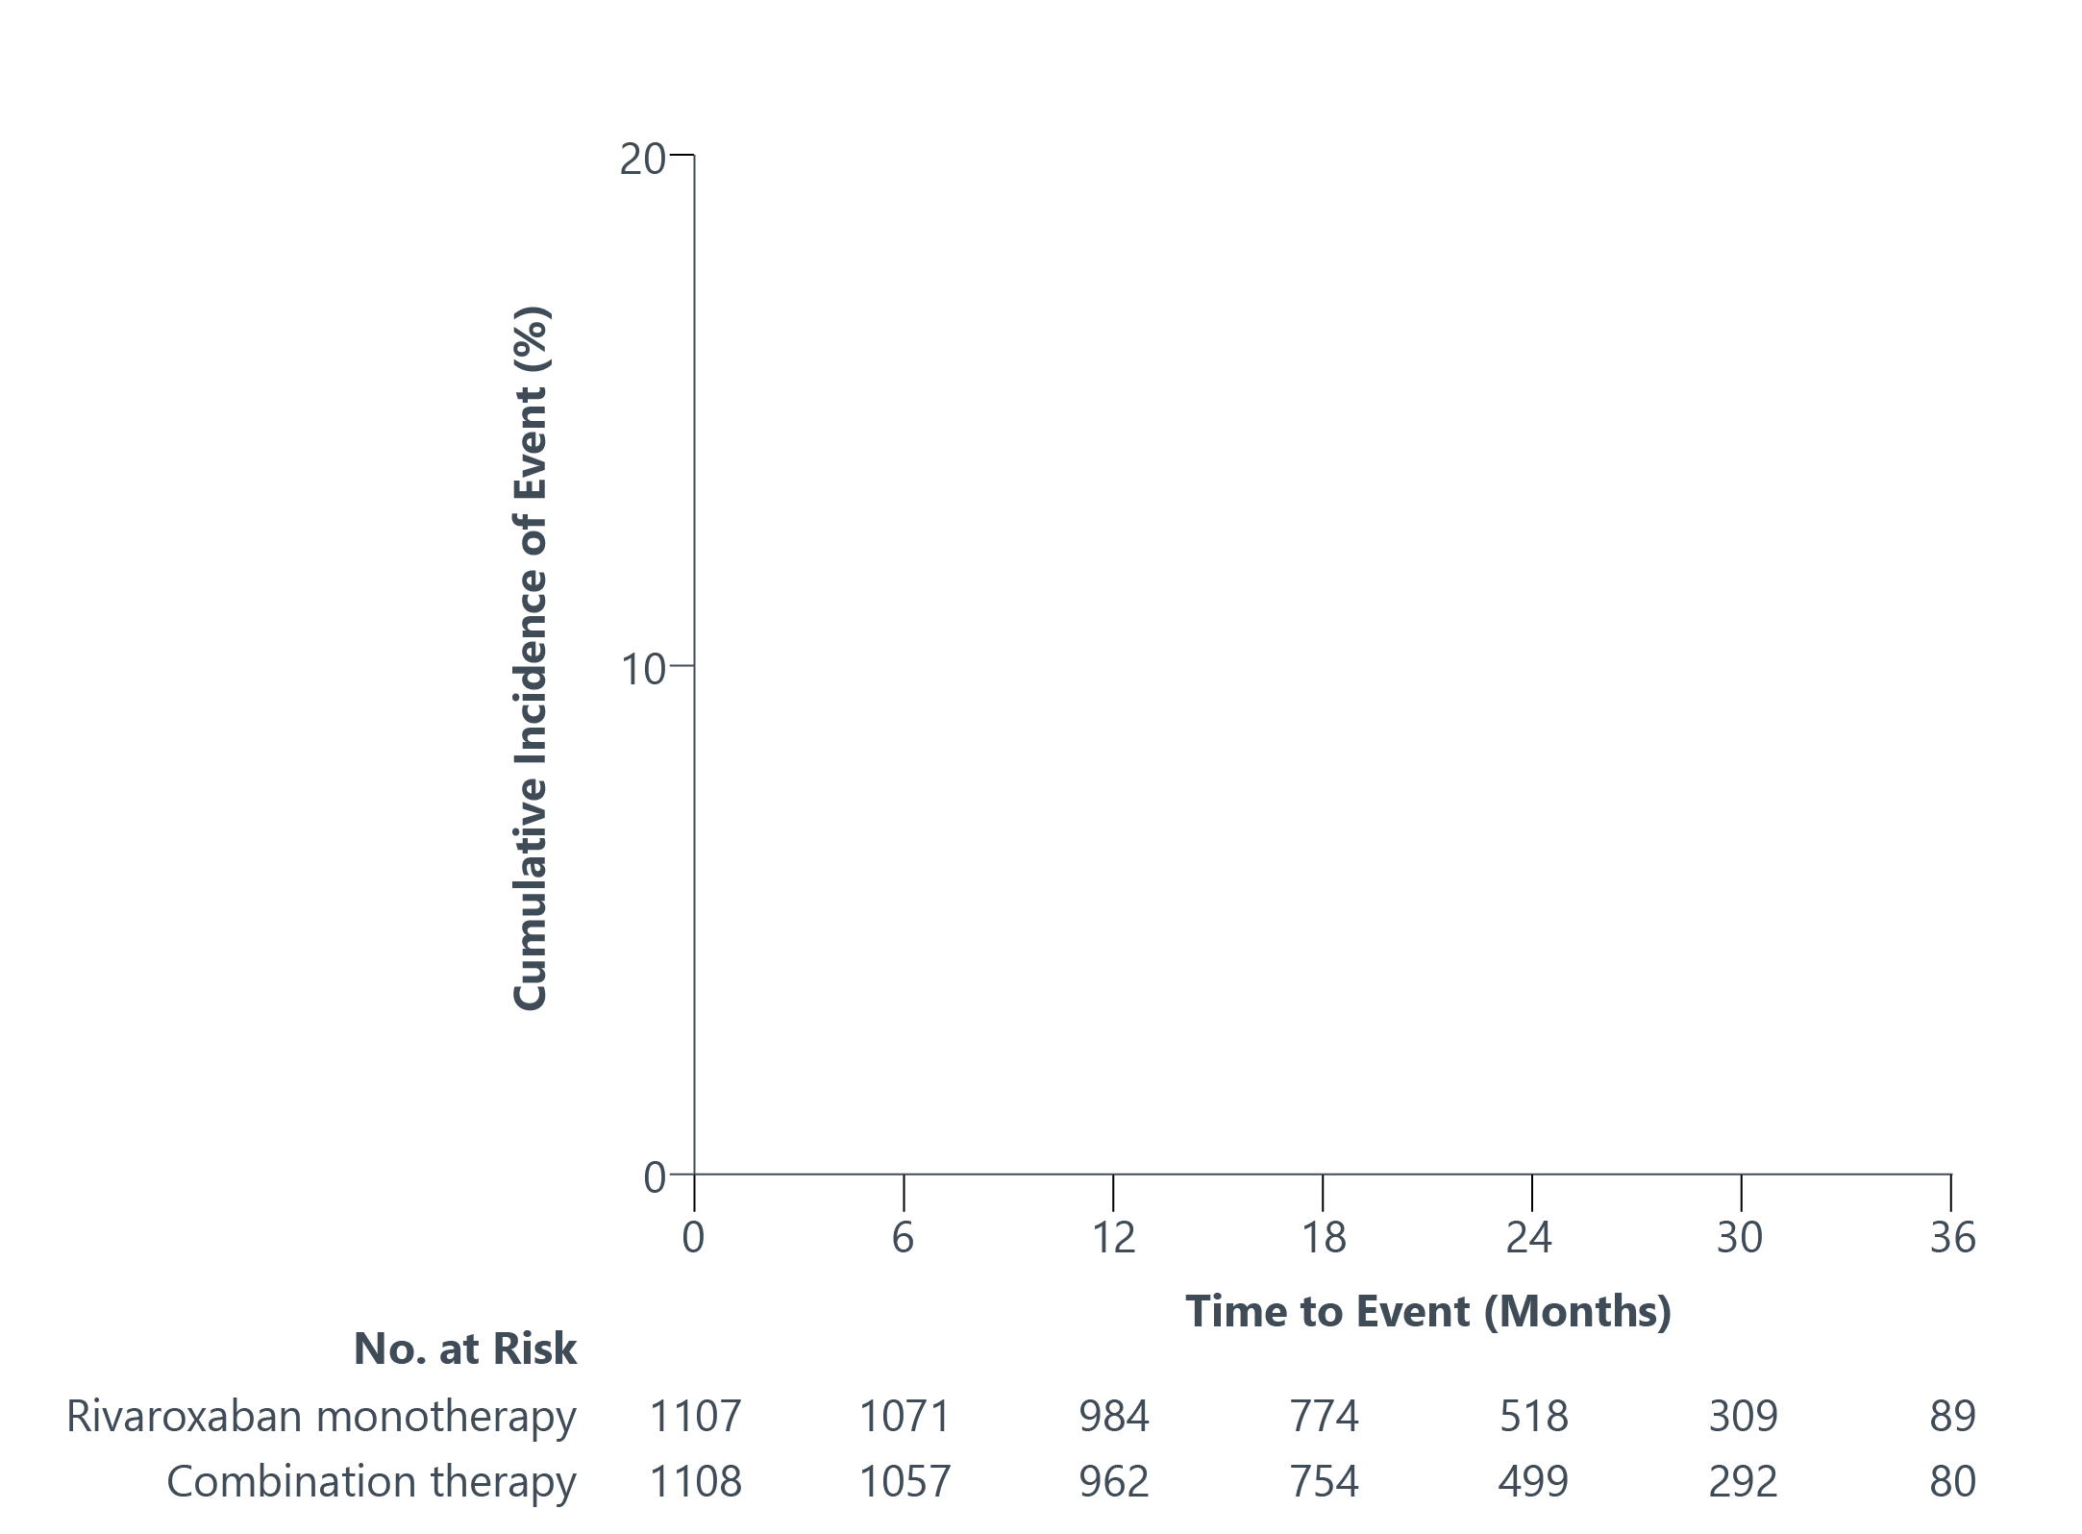
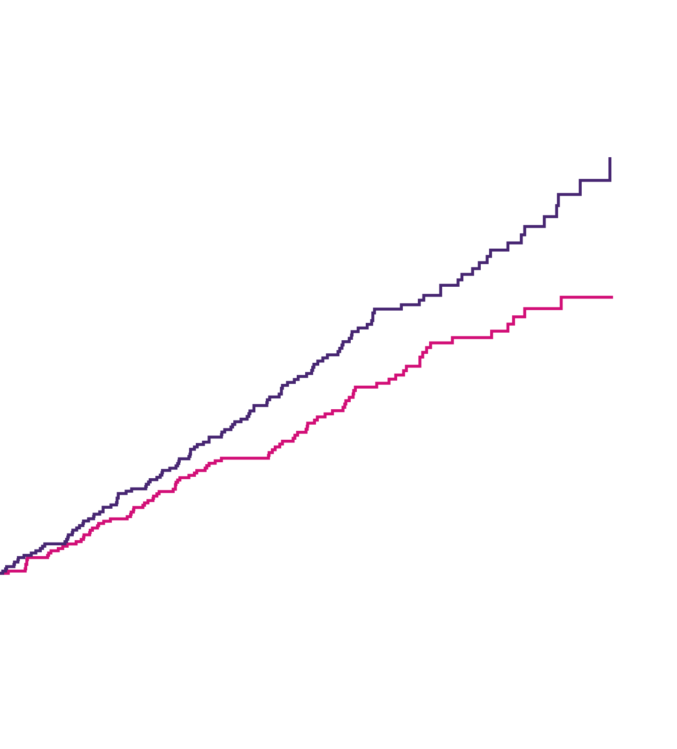
Kaplan-Meier Estimates of
First Occurrence of Primary Efficacy Events
Combination therapy
5.75% per patient-year
Monotherapy
4.14% per patient-year
HR, 0.72 (0.55 to 0.95)
P<0.001 (noninf.)
*In the assessment for superiority for the primary efficacy end point (that was not prespecified),
the P value was 0.02.
Notes:
Rivaroxaban monotherapy was noninferior to combination therapy for the primary efficacy end point, with event rates of 4.14% and 5.75% per patient-year, respectively.
The hazard ratio was 0.72 with P<0.001 for noninferiority.

Slide 13
Primary Safety End Point
Major bleeding, as defined according to the criteria of the ISTH
Notes:
Primary Safety End Point is as follows:

Slide 14
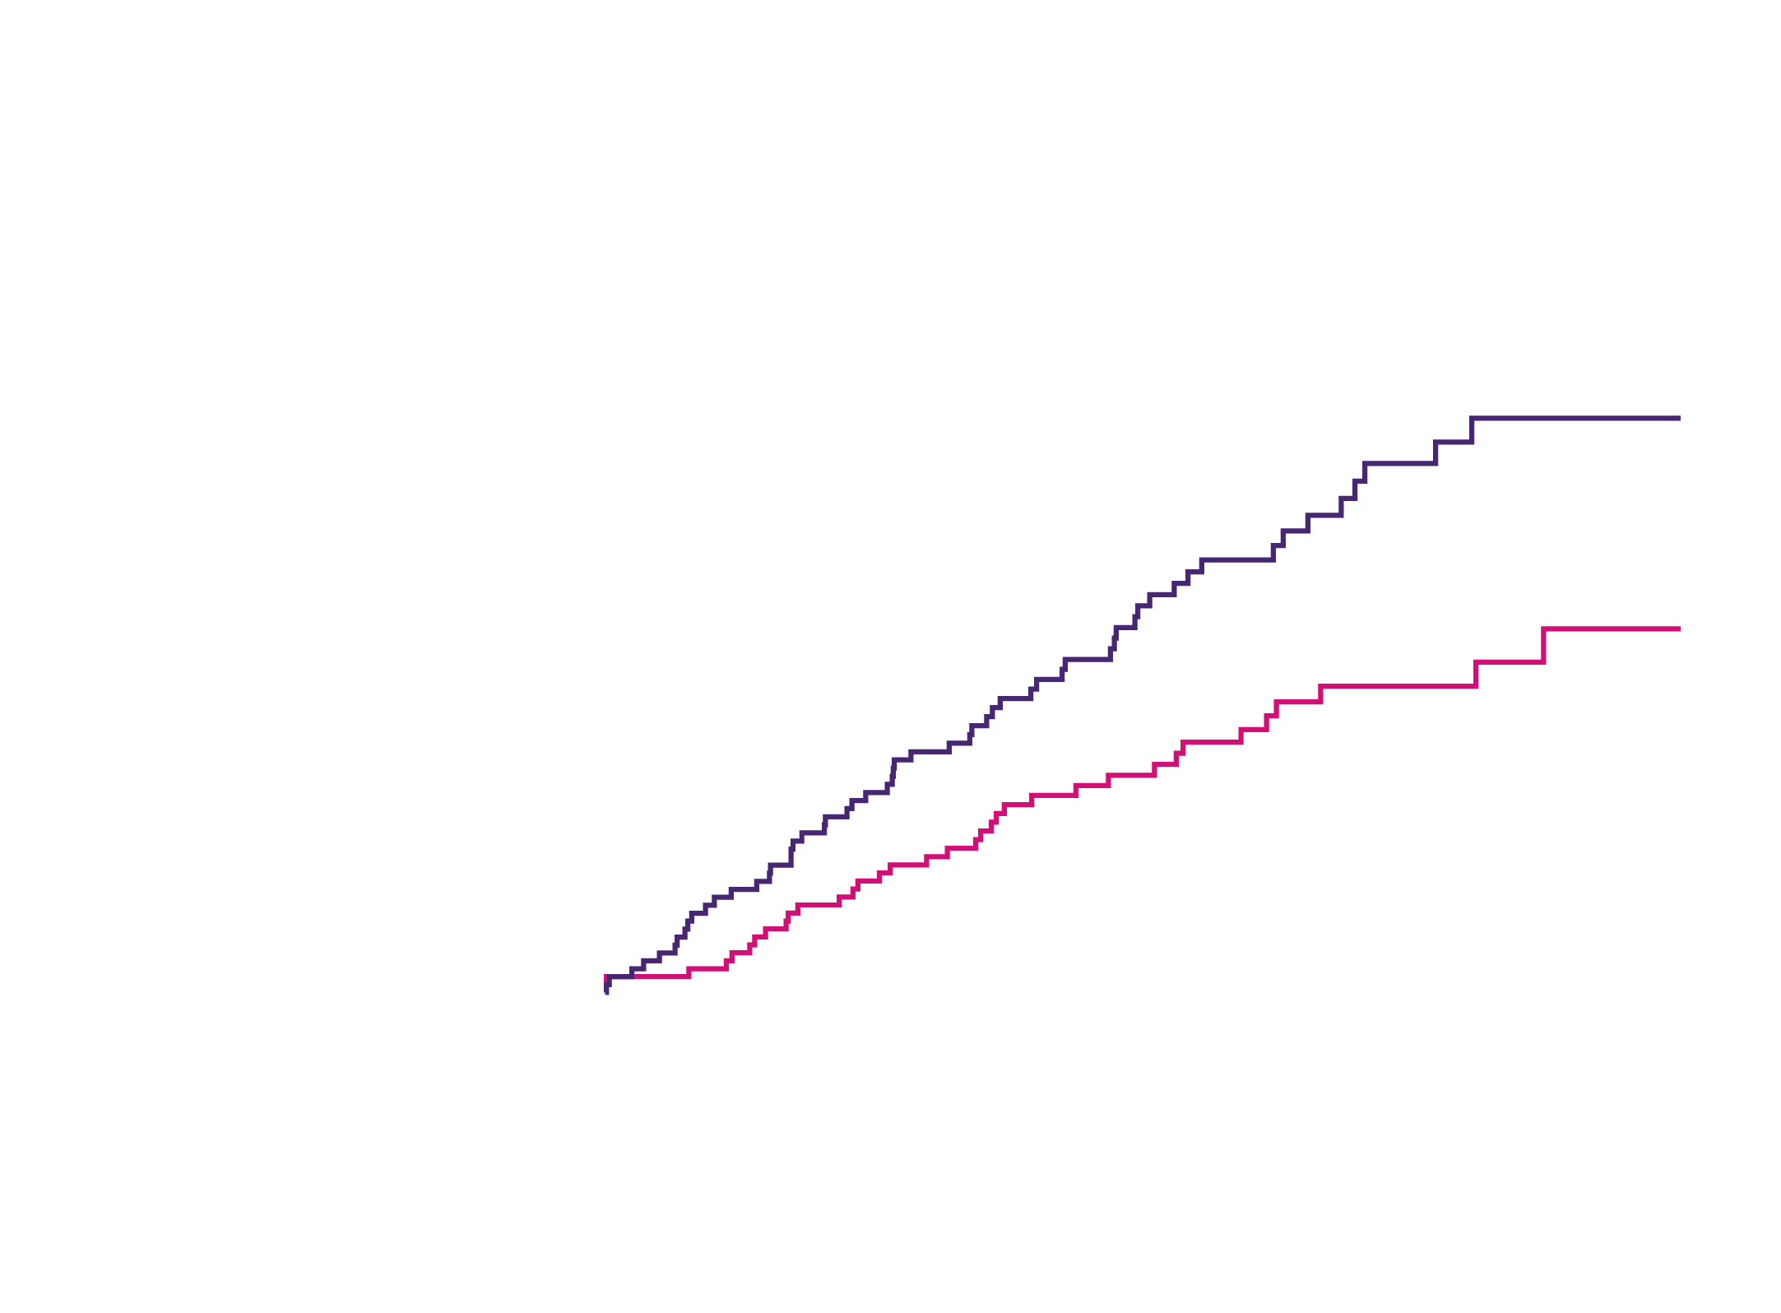
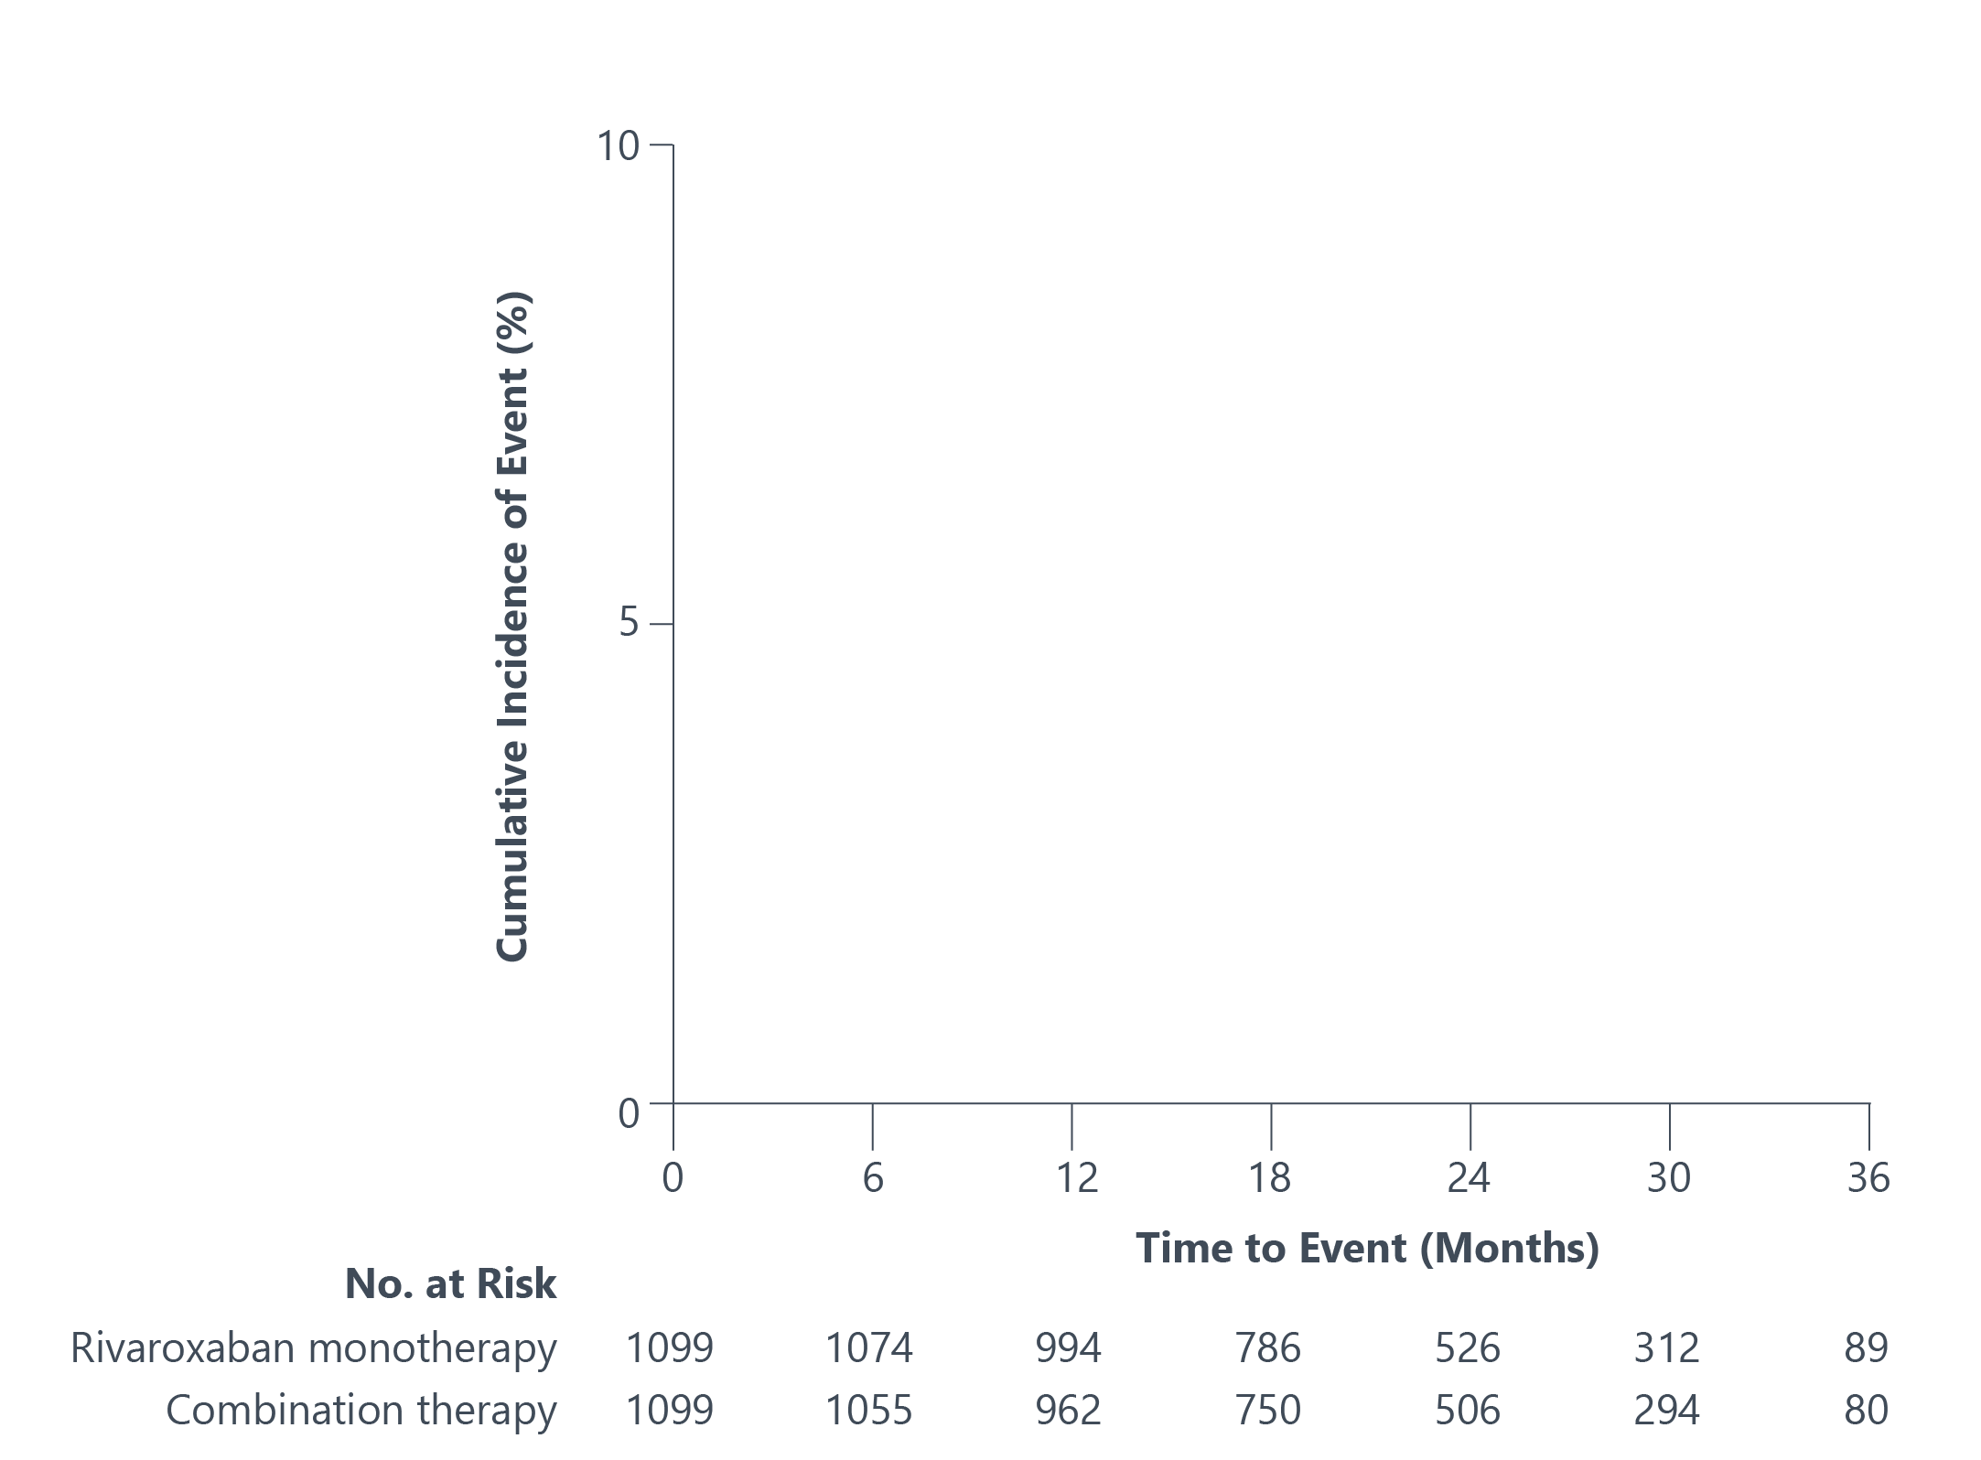
Kaplan-Meier Estimates of
First Occurrence of Primary Safety Events
Combination therapy
2.76% per patient-year
Monotherapy
1.62% per patient-year
HR, 0.59 (0.39 to 0.89)
P=0.01 (sup.)
Notes:
Rivaroxaban monotherapy was superior to combination therapy for the primary safety end point, with event rates of 1.62% and 2.76% per patient-year, respectively.
The hazard ratio was 0.59 with P = 0.01 for superiority.

Slide 15
Secondary End Points
The individual components of the primary efficacy end point
All-cause mortality
Net adverse clinical events
(death from any cause, myocardial infarction, stroke, and major bleeding)
Any bleeding events
Selected subgroup analysis for efficacy and safety
Notes:
Secondary end points are as follows.

Slide 16
The Respective Incidence Rates of
Secondary End Points
End Point – no. (% per patient-year) | Rivaroxaban Monotherapy | Combination Therapy | HR (95% CI)*
All-cause death # | 41 ( 1.85) | 73 ( 3.37) | 0.55 (0.38 to 0.81)
Cardiovascular | 26 ( 1.17) | 43 ( 1.99) | 0.59 (0.36 to 0.96)
Noncardiovascular | 15 ( 0.68) | 30 ( 1.39) | 0.49 (0.27 to 0.92)
CV events
Ischemic stroke # | 21 ( 0.96) | 28 ( 1.31) | 0.73 (0.42 to 1.29)
Hemorrhagic stroke # | 4 ( 0.18) | 13 ( 0.60) | 0.30 (0.10 to 0.92)
Myocardial infarction # | 13 ( 0.59) | 8 ( 0.37) | 1.60 (0.67 to 3.87)
Unstable angina requiring revascularization | 13 ( 0.59) | 18 ( 0.84) | 0.71 (0.35 to 1.44)
Systemic embolism | 2 ( 0.09) | 1 ( 0.05) | 1.97 (0.18 to 21.73)
Bleeding events
Major bleeding # | 35 ( 1.62) | 58 ( 2.76) | 0.59 (0.39 to 0.89)
Nonmajor bleeding | 121 ( 5.89) | 198 (10.31) | 0.58 (0.46 to 0.72)
All bleeding | 146 ( 7.22) | 238 (12.72) | 0.58 (0.47 to 0.71)
Net adverse clinical events | 84 ( 3.90) | 131 ( 6.28) | 0.62 (0.47 to 0.82)
* The 95% CIs presented in this table have not been adjusted for multiplicity; therefore, # Components of net adverse clinical events.
Notes:
All-cause mortality was lower among patients receiving monotherapy than those receiving combination therapy.
This was due to lower incidences of both cardiovascular death and noncardiovascular death.
There was a lower incidence of nonmajor bleeding events in patients receiving monotherapy than in those receiving combination therapy. There were two fatal bleeding events in each group.
The occurrence of net adverse clinical events, which was the composite of all-cause death, myocardial infarction, stroke, or major bleeding, was lower in the monotherapy group than in the combination-therapy group.

Slide 17
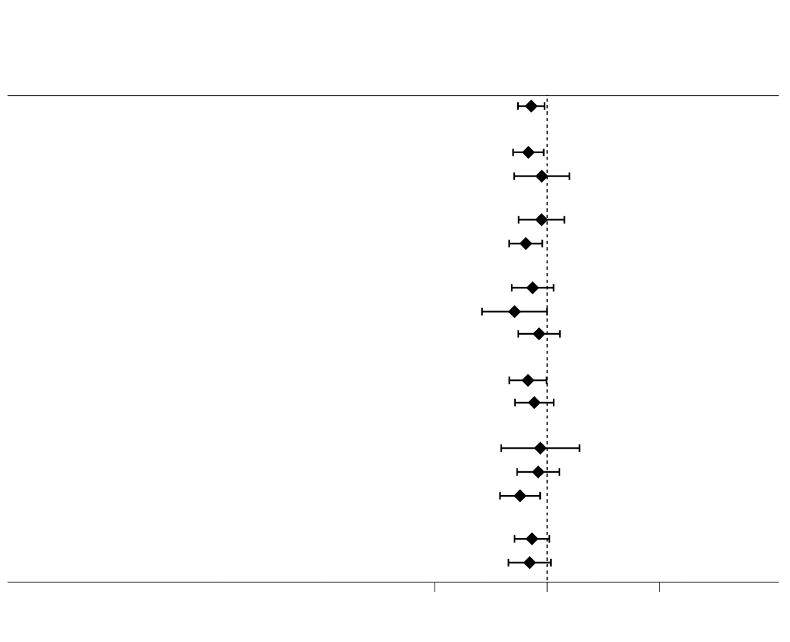
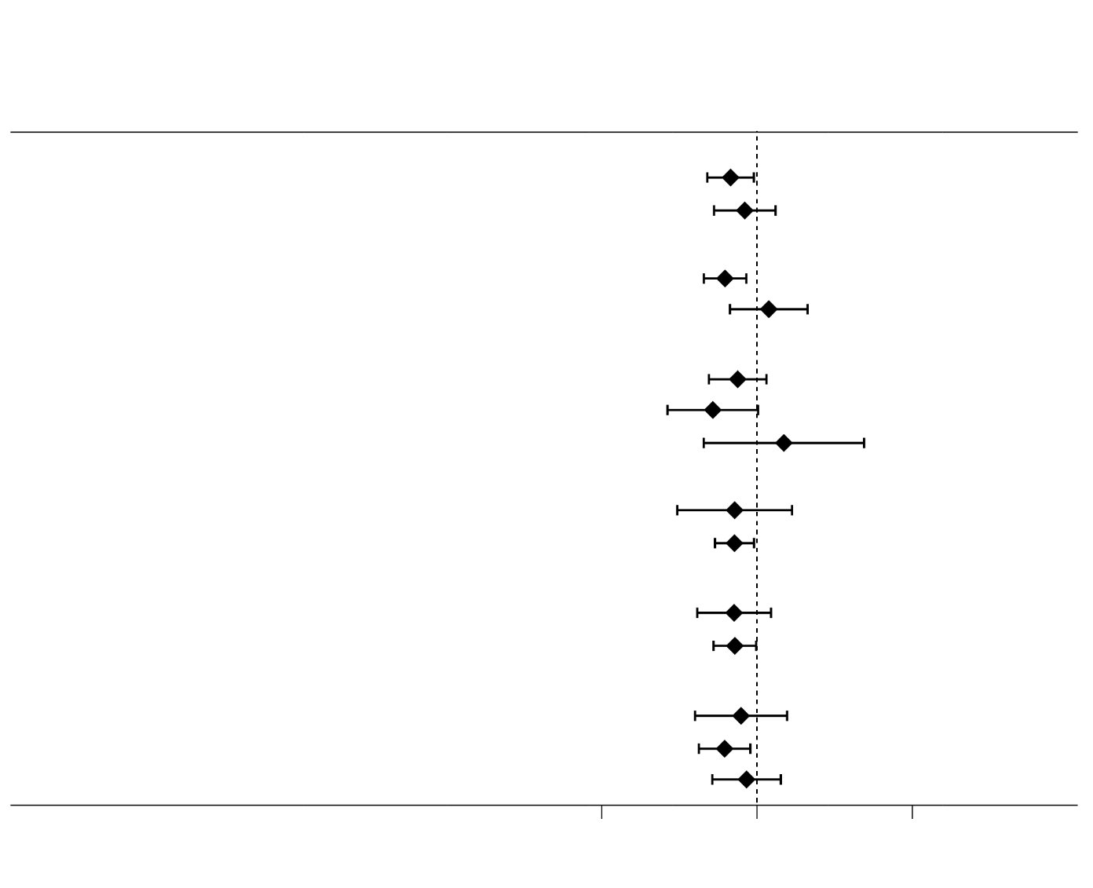
Primary Efficacy End Point, According to Subgroup
Rivaroxaban
Monotherapy
Combination
Therapy
Rivaroxaban
Monotherapy
Combination
Therapy
no. / total no. (% per patient-year)
Hazard Ratio(95% CI)
no. / total no. (% per patient-year)
Hazard Ratio(95% CI)
Male
Female
<75 years
≥75 years
Paroxysmal
Persistent
Permanent
Yes
No
<30
30 to 50
≥50
10 mg od
15 mg od
121 / 1108 ( 5.8)
95 / 876 ( 5.7)
26 / 232 ( 5.9)
37 / 527 ( 3.6)
84 / 581 ( 7.8)
48 / 580 ( 4.3)
26 / 175 ( 8.4)
47 / 353 ( 6.9)
65 / 466 ( 7.5)
56 / 642 ( 4.5)
14 / 60 (14.0)
43 / 293 ( 8.3)
61 / 686 ( 4.5)
72 / 513 ( 7.5)
48 / 585 ( 4.2)
0.72 (0.55–0.95)
0.68 (0.50–0.93)
0.90 (0.51–1.58)
0.89 (0.56–1.42)
0.64 (0.46–0.91)
0.74 (0.48–1.14)
0.51 (0.26–1.00)
0.85 (0.55–1.30)
0.68 (0.46–0.99)
0.77 (0.52–1.14)
0.87 (0.39–1.94)
0.83 (0.54–1.29)
0.57 (0.38–0.87)
0.73 (0.51–1.05)
0.70 (0.45–1.08)
Total
89 / 1107 ( 4.1)
66 / 875 ( 3.9)
23 / 232 ( 5.1)
33 / 525 ( 3.2)
56 / 582 ( 5.0)
37 / 596 ( 3.2)
13 / 164 ( 4.3)
39 / 347 ( 5.7)
45 / 461 ( 5.1)
44 / 646 ( 3.5)
11 / 54 (11.8)
39 / 300 ( 6.9)
36 / 699 ( 2.6)
52 / 497 ( 5.5)
35 / 599 ( 2.9)
Use of PPI
Yes
No
Yes
No
DES
BMS
DES+BMS
1
2 to 6
0 to 3
≥4
0 or 1
2
3 to 5
54 / 663 ( 4.2)
35 / 444 ( 4.0)
63 / 847 ( 3.8)
26 / 260 ( 5.1)
38 / 500 ( 3.9)
13 / 171 ( 3.8)
5 / 19 (15.0)
9 / 230 ( 2.0)
80 / 874 ( 4.7)
22 / 429 ( 2.6)
67 / 678 ( 5.2)
16 / 224 ( 3.6)
42 / 562 ( 3.8)
28 / 283 ( 5.2)
82 / 694 ( 6.3)
39 / 414 ( 4.8)
100 / 850 ( 6.2)
21 / 258 ( 4.3)
48 / 477 ( 5.3)
25 / 171 ( 7.4)
6 / 36 (10.0)
13 / 241 ( 2.8)
108 / 865 ( 6.6)
31 / 436 ( 3.6)
90 / 672 ( 7.2)
17 / 193 ( 4.6)
71 / 583 ( 6.2)
32 / 290 ( 6.1)
0.68 (0.48–0.95)
0.83 (0.53–1.32)
0.62 (0.45–0.85)
1.19 (0.67–2.11)
0.75 (0.49–1.15)
0.52 (0.27–1.02)
1.49 (0.45–4.88)
0.72 (0.31–1.68)
0.72 (0.54–0.96)
0.71 (0.41–1.23)
0.72 (0.52–0.99)
0.79 (0.40–1.56)
0.62 (0.42–0.91)
0.86 (0.52–1.42)
Sex
Previous
PCI or CABG
Age
Type of
AF
Type of
Stent
Diabetes
mellitus
CHADS₂
score
CrCl
(ml/min)
CHA₂DS₂-VASc
score
Rivaroxaban
dose
HAS-BLED
score
0.1
1
10
0.1
1
10
Favors
Monotherapy
Favors
Combination
Therapy
Favors
Monotherapy
Favors
Combination
Therapy
Notes:
With respect to the primary efficacy end point, the effect of monotherapy, as compared with combination therapy, was generally consistent across all prespecified subgroups, including those defined according to sex, age, stroke and bleeding risk scores, and renal function

Slide 18
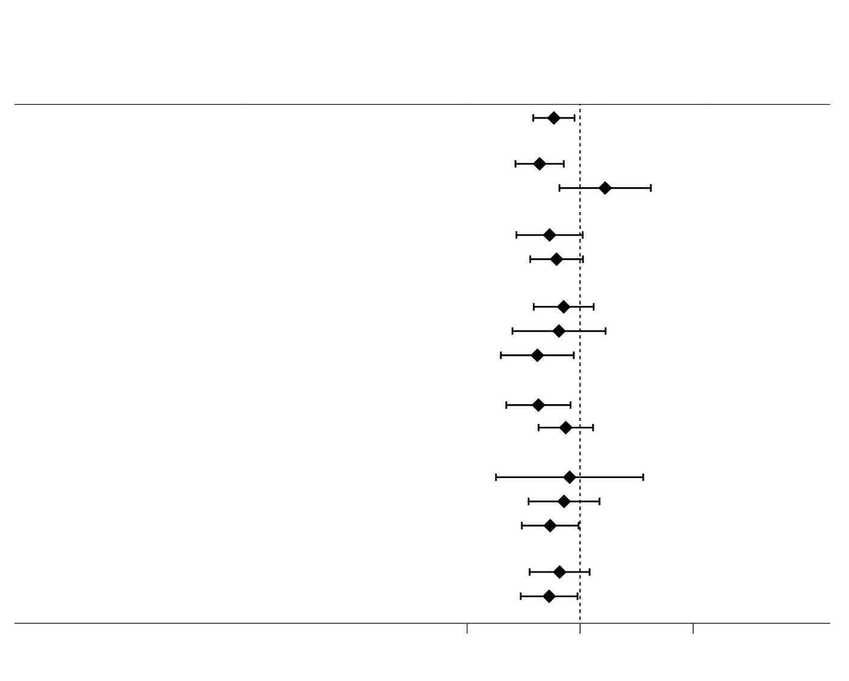
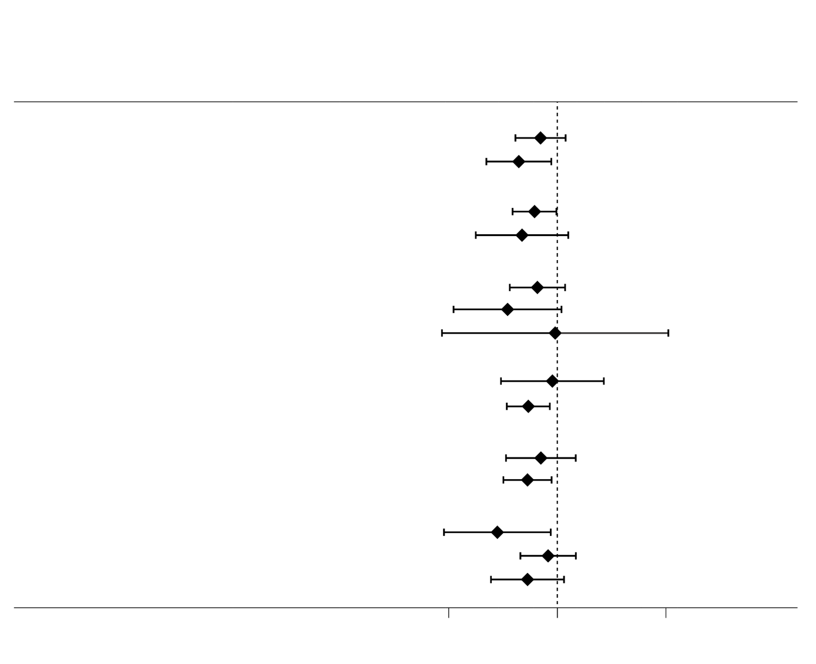
Primary Safety End Point, According to Subgroup
Rivaroxaban
Monotherapy
Combination
Therapy
Rivaroxaban
Monotherapy
Combination
Therapy
no. / total no. (% per patient-year)
Hazard Ratio(95% CI)
no. / total no. (% per patient-year)
Hazard Ratio(95% CI)
Male
Female
<75 years
≥75 years
Paroxysmal
Persistent
Permanent
Yes
No
<30
30 to 50
≥50
10 mg od
15 mg od
Total
35 / 1099 ( 1.6)
23 / 867 ( 1.3)
12 / 232 ( 2.6)
13 / 521 ( 1.3)
22 / 578 ( 2.0)
18 / 590 ( 1.6)
7 / 163 ( 2.3)
10 / 346 ( 1.4)
13 / 458 ( 1.4)
22 / 641 ( 1.8)
3 / 54 ( 3.2)
13 / 296 ( 2.3)
18 / 695 ( 1.3)
17 / 497 ( 1.8)
18 / 599 ( 1.5)
58 / 1099 ( 2.8)
51 / 870 ( 3.1)
7 / 229 ( 1.6)
24 / 523 ( 2.3)
34 / 576 ( 3.2)
24 / 574 ( 2.2)
11 / 174 ( 3.4)
23 / 351 ( 3.4)
29 / 462 ( 3.4)
29 / 637 ( 2.4)
4 / 58 ( 4.0)
17 / 291 ( 3.2)
32 / 684 ( 2.4)
26 / 513 ( 2.7)
32 / 585 ( 2.8)
0.59 (0.39–0.89)
0.44 (0.27–0.72)
1.66 (0.66–4.23)
0.54 (0.27–1.05)
0.62 (0.36–1.06)
0.72 (0.39–1.32)
0.65 (0.25–1.68)
0.42 (0.20–0.88)
0.43 (0.22–0.82)
0.75 (0.43–1.30)
0.81 (0.18–3.61)
0.72 (0.35–1.48)
0.54 (0.30–0.97)
0.66 (0.36–1.21)
0.53 (0.30–0.95)
Use of PPI
Yes
No
Yes
No
DES
BMS
DES+BMS
1
2 to 6
0 to 3
≥4
0 or 1
2
3 to 5
23 / 658 ( 1.8)
12 / 441 ( 1.4)
29 / 841 ( 1.8)
6 / 258 ( 1.2)
19 / 496 ( 2.0)
4 / 170 ( 1.2)
1 / 19 ( 2.8)
6 / 228 ( 1.3)
29 / 868 ( 1.7)
12 / 425 ( 1.4)
23 / 674 ( 1.8)
4 / 221 ( 0.9)
20 / 560 ( 1.8)
10 / 280 ( 1.8)
33 / 688 ( 2.5)
25 / 411 ( 3.1)
46 / 843 ( 2.9)
12 / 256 ( 2.5)
27 / 472 ( 3.0)
11 / 170 ( 3.3)
2 / 36 ( 3.2)
7 / 238 ( 1.5)
51 / 859 ( 3.2)
17 / 431 ( 2.0)
41 / 668 ( 3.3)
12 / 192 ( 3.3)
25 / 579 ( 2.2)
18 / 286 ( 3.4)
0.70 (0.41 – 1.19)
0.44 (0.22 – 0.88)
0.62 (0.39 – 0.98)
0.47 (0.18 – 1.26)
0.66 (0.36 – 1.18)
0.35 (0.11 – 1.09)
0.95 (0.09–10.53)
0.90 (0.30 – 2.68)
0.54 (0.34 – 0.85)
0.71 (0.34 – 1.48)
0.53 (0.32 – 0.89)
0.28 (0.09 – 0.87)
0.82 (0.46 – 1.48)
0.53 (0.25 – 1.15)
Sex
Previous
PCI or CABG
Age
Type of
AF
Type of
Stent
Diabetes
mellitus
CHADS₂
score
CrCl
(ml/min)
CHA₂DS₂-VASc
score
Rivaroxaban
dose
HAS-BLED
score
0.1
1
10
0.1
1
10
Favors
Monotherapy
Favors
Combination
Therapy
Favors
Monotherapy
Favors
Combination
Therapy
Notes:
A similar consistency of effect was seen with respect to major bleeding events.

Slide 19
Limitations
The open-label trial design had the potential to introduce bias.
There were relatively high rates of withdrawal of consent and loss of patients to follow-up.
The trial population received the rivaroxaban dose approved in Japan (10 mg or 15 mg once daily, according to the patient’s creatinine clearance) rather than the globally approved once-daily dose of 20 mg.
The choice of antiplatelet regimen, either aspirin or a P2Y₁₂ inhibitor, is a factor that makes it uncertain whether the benefit of rivaroxaban monotherapy applies equally to the two combination regimens
The early termination of the trial may overestimate the efficacy data.
The reductions in rate of ischemic events and death from any cause with rivaroxaban monotherapy were unanticipated and are difficult to explain.
Notes:
Some limitations of our trial should be noted.
The open-label trial design had the potential to introduce.
There were relatively high rates of withdrawal of consent and loss of patients to follow-up.
The trial population received the rivaroxaban dose approved in Japan (10 mg or 15 mg once daily, according to the patient’s creatinine clearance) rather than the globally approved once-daily dose of 20 mg.
The choice of antiplatelet regimen, either aspirin or a P2Y12 inhibitor, was at the discretion of the treating physicians, a factor that makes it uncertain whether the benefit of rivaroxaban monotherapy applies equally to the two combination regimens.
The early termination of the trial because of an increased risk of death from any cause in the combination-therapy group may overestimate the efficacy data.
Finally, the reductions in the rate of ischemic events and death from any cause with rivaroxaban monotherapy were unanticipated and are difficult to explain.

Slide 20
Conclusion
The AFIRE study demonstrated that rivaroxaban monotherapy was noninferior to combination therapy with rivaroxaban plus an antiplatelet agent with respect to CV events and death from any cause and superior with respect to major bleeding in patients with AF and stable CAD.
Notes:
In conclusion, ladies and gentlemen,
The AFIRE study demonstrated that rivaroxaban monotherapy was noninferior to combination therapy with rivaroxaban plus an antiplatelet agent with respect to CV events and death from any cause and superior with respect to major bleeding in patients with AF and stable CAD.

Slide 21
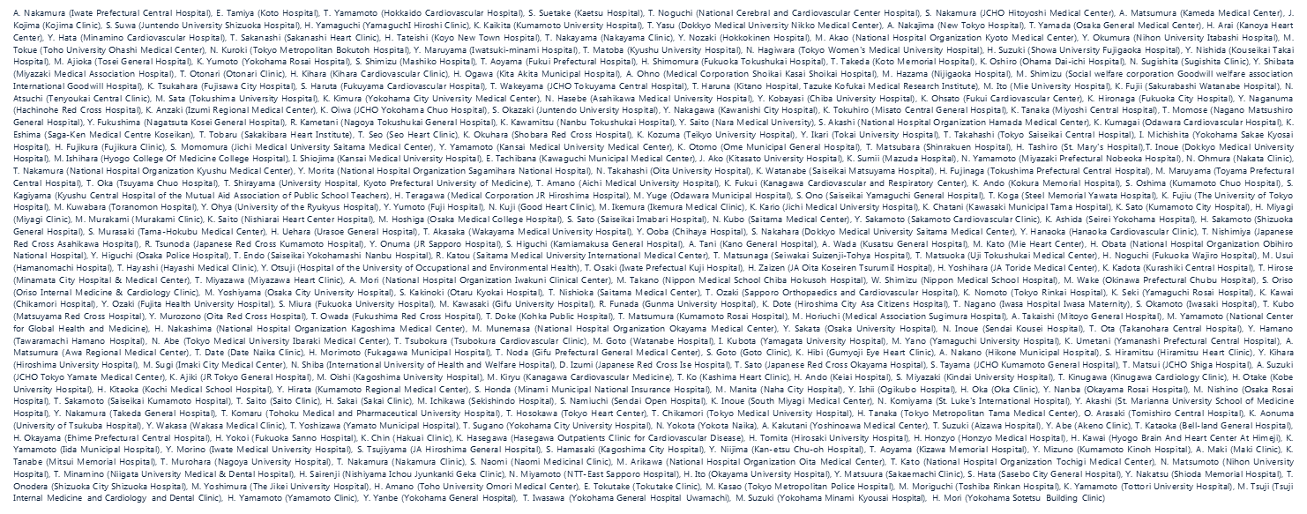
Acknowledgment
AFIRE Investigators in JAPAN, 294 centers
Notes:
We would like to acknowledge all of the AFIRE investigators from 294 centers in Japan.

