Slide 1
One-Month Dual Antiplatelet Therapy
Followed by Clopidogrel Monotherapy versus
Standard 12-Month Dual Antiplatelet Therapy with Clopidogrel
After Drug-Eluting Stent Implantation:
Hirotoshi Watanabe
Takenori Domei, Takeshi Morimoto, Hiroki Shiomi, Masahiro Natsuaki, Toshiaki Toyota, Kensuke Takagi, Yoshiki Hata, Satoru Suwa, Mamoru Nanasato, Masanobu Ohya, Masahiro Yagi, Takafumi Yokomatsu,
Mitsuru Abe, Kenji Ando, Kazushige Kadota, Ken Kozuma, Yoshihiro Morino, Yuji Ikari, Kengo Tanabe,
Koichi Nakao, Kazuya Kawai, Yoshihisa Nakagawa, and Takeshi Kimura,
on behalf of STOPDAPT-2 investigators
Notes:
Good morning ladies and gentlemen. It’s my great pleasure to present the primary result of the STOPDAPT-2 trial in this late breaking clinical trial session at ACC 2019.

Slide 2
Background
Mandatory 1-month DAPT had been the standard care after BMS implantation.
DAPT duration was prolonged after introduction of DES without firm scientific evidence.
New generation DES has substantially reduced stent thrombosis.
Prolonged DAPT is inevitably associated with increase in bleeding.
Bleeding is associated with subsequent mortality risk at least comparable to that of MI.
Therefore, very short mandatory DAPT duration after DES might be an attractive option,
if not associated with increase in ischemic events disproportionate to the reduction
in bleeding events.
Notes:
Mandatory 1-month dual antiplatelet therapy, that is DAPT, had been the standard care after BMS implantation.
DAPT duration was prolonged after introduction of DES without firm scientific evidences.
New generation DES has substantially reduced stent thrombosis.
Prolonged DAPT is inevitably associated with increase in bleeding.
Bleeding is associated with subsequent mortality risk at least comparable to that of MI.
Therefore, very short mandatory DAPT duration after DES might be an attractive option, if not associated with increase in ischemic events disproportionate to the reduction in bleeding events.

Slide 3
STOPDAPT
Prospective multicenter open-label single arm trial evaluating 3-month DAPT after CoCr-EES implantation
Primary Endpoint
Cardiovascular death, MI, Stroke, Definite ST, and Bleeding
Cumulative Incidence (%)
RESET
STOPDAPT
Adjusted HR 0.64 (0.42-0.95)
P=0.03
4.0%
2.8%
Days after PCI
Cardiovasc Interv Ther 2016; 31: 196–209.
Notes:
Previously we conducted the STOPDAPT, the prospective single-arm trial. The trial suggested a safety of 3-month DAPT followed by aspirin mono-therapy after cobalt-chromium everolimus-eluting stent implantation. Compared with the historical control of the RESET trial, continuing DAPT, one-year incidence of the primary net adverse clinical event was lower in STOPDAPT regimen.

Slide 4
Objective
The objective of the STOPDAPT-2 trial is to explore the safety and efficacy of the experimental regimen of
1-month DAPT followed by clopidogrel monotherapy as compared with the standard 12-month DAPT with aspirin and clopidogrel after implantation of cobalt-chromium everolimus-eluting stents (CoCr-EES).
Notes:
The objective of the STOPDAPT-2 trial is to explore the safety and efficacy of the experimental regimen of 1-month DAPT followed by clopidogrel monotherapy as compared with the standard 12-month DAPT followed by aspirin and clopidogrel after implantation of cobalt-chromium EES

Slide 5
STOPDAPT-2:
Prospective multicenter open-label randomized trial comparing 1-month versus 12-month DAPT after CoCr-EES implantation with limited exclusion criteria.
1M
(30-59d)
1Y
(335-394d)
1-month DAPT group
5Y
ASA
PCI
P2Y12i
Clopidogrel 75mg/d
R
Clopidogrel 75mg/day or
Prasugrel 3.75 mg/day
Primary analysis
for Non-inferiority
P2Y12i
Clopidogrel 75mg/d
ASA
ASA
ASA
12-month DAPT group
Notes:
STOPDAPT-2 is a prospective, multicenter, open-label, randomized clinical trial comparing 1-month versus 12-month DAPT after cobalt-chromium EES implantation with limited exclusion criteria.
Before hospital discharge after the index PCI, eligible patients were randomly assigned in a 1-to-1 fashion either to the experimental arm of 1-month DAPT or to the control arm of 12-month DAPT.
Choice of P2Y12 inhibitors within 1-month were left to the standard practice of each participating center.
At 1-month, patients in the experimental arm were to stop aspirin and to receive clopidogrel mono-therapy up to 5-year,
while patients in the control arm were to receive DAPT with aspirin and clopidogrel up to 12-month.
At 12-month, patients in the control arm were to stop clopidogrel and to receive aspirin mono-therapy up to 5-year.
The primary non-inferiority analysis was performed at 1-year.

Slide 6
Study Organization
Steering Committee
Takeshi Kimura (PI)
Kazushige Kadota
Ken Kozuma
Yoshihiro Morino
Keiichi Igarashi-Hanaoka
Yuji Ikari
Kengo Tanabe
Kenji Ando
Koichi Nakao
Kazuya Kawai
Mitsuru Abe
Trial Statistician
Takeshi Morimoto
Clinical Event Committee
Yoshihisa Nakagawa
Yutaka Furukawa
Masahiro Natsuaki
Hiroki Shiomi
Toshiaki Toyota
Safety Evaluation Committee
Shunichi Miyazaki
Ryuji Nohara
Coordinating Center
Research Institute for Production Development, Kyoto, Japan
Saori Tezuka
Yumika Fujino
Angiography Core Laboratory
Cardio Core Japan, Tokyo, Japan
Study administrative staff
Masahiro Natsuaki
Hirotoshi Watanabe
Toshiaki Toyota
Toshikazu Jinnai
Funded by
Abbott Vascular Japan, Co., Ltd.
Notes:
Here is the study organization. This study was funded by Abbott Vascular Japan.

Slide 7
90 Participating Centers
Teine Keijinkai Hospital
Hokko Memorial Hospital
Hirosaki University Hospital
Iwate Medical University Hospital
Sendai Kousei Hospital
Sendai Cardiovascular Center
Tohoku Medical and Pharmaceutical University Hospital
Nakadori General Hospital
Nihonkai General Hospital
Hoshi General Hospital
Jichi Medical University Hospital
Mashiko Hospital
Mitsui Memorial Hospital
Juntendo University Hospital
The Fraternity Memorial Hospital
Edogawa Hospital
Showa University Koto Toyosu Hospital
Tokyo Women's Medical University Hospital
Tokyo General Hospital
Juntendo University Nerima Hospital
Kawakita General Hospital
Sakakibara Heart Institute
Tokyo Metropolitan Tama Medical Center
Minamino Cardiovascular Hospital
Higashiyamato Hospital
St.Marianna University School of Medicine Hospital
Yokohama Rosai Hospital
Showa University Fujigaoka Hospital
Saiseikai Yokohamashi Tobu Hospital
Yokohama City University Medical Center
Kitasato University Hospital
Hiratsuka Kyosai Hospital
Tokai University Hospital
Kimitsu Chuo Hospital
Kanazawa Cardiovascular Hospital
University of Fukui Hospital
Municipal Tsuruga Hospital
University of Yamanashi Hospital
Gifu Prefectural General Medical Center
Ogaki Municipal Hospital
Juntendo University Shizuoka Hospital
Shizuoka General Hospital
Japanese Red Cross Nagoya Daini Hospital
Handa City Hospital
Tosei General Hospital
Ichinomiyanishi Hospital
Yokkaichi Hazu Medical Center
Matsusaka Central General Hospital
Nabari City Hospital
Otsu Red Cross Hospital
Hikone Municipal Hospital
Kyoto University Hospital
Kyoto Medical Center
Mitsubishi Kyoto Hospital
Kitano Hospital
Osaka Red Cross Hospital
National Cerebral and Cardiovascular Center
Kindai University Hospital
Mimihara General Hospital
Bell Land General Hospital
Kobe City Medical Center General Hospital
Kindai University Nara Hospital
Tenri Hospital
Japanese Red Cross Wakayama Medical Center
Wakayama Medical University Hospital
Shimane University Hospital
Japanese Red Cross Okayama Hospital
Kurashiki Central Hospital
Hiroshima University Hospital
Iwakuni Medical Center
Tokuyama Central Hospital
Shimonoseki City Hospital
Tokushima University Hospital
Tokushima Red Cross Hospital
Kagawa Prefectural Central Hospital
Ehime Prefectural Central Hospital
Matsuyama Red Cross Hospital
Chikamori Hospital
Kokura Memorial Hospital
Hospital of University of Occupational and Environmental Health Japan
Saiseikai Fukuoka General Hospital
Fukuoka Tokushukai Hospital
Kumamoto University Hospital
Saiseikai Kumamoto Hospital
Japanese Red Cross Kumamoto Hospital
Miyazaki Prefectural Nobeoka Hospital
Ibusuki Medical Center
Izumi Regional Medical Center
Urasoe General Hospital
Nakagami Hospital
Notes:
90 centers in Japan participated in this STOPDAPT-2 study. We really appreciate for the tremendous contribution of investigators.
Thank you very much for your kind attention.

Slide 8
Inclusion Criteria
PCI with exclusive use of CoCr-EES (XienceTM series)
No major complications during hospitalization for index PCI
No plan for staged PCI
Patients who could take DAPT with aspirin and P2Y₁₂ inhibitors
Key Exclusion Criteria
Needs for oral anticoagulants
History of intracranial hemorrhage
Notes:
We included patients with successful PCI with exclusive use of cobalt-chromium EES without major complications during the index hospitalization.
This study had very limited exclusion criteria such as need for oral anticoagulants and history of intracranial bleeding. In these patients, prolonged DAPT is contraindicated in our opinion.

Slide 9
Endpoints
・ Primary endpoint:
Net adverse cardiovascular events (NACE: Ischemia and Bleeding)
・ A composite of cardiovascular death, MI, Definite ST, Stroke,
or TIMI major/minor bleeding
・ Major secondary endpoints:
Ischemic composite endpoint
・ A composite of cardiovascular death, MI, Definite ST, or Stroke
Bleeding endpoint
・ TIMI major/minor bleeding
Notes:
The primary endpoint was a composite of cardiovascular death, MI, definite ST, stroke, or TIMI major or minor bleeding, representing net adverse cardiovascular events (NACE) for ischemia and bleeding. The major secondary endpoints included the ischemic composite endpoint, and the bleeding endpoint.

Slide 10
Sample Size Calculation
Hypothesis: Non-inferiority of 1-month DAPT to 12-month DAPT
for the primary endpoint at 1-year
Assumption: Event rate at 1-year: 4.6% (Based on RESET study).
Non-inferiority margin; 50% on the hazard ratio scale
Randomization ratio: 1:1
One-sided alpha: 0.025
Power: 85%
Sample size: 3000 patients (1500 in each arm)
Notes:
The primary hypothesis of this study is that 1-month DAPT is non-inferior to 12-month DAPT for the primary endpoint at 1-year.
Assuming 4.6% true event rate based on the RESET study, a total 3000 patients would yield 85% of power to detect non-inferiority with a margin of 50% on the hazard ratio scale.

Slide 11
Study Flow
Eligible patients
PCI exclusively with CoCr-EES/No scheduled staged PCI
Dec. 2015-Dec. 2017
N=6504
3459 did not participate
1731 Physicians’ judgement
1280 Patients’ refusal
0362 Logistic reasons
0047 Ethical reasons
0039 Unknown
Enrolled and randomized
N=3045
36 withdrawal
172 Data missing
Non-Participants
with demographic data
N=3287
Participants
N=3009
Notes:
Among the 6504 eligible patients, 3045 patients were enrolled into the STOPDAPT-2 trial.
A substantial proportion of the eligible patients were not enrolled, mainly by the physicians judgment or the patients’ refusal.
We collected demographic data in 3287 eligible but not enrolled patients.

Slide 12
Participants vs Non-participants
 | Participants N=3009 | Non-participants N=3287 | P value
Age, y | 68.6±10.7 | 70.0±11.7 | <0.001
ACS | 38% | 39% | 0.61
STEMI | 19% | 22% | 0.003
Prior MI | 14% | 23% | <0.001
Prior 1st-generation DES implantation | 4% | 6% | <0.001
Diabetes | 39% | 39% | 0.47
Severe CKD | 6% | 9% | <0.001
Dialysis | 3% | 5% | <0.001
Target of LMCA | 3% | 5% | <0.001
Two or more target vessels | 7% | 9% | 0.003
Notes:
When we compare the baseline demographics between participants and non-participants, non-participants have significantly more high-risk features like higher age STEMI, Prior MI, CKD and so on, but the actual difference were small.

Slide 13
Study Flow
Eligible patients
Dec. 2015-Dec. 2017
N=6504
3459 did not participate
1731 Physicians’ judgment
1280 Patients’ refusal
0362 Logistic reasons
0047 Ethical reasons
0039 Unknown
Enrolled and randomized
N=3045
Stratified by Center
1-month DAPT arm
N=1523
12-month DAPT arm
N=1522
23 withdrew consent
13 withdrew consent
ITT population
N=1500
ITT population
N=1509
Complete 1-Year FU
N=1478 (98.5%)
Complete 1-Year FU
N=1496 (99.1%)
Notes:
As the intention-to-treat study population, 3009 patients were assigned in a 1-to-1 fashion either to the 1-month DAPT arm, or to the 12-month DAPT arm.
Complete 1-year follow-up was achieved in 99% of patients.

Slide 14
Baseline Clinical Characteristics
 | 1-month DAPT N=1500 | 12-month DAPT N=1509
Age, years | 68.1±10.9 | 69.1±10.4
Men | 79% | 77%
ACS | 38% | 39%
STEMI | 19% | 18%
Stable CAD | 62% | 61%
Diabetes | 39% | 38%
Severe CKD (eGFR<30ml/min/m²) | 6% | 6%
Prior MI | 14% | 13%
Prior PCI | 34% | 35%
CREDO-Kyoto thrombotic risk score
High; Intermediate; Low | 8%; 21%; 71% | 8%; 24%; 68%
CREDO-Kyoto bleeding risk score
High; Intermediate; Low | 7%; 27%; 66% | 7%; 27%; 66%
Notes:
The study population reflected typical Japanese PCI population including large proportions of patients with advanced age, 60% of stable CAD, and 40% of diabetes,
The majority of patients had low or intermediate thrombotic and bleeding risk based on the CREDO-Kyoto risk scores.
The baseline characteristics were well balanced between the 2 groups.
75歳以上は約30%

Slide 15
Procedural Characteristics and Medications
 | 1-month DAPT N=1500 | 12-month DAPT N=1509
Transradial approach | 82% | 84%
N of target lesions | 1.12±0.35 | 1.14±0.39
Minimal stent diameter, mm | 2.98±0.49 | 2.96±0.48
Total stent length, mm | 30.3±16.7 | 30.5±16.8
SYNTAX Score | 8 (5-14) | 9 (6-15)
Target of LMCA | 3% | 3%
CTO | 4% | 4%
IVUS or OCT | 97% | 98%
ASA | 99.8% | 100%
Clopidogrel | 60% | 63%
Prasugrel (3.75mg/day) | 40% | 37%
Statin | 88% | 87%
PPI | 79% | 79%
Notes:
Procedural characteristics also reflected typical Japanese PCI practice with predominance of radial approach and intracoronary imaging guidance. The median SYNTAX score was 8 to 9. Regarding the medications at discharge, statins were prescribed in 90% and proton pump inhibitors were in 80%. The procedural characteristics and medications were also well balanced between the 2 groups.

Slide 16
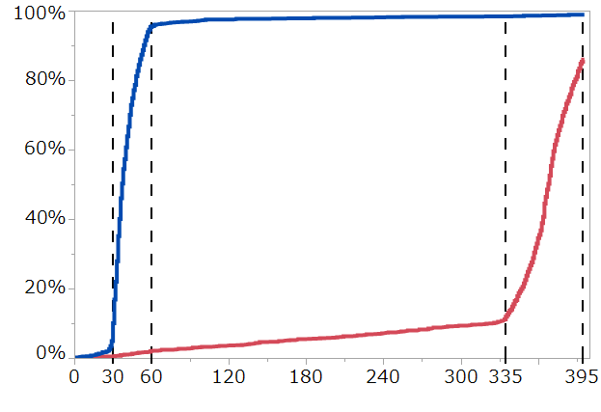
Persistent DAPT discontinuation rate
98.8%
95.5%
1-month DAPT
12-month DAPT
85.9%
Cumulative incidence
2.1%
11.9%
Days after index PCI
Number of patients on DAPT
1-month DAPT | 1500 | 1346 | 67 | 38 | 32 | 28 | 25 | 23 | 9
12-month DAPT | 1509 | 1499 | 1467 | 1442 | 1412 | 1387 | 1352 | 1314 | 178
Notes:
As for antiplatelet95.5% in the experimental arm had stopped DAPT at 1-month and nearly 90% in control arm continued DAPT for 1 year.
Therefore, the majority of patients properly followed the study protocol for antiplatelet therapy.

Slide 17
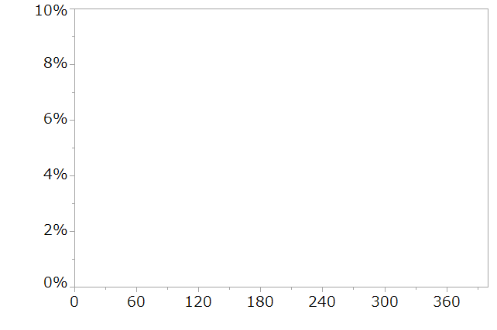
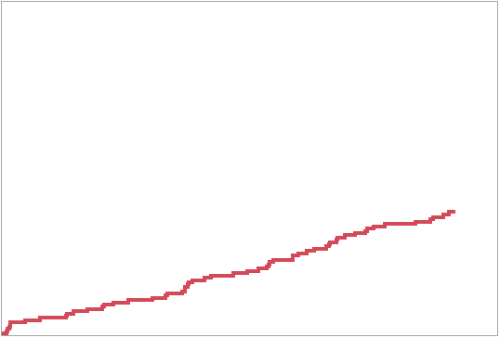
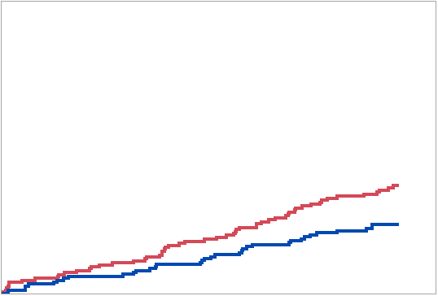
Primary Endpoint: Net clinical benefit
CV death/MI/ST/Stroke/TIMI major/minor bleeding
1-month DAPT
HR 0.64, 95%CI (0.42-0.98)
P non-inferiority <0.001
P superiority =0.04
12-month DAPT
Log rank P=0.037
Cumulative Incidence
3.7%
3.7%
2.4%
30
Days after index PCI
No. at risk
12-month DAPT
1-month DAPT
No. at risk
12-month DAPT | 1509 | 1501 | 1486 | 1481 | 1469 | 1458 | 1442 | 1159
1-month DAPT
No. at risk
12-month DAPT | 1509 | 1501 | 1486 | 1481 | 1469 | 1458 | 1442 | 1159
1-month DAPT | 1500 | 1494 | 1479 | 1475 | 1468 | 1453 | 1441 | 1151
Notes:
Here is the primary endpoint result.
1-year cumulative incidences of primary endpoint were 3.7% in 12-month DAPT and 2.4% in 1-month DAPT.
One-month DAPT was NOT ONLY non-inferior, BUT ALSO superior to the 12-month DAPT for the primary.

Slide 18
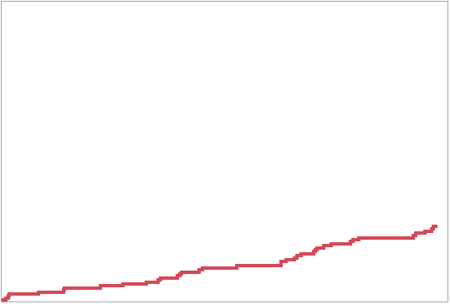
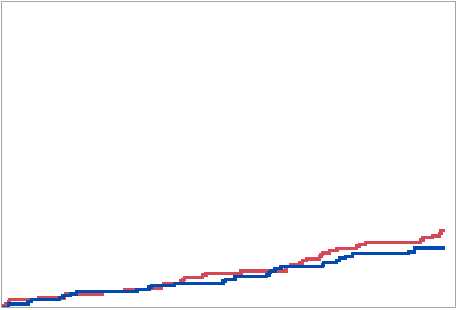
Major secondary ischemic endpoint
CV death/MI/ST/Stroke
1-month DAPT
HR 0.79, 95%CI (0.49-1.29)
P non-inferiority =0.005
P superiority =0.34
12-month DAPT
Cumulative Incidence
Log rank P=0.34
2.5%
2.5%
2.0%
30
Days after index PCI
No. at risk
12-month DAPT
1-month DAPT
No. at risk
12-month DAPT | 1509 | 1504 | 1490 | 1488 | 1479 | 1473 | 1458 | 1172
1-month DAPT
No. at risk
12-month DAPT | 1509 | 1504 | 1490 | 1488 | 1479 | 1473 | 1458 | 1172
1-month DAPT | 1500 | 1495 | 1480 | 1476 | 1471 | 1458 | 1446 | 1157
Notes:
For the major secondary ischemic endpoint, 2.5% in 12-month DAPT and 2.0% in 1-month DAPT. 1-month DAPT was also non-inferior to 12-month DAPT, without significant difference between the 2 groups.

Slide 19
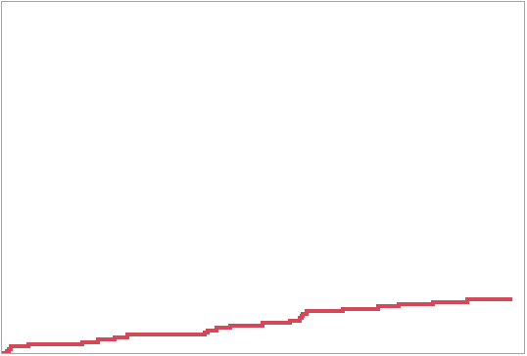
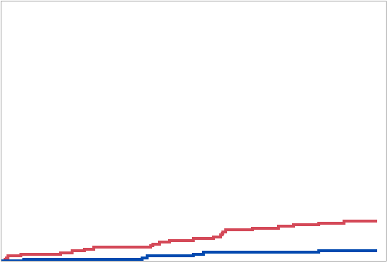
Major secondary bleeding endpoint
TIMI major/minor bleeding
1-month DAPT
HR 0.26, 95%CI (0.11-0.64)
P superiority =0.004
12-month DAPT
Cumulative Incidence
Log rank P=0.002
1.5%
1.5%
0.4%
30
Days after index PCI
No. at risk
12-month DAPT
1-month DAPT
No. at risk
12-month DAPT | 1509 | 1504 | 1491 | 1487 | 1480 | 1471 | 1462 | 1180
1-month DAPT
No. at risk
12-month DAPT | 1509 | 1504 | 1491 | 1487 | 1480 | 1471 | 1462 | 1180
1-month DAPT | 1500 | 1495 | 1483 | 1481 | 1477 | 1467 | 1457 | 1166
Notes:
For the major secondary bleeding endpoint, 1.5% in 12-month DAPT and 0.4% in 1-month DAPT. 1-month DAPT was superior to 12-month DAPT.
The rate of bleeding was remarkably low in the 1-month DAPT group.

Slide 20
Clinical Outcomes at 1 year
P values for superiority
P=0.61
P=0.66
P=0.57
P=0.11
P=0.004
P=0.003
*
Death
MI
Definite
ST
Probable
ST
Stroke
TIMI
major/minor
Bleeding
BARC 3 or 5
Bleeding
* 2 cases of probable ST (undefined death) in the 1-month DAPT group occurred before discontinuing DAPT at 1-month
Notes:
If we look at individual endpoints, BARC 3 or 5 bleeding was also significantly lower in the 1-month DAPT group. There were no significant difference between 2 groups in the incidence of all-cause death, MI, ST, and stroke.
The incidence of definite or probable ST was very low.
Two cases of probable ST in the 1-month DAPT group occurred before stopping aspirin at 1-month.

Slide 21
Subgroup analysis for the primary endpoint (1)
NI
margin
 | 1-month DAPT (N=1500) |  | 12-month DAPT (N=1509) |  |  | HR (95%CI) | P _{superiority} | P_{interaction}
Age
>=75 years | 10/448 | (2.26%) | 25/499 | (5.08%) |  | 0.44 (0.21-0.92) | 0.03 | 0.20
<75 years | 25/1052 | (2.41%) | 30/1010 | (3.02%) |  | 0.80 (0.47-1.36) | 0.41
ACS
Yes | 16/565 | (2.88%) | 23/583 | (4.02%) |  | 0.72 (0.38-1.36) | 0.44 | 0.64
No | 19/935 | (2.05%) | 32/926 | (3.49%) |  | 0.59 (0.33-1.03) | 0.06
STEMI
Yes | 9/291 | (3.15%) | 14/270 | (5.26%) |  | 0.60 (0.26-1.38) | 0.23 | 0.87
No | 26/1209 | (2.18%) | 41/1239 | (3.36%) |  | 0.65 (0.40-1.06) | 0.08
Severe CKD
Yes | 9/82 | (11.22%) | 5/84 | (5.97%) |  | 1.93 (0.65-5.75) | 0.24 | 0.03
No | 26/1418 | (1.86%) | 50/1425 | (3.56%) |  | 0.52 (0.32-0.84) | 0.007
Diabetes
Yes | 18/585 | (3.12%) | 25/574 | (4.45%) |  | 0.70 (0.38-1.29) | 0.26 | 0.65
No | 17/915 | (1.88%) | 30/935 | (3.24%) |  | 0.58 (0.32-1.05) | 0.07
Total stent length >=28mm
Yes | 19/742 | (2.60%) | 33/787 | (4.23%) |  | 0.61 (0.35-1.07) | 0.08 | 0.76
No | 16/758 | (2.14%) | 22/722 | (3.12%) |  | 0.69 (0.36-1.32) | 0.26
Two or more target vessels
Yes | 4/100 | (4.14%) | 8/116 | (6.94%) |  | 0.58 (0.17-1.92) | 0.37 | 0.85
No | 31/1400 | (2.24%) | 47/1393 | (3.43%) |  | 0.66 (0.42-1.03) | 0.07
Overall | 35/1500 | (2.36%) | 55/1509 | (3.70%) |  | 0.64 (0.42-0.98) | 0.038
1-month DAPT better
12-month DAPT better
Notes:
In the subgroup analysis, the lower risk of 1-month DAPT for the primary endpoint was consistently seen across the subgroups except for the very small subgroup of severe chronic kidney disease.

Slide 22
Subgroup analysis for the primary endpoint (2)
 | 1-month DAPT (N=1500) |  | 12-month DAPT (N=1509) |  |  | HR (95%CI) | P _{superiority} | P_{interaction}
PARIS thrombotic risk score
Intermediate/High | 26/771 | (3.43%) | 37/751 | (5.00%) |  | 0.68 (0.41-1.13) | 0.14 | 0.56
Low | 9/729 | (1.24%) | 18/758 | (2.40%) |  | 0.52 (0.23-1.15) | 0.11
CREDO-Kyoto thrombotic risk score
Intermediate/High | 15/431 | (3.55%) | 30/480 | (6.31%) |  | 0.55 (0.30-1.03) | 0.06 | 0.45
Low | 20/1069 | (1.89%) | 25/1029 | (2.47%) |  | 0.77 (0.43-1.39) | 0.38
Overall | 35/1500 | (2.36%) | 55/1509 | (3.70%) |  | 0.64 (0.42-0.98) | 0.038
NI
margin
1-month DAPT better
12-month DAPT better
Notes:
Patients with intermediate or high thrombotic risk scores had higher incidences of the primary endpoint than patients with low scores.
However, there was no significant interaction between the subgroup of thrombotic risk scores and the effects of 1-month DAPT.

Slide 23
Limitations
Lack of consensus on the use of the NACE as primary endpoint
Open label design with its inherent limitations
Limited enrollment of high ischemic risk patients
Lower ischemic risk of Japanese versus US/European CAD patients
Ticagrelor / Prasugrel (standard dose) not available in Japan
No assessment of aspirin monotherapy after 1-month DAPT
Notes:
There are several important limitations in the present study.
There is a lack of consensus on the definition and validity of the NACE endpoint.
Open label trial design has its inherent limitations.
The study had limited enrollment of high ischemic risk patients.
The study was conducted in Japan, where the ischemic risk of patients is known to be lower than in US and Europe.
Standard antiplatelet regimen was different between Japan and US or Europe.
Finally, we did not assess aspirin monotherapy after 1-month DAPT, which is the current standard therapy after stopping DAPT.

Slide 24
Conclusions
One-month DAPT followed by clopidogrel monotherapy provided a net clinical benefit for ischemic and bleeding events over 12-month DAPT with aspirin and clopidogrel after CoCr-EES implantation.
The benefit was driven by significant reduction in bleeding events without increase in ischemic events.
Notes:
In conclusion, ladies and gentlemen, 1-month DAPT followed by clopidogrel monotherapy provided a net clinical benefit for ischemic and bleeding events over 12-month DAPT regimen with aspirin and clopidogrel after CoCr-EES implantation. The benefit was driven by significant reduction in bleeding events without increase in ischemic events.

