Slide 1
AMERICAN COLLEGE OF CARDIOLOGY SCIENTIFIC SESSIONS 2019
Safety and Efficacy of Neladenoson Bialanate,
a Partial Adenosine A1 Receptor Agonist,
in Patients with HFpEF:
Results from the PANACHE Phase 2b RCT
Sanjiv J. Shah, MD, FACC, FAHA, FASE
Stone Professor of Medicine
Director, T1 Center for Cardiovascular Therapeutics
Division of Cardiology, Department of Medicine
Northwestern University Feinberg School of Medicine
sanjiv.shah@northwestern.edu • http://www.hfpef.org • Twitter: @HFpEF
NORTHWESTERN UNIVERSITY FEINBERG SCHOOL OF MEDICINE
Notes:
Thank you for allowing me to present the results of the PANACHE, a phase 2b randomized clinical trial of neladenoson bialanate, a partial A1 receptor agonist, in patients with HFpEF

Slide 2
Disclosures
Research funding:
  NIH R01 HL107577, R01 HL127028, R01 HL140731
  AHA #16SFRN28780016, #15CVGPSD27260148
  Actelion, AstraZeneca, Corvia, Novartis
Consulting / advisory board / steering committee:
  Actelion, AstraZeneca, Amgen, Bayer, Boehringer-Ingelheim, Cardiora, Coridea, CVRx, Eisai, Ionis, Ironwood, Merck, MyoKardia, Novartis, Pfizer, Sanofi, Tenax, United Therapeutics

Slide 3
PANACHE study leadership
PANACHE: Partial AdeNosine A1 receptor Agonist in patients with Chronic Heart failure and preserved Ejection fraction
Steering committee:
  Sanjiv Shah (Chair)
  Scott Solomon (Chair)
  Dalane Kitzman
  John McMurray
  Adriaan Voors
Data monitoring committee:
  Henry Dargie (Chair)
  John Cleland
  Martin Borggrefe
  Jan Tijssen
Bayer (sponsor):
  Antonieta Bomfim Wirtz, Thomas Viethen, Erya Huang, Akos Ferenc Pap
Notes:
I would like to thank the PAANCHE study leadership who were instrumental in the successful and efficient completion of this trial

Slide 4

Therapeutic landscape for HFpEF
Neurohormonal antagonists
Diuretics (MRA, SGLT-2i)
NO-cGMP-PKG pathway (nitrates, nitrites, sGC stimulators, PDE5 inhibitors)
NP-cGMP-PKG pathway (ARNI [i.e., LCZ696])
Notes:
The therapeutic landscape for HFpEF has been challenging. Drugs tested include neurohormonal antagonists, diuretics with pleiotropic effects, and both the nitric oxide and natriuretic peptide cyclic GMP-PKG pathways.

Slide 5
Therapeutic landscape for HFpEF
Neurohormonal antagonists
Diuretics (MRA, SGLT-2i)
NO-cGMP-PKG pathway (nitrates, nitrites, sGC stimulators, PDE5 inhibitors)
NP-cGMP-PKG pathway (ARNI [i.e., LCZ696])
Alternate approach?
Notes:
Several trials of these drugs have failed, though we are hopeful for ongoing trials of MRAs, SGLT2 inhbitors, nitrites, sGC stimulators, and neprilysin inhibitors. However, the general lack of benefit in these trials begs the question: Is there an alternate approach?

Slide 6
Advantages of a partial A1-receptor agonist
EXERCISE CAPACITY,
ACTIVITY LEVELS
Voors AA, Shah SJ, et al. EJHF 2018
Notes:
A partial adenosine A1 receptor agonist may be one. We know that adenosine, a full A1 receptor agonist has multiple untoward effects such as… However, partial A1 receptor agonists have been shown in pre-clinical studies to…

Slide 7
Hypothesis
After 20 weeks of treatment, there will be a positive dose-response relationship of neladenoson vs. placebo:
  Efficacy: Improvement in 6MWT, QOL, physical activity, and cardiac structure/function
  Safety: No significant bradyarrhythmias or renal dysfunction
Notes:
We therefore hypothesized that after 20 weeks of treatment..

Slide 8
PANACHE trial design: overview
Phase 2b, parallel group, dose-finding, RCT
Randomized 3:1:2:2:2:2 (placebo, 5 mg, 10 mg, 20 mg, 30 mg, 40 mg neladenoson)
Primary endpoint: change in 6MWD at 20 weeks
Secondary endpoints:
  Medtronic AVIVO patch: continuous ECG, activity
  Biomarkers (NTproBNP, high-sensitivity troponin T)
  Echocardiography (multiple domains)
Voors AA, Shah SJ, et al. EJHF 2018
Notes:
Panache was a…

Slide 9
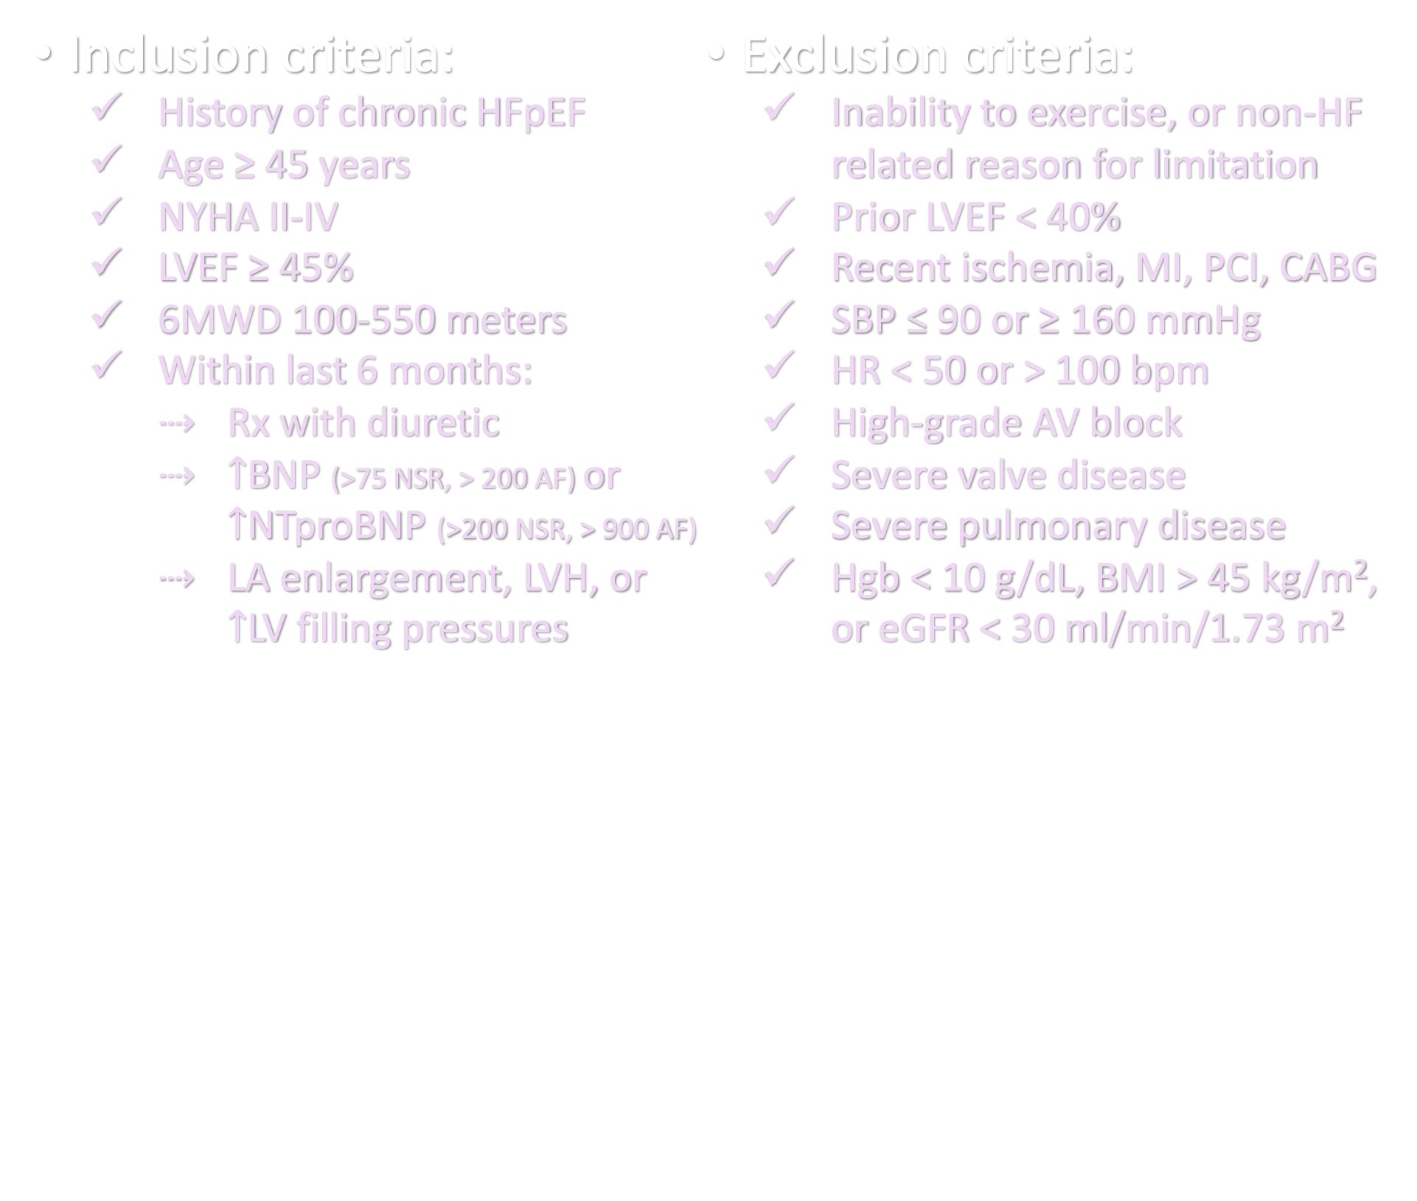
Key inclusion/exclusion criteria
Inclusion criteria:
  History of chronic HFpEF
  Age ≥ 45 years
  NYHA II-IV
  LVEF ≥ 45%
  6MWD 100-550 meters
  Within last 6 months:
    Rx with diuretic
    $↑$BNP (>75 NSR, > 200 AF) or $↑$NTproBNP (>200 NSR, > 900 AF)
    LA enlargement, LVH, or $↑$LV filling pressures
Exclusion criteria:
  Inability to exercise, or non-HF related reason for limitation
  Prior LVEF < 40%
  Recent ischemia, MI, PCI, CABG
  SBP ≤ 90 or ≥ 160 mmHg
  HR < 50 or > 100 bpm
  High-grade AV block
  Severe valve disease
  Severe pulmonary disease
  Hgb < 10 g/dL, BMI > 45 kg/m², or eGFR < 30 ml/min/1.73 m²
Notes:
Key inclusion criteria included…
Key exclusion criteria are shown here (pause)

Slide 10
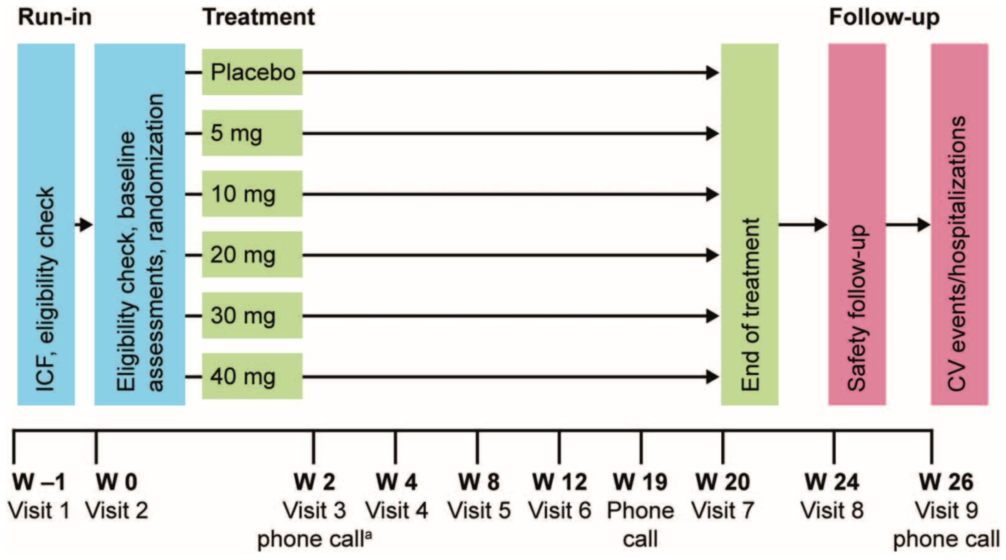
Study visit timeline
6MWT
6MWT
Notes:
Here is the study timeline. Importantly there was a run-in period which was mainly used to perform 2 6MWTs so that patients could get familiarized with the test.

Slide 11
Statistical analysis
Power calculation (80% power, alpha=0.05):
  Assumptions based on 6MWD difference of 40 m (neladenoson vs. placebo), standard deviation of 80 m
  Overall sample size of n=216 (1:2:2:2:2:3 allocation across 5 neladenoson doses and placebo)
  Final sample size n=288 patients to account for 25% dropout
Primary endpoint analysis:
  MCP-Mod approach to dose finding
  Accounts for multiple possible dose-response profiles, correcting for multiple comparisons
Notes:
The study sample size was based on a power of 80% and alpha of 0.05, with an assumed 6MWD difference of 40 m (SD 80 m) in any one of the neladenoson groups vs. placebo. Overall sample size was 216, with a final sample size of 288 to account for 25% dropout.
The primary endpoint analysis was based on the MCP-Mod approach, which accounts for…

Slide 12
MCP-Mod approach to dose finding
linear
sigEmax1
sigEmax2
Dose-response curves showing various model types tested using MCP-Mod approach
40
30
20
10
0
Model means (6MWD, absolute change from baseline in m)
quadratic
emax
0
10
20
30
40
40
Dose d in mg
30
20
10
0
Franchetti Y, et al. J Biopharm Stat 2013
Pinheiro J, et al. Stat Med 2014
Voors AA, Shah SJ, et al. EJHF 2018
0
10
20
30
40
0
10
20
30
40
Notes:
Here are the dose response curves showing the various model types tested using the MCP-Mod approach.

Slide 13
Patient disposition flow chart
N=339
enrolled patients with symptomatic chronic HFpEF
N=34 screen failures:
N=15 inclusion/exclusion criteria not met
N=14 withdrawal by subject
N=4 adverse event
N=1 physician decision
N=305
randomized patients
N=275
completed treatment
N=30
discontinuations
Notes:
A total of 339 patients with symptomatic chronic HFpEF were enrolled, of which there were 34 screen failures, thus, 305 patients were ultimately randomized and 274 completed treatment.

Slide 14
Patient disposition flow chart
305 Randomized
N=76
placebo
N=27
nela 5 mg
N=50
nela 10 mg
N=51
nela 20 mg
N=50
nela 30 mg
N=51
nela 40 mg
70 Completed treatment
25 Completed treatment
46 Completed treatment
46 Completed treatment
41 Completed treatment
47 Completed treatment
3 Missing baseline
or end-of-treatment 6MWT
1 Missing baseline
or end-of-treatment 6MWT
0 Missing baseline
or end-of-treatment 6MWT
2 Missing baseline
or end-of-treatment 6MWT
3 Missing baseline
or end-of-treatment 6MWT
5 Missing baseline
or end-of-treatment 6MWT
67 Analyzed for primary outcome (6MWT distance)
(65 valid for
per-protocol set)
24 Analyzed for primary outcome (6MWT distance)
(22 valid for
per-protocol set)
46 Analyzed for primary outcome (6MWT distance)
(44 valid for
per-protocol set)
44 Analyzed for primary outcome (6MWT distance)
(41 valid for
per-protocol set)
38 Analyzed for primary outcome (6MWT distance)
(34 valid for
per-protocol set)
42 Analyzed for primary outcome (6MWT distance)
(37 valid for
per-protocol set)
Notes:
Across the dose groups, 76 were enrolled into the placebo arm, 27 in the neladenoson 5 mg group, and approximately 50 in the remaining neladenoson groups

Slide 15
Results: Baseline characteristics (1)
Characteristic | Placebo (N=76) | Neladenoson
 |  | 5 mg (N=27) | 10 mg (N=50) | 20 mg (N=51) | 30 mg (N=50) | 40 mg (N=51)
Age (years) | 74±9 | 74±10 | 72±11 | 74±8 | 73±10 | 73±10
Female | 47% | 59% | 52% | 41% | 64% | 54%
Race White Asian Other | 84% 12% 4% | 89% 11% 0% | 88% 12% 0% | 88% 10% 2% | 90% 10% 0% | 88% 10% 2%
NYHA class II/III | 80/20% | 85/15% | 74/26% | 80/20% | 60/40% | 77/23%
BMI (kg/m²) | 29±5 | 28±6 | 29±5 | 31±5 | 30±5 | 29±6
SBP (mmHg) | 133±15 | 133±14 | 133±14 | 132±15 | 134±13 | 133±14
6MWD (meters) | 323±97 | 312±108 | 296±110 | 325±105 | 321±93 | 347±95
Notes:
The randomized patients had characteristics similar to other HFpEF studies, and there were no significant differences among groups.
The patients were older, approximately 50% female, mostly NYHA class II, overweight or obese, and had reduced exercise capacity.

Slide 16
Results: Baseline characteristics (2)
Characteristic | Placebo (N=76) | Neladenoson
 |  | 5 mg (N=27) | 10 mg (N=50) | 20 mg (N=51) | 30 mg (N=50) | 40 mg (N=51)
Hypertension | 87% | 93% | 90% | 88% | 92% | 82%
Atrial fibrillation | 37% | 37% | 36% | 37% | 40% | 41%
CAD | 15% | 22% | 12% | 14% | 14% | 16%
Diabetes mellitus | 47% | 26% | 46% | 39% | 44% | 41%
Obesity | 45% | 33% | 36% | 53% | 46% | 41%
CKD | 22% | 44% | 32% | 31% | 20% | 22%
Notes:
Comorbidities were common as shown here with a high prevalence of HTN, atrial fibrillation, diabetes, and obesity, but a relatively low level of CAD

Slide 17
Results: Baseline evidence of HFpEF
Characteristic | Placebo (N=76) | Neladenoson
 |  | 5 mg (N=27) | 10 mg (N=50) | 20 mg (N=51) | 30 mg (N=50) | 40 mg (N=51)
NTproBNP (pg/ml) | 975 (531-2576) | 1161 (401-2568) | 1140 (393-2271) | 1343 (358-3399) | 1458 (470-2653) | 1174 (433-2576)
LVEF (%) | 57±9 | 57±10 | 54±12 | 57±10 | 59±9 | 52±13
LA volume (ml) | 88±47 | 88±44 | 87±31 | 84±30 | 85±26 | 86±36
Loop diuretics | 84% | 82% | 80% | 92% | 82% | 84%
MRAs | 37% | 48% | 34% | 51% | 38% | 51%
Thiazide diuretics | 26% | 26% | 30% | 37% | 26% | 20%
Notes:
The study participants had objective evidence of HFpEF with elevated NTproBNP, preserved EF, enlarged left atrial volume, and high rates of loop diuretic use

Slide 18

RESULTS:
PRIMARY ENDPOINT
Notes:
The results for the primary endpoint are as follows

Slide 19
Results: Primary endpoint (6MWD)
Model shape | P-value
Linear | 0.52
SigEmax 1 | 0.33
SigEmax 2 | 0.62
Emax | 0.09
Quadratic | 0.27
Mean±SD
change
1.9±49.5 | 24.8±72.4 | 27.2±90.0 | 14.6±54.1 | 16.3±55.4 | 10.7±60.2
Notes:
There was no differences in change in 6MWD among the treatment groups for any of the dose-response relationships. While there were increases in 6MWD vs. placebo across the neladenoson groups, they were not statistically significant.

Slide 20
RESULTS:
SECONDARY ENDPOINTS
Notes:
The results for the secondary endpoints were as follows

Slide 21
Results: Activity intensity
Model shape | P-value
Linear | 0.46
SigEmax 1 | 0.33
SigEmax 2 | 0.47
Emax | 0.43
Quadratic | 0.38
Mean±SD
change
-0.2±0.6 | -0.3±0.5 | -0.1±0.6 | -0.1±0.7 | -0.2±0.6 | -0.1±0.6
Notes:
There were no significan tdifferences in any of the endpoints tested.

Slide 22
Results: KCCQ overall summary score
Model shape | P-value
Linear | 0.77
SigEmax 1 | 0.87
SigEmax 2 | 0.75
Emax | 0.78
Quadratic | 0.82
Mean±SD
change
2.9±13.3 | 7.0±17.4 | -1.0±19.7 | 3.7±13.2 | 0.5±14.2 | 2.8±13.9

Slide 23
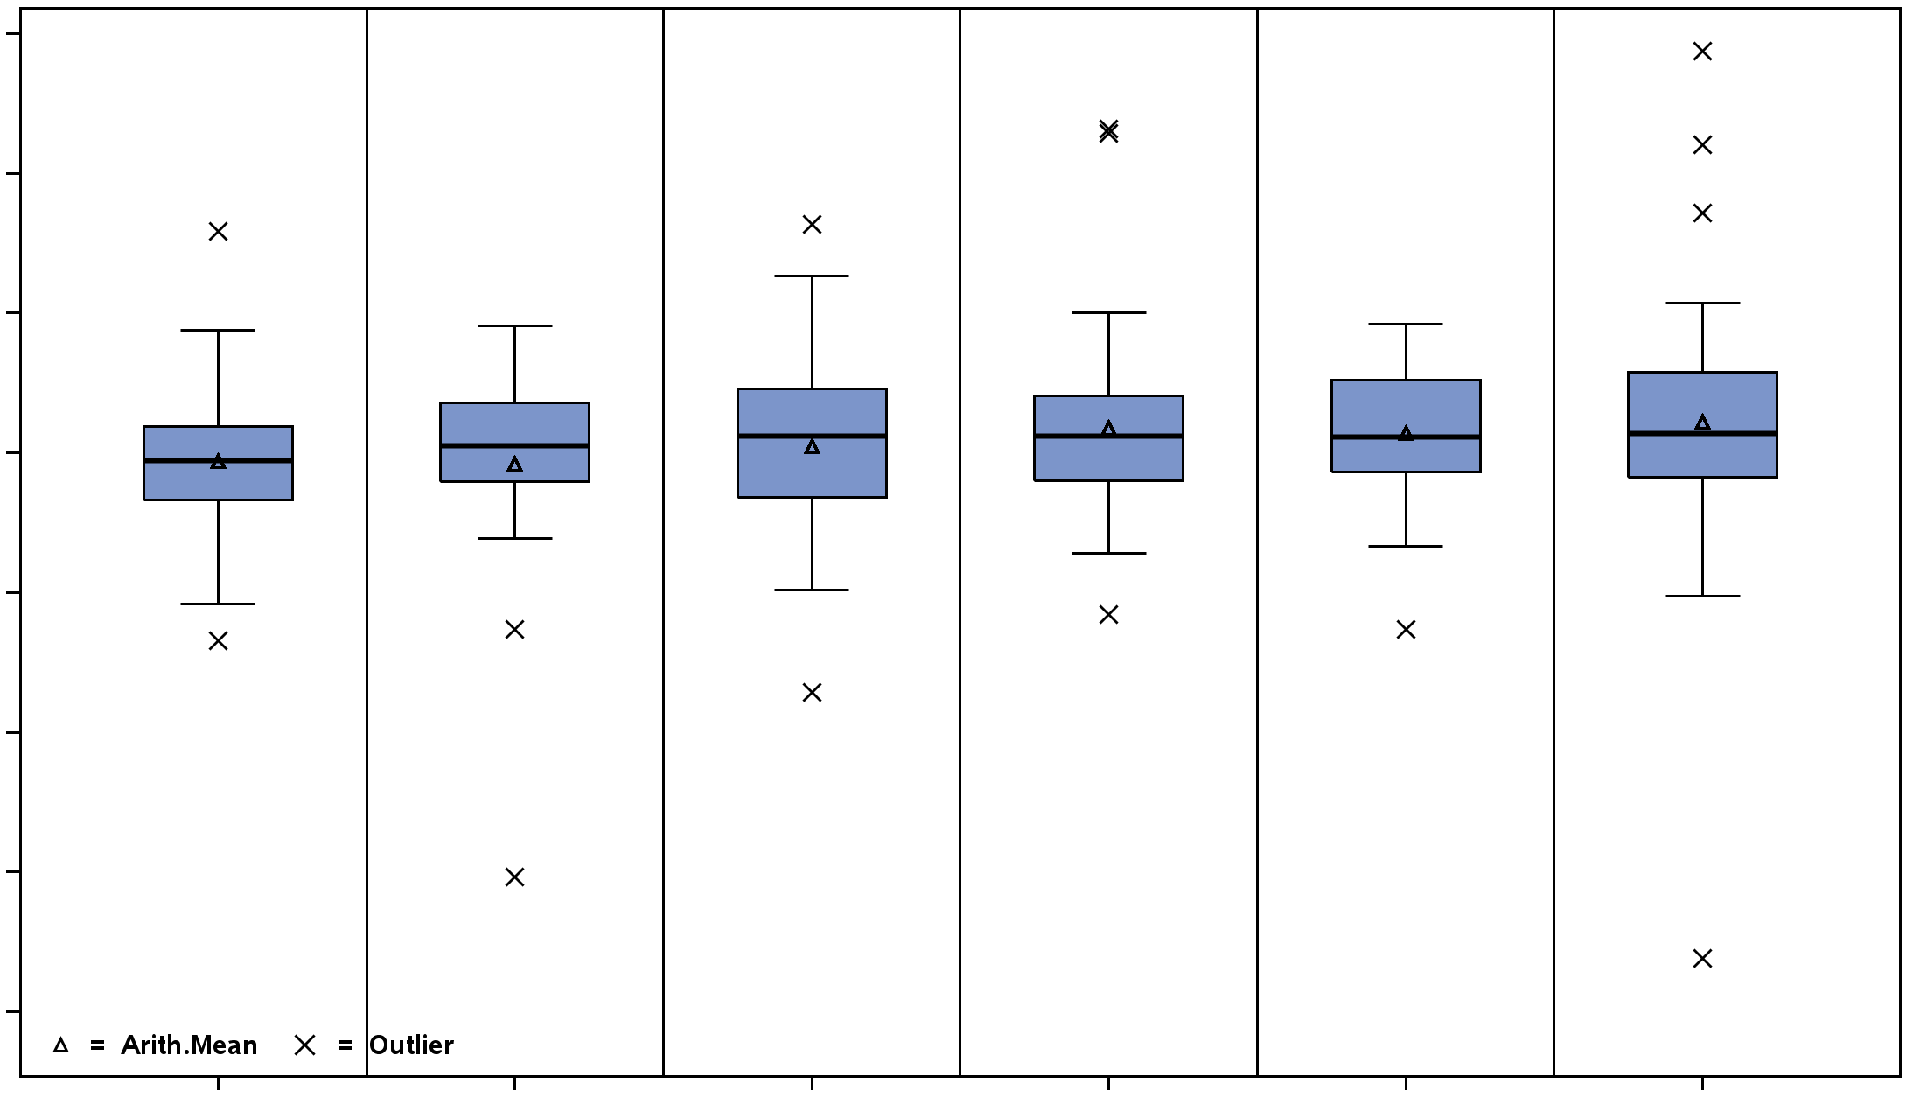
Results: NTproBNP
3.0
2.0
1.0
0
-1.0
-2.0
-3.0
-4.0
Model shape | P-value
Linear | 0.99
SigEmax 1 | 0.99
SigEmax 2 | 0.99
Emax | 0.99
Quadratic | 0.99
Change in Log NTproBNP (pg/ml)
Placebo
5 mg
10 mg
20 mg
30 mg
40 mg

Slide 24
Results: Adverse events
Characteristic | Placebo (N=76) | Neladenoson
 |  | 5 mg (N=27) | 10 mg (N=50) | 20 mg (N=51) | 30 mg (N=50) | 40 mg (N=51)
Symptomatic bradycardia | 1 (1.3%) | 0 | 0 | 0 | 1 (1.3%) | 0
Death | 1 (1.3%) | 0 | 2 (4.0%) | 1 (2.0%) | 1 (2.0%) | 1 (2.0%)
Heart failure hospitalization | 2 (2.6%) | 2 (7.4%) | 3 (6.0%) | 4 (7.8%) | 2 (4.0%) | 7 (13.7%)
Acute kidney injury | 1 (1.3%) | 0 | 0 | 2 (3.9%) | 1 (2.0%) | 1 (2.0%)
No differences in major adverse events (neladenoson vs. placebo)

Slide 25
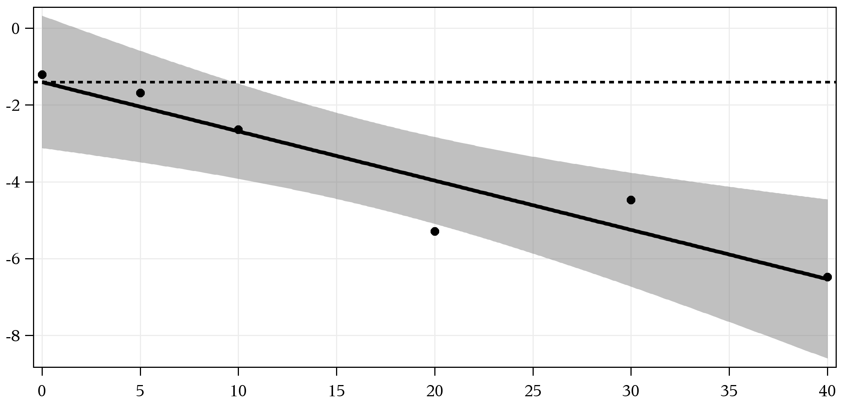
Results: Safety – Renal function
Model shape | P-value
Linear | 0.004
SigEmax 1 | 0.005
SigEmax 2 | 0.005
Emax | 0.013
Quadratic | 0.005
Placebo effect
Change in eGFR
(ml/min/1.73 m²)
Neladenoson effect (95% CI)
Neladenoson dose (mg)
Notes:
There was a slight decrease in GFR, which was greater with increasing doses of neladenoson

Slide 26
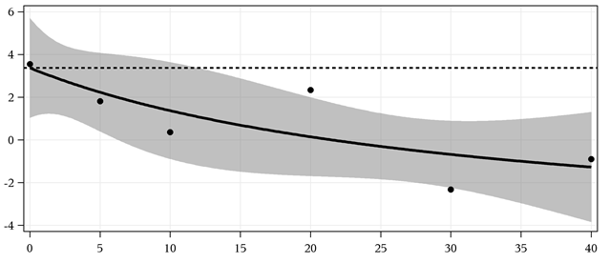
Results: Safety – Heart rate
Model shape | P-value
Linear | 0.045
SigEmax 1 | 0.059
SigEmax 2 | 0.054
Emax | 0.032
Quadratic | 0.036
Placebo effect
Change in HR (bpm)
Neladenoson effect (95% CI)
Neladenoson dose (mg)
No increase in AV blocks with neladenoson vs. placebo
Notes:
There was also greater reduction in heart rate with neladenoson although the differences were slight. Importantly , there were no increases in AV block in neladenoson vs. placebo.

Slide 27
PANACHE neutral results: post-mortem
Evidence of HFpEF? YES
  LVEF preserved (56±11%)
  LA volume index enlarged (39±15 mL/m²)
  LV global longitudinal strain abnormal (-15.1±3.8%)
  NTproBNP elevated (median 869 pg/ml)
  Exercise capacity impaired (6MWD 322±101 meters)
Was the study drug taken? YES
  98% of enrolled patients had a treatment adherence of > 80% (range 96-100% among Rx groups)
Notes:
Whenever there is a neutral trial in HFpEF, we must perform a post-mortem to examine potential reasons.

Slide 28
PANACHE neutral results: post-mortem
Did the drug have a pharmacological effect? YES
  Progressively lower GFR and HR with increasing doses
  Progressively lower GFR and HR with increasing exposure
Was there adequate pre-clinical data? MAYBE NOT
  Preclinical data in cellular models
  Small animal models and large animal model of HFrEF
Were the correct endpoints measured? YES
  Multi-domain endpoint evaluation
Notes:
Was there eadequate preee-clinical data? Maybe not.

Slide 29
Multi-domain endpoint evaluation
Safety: AVIVO patch for arrhythmias

Slide 30
Conclusions
First RCT of a partial adenosine A1-receptor agonist in HFpEF
  Rapid enrollment (300+ patients in 6 months) with evidence of true HFpEF
  Multi-domain endpoint evaluation
No neladenoson dose-response effect for any of the studied endpoints
Good safety profile at 20 weeks, though there were slight decreases in renal function and heart rate

