Slide 1
Primary Results From the Evolut Low Risk Trial
Michael J. Reardon, MD, FACC
Houston Methodist DeBakey Heart & Vascular Institute, Houston, TX For the Evolut Low Risk Trial Investigators

Slide 2
Disclosure Statement of Financial Interests
Within the past 12 months, I have had a financial interest/arrangement or affiliation with the organization(s) listed below.
Financial Relationship | Company
Consultant (fees paid to institution) | Medtronic
Medtronic personnel performed all statistical analyses and assisted with the graphical display of the data presented.

Slide 3
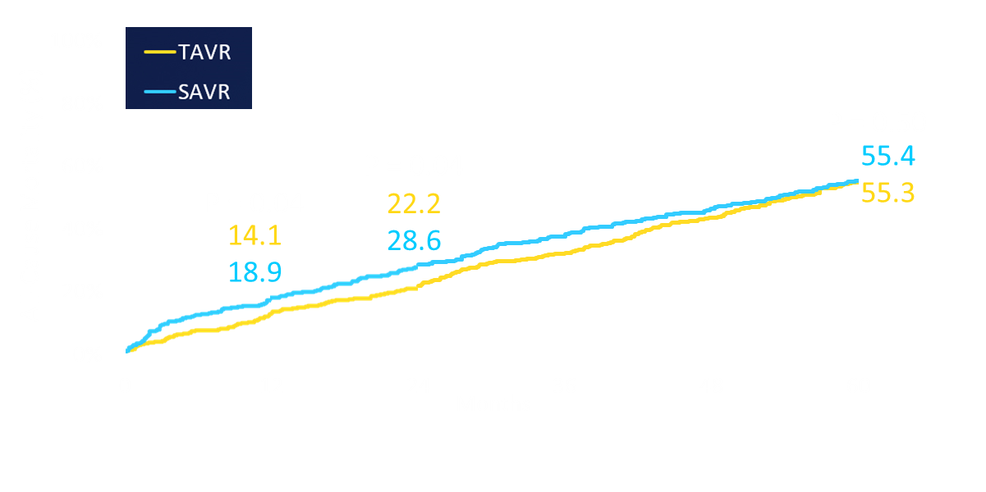
Background
We performed a series of randomized controlled trials in patients with severe aortic stenosis across a spectrum of surgical risk.
In high-risk patients, TAVR was superior to SAVR for the primary endpoint to 2 years¹ and similar at 5 years.²
¹Reardon et al. J Am Coll Cardiol 2015; 66: 113-21; ²Gleason, et al. J Am Coll Cardiol 2018; 72: 2687-96.

Slide 4
Background
The SURTAVI intermediate risk trial showed noninferiority at interim analysis.
The final analysis of the SURTAVI Trial confirmed the early Bayesian results, showing TAVR noninferior to SAVR.
Death or Disabling Stroke (%)
Interim Analysis from the SURTAVI Trial¹
Death or Disabling Stroke (%)
Final Analysis from the SURTAVI Trial²
TAVR | 864 | 755 | 612 | 456 | 272
SAVR | 796 | 674 | 555 | 407 | 241
TAVR | 864 | 840 | 786 |  | 663
SAVR | 796 | 761 | 698 |  | 583
¹Reardon MJ, et al. NEJM 2017; 376:1321-31.
²Popma JJ, et al. Presented at TCT 2018.
Notes:
Showed that our early analysis was confirmed when all patients had 2-year follow-up…script -Focus on the numbers at risk –since we are showing KM curves – isn’t this about the fact that when the full cohort completed 2-year follow-up – the results were similar? Should we only report the KM rates?

Slide 5
Objective
To assess the safety and efficacy of TAVR with the Evolut self-expanding supra-annular valve compared with surgical AVR in patients with a low predicted risk of 30-day surgical mortality.

Slide 6
Study Administration
Principal Investigators: Jeffrey Popma, Michael Reardon
Executive Committee: Jeffrey Popma, Michael Reardon, G. Michael Deeb, Steven Yakubov
Steering Committee: David Adams, Stan Chetcuti, G. Michael Deeb, John Forrest, Thomas Gleason, John Heiser, William Mehri, Mubashir Mumtaz, Daniel O’Hair, Nicolo Piazza, Joshua Rovin, Michael Reardon, Paul Sorajja, Didier Tchétché, Paul Teirstein, Antony Walton, Steven Yakubov, George Zorn III
Screening Committee: G. Michael Deeb (Chair), Thomas Gleason, Jeffrey Popma, Michael Reardon, Steven Yakubov
Echo Core Laboratory: Jae Oh, Mayo Clinic, Rochester, MN
Data & Safety Monitoring Board: Baim Institute for Clinical Research; David Faxon (Chair), William Holman, John Lopez, Scott Kasner, John Orav
Clinical Events Committee: Baim Institute for Clinical Research; Claudia Hochberg (Chair), Cliff Berger, Torin Fitton, Sergio Waxman, Scott Bortman, Carey Kimmelstiel, David Grossman, Manish Chauhan, Jeffrey Veluz, Robert Rodriguez, Sanjay Samy, Gregory Smaroff, Jonathan Waks, Daniel Kramer
Statistical Design and Analyses: Andrew Mugglin, Paradigm Biostatistics, LLC
Sponsor: Medtronic

Slide 7
Participating Sites in the United States
Swedish MC
Univ. of Michigan
Oregon Health & Science Univ.
St. John Hospital
Sanford MC
Univ. Vermont MC
Case MC
Mass General
Baystate MC
Beth Israel Deaconess
Abbott NW
Spectrum Health
Yale New Haven Hospital
Strong Memorial
North Shore Univ. Hospital
Mercy General Hospital
St. Lukes/Aurora
St. Francis Hospital
St. Joseph’S Hospital
The Mount Sinai MC
Univ. of Utah
Mercy Medical Ctr
Loyola
Univ. of Pittsburgh
Geisinger MC
El Camino
Riverside Methodist & OSU
U Pittsburg Pinnacle Health
Lehigh Valley Hospital
Univ. of Colorado Hospital
St. Vincent
Johns Hopkins, MedStar Union, & Univ. of Maryland MC
Univ. of Kansas
Good Samaritan
Winchester MC
Jewish Hospital
Bon Secours Heart & Vascular Institute
Vanderbilt
Duke Univ.
Los Robles Hospital
Mercy Hospital
Wake Forest Baptist MC
Keck Hospital
Integris Baptist MC
Scripps Hospital
Abrazo Arizona Heart Hospital
Piedmont Heart Institute
Medical Univ. of South Carolina
Baylor Heart & Vascular
Methodist Hospital
Methodist Debakey & Baylor College of Medicine
Tallahassee Research Institute
CV Institute of the South
Morton Plant
Lee Memorial Health System
Delray Medical Center
Univ. of Miami

Slide 8
Australia, Canada, Europe, Japan and New Zealand
CHRU de Lille
Sapporo Higashi Taoushukai Hospital
Jacques Cartier
Sendai Kousei Hospital
Sakakibara Heart Institute
Royal North Shore
Shonan Kamakura General Hospital
Clinique Pasteur
St. Vincent’s Hospital
Kokura Memorial Hospital
Osaka General Hospital & NCCC
Fiona Stanley Hospital
The Alfred Hospital & MonashHeart
St. Antonius Hospital
Erasmus
Waikato Hospital
IUCPQ
Catherina Hospital
McGill University & Montreal Heart Institute
Toronto General Hospital, Sunnybrook Health & London Health Sciences

Slide 9
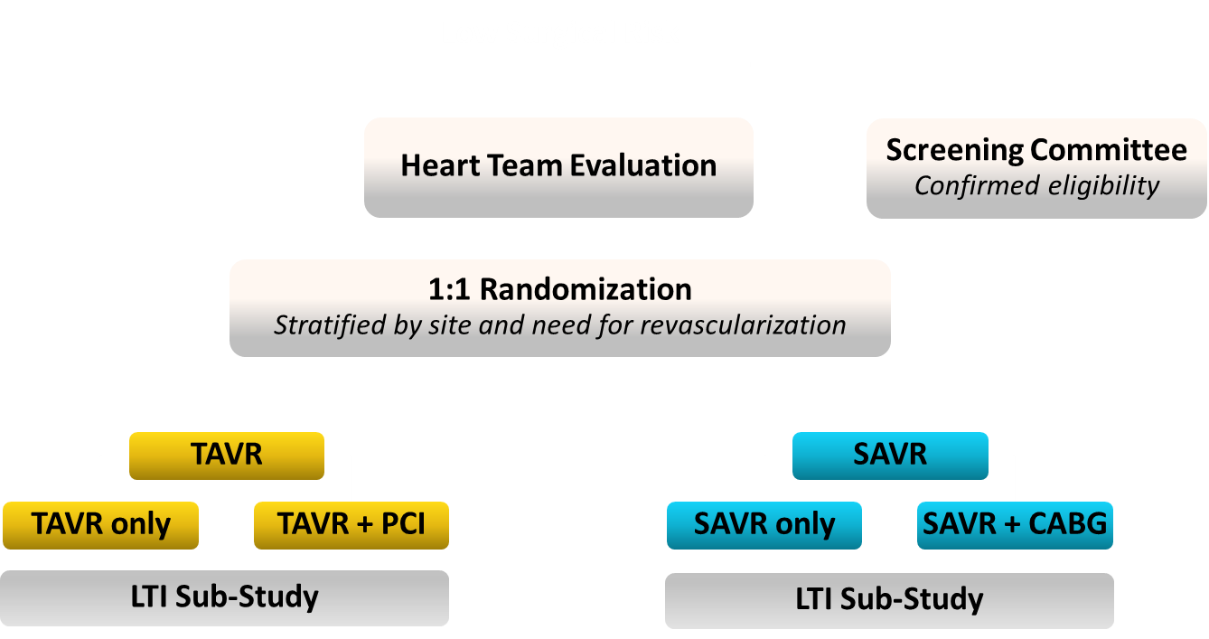
Study Design

Slide 10
Study Endpoints
Primary Safety and Effectiveness Endpoint
All-cause mortality or disabling stroke at 2 years
Noninferiority
Mean gradient at 1 year
EOA at 1 year
Change in NYHA class from baseline to 1 year
Change in KCCQ score from baseline to 1 year
Superiority
Mean gradient at 1 year
EOA at 1 year
Change in KCCQ score from baseline to 30 days
Other Secondary Endpoints
30-day safety composite of
All-cause mortality
Disabling stroke
Life-threatening bleeding
Major vascular complications
Stage 2 or 3 acute kidney injury
New pacemaker implantation at 30 days
Heart failure rehospitalizations at 1 year
Aortic-valve reintervention at 1 year
Moderate/severe AR at 1 year
All stroke at 1 year
Life-threatening bleeding at 1 year
Hierarchical Powered Secondary Endpoints

Slide 11
Key Inclusion Criteria
Symptomatic severe AS¹:
Aortic valve area ≤1.0 cm² (or aortic valve area index <0.6 cm²/m²), OR mean gradient ≥40 mmHg OR Vmax ≥4 m/sec at rest
Asymptomatic very severe AS¹:
Aortic valve area ≤1.0 cm² (or aortic valve area index <0.6 cm²/m²), AND Vmax ≥5 m/sec or mean gradient ≥ 60 mmHg at rest
Aortic valve area of ≤1.0 cm² (or aortic valve area index of ≤0.6 cm²/m²), AND a mean gradient ≥40 mmHg or Vmax ≥4.0 m/sec by transthoracic echocardiography at rest, AND an exercise tolerance test that demonstrates limited exercise capacity, abnormal BP response, or arrhythmia
Aortic valve area of ≤1.0 cm² (or aortic valve area index of ≤0.6 cm²/m²), AND mean gradient ≥40 mmHg, OR Vmax ≥4.0 m/sec by transthoracic echocardiography at rest, AND LVEF<50%.
A predicted risk of 30-day mortality <3% per multidisciplinary local heart team assessment.
¹Nishimura RA, et al. Circulation. 2014;129:2440-92.

Slide 12
Key Exclusion Criteria
Contraindication for placement of a bioprosthetic valve
Multivessel coronary artery disease with SYNTAX score >22
Bicuspid aortic valve verified by imaging
Hypersensitivity or contraindication to all anticoagulation/ antiplatelet regimens
Any PCI or peripheral intervention within 30 days prior to randomization
Symptomatic carotid or vertebral artery disease or successful treatment of carotid stenosis within 10 weeks of Heart Team assessment
Recent (within 2 months) cerebrovascular accident or transient ischemic attack
Acute MI within 30 days
Severe liver, lung or renal disease
Unsuitable anatomy including native aortic annulus <18 mm or >30 mm
Severe mitral or tricuspid regurgitation

Slide 13
Statistical Methods
Noninferiority Testing of the Primary Endpoint
This was a randomized, multinational, noninferiority trial.
The Bayesian adaptive design prespecified an “early-win” interim analysis when 850 patients reached 1-year follow-up.
The estimated sample size was 1200 patients.
The 2-year primary analysis cohort comprised all patients with an attempted implant procedure (as-treated).
The prespecified criteria for success was posterior probability >0.972.
Posterior Distribution of the Difference
(TAVR rate – SAVR rate)
Noninferiority margin
(6%)
Area > 0.972*
*Selected to maintain α < 0.05

Slide 14
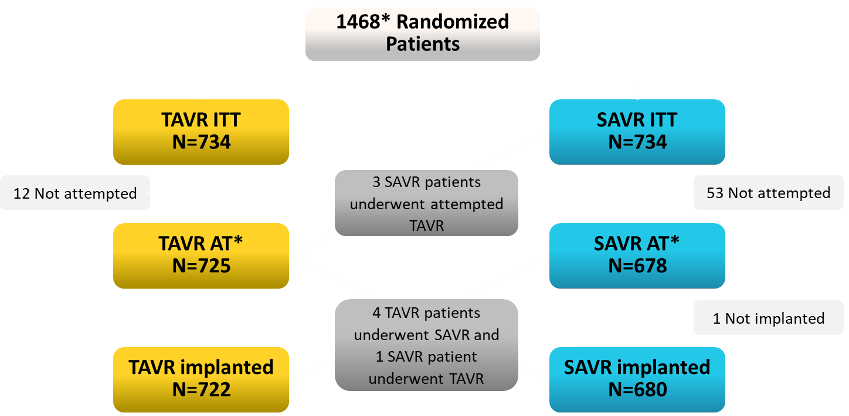
Patient Flow
*Additional patients were randomized to permit completion of the LTI substudy and to enroll a Japanese cohort.

Slide 15
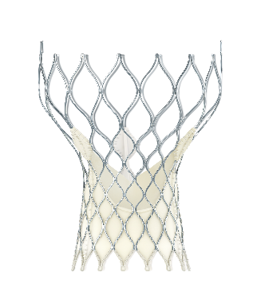
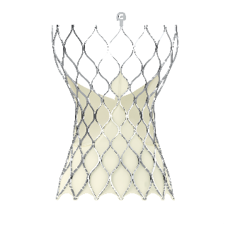
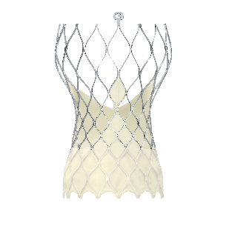
Study Timeline and Valves Studied
2016 | 2017 | 2018
First Patient Randomized Mar. 28, 2016
*Last Patient Randomized Nov. 27, 2018
CoreValve 31 mm
Evolut R: 23, 26, 29
Added Evolut R 34 mm
Evolut PRO: 23, 26, 29 mm
Primary Endpoint Assessment Dec. 27, 2018
Vascular access
99% transfemoral
0.6% subclavian
0.4% direct aortic
CoreValve 31 = 3.6% | Evolut R = 74.1% | Evolut PRO = 22.3%
*For this analysis

Slide 16
RESULTS

Slide 17
Baseline Characteristics
Mean ± SD or % | TAVR (N=725) | SAVR (N=678)
Age, years | 74.1 ± 5.8 | 73.6 ± 5.9
Female sex | 36.0 | 33.8
Body surface area, m² | 2.0 ± 0.2 | 2.0 ± 0.2
STS PROM, % | 1.9 ± 0.7 | 1.9 ± 0.7
NYHA Class III or IV | 25.1 | 28.5
Hypertension | 84.8 | 82.6
Chronic lung disease (COPD) | 15.0 | 18.0
Cerebrovascular disease | 10.2 | 11.8
Peripheral arterial disease | 7.5 | 8.3
There are no significant differences between groups.

Slide 18
Baseline Cardiac Risk Factors
Mean ± SD or % | TAVR (N=725) | SAVR (N=678)
SYNTAX Score | 1.9 ± 3.7 | 2.1 ± 3.9
Permanent pacemaker, CRT or ICD | 3.2 | 3.8
Prior CABG | 2.5 | 2.1
Previous PCI | 14.2 | 12.8
Previous myocardial infarction | 6.6 | 4.9
Atrial fibrillation/flutter | 15.4 | 14.5
Aortic valve gradient, mm Hg | 47.0 ± 12.1 | 46.6 ± 12.2
Aortic Valve area, cm² | 0.8 ± 0.2 | 0.8 ± 0.2
Left ventricular ejection fraction, % | 61.7 ± 7.9 | 61.9 ± 7.7
There are no significant differences between groups.

Slide 19
TAVR Procedural Data
% | TAVR (N=724)
General anesthesia | 56.9
Iliofemoral access | 99.0
Embolic protection device used | 1.2
Pre-TAVR balloon dilation | 34.9
Post-TAVR balloon dilation | 31.3
More than 1 valve used | 1.2
Partial or complete repositioning of the valve (Evolut/PRO only) | 37.3
Staged or concomitant PCI performed | 6.9

Slide 20
Primary Endpoint
All-Cause Mortality or Disabling Stroke at 2 Years
Primary Endpoint Met
TAVR is noninferior to SAVR
TAVR 5.3%
SAVR 6.7%
Posterior probability of noninferiority > 0.999
PP>0.999
TAVR –SAVR difference = -1.4% (95% BCI; -4.9, 2.1)
19

Slide 21
Hierarchical Secondary Endpoints
All Noninferiority and Superiority Endpoints Met
 | TAVR | SAVR | Difference TAVR–SAVR | Posterior Probability
Noninferiority (margin) |  |  | (90% BCI)
Mean gradient at 12 months (5 mmHg) | 8.6 ± 3.7 | 11.2 ± 4.9 | -2.6 (-3.1, -2.1) | > 0.999
Mean EOA at 12 months (0.1 cm²) | 2.3 ± 0.7 | 2.0 ± 0.6 | 0.3 (0.2, 0.4) | > 0.999
Mean NYHA class change (12 months –Baseline) (0.375) | 0.9 ± 0.7 | 1.0 ± 0.7 | -0.1 (-0.2, 0.0) | > 0.999
Mean KCCQ change (12 months –Baseline) (5) | 22.2 ± 20.3 | 20.9 ± 21.0 | 1.3 (-1.2, 3.8) | > 0.999
Superiority |  |  | (95% BCI)
Mean gradient at 12 months, mmHg | 8.6 ± 3.7 | 11.2 ± 4.9 | -2.6 (-3.2, -2.0) | > 0.999
Mean EOA at 12 months, cm² | 2.3 ± 0.7 | 2.0 ± 0.6 | 0.3 (0.2, 0.4) | > 0.999
Mean KCCQ change (30 Days–Baseline) | 20.0 ± 21.1 | 9.1 ± 22.3 | 10.9 (8.6, 13.2) | > 0.999

Slide 22
Clinical Outcomes at 30 Days
Bayesian rates as % | TAVR (N=725) | SAVR (N=678) | (95% BCI for Difference)
30-Day composite safety endpoint* | 5.3 | 10.7 | (-8.3, -2.6)
All-cause mortality | 0.5 | 1.3 | (-1.9, 0.2)
Disabling stroke* | 0.5 | 1.7 | (-2.4, -0.2)
Life-threatening or disabling bleeding* | 2.4 | 7.5 | (-7.5, -2.9)
Acute kidney injury, stage 2-3* | 0.9 | 2.8 | (-3.4, -0.5)
Major vascular complication | 3.8 | 3.2 | (-1.4, 2.5)
Atrial fibrillation* | 7.7 | 35.4 | (-31.8, -23.6)
Permanent pacemaker implant* | 17.4 | 6.1 | (8.0, 14.7)
All-cause mortality or disabling stroke* | 0.8 | 2.6 | (-3.2, -0.5)
All stroke | 3.4 | 3.4 | (-1.9, 1.9)
Aortic valve reintervention | 0.4 | 0.4 | (-0.8, 0.7)
* Significantly favors TAVR; * Significantly favors SAVR
BCI = Bayesian credible interval

Slide 23
Clinical Outcomes at 1 Year
Bayesian rates as % | TAVR (N=725) | SAVR (N=678) | (95% BCI for Difference)
All-cause mortality or disabling stroke | 2.9 | 4.6 | (-4.0, 0.4)
All-cause mortality | 2.4 | 3.0 | (-2.6, 1.3)
Cardiovascular mortality | 1.7 | 2.6 | (-2.7, 0.7)
All stroke | 4.1 | 4.3 | (-2.4, 1.9)
Disabling stroke* | 0.8 | 2.4 | (-3.1, -0.3)
Transient ischemia attack | 1.7 | 1.8 | (-1.6, 1.3)
Myocardial infarction | 1.7 | 1.6 | (-1.3, 1.5)
Endocarditis | 0.2 | 0.4 | (-0.9, 0.5)
Valve thrombosis | 0.2 | 0.3 | (-0.9, 0.5)
Aortic valve reintervention | 0.7 | 0.6 | (-1.0, 0.9)
Heart failure hospitalization* | 3.2 | 6.5 | (-5.9, -1.0)
* Significantly favors TAVR
BCI = Bayesian credible interval

Slide 24
K-M All-Cause Mortality or Disabling Stroke at 1 Year
Death or Disabling Stroke (%)
Log-rank P = 0.065
1 Year 4.6 2.7
30 Days 2.5 0.7
No. at risk
Months
TAVR | 725 | 718 | 648 | 435
SAVR | 678 | 656 | 576 | 366
23

Slide 25
K-M Rates of All-Cause Mortality at 1 Year
All-Cause Mortality (%)
Log-rank P = 0.412
1 Year 3.0
2.3
30 Days 1.2
0.4
No. at risk
Months Post Procedure
TAVR | 725 | 720 | 651 | 435
SAVR | 678 | 665 | 583 | 373
24
Notes:
This Slide Builds – ok?

Slide 26
K-M Disabling Stroke at 1 Year
Disabling Stroke (%)
Log-rank P = 0.024
1 Year 2.3
0.7
No. at risk
Months
TAVR | 725 | 720 | 648 | 435
SAVR | 678 | 656 | 576 | 366

Slide 27
K-M Heart Failure Hospitalization at 1 Year
Heart Failure Hospitalization (%)
Log-rank P = 0.006
1 Year
6.4
3.1
No. at risk
Months
TAVR | 725 | 712 | 636 | 420
SAVR | 678 | 649 | 561 | 358

Slide 28
Clinical Implications Death, Disabling Stroke and Heart Failure Hospitalizations to 1 Year
Composite Rates
TAVR | SAVR | Difference = –4.5%
5.6% | 10.2% | P = 0.002
Estimated KM rates, %
HF Hospitalization
Disabling Stroke
Death

Slide 29
Procedural Time and Length of Stay
Time in Cath Lab or OR
Hospital Length of Stay
Minutes
276.6± 79.5
Days
6.2± 3.3
P<0.001
P<0.001
148.2± 55.1
2.6 ±2.1

Slide 30
Valve Hemodynamics
TAVR Statistically Superior At All Time Points
Implanted population. Core lab assessments.

Slide 31
Prosthesis-Patient Mismatch
P<0.001
P<0.001
N = 609
N = 541
Implant population. Core lab assessments.

Slide 32
Total Aortic Valve Regurgitation
Proportion of Patients with Echo (%)
Implant population. Core lab assessments.
Notes:
Add numbers in notes

Slide 33
NYHA Functional Class
Proportion of Patients (%)

Slide 34
KCCQ Summary Score
Patients Recover Quality of Life Sooner After TAVR
KCCQ Overall Summary Score
 | Change from Baseline
TAVR | 20.0 ± 21.1 | 21.9 ± 21.2 | 22.2 ± 20.3
SAVR | 9.1 ± 22.3 | 20.5 ± 20.5 | 20.9 ± 20.9
95% BCI for difference | (8.6, 13.2) | (-1.0, 3.8) | (-1.6, 4.3)

Slide 35
Subgroup Analysis for Death or Disabling Stroke at 1 Year
Subgroup | TAVR | SAVR | Hazard Ratio (95% BCI) |  | P for Interaction
 | n/N (% KM rate at 1 Year)
Age, years |  |  |  |  | 0.50
< 75 | 10/351 (3.3) | 14/350 (4.3) | 0.70 (0.31-1.57)
≥ 75 | 7/374 (2.2) | 13/328 (4.9) | 0.45 (0.18-1.14)
Sex |  |  |  |  | 0.22
Male | 10/464 (2.5) | 21/449 (5.4) | 0.44 (0.21-0.93)
Female | 7/261 (3.0) | 6/229 (2.9) | 1.01 (0.34-3.02)
BMI, kg/m² |  |  |  |  | 0.98
≤ 30 | 8/366 (2.5) | 13/345 (4.4) | 0.57 (0.24-1.38)
> 30 | 9/359 (2.9) | 14/333 (4.7) | 0.56 (0.24-1.31)
LVEF, % |  |  |  |  | 0.28
≤ 50 | 3/56 (7.4) | 2/56 (3.6) | 1.44 (0.24-8.63)
> 50 | 14/669 (2.3) | 25/621 (4.6) | 0.50 (0.26-0.97)
0.01
0.1
1.0
10.0
Favors TAVR
Favors SAVR

Slide 36
Subgroup Analysis for Death or Disabling Stroke at 1 Year
Subgroup | TAVR | SAVR | Hazard Ratio (95% BCI) |  | P for Interaction
 | n/N (% KM rate at 1 Year)
Peripheral Artery Disease |  |  |  |  | 0.92
No | 15/664 (2.7) | 25/621 (4.6) | 0.54 (0.29-1.03)
Yes | 1/54 (1.9) | 2/56 (4.9) | 0.46 (0.04-5.15)
Diabetes Mellitus |  |  |  |  | 0.81
No | 12/497 (2.8) | 18/471 (4.7) | 0.59 (0.28-1.23)
Yes | 5/228 (2.3) | 9/207 (4.4) | 0.50 (0.17-1.50)
Need for Revascularization |  |  |  |  | 0.31
No | 17/640 (3.1) | 24/599 (4.7) | 0.64 (0.34-1.18)
Yes | 0/85 (0.0) | 3/79 (3.9) | 0.13 (0.00-1.36)
STS PROM, % |  |  |  |  | 0.99
< 3 | 15/678 (2.5) | 25/650 (4.4) | 0.56 (0.29-1.06)
≥ 3 | 2/47 (5.3) | 2/28 (7.6) | 0.55 (0.08-3.90)
0.01
0.1
1.0
10.0
Favors TAVR
Favors SAVR

Slide 37
Summary
TAVR with self-expanding supra-annular valves was noninferior to surgery for the primary endpoint of death or disabling stroke at 2 years in patients with severe aortic stenosis at low surgical risk.
At 30 days, TAVR showed a better safety and recovery profile than surgery, with less death or disabling stroke, less disabling stroke, shorter length of stay and better QOL while SAVR had fewer pacemakers implanted and less residual AR.
At 1 year, both groups had excellent survival. TAVR showed fewer disabling strokes and heart failure rehospitalizations with superior hemodynamics manifest by lower gradients, larger EOAs and less PPM.

Slide 38
Conclusion
TAVR may be a preferred strategy to surgery in patients with severe aortic stenosis at low risk of surgical mortality.

Slide 39
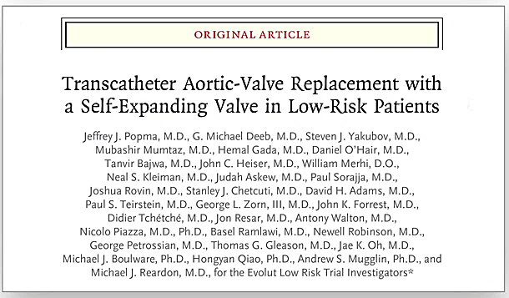

Slide 40
Thank you to the Evolut Low Risk patients, site personnel, investigators and sponsor for making this and our series of randomized trials possible

