Slide 1


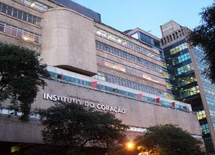


Sonothrombolysis in ST Segment Elevation Myocardial Infarction Treated with Primary Percutaneous Coronary Intervention: Final Results from the First Randomized Study in Humans
Wilson Mathias, Jr¹, Jeane M Tsutsui¹, Bruno G Tavares¹, Agostina Fava², Miguel O D Aguiar¹, Bruno C Borges¹, Mucio T Oliveira Jr¹, Alexandre Soeiro¹, Jose C Nicolau¹, Henrique B Ribeiro¹, Hsu Pochiang¹, João C N Sbano¹, Abdul Morad ², Andrew Goldsweig², Carlos E Rochitte¹, Bernardo B C Lopes¹, José A F Ramirez¹, Roberto Kalil Filho¹, Thomas R Porter².
¹ Heart Institute (InCor), The University of São Paulo Medical School, Brazil
² Cardiology Department of The University of Nebraska Medical Center, USA
State of São Paulo, Government Agency
“BRAZILIAN NIH”
Heart Institute (InCor)
University of São Paulo Medical School
São Paulo, Brazil
Theodore F. and Claire M. Hubbard Family Foundation
Late Breaking Clinical Trials Session, ACC19, March 17, 2019
Notes:
.
Mr. Chairman and selected board, dear Colleagues, it is my privilege to present you in the name of all co-authors our study entitled “ Sonothrombolysis in ST Segment Elevation Myocardial Infarction Treated with Primary Percutaneous Coronary Intervention: Final Results from the First Randomized Study in Humans”

Slide 2




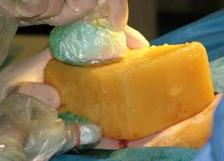




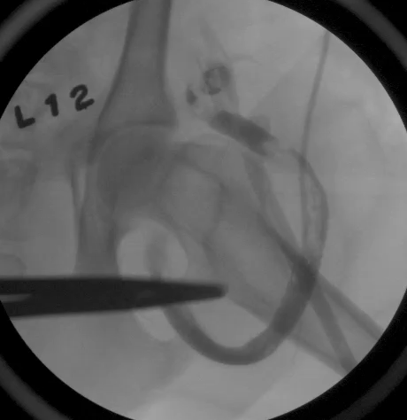
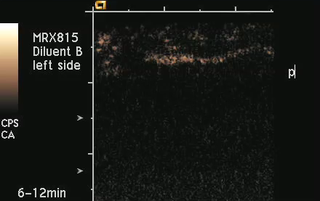
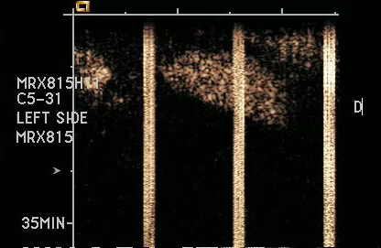
BACKGROUND
High Energy – IM > 1.0
% Angiographic recanalization
100
92%
90
Therapeutic US
80
12 Dogs – Thrombotic Occlusions
70
58%
60
% flow score TIMI 3
50
33%
33%
40
Diagnostic
Transducer
Tissue 6 cm
30
20
17%
10
0%
0%
0
0%
0%
Occluded vessel
Therapeutic US1 MHz
20 min
30 min
45 min
Treatment time
Low MI Imaging
Small channels despite
Graft Occlusion
Increase in Channels size
After Intermitent
High MI US
Occluded Graft
Tsutsui JM et al. Treatment of Deeply Located Acute Intravascular Thrombi With Therapeutic Ultrasound Guided by Diagnostic Ultrasound and Intravenous Microbubbles. J Ultrasound Med. 2006 Sep;25(9):1161-8.
Notes:
In this canine arteriovenious graft thrombosis that appeared angiographically ocluded they showed that using low MI imaging guidance they could detect small channels where microbubbles were penetrating the thrombus that they used to guide the application of high MI impulses. This lead to restoration of flow overtime.

Slide 3



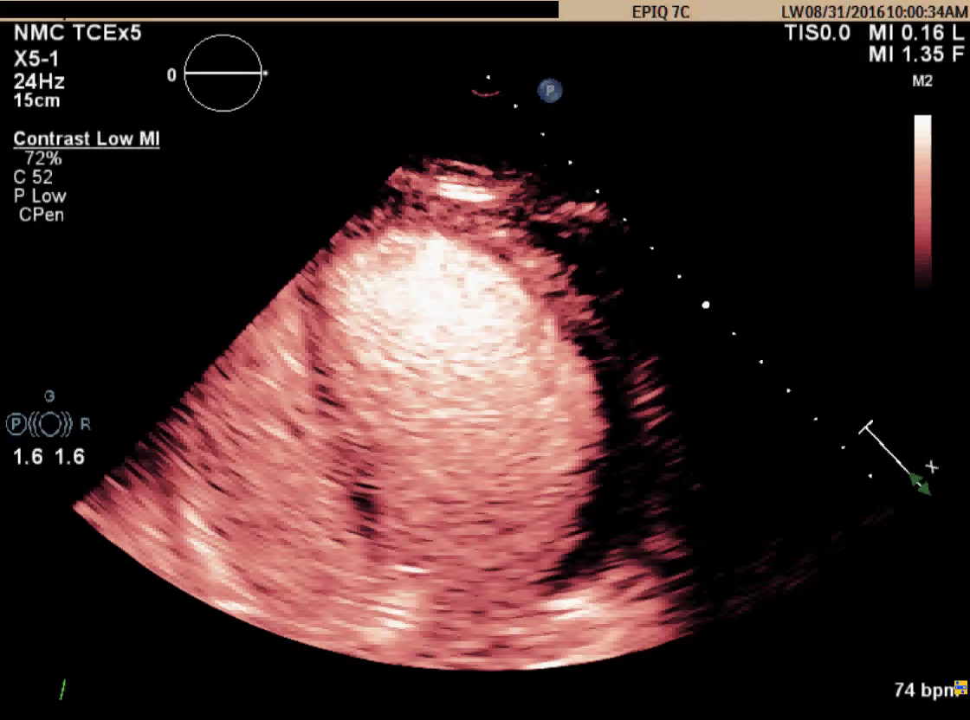
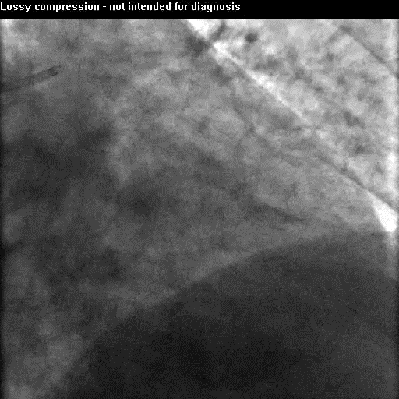
Coronary Reperfusion Therapies in 2019
Drawbacks
Fibrinolysis: Major Haemorragic Complications in ~ 17%
Recanalization rates ~ 60% cases when patients present within 4h of pain
Fibrinolysis and PCI are Available in Brazil to only ~40% of patients
Even with PCI, microvascular occurs in ~35 % of Cases
Aggarwal S et.al. J Am Soc Echocardiogr 2018;31:674-82
Nicoli G et al. Am Coll Cardiol 54:281-92, 2009
Nicolau JC et al. Arq Bras Cardiol. 105(2):1-105, 2015
Notes:
Fibrinolysis: Major Haemorragic Complications can Occurs in ~ 17%
Fibrinolysis: recanalization rate occurs in ~ 60% cases when patients presente in less than 4h of chest pain.
Fibrinolysis and PCI are Available in Brazil to only ~40% of patients
No reflow phenomena occurs in ~35 % of Cases

Slide 4

Study Design
Prospective, single-center, two arm randomized study
Patients with 1st ST elevation AMI
May 2014 – July 2018
  Research Project # 2010/52114-1
  Final IRB Approval # 342.799 (07/08/2013)
  Clinical Trials.gov # NCT02410330
Notes:
Prospective, single-center, two arm randomized study
Patients with 1st ST elevation AMI
May 2014 – July 2018

Slide 5

OBJECTIVES
1 – To determine the safety and feasibility of sonothrombolysis in humans during acute STEMI in 100 patients
2 – To determine the potential efficacy of sonothrombolysis in achieving early infarct vessel patency and restoring left ventricular systolic function by reducing MI size
Notes:
Our primary endpoints were:
1 – To determine the safety and feasibility of guided high MI impulses during a comercially available microbubble infusion in acute ST elevation myocardial infarction
2 – To determine the potencial efficacy of these guided high MI impulses in achieving early infarcted vessel patency and restoring left ventricular systolic function

Slide 6
Study Workflow
Emergency Room
Interventional Lab
Imaging Lab
Follow-up
Therapy Group
(n = 50)
Primary
PCI
Sonothrombolysis: intravenous microbubbles +
intermittent High MI impulses pre/post PCI
Median Time: 50 minutes
Randomization
Clinical data
Pre-angio Echo
Biomarkers
EKG
Door to
balloon time
ARR pre-PCI
Post-treatment Echo
Biomarkers
EKG
48-72h MRI and Echo
1-month Echo
Follow-up data
6-month Echo
Follow-up data
Control Group
(n = 50)
Primary
PCI
Intravenous microbubbles + 3 sets of Low MI images
Reference Group
(n = 203)
Door to
balloon time
Primary
PCI
Arrival at night
Weekends / Holidays
Clinical data
ARR pre-PCI

Slide 7
Patient Selection
3479 patients with AMI at Emergency Department
from May 2014 to July 2018
1622 Non-STEMI excluded
1857 patients with STEMI
1554 exclusion criteria:
Pharmacological fibrinolysis: 728
> 12 h chest pain: 501
Hemodynamic instability: 161
Previous myocardial infarction: 114
Others: 50
303 patients with STEMI and inclusion criteria
100 STEMI patients
randomized into 2 groups
203 STEMI patients arrived
at night or weekends
Therapy group
(n = 50)
Control group
(PCI only)
(n = 50)
Reference group
(n = 203)

Slide 8
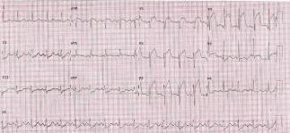
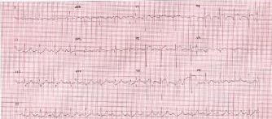
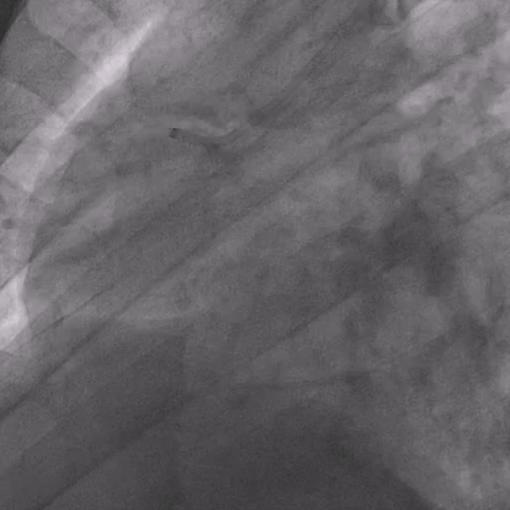
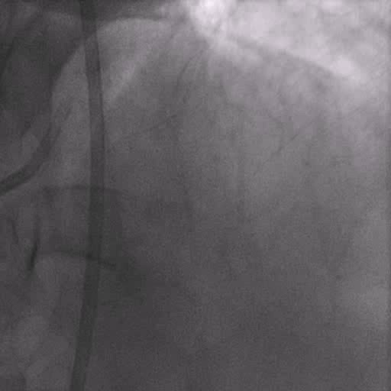
Elektrocardiogram, Biomarkers and Angiography
ST segment resolution as a % or >50% ST resolution from baseline to Post sonolysis pre PCI and at the and of the second sonolysis (*).
Cardiac specific troponin and creatinine kinase MB fraction (MB-CK) every 3 hours for 18 hours.
    Closed artery – TIMI 0 and 1
    Opened artery – TIMI 2 and 3
Interpretation: UNMC, Nebraska
* Spitaleri G at al. . Am J Cardiol 121:1039-1045, 2018.
Notes:
ST segment resolution in the lead with maximum ST deviation as an % or >50% ST deviation resolution from baseline to Post sonolysis pre PCI and at the and of the second sonolysis (*).
Cardiac specific troponin and creatinine kinase MB fraction (CPK MB) every 3 hours for 18 hours following randomization. Peak values were compared between groups.
Interpretation: experienced interventional cardiologist blinded to treatment assignment and outside of the recruitment center (UNMC, USA)

Slide 9
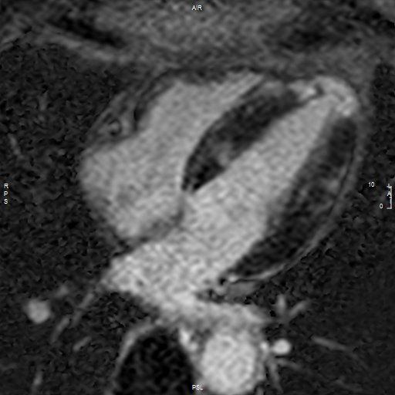
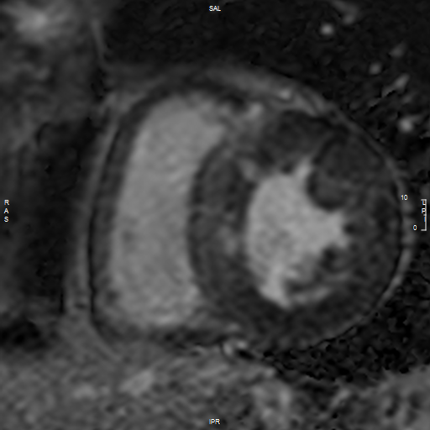
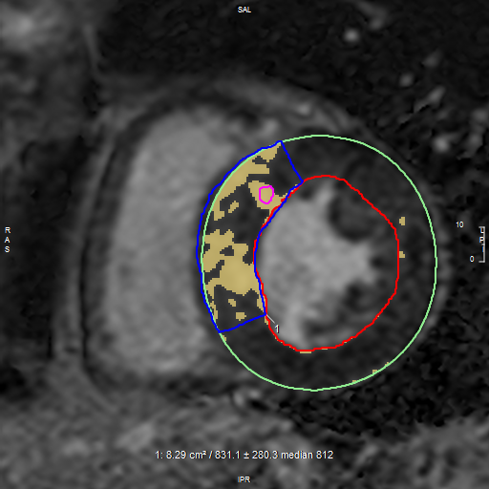
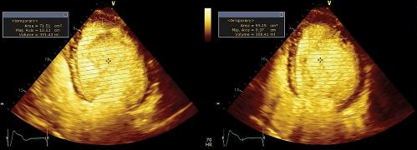
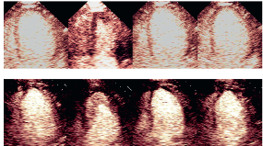
Echocardiography and cMRI
cMRI by Achieva 1.5T Scanner
Early (EGE) and Late gadolinium enhancement (LGE) images were obtained at 2 and 10 minutes following injection of 0.2 mmol/Kg Gadolinium. Interpretation: UNMC - Nebraska
A score of 1: normal perfusion; 2: >4 second delay; 3: absent replenishment at 10 seconds post high MI impulse (MVO).
EDV, ESV and Ejection Fraction were computed by contrast images using Simpson’s Rule.
Interpretation: two experienced cardiologists blinded to treatment assignment (InCor, Brazil)
Echocardiography by IE33 – Philips Medical Systems
1sec
2sec
3sec
4sec
Score 1
Score 3
Botker HE et al. J Cardiovas Magn Reson., 14;68, 2012.
Lang RM et al. J Am Soc Echocardiogr 28:1–39, 2015.
Porter TR et al. 31, 241-274, 2018.
Notes:
MRI by Achieva de 1,5T, Philips Medical Systems.
Early (EGE) and Late gadolinium enhancement (LGE) images were obtained in the same short axis planes at 2 and 10 minutes following injection of 0.2 mmol/Kg Gadolinium Chelate (Dotarem® - Guerbet, Paris, France). Interpretation: experienced interventional cardiologist blinded to treatment assignment and outside of the recruitment center (UNMC, USA)
Echocardiography by IE33 – Philips Medical Systems
By Contrast Echocardiography, a perfusion defect score using a 17 segment model was computed. Myocardial infarction area was computed as segments exhibiting perfusion defects with a delay in replenishment at >4 seconds after the high MI impulse (A and B).
A score of 1 was given to normal perfusion, 2 for a >4 second delay in replenishment, and 3 absent replenishment at 10 seconds post high MI impulse consistent with microvascular obstruction (MVO).
EDV, ESV and Ejection Fraction were computed by contrast images Simpson’s Rule.
Interpretation: experienced interventional cardiologist blinded to treatment assignment and in the recruitment center (InCor, Brasil)

Slide 10

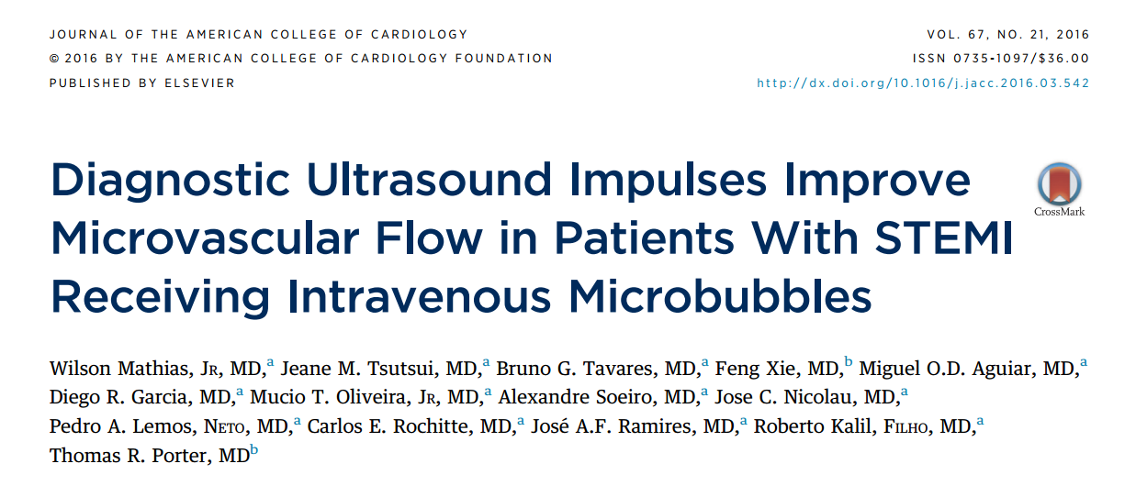

Statistics
Based on pilot data (*), we anticipated randomizing 100 patients to achieve statistical significance (p<0.05 using unpaired one-tailed t testing for continuous variables.
Data were analyzed for possible confounders
Primary outcomes: rate of ST segment resolution and angiographic patency prior to PCI as continuous and dichotomous variable.
Secondary outcomes: Infarct size by CMRI and microvascular flow, LVEF and Myocardial Perfusion post PCI, one week and six months.
Differences were compared between groups at specific time points, and no adjustments were made for multiple comparisons over time.
p = 0.0078
ANOVA p = 0.0011
Notes:
Based on pilot data (*), we anticipated randomizing 100 patients to achieve statistical significance (p<0.05 using unpaired one-tailed t testing for continuous variables.
Data were analyzed for possible confounders, including demographics, patient medications, and disease characteristics. We expected the High MI/PCI group to have >50% ST segment resolution in 80% of cases versus 50% of cases in the PCI only group after all interventions were completed.
We also projected an expected early angiographic patency rate of at least 50% in the High MI/PCI group versus 20% in the PCI only group.
Primary outcomes: rate of ST segment resolution and angiographic patency prior to PCI as continuous and dichotomous variable.
Secondary outcomes: Infarct size by CMRI and microvascular flow, LVEF and Myocardial Perfusion at baseline, post PCI, one week and six months. Differences were compared between groups at specific time points, and no adjustments were made for multiple comparisons over time.
Proportional differences were compared using contingency tables with Chi Square X² testing 2x2 contingency tables or Fisher’s Exact test if <5 in any sample size.
Analysis of Variance was used for comparisons of continuous variables in the high MI/PCI versus PCI only and Reference groups.

Slide 11
Demographic Variables
 | Control Group | Therapy Group | Reference Group
Variable | n= 50 | n = 50 | n = 203 | p Value
Age (years) | 59±11 | 59±10 | 59+11 | 0.96⁽¹⁾
Gender (male) | 40 (80%) | 32 (64%) | 148 (73%) | 0.20⁽²⁾
Weight (kg) | 77±16 | 74±16 | 76+13 | 0.65⁽¹⁾
BSA (m²) | 1.86 + 0.22 | 1.82 + 0.22 | 1.82 + 0.19 | 0.41⁽¹⁾
Diabetes | 11 (22%) | 21 (42%) | 67 (33%) | 0.10⁽²⁾
Hypertension | 28 (56%) | 28 (56%) | 118 (58%) | 0.95⁽²⁾
Hyperlipidemia | 15 (30%) | 20 (40%) | 55 (27%) | 0.20⁽²⁾
Smoking | 20 (40%) | 24 (48%) | 70 (34%) | 0.20⁽²⁾
Medication in use
Statin | 14 (28%) | 19 (38%) | 21 (10%) | <0.001⁽²⁾
Beta blocker | 5 (10%) | 14 (28%) | 27 (13%) | 0.019⁽²⁾
Aspirin | 50 (100%) | 48 (96%) | 202 (99%) | 0.14⁽³⁾
Nitrate | 25 (50%) | 27 (54%) | 95 (47%) | 0.64⁽²⁾
Calcium channel Blocker | 4 (8%) | 5 (10%) | 14 (7%) | 0.72⁽³⁾
STEMI arterial territory
LAD | 26 (52%) | 26 (52%) | 90 (44%) | 0.83⁽²⁾
RCA | 14 (28%) | 17 (34%) | 84 (41%)
LCX | 10 (20%) | 7 (14%) | 29 (14%)
Variables expressed as mean ± standard deviation or number (%). (1) Analysis of variance; (2) Chi- square test; (3) Fisher Exact test.

Slide 12
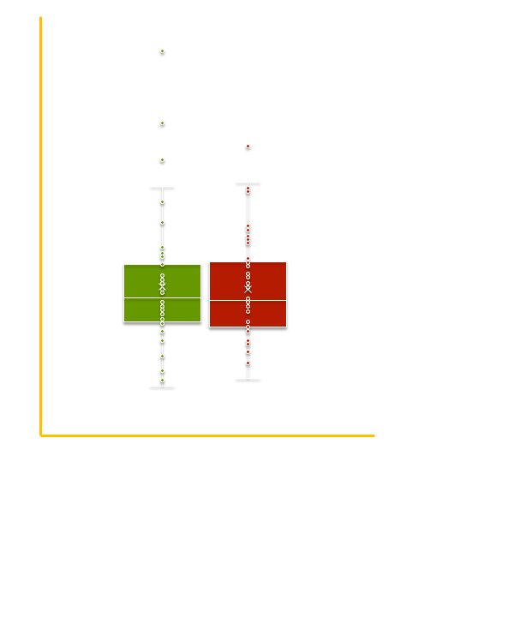
Door to Balloon Time
p = 0.42
Time (min)
Controls
(PCI only Group)
Therapy
(High MI+PCI Group)
Fisher Exact test

Slide 13
Angiographic Recanalization Rate Pre PCI
p < 0.001 between groups
48%
20%
21%
Chi Square X2 test

Slide 14
Change in Perfusion Score # Segs MVO (Baseline - Post PCI)
Perfusion Score (Echo)
# of Segments with MVO (Echo)
p = 0.083**
p = 0.032**
***p= 0.56
***p = 0.005
p= 0.86*
p= < 0.001*
1.76
1.72
1.74
1.57
0
Pre Treatment
Post-PCI
Pre Treatment
Post-PCI
Control Group
Therapy Group
* Paired Student T test
** Unpaired Student T test
*** Chi Square test

Slide 15
ST Segment Resolution and Peak Troponin/MB-CK Values
**
p = 0.011
p = 0.093
*
p = 0.011
p < 0.001
(*) Mann- Whitney test; (**) Student T test.
Notes:
There were no changes in blood pressure, heart rate or oxygen saturation before or after contrast administration.
There were 2 cases of backpain, no alergic reaction, one acute stent thrombosis in the Non- Standard high MI group and one self limited unsustained ventricular tachycardia in the Standard high MI group. There were no deaths.

Slide 16




Clinical Case # 76
Randomized to Therapy Group
CAF, 52y/o Male
Hypertensive
Dyslipidemia
Continuous chest pain (9/10 Scale) for ~1:45h
Notes:
This is an example of a patient randomized to Therapy group. It was a 52 year old man, hypertensive, smoker with dyslipidemia that arrived in our ER with continuous chest pain for approximately 1:45h.

Slide 17
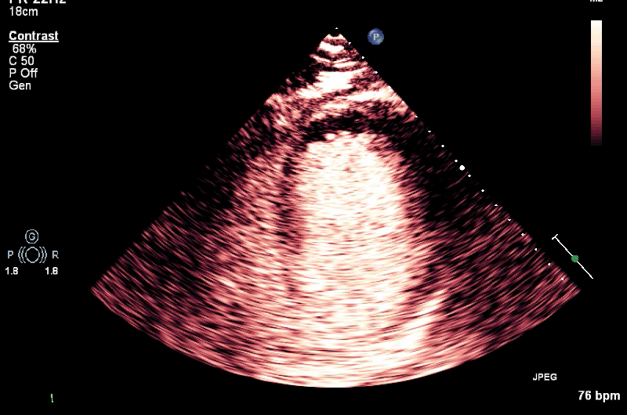
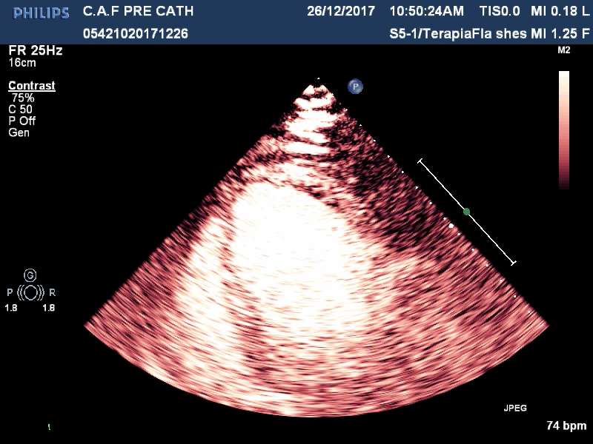
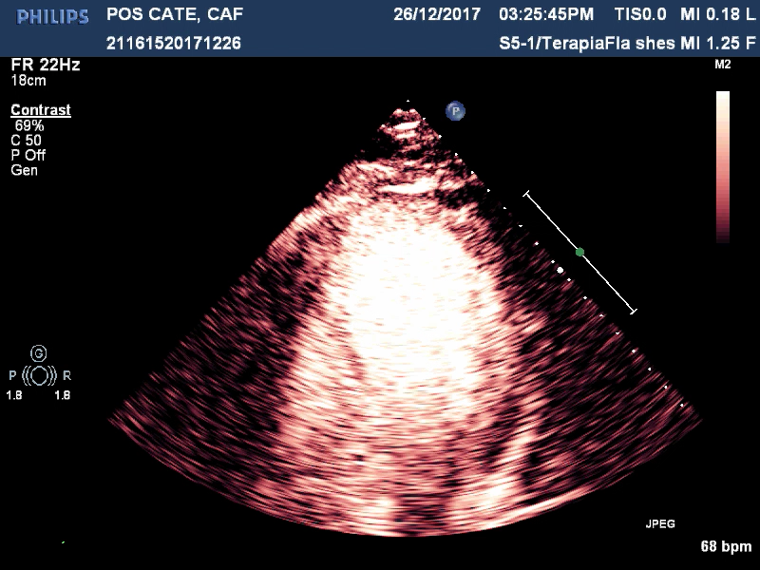
Clinical Case # 76
EKG at arrival
EKG post PCI
Beginning of Sonothrombolysis
At 12 minutes of Sonothrombolysis
Echo post PCI
LVEF 29%
Notes:
His EKG on admission showed ST elevation from leads V1 to V4 and maximum of 3 mm ST elevation.
After the first Sonolysis there was a 1.5mm improvement in ST elevation

Slide 18
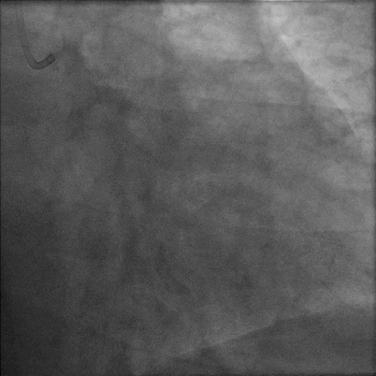
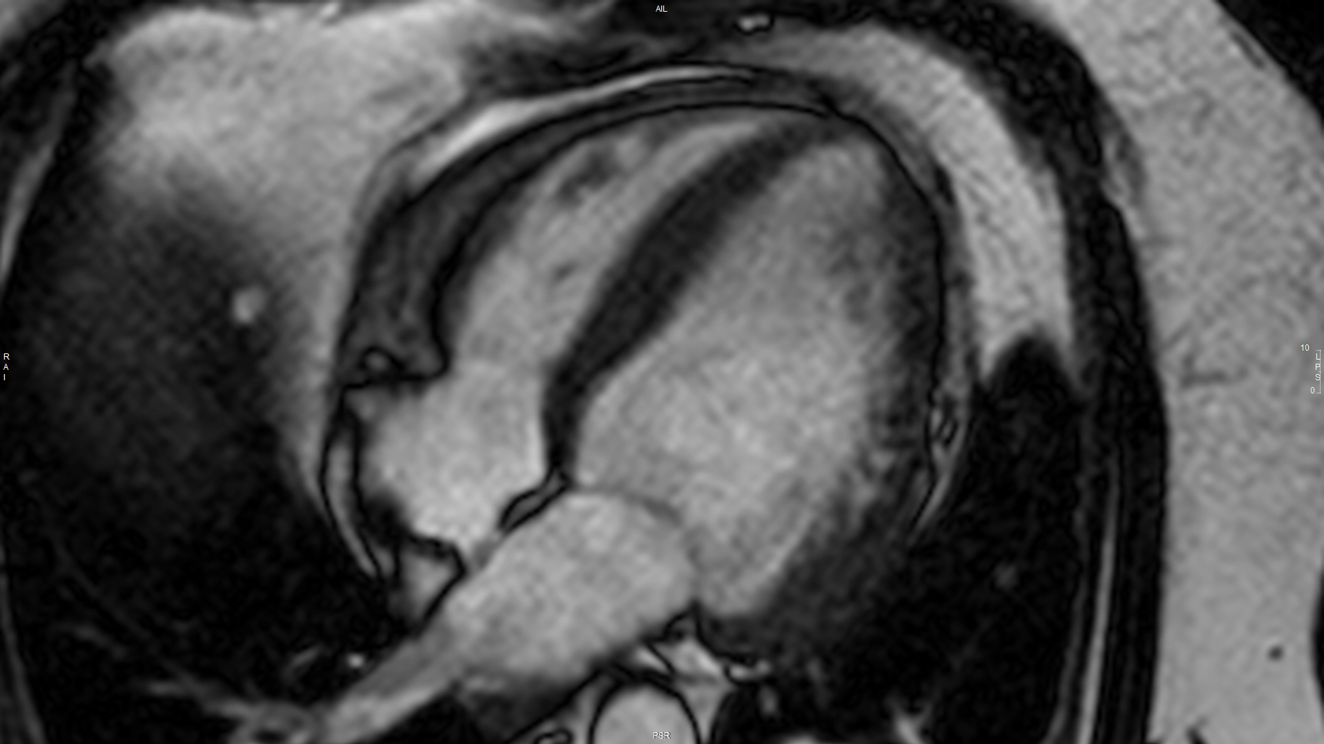
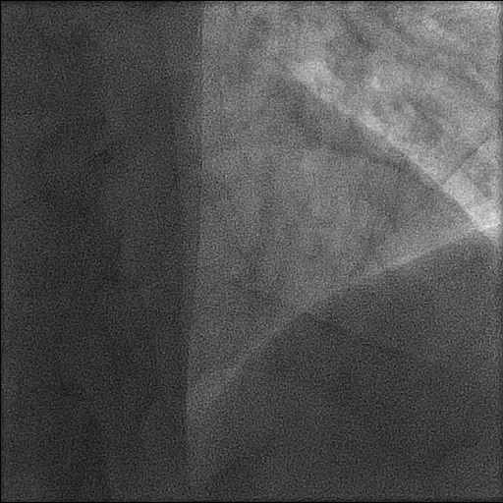
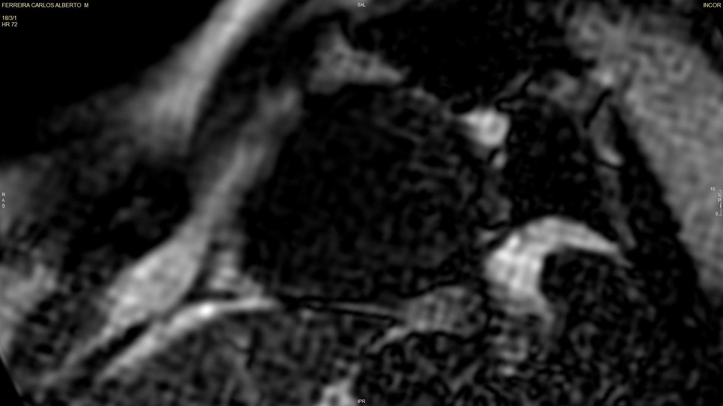
Clinical Case # 76
Coronary Angiography
Before PCI
72h cMRI
Post PCI
72h MRI demonstrating 4 Chamber View and a focal perfusion defect on first pass in mid anterior wall segment
Notes:
The initial angiogram image shows that there was na obstructed proximal LAD coronary lesion.
After PCI we can observe TIMI 3 flow.
72 h MRI demonstrated a focal scar in the mid to distal anterior segment but no microvascular obstruction.

Slide 19
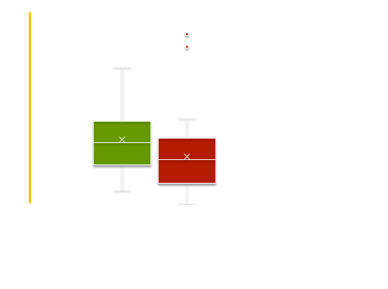
Infarct Size by MRI and LVEF by Echo
p = 0.39
p = 0.032
p = 0.015
p = 0.026
Infarct size by cMRI (g)
Controls
(PCI only Group)
Therapy
(High MI+PCI Group)
Mann Whitney test

Slide 20
Follow-up – EF < 30%
Qualified for Automatic Implantable Cardioverter Defibrillator
p= 0.045*
* Fisher Exact test

Slide 21
Sonothrombolysis in ST Segment Elevation Myocardial Infarction Treated with Primary Percutaneous Coronary Intervention: Final Results from the First Randomized Study in Humans
1 – Sonothrombolysis in humans is safe and feasible in patients with STEMI
2 – Sonothrombolysis is efficacious in achieving early infarct vessel patency, microvascular flow, reducing infarct size and consequently restoring left ventricular systolic function
3- A Phase III multicenter clinical trial is warranted with focus on earlier sonothrombolysis at point of patients care
Notes:
1 – Sonothrombolysis in humans is safe and feasible in patients with STEMI.
2 –Sonothrombolysis is efficatious in achieving early infarct vessel patency and restoring left ventricular systolic function and reducing MI size.
Thank you

Slide 22
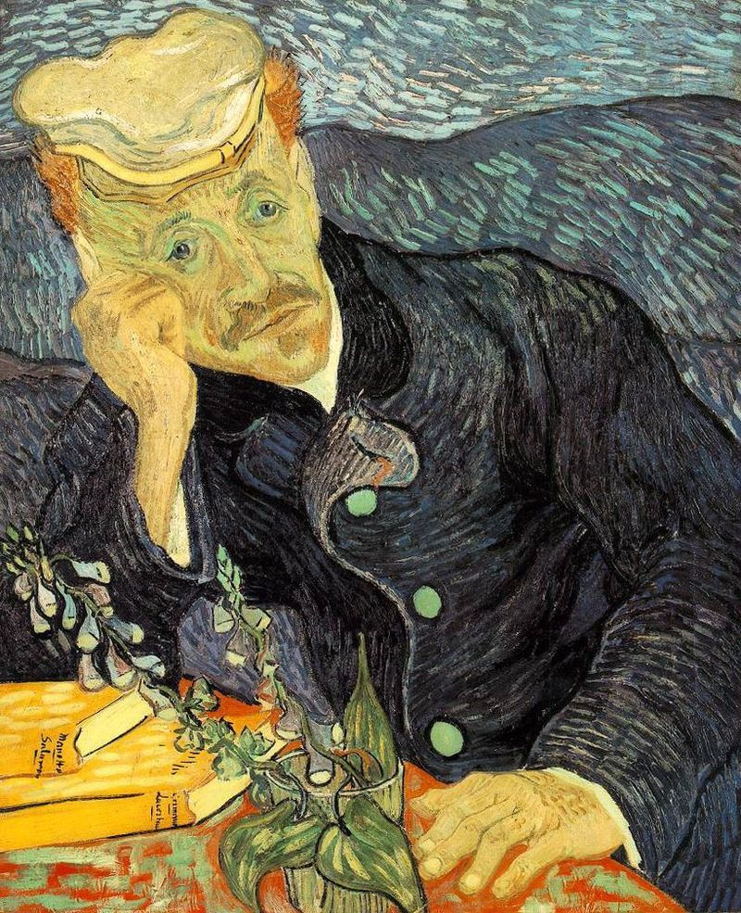
“This is not the end. This is not even the beginning of the end, but perhaps, it is the end of the beginning”
Winston Churchil
2nd Battle of El Alamain
Email for correspondence: wmathias@incor.usp.br
Notes:
1 – Sonothrombolysis in humans is safe and feasible in patients with STEMI.
2 –Sonothrombolysis is efficatious in achieving early infarct vessel patency and restoring left ventricular systolic function and reducing MI size.
Thank you

