Slide 1
The SAfety and Efficacy of Femoral Access vs RadIal Access in STEMI:
The SAFARI-STEMI Trial
ClinicalTrials.gov identifier: NCT01398254
Michel R Le May MD, FRCP, FACC
University of Ottawa Heart Institute,
Ottawa, Ontario,
Canada

Slide 2
The SAfety and Efficacy of Femoral Access vs. RadIal Access in ST-Elevation Myocardial Infarction (SAFARI-STEMI) trial
Investigators: Michel R. Le May, George A. Wells, Derek Y. So, Aun Yeong Chong, Michael Froeschl, Alexander Dick, Christopher Glover, Benjamin Hibbert, Jean-François Marquis, Melissa Blondeau, Christina Osborne, Andrea MacDougall, Malek Kass, Vernon Paddok, Ata Quraishi, Marino Labinaz.
Participating Centers:
University of Ottawa Heart Institute, Ottawa, Ontario
New Brunswick Heart Centre, Saint John Regional Hospital, New Brunswick
Thunder Bay Regional Heath Sciences Centre, Thunder Bay, Ontario
St. Boniface General Hospital, Winnipeg, Manitoba
Queen Elizabeth II Health Science Centre , Halifax, Nova Scotia

Slide 3
Background: Radial vs Femoral Access
SAFARI-STEMI
Radial access has been endorsed because
bleeding is reported to be less frequent than with femoral access, and
bleeding associated with PCI is linked to mortality
Previous trials suggest that radial access is associated with lower mortality in STEMI pts
Mortality advantage for radial access over femoral access in pts undergoing primary PCI is controversial.
Objective:
Determine if radial access improves survival when compared to femoral access in pts referred for primary PCI

Slide 4
STUDY DESIGN
SAFARI-STEMI
Investigator-driven, multi-center, prospective, randomized open-label trial with blinded evaluation of outcomes
Inclusion:
STEMI pts referred for primary PCI with symptom onset ≤12 hrs
Main exclusion criteria:
Fibrinolytic therapy
Oral anticoagulants
Prior CABG

Slide 5
Outcomes
SAFARI-STEMI
Primary outcome:
all-cause mortality measured at 30 days
Key secondary outcomes at 30 days:
stroke
reinfarction
stent thrombosis
bleeding (TIMI definition)

Slide 6
Sample size
SAFARI-STEMI
Expected 30-day mortality of 4.0% in femoral access group
Minimal clinically important difference of 1.5% between femoral and radial access
Crossover rate: radial access 5% vs.1% femoral access
Loss to follow-up of 0.5%
Sample size of 2442 pts per group (total of 4884 pts) required with a level of significance of 0.05 and 80% power

Slide 7
Role of DSMB
SAFARI-STEMI
An independent DSMB oversaw the safety and scientific validity of the trial
On December 7, 2018, recruitment was stopped early as recommended by the DSMB

Slide 8
Patient Flow Diagram
SAFARI-STEMI

Slide 9
Baseline Characteristics
SAFARI-STEMI
Characteristic | Radial Access (n=1136) | Femoral Access (n= 1156)
Age, mean ± SD, y | 61.6 ± 12.3 | 62.0 ± 12.1
Male sex | 77.7% | 77.9%
Hypertension | 49.1% | 46.8%
Diabetes mellitus | 16.7% | 18.3%
Current smoker | 39.6% | 38.2%
Dyslipidemia | 37.2% | 37.3%
Previous MI | 11.0% | 10.0%
Previous PCI | 9.2% | 9.0%
Previous stroke or TIA | 3.6% | 3.5%
Anterior myocardial infarction | 37.7% | 34.3%
Heart rate, mean ± SD, beats per minute | 76.7 ± 30.3 | 77.5 ± 25.5
Systolic blood pressure, mean ± SD, mm Hg | 141.0 ± 28.5 | 142.4 ± 27.7
Killip class II, III, or IV | 7.0% | 6.7%
Body-mass index, mean ± SD kg/m² | 28.2 ± 4.9 | 28.2 ± 4.9

Slide 10
Medications for the Procedure
Before Procedure
During Procedure
 | Radial Access (n=1136) | Femoral Access (n= 1156)
Aspirin | 99.9% | 99.6%
P2Y12 inhibitor
Clopidogrel* | 18.6% | 20.4%
Prasugrel | 0.1% | 0.1%
Ticagrelor | 91.5% | 91.5%
UFH, 60 units/kg (max 4000 u) | 98.2% | 97.5%
 | Radial Access (n=1136) | Femoral Access (n= 1156)
Antithrombin
Bivalirudin | 88.1% | 92.4%
UFH | 11.9% | 7.6%
Glycoprotein IIb/IIIa inhibitor | 6.1% | 5.9%
*Pts already given a LD of clopidogrel,
additional LD of ticagrelor allowed

Slide 11
Cardiac Catheterization/PCI Results
Variable | Radial Access (n=1136) | Femoral Access (n= 1156)
Coronary angiography | 100% | 100%
PCI performed | 95.2% | 95.9%
Stent insertion | 91.3% | 92.6%
Stents per patient, mean ± SD | 1.5 ±1.2 | 1.5 ±1.0
Drug-eluting, % of pts stented | 87.3% | 88.4%
Manual aspiration thrombectomy, % of PCI | 38.8% | 42.9%
No of diagnostic & guiding catheters/pt, mean ± SD | 3.2 ±1.4 | 3.1 ±1.0
Intraaortic balloon pump | 1.8% | 2.5%
Impella device or ECMO | 0.26% | 0.35%
Peak activated clotting time, mean ± SD, sec | 395 ±130 | 389 ±116
Crossover | 8.1% | 2.3%
Use of vascular closing device | 5.5% | 68.2%

Slide 12
Key Time Intervals: median (q1,q3) - min
SAFARI-STEMI
Interval | Radial Access (n=1136) | Femoral Access (n= 1156) | P Value
Symptom onset to first balloon inflation/device | 166 (111-247) | 161 (109-239) | 0.42
Arrival at PCI center to first balloon inflation/device | 47 (35-63) | 44 (33-60) | 0.007
Arrival at catheterization laboratory to first balloon inflation/device | 20 (16-25) | 18 (14-22) | <0.0001
Lidocaine administration to first balloon inflation/device | 13 (10-17) | 11 (9-14) | <0.0001
Fluoroscopy time | 9.4 (6.5-13.5) | 8.2 (6.0-12.5) | <0.0001

Slide 13
Angiographic results
SAFARI-STEMI
 | Radial Access (n=1136) | Femoral Access (n= 1156)
Multivessel disease | 57.0% | 58.3%
Infarct-related coronary artery
Left main | 0.53% | 0.9%
Left anterior descending | 40.1% | 36.9%
Left circumflex | 13.9% | 15.2%
Right | 44.0% | 45.3%
Unknown | 1. 5% | 1.6%

Slide 14
TIMI Flow Grade
SAFARI-STEMI
Baseline
End of Procedure
% pts
% pts
P=0.004
P=0.08

Slide 15
DSMB’s Recommendation
SAFARI-STEMI
As a result of a continual lower than expected rate of the primary outcome, the DSMB requested a futility analysis
A futility index of 0.83 for the primary outcome was calculated
Based on this analysis, the DSMB recommended terminating the trial because it was highly unlikely that the trial would show a clinically important difference in 30-day all-cause mortality between the access site strategies
The steering committee met to discuss the recommendation and enrollment was terminated on Dec 7 2018
2292 pts enrolled and 30-day follow-up available on 2283 (99.6%)

Slide 16
Primary Outcome: 30-day Mortality
SAFARI-STEMI
% of Pts

Slide 17
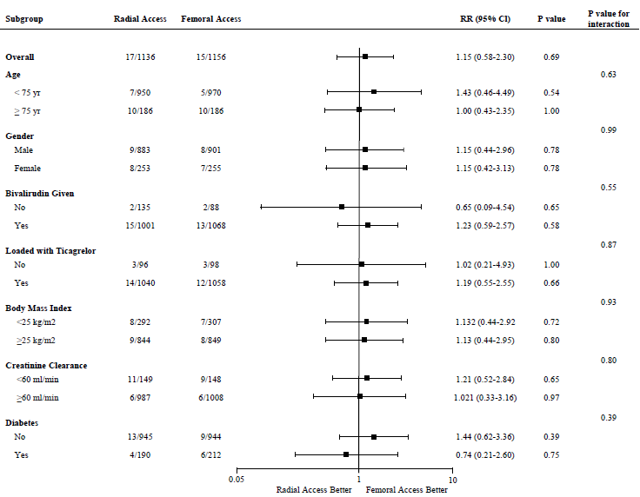
Subgroup Analysis of the Primary Outcome
SAFARI-STEMI

Slide 18
Secondary Outcomes at 30 days
SAFARI-STEMI

Slide 19
Stent Thrombosis
SAFARI-STEMI

Slide 20
Bleeding at 30 days
SAFARI-STEMI
*CABG done in 3.8% radial and 3.5% femoral

Slide 21
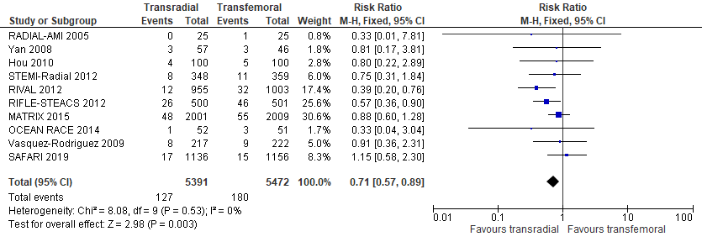
SAFARI-STEMI
Mortality in STEMI pts in randomized trials
SAFARI-STEMI is largest study after MATRIX and the largest dedicated PPCI study
Precision similar to RIVAL and RIFLE-STEACS
More consistent with other studies than RIVAL and RIFLE-STEACS
Influence analysis – RIVAL corresponds to most significant interaction p-value (P=0.06)

Slide 22
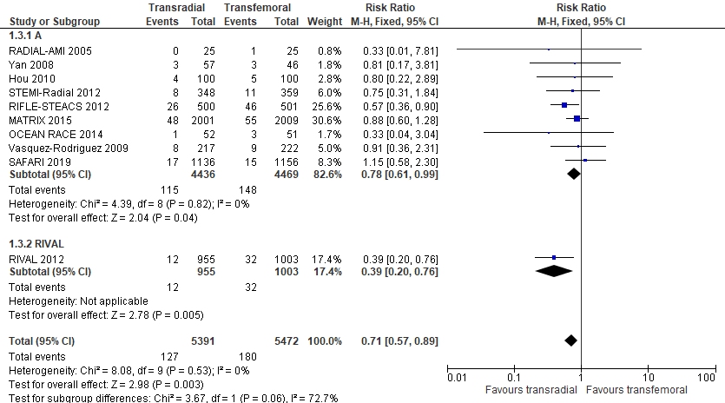
SAFARI-STEMI
Mortality in STEMI pts in randomized trials

Slide 23
CONCLUSIONS
SAFARI-STEMI
In pts with STEMI referred for primary PCI, we did not find a difference in survival at 30 days between the use of radial access and femoral access
Our findings suggest that adequately trained operators should be able to achieve similar results using either radial or femoral access for primary PCI

Slide 24
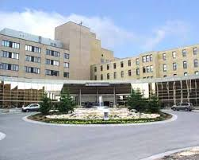
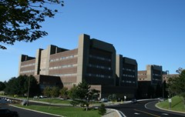
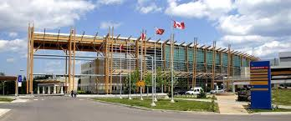
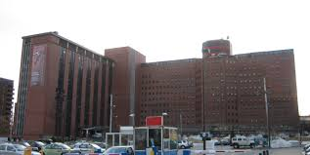
Acknowledgment
1) Cath lab nurses/staff
2) CCU nurses /staff
3) Coordinators
4) Cardiology residents
5) Members of adjudication committee
6) Members of DSMB
University of Ottawa Heart Institute,
Ottawa, Ontario
,
St. Boniface General Hospital,
Winnipeg, Manitoba
New Brunswick Heart Centre, Saint John Regional Hospital, NB
Thunder Bay Regional Heath Sciences Centre,
Thunder Bay, Ontario
Queen Elizabeth II Health Science Centre ,
Halifax, Nova Scotia

