Slide 1

Blinded Physiological Assessment of Residual Ischemia after Successful Angiographic PCI
Allen Jeremias, MD, MSc
On behalf of Justin Davies, Manesh Patel, Gregg Stone
and the DEFINE PCI Investigators

Slide 2
Disclosure Statement of Financial Interest
Within the past 12 months, I or my spouse/partner have had a financial interest/arrangement or affiliation with the organization(s) listed below.
Affiliation/Financial Relationship
Company
Institutional Educational Grants
Consulting Fees/Honoraria
Volcano/Philips
Abbott Vascular
Volcano/Philips
Abbott Vascular
Opsens
Boston Scientific
Chiesi
Astra Zeneca

Slide 3
Background (I)
Recurrent Angina at 1 Year After PCI remains between 20-30%
34%
27%
27%
28%
26%
21%
22%
19%
Courage
BMS
10 MVD
RCTs
BMS/PTCA
SPIRIT IV
PES
SPIRIT IV
EES
SYNTAX
PES
FREEDOM
SES/PES
FAME I
DES
FAME I
DES + FFR
NEJM
2007;365:1503-16
NEJM
20011;364:1016-26
LANCET
2009;373:1190-7
SPIRIT IV
UNPUBLISHED
JAMA
20013;310:1581-90
NEJM
2009;360:213-24
Courtesy of Dr. Gregg Stone

Slide 4
Background (II)
Post PCI ischemia based on FFR ≤0.80 occurs in 10-20% of cases
Lee JM., et al. J Am Coll Cardiol Intv. 2018;11:2099–109.
Agarwal SK, et al. J Am Coll Cardiol 2016;9:1022-31.

Slide 5
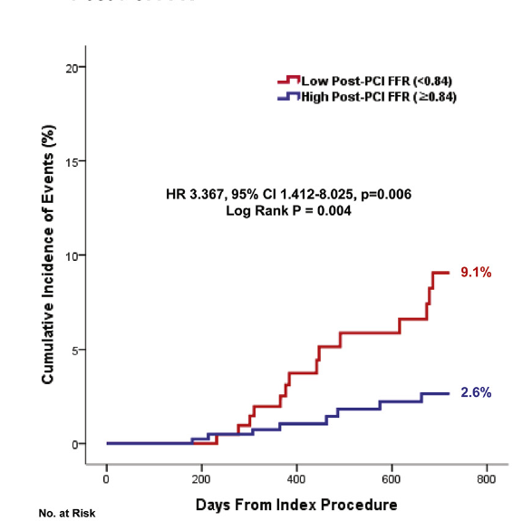
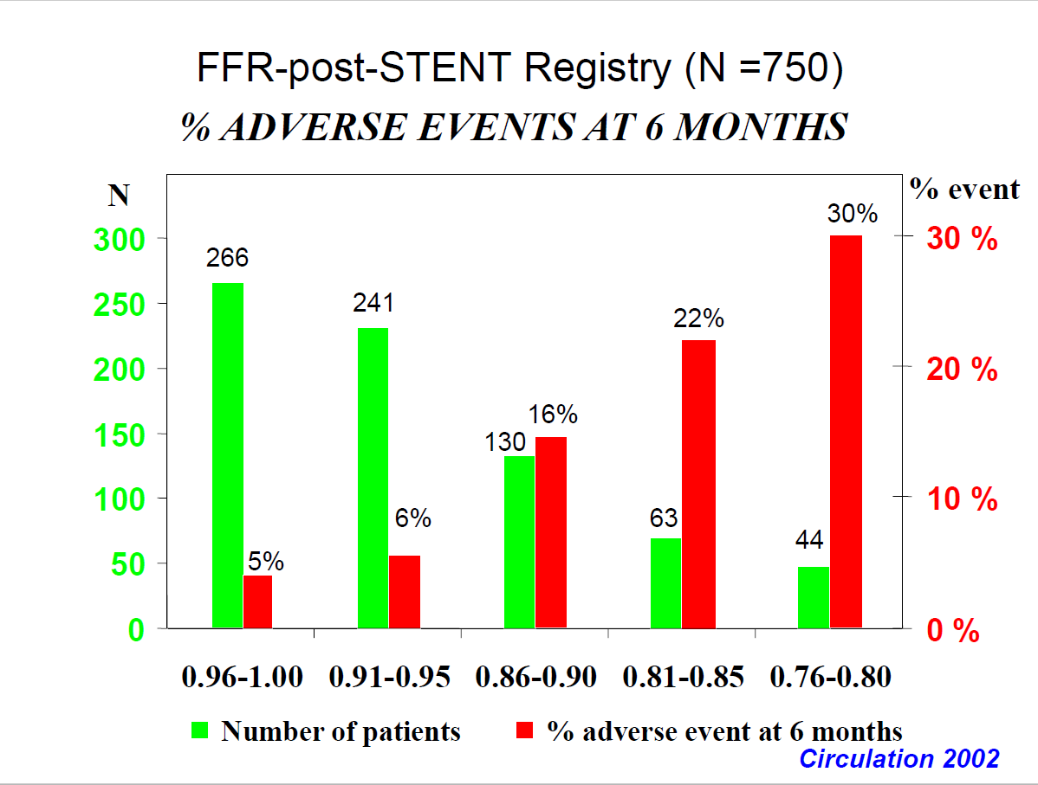
Background (III)
Low post-PCI FFR is related to adverse events
Pijls N., et al. Circulation. 2002;105:2950-54.
Lee JM., et al. J Am Coll Cardiol Intv. 2018;11:2099–109.

Slide 6
Study Objectives
How often do patients leave the cardiac cath lab with significant residual ischemia (i.e. iFR ≤0.89), despite angiographically satisfactory results?
Why are the post PCI values ≤0.89?
Missed focal lesion (‘physiologic miss’), stent related, diffuse disease
What is the impact of residual ischemia on patient outcomes?
MACE, recurrent angina, and quality of life
(ongoing follow-up)
Notes:
iFR allows rapid assessment of the lesion without hyperemia, with pullback capability to interrogate the entire artery

Slide 7
Study Endpoints
Primary Endpoint
Rate of residual ischemia (iFR ≤0.89) after operator-assessed angiographically successful PCI (residual DS<50% in any treated lesion)
Secondary Endpoints
Correlation between iFR ≤0.89 and coronary stenosis >50%
Differentiation of the cause for impaired iFR (categorized as stent related, distant focal stenosis, or diffuse atherosclerosis)
Proportion of cases in which the iFR would become non-significant if a focal stenosis demonstrated by iFR pullback were treated with PCI
Predictors of impaired post PCI iFR

Slide 8
Study
Leadership
Study Chairman
Gregg W. Stone, Columbia University Medical Center
Principal Investigators
Allen Jeremias, St. Francis Hospital, Roslyn, NY
Justin Davies, Imperial College London
Manesh Patel, Duke Health Care System
Steering Committee
Habib Samady, Emory University
Andrew Sharp, Royal Devon and Exeter
Arnold Seto, VAMC, Long Beach, CA
Clinical Events Committee
Cardiovascular Research Foundation, New York, NY; Steven O. Marx, MD, chair
Physiology Core Laboratory
Allen Jeremias, Cardiovascular Research Foundation, New York, NY
Akiko Maehara, Cardiovascular Research Foundation, New York, NY
Mitsuaki Matsumura, Cardiovascular Research Foundation, New York, NY
Angiography Core Laboratory
Ziad Ali, Cardiovascular Research Foundation, New York, NY
Sponsor
Philips/Volcano, Amsterdam, The Netherlands

Slide 9
International, prospective, observational multi-center study
Inclusion Criteria
Pts with stable or unstable angina
Lesions of ≥40% angiographic severity
Single vessel CAD with long lesion (≥20 mm), multi-lesion CAD of a single vessel or multi-vessel CAD
Pre-PCI iFR performed in all vessels with angiographic lesion severity of ≥40%
Exclusion Criteria
STEMI within past 7 days
Cardiogenic shock
Ventricular arrhythmias
Prior CABG
CTO
EF < 30%
Severe valvular heart disease
TIMI flow <3 at baseline or post PCI
Intra-coronary thrombus on baseline angiography
Procedural complications
iFR ≤0.89 in 1 or more vessel
PCI of all vessels with abnormal baseline iFR
Angiographic confirmation of PCI result
Blinded iFR and blinded iFR pullback at end of procedure

Slide 10
DEFINE PCI
Patients with stable and unstable angina (N = 500)
iFR of all vessels with angiographic lesions ≥ 40% stenosis
Baseline iFR ≤0.89
Baseline iFR >0.89
Standard of care algorithm for PCI as per local operators
(Intravascular imaging optional)
Guideline Directed Medical Therapy
Successful angiographic PCI result
Blinded final iFR with iFR pullback
Guideline Directed Medical Therapy
30 day, 6 month & 1 year follow up

Slide 11
DEFINE PCI: Total enrollment 500 pts in 27 US and European Sites
Top 15 Enrolling Centers
North Carolina Heart & Vascular (J. Schneider)
Essex Cardiothoracic Centre (K. Tang)
Royal Bournemouth Hospital (S. Talwar)
VU University Medical Center (K. Marques)
Midwest Cardiovascular Research Foundation (N. Shammas)
Northwell Health (L. Gruberg)
Colorado Heart & Vascular (J. Altman)
Dartmouth Hitchcock (J. Jayne)
VAMC Long Beach (A. Seto)
VAMC Atlanta (G. Kumar)
AMC Amsterfdam (J. Piek)
St. Francis Hospital (R. Schlofmitz)
Minneapolis Heart Institute (E. Brilakis)
Royal Devon & Exeter (A. Sharp)
Stony Brook University Hospital (W. Lawson)
67
50
40
36
32
32
26
25
25
22
18
17
17
15
13

Slide 12
Study Methods (I)
Blinding was achieved by turning off monitor in procedure room with guidance of measurements by unblinded research staff in control room
Pullback performed manually under continuous fluoroscopy with bookmarks inserted 5 mm distal and proximal to stent for core lab analysis
A final drift check was performed and recorded; if drift exceeded >0.02 units, the wire was re-equalized and all measurements were repeated
All pressure tracings were sent to the physiology and angiography core laboratories at CRF (New York, NY) for centralized independent review

Slide 13
Study Methods (II)
Each tracing was assessed for quality, including evaluation of aortic and coronary pressure signal for wave-form distortion and ventricularization
Trans-stenotic pressure gradients in post-PCI iFR pullback were categorized according to their location (distal vessel, stented segment or proximal vessel) and classified into focal lesions or diffuse disease
Trans-stenotic pressure gradients of ≥0.03 units were categorized as focal lesions when their length was ≤15 mm and as diffuse disease when their length exceeded 15 mm
The angiographic core laboratory analyzed all angiograms before and after PCI using standard methods

Slide 14
Baseline Patient Characteristics
 | N = 500 Patients
Age (years) | 66.4 ± 9.9
Male | 379 (75.8%)
Diabetes mellitus | 169 (33.8%)
Prior PCI | 227 (45.4%)
Prior myocardial infarction | 134 (26.8%)
Left ventricular ejection fraction (%) | 56.3 ± 9.0
Clinical presentation
Stable angina | 212 (42.4%)
Silent ischemia | 27 (5.4%)
Unstable angina | 155 (31.0%)
NSTEMI | 85 (17.0%)
Recent STEMI (>7 days) | 21 (4.2%)

Slide 15
Baseline Procedural Characteristics
 | N = 562 Vessels
Left anterior descending artery | 342 (60.9%)
Multivessel PCI performed (≥2 vessels) | 60 (12.0%)
Bifurcation lesion | 188/557 (33.8%)
Lesion length (mm) | 23.6 ± 13.6
Pre-PCI diameter stenosis (%) | 67.4 ± 11.1
Post-PCI diameter stenosis (%) | 24.3 ± 15.0
Post-PCI residual stenosis ≥50% | 39/560 (7.0%)
Total number of stents used | 1.4 ± 0.8
Total stent length (mm) | 32.9 ± 19.5
Maximum device size (mm) | 3.3 ± 2.2
Maximum balloon pressure (atm) | 17.8 ± 4.0
Post-dilatation performed | 324/553 (58.6%)

Slide 16
Pre- and Post-PCI iFR in Individual Vessels
0.89
0.93 ± 0.07
iFR
0.69 ± 0.22
iFR increased post-PCI
iFR decreased post-PCI
Pre-PCI iFR
Post-PCI iFR
Pre-PCI
Post-PCI

Slide 17
iFR Gain in Individual Pts from Pre- to Post-PCI
0.89
iFR Gain
 | Change in iFR
Average | 0.24±0.23
Minimum | -0.07
Maximum | 0.86
Number of Vessels

Slide 18
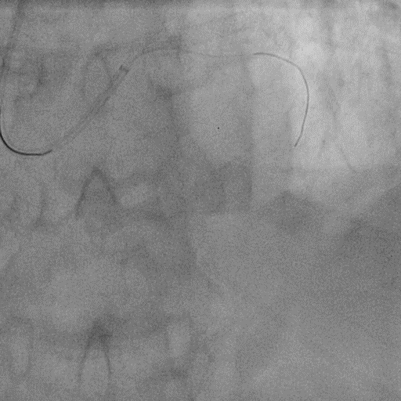
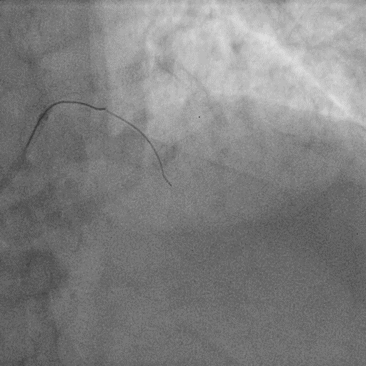
Case Example – Severe LAD Stenosis
Pre Angiogram
Final Angiogram

Slide 19
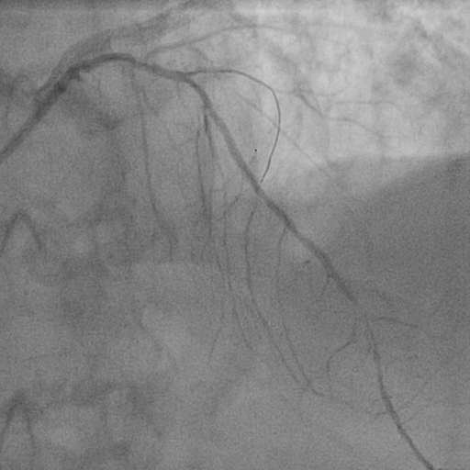
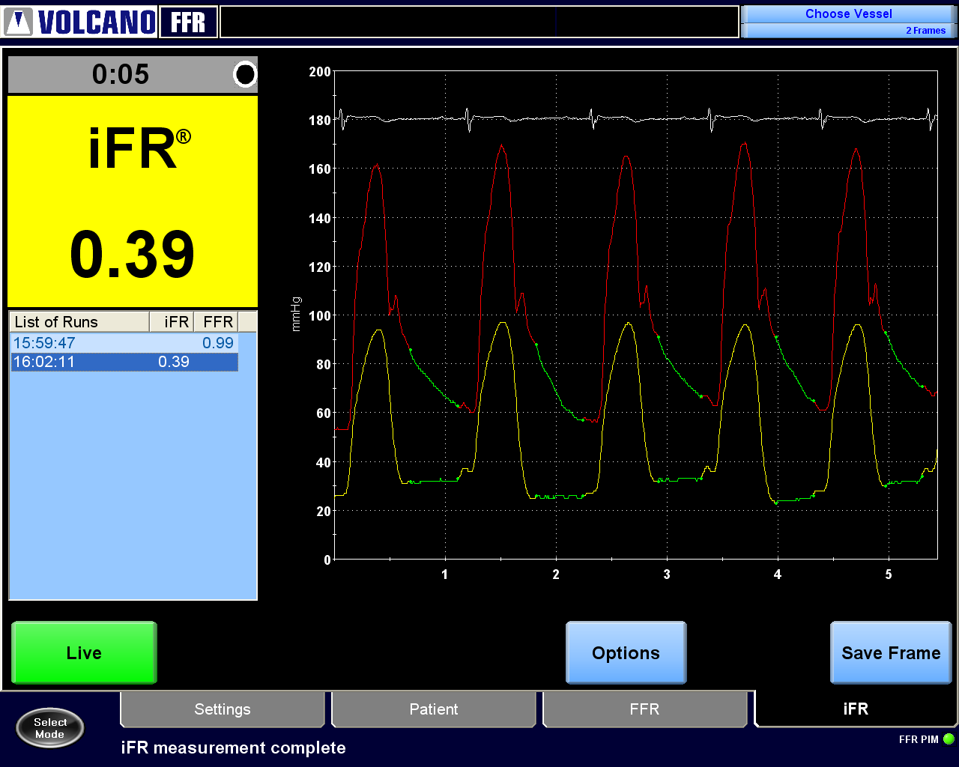

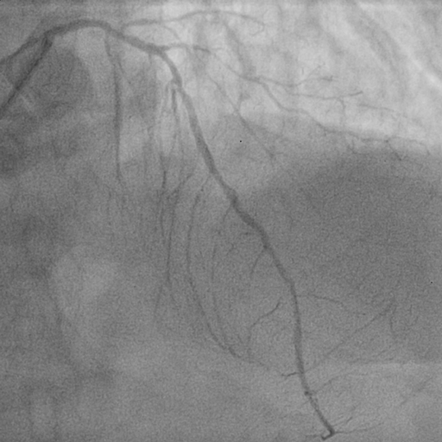
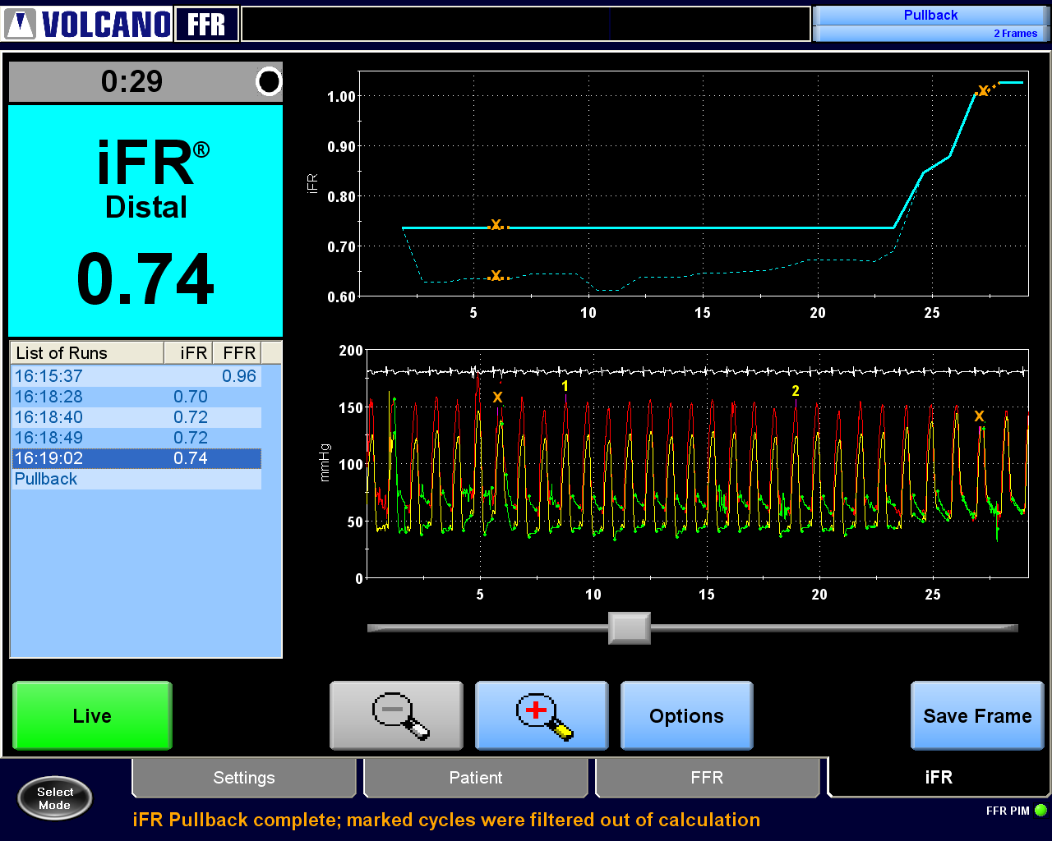

Case Example – Severe LAD Stenosis
Pre-PCI
iFR: 0.39
Distal
Proximal
Post-PCI
(Blinded
Physiology)
Stent + 5 mm Reference Segment
Δ0.26
Stent
Stent
iFR: 0.74

Slide 20
Primary Study Endpoint
467 Patients with Angiographically Successful PCI
and qualified iFR pullbacks
24% Residual Ischemia
(112 patients with Post PCI iFR≤0.89)
24%
Post PCI ≤0.89
Focal defined as step-up of ≥0.03 units in ≤15 mm segment
Diffuse defined as >15 mm segment

Slide 21
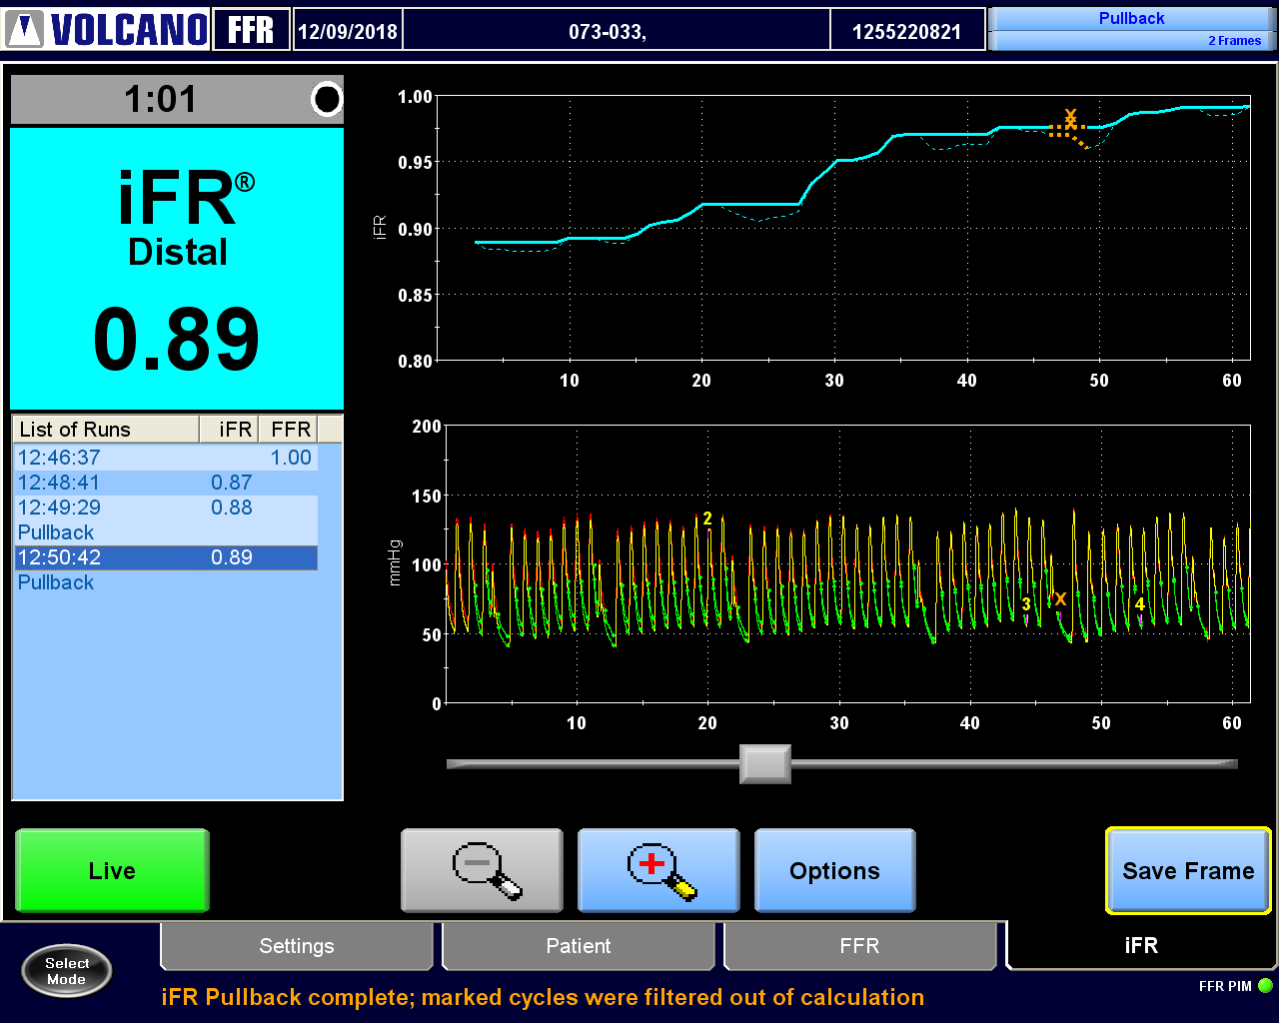
Focal Residual Pressure Gradient in-stent
Among the 93 vessels with focal disease, there were 146 segments (stent, proximal or distal) that had significant residual pressure gradients
Distal
Proximal
Δ0.05
Focal Step-up
Stent + 5 mm Reference Segment
iFR
0.97
iFR
0.98
iFR
0.99
iFR
0.89
iFR
0.92
Focal Stenosis
Stent + 5 mm
Reference Segment
1
2

Slide 22

Focal Residual Pressure Gradient Prox to stent
‘Physiologic miss’ occurred in 31.5% of focal lesions proximally
Distal
Proximal
Δ0.26
Stent + 5 mm Reference Segment
Focal Step-up
iFR
1.03
iFR
0.74
iFR
0.74
iFR
0.74
Focal Stenosis
Stent
Stent + 5 mm
Reference Segment
1
2

Slide 23
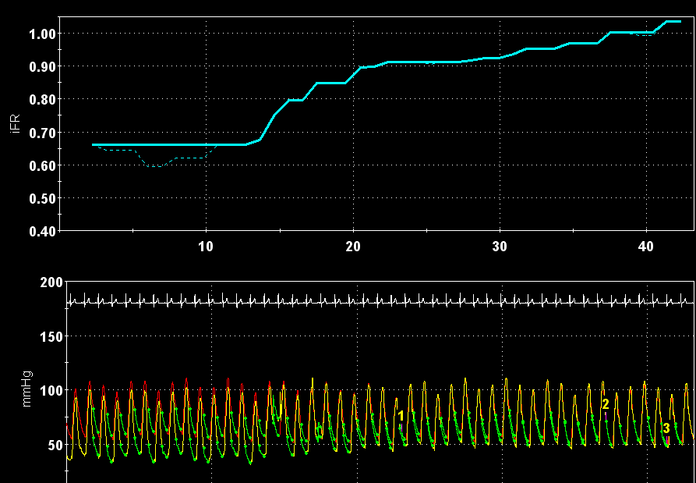

Focal Residual Pressure Gradient Distal to stent
‘Physiologic miss’ occurred in 30.1% of focal lesions distally
Distal
Proximal
Δ0.25
Focal Step-up
Stent + 5 mm Reference Segment
iFR
1.00
iFR
0.91
iFR
0.95
iFR
0.66
Focal Stenosis
Stent
Stent + 5 mm
Reference Segment
1
2

Slide 24
Focal Residual Pressure Gradient Distal to stent
‘Physiologic miss’ occurred in 30.1% of focal lesions distally
Distal
Proximal
If all residual focal lesions could be treated with additional PCI, the rate of significant ischemia could be theoretically reduced from 24% to 5%
Δ0.25
Focal Step-up
Stent + 5 mm Reference Segment
iFR
1.00
iFR
0.91
iFR
0.95
iFR
0.66
Stent
Stent + 5 mm
Reference Segment
Focal Stenosis
1
2

Slide 25
Angiographic diameter stenosis correlates poorly with post PCI iFR
 | Residual DS ≥50% | Residual DS <50% | P-Value
iFR ≤0.89 | 29.7% | 21.4% | 0.24
Predictors of post-PCI iFR≤0.89 by multi-variate analysis
 | OR | 95% CI | P-value
Reference Vessel Diameter | 0.32 | 0.18-0.58 | 0.0002
LAD | 5.65 | 3.07-10.40 | <0.0001
Post-PCI DS | 1.01 | 1.00-1.03 | 0.08
Notes:
modeled to improve from 0.84 ± 0.06 to 0.95 ± 0.05

Slide 26
Limitations
Intravascular imaging was not routinely performed, and thus the specific stent-related and untreated lesion-related characteristics that contributed to the decrement in pressure gradient are unknown
Given the specific enrollment criteria, the actual proportion of “real-world” cases in which post-PCI physiology could be further optimized with additional PCI remains speculative

Slide 27
Conclusions
Significant epicardial residual ischemia after angiographically successful PCI is not uncommon, occurring in nearly 25% of patients in the present study
Post-PCI angiography poorly correlated with physiologic measures
In a large majority of cases residual pressure gradients were focal and thus potentially amenable to treatment with additional PCI

Slide 28
DEFINE GPS (Guided Physiologic Stenting)
iFR Guided Therapy
Standard of Care
iFR Pullback with SyncVision
Angiographically Guided PCI
PCI based on SyncVision Plan
Baseline Physiology & Intravascular Imaging Optional

