Slide 1

Left Atrial Appendage Closure or Anticoagulation for Atrial Fibrillaton: The CHAMPION-AF Clinical Trial
Saibal Kar, MD and Shephal K. Doshi, MD
Los Robles Medical Center, CA and Cedars Sinai Smidt Heart Institute, CA
On behalf of the CHAMPION-AF investigators

Slide 2
Disclosures for Saibal Kar
Grants and institutional research support: Abbott, Boston Scientific, Johnson & Johnson, Medtronic, InterShunt, Sierra Valve, HighLife Medical, inQB8 Med Technologies, Edwards Lifescience, CARDIOMECH, Occlutech
Consulting fees/honoraria: Abbott, Boston Scientific, W.L. Gore, and Medtronic, Johnson & Johnson
Steering committee member: Elite AF trial (Boston Scientific), TRILUMINATE trial (Abbott).
National principal investigator: CHAMPION Trial, SIMPLAAFY (Boston Scientific), EXPAND & REPAIR MR (Abbott), Laminar LAA Elimination Pivotal Study ( Johnson & Johnson), ASCENT ASD Study ( atHeart Medical), STAR-US study( Microinterventional Devices)
The CHAMPION AF trial was funded by Boston Scientific Corporation

Slide 3
Background and Purpose
Non-vitamin K oral anticoagulants (NOACs) reduce thromboembolic events in patients with atrial fibrillation (AF), but are limited by compliance, cost and bleeding.
Left atrial appendage closure (LAAC) may be considered in AF patients who are poor candidates for long-term NOACs.
The purpose of CHAMPION-AF, is to determine if LAAC using the Watchman FLX™ is a reasonable alternative in AF patients deemed suitable for long-term NOACs.

Slide 4
CHAMPION-AF Trial Design
3000 Randomized Patients (1:1)
Non-valvular AF suitable for long-term NOACs
CHA₂DS₂-VASc score of ≥2 for males or ≥3 for females
3mo NOAC
± ASA /DAPT
LAAC (WATCHMAN FLX)
(ASA for remainder of trial)
Randomization
NOAC Rx
(NOAC per label for duration of trial)
0
3m
4m
1y
2y
3y
4y
5y
SAPT
Imaging FU
Primary endpts: efficacy & safety
Secondary endpts: major bleeding & net clinical benefit
Primary endpts: efficacy
Secondary endpts: safety & net clinical benefit
Kar S, Doshi SK,…Leon MB. Am Heart J 2023; 264:123-132

Slide 5



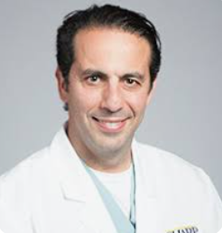
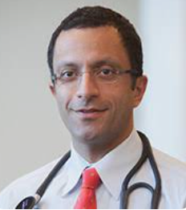

CHAMPION-AF Trial Leadership & Top Enrollers
Co-PIs: Shephal Doshi and Saibal Kar
Co-Chairs: Kenneth Ellenbogen and Martin Leon
Steering Committee: Mohamad Alkhouli, John Camm, Megan Coylewright, Michael Gibson, Christopher Granger, Edip Gurol, Kenneth Huber, Moussa Mansour, Devi Nair, Andrea Natale, Stuart Pocock, Vivek Reddy, Walid Saliba
Core Lab: Federico Asch, Medstar Health Research Institute
Data Monitoring Committee: Joseph Kannam (Chair), Viken Babikian, Wendy Shear, Richard Asinger, Christopher Pulling
Clinical Events Committee: Michael Manoles (Chair), Robert Taylor, Alejandro Rabinstein, John Schoenhard, Jonathan Kleefield
Top Enrollers:
Devi Nair, MD
Arrhythmia Research Group
Jonesboro, AR
Thomas E. Waggoner, DO
Pima Heart Physicians
US Heart & Vascular
Tucson, AZ
Himanshu Agarwal, MD
Bergan Cardiology
Omaha, NE
Mehran Moussavian, MD
Cardiovascular Institute
of San Diego
Chula Vista, CA
Amir Kashani, MD
Memorial Hermann
Memorial City Medical Ctr
Houston, TX
Saumil Oza, MD
Ascension St. Vincent’s
Jacksonville, FL

Slide 6
CHAMPION-AF Primary Endpoints
Three-year Endpoints
Primary Efficacy (non-inferiority):
Cardiovascular death, stroke, and systemic embolism
Primary Safety (superiority):
Non-procedural ISTH major and modified* ISTH clinically relevant non-major bleeding
Five-year Endpoints
Primary Efficacy (non-inferiority):
Ischemic stroke and systemic embolism
Study success: meeting the three-year primary endpoints
International Society on Thrombosis and Heamostasis (ISTH) major bleeding: symptomatic and (1) fatal and/or (2) in a critical organ/area and/or (3) causes a fall in hemoglobin ≥2 g/dL leading to transfusion of ≥2 units of whole blood or red cells.
*Modified ISTH clinically relevant non-major bleeding: does not fit criteria for the ISTH definition of major bleeding but requires hospitalization or increased level of care.

Slide 7
Study Methodology
Primary Efficacy Endpoint at 3 Years
Non-inferiority hypothesis
Expected rates: 12% in each group
Absolute non-inferiority margin: 4.8% (relative margin 40%)
Statistical Power and sample size
Given a 12.5% expected attrition rate and a 1-sided test significance level (α) of 2.5%, a sample size of 3000 patients provided a 90% power for primary efficacy analysis

Slide 8
CHAMPION-AF Secondary Endpoints
Three-year Endpoints
Secondary Safety (non-inferiority):
Procedural and non-procedural ISTH major bleeding
Secondary Net Clinical Benefit (non-inferiority):
Cardiovascular death, stroke, systemic embolism, and non-procedural ISTH major and modified* ISTH clinically-relevant non-major bleeding
Five-year Endpoints
Secondary Safety (superiority):
Procedural and non-procedural ISTH major bleeding
Secondary Net Clinical Benefit (superiority):
Cardiovascular death, stroke, systemic embolism, and non-procedural ISTH major and modified* ISTH clinically-relevant non-major bleeding
International Society on Thrombosis and Heamostasis (ISTH) major bleeding: symptomatic and (1) fatal and/or (2) in a critical organ/area and/or (3) causes a fall in hemoglobin ≥2 g/dL leading to transfusion of ≥2 units of whole blood or red cells.
*Modified ISTH clinically relevant non-major bleeding: does not fit criteria for the ISTH definition of major bleeding but requires hospitalization or increased level of care.
Notes:
We also have secondary safety and net clinical benefit endpoints that will be discussed with the results

Slide 9
Study Flow
3000 eligible pts; 1:1 randomization
NOAC
N=1501 ITT
LAAC
N=1499 ITT
Reasons for no implant
46 withdrew prior to implant
23 unsuitable anatomy
22 unsuccessful implant
21 other reasons
1501 treated as assigned
1386 received LAAC
115 withdrew
64 lost to follow-up
17 other
61 withdrew post-implant
41 lost to follow-up
7 other
Reached 3 years or an endpoint event
N=1305 ITT
Reached 3 years or an endpoint event
N=1390 ITT

Slide 10
Baseline Characteristics
 | NOAC (n=1501) | LAAC (n=1499)
Age, yr, avg ± SD | 71.8±7.5 | 71.6±7.5
Female | 31.5% | 32.4%
Caucasian | 85.0% | 85.1%
CHA₂DS₂-VASc score, avg ± SD | 3.5±1.3 | 3.5±1.2
2 | 23.3% | 23.7%
3-4 | 58.4% | 57.6%
≥5 | 18.4% | 18.6%
HAS-BLED score, avg ± SD | 1.3±0.8 | 1.3±0.8
Prior ischemic stroke | 7.6% | 7.9%
Prior hemorrhagic stroke | 0.7% | 0.3%
History of congestive heart failure | 22.4% | 21.2%
History of major bleeding | 3.3% | 3.5%
Paroxysmal AF | 68.5% | 69.3%
Persistent AF | 25.4% | 23.9%
Permanent AF | 6.1% | 6.8%
Prior AF ablation | 46.9% | 48.7%

Slide 11
LAAC Procedural Characteristics
LAAC Procedure | Attempted Implants (n=1408)
Successful implant (deployed, released) | 98.8%
General anesthesia | 84.4%
Procedural imaging | n=1386
TEE | 87.1%
ICE | 9.5%
Discharge medication
NOAC | 85.0%
DAPT | 12.6%
Serious Adverse Events | Attempted Implants (n=1408)
Within 7 days of procedure
Death | 0% (0)
Stroke | 0.1% (1)
Systemic embolism | 0% (0)
Pericardial effusion requiring intervention | 0.6% (8)
Other major bleeding | 0.4% (5)
Device embolization | 0% (0)
Values are % (number of patients)

Slide 12
Peri-Device Leak & Device-Related Thrombus
 | 4 months post-procedure analyzable images
Peri-Device Leak | n=1,012
≤3 mm | 98.6% (998)
>3 to ≤5 mm | 1.4% (14)
>5 mm | 0% (0)
Device-Related Thrombus (DRT) | n=1,320
DRT | 4.8% (63)
Pedunculated | 0.9% (12)
DRT and NOAC resumption | 1.8% (24)
DRT followed by stroke | 0.2% (2)
1.8%
3.0%
Values are % (number of patients)
Results are core lab adjudicated and include those with CT (18.3%) or TEE (81.7%) imaging

Slide 13
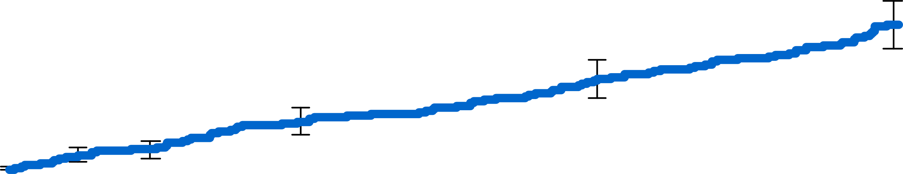
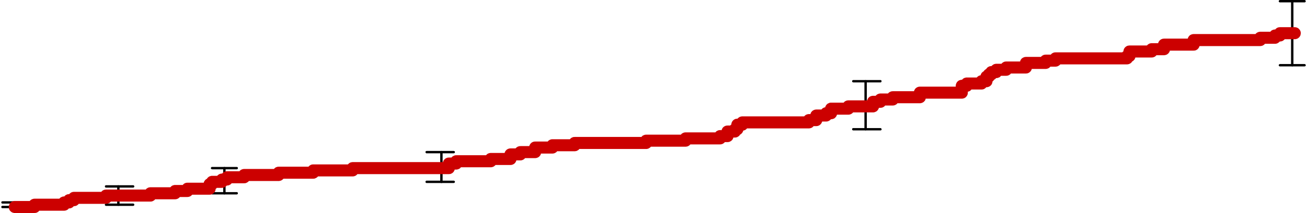
Primary Efficacy Endpoint
Cardiovascular death, stroke or systemic embolism
LAAC
5.7%
P<0.001 (non-inferiority)
4.8%
NI margin
4.8%
NOAC
Percentage of Patients
0.9%
2.6%*
1
2
3
HR [95% CI]: 1.20 [0.87, 1.66]
Intergroup difference
1
2
3
Years post-randomization
No. at risk
LAAC | 1499 |  | 1430 |  | 1395 |  | 1326
NOAC | 1501 |  | 1394 |  | 1344 |  | 1254
*1-sided 97.5% Z upper confidence bound = 2.6%
KM Event Rate ± 1.5 SE

Slide 14
Primary Efficacy Endpoint Components
 | NOAC (n=1501) | LAAC (n=1499) | Hazard Ratio [95% CI]
Cardiovascular death | 2.7% (36) | 2.7% (38) | 1.01 [0.64, 1.59]
Stroke | 2.5% (33) | 3.6% (50) | 1.46 [0.94, 2.27]
Ischemic | 2.0% (27) | 3.2% (45) | 1.61 [1.00, 2.59]
Hemorrhagic | 0.4% (5) | 0.4% (5) | 0.96 [0.28, 3.32]
Undetermined | 0.1% (1) | 0% (0) | 0.00 [NA, NA]
Systemic embolism | 0.1% (2) | 0% (0) | 0.00 [NA, NA]
Values are Kaplan-Meier estimate (number of patients)
The annual average difference in ischemic stroke & systemic embolism rates was 0.33%/year
87% of ITT NOAC patients were adherent to medications during a majority of follow-up
76% of ITT LAAC patients had a successful implant and were adherent to medications during a majority of follow-up

Slide 15
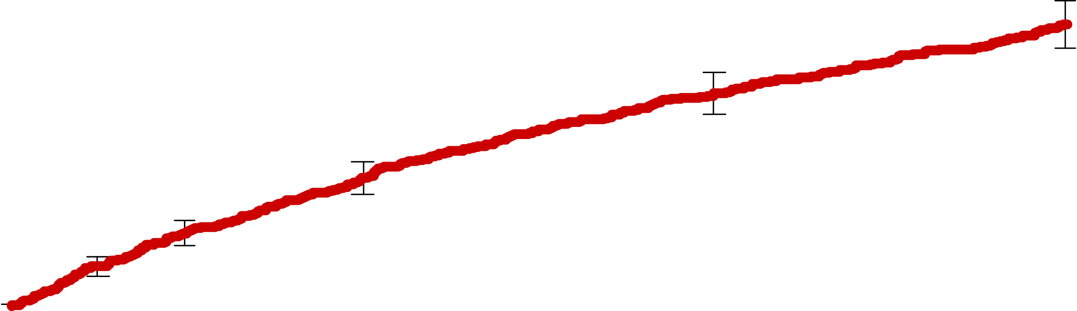
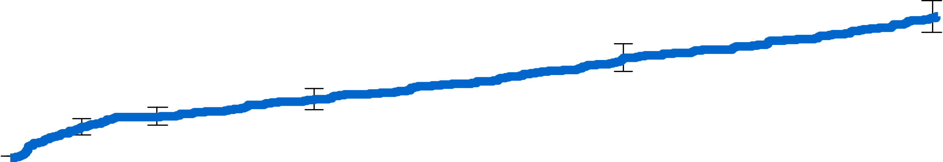
Primary Safety Endpoint
Non-procedural bleeding*
NOAC
19.0%
10.9%
Percentage of Patients
LAAC
HR [95% CI]: 0.55 [0.45, 0.67]
P<0.001 (superiority)
Years post-randomization
No. at risk
LAAC | 1499 |  | 1392 |  | 1349 |  | 1252
NOAC | 1501 |  | 1330 |  | 1236 |  | 1093
*ISTH major and modified clinically relevant non-major
KM Event Rate ± 1.5 SE; log-rank P value

Slide 16
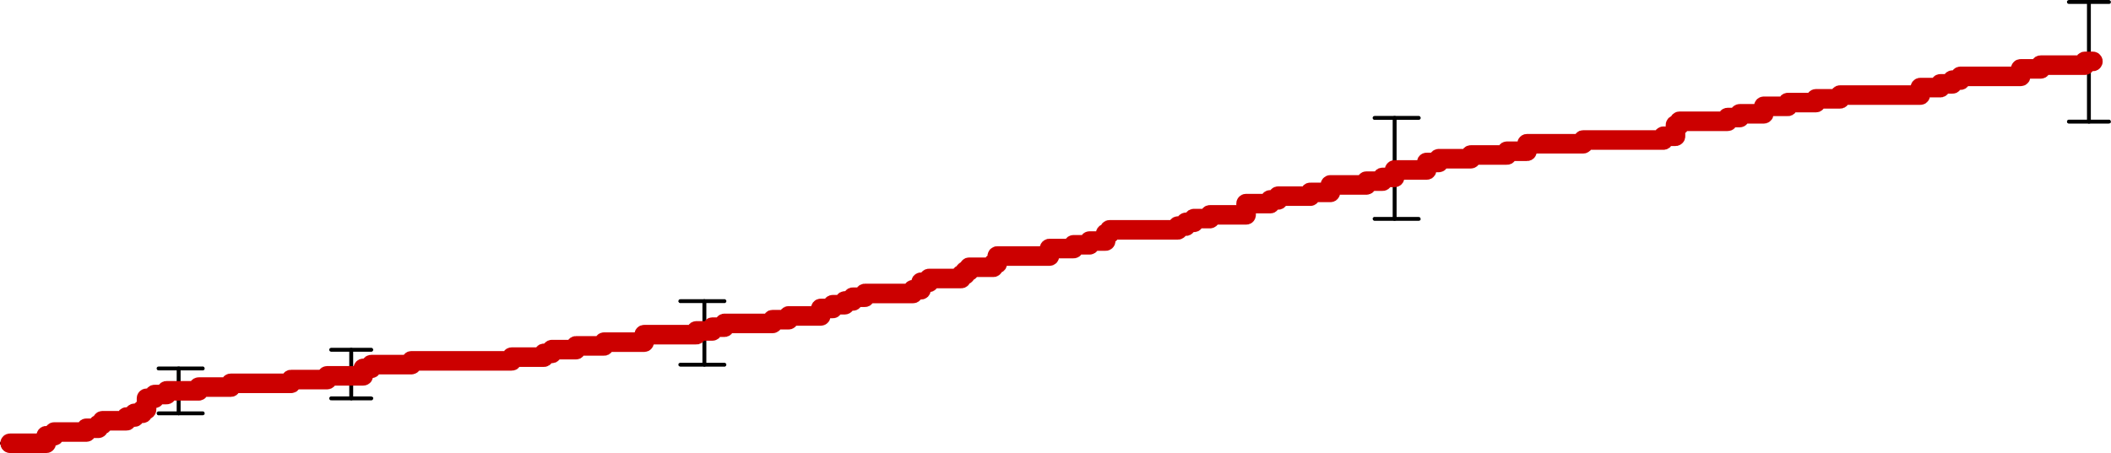
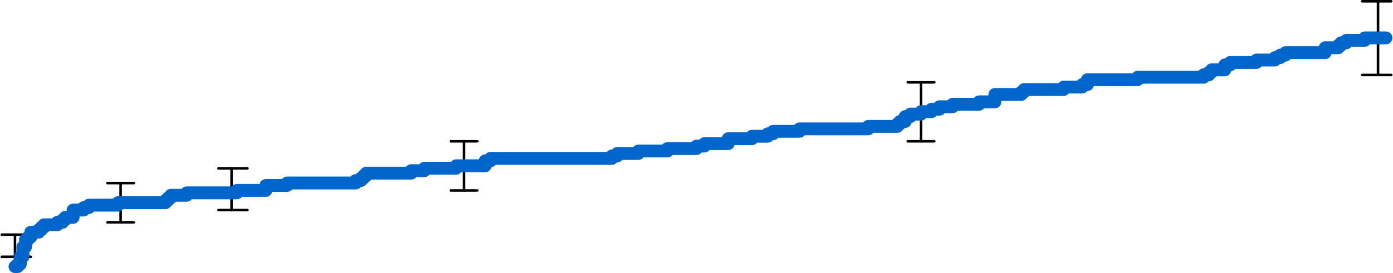
Secondary Safety Endpoint
ISTH major bleeding (procedural and non-procedural)
6.4%
NOAC
5.9%
LAAC
P<0.001 (non-inferiority)
Percentage of Patients
NI margin
4.8%
HR [95% CI]: 0.92 [0.68, 1.24]
-0.6%
1.2%*
Intergroup difference
Years post-randomization
No. at risk
LAAC | 1499 |  | 1430 |  | 1395 |  | 1329
NOAC | 1501 |  | 1394 |  | 1344 |  | 1254
*1-sided 97.5% Z upper confidence bound = 1.2%
KM Event Rate ± 1.5 SE

Slide 17
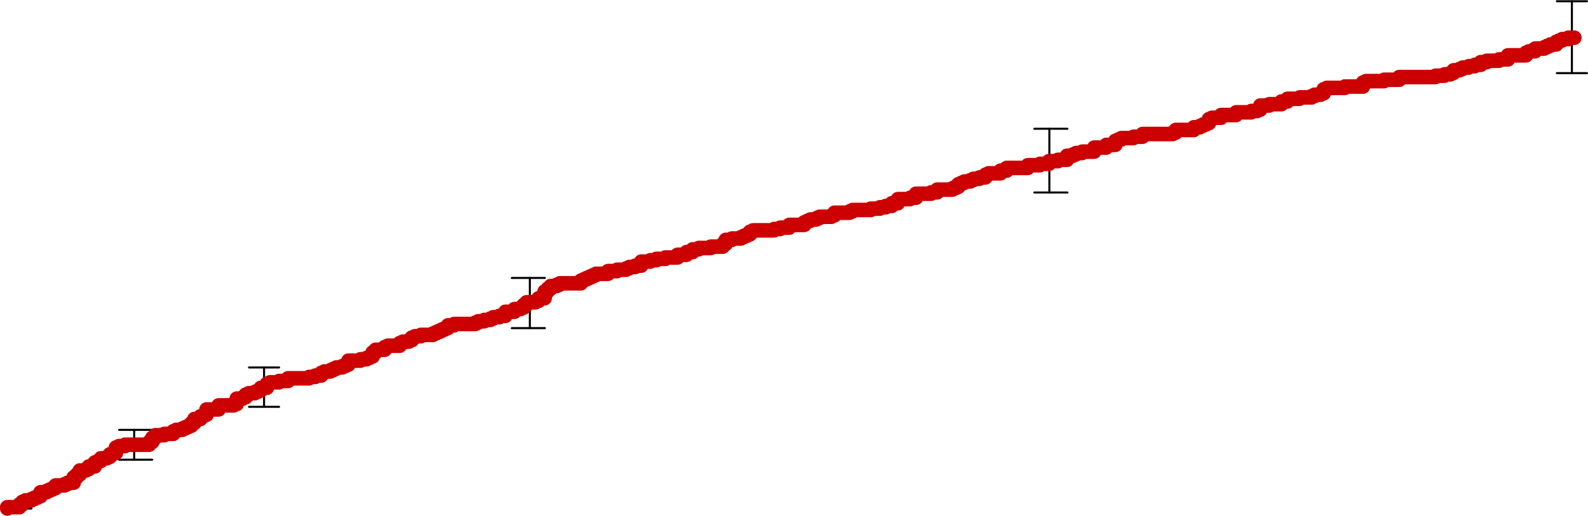
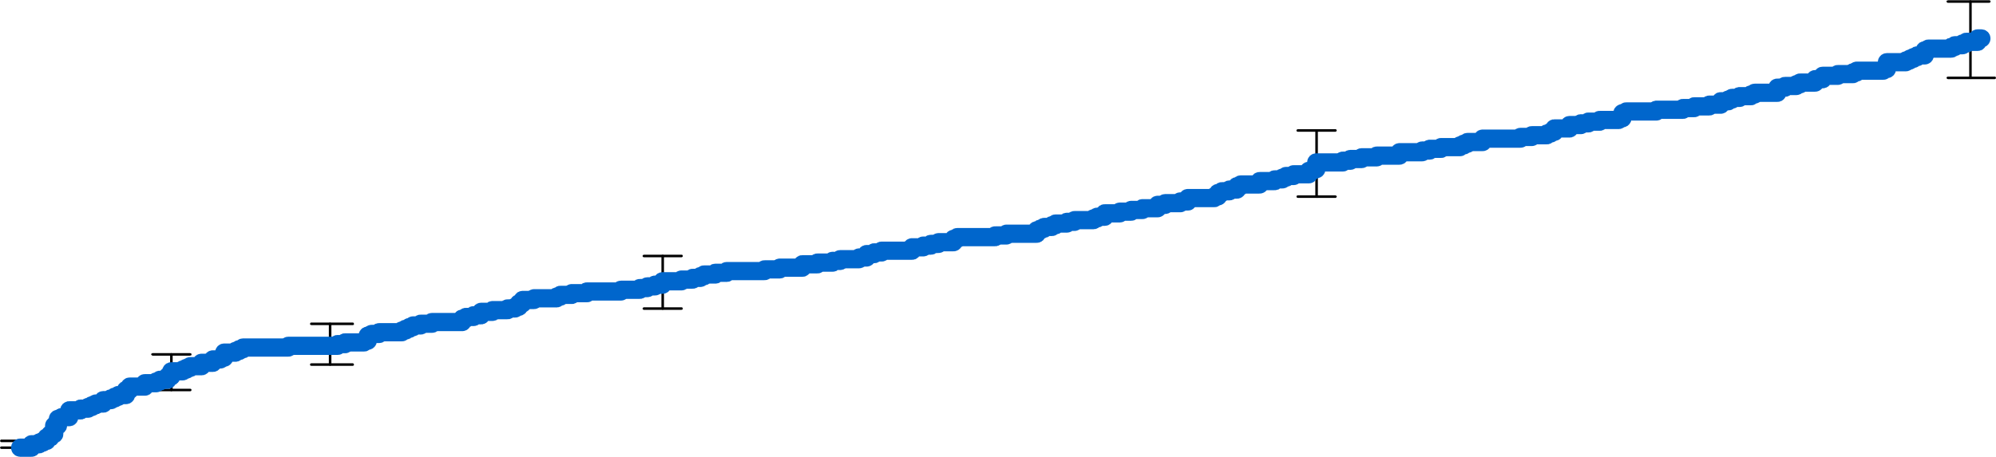
Secondary Net Clinical Benefit Endpoint
Cardiovascular death, stroke, systemic embolism and non-procedural bleeding
21.8%
NOAC
15.1%
LAAC
P<0.001 (non-inferiority)
Percentage of Patients
NI margin
9.6%
HR [95% CI]: 0.66 [0.56, 0.79]
-6.7%
-3.8*
P<0.001 (superiority)
Intergroup difference
Years post-randomization
No. at risk
LAAC | 1499 |  | 1388 |  | 1339 |  | 1237
NOAC | 1501 |  | 1328 |  | 1235 |  | 1088
*1-sided 97.5% Z upper confidence bound = -3.8%
KM Event Rate ± 1.5 SE

Slide 18
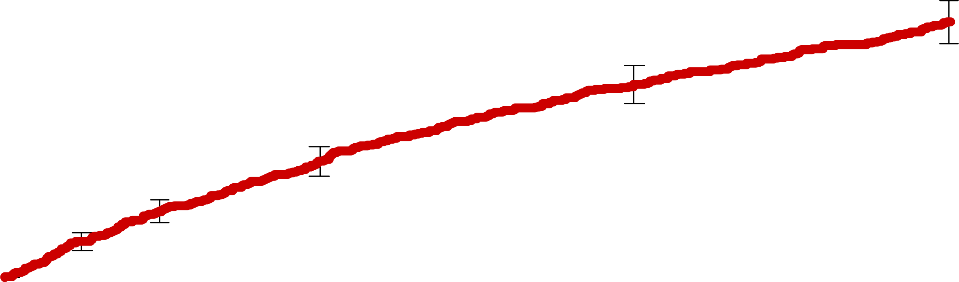
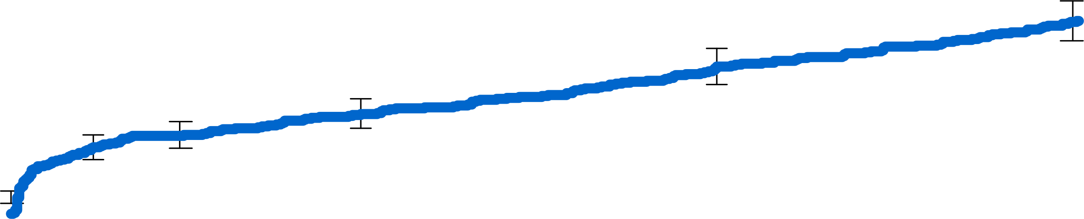
Procedural and Non-procedural Bleeding
ISTH major and modified clinically relevant non-major
NOAC
19.0%
12.8%
LAAC
P<0.001
Percentage of Patients
6m
Years post-randomization
No. at risk
LAAC | 1499 |  | 1412 |  | 1397 |  | 1334
NOAC | 1501 |  | 1382 |  | 1324 |  | 1212
KM Event Rate ± 1.5 SE

Slide 19
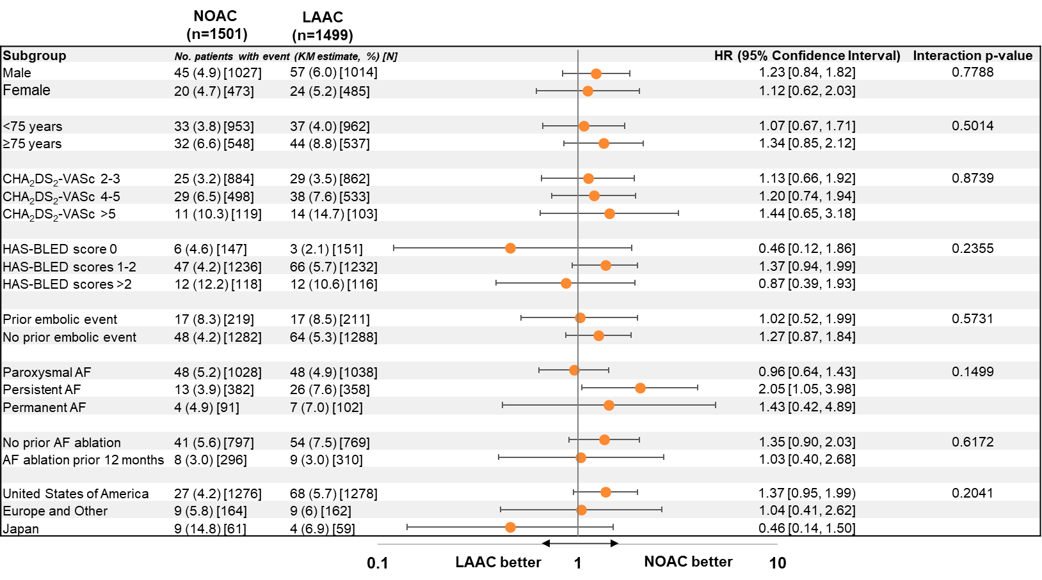
Pre-Specified Subgroups: Primary Efficacy

Slide 20
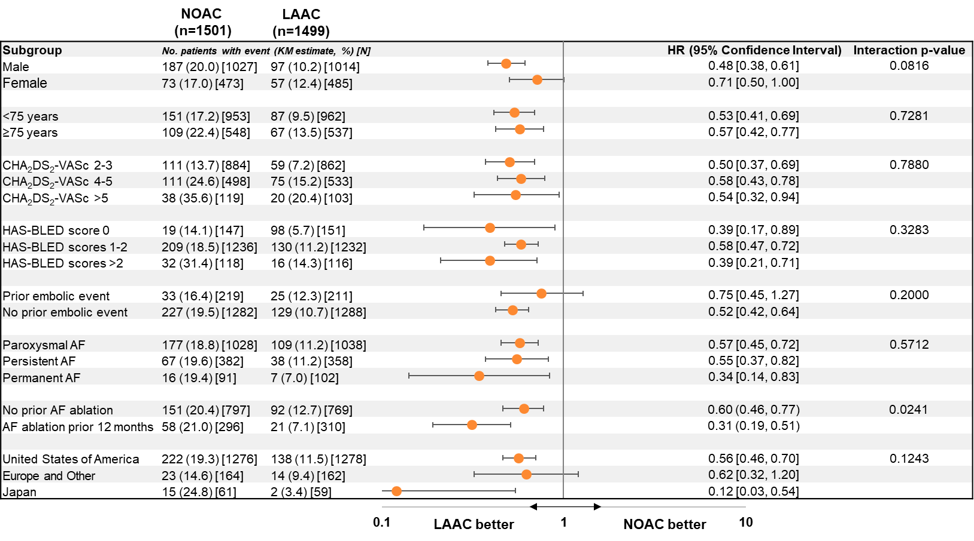
Pre-Specified Subgroups: Primary Safety

Slide 21
Limitations
Trial results may not apply to all LAAC devices and post-implant medication regimens.
Findings may not be generalizable to all AF patients; e.g. advanced heart failure and low EF (<30%) were exclusion criteria.
Non-inferiority margins for the primary efficacy endpoint were absolute and not relative. The lower-than-expected observed primary efficacy rate in the NOAC arm facilitated achieving statistical non-inferiority.

Slide 22
Conclusions
In patients with non-valvular AF deemed suitable for anticoagulation, left atrial appendage closure using WATCHMAN FLX at three years was…
Non-inferior to NOACs for the composite primary endpoint of cardiovascular death, stroke, and systemic embolism.
AND, significantly reduced clinically-relevant non-procedural bleeding.
The third primary endpoint assessing ALL thromboembolic events (stroke and systemic) will be reported at five years.

Slide 23
Clinical Implications
WATCHMAN FLX left atrial appendage closure may be considered as an alternative to NOACs in a shared decision-making process with atrial fibrillation patients who are deemed suitable for long-term oral anticoagulation!

Slide 24
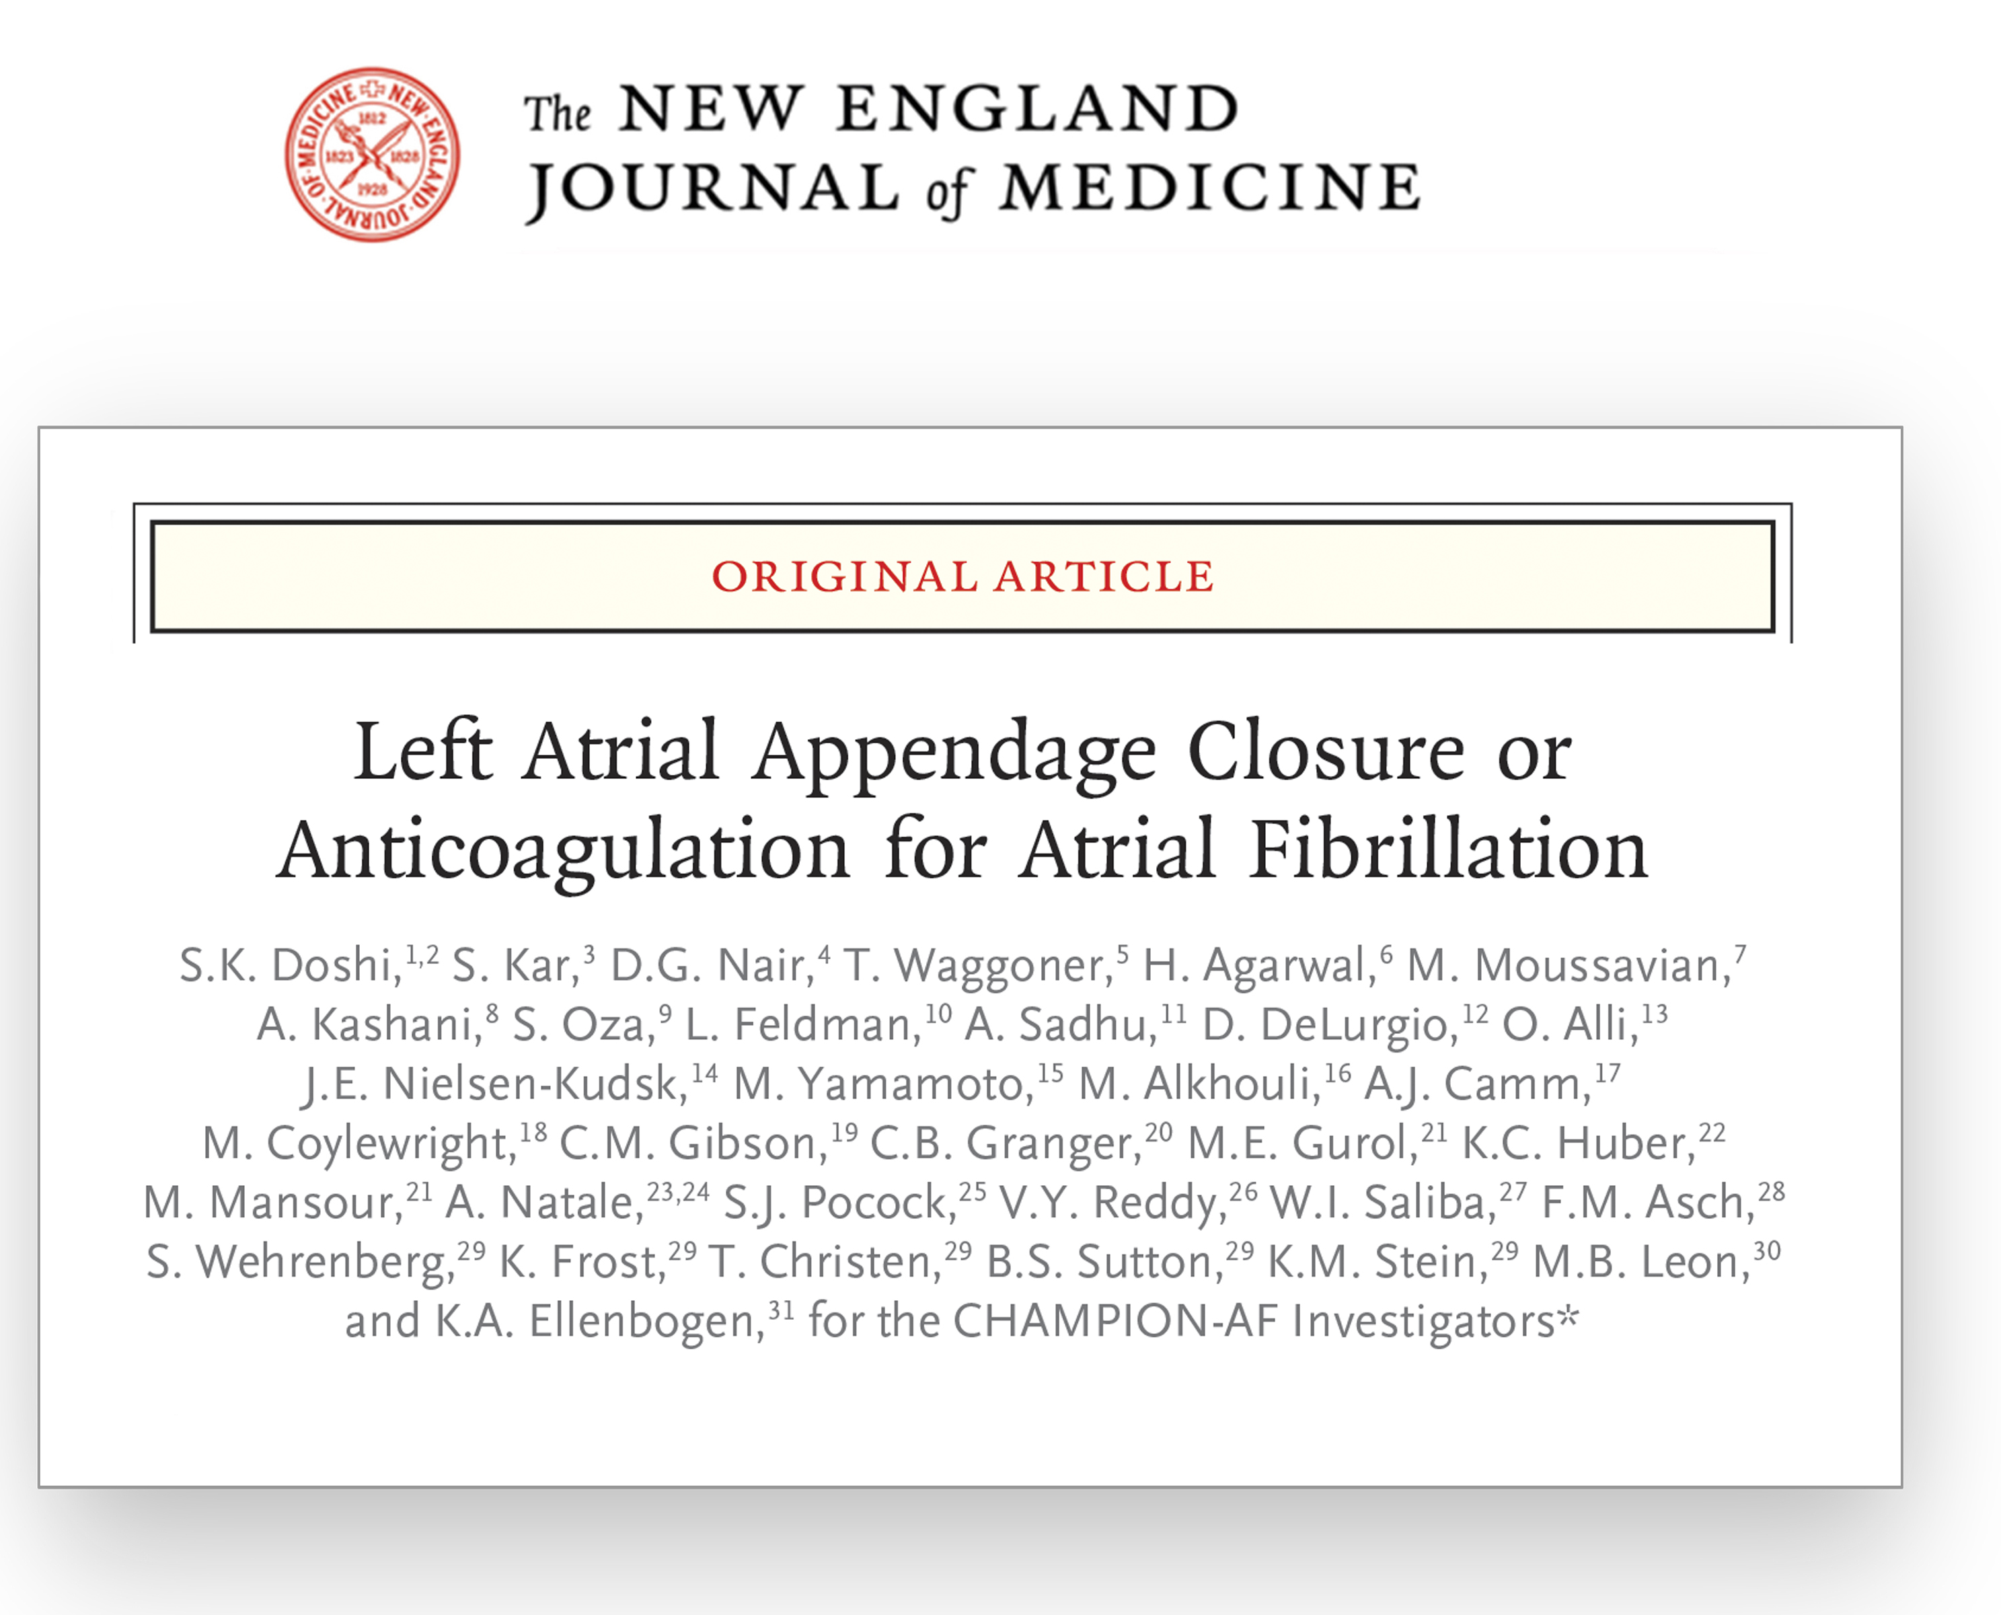


Slide 25
Thank you to the Sponsor (BSC) Investigators /Research Coordinators The patients who trusted us

Slide 26
CLOSURE AF
CLOSURE adds to the wealth of evidence showing that stroke rates are noninferior with LAAC vs NOAC: Prague—17, OPTION, CLOSURE and now CHAMPION.
Complications and early bleeding rates in CLOSURE do not reflect contemporary practice.
 | CHAMPION-AF | CLOSURE-AF
 | LAAC (n=1499) | LAAC (N=446)
Procedural adverse events* | within 7 days | Within 7 days or discharge
Pericardial tamponade or effusion requiring intervention | 0.6% | 1.1%
Major bleeding | 0.4% | 4.0%
Device embolization | 0% | 0.2%
TIA or stroke | 0.1% | 0.2%
Systemic embolism | 0% | 0.2%
Death | 0% | 0.5%
*Definitions of events may differ between trials

Slide 27
Recent Trials
 | CHAMPION-AF |  | CLOSURE-AF |  | OPTION-AF
 | LAAC (n=1499) | OAC (n=1501) | LAAC N=446 | OAC N=442 | LAAC (n=803) | OAC (n=797)
Population | Suitable for long-term OAC |  | High risk of stroke and bleeding |  | Recent or concomitant AF ablation
Age, yrs, avg ± SD or md (IQR) | 71.6 ± 7.5 | 71.8 ± 7.5 | 79.5 (74.6, 83.0) | 78.4 (72.8, 82.6) | 69.7 ± 7.4 | 69.4± 7.9
CHA₂DS₂-VASc, avg ± SD | 3.5 ± 1.2 | 3.5 ± 1.3 | 5.2 ± 1.5 | 5.1 ± 1.6 | 3.5 ± 1.3 | 3.5 ± 1.3
HAS-BLED, avg ± SD | 1.3 ± 0.8 | 1.3 ± 0.8 | 3.1 ± 0.9 | 3.0 ± 0.9 | 1.2 ± 0.8 | 1.2 ± 0.8
AF Type: Paroxysmal | 69.3% | 68.5% | -- | -- | 59.4% | 62.9%
AF Type: Persistent | 23.9% | 25.2% | -- | -- | 40.6% | 37.1%
 | Primary Findings |  | Primary Findings |  | Primary Findings
Primary Efficacy | CV/Unexp. death, stroke, SE (3-year KM estimate) |  | Stroke, SE, CV/Unexp. death, major bleeding, median f/u 3yrs |  | All-cause death, stroke, SE (3-year KM estimate)
 | 5.7% | 4.8% | 16.83/100 pt yrs | 13.27/100 pt yrs | 5.3% | 5.8%
Primary Safety | Non-procedural bleeding (3-year KM estimate) |  | -- |  | Major bleeding (3-year KM estimate)
 | 10.9% | 19.0% | -- | -- | 3.9% | 5.0%

