Slide 1

TCT Template
Title 30 pt Bold Arial
Prognostic Value of Post-PCI FFR and Intravascular Imaging in the FAME 3 Trial
Zsolt Piróth MD PhD FESC FACC
Gottsegen National Cardiovascular Center
Budapest, Hungary
On behalf of the FAME 3 investigators
John Doe, MD
Subtitle 25 pt Arial Bold Italics

Slide 2
Disclosure Statement of Financial Interest
Within the past 12 months, I or my spouse/partner have had a financial interest/arrangement or affiliation with the organization(s) listed below.
Affiliation/Financial Relationship | Company
Consulting Fees/Honoraria | Abbott, Boston Scientific, OpSens

Slide 3
Background
The prognostic value of measuring post-PCI FFR after DES implantation in patients with complex 3-vessel CAD is unknown
The impact of intravascular imaging (IVUS/OCT) is also poorly defined in this setting
Investigators were requested to measure post-PCI FFR and IVUS/OCT guidance was tracked
Faculty disclosure information can be found on the app

Slide 4
Post-PCI FFR Flowchart
PCI arm
N=757 pts
With post-PCI FFR
N=461 pts (61%)
Without post-PCI FFR
N=296 pts (39%)
Valid data vessels
N=854
3 LMT
56 side branches (main vessel enrolled)
N=795 vessels
LAD*
N=382 (48%)
LCX
N=193 (24%)
RCA
N=220 (28%)
*N=12 (1.5%) were diagonal branches included as LAD

Slide 5
Predictors of Post-PCI FFR
Variable | Partial Regression Coefficient | 95% CI | P value
Male sex | -0.012 | -0.018 to -0.006 | <0.001
LAD | -0.024 | -0.029 to -0.019 | <0.001
Minimum stent diameter | 0.020 | 0.009 to 0.031 | <0.001
Total stent length | -0.0004 | -0.0006 to -0.0001 | 0.006
Diabetes mellitus | 0.004 | -0.002 to 0.010 | 0.15
Baseline FFR | 0.025 | -0.012 to 0.062 | 0.18
Faculty disclosure information can be found on the app

Slide 6
Primary Endpoint: TVF at 1 Year
(Vessel-Level Analysis)
5.7%
2.1%
Post-PCI FFR ≤0.88 | 367 |  | 360 | 355 | 351 | 345
Post-PCI FFR >0.88 | 428 |  | 427 | 427 | 415 | 414
TVF = Target Vessel Failure, defined as cardiac death, target vessel MI, or target vessel revascularization (vessel-level)

Slide 7
1-Year Outcomes Based on Post-PCI FFR
(Vessel-Level Analysis)
Outcome | HR | 95% CI | P value
TVF (Cardiac death, TVMI, TVR) | 0.67 | 0.48 – 0.93 | 0.017
Cardiac death | 0.81 | 0.66 – 0.98 | 0.029
TVMI | 0.72 | 0.45 – 1.16 | 0.18
Cardiac death + TVMI | 0.75 | 0.55 – 1.04 | 0.09
TVR | 0.64 | 0.41 – 1.00 | 0.051

Slide 8
Secondary Endpoint: TVF at 1 Year
(Patient-Level Analysis)
6.1%
3.8%
Post-PCI FFR ≤0.88 | 299 |  | 294 | 289 | 284 | 280
Post-PCI FFR >0.88 | 162 |  | 161 | 161 | 157 | 156
TVF = Target Vessel Failure, defined as cardiac death, target vessel MI, or target vessel revascularization (patient-level)

Slide 9
1-Year Outcomes Based on Post-PCI FFR
(Patient-Level Analysis)
Outcome | HR | 95% CI | P value
TVF (Cardiac death, TVMI, TVR) | 0.65 | 0.48 – 0.89 | 0.0074
Cardiac death | 0.89 | 0.70 – 1.14 | 0.36
TVMI | 0.72 | 0.50 – 1.05 | 0.08
Cardiac death + TVMI | 0.77 | 0.56 – 1.04 | 0.08
TVR | 0.60 | 0.42 – 0.86 | 0.0049

Slide 10
Independent Predictors of TVF
(Patient Level)
 | Hazard Ratio | 95% CI | P-value
Renal disease | 5.71 | 1.91 – 17.1 | 0.002
Post-PCI FFR (per 0.01 increase) | 0.96 | 0.92 – 1.00 | 0.03
Total stent length | 1.00 | 0.99 – 1.02 | 0.46
Number of stents | 1.12 | 0.81 – 1.54 | 0.47
Faculty disclosure information can be found on the app
TVF = Target Vessel Failure, defined as cardiac death, target vessel MI, or target vessel revascularization (patient-level)

Slide 11
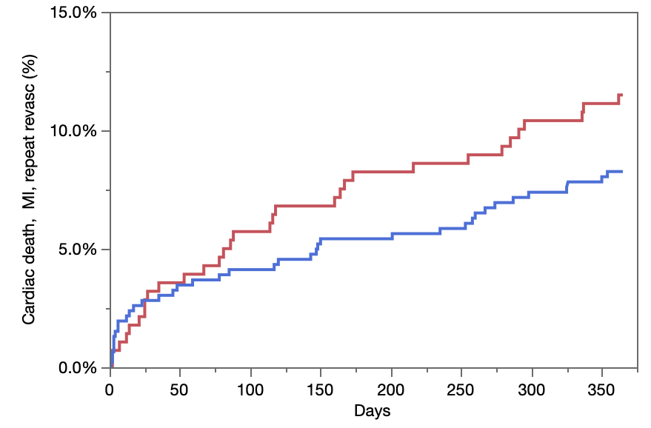


TVF According to Post-PCI FFR
15
Log-rank p=0.15
11.5%
10
8.3%
5
0
Post-PCI FFR not measured | 279 |  | 263 | 256 | 249 | 245
Post-PCI FFR measured | 461 |  | 440 | 432 | 421 | 416
Baseline characteristics were similar between groups

Slide 12
TVF According to Intravascular Imaging
13.5%
Log-rank p=0.21
9.0%
No imaging | 658 |  | 626 | 614 | 602 | 595
Imaging-guided | 82 |  | 80 | 78 | 72 | 70
Baseline characteristics were similar between groups

Slide 13
Conclusions
In patients undergoing FFR-guided PCI with current-generation DES for anatomically defined 3-vessel disease:
Low post-PCI FFR was associated with a significantly higher rate of TVF, on a vessel-, and patient-level
Post-PCI FFR was an independent predictor of TVF
The limited use of intravascular imaging did not affect outcomes
Faculty disclosure information can be found on the app
Notes:
In patients undergoing FFR-guided PCI with current-generation DES for anatomically defined 3-vessel disease:
Low post-PCI FFR was associated with a significantly higher rate of TVF as well as TVMI alone on a vessel as well as on a patient-level.
On multivariable analysis, post-PCI FFR were found to be independent predictor of TVF.
The limited use of intravascular imaging did not affect outcomes.

Slide 14

Faculty disclosure information can be found on the app

Slide 15
Thank You
Faculty disclosure information can be found on the app

