Slide 1

TCT Template
Title 30 pt Bold Arial
Effects of Routine Early Treatment with PCSK-9 Inhibitor in Patients Undergoing Primary Percutaneous Coronary Intervention for ST-Segment Elevation Myocardial Infarction: A randomized, double-blind, sham-controlled trial
John Doe, MD
Subtitle 25 pt Arial Bold Italics
Shamir R. Mehta, MD, MSc, FRCPC, FACC, FESC
Guillaume Pare, MD, MSc; Eva M. Lonn, MD, MSc; Sanjit S. Jolly, MD; Madhu K. Natarajan, MD; Natalia Pinilla-Echeverri, MD, MSc; Jon-David Schwalm, MD, MSc; Tej Sheth, MD; Matthew Sibbald, MD, PhD; Michael Tsang, MD; Nicholas Valettas, MD, MASc; James L. Velianou, MD; Shun Fu Lee, PhD; Tahsin Ferdous, MSc; Sadia Nauman, MBBS, MSc; Helen Nguyen, BSc; Tara McCready, PhD, MBA; Matthew J. McQueen, MBChB, PhD

Slide 2
Background
In patients with STEMI, early initiation of high intensity statin therapy, regardless of baseline LDL level is standard practice worldwide.
The greater the reduction in LDL with statins, the lower the risk, with no apparent lower limit beyond which a benefit is not observed. Yet, a significant proportion of STEMI patients never achieve optimal LDL levels with statins
PCSK9 inhibitors further reduce LDL and events but have been not studied when given acutely nor as routine treatment
Whether a simplified regimen of initiating PCSK9 inhibitor routinely in the acute setting of STEMI on top of high intensity statins would add additional benefit by further reducing LDL-cholesterol levels in a much wider population of patients is unknown.
On a population level, such an approach would be expected to substantially reduce the number of major cardiovascular events in this high-risk population.

Slide 3
Objectives
EPIC-STEMI was designed to evaluate the routine, early administration of PCSK9 inhibitor, regardless of baseline LDL levels or prior statin use, in order to determine:
The degree of LDL reduction that might be expected with this approach
The time course of LDL lowering during the acute period after STEMI
The overall feasibility of this approach.

Slide 4
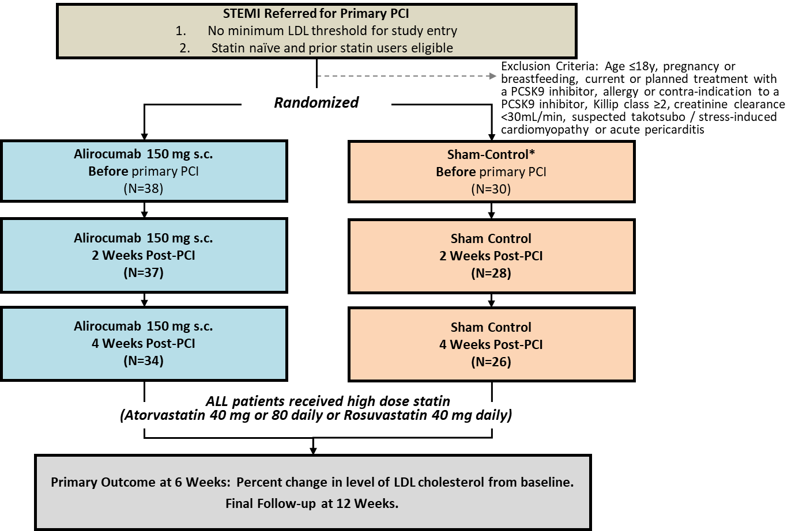
Design
Flow

Slide 5
Baseline Characteristics
Median follow-up 45 days
 | Alirocumab N=38 | Sham-Control N=30
Age (year) | 61.37 (11.04) | 63.63 (10.38)
Sex (male) - no.(%) | 27 (71.05) | 28 (93.33)
Medical History
Diabetes - no.(%) | 5 (13.16) | 1 (3.33)
Prior myocardial infarction - no.(%) | 3 (7.89) | 3 (10.00)
Current smoker - no.(%) | 16 (42.11) | 7 (23.33)
Hypertension - no.(%) | 17 (44.74) | 13 (43.33)
Dyslipidemia - no.(%) | 13 (34.21) | 12 (40.00)
Prior stroke - no.(%) | 1 (2.63) | 0 (0.00)
Time from symptom onset to primary PCI (hours) | 3.40 (2.23) | 3.96 (2.26)
Statin use within 7 days of randomization no.(%) | 8 (21.05) | 8 (26.67)
Statin use after randomization
Atorvastatin 40-80 mg or Rosuvastatin 40 mg daily | 37 (97.37) | 30 (100)
Atorvastatin 80 mg or Rosuvastatin 40 mg daily | 37(97.37) | 27(90.00)
Ezetimibe | 2 (5.26) | 1 (3.33)

Slide 6
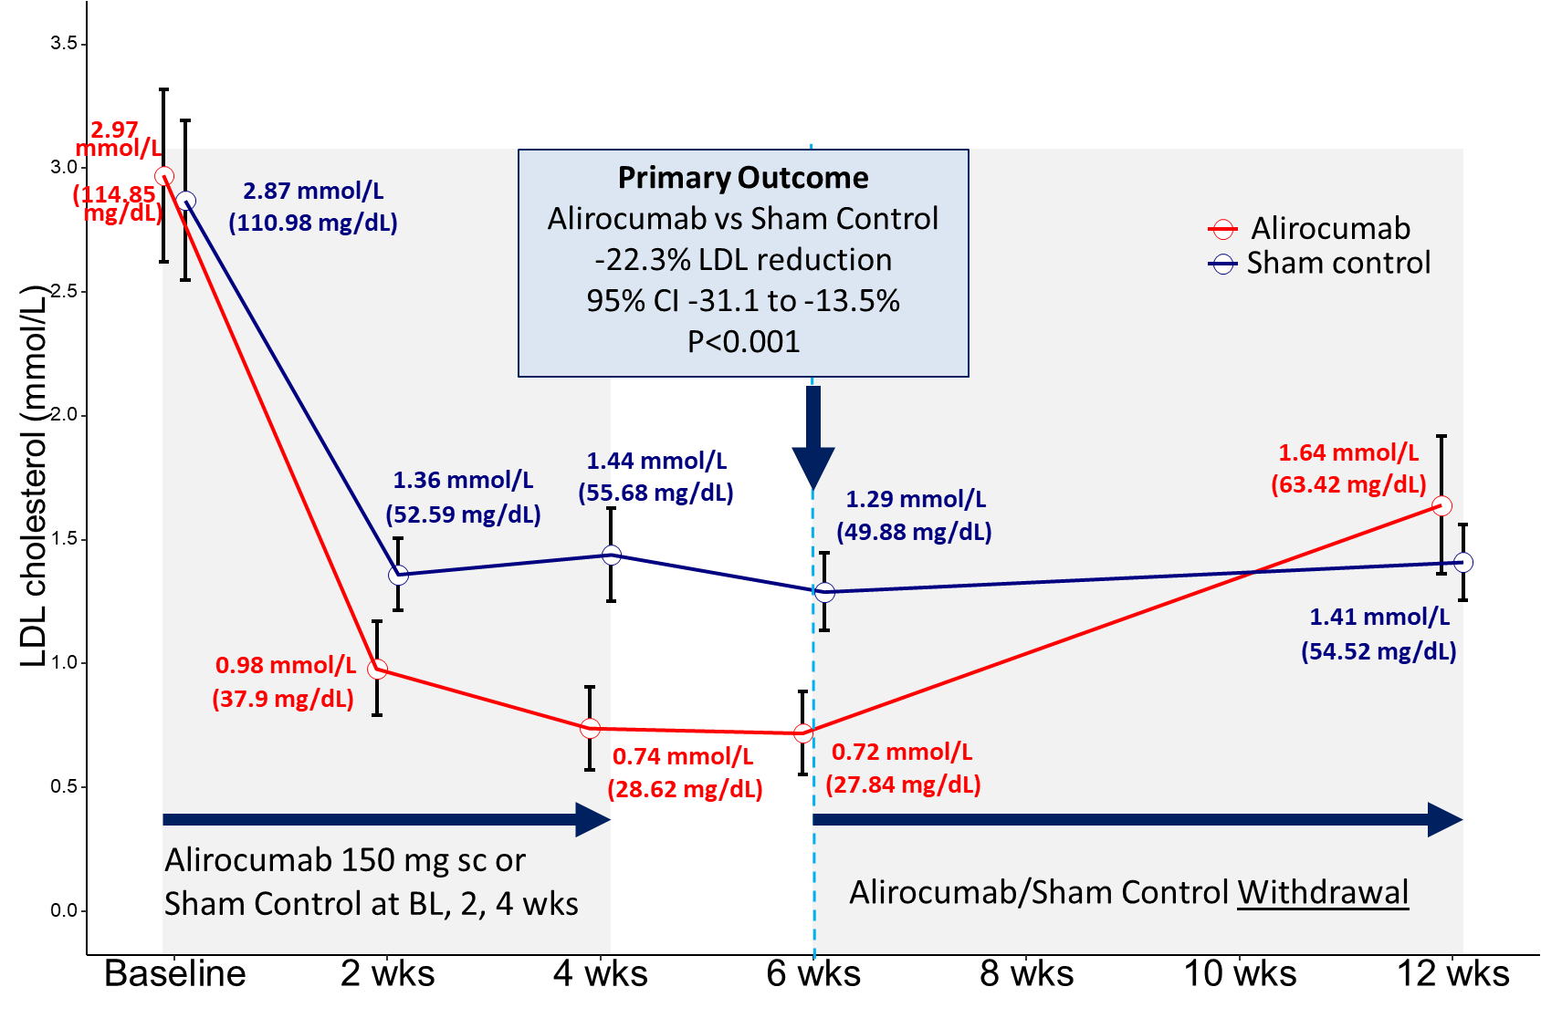
Primary Outcome
LDL Reduction at 6 weeks (median 42 days)

Slide 7
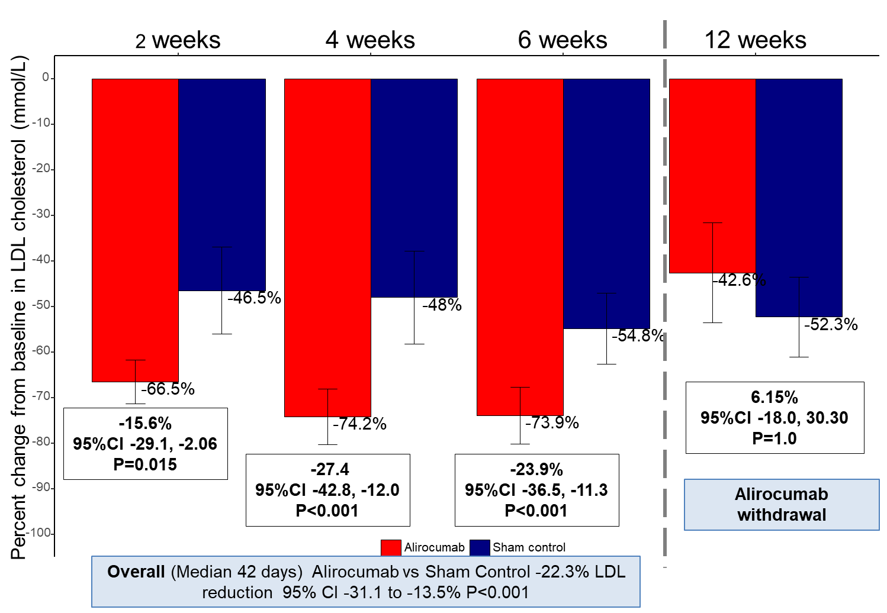
Timing of LDL reduction

Slide 8
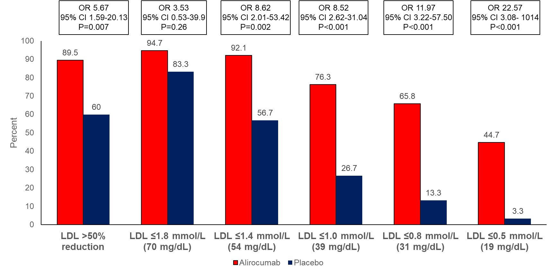
LDL Targets

Slide 9
Conclusions
In patients with STEMI undergoing primary PCI, the routine early initiation of PCSK9 inhibitor (regardless of baseline LDL level or prior statin use) compared with sham-control:
Reduced LDL-cholesterol by 22% at 6 weeks (median 45 days) on a background of high intensity statin therapy.
Resulted in a greater proportion of patients achieving >50% reduction or ESC LDL target of ≤ 1.4 mmol/L (70 mg/dL).
Appeared to be feasible and safe.

Slide 10
Implications
Routine, early administration of PCSK9 inhibitor has the potential to substantially reduce morbidity and mortality globally after high-risk ACS by further reducing LDL beyond statins in a much greater number of high-risk patients than is currently treated with these agents.
A large outcomes trial evaluating this simplified strategy is needed

Slide 11

Simultaneous Publication
EuroIntervention 2022;17:1-1

