Slide 1
TCT Template Title 30 pt Bold Arial
3-Year Outcomes from the AmplatzerTM AmuletTM Left Atrial Appendage Occluder Randomized Controlled Trial (Amulet IDE)
Dhanunjaya Lakkireddy David Thaler, Christopher R. Ellis, Vijendra Swarup, Alok Gambhir, James Hermiller, Jens Erik Nielsen-Kudsk, Stephen Worthley, Devi Nair, Boris Schmidt, Mohamad Alkhouli, Rodney Horton, Nigel Gupta, Stephan Windecker
John Doe, MD
Subtitle 25 pt Arial Bold Italics

Slide 2
Disclosure Statement of Financial Interest
I, Dhanunjaya Lakkireddy, DO NOT have a financial interest/arrangement or affiliation with one or more organizations that could be perceived as a real or apparent conflict of interest in the context of the subject of this presentation.
The Amulet IDE trial was funded by Abbott
Faculty disclosure information can be found on the app

Slide 3
Disclosure Statement of Financial Interest
Within the past 12 months, I or my spouse/partner have had a financial interest/arrangement or affiliation with the organization(s) listed below.
Affiliation/Financial Relationship | Company
Grant/Research Support | Abbott, Atricure, Alta Thera, Medtronic, Biosense Webster, Biotronik, Boston Scientific
Speaker honorarium | Abbott, Medtronic, Biotronik, Boston Scientific
Principal investigator of the Amulet IDE trial | Abbott
Faculty disclosure information can be found on the app

Slide 4
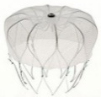
Amulet IDE Trial
Primary Mechanism of Action Endpoint
Primary Safety Endpoint
Primary Effectiveness Endpoint
Key Follow-Up Outcomes
934 AmuletTM Occluder
1878 Randomized at 78 US Centers and 30 OUS Centers
45 Day 6M 12M 18M 3Yr
944 WatchmanTM 2.5 Device
Visit + TEE
Clinic Visit
Visit + TEE
Clinic Visit
Phone Visit
Amulet Occluder
DAPT
DAPT
or
Aspirin throughout follow-up (both groups per protocol)
Medications:
OAC
Watchman Device
Warfarin
DAPT
Notes:
3

Slide 5
Primary Endpoints
Results from the Amulet IDE trial were reported at the ESC congress on August 30, 2021
Results Summary*:
All 3 primary endpoints were met: Closure (PDL ≤5mm) at 45 days, Safety at 12 months, & Effectiveness at 18 months
Non-inferiority of secondary composite endpoint (stroke, SE, CV death) at 18 months was met
At 45 days, the AmplatzerTM AmuletTM LAA occluder achieved superior closure (PDL ≤5mm) over the WatchmanTM device
Endpoints | Amulet, n (%) | Watchman, n (%)
Closure (PDL ≤5mm) at 45 days¹ | 792 (98.9%) | 767 (96.8%)
Safety (procedure-related complications, major bleeding, all-cause death) at 12 months² | 131 (14.5%) | 130 (14.7%)
Effectiveness (ischemic stroke/systemic embolism) at 18 months³ | 25 (2.8%) | 24 (2.8%)
Secondary endpoint (stroke, systemic embolism, cardiovascular death) at 18 months⁴ | 50 (5.6%) | 67 (7.7%)
¹ Analyzed in patients who received a device as randomized
² Analyzed in per protocol population
³ Analyzed in intent-to-treat population
⁴ Analyzed in attempt as randomized population
*Lakkireddy et al. Circulation 2021;144:1543-1552.
Notes:
4

Slide 6
AmuletTM Occluder had Higher Complete LAA Closure on Core Lab Analyzed TEEs
Amulet occluder patients had significantly higher complete LAA closure rate by TEE compared to WatchmanTM device patients at both 45 days and 12 months
N=801
N=792
N=673
N=618
p<0.01 for None, ≥Mild, ≥Moderate, and Severe categories at 45 days and 12 months
Results presented at HRS 2022 (Ellis et al.)
Notes:
5

Slide 7
Objective
To evaluate the device effect on 3-year outcomes in the Amulet IDE Trial
Notes:
6

Slide 8
Methods
Descriptive analyses of clinical outcomes are reported at 3 years based on the “as attempted” population to evaluate device effect:
Composite of stroke, systemic embolism, or cardiovascular death
All-cause death and cardiovascular death
Major bleeding
Composite of ischemic stroke or systemic embolism
Kaplan-Meier method was used to summarize outcomes
Annualized rates were calculated using recurrent events
Patient-level details on outcomes >6 months
Medication regimen consistent between groups beyond 6 months (aspirin only recommended)
Notes:
7

Slide 9
Patient Follow-Up Through 3 Years
AmuletTM Occluder
WatchmanTM Device
Randomized
N=934
Randomized
N=944
17 excluded:
11 withdrew consent
1 died before procedure
1 no implant attempt
4 other reasons
28 excluded:
20 withdrew
1 died before procedure
3 no implant attempt
4 other reasons
Implant Attempt (As Attempted)
N=917
Implant Attempt (As Attempted)
N=916
0 – 18 Months (86 Total):
N=63 Deaths
N=23 Withdrew
0 – 18 Months (135 Total):
N=85 Deaths
N=50 Withdrew
Completed 18-Month Visit (N=797)
93.3% (Missed Visit: N=34)
Completed 18-Month Visit (N=742)
89.3% (Missed Visit: N=39)
18M – 3 Years (89 Total):
N=70 Deaths
N=19 Withdrew
n=9 LTFU
n=7 health or travel reason
n=3 other reasons
18M – 3 Years (99 Total):
N=69 Deaths
N=30 Withdrew
n=16 LTFU
n=8 health or travel reason
n=6 other reasons
Completed 3-Year Visit (N=721)
92.0% (Missed Visit: N=21)
Completed 3-Year Visit (N=659)
86.7% (Missed Visit: N=21)
Higher follow-up rate with Amulet occluder driven by increased deaths and withdrawals in the Watchman device group within 18 months
Actual Follow-up Rate % - Visit Complete / (Visit Complete + Missed or Overdue Visits + Withdrawal (cumulative) + Lost to Follow-up (cumulative)).
Notes:
8

Slide 10
Baseline Characteristics are Well Matched Between Device Groups
Clinical Characteristics* | AmuletTM (N=917) | WatchmanTM (N=916)
Age (yrs) | 75.0 ± 7.6 | 75.2 ± 7.6
Male sex | 58.6% | 61.3%
AF Classification
-Paroxysmal | 56.7% | 54.0%
-Persistent/Permanent | 43.3% | 46.0%
AF at procedure | 39.7% | 40.8%
CHA₂DS₂-VASc Score | 4.5 ± 1.3 | 4.7 ± 1.4
HAS-BLED Score | 3.2 ± 1.0 | 3.3 ± 1.0
Major or Minor Bleeding | 72.2% | 71.8%
Stroke/TIA/Thromboembolism | 25.5% | 28.9%
*Analyzed in as attempted population
Notes:
9

Slide 11
Through 3 Years, OAC Usage was Lower with AmuletTM Occluder than WatchmanTM Device
More patients were placed on OAC after identification of late DRT (>6 months) in Watchman device (n=23) than Amulet occluder (n=10)*
p<0.01
p=0.04
p=0.01
OAC includes monotherapy or combined with other antiplatelet medications
*Results presented at ACC 2022 (Schmidt et al.)
Notes:
10

Slide 12
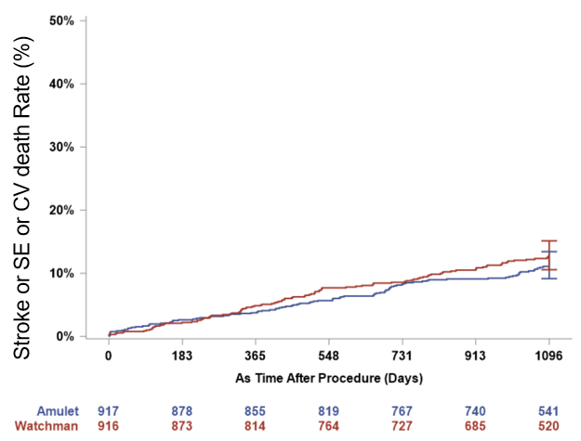
Composite Rates of Stroke/Systemic Embolism/CV Death at 3 Years are Comparable
Amulet: 11.1%
Watchman: 12.7%
HR [95% CI] 0.87 [0.66-1.14]
(p = 0.31)
 | AmuletTM (N=917) | WatchmanTM (N=916)
Stroke/systemic embolism/CV death | 11.1% (n=95) | 12.7% (n=105)
All stroke | 5.3% (n=44) | 5.2% (n=42)
Systemic embolism | 0.3% (n=3) | 0.2% (n=2)
Cardiovascular death | 6.6% (n=56) | 8.5% (n=70)
Notes:
11

Slide 13
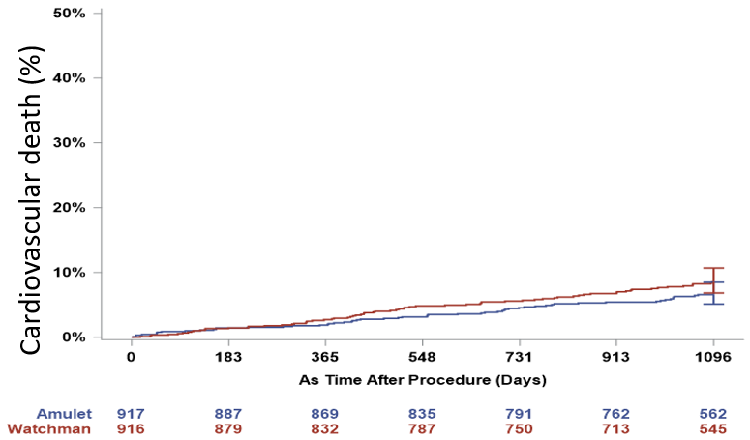
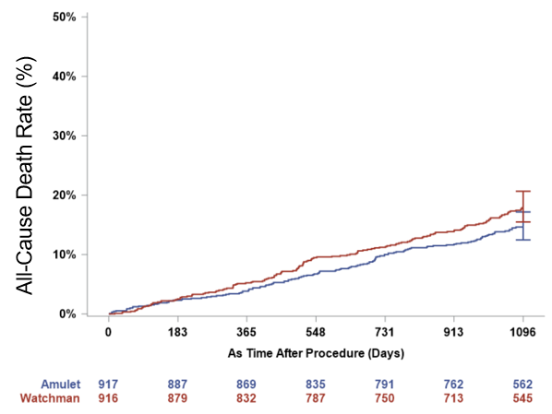
Both Cardiovascular Death and All-Cause Death Trended Lower at 3 Years with AmuletTM Occluder than WatchmanTM Device*
Cardiovascular Death
All-Cause Death
Amulet: 6.6%
Watchman: 8.5%
HR [95% CI] 0.77 [0.54-1.09]
(p = 0.14)
Amulet: 14.6%
Watchman: 17.9%
HR [95% CI] 0.81 [0.64-1.02]
(p = 0.07)
*Descriptive analysis of non-powered endpoints in a population with differential long-term follow-up at 3 years
Notes:
12

Slide 14
Device Factors More Often Observed in WatchmanTM Device Patients with CV Death
Majority CV deaths in the AmuletTM occluder group were not preceded by a device factor, whereas device factors (DRT or PDL) frequently preceded CV deaths in the Watchman device group
CV Death Patient Details (6 Months – 3 Years)* | Amulet (n=43) | Watchman (n=58)
Patient factors
CHA₂DS₂-Vasc score | 5.0 ± 1.6 | 5.0 ± 1.4
HAS-BLED score | 3.5 ± 0.9 | 3.4 ± 1.0
Device factors
Device-related thrombus | 1 | 4
Peridevice leak (≥3mm) | 5 | 15
Pericardial effusion | 0 | 0
OAC usage time of death | 2 | 5
* ASA only recommended for both groups after 6 months
Notes:
13

Slide 15
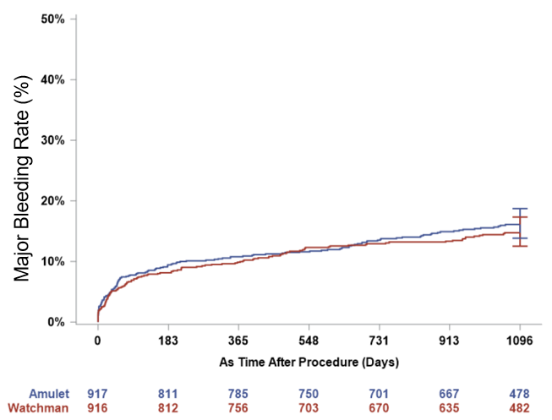
Major Bleeding Rates were Comparable at 3 Years
Amulet: 16.1%
Watchman: 14.7%
HR [95% CI] 1.09 [0.86-1.39]
(p = 0.46)
 | AmuletTM (N=917) | WatchmanTM (N=916)
Major bleeding | 16.1% (n=141) | 14.7% (n=127)
Non-procedure related | 13.4% (n=116) | 13.0% (n=110)
Annualized rate at 3 years | 7.2%/year | 6.9%/year
0 – 6 months annualized rate | 22.2%/year | 18.7%/year
6 months – 3 years annualized rate* | 3.9%/year | 4.2%/year
*ASA only recommended for both groups after 6 months
Major bleeding is defined as BARC Type 3 or greater (any transfusion with overt bleeding)
Notes:
14

Slide 16
Major Bleeding Events During Aspirin Monotherapy were GI Related
Source of Bleeding (n of events) (6 Months – 3 Years) | AmuletTM (n=81) | WatchmanTM (n=80)
Gastrointestinal | 46 | 45
Trauma or fall | 7 | 17
Hematoma* | 8 | 4
Intracerebral or subdural hemorrhage | 5 | 6
Pericardial effusion (PE)** | 3 | 3
Hemothorax | 4 | 1
Hematuria | 2 | 2
Cancer | 2 | 2
Epistaxis | 3 | 0
Aortic aneurysm | 1 | 0
*All hematoma events >6 months occurred from other elective procedures
(Amulet: 3 orthopedic, 2 lumbar laminectomy, 1 aneurysm, 1 craniotomy, 1 other; Watchman: 1 orthopedic, 1 lumpectomy, 1 lumbar, 1 other)
**Amulet: 2 PEs undetermined cause, 1 PE from other elective procedure
Watchman: 2 PEs from secondary closure of PDL, 1 PE from other elective procedure
Major bleeding is defined as BARC Type 3 or greater (any transfusion with overt bleeding); ASA only recommended for both groups >6 months
Notes:
15

Slide 17
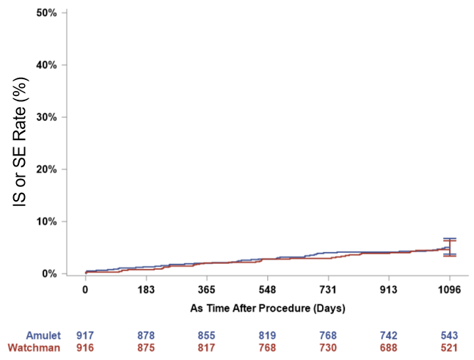
Thromboembolic Event Rates were Comparable at 3 Years
Amulet: 5.0%
Watchman: 4.6%
HR [95% CI] 1.09 [0.70-1.70]
(p = 0.69)
 | AmuletTM (N=917) | WatchmanTM (N=916)
Ischemic stroke/systemic embolism | 5.0% (n=42) | 4.6% (n=37)
Ischemic stroke | 4.7% (n=39) | 4.5% (n=36)
Systemic embolism | 0.3% (n=3) | 0.2% (n=2)
Annualized ischemic stroke at 3 years | 1.6%/year | 1.6%/year
0 – 6 months annualized rate | 2.2%/year | 1.6%/year
6 months – 3 years annualized rate* | 1.5%/year | 1.6%/year
*ASA only recommended for both groups after 6 months
Notes:
16

Slide 18
Device Factors More Often Observed in Stroke Patients with WatchmanTM Device
Device factors (DRT or PDL) frequently preceded strokes in the Watchman device group; most patients were not on OAC at the time of stroke occurrence in both groups
Ischemic Stroke Patient Details (6 Months – 3 Years)* | AmuletTM (n=29) | WatchmanTM (n=29)
Device factors**
Device-related thrombus | 1 | 2
Peridevice leak (≥3mm) | 3 | 15
OAC usage at time of stroke | 0 | 3
*ASA only recommended for both groups after 6 months
**Device factors had to occur prior to the stroke occurrence to be counted
The protocol required all patients with an ischemic stroke to undergo TEE/TOE within 7 days of neurological imaging confirming the event.
Notes:
17

Slide 19
First Analysis of AmuletTM Occluder versus WatchmanTM Device Long-Term Outcomes
DISCOVERED INSIGHTS FROM THE AMULET IDE TRIAL AT 3 YEARS
Withdrawals occurred at a higher rate in the Watchman than Amulet device group
Both cardiovascular and all-cause deaths trended higher in the Watchman than Amulet device group with no pericardial effusion related deaths in either group
More patients were on OAC in the Watchman than Amulet device group
Ischemic stroke and major bleeding rates were comparable between device groups
Device factors (DRT or PDL) preceded strokes in more Watchman device patients than Amulet occluder patients
CONCLUSION
The dual-seal AmplatzerTM AmuletTM LAA occluder continued to demonstrate safety and effectiveness through 3 years
Notes:
18

