Slide 1
Rivaroxaban for rheumatic heart disease associated atrial fibrillation - INVICTUS
Ganesan Karthikeyan, Stuart Connolly*, Mpiko Ntsekhe, Bongani Mayosi* and Salim Yusuf**, for the INVICTUS Steering Committee and investigators
28th August 2022
*PI, **Steering committee chair

Slide 2
Background and rationale
RHD affects over 40 million people, mainly in LMICs
About 20% of symptomatic RHD patients have AF
No RCTs of anticoagulation in RHD-AF
Less than ½ the patients are prescribed VKA, and just 1/3rd achieve therapeutic INRs
An anticoagulant that does not need monitoring would be of great benefit

Slide 3
Design
Design Investigator-initiated, international, open-label, randomized, non-inferiority trial, with blinded outcome assessment
Designed and coordinated by Population Health Research Institute, Canada
Funding: Unrestricted grant from Bayer AG
Am Heart J 2020;225:69-77

Slide 4
Patients and interventions
Rivaroxaban 20mg od (n=2275)
(15 mg od if CrCl 15-49 ml/min)
Patients with RHD-AF with either of:
Mitral stenosis (valve area ≤2cm²)
CHA₂DS₂VASc score ≥2
R
1:1
VKA (n=2256)
(INR 2-3)
Am Heart J 2020;225:69-77

Slide 5
Outcomes and analysis
Primary outcome: Composite of stroke/systemic embolism*, MI, death due to vascular or unknown cause
*Original primary outcome
Primary safety outcome: ISTH major bleeding
4500 patients, 80% power for non-inferiority, with margin at HR of 1.186 (upper bound of the 97.5% CI)
Lancet 2006;367:1903-1912

Slide 6
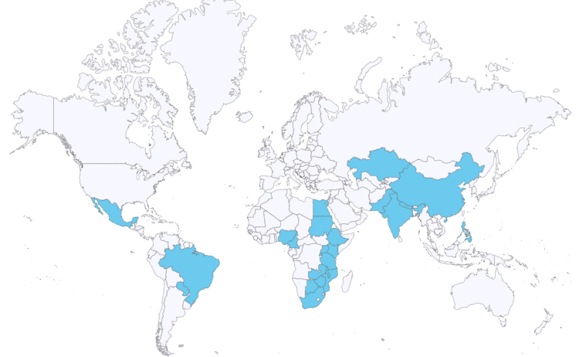
Centres and countries
- 138 centres in 24 countries
- Africa, Asia, and Latin America
- PHRI, Hamilton Coordinating Centre

Slide 7
Baseline characteristics
 | Rivaroxaban (n=2275) | VKA (n=2256)
Age, years, mean | 50.7 | 50.3
Female sex, n (%) | 1648 (72.4) | 1626 (72.1)
Mitral valve stenosis, n (%) | 1927 (85.5) | 1903 (85.2)
Congestive HF, n (%) | 879 (38.6) | 866 (38.4)
Hypertension, n (%) | 522 (22.9) | 535 (23.7)
Diabetes, n (%) | 158 (6.9) | 132 (5.9)
Stroke, n (%) | 248 (10.9) | 257 (11.4)
Coronary artery disease, n (%) | 32 (1.4) | 20 (0.9)
CHA₂DS₂-VASc score 0-1, n (%) | 978 (43) | 993 (44)

Slide 8
Drug compliance and INR control
Drug compliance by visit (%) | Rivaroxaban (n=2275) | VKA (n=2258)
Visit | Riva | VKA
I year | 88.7 | 98
II year | 84.4 | 97.7
III year | 81.2 | 97.1
IV year | 79 | 96.4
INR control by visit
Visit | INRs between 2-3, (%)
Baseline | 33.2
I year | 59.0
II year | 65.3
III year | 65.1
IV year | 64.1
Permanent discontinuation: Riva 23%, VKA 6%
Notes:
2/3rd restarted non-study VKA

Slide 9
Results: Stroke, SE, MI or death (vascular or unknown)
4531 patients, 97% follow-up, average of 3.1 years
32
Rivaroxaban
28
24
Proportional hazards assumption NOT met
20
VKA
Cumulative Incidence (%)
16
12
HR 1.25 (1.10-1.41)
9
6
3
0
0
6
12
18
24
30
36
42
48
54
Time since randomization (months)
Notes:
75% had a follow-up of nearly 4 years

Slide 10
Results: Efficacy - Intention-to-treat
Outcomes % per year (n) | Rivaroxaban (n=2275) | VKA (n=2256) | HR (95% CI) | RMST difference, days (95% CI) | p value (RMST)
Primary composite | 8.2 (560) | 6.5 (446) | 1.25 (1.10-1.41) | -76 (-121, -31) | 0.001
Death | 8.0 (552) | 6.4 (442) | 1.23 (1.09-1.40) | -72 (-117, -28) | 0.001
Ischemic stroke | 1.1 (74) | 0.7 (48) | 1.53 (1.06-2.20) | -23 (-40, -6) | 0.01
Few systemic embolism (16), and MI (8) events
On-treatment analysis showed similar results

Slide 11
Results: Safety - On treatment
Outcome % per year (n) | Rivaroxaban (n=2265) | VKA (n=2251) | HR (95% CI) | p value (RMST)
Major bleeding | 0.7 (40) | 0.8 (56) | 0.76 (0.51-1.15) | 0.18
- Life-threatening | 0.4 (22) | 0.5 (31) | 0.77 (0.44-1.32) | 0.31
- Intracranial | 0.1 (8) | 0.2 (14) | 0.63 (0.26-1.50) | 0.27
- Fatal | 0.1 (4) | 0.2 (15) | 0.29 (0.10-0.88) | 0.02

Slide 12
Difference in death unanticipated
Not explained by difference in stroke
VKA prevented 26 ischemic strokes vs. 110 deaths
Difference in mortality driven entirely by HF and sudden deaths
No difference in bleeding
More frequent healthcare contact in the VKA arm for INR
Delayed effect - apparent only after 3 years

Slide 13
Conclusions
In RHD-AF, compared to rivaroxaban, VKAs reduced ischemic stroke and mortality, without increasing the risk of major bleeding
VKAs should remain the standard of care for RHD-AF
Mortality benefit of VKA in RHD requires further study

Slide 14
INVICTUS study team
Country | National Leader | Country | National Leader
Botswana | Julia Molefe-Baikai | Nepal | Sanjib Kumar Sharma
Brazil | Alvaro Avezum | Nigeria | Okechukwu Ogah
Cameroon | Tantchou Tchoumi Jacques Cabral | Pakistan | Khawar Kazmi
China | Dayi Hu & Ma Changsheng | Paraguay | Maria Paniagua
Egypt | Alaa El Ghamrawy & Fathi Maklady | Philippines | Antonio Miguel L. Dans
Ethiopia | Abraham Haileamlak | Rwanda | Emmanuel Rusingiza Kamanzi
India | Ganesan Karthikeyan | South Africa | Mpiko Ntsekhe, Liesl Zuhlke, Bongani Mayosi
Kazakhstan | Kairat Davletov | Sudan | Ahmed ElSayed
Kenya | Bernard Gitura | Tanzania | Pilly Chillo
Malawi | Lillian Gondwe-Chunda | Uganda | Peter Lwabi
Mexico | Jesus Antonio Gonzalez-Hermosillo | Zambia | John Musuku
Study Team Members | Statistical Support | ICT Support
Sumathy Rangarajan | Kumar Balasubramanian | Matt Smart
Amy Krol | Chintanie Ramasundarahettige | Kristen Avery
Divya Pattath | Xiumei Yang | Miroslaw Malysz
Sufia Tariq | Cissy Tang | Herbert Mawema
Edith Wagan | Tahsin Ferdous
Ruchi Patel | Toby Wei
Rhonda Masney

