Slide 1
Aspirin in 2022:
A New Aspirin for a New Chapter
March 28, 2022

Slide 2
Disclosures
Spouse: Employee of Boston Clinical Research Institute, she has equity position
Present Research/Grant Funding
Janssen/Johnson & Johnson
CSL Behring
SCAD Alliance
Baim Institute
Patents and Stocks: None
Equity: nference, Inc.
Dyad Medical
Absolutys
Consultant
Amag Pharmaceuticals | Inari
Amarin | MD Magazine
Anthos Therapeutics | MedImmune
AstraZeneca | Medtelligence
Bayer/Janssen/ J&J | MedTrace
Bioclinica | Merck
Boston Clinical Research Institute | Micodrop, LLC
Boston Scientific | Microport
Bristol-Myers Squibb | NovoNordisk
Calardius Biosciences | Paratek
Cardiovascular Clinical Science Foundation | PERT Consortium
Cardiovascular Research Foundation | Pfizer
CeleCor Therapeutics | PhaseBio
CSL Behring | PHRI
CytoSorbents Medical | PLxPharma
DCRI | Revance Therapeutics
Eidos Therapeutics | SCAI
EXCITE International ($0 Received) | Smart Medics
Gilead Sciences, Inc. | Somahlution
Amag Pharmaceuticals
Angel Medical Corporation
Anthos Therapeutics
AstraZeneca
Bayer
Boston Clinical Research Institute
Bristol-Myers Squibb
Caladrius Biosciences
Cardiovascular Research Foundation
CeleCor Therapeutics
CytoSorbent Medical, Inc.
Eidos Therapeutics
EXCITE International ($0 Received)
Janssen/ J&J
MD Magazine
Micodrop, LLC
Microport
NovoNordisk
Pfizer
PLxPharma
Smart Medics
Somahlution
WedMD
Check the label in your country. Rivaroxaban is not FDA approved in the ACS setting or in patients with atrial fibrillation undergoing stent placement. It is in many other countries. Check your local label. The use of Rivaroxaban in chronic CAD is under regulatory review and is off label at present.
Slide by C. Michael Gibson, M.S., M.D.

Slide 3
Disclosures
Jacqueline E. Tamis-Holland, MD, FACC, FAHA, FSCAI
No relevant disclosures
Neha J. Pagidipati, MD, MPH, FACC
Dr. Pagidipati reports research grants from: Amgen, Inc.; AstraZeneca; Baseline Study LLC; Boehringer Ingleheim; Duke Clinical Research Institute; Eggland’s Best, Eli Lilly & Company; Novartis Pharmaceuticals, Novo Nordisk Pharmaceutical Company; Sanofi-S.A.; Verily Sciences Research Company. She reports consulting fees from AstraZeneca; Boehringer Ingleheim; Esperion Therapeutics, Eli Lilly & Company, Novo Nordisk Pharmaceutical Company.
Dominick J. Angiolillo, MD, PhD, FACC, FESC, FSCAI
D.J.A. declares that he has received consulting fees or honoraria from Abbott, Amgen, AstraZeneca, Bayer, Biosensors, Boehringer Ingelheim, Bristol-Myers Squibb, Chiesi, Daiichi-Sankyo, Eli Lilly, Haemonetics, Janssen, Merck, PhaseBio, PLx Pharma, Pfizer, and Sanofi.
D.J.A. also declares that his institution has received research grants from Amgen, AstraZeneca, Bayer, Biosensors, CeloNova, CSL Behring, Daiichi-Sankyo, Eisai, Eli Lilly, Gilead, Janssen, Matsutani Chemical Industry Co., Merck, Novartis, Osprey Medical, Renal Guard Solutions and Scott R. MacKenzie Foundation.

Slide 4
Agenda
Introduction
  Dr. C. Michael Gibson
Aspirin Use in Secondary Prevention Patients with Diabetes and/or Obesity
  Dr. Neha J. Pagidipati
DAPT SAPT: What Does the Evidence and New Guidelines Tell Us?
  Dr. Jacqueline E. Tamis-Holland
A New Aspirin Formulation
  Dr. Dominick J. Angiolillo
Closing Remarks
  Dr. C. Michael Gibson

Slide 5
Aspirin Use in Secondary Prevention Patients with Diabetes and/or Obesity
Neha J. Pagidipati, MD MPH FACC
Assistant Professor of Medicine, Duke University SOM
Director, Duke Cardiometabolic Prevention Clinic
Associate Program Director, Duke CV Fellowship
Associate Program Director, DCRI Research Fellowship

Slide 6
Disclosures
Neha J. Pagidipati, MD MPH FACC
Research support from Amgen, AstraZeneca, Boehringer Ingelheim, Cleerly, Eggland’s Best, Eli Lilly, Novartis, Novo Nordisk, Verily Life Sciences
Consultation/Advisory Panels for Boehringer Ingelheim, Eli Lilly, AstraZeneca, Novartis, and Novo Nordisk.
Executive Committee member for trials sponsored by Novo Nordisk and by Amgen.

Slide 7
Aspirin in Secondary Prevention
Amsterdam et al JACC 2014;64:e139-228.
Notes:
Many patient-level meta-analyses from Antithrombotic Trialists’ Collaboration

Slide 8
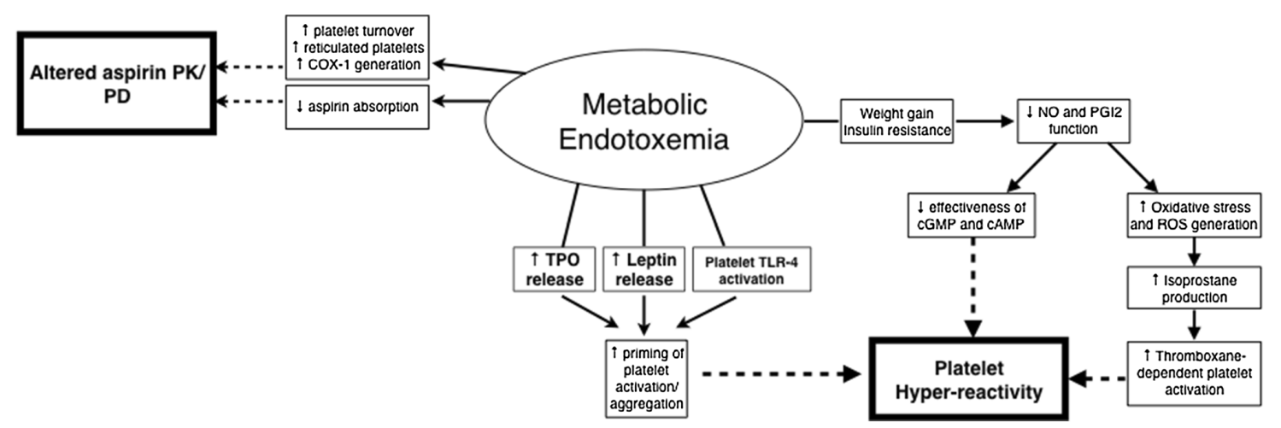
Weight and Aspirin Dosing
Obesity may affect:
  Aspirin Pharmacokinetics: failure to achieve adequate concentration of drug
    Decreased absorption and bioavailability
  Aspirin pharmacodynamics: failure to inhibit platelet function
    Alterations in baseline platelet reactivity and platelet turnover
Norgard NB. Clin Pharmacokinet, 2018; 57: 663.
Notes:
iNTERESTING: bariatric surgery results in improved aspirin response!

Slide 9
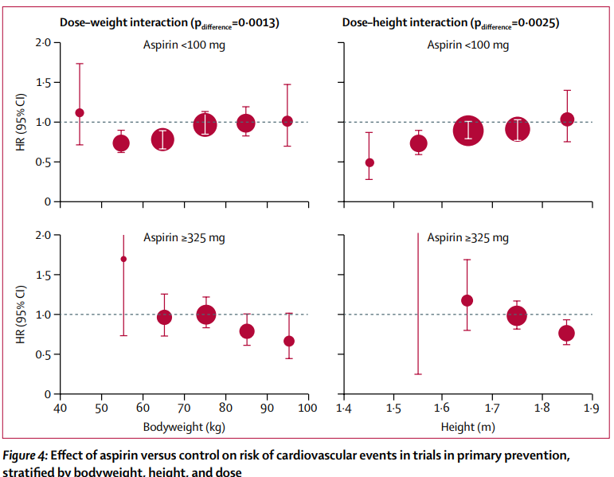
Weight and Aspirin Dosing
2018 patient-level meta-analysis of 10 trials in primary prevention (N=117,279):
  Low doses of aspirin (75–100 mg) were only effective in preventing vascular events in patients weighing less than 70 kg, and had no benefit in the 80% of men and nearly 50% of all women weighing 70 kg or more. By contrast, higher doses of aspirin were only effective in patients weighing 70 kg or more
  The findings were similar in men and women, in people with diabetes, and in a separate analysis of trials of aspirin for secondary prevention.
Rothwell et al. Lancet 2018; 392: 387.
Notes:
Importantly, NONE of these trials were designed to look at the interaction between weight and aspiring responsiveness, so at best these data can be hypothesis-generating only.

Slide 10
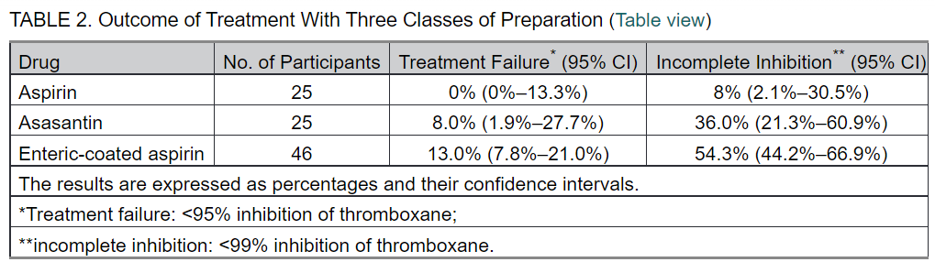
Weight and Aspirin Dosing
Cox et al. Stroke, 2006; 37: 2153
Notes:
We already know that EC-ASA has lower bioavailability to begin with, esp in patients with obesity –
Purpose: to determine whether enteric-coated aspirin is as effective as plain aspirin in healthy volunteers
Seventy-one healthy volunteers were enrolled in 3 separate bioequivalence studies. Using a crossover design, each volunteer took 2 different aspirin preparations. Five aspirin preparations were evaluated, 3 different enteric-coated 75-mg aspirins, dispersible aspirin 75 mg and asasantin (25-mg standard release aspirin plus 200-mg modified-release dipyridamole given twice daily).
Serum thromboxane (TX) B₂ levels and arachidonic acid–induced platelet aggregation were measured before and after 14 days of treatment.
Conclusions— Equivalent doses of the enteric-coated aspirin were not as effective as plain aspirin. Lower bioavailability of these preparations and poor absorption from the higher pH environment of the small intestine may result in inadequate platelet inhibition, particularly in heavier subjects

Slide 11
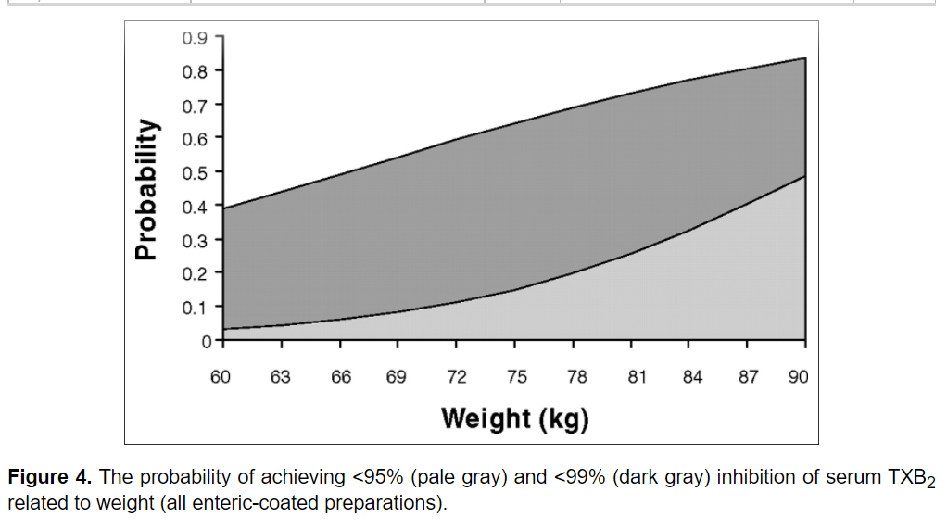
Weight and Aspirin Dosing
Cox et al. Stroke, 2006; 37: 2153
Notes:
But what was really interesting was the relationship with weight:
A 10-kg (22-lb) increase in weight was associated with an approximate doubling of risk of treatment failure (relative risk 1.9 [95% CI: 1.3 to 2.7] for asasantin and 2.2 [95% CI: 1.7 to 3.0] for enteric-coated aspirin).

Slide 12
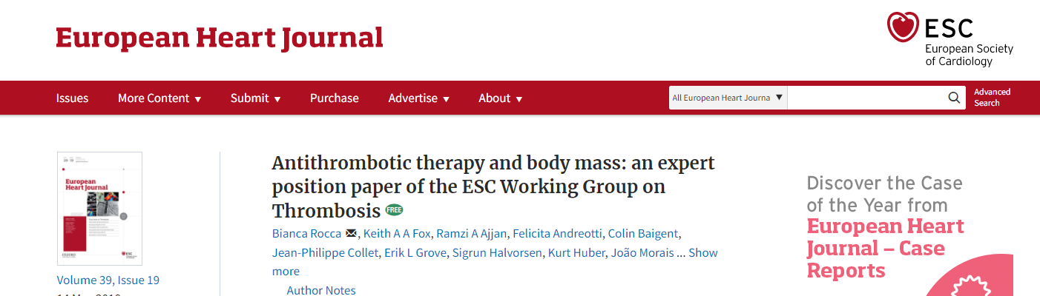
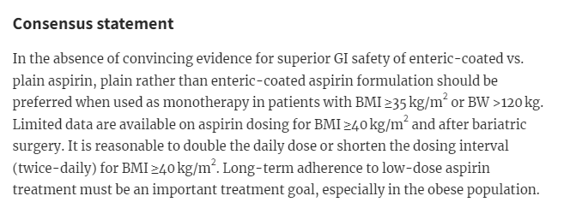
Weight and Aspirin Dosing
Neha’s Take:
We do not yet have enough evidence to justify changing dosage or frequency based on weight. We need weight-based dose-tailoring strategies to be tested in CV outcomes trials.
Notes:
2018

Slide 13
Aspirin Weight Interaction: By Formulation
Lower aspirin response with increased weight is dependent on type of aspirin formulation.
Methods:
2 randomized crossover studies in obese diabetic patients after 3 doses of 325 mg EC-ASA or PL-ASA were pooled at the patient level (n=183).
Regression analysis determined the impact of weight on inhibition of thromboxane B2 (TXB2).
Results:
There was a significantly earlier drop below the threshold of TxB2 inhibition with EC-ASA than PL-ASA (95 kg vs. 131 kg, p < 0.001).
Lower aspirin response with increased weight is dependent on type of aspirin formulation.
Bhatt DL, et al. JACC 2020;75:1344.
Notes:
It was in this context that Bhatt and colleagues explored the impact of different formulations on ASA response across weight ranges.
Compared EC aspirin with a newer formulation that is a lipid-aspirin complex in patients with obesity. We know that bioavailability is lower in EC ASA than non-EC aspirin, and we know that patients with obesity already have lower bioavailability. So perhaps another formulation would improve bioavailability?

Slide 14
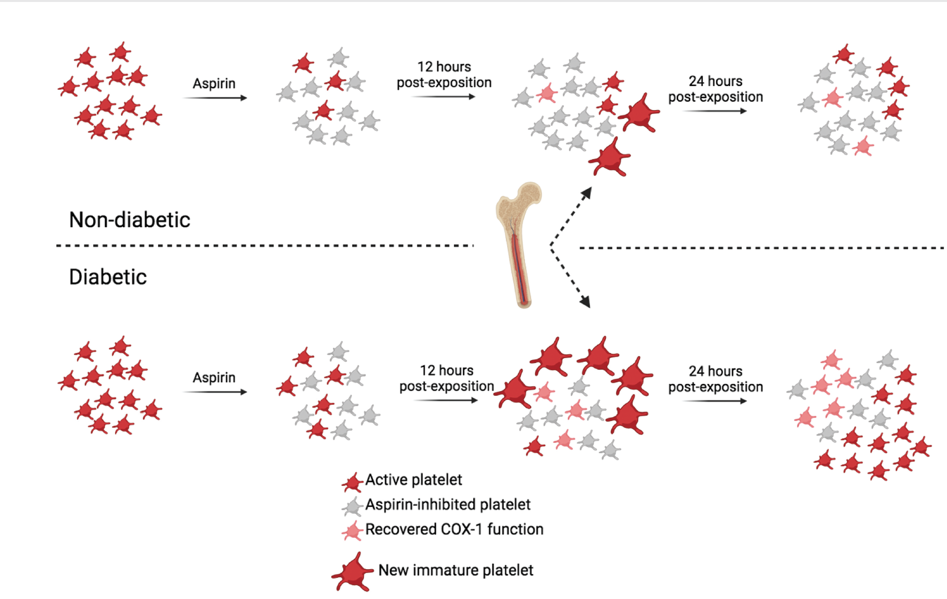
Aspirin in Patients with Diabetes
Diabetes increases baseline platelet reactivity
Increased platelet turnover
‘Chronopharmacology’ (more frequent administration, timing of dose) may be important
Obesity, frequently present with diabetes, may also alter the PK of aspirin (increased distribution volume)
Erratic absorption of enteric aspirin may be exacerbated by impaired gastroparesis in diabetes
Faster platelet function recovery in patients with diabetes
Del Bianco-Rondeau M. Thromb Haemost. 2022. doi: 10.1055/s-0042-1743469.
Notes:
What about diabetes?
This is an excellent review just published – they nicely summarize many smaller studies that suggest patients with diabetes have incomplete and nonsustained platelet inhibition with once-daily ASA – and this may be reverse with BID dosing, but we don’t really know this yet. ANDAMAN randomized Trial will assess impact of BID ASA dosing on pts with DM and ACS

Slide 15
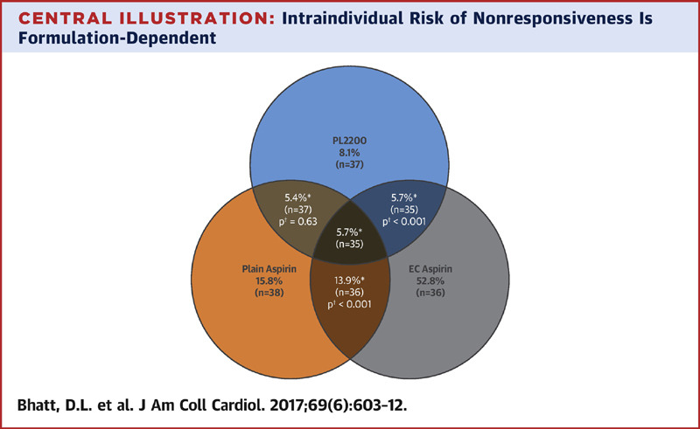
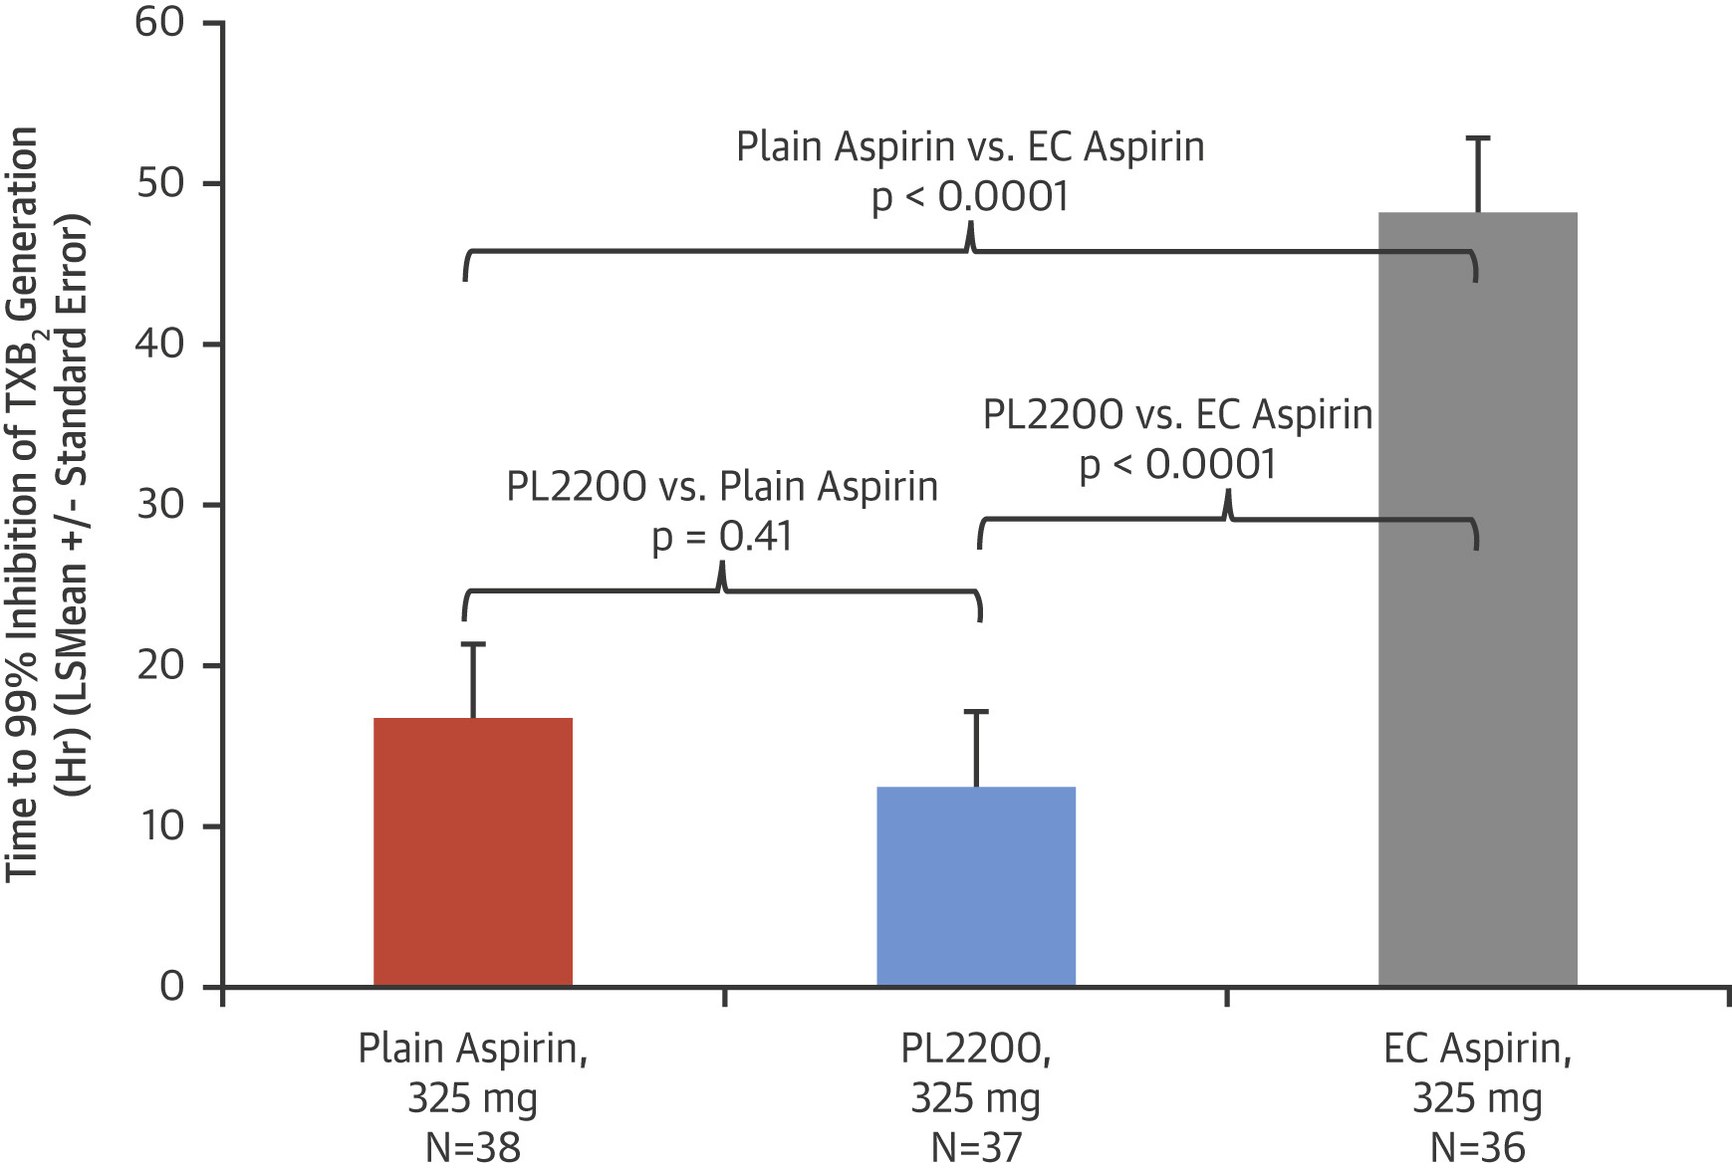
Aspirin in Patients with Diabetes
Bhatt et al. JACC 2017; 69: 603.
Notes:
40 patients with DM – exposed to ASA 325 as plain ASA, PL2200, EC ASA. Looked at aspirin responsiveness.

Slide 16

Guideline Recommendations for Aspirin Use after Coronary Revascularization
Jacqueline E. Tamis-Holland
Professor of Medicine, Icahn School of Medicine at Mount Sinai
Associate Director, Mount Sinai Morningside Cardiac Catheterization Laboratory
Program Director, Mount Sinai Morningside-Bronx Care Cardiology Fellowship

Slide 17

Disclosure
I, Jacqueline E. Tamis-Holland do not have any relevant disclosures

Slide 18
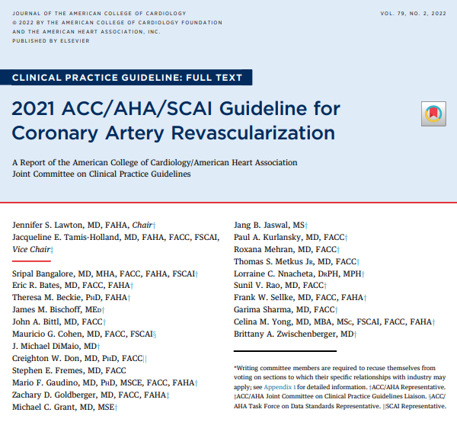

Slide 19
Overview
Review the Guideline Recommendations for aspirin therapy after PCI
Review the Guideline Recommendations for Duration of DAPT after PCI
Review the Guideline Recommendations for triple therapy after PCI
Highlight Unanswered Questions

Slide 20
Recommendations for Aspirin Use After PCI

Slide 21
2021 Recommendations for Aspirin in Patients Undergoing PCI
COR | LOE | Recommendations
1 | B-R | In patients undergoing PCI, a loading dose of aspirin, followed by daily dosing, is recommended to reduce ischemic events.*
J Am Coll Cardiol 2022;79:e21-e129

Slide 22
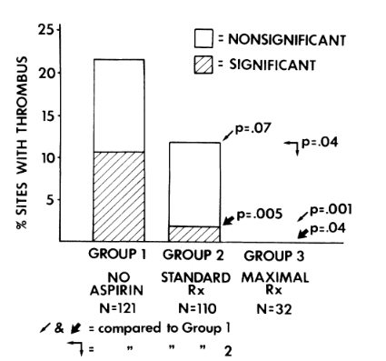
Aspirin During PCI
Circulation 1987;76:,125-134.
Notes:
ABSTRACTTotestthehypothesisthatpretreatmentwithadequateantiplatelettherapyreducesthelikelihoodofacutecoronarythrombosisduringroutinepercutaneoustransluminalcoronaryangioplasty(PTCA),wereviewed,blindedtotreatmentgroup,thefilmsandrecordsof300consecutiveinitiallysuccessfulPTCAs.FilmsbeforePTCA,immediatelyafter,andatleast30minafterthelastballooninflationwereassessedforthepresenceofanythrombusatthePTCAsite.Weexcluded37patientswhoreceivedstreptokinasebeforePTCAorwhohad100%occlusionorthrombusonpre-PTCAfilms.Newthrombiwereclassifiedasclinicallysignificant(definedascausing100%occlusionorrequiringemergencysurgeryorstreptokinasetherapy)orasnotsignificant(notcausinganacuteproblemorrequiringintervention).Patientswereclassifiedintothreegroups,basedonthetypeandextentofantiplatelettherapyreceived.Group1(noaspirin,n=121)consistedofpatientswhodidnotreceiveaspirineitherbeforeadmissionorinhospitalbeforePTCA(withorwithoutdipyridamole).Group2(standardtreatment,n=110)receivedaspirinwithorwithoutdipyridamolebutdidnotreceivebothdrugsbeforeadmissionandinhospitalbeforePTCA.Group3(maximaltreatment,n=32)receivedbothaspirinanddipyridamolebeforeadmissionandinhospitalbeforePTCA.Newthrombiweredetectedat39(14.8%)PTCAsites,ofwhich15(5.7%ofallPTCAsites)wereconsideredclinicallysignificant.Group1hadthehighestincidenceofboththrombus(21.5%)andclinicallysignificantthrombus(10.7%).Areductionwasseeningroup2inthrombus(11.8%;p=.07)andinclinicallysignificantthrombus(1.8%;p=.005).Group3hadnothrombus(p=.001)andnoclinicallysignificantthrombus(p=.04).Inadditiontoinadequatepretreatmentwithantiplatelettherapy,univariateanalysesdemonstratedseveralotherriskfactorsforthrombus:higherpercentdiameterstenosisbeforePTCA(p<.008),higherplateletcount(p=.013),andcurrentsmoking(p=.03).Onlyhigherplateletcount(p<.001)andinadequatepretreatment(p=.001)wereassociatedwithclinicallysignificantthrombus.Stepwiselogisticregressionanalysisdemonstratedthatforthrombus,thelackofeffectiveantiplatelettherapywasthemostdiscriminatoryvariable,followedbycurrentsmoking,higherpercentdiameterstenosis,anddissection.Forclinicallysignificantthrombus,oncethelackofpretreatmentwitheffectiveantiplatelettherapywasconsidered,nootherfactorsaddedsignificantdiscriminatoryinformation.Thus,antiplatelettherapyadministeredbeforePTCAisassoci-atedwithadecreasedincidenceandsignificanceofacutecoronarythrombosiscomplicatingPTCA.ThelackofeffectiveantiplatelettherapybeforePTCA,aswellascurrentsmoking,higherpercentdiameterstenosis,anddissection,identifypatientsatriskforthiscomplication.Circulation76,No.1,125-134,1987.FromtheCardiovascularandGeneralMedicineSections,Depart-ACUTECORONARYTHROMBOSISisapotentiallymentofMedicine,andtheLeonardDavisInstituteofHealthEconom-seriouscomplicationofpercutaneoustransluminalics,UniversityofPennsylvania,Philadelphia.coronaryangioplasty(PTCA)1-1andmayoccurinspiteDr.BarnathanisarecipientofAmericanHeartAssociationFellow-coronarytapayTa)loandumaycculrinjspitships,NortheasternandSouthCentralPennsylvaniaChapters.ofheparintherapy.Balloon-inducedvascularinjuryiSAddressforcorrespondence:ElliotBarnathan,M.D.,Cardiovascularapotentstimulusforplateletactivation,whichmaySection,HospitaloftheUniversityofPennsylvania,3400SpruceSt.,leadtothrombosis.AntiplatelettherapygivenbeforePhiladelphia,PA19104.ReceivedJan.28,1987;revisionacceptedMarch26,1987.noncoronaryangioplastywasassociatedwithde-PresentedinpartattheAmericanCollegeofCardiologyScientificcreaseddepositionofplateletsattheangioplastysiteinSessions,Atlanta,1986,andattheAmericanHeartAssociationScienti-ficSessions,Dallas,1986.pigsgivenlow-doseaspirinoraspirinanddipyrida-Vol.76,No.1,July1987125

Slide 23

Oral Antiplatelet Agents in Patients Undergoing PCI
Drug | Loading Dose | Maintenance Dose
Oral antiplatelet agents
Aspirin | Loading dose of 162-325 mg orally Aspirin may be chewed to achieve faster action | Maintenance dose of 75-100 mg orally daily
Clopidogrel | Loading dose of 600 mg orally A lower loading dose of 300 mg should be considered in patients after fibrinolytic therapy | Maintenance dose of 75 mg orally daily
Prasugrel | Loading dose of 60 mg orally | Maintenance dose of 10 mg orally daily In patients with body weight <60 kg, a maintenance dose of 5 mg orally daily is recommended In patients ≥75 years of age, a dose of 5 mg orally daily can be used if deemed necessary
Ticagrelor | Loading dose of 180 mg orally Ticagrelor may be chewed to achieve faster action | Maintenance dose of 90 mg orally twice a day
J Am Coll Cardiol 2022;79:e21-e129

Slide 24
Aspirin Dosing in ACS:
The Translate ACS Study
Bleeding
Ischemic Events
Circulation 2015; DOI: 10.1161/CIRCULATIONAHA.114.014992
Notes:
The Association of Discharge Aspirin Dose With Outcomes After Acute Myocardial Infarction: Insights From the TRANSLATE-ACS Study
Ying Xian, Tracy Y. Wang, Lisa A. McCoy, Mark B. Effron, Timothy D. Henry, Richard G. Bach, Marjorie E. Zettler, Brian A. Baker, Gregg C. Fonarow and Eric D. Peterson
Background—Aspirin is the most widely used antiplatelet drug post-myocardial infarction (MI), yet its optimal maintenance dose after percutaneous coronary intervention (PCI) with stenting remains uncertain.
Methods and Results—We compared outcomes of 10,213 MI patients who underwent PCI and were discharged on dual antiplatelet therapy at 228 United States hospitals in the TRANSLATE- ACS study from 2010–2012. Major adverse cardiovascular events (MACE) and bleeding within 6 months post-discharge were compared between high- (325 mg) and low-dose aspirin (81 mg) using regression models with inverse probability-weighted propensity adjustment. Overall, 6,387 patients (63%) received high-dose aspirin at discharge. MACE risk was not significantly
d
i
f
f
e
r
e
n
t
b
e
t
w
e
e
n
g
r
o
u
p
s
(
h
i
g
h
v
8.2% vs. 9.2%; adjusted hazard ratio 0.99, 8
di
u
s
t
e
d
2
4
.
2
%
v
s
.
2
2
.
7
%
;
a
d
j
u
s
t
e
d
o
d
d
s
r
a
t
i
o
[
O
R
]
1
.
1
9
,
%
B
A AR
C C
1 1
g g
pitalization (unadjusted 21.4% vs. 19.5%; p
B
t
y
p
e
o
r
2
b
l
e
e
d
i
n
e
v
e
n
t
s
n
o
t
r
e
q
u
s
a
3 3
a a
djusted OR 1.22, 95% CI 0.87–1.70). Similar
a
s
p
i
r
i
n
d
o
s
i
n
g
g
r
o
u
p
s
(
u
n
a
d
j
u
s
t
e
d
2
.
8
%
v
.
.
2
%
,
d
a
s
s
o
c
i
a
t
i
o
n
s
w
e
r
e
o
b
s
e
r
v
e
d
i
n
l
a
n
d
m
a
s
s
o
c
i
a
t
i
o
n
s
w
e
r
e
o
b
s
e
r
v
e
d
i
n
l
a
n
d
m
e
s
a
c
s
f
sp
f
e
R
t
y
p
e
o
r
2
b
l
e
e
d
i
n
e
v
e
n
t
s
n
o
t
r
e
q
u
u
s
t
e
d
O
R
1
.
1
9
,
9
5
%
–
1
.
3
4
)
.
l
e
e
d
i
n
g
e
n
i
r
r
i
e
n
d
n
t
b
s
.
2
e
t
w
2
.
e
7
%
e
n
g
;
a
r
d
o
j
u
u
p
s
t
s
(
e
n
d
o
a
h
d
i
j
g
d
u
h
v
d
s
s
r
t
e
s
s
d
2
.
l
o
w
:
u
n
a
d
j
.
l
a
t
i
o
o
[
.
w
8
a
r
k
a
n
a
a
r
k
a
n
a
l
y
s
e
s
a
c
%
v
:
u
O
R
n
s
s
.
.
2
%
,
]
1
.
1
9
,
9 9
a
d
i
r
i
n
g
h
o
s
i
r
i
n
g
h
o
j
i
n
u
s
g
v
t
e
c
inhibitor (clopidogrel vs. prasugrel/ticagrelor).
Conclusions—Among PCI-treated MI patients, high maintenance dose aspirin was associated with similar rates of MACE, but greater risk of minor bleeding compared with those discharged on low-dose aspirin.

Slide 25
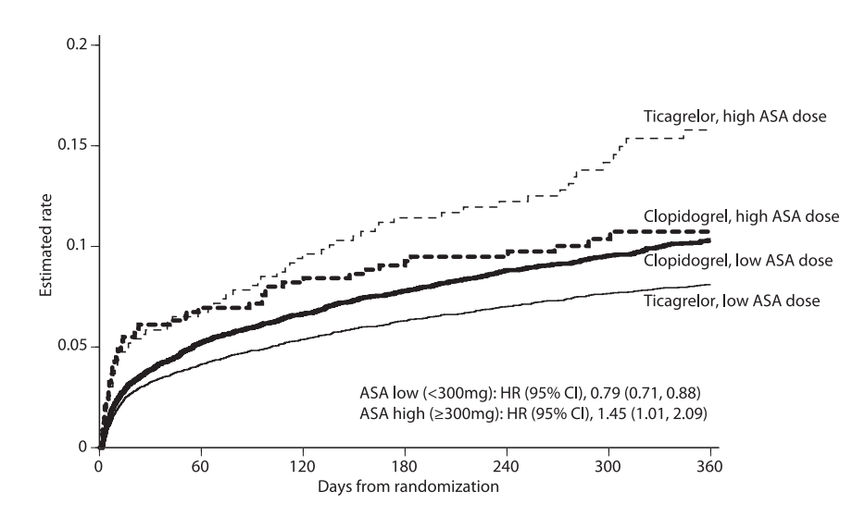
Aspirin Dose with Ticagrelor:
The PLATO Trial
Circulation 2011: doi.org/10.1161/CIRCULATIONAHA.111.047498
Notes:
Enrolled 18,654
Ticagrelor is an oral, reversible, direct-acting inhibitor of the adenosine diphosphate
receptor P2Y12 that has a more rapid onset and more pronounced platelet
inhibition than clopidogrel.
Methods
In this multicenter, double-blind, randomized trial, we compared ticagrelor (180-mg
loading dose, 90 mg twice daily thereafter) and clopidogrel (300-to-600-mg loading
dose, 75 mg daily thereafter) for the prevention of cardiovascular events in 18,624
patients admitted to the hospital with an acute coronary syndrome, with or without
ST-segment elevation.
Results
At 12 months, the primary end point — a composite of death from vascular causes,
myocardial infarction, or stroke — had occurred in 9.8% of patients receiving ticagrelor
as compared with 11.7% of those receiving clopidogrel (hazard ratio, 0.84;
95% confidence interval [CI], 0.77 to 0.92; P<0.001). Predefined hierarchical testing
of secondary end points showed significant differences in the rates of other composite
end points, as well as myocardial infarction alone (5.8% in the ticagrelor
group vs. 6.9% in the clopidogrel group, P = 0.005) and death from vascular causes
(4.0% vs. 5.1%, P = 0.001) but not stroke alone (1.5% vs. 1.3%, P = 0.22). The rate of
death from any cause was also reduced with ticagrelor (4.5%, vs. 5.9% with clopidogrel;
P<0.001). No significant difference in the rates of major bleeding was found
between the ticagrelor and clopidogrel groups (11.6% and 11.2%, respectively;
P = 0.43), but ticagrelor was associated with a higher rate of major bleeding not related
to coronary-artery bypass grafting (4.5% vs. 3.8%, P = 0.03), including more
instances of fatal intracranial bleeding and fewer of fatal bleeding of other types.
Conclusions
In patients who have an acute coronary syndrome with or without ST-segment elevation,
treatment with ticagrelor as compared with clopidogrel significantly reduced
the rate of death from vascular causes, myocardial infarction, or stroke without an
increase in the rate of overall major bleeding but with an increase in the rate of non–

Slide 26
Recommendations for Duration of DAPT After PCI

Slide 27
2016 Recommendations for Duration of DAPT after PCI for ACS
COR | LOE | Recommendations
I | B-R | In patients with ACS (NSTE-ACS or STEMI) treated with DAPT after BMS or DES implantation, P2Y₁₂ inhibitor therapy (clopidogrel, prasugrel, or ticagrelor) should be given for at least 12 months.
IIb | A ^{SR} | In patients with ACS (NSTE-ACS or STEMI) treated with coronary stent implantation who have tolerated DAPT without a bleeding complication and who are not at high bleeding risk (e.g., prior bleeding on DAPT, coagulopathy, oral anticoagulant use), continuation of DAPT (clopidogrel, prasugrel, or ticagrelor) for longer than 12 months may be reasonable .
IIb | C-LD | In patients with ACS treated with DAPT after DES implantation who develop a high risk of bleeding (e.g., treatment with oral anticoagulant therapy), are at high risk of severe bleeding complication (e.g., major intracranial surgery), or develop significant overt bleeding, discontinuation of P2Y₁₂ inhibitor therapy after 6 months may be reasonable.
J Am Coll Cardiol 2016;68:1082–115;

Slide 28
2016 Recommendations for Duration of DAPT after PCI for SIHD
COR | LOE | Recommendations
I | B-R ^{SR} | In patients with SIHD treated with DAPT after DES implantation, P2Y₁₂ inhibitor therapy (clopidogrel) should be given for at least 6 months.
IIb | A ^{SR} | In patients with SIHD treated with DAPT after BMS or DES implantation who have tolerated DAPT without a bleeding complication and who are not at high bleeding risk (e.g., prior bleeding on DAPT, coagulopathy, oral anticoagulant use), continuation of DAPT with clopidogrel for longer than 1 month in patients treated with BMS or longer than 6 months in patients treated with DES may be reasonable.
IIb | C-LD | In patients with SIHD treated with DAPT after DES implantation who develop a high risk of bleeding (e.g., treatment with oral anticoagulant therapy), are at high risk of severe bleeding complication (e.g., major intracranial surgery), or develop significant overt bleeding, discontinuation of P2Y₁₂ inhibitor therapy after 3 months may be reasonable.
J Am Coll Cardiol 2016;68:1082–115;

Slide 29
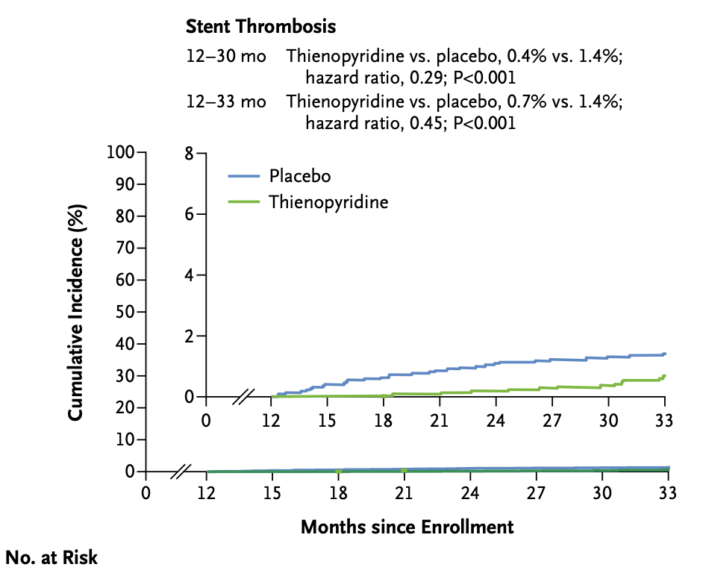
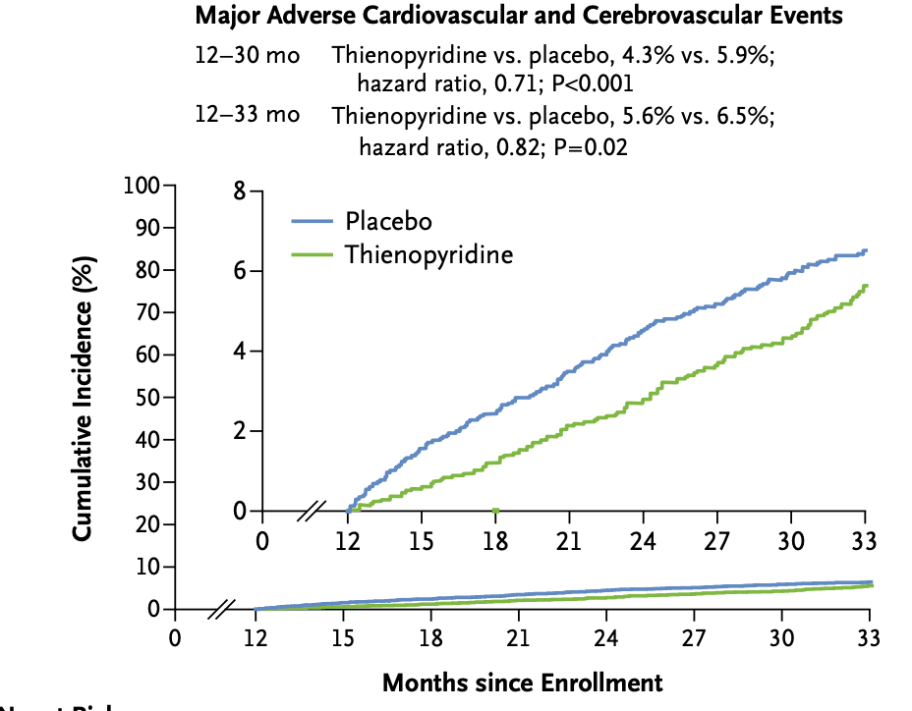
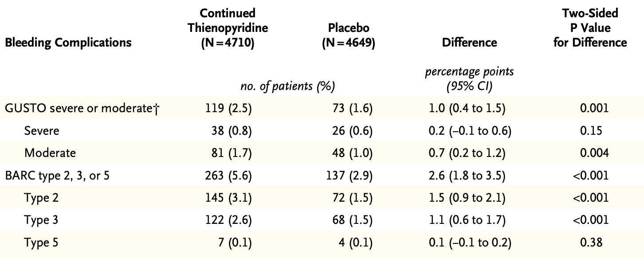
Duration of DAPT
The DAPT Trial
N Engl J Med 2014; 371:2155-2166

Slide 30
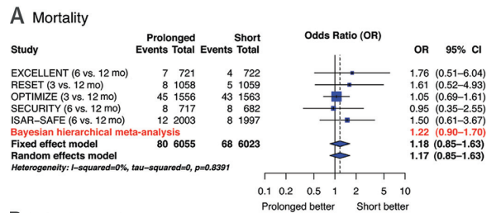
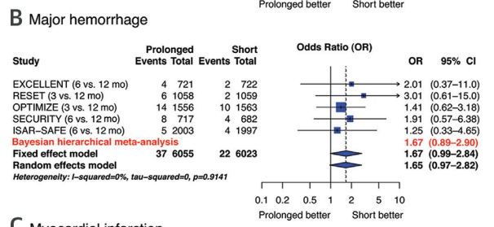
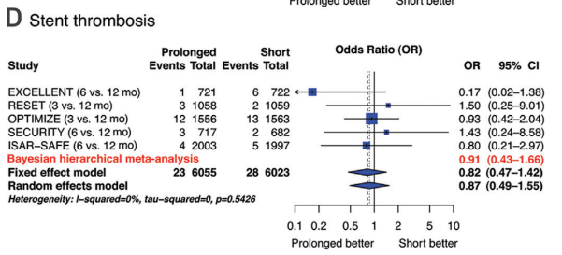
Duration of DAPT
Pooled Data 3-6 Months vs 12 Months
J Am Coll Cardiol 2016;68:1116–39

Slide 31
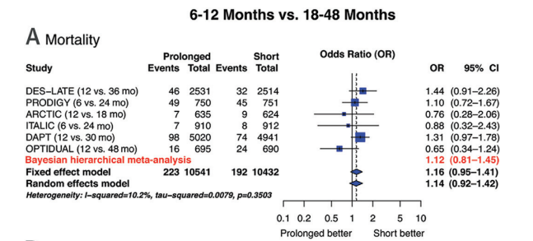
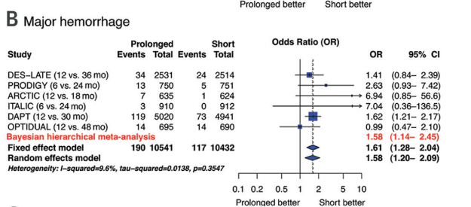
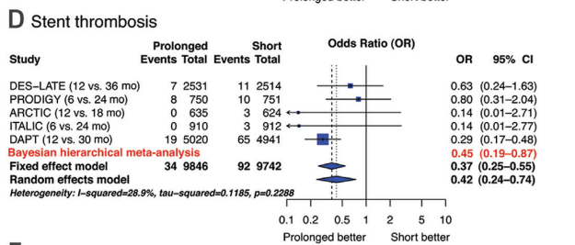
Duration of DAPT
Pooled Data 6-12 Months vs 18-48 Months
J Am Coll Cardiol 2016;68:1116–39

Slide 32
2021 Recommendations for Duration of DAPT After PCI
COR | LOE | Recommendation
2a | A | In selected patients undergoing PCI, shorter-duration DAPT (1–3 months) is reasonable, with subsequent transition to P2Y12 inhibitor monotherapy to reduce the risk of bleeding events.
J Am Coll Cardiol 2022;79:e21-e129

Slide 33
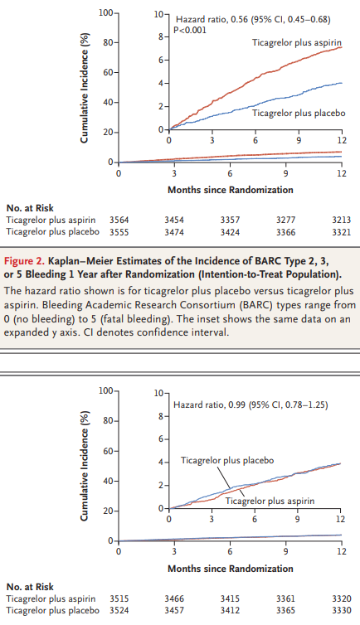
Duration of DAPT
The TWILIGHT Trial
BARC 2, 3 or 5 Bleeding at 12 Months
Death, MI or CVA at 12 Months
N Engl J Med 2019;381:2032-42

Slide 34
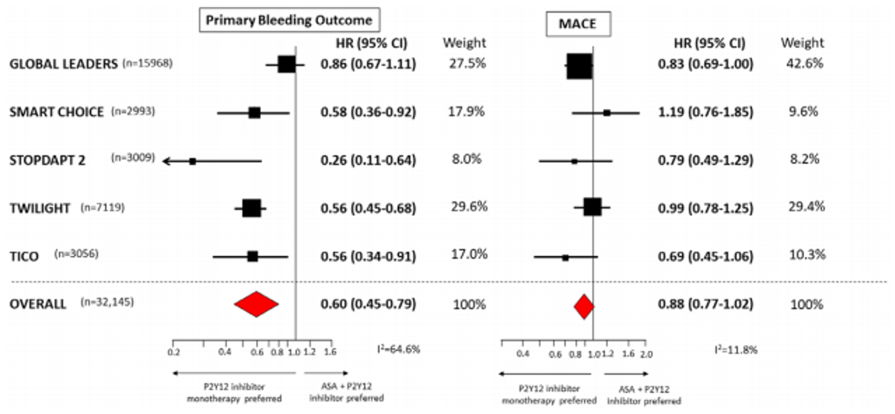
P2Y12 Mono-therapy Trials
Pooled Data
Circulation. 2020;142:538–545

Slide 35
Patients Undergoing PCI
SIHD
ACS
DES
BMS
0 mo
≥6 mo
aspirin plus clopidogrel (Class 1)
≥1 mo
aspirin plus clopidogrel (Class 1)
≥12 mo
aspirin plus clopidogrel,
or prasugrel,
or ticagrelor (Class 1)
1 mo
Discontinue aspirin after
1-3 mo with continued P2Y12 monotherapy (Class 2a)
Discontinue aspirin after 1-3 month with continued P2Y12 monotherapy (Class 2a)
If high risk of bleeding or overt bleeding on DAPT, discontinuing
P2Y12 after 3mo may be reasonable (Class 2b)
3 mo
If high risk of bleeding or overt bleeding on DAPT, discontinuing P2Y12 after 6mo may be reasonable (Class 2b)
6 mo
If no high risk of bleeding or significant overt bleeding on DAPT, >6 mo. DAPT may be reasonable (Class 2b)
If no high risk of bleeding or significant overt bleeding on DAPT, >1 mo DAPT may be reasonable (Class 2b)
12 mo
If no high risk of bleeding or significant overt bleeding on DAPT, >1 y DAPT may be reasonable (Class 2b)
J Am Coll Cardiol 2022;79:e21-e129

Slide 36
Recommendations for Triple Therapy in Patients with Atrial Fibrillation Undergoing PCI

Slide 37
Recommendations for Triple Therapy in Patients with Atrial Fibrillation Undergoing PCI
COR | LOE | Recommendations
1 | B-R | In patients with atrial fibrillation who are undergoing PCI and are taking oral anticoagulant therapy, it is recommended to discontinue aspirin treatment after 1 to 4 weeks while maintaining P2Y12 inhibitors in addition to a non–vitamin K oral anticoagulant (rivaroxaban, dabigatran, apixaban, or edoxaban) or warfarin to reduce the risk of bleeding.
J Am Coll Cardiol 2022;79:e21-e129

Slide 38
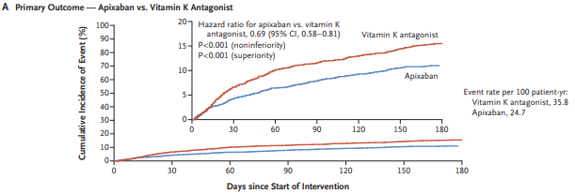
Triple Therapy
The AUGUSTUS Trial
Major or Clinically Relevant Bleeding
N Engl J Med 2019;380:1509-24
Notes:
BACKGROUND
Appropriate antithrombotic regimens for patients with atrial fibrillation who have an acute coronary syndrome or have undergone percutaneous coronary intervention (PCI) are unclear.
METHODS
In an international trial with a two-by-two factorial design, we randomly assigned patients with atrial fibrillation who had an acute coronary syndrome or had undergone PCI and were planning to take a P2Y₁₂ inhibitor to receive apixaban or a vitamin K antagonist and to receive aspirin or matching placebo for 6 months. The primary outcome was major or clinically relevant nonmajor bleeding. Secondary outcomes included death or hospitalization and a composite of ischemic events.
RESULTS
Enrollment included 4614 patients from 33 countries. There were no significant interactions between the two randomization factors on the primary or secondary outcomes. Major or clinically relevant nonmajor bleeding was noted in 10.5% of the patients receiving apixaban, as compared with 14.7% of those receiving a vitamin K antagonist (hazard ratio, 0.69; 95% confidence interval [CI], 0.58 to 0.81; P<0.001 for both noninferiority and superiority), and in 16.1% of the patients receiving aspirin, as compared with 9.0% of those receiving placebo (hazard ratio, 1.89; 95% CI, 1.59 to 2.24; P<0.001). Patients in the apixaban group had a lower incidence of death or hospitalization than those in the vitamin K antagonist group (23.5% vs. 27.4%; hazard ratio, 0.83; 95% CI, 0.74 to 0.93; P=0.002) and a similar incidence of ischemic events. Patients in the aspirin group had an incidence of death or hospitalization and of ischemic events that was similar to that in the placebo group.
CONCLUSIONS
In patients with atrial fibrillation and a recent acute coronary syndrome or PCI treated with a P2Y₁₂ inhibitor, an antithrombotic regimen that included apixaban, without aspirin, resulted in less bleeding and fewer hospitalizations without significant differences in the incidence of ischemic events than regimens that included a vitamin K antagonist, aspirin, or both. (Funded by Bristol-Myers Squibb and Pfizer; AUGUSTUS ClinicalTrials.gov number, NCT02415400. opens in new tab.)

Slide 39
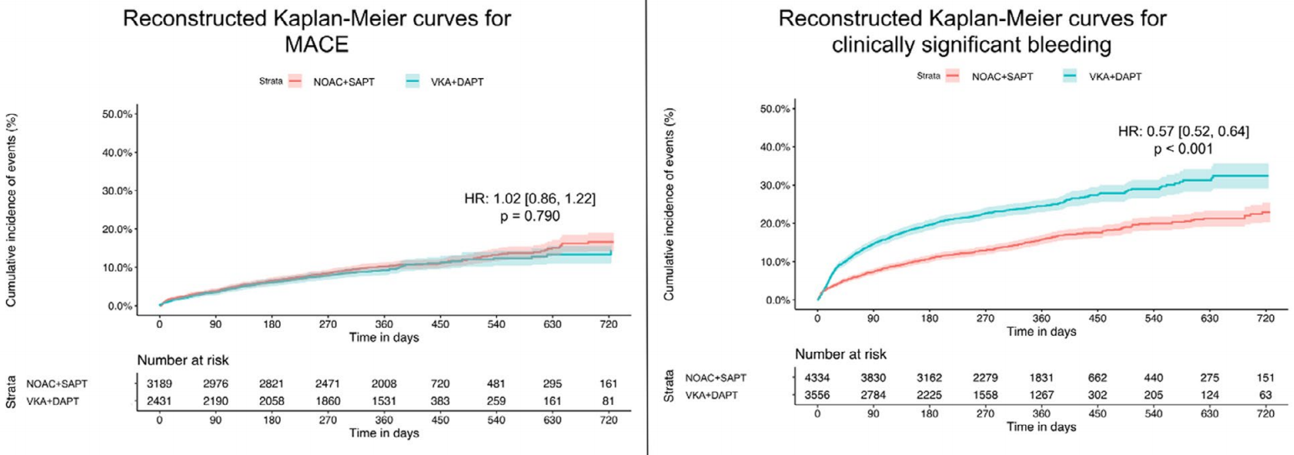
Triple Therapy
Pooled Data
J Am Heart Assoc. 2020;9:e017212. DOI: 10.1161/JAHA.120.017212

Slide 40
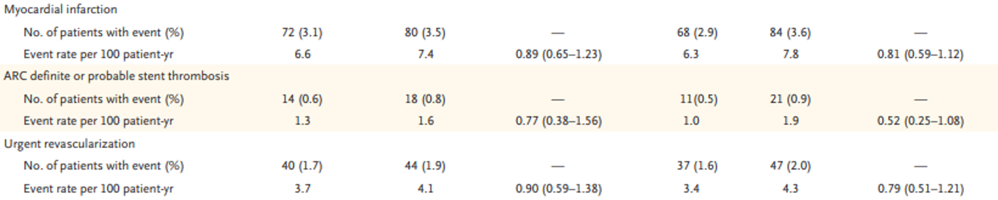
A Deep Dive into the Data from the AUGUSTUS Trial
N Engl J Med 2019;380:1509-24

Slide 41
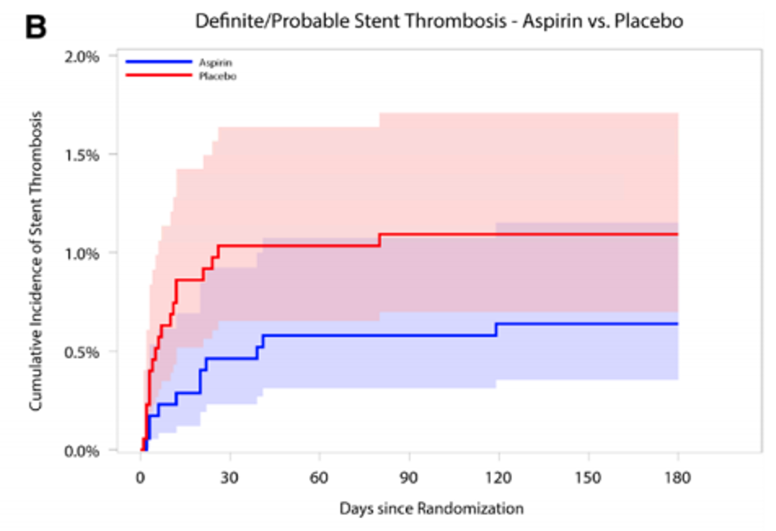
Timing of Stent Thrombosis in The AUGUSTUS Trial
Circulation 2020;141:781-783

Slide 42
Unanswered Questions

Slide 43
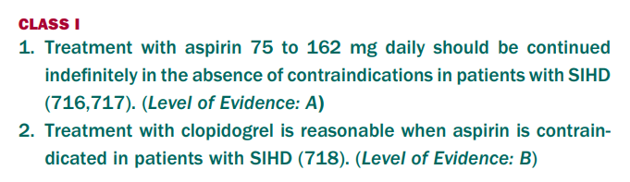
Recommendations for Chronic Use of Anti-platelet therapy
J Am Coll Cardiol 2012;60:e44–164.

Slide 44
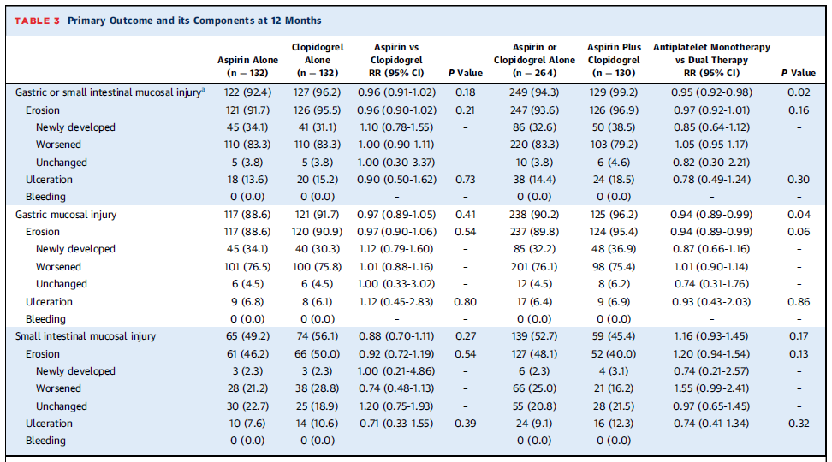
Gastric Erosions with Various Anti-Platelet Regimens
The OPT-PEACE Trial
J Am Coll Cardiol 2022;79:116–128
Notes:
OBJECTIVES The authors sought to assess the effects of different antiplatelet regimens on gastrointestinal mucosal
injury by means of a novel magnetically controlled capsule endoscopy system in patients at low bleeding risk.
METHODS Patients (n ¼ 505) undergoing percutaneous coronary intervention in whom capsule endoscopy demonstrated
no ulcerations or bleeding (although erosions were permitted) after 6 months of dual antiplatelet therapy (DAPT)
were randomly assigned to aspirin plus placebo (n ¼ 168), clopidogrel plus placebo (n ¼ 169), or aspirin plus clopidogrel
(n ¼ 168) for an additional 6 months. The primary endpoint was the incidence of gastrointestinal mucosal injury (erosions,
ulceration, or bleeding) at 6-month or 12-month capsule endoscopy.
RESULTS Gastrointestinal mucosal injury through 12 months was less with single antiplatelet therapy (SAPT) than with
DAPT (94.3% vs 99.2%; P ¼ 0.02). Aspirin and clopidogrel monotherapy had similar effects. Among 68 patients without
any gastrointestinal injury at randomization (including no erosions), SAPT compared with DAPT caused less gastrointestinal
injury (68.1% vs 95.2%; P ¼ 0.006), including fewer new ulcers (8.5% vs 38.1%; P ¼ 0.009). Clinical gastrointestinal
bleeding from 6 to 12 months was less with SAPT than with DAPT (0.6% vs 5.4%; P ¼ 0.001).
CONCLUSIONS Despite being at low risk of bleeding, nearly all patients receiving antiplatelet therapy developed
gastrointestinal injury, although overt bleeding was infrequent. DAPT for 6 months followed by SAPT with aspirin or
clopidogrel from 6 to 12 months resulted in less gastrointestinal mucosal injury and clinical bleeding compared with DAPT
through 12 months. (OPT-PEACE [Optimal Antiplatelet Therapy for Prevention of Gastrointestinal Injury Evaluated by
Ankon Magnetically Controlled Capsule Endoscopy]; NCT03198741) (J Am Coll Cardiol 2022;79:116–128) © 2022 the
American College of Cardiology Foundation. Published by Elsevier. All rights reserved.

Slide 45
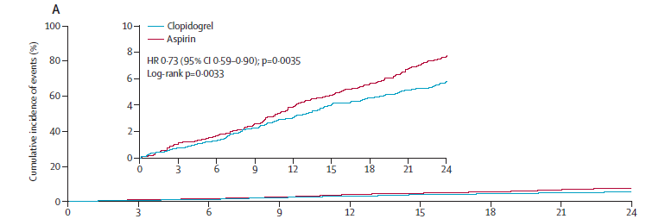
Clinical Outcomes with Aspirin vs Clopidogrel
The HOST Trial
Death, myocardial infarction, stroke, readmission due to ACS, and BARC 3 or More Bleeding
Major bleeding (BARC type ≥3)
Clopidogrel vs Aspirin
1·2% vs 2·0%, p=0·035
Lancet 2021; 397: 2487–96
Notes:
Summary
Background Optimal antiplatelet monotherapy during the chronic maintenance period in patients who undergo coronary stenting is unknown. We aimed to compare head to head the efficacy and safety of aspirin and clopidogrel monotherapy in this population.
Methods We did an investigator-initiated, prospective, randomised, open-label, multicentre trial at 37 study sites in South Korea. We enrolled patients aged at least 20 years who maintained dual antiplatelet therapy without clinical events for 6–18 months after percutaneous coronary intervention with drug-eluting stents (DES). We excluded patients with any ischaemic and major bleeding complications. Patients were randomly assigned (1:1) to receive a monotherapy agent of clopidogrel 75 mg once daily or aspirin 100 mg once daily for 24 months. The primary endpoint was a composite of all-cause death, non-fatal myocardial infarction, stroke, readmission due to acute coronary syndrome, and Bleeding Academic Research Consortium (BARC) bleeding type 3 or greater, in the intention-to-treat population. This trial is registered with ClinicalTrials.gov, NCT02044250.
Findings Between March 26, 2014, and May 29, 2018, we enrolled 5530 patients. 5438 (98·3%) patients were randomly assigned to either the clopidogrel group (2710 [49·8%]) or to the aspirin group (2728 [50·2%]). Ascertainment of the primary endpoint was completed in 5338 (98·2%) patients. During 24-month follow-up, the primary outcome occurred in 152 (5·7%) patients in the clopidogrel group and 207 (7·7%) in the aspirin group (hazard ratio 0·73 [95% CI 0·59–0·90]; p=0·0035).
Interpretation Clopidogrel monotherapy, compared with aspirin monotherapy during the chronic maintenance period after percutaneous coronary intervention with DES significantly reduced the risk of the composite of all-cause death, non-fatal myocardial infarction, stroke, readmission due to acute coronary syndrome, and BARC bleeding type 3 or greater. In patients requiring indefinite antiplatelet monotherapy after percutaneous coronary intervention, clopidogrel monotherapy was superior to aspirin monotherapy in preventing future adverse clinical events.

Slide 46
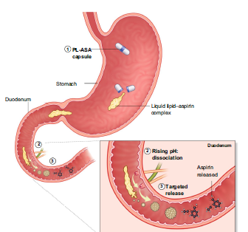
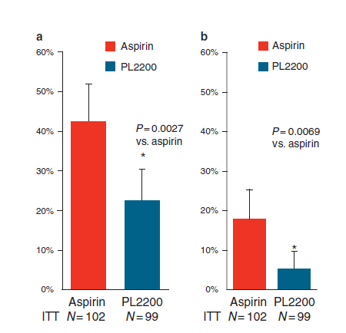
Aspirin-Phosphatidylcholine Complex
Gastro-duodenal Mucosal Damage
Clinical Pharmacokinetics https://doi.org/10.1007/s40262-021-01090-2
Am J Gastroenterol advance online publication, 16 November 2010; doi: 10.1038/ajg.2010.436

Slide 47
Thank you
Questions?

