Slide 1
Fractional Flow Reserve versus Intravascular Ultrasound to Guide Percutaneous Coronary Intervention
The FLAVOUR trial
Bon-Kwon Koo, MD, PhD
Seoul National University Hospital, Seoul, Republic of Korea

Slide 2
Fractional Flow Reserve vs. Intravascular Ultrasound
to Guide Percutaneous Coronary Intervention
The FLAVOUR trial
Bon-Kwon Koo, MD, PhD
Seoul National University Hospital, Seoul, Republic of Korea

Slide 3
Disclosures
The FLAVOUR [Fractional Flow Reserve and Intravascular Ultrasound-Guided Intervention Strategy for Clinical Outcomes in Patients with Intermediate Stenosis] trial is an investigator-initiated, prospective, randomized, open-label, multinational trial.
The FLAVOUR trial received research grants from Boston Scientific.
The study funder had no role in trial design, data collection, analysis, interpretation, or manuscript writing.

Slide 4
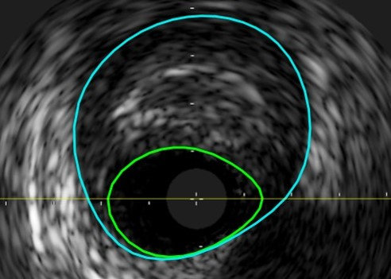
Background
The prognosis of patients with coronary artery disease is determined by multiple factors such as degree of luminal narrowing, plaque burden, plaque characteristics, physiologic significance, and appropriateness of revascularization procedures.
Adjunctive tools are used to better determine the need for percutaneous coronary intervention (PCI) and its optimization.
An outcome-based comparison trial is needed to unravel the clinical relevance of the conceptual difference between physiology-guided PCI and imaging-guided PCI.
“Which approach can bring better clinical and patient-reported outcomes?”
Fractional Flow Reserve (FFR)
Invasive physiologic index to define ischemia-causing stenosis.
Intravascular Ultrasound (IVUS)
Invasive imaging tool to evaluate anatomical severity and plaque characteristics, and to optimize PCI

Slide 5
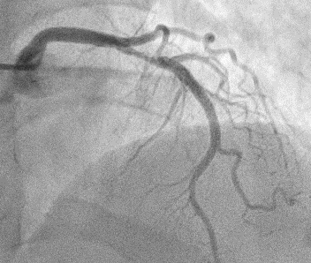
Objective
To compare the efficacy of FFR-guided PCI strategy with IVUS-guided PCI strategy in patients with intermediate coronary stenosis.
Working Hypothesis
The FFR-guided PCI strategy will be non-inferior to the IVUS-guided PCI strategy in regard to clinical outcomes at 2 years after the index procedure.

Slide 6
Endpoints and Sample Size Calculation
Endpoints
Primary Endpoint: Patient-oriented composite outcome (POCO) at 24 months
A composite of death from any cause, myocardial infarction (MI), and any revascularization at 24 months
Secondary Endpoints
Individual components of the primary end point, number of stents used, stroke, and patient-reported outcomes measured with Seattle Angina Questionnaire (SAQ)
Sample size calculation
Assumed 24-month POCO in the FFR-guided PCI group: 10.0%
Assumed 24-month POCO in the IVUS-guided PCI group: 12.0%
Type I error: 0.05, Power: 90%
Non-inferiority margin: 2.5%
A total of 1,700 patients was needed.

Slide 7
Randomization and Data Collection
Randomization
Eligible patients were randomized via a web-based randomization sequence.
Stratification methods were applied by participating centers and by the presence of diabetes mellitus.
Data collection and management
Data collected by a web-based electronic case report form (eCRF)
An independent data and safety monitoring board monitored the trial.
All clinical events were adjudicated by an independent clinical event adjudication committee.

Slide 8
Study Organization
Principal Investigators
JianAn Wang, Bon-Kwon Koo, Seung-Jea Tahk
Executive Committee
Bon-Kwon Koo
JianAn Wang
Seung-Jea Tahk
Xinyang Hu
Chang-Wook Nam
Joon-Hyung Doh
Eun-Seok Shin
Bong-Ki Lee
Clinical Event Adjudication Committee
Jang-Whan Bae (Chair)
Sang Hyun Park
Jin-Sin Koh
Data Safety Monitoring Board
Jung-Sun Kim (Chair)
Hyun-Kuk Kim
Woojoo Lee (Statistician)
Publication Committee
Bon-Kwon Koo
Chang-Wook Nam
Joo-Yong Hahn
Joon-Hyung Doh
Xinyang Hu
Jeehoon Kang
Jinlong Zhang
Data Coordination and Management
Xiaoyuan Qu, Beijing Yjheal Medical Research Center

Slide 9
Study Design and Patient Population
Inclusion and Exclusion criteria
Patients with de novo intermediate stenosis (40-70% stenosis in major vessels) eligible for PCI
Inclusion criteria
a) ≥ 19 years old b) Suspected to have ischemic heart disease and have intermediate coronary stenosis on coronary angiography c) Eligible for PCI, target vessel size ≥ 2.5mm d) Written informed consent
Exclusion criteria
a) Known hypersensitivity or contraindication to key medications b) Patients with active pathologic bleeding c) Target lesion in bypass graft or in left main artery d) History of bleeding diathesis, known coagulopathy e) Co-morbid conditions with life expectancy <2 years
Randomization
FFR-guided PCI
IVUS-guided PCI
Patient-oriented composite outcome* at 24 months after the index procedure
* Primary Endpoint: a composite of death from any cause, myocardial infarction, and any revascularization

Slide 10
Indications for PCI & PCI Optimization
FFR-guided PCI | IVUS-guided PCI
Indications for PCI
FFR ≤ 0.80 | Minimum lumen area (MLA) ≤ 3mm² or 3 < MLA ≤ 4mm² & Plaque burden > 70%
Criteria for optimal PCI
Post-PCI FFR ≥ 0.88 or Post-PCI ∆FFR (FFR across the stent) < 0.05 | Plaque burden at stent edge ≤ 55% Minimal stent area ≥ 5.5mm² or Minimal stent area ≥ distal reference lumen area

Slide 11
Trial Flow
1700 eligible patients
18 patients excluded from randomization
1682 patients randomized
838 patients enrolled in the
FFR-guided PCI group
844 patients enrolled in the
IVUS-guided PCI group
3 failed to get adequate FFR results
16 failed to get adequate IVUS results
16 protocol violations
12 were deferred with positive FFR
4 underwent PCI with negative FFR
28 protocol violations
16 were deferred with positive IVUS
7 underwent PCI with negative IVUS
5 received PCI with POBA or DCB treatment
6 were lost to follow-up
8 were lost to follow-up
832 (99.3%) patients completed
24 months follow-up
836 (99.1%) patients completed
24 months follow-up

Slide 12
Baseline Clinical Characteristics
 | Total (N=1682) | FFR-guided PCI (N=838) | IVUS-guided PCI (N=844)
Age, years | 65.1±9.6 | 65.4±9.4 | 64.8±9.9
Male, n (%) | 1187 (70.6) | 584 (69.7) | 603 (71.4)
Diagnosis, n (%)
Stable angina | 1063 (63.2) | 519 (61.9) | 544 (64.5)
Acute coronary syndrome | 496 (29.5) | 252 (30.1) | 244 (28.9)
Diabetes mellitus, n (%) | 554 (32.9) | 272 (32.5) | 282 (33.4)
Hypertension, n (%) | 1147 (68.2) | 577 (68.9) | 570 (67.5)
Current smoking, n (%) | 321 (19.1) | 166 (19.8) | 155 (18.4)
Prior MI, n (%) | 95 (5.6) | 56 (6.7) | 39 (4.6)
LV ejection fraction, % | 63.6±8.4 | 63.3±8.5 | 63.9±8.3
Discharge medication
Aspirin, n (%) | 1323 (78.7) | 630 (75.2) | 693 (82.1)
P2Y₁₂ inhibitor, n (%) | 1383 (82.2) | 653 (77.9) | 730 (86.5)
Dual antiplatelet therapy, n (%) | 1093 (65.0) | 487 (58.1) | 606 (71.8)
Statin, n (%) | 1612 (95.8) | 800 (95.5) | 812 (96.2)
Beta blocker, n (%) | 733 (43.6) | 355 (42.4) | 378 (44.8)

Slide 13
Baseline Procedural Characteristics
 | Total | FFR-guided PCI | IVUS-guided PCI | P value
Angiographic findings | n=1682 | n=838 | n=844
Multi-vessel disease, n (%) | 875 (52.0) | 445 (53.1) | 430 (50.9) | 0.782
Patients who received PCI, n (%) | 923 (54.9) | 372 (44.4) | 551 (65.3) | <0.001
Total stent number / total no. of patients | 0.8±0.9 | 0.6±0.9 | 0.9±1.0 | <0.001
Total stent length / total no. of patients, mm | 20.9±26.6 | 16.5±24.1 | 25.2±28.1 | <0.001
Target vessel | n=1820 | n=919 | n=901
Lesion length, mm | 20.3±10.6 | 20.1±10.3 | 20.5±11.0 | 0.487
Reference vessel diameter, mm | 3.0±0.5 | 3.0±0.5 | 3.0±0.5 | 0.784
Diameter stenosis, % | 56.8±10.1 | 56.7±10.1 | 56.9±10.1 | 0.633
Target vessel PCI, n (%) | 831 (45.7) | 305 (33.2) | 526 (58.4) | <0.001
IVUS findings
Minimal luminal area, mm² |  |  | 3.4±1.3
Plaque burden, % |  |  | 70.1±10.2
Post PCI minimal stent area, mm² |  |  | 7.0±2.2
FFR findings
FFR |  | 0.83±0.09
Post PCI FFR |  | 0.88±0.06

Slide 14
Primary Outcome
100
15
P for non-inferiority = 0.015
Difference in risk: -0.4%
(95% upper one-sided bound = 1.8, 97.5% = 2.2)
IVUS group
8.5%
80
10
8.1%
FFR group
60
Patients with POCO (%)
5
40
0
0
3
6
9
12
15
18
21
24
20
0
0
3
6
9
12
15
18
21
24
Number at risk
Months after Randomization
IVUS
844
828
825
820
809
792
784
771
690
FFR
838
818
816
812
796
781
778
770
699
* Primary Endpoint: death from any cause, myocardial infarction, and any revascularization

Slide 15
Clinical Outcomes at 24-months
 | Total (n=1682) | FFR-guided PCI (n=838) | IVUS-guided PCI (n=844) | P Value
Death from any cause | 30 (1.8) | 11 (1.3) | 19 (2.3) | 0.147
- Death from cardiac cause | 18 (1.1) | 7 (0.8) | 11 (1.3) | 0.350
- Death from non-cardiac cause | 12 (0.7) | 4 (0.5) | 8 (1.0) | 0.251
Myocardial infarction | 30 (1.8) | 16 (1.9) | 14 (1.7) | 0.696
- Peri-procedural myocardial infarction | 18 (1.1) | 10 (1.2) | 8 (0.9) | 0.623
- Spontaneous myocardial infarction | 12 (0.7) | 6 (0.7) | 6 (0.7) | 0.989
- Target vessel myocardial infarction | 5 (0.3) | 3 (0.4) | 2 (0.2) | 0.648
Revascularization | 91 (5.5) | 47 (5.7) | 44 (5.3) | 0.713
- Ischemia-driven revascularization | 71 (4.3) | 38 (4.6) | 33 (4.0) | 0.522
- Target vessel revascularization | 47 (2.8) | 27 (3.3) | 20 (2.4) | 0.288
Stroke | 16 (1.0) | 6 (0.7) | 10 (1.2) | 0.323

Slide 16
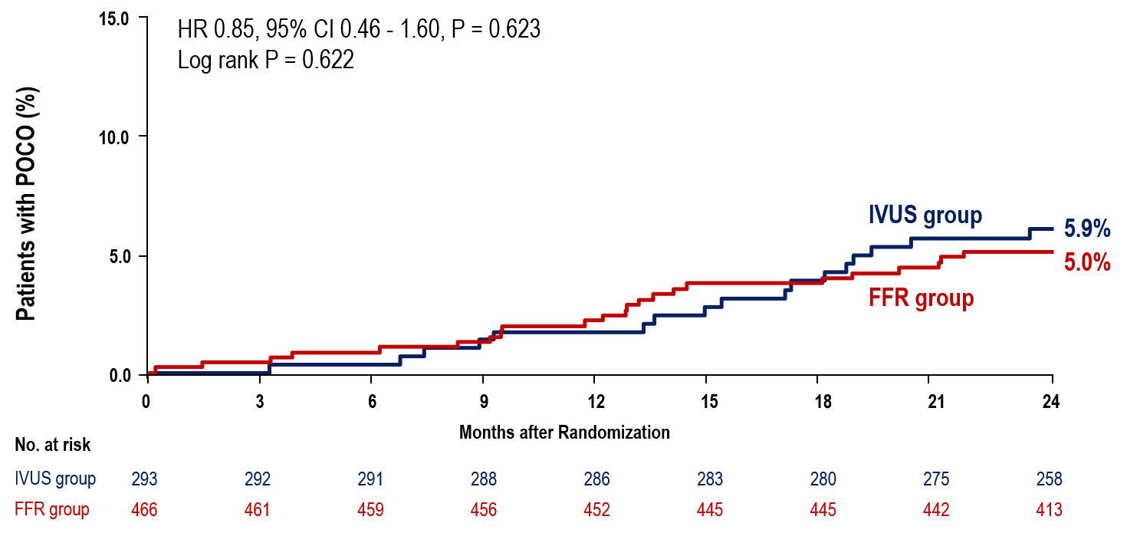
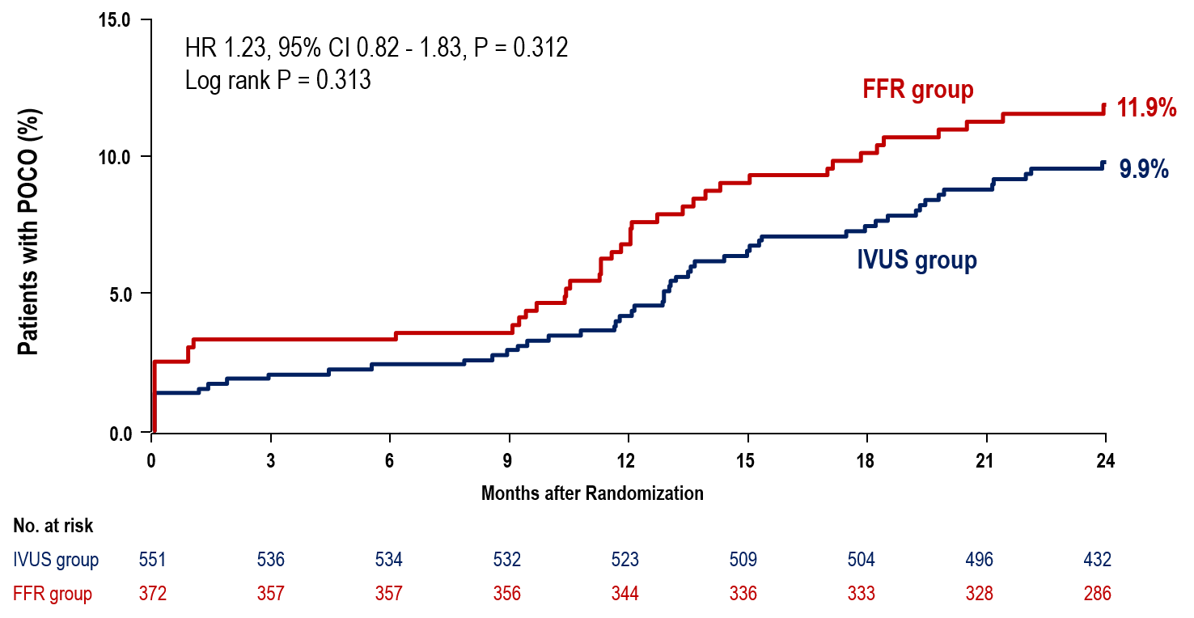
Primary Outcome According to Treatment
Medical treatment
PCI

Slide 17
Optimal PCI vs. Suboptimal PCI
Optimal PCI: FFR-guided PCI 50.1%, IVUS-guided PCI 54.8%
FFR-guided PCI
IVUS-guided PCI
15.0
Overall p-value = 0.001
Optimal PCI 12.3%
15.0
Overall p-value = 0.212
Suboptimal PCI 9.8%
10.0
Suboptimal PCI 11.8%
10.0
Optimal PCI 8.5%
Patients with POCO (%)
Medical treatment 5.0%
Patients with POCO (%)
5.0
5.0
Medical treatment 5.9%
0.0
0.0
0
3
6
9
12
15
18
21
24
0
3
6
9
12
15
18
21
24
Months after Randomization
Months after Randomization
No. at risk
No. at risk
MT
466
461
459
456
452
445
445
442
413
MT
293
292
291
288
286
283
280
275
258
Optimal
172
165
165
164
160
155
153
152
135
Optimal
261
255
254
254
249
242
240
237
211
Suboptimal
171
163
163
163
157
154
153
150
129
Suboptimal
215
209
208
206
203
198
196
192
162

Slide 18
No significant interaction between the treatment effect and key subgroups
Subgroup Analysis
Subgroup | FFR group (events/patients) | IVUS group (events/patients) |  | Hazard Ratio (95% CI)
Age
< 65 years | 29/376 | 26/397 |  | 1.19 (0.70-2.02)
≥ 65 years | 38/462 | 45/447 |  | 0.82 (0.53-1.26)
Sex
Male | 50/584 | 54/603 |  | 0.96 (0.65-1.41)
Female | 17/254 | 17/241 |  | 0.95 (0.49-1.87)
Diabetes mellitus
Yes | 25/272 | 23/282 |  | 1.12 (0.64-1.98)
No | 42/566 | 48/562 |  | 0.87 (0.58-1.32)
Clinical presentation as ACS
Yes | 25/252 | 25/244 |  | 0.98 (0.56-1.70)
No | 42/586 | 46/600 |  | 0.94 (0.62-1.42)
LAD as the target vessel
Yes | 40/573 | 45/554 |  | 0.86 (0.56-1.32)
No | 27/265 | 26/290 |  | 1.15 (0.67-1.97)
Multivessel coronary artery disease
Yes | 53/445 | 46/430 |  | 1.13 (0.76-1.67)
No | 14/393 | 25/414 |  | 0.59 (0.30-1.13)
FFR-guided PCI better
IVUS-guided PCI better

Slide 19
Per-Protocol Analysis: Primary Outcome
15.0
P for non-inferiority = 0.016
Difference in risk: -0.5%
(95% upper one-sided bound = 1.8, 97.5% = 2.3)
IVUS group
10.0
8.7%
Patients with POCO (%)
8.2%
FFR group
5.0
0.0
0
3
6
9
12
15
18
21
24
Months after Randomization
No. at risk
IVUS group
800
784
781
776
766
749
741
729
649
FFR group
819
799
797
793
777
762
759
751
685
* Primary Endpoint: death from any cause, myocardial infarction, and any revascularization

Slide 20
No difference in SAQ scores
Patient-Reported Outcomes
Seattle Angina Questionnaire (SAQ) scores at follow-up
FFR-guided PCI
IVUS-guided PCI

Slide 21
Limitations
Our study included patients with angiographically intermediate coronary stenosis. The impact of FFR and IVUS guidance can be different in patients with more severe stenosis.
FFR and IVUS were used as representative tools for invasive physiology and imaging guidance, respectively. The role of non-hyperemic pressure ratios, image-derived FFR, OCT or NIRS-IVUS needs further investigation.
The criteria for PCI in our study did not incorporate local hemodynamic significance and features of plaque vulnerability.

Slide 22
Conclusion
Among patients with intermediate coronary stenosis,
FFR-guided PCI was noninferior to IVUS-guided PCI with respect to a composite of death from any cause, MI, and any revascularization at 24 months after the index procedure.
FFR-guided PCI was associated with a lower rate of stent implantation.
No difference was observed in patient-reported outcomes between the two strategies.

Slide 23
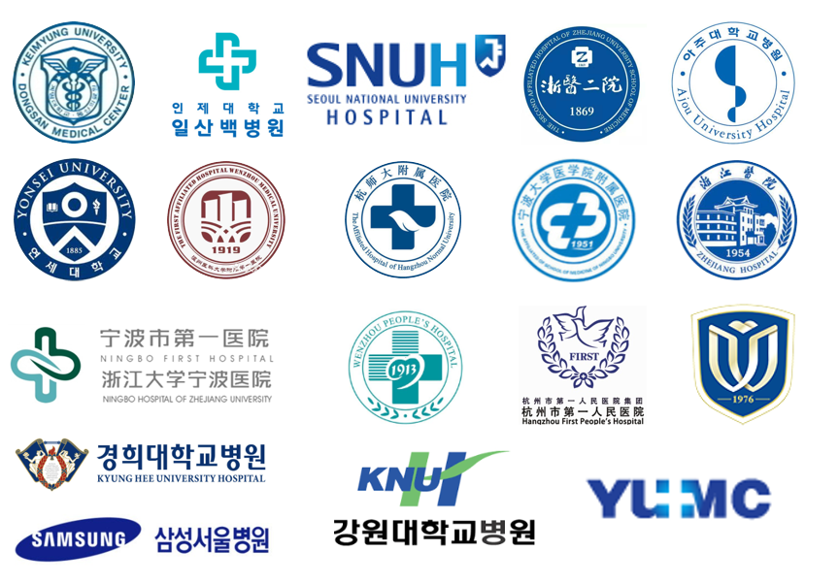
FLAVOUR investigators
Thank You! 감사합니다! 谢谢!
JianAn Wang, MD, The Second Affiliated Hospital Zhejiang University School of Medicine, China
Seung-Jea Tahk, MD, Ajou University Hospital, Republic of Korea
Bon-Kwon Koo, MD, Seoul National University Hospital, Republic of Korea
Xinyang Hu, MD, The Second Affiliated Hospital Zhejiang University School of Medicine, China
Jinlong Zhang, MD, The Second Affiliated Hospital Zhejiang University School of Medicine, China
Hyo-Soo Kim, MD, Seoul National University Hospital, Republic of Korea
Jeehoon Kang, MD, Seoul National University Hospital, Republic of Korea
Joo-Yong Hahn, MD, Samsung Medical Center, Republic of Korea
Joo Myung Lee, MD, Samsung Medical Center, Republic of Korea
Chang-Wook Nam, MD, Keimyung University Dongsan Medical Center, Republic of Korea
Joon-Hyung Doh, MD, Inje University Ilsan Paik Hospital, Republic of Korea
Bong-Ki Lee, MD, Kangwon National University Hospital, Republic of Korea
Jinyu Huang, MD, Affiliated Hangzhou First People's Hospital, China
Fan Jiang, MD, Hangzhou Normal University Affiliated Hospital, China
Myeong-Ho Yoon, MD, Ajou University Hospital, Republic of Korea
Weon Kim, MD, KyungHee University Hospital, Republic of Korea
Hao Zhou, MD, The 1st Affiliated Hospital of Wenzhou Medical University, China
Peng Chen, MD, The 2nd Affiliated Hospital of Wenzhou Medical University, China
Lijiang Tang, MD, Zhejiang Hospital, China
Wenbing Jiang, MD, The Third Clinical Institute Affiliated To Wenzhou Medical University, China
Xiaomin Chen, MD, Ningbo First Hospital, China
Wenming He, MD, The Affiliated Hospital of Medical School of Ningbo University, China
Sung Gyun Ahn, MD, Yonsei University Wonju Severance Hospital, Republic of Korea
Woong Kim, MD, Yeungnam University Medical Center, Republic of Korea
Eun-Seok Shin, MD, Ulsan University Hospital, Republic of Korea
You-Jeong Ki, MD, Uijeongbu Eulji Medical Center, Republic of Korea
Doyeon Hwang, MD, Seoul National University Hospital, Republic of Korea
Seokhun Yang, MD, Seoul National University Hospital, Republic of Korea
Eun-Chae Jang, RN, Seoul National University Hospital, Republic of Korea
Jun Su Seong, S-soft, Republic of Korea
Jiyeob Lee, Seoul National University Hospital, Republic of Korea
Xiaoyuan Qu, Beijing Yjheal Medical Research Center, China

