Slide 1
Transcatheter Treatment of Tricuspid Regurgitation: One-Year Results of the CLASP TR Study
Adam Greenbaum, MD
Emory University Hospital, Atlanta
@AdamGreenbaumMD
On behalf of the CLASP TR study investigators

Slide 2
Speaker Disclosures
Speaker’s name: Adam Greenbaum, MD
☑ I have the following potential conflicts of interest to declare:
Affiliation/Financial Relationship | Company
Proctor | Edwards Lifesciences Medtronic
Equity | Transmural Systems
Institutional research contracts for clinical investigation of transcatheter aortic, mitral, and tricuspid devices | Edwards Lifesciences Medtronic Abbott Vascular Boston Scientific

Slide 3
Tricuspid Regurgitation Challenges
Mortality Increases with TR Severity¹
Prevalent
Undertreated
Medical Therapy Unsatisfactory
U.S. Prevalence: 2.4 million
10,000 TR surgeries/year²
↓
In-hospital mortality 9-11%³⁻⁶
Conservative medical therapy has unsatisfactory outcomes
Transcatheter Therapies Are Emerging
⁴Kawsara, et al. J Am Heart Assoc. 2021;10:e018417.
⁵Zack, et al. J Am Coll Cardiol. 2017;70:2953-2960.
⁶Dreyfus, et al. Eur Heart J. 2020;41:4304-4317.
¹Benfari, et al. Circulation. 2019;140:196-206.
²Enriquez-Sarano, et al. Prog Cardiovasc Dis. 2019;62:447-451.
³Axtell, et al. J Am Coll Cardiol. 2019;74:715-725.

Slide 4
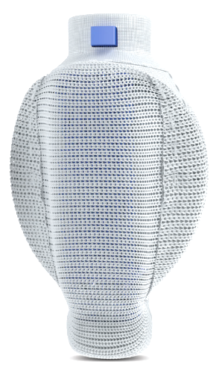
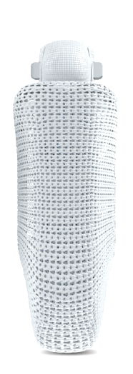
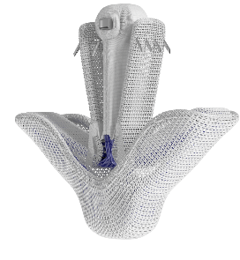
PASCAL Repair System for Tricuspid Regurgitation
Implants
Central Spacer
Bridge the coaptation gap
Elongation
Navigate in dense chordae
Nitinol Design
PASCAL
PASCAL Ace
A narrow profile and central spacer designed to complement PASCAL​ and provide additional options for patients
Passive closure, acute implant flexing
Independent Clasps
Staged leaflet capture and adjustment
PASCAL Ace
For professional use. See instructions for use for full prescribing information. CE marked medical device.

Slide 5
CLASP TR Study Overview
CLASP TR Study
Prospective, single-arm, multicenter study
Purpose | Evaluate the safety and performance of the PASCAL transcatheter valve repair system in tricuspid regurgitation
Trial oversight​
Central screening committee​
Echocardiographic core laboratory​
Clinical events committee​
Data safety monitoring board
Patients with symptomatic severe tricuspid regurgitation
Heart team assessment
Severe functional or degenerative TR
Symptomatic despite medical therapy
Patient appropriate for the device
PASCAL repair system
Primary endpoint: Composite of major adverse events (MAE) at 30 days
Follow-up: 30 days, 6 months, 1 year and annually up to 5 years
NCT03745313
www.clinicaltrials.gov

Slide 6
CLASP TR Study
Patient Characteristics
Enrollment and follow up
​Baseline characteristics | % or Mean ± SD​ (n/N)​
Age, years​ | 77 ± 9​
Female​ | 55%​
STS mortality score, MV repair​ | 7.7% ± 5.5*
EuroSCORE II​ | 5.0 ± 4.7¶
NYHA functional class III or IV​ | 71%
Tricuspid regurgitation (≥ severe)¹​ | 97%*ª
Atrial fibrillation/flutter​ | 89%
Systemic hypertension​ | 92%
Prior CABG​ | 31%​
Prior aortic valve surgery/intervention​ | 17%​
Prior mitral valve surgery/intervention​ | 20%​
Pacemaker lead crossing TV annulus | 14%​
Ascites | 28%
Renal insufficiency or failure | 43%
Enrolled patients
N=65
Death n=7
Study exit n=7
Visit not due n=2
Missed visit n=2
Withdrew n=1
1-year follow up
n=46
¹Core Laboratory, Cardiovascular Research Foundation​
ªTR severity for one patient was deemed inconclusive after core laboratory adjudication​. *N=64. ¶N=62.
CABG, coronary artery bypass graft; ICD, implantable cardioverter defibrillator; NYHA, New York Heart Association; STS, Society for Thoracic Surgeons

Slide 7
Device and Procedural Success
CLASP TR Study
​ | %, Mean ± SD or Median (Q1, Q3)
Successful implant rate^{1,2} ​ | 91%​*
Procedural success³​ | 88%¶
Clinical success⁴​ | 77%¶
Discharged to home​ | 95%​​‡
Device time, minutes (implant insertion to release) | 147 ± 89​^
Length of hospital stay (procedure to discharge), days​ | 2.6 ± 3.5​‡ 1.0 (1.0, 3.0)
3.1%
3 devices
Number of Devices
Per patient
¹Implant deployed and delivery system retrieved as intended at exit from the cardiac catheterization laboratory.​ ²Implants were successfully retrieved in six patients whose leaflets were unable to be captured due to complex anatomy with no adverse sequelae. ​ ³Implant success with at least one grade reduction in TR at the end of the procedure without surgical or percutaneous intervention prior to hospital discharge. TR grade availability dependent on data entry timing and imaging readability.​ ⁴Procedural success without major adverse events at 30 days.
*N=65. ¶N=56. ^N=58. ‡N=62

Slide 8
Major Adverse Events (30 Days, 1 Year)
CLASP TR Study
CEC Adjudicated MAEs | 30 days N=65 % (n) | 1 year N=65 % (n)
Cardiovascular mortality | 3.1% (2) | 7.7% (5)
Myocardial infarction | 0 | 0
Stroke | 1.5% (1) | 4.6% (3)
New need for dialysis or renal replacement therapy | 0 | 0
Reintervention related to the device | 0 | 1.5% (1)ª
Severe bleeding* | 7.7% (5) | 9.2% (6)
Major access site and vascular complications requiring intervention | 3.1% (2) | 3.1% (2)
Composite MAE rate | 9.2% (6) | 16.9% (11)
Other events
All-cause mortality | 3.1% (2) | 10.8% (7)
Heart failure rehospitalization | 0 | 18.5% (12)
SLDA (core laboratory)¶ | 4.6% (3) | 4.6% (3)
ªSurgical explant of study device and successful tricuspid repair with a surgical ring.
*Severe bleeding is major, extensive, life-threatening or fatal bleeding, as defined by Mitral Valve Academic Research Consortium.
¶Core Laboratory, Cardiovascular Research Foundation​
MAE, major adverse events; SLDA, single-leaflet device attachment

Slide 9
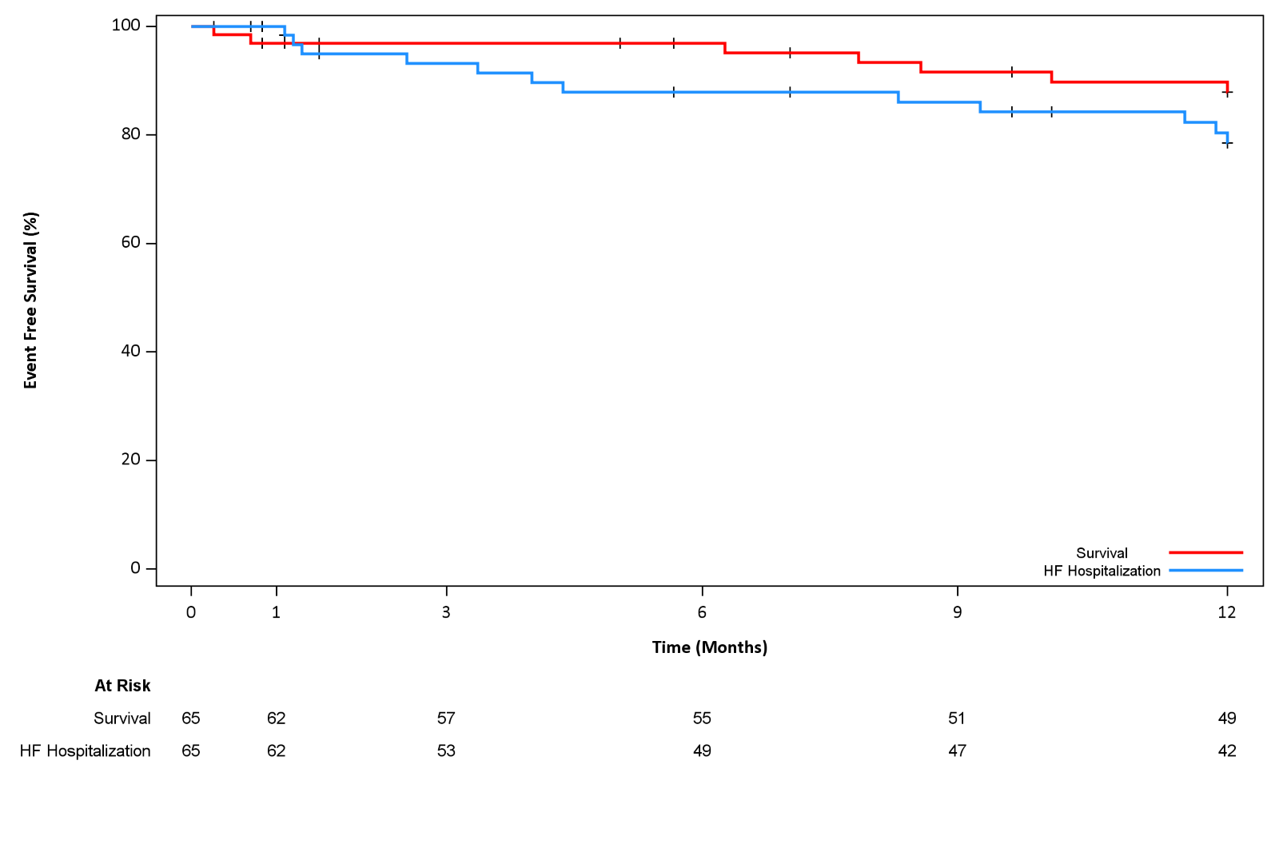
CEC Adjudicated Survival and Freedom from Heart Failure Hospitalization¹
CLASP TR Study
97±2%
88±4%
88±4%
79±6%
Event Free Survival (%)
At Risk
Survival
Freedom from heart failure hospitalization
55
49
49
42
¹Kaplan-Meier analysis estimate ± std error

Slide 10
TR Reduction at One Year
CLASP TR Study
TR Severity by Core Lab¹
P<0.001ª
P<0.001ª
Patients (%)
Patients (%)
In paired analyses at one year:
100% improved by ≥ one TR grade
75% improved by ≥ two grades
86% reached ≤ moderate TR
70%
I
Baseline
30 days
Baseline
1 year
N=56
N=36
Graphs show paired data. ¹Core Laboratory, Cardiovascular Research Foundation​. *Two patients initially considered to have severe TR at baseline by transoesophageal echocardiography were reclassified as moderate TR by transthoracic echocardiography. ªWilcoxon signed-rank test.
TR, tricuspid regurgitation.

Slide 11
Clinical, Functional, and Quality of Life at One Year
CLASP TR Study
NYHA Class
KCCQ Score
6MWD
P<0.001ª
P<0.001^{b}
Δ=18
P<0.014^{b}
Δ=94
Patients (%)
Overall Score
Distance Walked (m)
73±23
311±218
55±21
217±125
92%
I
Baseline
1 year
Baseline
1 year
Baseline
1 year
N=39
N=42
N=32
Graphs show paired data. ªWilcoxon signed-rank test. ^{b}Paired t-test. TR, tricuspid regurgitation; NYHA Class, New York Heart Association; 6MWD, 6-minute walk distance; KCCQ, Kansas City Cardiomyopathy Questionnaire

Slide 12
RV Remodeling by Core Lab¹ at One Year
CLASP TR Study
Variable | Baseline | 1 year | P-value*
Tricuspid annulus diameter, cm (end-diastole, apical 4-chamber) | 4.5 ± 0.8 | 4.0 ± 0.6 | <0.001
RV end-diastolic diameter (mid) (4Ch), cm | 4.0 ± 0.9 | 3.5 ± 0.7 | <0.001
RA volume (single-plane Simpson's) (4Ch), ml | 148.9 ± 81.7 | 130.6 ± 63.9 | 0.013
IVC diameter, cm | 2.5 ± 0.6 | 2.1 ± 0.6 | 0.002
TR jet area (maximum), cm² | 15.1 ± 5.0 | 6.9 ± 3.6 | <0.001
¹Core Laboratory, Cardiovascular Research Foundation​. Data presented are paired mean ± SD. *p values calculated by Student’s t-test. IVC, inferior vena cava; RA, right atrial; RV, right ventricular; TR, tricuspid regurgitation

Slide 13
Conclusions
CLASP TR Study
In the CLASP TR study, transcatheter valve repair with the PASCAL system demonstrated significant TR reduction and durable outcomes at one year
Significant TR reduction was sustained at one year with 100% of patients achieving ≥ 1 grade reduction, and 75% ≥ 2 grade reduction
86% of patients improved to ≤ moderate TR at one year
Significant one-year improvements in NYHA class, KCCQ score, and 6MWD
Survival and freedom from heart failure hospitalization rates were 88% and 79%, respectively, at one year
Randomized CLASP II TR pivotal trial is underway (NCT04097145)

