Slide 1

Amphilimus- vs zotarolimus-eluting stents in patients with diabetes and coronary artery disease
(SUGAR trial)
Rafael Romaguera
and Pablo Salinas
on behalf of the SUGAR trial investigators
email: rafaromaguera@gmail Twitter: @rafa_romaguera

Slide 2
Disclosure Statement of Financial Interest
Within the past 12 months, I (Rafael Romaguera)or my spouse/partner have had a financial interest/arrangement or affiliation with the organization(s) listed below.
Affiliation/Financial Relationship | Company
Grant/Research Support | -
Consulting Fees/Honoraria | Boston Scientific, Biotronik
Major Stock Shareholder/Equity | -
Royalty Income | -
Ownership/Founder | -
Intellectual Property Rights | -
Other Financial Benefit | -
Faculty disclosure information can be found on the app

Slide 3
Background: overview of the problem
463 million patients with DM worldwide
In US, 38% of PCI have diabetes
(~250.000 patients in 2019)
IDF Athlas 9th edition. Inohara T. JACC 2020
Notes:
2
This is the Bulleted List slide.
To create this particular slide, click the NEW SLIDE button on your toolbar and choose the BULLETED LIST format. (Top row, second from left)
The Sub-Heading and footnote will not appear when you insert a new slide. If you need either one, copy and paste it from the sample slide.
If you choose not to use a Sub-Heading, let us know when you hand in your presentation for clean-up and we’ll adjust where the bullets begin on your master page.
Also, be sure to insert the presentation title onto the BULLETED LIST MASTER as follows:
Choose View / Master / Slide Master from your menu.
Select the text at the bottom of the slide and type in a short version of your presentation title.
Click the SLIDE VIEW button in the lower left hand part of your screen to return to the slide show. (Small white rectangle)

Slide 4
Background: overview of the problem
Patients with DM have 2x risk of events with contemporary DES
Patients with DM & multivessel disease have ↑ mortality compared to CABG when treated with DES
Silver S. JACC Intv 2013
Notes:
3
This is the Bulleted List slide.
To create this particular slide, click the NEW SLIDE button on your toolbar and choose the BULLETED LIST format. (Top row, second from left)
The Sub-Heading and footnote will not appear when you insert a new slide. If you need either one, copy and paste it from the sample slide.
If you choose not to use a Sub-Heading, let us know when you hand in your presentation for clean-up and we’ll adjust where the bullets begin on your master page.
Also, be sure to insert the presentation title onto the BULLETED LIST MASTER as follows:
Choose View / Master / Slide Master from your menu.
Select the text at the bottom of the slide and type in a short version of your presentation title.
Click the SLIDE VIEW button in the lower left hand part of your screen to return to the slide show. (Small white rectangle)

Slide 5
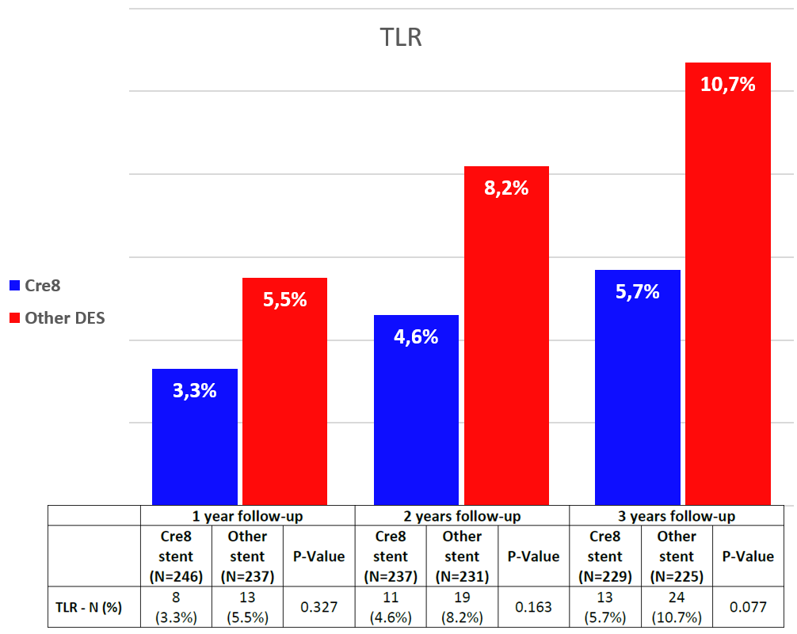
Background: overview of the problem
Cre8 EVO stents have shown positive results in non-randomized and small-randomized studies.
-47%
-44%
-40%
Romaguera R. JACC Intv 2016 Stella P. Circulation 2019 Carrie D. JACC 2012
Notes:
4
This is the Bulleted List slide.
To create this particular slide, click the NEW SLIDE button on your toolbar and choose the BULLETED LIST format. (Top row, second from left)
The Sub-Heading and footnote will not appear when you insert a new slide. If you need either one, copy and paste it from the sample slide.
If you choose not to use a Sub-Heading, let us know when you hand in your presentation for clean-up and we’ll adjust where the bullets begin on your master page.
Also, be sure to insert the presentation title onto the BULLETED LIST MASTER as follows:
Choose View / Master / Slide Master from your menu.
Select the text at the bottom of the slide and type in a short version of your presentation title.
Click the SLIDE VIEW button in the lower left hand part of your screen to return to the slide show. (Small white rectangle)

Slide 6
Objective
To compare Cre8 EVO stents to a contemporary DES in patients with DM and coronary artery disease
Notes:
5
This is the Bulleted List slide.
To create this particular slide, click the NEW SLIDE button on your toolbar and choose the BULLETED LIST format. (Top row, second from left)
The Sub-Heading and footnote will not appear when you insert a new slide. If you need either one, copy and paste it from the sample slide.
If you choose not to use a Sub-Heading, let us know when you hand in your presentation for clean-up and we’ll adjust where the bullets begin on your master page.
Also, be sure to insert the presentation title onto the BULLETED LIST MASTER as follows:
Choose View / Master / Slide Master from your menu.
Select the text at the bottom of the slide and type in a short version of your presentation title.
Click the SLIDE VIEW button in the lower left hand part of your screen to return to the slide show. (Small white rectangle)

Slide 7
Design
Investigator initiated, randomized (1:1), multicenter (23 centers in Spain), controlled, parallel trial.
Randomization: web-based, no stratification, blocks of four.
Masking: event committee.
Funding: Spanish Society of Cardiology
Notes:
6
This is the Bulleted List slide.
To create this particular slide, click the NEW SLIDE button on your toolbar and choose the BULLETED LIST format. (Top row, second from left)
The Sub-Heading and footnote will not appear when you insert a new slide. If you need either one, copy and paste it from the sample slide.
If you choose not to use a Sub-Heading, let us know when you hand in your presentation for clean-up and we’ll adjust where the bullets begin on your master page.
Also, be sure to insert the presentation title onto the BULLETED LIST MASTER as follows:
Choose View / Master / Slide Master from your menu.
Select the text at the bottom of the slide and type in a short version of your presentation title.
Click the SLIDE VIEW button in the lower left hand part of your screen to return to the slide show. (Small white rectangle)

Slide 8
Patients
INCLUSION CRITERIA:
    Diabetes mellitus according to ADA
    Indication for PCI
EXCLUSION CRITERIA:
    Life expectancy <2 years
    Cardiogenic shock at presentation
    Mechanical ventilation
    Contraindication for DAPT at least 1 month
    Pregnancy
All-comers
No limitation in clinical presentation, complexity, number of lessions, left main disease, etc.
Notes:
7
This is the Bulleted List slide.
To create this particular slide, click the NEW SLIDE button on your toolbar and choose the BULLETED LIST format. (Top row, second from left)
The Sub-Heading and footnote will not appear when you insert a new slide. If you need either one, copy and paste it from the sample slide.
If you choose not to use a Sub-Heading, let us know when you hand in your presentation for clean-up and we’ll adjust where the bullets begin on your master page.
Also, be sure to insert the presentation title onto the BULLETED LIST MASTER as follows:
Choose View / Master / Slide Master from your menu.
Select the text at the bottom of the slide and type in a short version of your presentation title.
Click the SLIDE VIEW button in the lower left hand part of your screen to return to the slide show. (Small white rectangle)

Slide 9
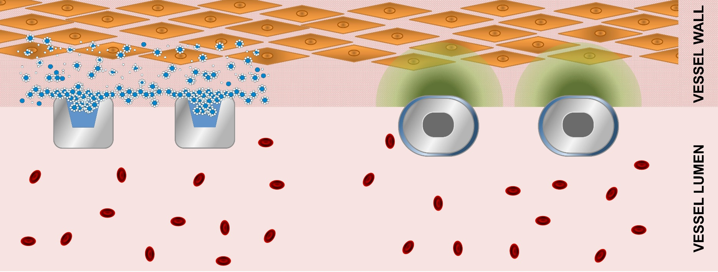
Procedures
70-80 µm
No polymer
Sirolimus + carrier
92-102 µm
Permanent polymer
Zotarolimus alone
Romaguera R. AHJ 2020
Notes:
8
This is the Bulleted List slide.
To create this particular slide, click the NEW SLIDE button on your toolbar and choose the BULLETED LIST format. (Top row, second from left)
The Sub-Heading and footnote will not appear when you insert a new slide. If you need either one, copy and paste it from the sample slide.
If you choose not to use a Sub-Heading, let us know when you hand in your presentation for clean-up and we’ll adjust where the bullets begin on your master page.
Also, be sure to insert the presentation title onto the BULLETED LIST MASTER as follows:
Choose View / Master / Slide Master from your menu.
Select the text at the bottom of the slide and type in a short version of your presentation title.
Click the SLIDE VIEW button in the lower left hand part of your screen to return to the slide show. (Small white rectangle)

Slide 10
Events and assumptions
Primary endpoint: TLF at 1-year (cardiac death + target-vessel MI + target-lesion failure)
Adjudication by independent CEC & Barcicore-Lab.
Hypothesis at 1-year: Non-inferiority at 1-year. α=0.025, β=80%, 8% events in Resolute Onyx group, 4% NI margin (1.5 RR). Prespecified superiority analysis if NI is met.
Notes:
9
This is the Bulleted List slide.
To create this particular slide, click the NEW SLIDE button on your toolbar and choose the BULLETED LIST format. (Top row, second from left)
The Sub-Heading and footnote will not appear when you insert a new slide. If you need either one, copy and paste it from the sample slide.
If you choose not to use a Sub-Heading, let us know when you hand in your presentation for clean-up and we’ll adjust where the bullets begin on your master page.
Also, be sure to insert the presentation title onto the BULLETED LIST MASTER as follows:
Choose View / Master / Slide Master from your menu.
Select the text at the bottom of the slide and type in a short version of your presentation title.
Click the SLIDE VIEW button in the lower left hand part of your screen to return to the slide show. (Small white rectangle)

Slide 11
Trial profile
3465 pt with DM treated with PCI
2290 not screened or ineligible
1175 enrolled and randomly assigned
586 assigned to Cre8 EVO stents
581 given assigned stents
3 crossover
1 given non-study stent
1 given no stent
589 assigned to Resolute Onyx stents
587 given assigned stents
1 crossover
1 given non-study stent
12 did not complete 1-year follow-up
0 withdrew consent
8 non-cardiovascular death
4 lost to follow-up
18 did not complete 1-year follow-up
0 withdrew consent
13 non-cardiovascular death
5 lost to follow-up
574 followed up at 12 months
586 included in intention-to-treat analysis
571 followed up at 12 months
589 included in intention-to-treat analysis
Notes:
^{Figure 1: Trial profile}

Slide 12
Baseline characteristics
 | Cre8 EVO (n=586) | Resolute Onyx (n=589)
Age (years) | 68.6 (9.8) | 67.2 (10.6)
Male sex | 449 (76.6%) | 439 (74.5%)
LVEF | 56.6 (11.3) | 56.7 (10.8)
Indication index procedure
Chronic coronary syndromes | 243 (41.5%) | 229 (38.9%)
NSTEACS | 277 (47.3%) | 280 (47.5%)
STEMI | 66 (11.3%) | 80 (13.6%)
Diabetes and metabolic characteristics
Diabetes type 2 | 565 (96.4%) | 557 (94.6%)
Years with known diabetes | 10.6 (8.7) | 11.4 (9.2)
Insulin-treated diabetes at randomization | 183 (31.2%) | 194 (32.9%)
Waist circumference (cm) | 103.1 (13.5) | 102.5 (12.4)
LDL cholesterol (mg/dL) | 78.8 (44.7) | 80.9 (45.5)
HbA1c (%) | 7.4 (1.5) | 7.5 (1.5)
Creatinine clearance (mL/min) | 70.0 (25.4) | 73.1 (24.0)

Slide 13
Procedural characteristics
 | Cre8 EVO (patients=586) (lesions=879) | Resolute Onyx (patients=589) (lesions=950)
Syntax Score at randomization | 13.0 (9.7) | 13.0 (8.7)
Number of vessel diseased
2 | 189 (32.3%) | 200 (34.0%)
3 | 102 (17.4%) | 107 (18.2%)
Number of stents per patient | 1.63 (1.02) | 1.75 (1.07)
Complete revascularization | 397 (67.7%) | 389 (66.0%)
Staged procedures | 21 (3.6%) | 30 (5.1%)
Target vessel Left Main | 28 (3.7%) | 25 (3.2%)
Chronic total occlusion | 16 (2.1%) | 19 (2.4%)
Bifurcation with 2-stents | 43 (5.6%) | 38 (4.9%)
Reference vessel diameter | 2.98 (0.51) | 2.96 (0.50)
Total stented length (mm) | 26.5 (13.7) | 27.4 (14.9)
Postdilation | 286 (37.4%) | 226 (28.9%)
Rotational atherectomy | 22 (2.9%) | 11 (1.4%)

Slide 14
Treatment
 | Cre8 EVO (n=586) | Resolute Onyx (n=589) | p-value
Medication at discharge
Acetylsalicylic acid | 560 (95.6%) | 567 (96.3%) | 0.54
P2Y12-inhibitors |  |  | 0.98
Clopidogrel | 282 (48.1%) | 278 (47.2%)
Prasugrel | 47 (8%) | 47 (8%)
Ticagrelor | 241 (41.1%) | 249 (42.3%)
Glucose-lowering drugs
Insulin | 200 (34.1%) | 219 (37.2%) | 0.28
SGLT2 inhibitors | 119 (20.3%) | 107 (18.2%) | 0.35
GLP1 agonists | 18 (3.1%) | 14 (2.4%) | 0.46
Dual antiplatelet therapy
At 1 month | 552 (94.2%) | 554 (94.1%) | 0.919
At 6 months | 504 (86%) | 504 (85.6%) | 0.830
At 12 months | 314 (53.6%) | 349 (59.3%) | 0.050

Slide 15
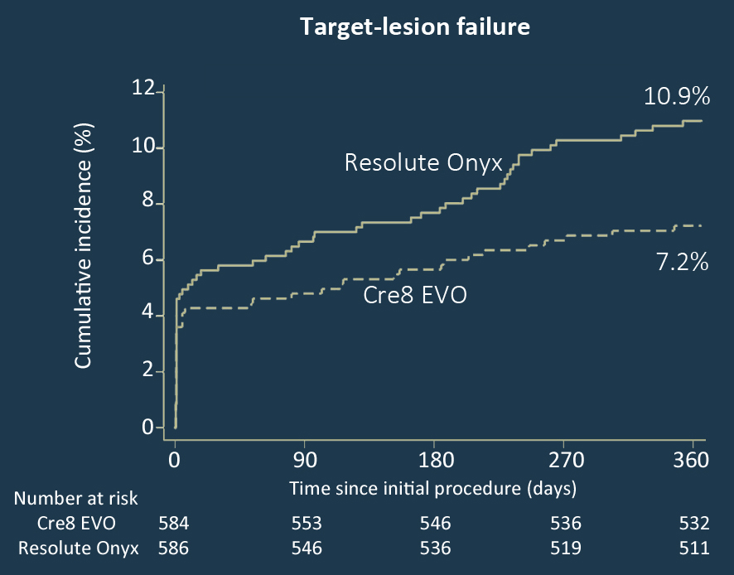
Primary endpoint
Difference -3.73%
(95% CI -7.01 to -0.45)
p <0.001 for noninferiority
HR 0.65 (95% CI 0.44 to 0.96)
p = 0.030 for superiority

Slide 16
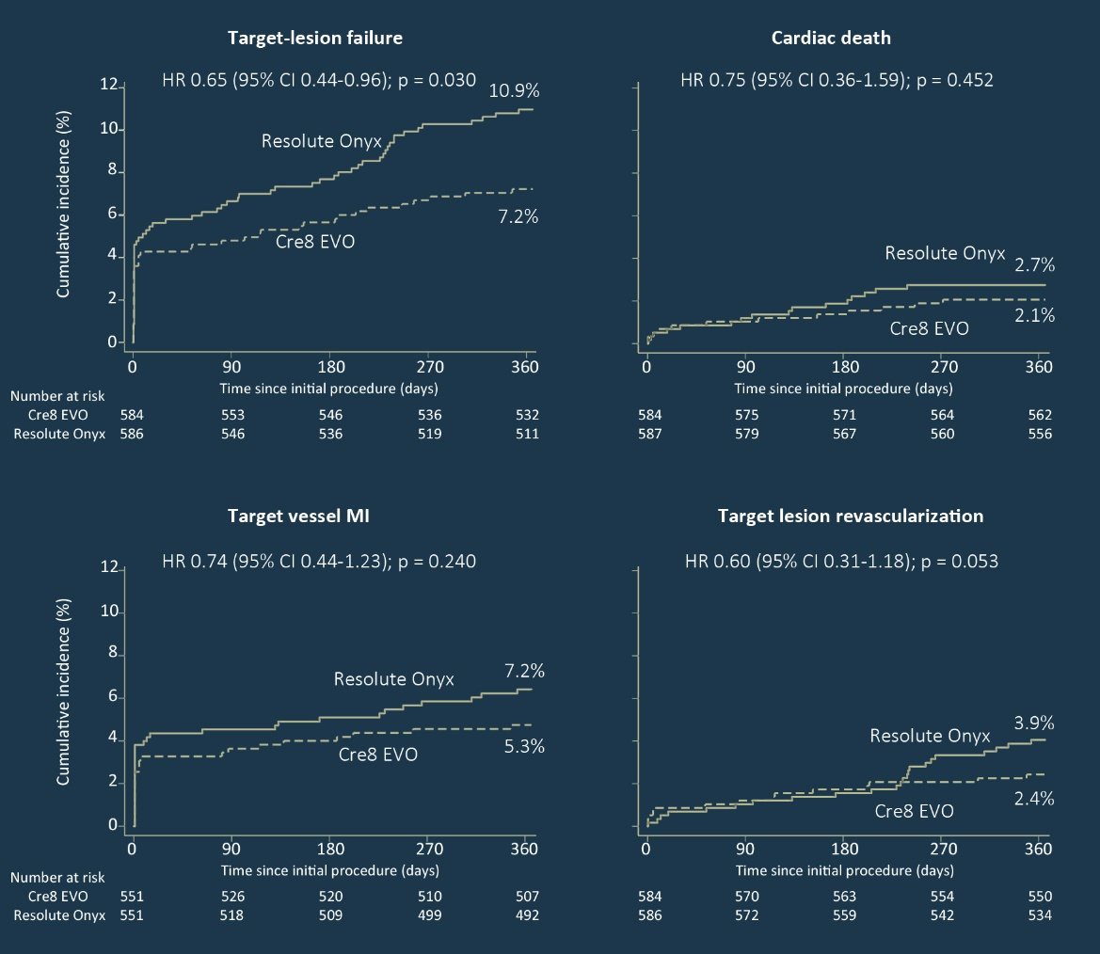
Individual components of the primary endpoint

Slide 17
Other secondary endpoints
 | Cre8 EVO (n=586) | Resolute Onyx (n=589) | HR (95% CI) | p-value
All-cause mortality | 20 (3.4%) | 29 (5.0%) | 0.69 (0.39-1.22) | 0.201
Any MI | 34 (6.2%) | 43 (7.7%) | 0.78 (0.50-1.23) | 0.289
Any revascularizations | 29 (5.0%) | 37 (6.3%) | 0.78 (0.48-1.27) | 0.314
Target vessel revascularization | 18 (3.1%) | 24 (4.1%) | 0.75 (0.40-1.37) | 0.346
Definite stent thrombosis | 6 (1.0%) | 5 (0.9%) | 1.20 (0.37-3.94) | 0.760
Probable or definite stent thrombosis | 8 (1.4%) | 8 (1.4%) | 1.00 (0.38-2.67) | 0.994
Acute | 3 (0.5%) | 2 (0.3%) | -
Subacute | 4 (0.7%) | 4 (0.7%) | -
Late | 1 (0.2%) | 2 (0.3%) | -
Target vessel failure | 44 (7.5%) | 65 (11.1%) | 0.67 (0.46-0.99) | 0.042
MACE | 64 (11.7%) | 88 (15.7%) | 0.74 (0.53-1.02) | 0.067

Slide 18
Conclusions
SUGAR is the first powered trial to compare new-generation DES in patients with diabetes, and also the first to include a broad population of patients with diabetes (all-comers design).
Cre8 EVO stents were non-inferior to Resolute Onyx stents with regards to TLF composite outcome.
In the prespecified superiority analysis, Cre8 EVO stents were also superior to Resolute Onyx stents with regards to the same outcome (35% risk reduction of TLF at 1-year).

