Slide 1
The Individualized Studies of Triggers of Paroxysmal Atrial Fibrillation Trial
1 R01 HL158825-01
Gregory M Marcus, MD, MAS, Madelaine Faulkner Modrow, MPH, Christopher H Schmid, PhD, Kathi Sigona, MA, Gregory Nah, MA, Jiabei Yang, MS, Tzu-Chun Chu, MPH, Sean Joyce, BS, Shiffen Gettabecha, MPH, Kelsey Ogomori, Vivian Yang, Xochitl Butcher, Mellanie True Hills, BS, Debbe McCall, MBA, Kathleen Sciarappa, EdD, Ida Sim, MD, PhD, Mark J Pletcher, MD, MPH, Jeffrey E Olgin, MD
11/10/2021

Slide 2
Disclosures
Research
NIH (NIBIB, NCI, NHLBI)
PCORI
TRDRP
Medtronic
Eight Sleep
Baylis
Consulting
InCarda Therapeutics
Johnson and Johnson
Equity
InCarda Therapeutics (as co-founder)
Notes:
Here are my disclosures

Slide 3
Funder
The Patient Outcomes Research Institute
Investigator-initiated
Part of a Patient-Powered Research Network Grant
Funder was not involved in study design or conduct of the study Research

Slide 4
Risk Factors for Atrial Fibrillation
Age, Male sex, European ancestry, hypertension, diabetes, increased BMI, heart failure, coronary disease, obstructive sleep apnea
Fairly static, chronic, and often immutable

Slide 5
What about acute effects?
Can we, or our patients, influence the chance a discrete episode of AF will occur?

Slide 6
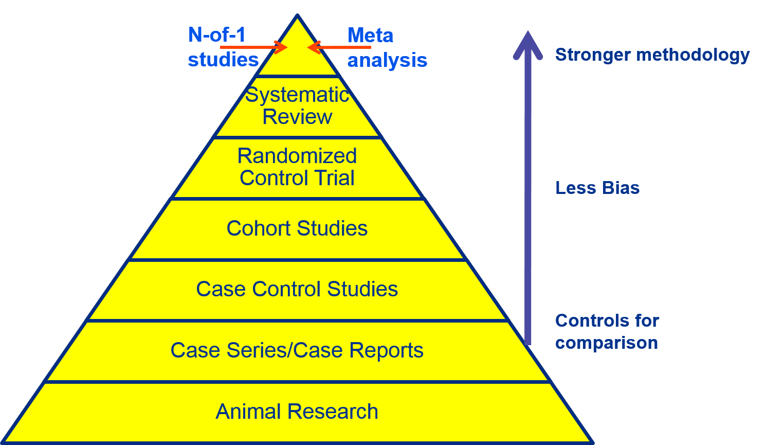

Slide 7
N-of-1 Studies
To conduct an N-of-1 Study (or studies), you need:
An exposure and outcome that are:
Repeated
And have near-term effects
An exposure that is modifiable (can introduce or withhold)
An outcome that is not catastrophic

Slide 8
2014 Health eHeart Alliance Patient-Powered Research Summit
A brainstorming session that brought together cardiovascular patients and investigators funded by PCORI
Dr. Ida Sim gave a talk on N-of-1 Studies
An atrial fibrillation interest group organically formed
Designed this study
Original members of that group, including three AF patients, are coauthors of this presentation and the resulting manuscript

Slide 9
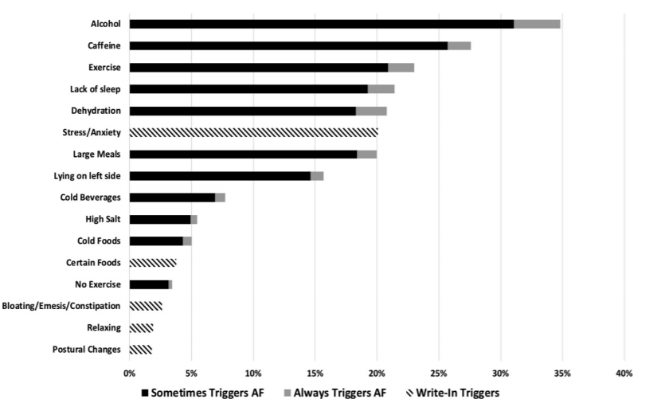
We needed a “menu” of potential AF triggers
N=957
Groh et al. Heart Rhythm 2019

Slide 10
Methods: Inclusion Criteria
Adult symptomatic AF patients
Owned a smartphone (either Android or iOS)
Interested in testing a presumed AF trigger they could readily introduce or withhold

Slide 11
Methods: Exclusion Criteria
Those who planned to change their AF management (e.g., with catheter ablation or medication changes) in the subsequent 6 months
Did not speak English
A history of an AV junction ablation

Slide 12
Methods
Recruited via Health eHeart Study, StopAfib.org, social media, word of mouth, and healthcare providers
Interested participants downloaded the Eureka mobile app
Eureka is an NIH-funded digital research platform housed at UCSF
Eligibility was determined on the mobile app
Eligible participants were consented on the mobile app

Slide 13
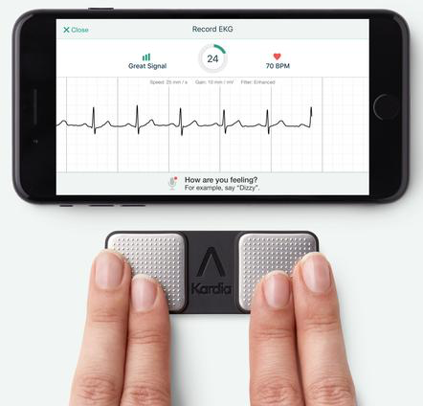
Methods
Those who already owned a KardiaMobile (AliveCor, San Francisco) could integrate their device
Otherwise participants were sent a device

Slide 14
Methods
Randomly Assigned

Slide 15
Methods
Participants selected from a menu of triggers
Could write-in “custom” triggers to test
Randomly Assigned

Slide 16
Methods
Randomly assigned in one-week blocks with daily text-based instructions to expose to a given trigger at some point during that week versus avoid their trigger for the entire week
Randomly Assigned

Slide 17
Methods
Trigger compliance was assessed with daily questionnaires
Randomly Assigned

Slide 18
Methods
Randomly Assigned

Slide 19
Methods
All participants received daily text-based queries regarding the presence or absence of AF the previous day
Randomly Assigned

Slide 20
Methods
Notes:
Note ALiveCors only over-read for first treatment period

Slide 21
Methods: Outcomes
The primary outcome was the follow-up AFEQT using intention to treat
Secondary outcomes included:
The number of daily AF episodes recorded in the final 4 weeks of the primary study period
The N-of-1 trials analyzed as intention-to-treat and “per-protocol”
Meta-analyses and network meta-analyses of the relationships between specific triggers and the risk of an AF event

Slide 22
Methods: Power Calculations
We estimated 239 patients in each group would provide 80% power to detect a mean change of 5 AFEQT points using a two-sided alpha of 0.05.

Slide 23
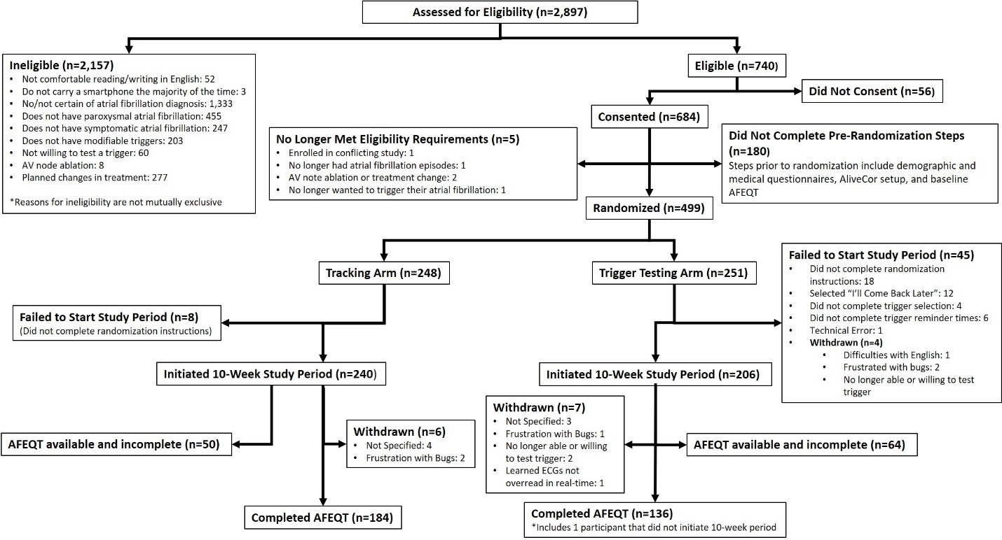

Slide 24
Results
 | Trigger Testing Arm N=251 Mean ± SD or # (%) | Monitoring Only Arm N=248 Mean ± SD or # (%)
Mean baseline AFEQT score | 74 ± 19 | 72 ± 19
Mean Age (years) | 58 ± 14 | 58 ± 14
Mean Height (feet) | 5.7 ± 0.3 | 5.7 ± 0.4
Mean Weight (pounds) | 193 ± 49 | 195 ± 47
Sex (Male) | 149 (61%) | 140 (56%)
Race
White | 233 (92%) | 228 (93%)
Black | 2 (1%) | 5 (2%)
Asian | 12 (5%) | 9 (3%)
Other | 3 (2%) | 2 (1%)
Unknown | 1 (0.4%) | 4 (2%)
Hispanic ethnicity | 16 (6.4%) | 8 (3.2%)
Education
Undergraduate degree or higher | 187 (74%) | 153 (62%)
Some college | 52 (21%) | 64 (26%)
High School or less | 10 (4%) | 25 (10%)
Other | 3 (1%) | 4 (2%)
Notes:
Differed by baseline AFEQT and education
None had coronary disease

Slide 25
Results
 | Trigger Testing Arm N=251 Mean ± SD or # (%) | Monitoring Only Arm N=248 Mean ± SD or # (%)
Taking a Vaughan-Williams Class 1 or 3 drug | 57 (23%) | 68 (27%)
Hypertension | 104 (41%) | 109 (44%)
Diabetes | 18 (7%) | 29 (12%)
Coronary artery disease | 28 (11%) | 27 (11%)
History of myocardial infarction | 8 (3%) | 11 (4%)
Congestive heart failure | 12 (5%) | 16 (7%)
History of stroke | 16 (6%) | 24 (10%)
Sleep apnea | 78 (31%) | 75 (30%)
Notes:
None had coronary disease

Slide 26
Results
Triggers selected during the initial N-of-1 assessment period included caffeine (n=53), alcohol (n=43), reduced sleep (n=31), exercise (n=30), laying on left side (n=17), dehydration (n=10), large meals (n=7), cold food or drink (n=5), specific diets (n=6) and customized triggers (n=4)

Slide 27
Results
 | Participants |  | Mean | SD
Trigger-Testing Arm | 136 | Baseline AFEQT | 76.1 | 16.8
 |  | 10-week AFEQT | 77.9 | 19.6
 |  | AFEQT Difference | 1.7 | 13.0
Monitoring Only Arm | 184 | Baseline AFEQT | 72.4 | 19.1
 |  | 10-week AFEQT | 72.9 | 18.7
 |  | AFEQT Difference | 0.5 | 14.1
 | Average difference in 10-week AFEQT between Arms | 95% CI | P value
*Adjusted for baseline AFEQT and education | 2.1 | -0.9 to 5.0 | 0.17
†Adjusted for baseline AFEQT, age and race | 2.1 | -0.0 to 5.0 | 0.17

Slide 28
Results
Those randomized to N-of-1 testing self-reported 40% fewer AF events in the 4 weeks following receiving the results of their N-of-1 study compared to monitoring-only participants during the same time frame (adjusted RR 0.60, 95% CI 0.43-0.83, p<0.0001).
Driven by those testing alcohol, dehydration, and exercise (each alone was associated with significantly less AF in the last 4 weeks)

Slide 29
Results: N-of-1 Trials
No significant differences examining exposures in intention-to-treat were observed
No significant relationships were observed when analyses were restricted to the first treatment period
KardiaMobile over-reads were only available for the first treatment period
Of all study periods: 326 participants conducted 474 trials testing various triggers: caffeine (n=100), alcohol (n=82), exercise (n=75), reduced sleep (n=66), laying on left side (n=42), dehydration (n=37), cold food or drink (n=9), large meals (n=29), specific diets (n=17) and customized triggers (n=17)

Slide 30
Meta-analyses of all treatment periods
 | Odds of Self-reported AF
 | Intention-to-Treat |  | Per protocol
 | OR (95% CrI) †† | Pr(OR > 1) ††† | OR (95% CrI) †† | Pr(OR > 1) †††
Alcohol | 1.17 (0.81-1.72) | 0.81 | 1.77 (1.20-2.69) | 1.00
Caffeine | 1.01 (0.68-1.45) | 0.51 | 0.95 (0.58-1.55) | 0.42
Lack of sleep | 1.03 (0.71-1.53) | 0.55 | N/A†
Exercise | 1.05 (0.64-1.68) | 0.57 | 1.02 (0.50-1.95) | 0.52
Dehydration | 1.73 (0.61-4.06) | 0.87 | N/A†
Cold food or drink | 0.53 (0.14-2.03) | 0.14 | 0.85 (0.08-10.27) | 0.43
Laying on left side | 1.00 (0.51-2.09) | 0.51 | 0.81 (0.38-1.63) | 0.29
Large meals | 0.92 (0.51-1.65) | 0.39 | 0.63 (0.22-1.40) | 0.12
Custom | 1.01 (0.22-3.49) | 0.51 | 6.30 (0.83-23.90) | 0.97
Diet | 1.34 (0.28-5.49) | 0.65 | 3.46 (0.68-12.13) | 0.94

Slide 31
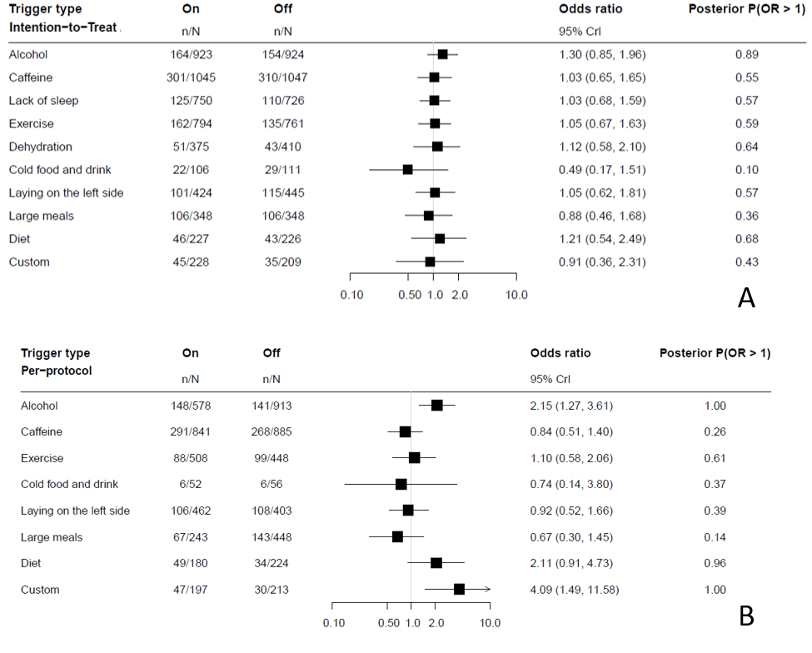
Network meta-analyses of all treatment periods: intention-to-treat

Slide 32
Network meta-analyses of all treatment periods: per-protocol

Slide 33
Limitations
Although target enrollment numbers were achieved, there was substantial attrition
Likely bias introduced by the nature of those lost-to follow-up
Continuous ECG monitoring was not employed
Self-reported AF may not be accurate
The population studied may not represent the general population with AF

Slide 34
Conclusions
Randomized assignment to individual trigger testing did not result in improved AF-related quality of life
Those randomized to trigger testing subsequently reported less AF episodes
Perhaps less prone to recall bias than the AFEQT
Perhaps AFEQT captured experiences more broadly pertinent to AF severity
Although caffeine was the most common trigger selected for testing, only alcohol exhibited consistent evidence of a near-term effect on self-reported AF episodes

Slide 35
Thank You

