Slide 1
Amulet or Watchman FLX Device for Percutaneous LAAC: Primary Results of the SWISS-APERO Randomized Clinical Trial
Roberto Galea, MD
Department of Cardiology, Bern University Hospital, Bern, Switzerland
on behalf of the SWISSAPERO Investigators
@robertogalea7
roberto.galea@insel.ch

Slide 2
Disclosure Statement of Financial Interest
I, Roberto Galea, DO NOT have a financial interest/arrangement or affiliation with one or more organizations that could be perceived as a real or apparent conflict of interest in the context of the subject of this presentation.
Acknowledgements
Images of Amplatzer Amulet device are reproduced with permission of Abbott, © 2021. All rights reserved. Images of Watchman FLX have been provided courtesy of Boston Scientific, ©2021 Boston Scientific Corporation or its affiliates. All rights reserved.

Slide 3
Background and objectives
Residual LAA patency after LAAC is routinely assessed after intervention, by means of TEE or CCTA, as it might undermine LAAC therapeutic principle (i.e. complete LAA sealing)
Watchman and Amulet are the two most frequently used LAAC devices worldwide and were recently compared in the Amulet IDE trial
The new Watchman FLX was not included
CCTA (with greater ability to detect LAA patency) was not routinely performed during follow-up
Post-implantation drug regimen was different between the 2 arms reflecting the US but not the EU IFUs
To assess whether Amulet is superior to Watchman FLX in terms of crossover to the other device or complete LAA sealing, as assessed by means of CCTA 45 days after implantation

Slide 4
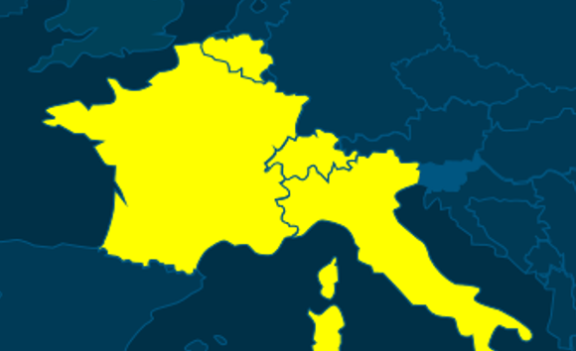
Study Organization
Sponsor: University Hospital of Bern
Coordinating Investigators: M. Valgimigli
Study Project Leader: R. Galea
Grant Supplier: Abbott
CROs: Advice Pharma
Sites: 8 Countries: 4 countries
CEC: A. Franzone (Chair) , P. Vranckx,
U. Fischer
DMC: Enrica Paschetto , E. Frigoli
Stats: F. Babongo , D. Heg
Executive Committee:
M. Valgimigli , L. Räber , F. Anselme ,
A. Aminian , F. De Marco
Principal Investigators:
A. Aminian
F. Anselme
E. Teiger
L. Räber
G. Pedrazzini
Imaging Core Lab: Department of Radiology and Cardiology, University Hospital of Bern
F. De Marco
N. Meneveau
X. Iriart

Slide 5
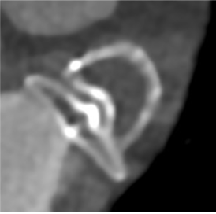
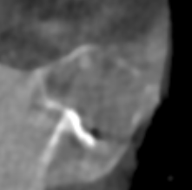
SWISS-APERO Trial Design
Screening phase
DEVICE RANDOMIZATION
Amulet
LAAC clinically indicated
LAAC
45-DAY fu
CROSSOVER
Mid-term LAA PATENCY
Watchman
FLX
Eligibility
High bleeding risk
LAA morhology suitable for both devices
No LAA thrombus
ASA
Clopidogrel or (N)OAC
45 ± 7
Days after LAAC
Medical and drug history assessment
Laboratory tests
TEE (optional if intraprocedural TEE)
CCTA
Intraprocedural TEE/ICE
Randomization
Medical and drug history assessment
TEE
CCTA
O

Slide 6
Study Endpoints
DEFINITIONS
Primary Endpoint
The Composite of justified crossover to the non-randomly allocated device and
LAA patency at 45-day CCTA
implantation of the non-randomized device after at least an attempt to implant the assigned device
LAA density ≥ 100 HU or
≥ 25% of that of the LA
Both components
centrally evaluated
Secondary Endpoints
PDL at 45-day TEE
DRT at 45-day TEE and CCTA
Procedural complications
Clinical outcomes at 45 days:
Composite of CV death, stroke or systemic embolism
All bleedings (BARC 1-5)

Slide 7
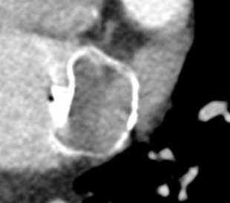
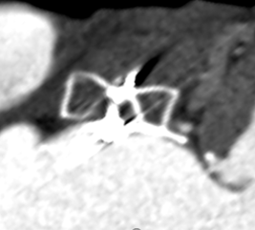
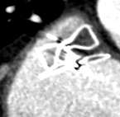
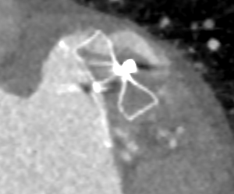
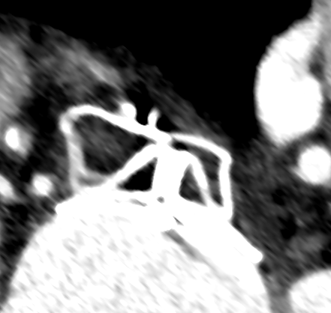
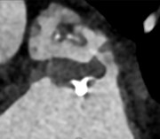
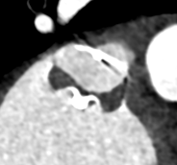
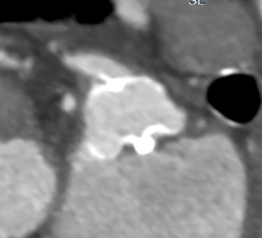
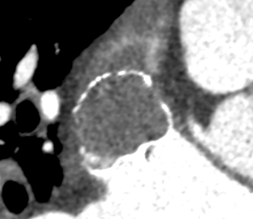
LAA Patency subtypes
LAA PATENCY DEFINITION:
LAA density ≥ 100 HU and/or
LAA density ≥ 25% of that of the LA
PATENT LAA (PA)
NON PATENT LAA (NPA)
C
64 HU
457 H
457 HU
526 HU
421 HU
PERIDEVICE
MIXED
INTRADEVICE
PANVL
115
HU
AMULET
132 HU
WATCHMAN
Underlying
Leak Mechanisms
INCOMPLETE SIDE
SEALING (GAP LEAKS)
DEVICE PERMEABILITY
UNCLEAR

Slide 8
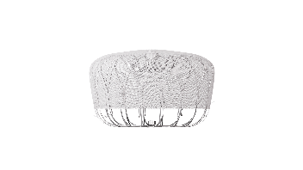
Flow Chart
Excluded (n=202)
Enrolled in other cardiovascular device or an investigational drug trial (n=47)
Patient did not provide consent (n=44)
Severe chronic kidney insufficiency (n=40)
Incomplete screening (n=25)
First operator with limited experience with one of the two LAAC devices (n=18)
Intra-cardiac thrombus (n=10)
LAA morphology not suitable for one of the two devices (n=9)
Other eligibility criteria not met (n=9)
LAA Closure performed (n = 423)
Randomized (n = 221)
Allocated to
Amulet (n=111)
Allocated to
Watchman/FLX (n=110)
Until October 2019 only Watchman 2.5 available
(n = 25)
Death (n = 2)
CCTA not performed (n=1)
LAA patency not assessable (n=2)
Withdrew consent (n=1)
Death (n = 4)
CCTA not performed (n=5)
LAA patency not assessable (n=1)
Considered for primary endpoint analysis
(n=105)
Considered for primary endpoint analysis
(n=100)

Slide 9
Baseline Characteristics
 | Amulet (N=111) | Watchman/FLX (N=110)
Age (years), mean ±SD | 76.5 ± 7.1 | 77.3 ± 8.4
Male sex, no. (%) | 79 (71.2%) | 77 (70.0%)
Diabetes mellitus, no. (%) | 24 (21.6%) | 34 (30.9%)
History of coronary heart disease, no. (%) | 39 (35.1%) | 41 (37.3%)
Prior cerebrovascular event, no. (%) | 45 (40.5%) | 42 (38.2%)
Paroxysmal atrial fibrillation, no. (%) | 43 (38.7%) | 44 (40.0%)
CHA2DS2Vasc score, mean ± SD | 4.2 ± 1.4 | 4.4 ± 1.4
HASBLED score, mean ± SD | 3.1 ± 0.8 | 3.2 ± 1.0
History of relevant bleeding, no. (%) | 98 (88.3%) | 96 (87.3%)
Documented anaemia, no. (%) | 34 (30.6%) | 31 (28.2%)
Bowel angiodysplasia, no. (%) | 17 (15.3%) | 25 (22.7%)
Blood cell dyscrasia associated with increased bleeding risk, no. (%) | 9 (8.1%) | 6 (5.5%)
Patients under anticoagulation at the randomization, no. (%) | 51 (45.9%) | 57 (51.8%)

Slide 10
Procedural Outcomes and Discharge Medication
 |  | Amulet (N=111) | Watchman/FLX (N=110) | P value
Sinus rhythm at the begin of procedure, no. (%) |  | 57 (51.4%) | 51 (46.4%) | 0.683
Conscious sedation, no. (%) |  | 65 (58.6%) | 67 (60.9%) | 0.784
Transesophageal echocardiography, no. (%) |  | 108 (97.3%) | 108 (98.2%) | 1.000
Procedure time (min), mean ± SD |  | 45.9 ± 25.1 | 43.0 ± 23.1 | 0.371
Fluoroscopy time (min), mean ± SD |  | 12.3 ± 8.1 | 12.8 ± 9.2 | 0.628
Contrast medium (ml), mean ± SD |  | 60.1 ± 42.7 | 62.9 ± 45.3 | 0.643
Concomitant procedure, no. (%) |  | 21 (18.9%) | 16 (14.5%) | 0.472
First device used successfully implanted, no. (%) |  | 105 (94.6%) | 107 (97.3%) | 0.499
Justified crossover, no. (%) |  | 1 (0.9%) | 0 (0%) | 0.318
Aborted procedure, no. (%) |  | 1 (0.9%) | 0 (0%) | 1.000
Any PDL detected by TEE or Angiography, no. (%) |  | 5 (4.5%) | 13 (11.8%) | 0.053
Drug regimen at discharge | Any SAPT, no. (%) | 22 (20.2%) | 23 (21.1%) | 1.000
 | Any DAPT, no. (%) | 78 (71.6%) | 77 (70.6%) | 1.000

Slide 11
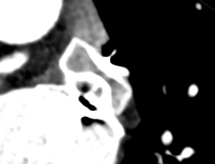
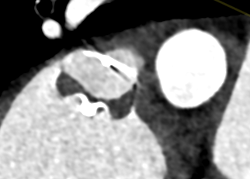
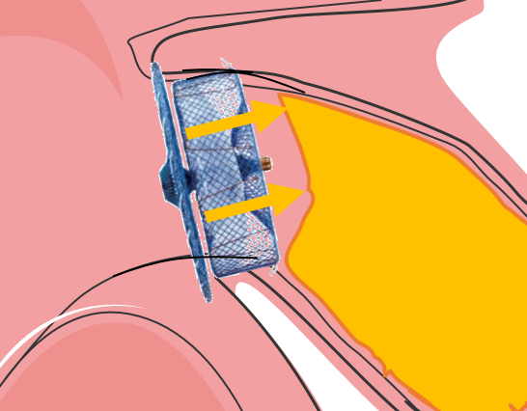
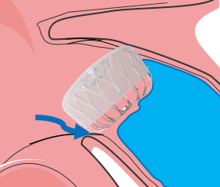
Primary Endpoint ≈ PA at 45-day CCTA
AMULET
67.6%
(n=71/105)
WATCHMAN/FLX
70%
(n=70/100)
VS.
0.97 (0.80-1.16);
P= 0.713
Number of patients
Intradevice leaks
44.8% vs. 23%
p = 0.001
INTRADEVICE LEAK
Mixed leaks
3.8% vs. 14%
p = 0.010
MIXED LEAK

Slide 12
Primary Endpoint ≈ PA at 45-day CCTA
*Watchman 2.5 and Watchman FLX periods (before and after 22.10.2019, respectively) are the two time periods when Watchman 2.5 or Watchman FLX was the only Watchman device available in the study centers, respectively

Slide 13
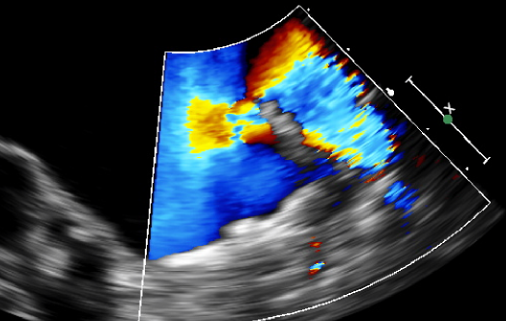
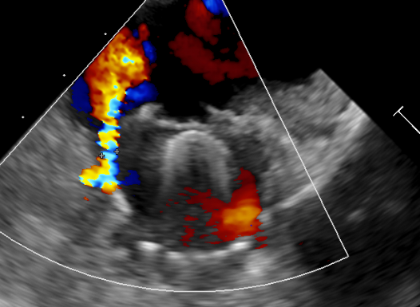
LAA patency at 45-day TEE
AMULET
13.7%
(n=13/95)
WATCHMAN/FLX
27.5%
(n=25/91)
VS.
0.50 (0.27-0.91);
P= 0.020
NO PDL >5mm
NO PDL >5mm
NO MULTIPLE PDLs
2.2% MULTIPLE PDLs
(all in Watchman 2.5)

Slide 14
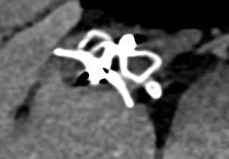
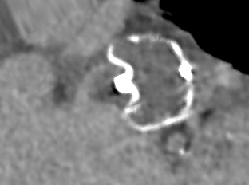
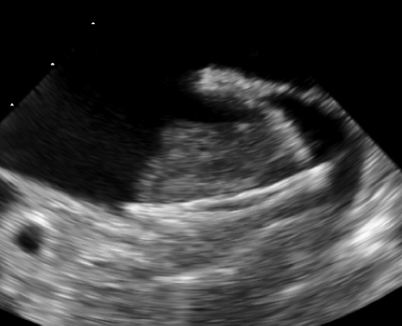
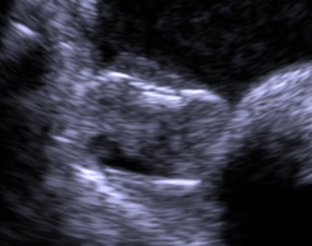
Device Related Thrombus at 45 days
AMULET
WATCHMAN/FLX
CCTA
Definite DRT
0.9%
(n=1/107)
VS.
3.0%
(n=3/101)
0.31 (0.03-2.98); P= 0.285
Definite or possible DRT
3.7%
(n=4/107)
9.9%
(n=10/101)
0.38 (0.12-1.17); P= 0.076
VS.
TEE
2.1%
(n=2/95)
VS.
5.5%
(n=5/91)
0.38 (0.08-1.93); P= 0.225
1.1%
(n=1/92)
VS.
6.4%
(n=6/94)
«as treated population»
0.17 (0.02-1.39); P= 0.058

Slide 15
Procedure related complications
 | Amulet (N=111) | Watchman/FLX (N=110) | Amulet vs Watchman Risk ratio (95% CI) | P value
Major procedure related complication, no. (%) * | 10 (9.0%) | 3 (2.7%) | 3.30 (0.93 - 11.68) | 0.047
Death, no. (%) | 2 (1.8%) | 0 (0.0%) |  | 0.498
Cerebrovascular event, no. (%) | 2 (1.8%) | 0 (0.0%) |  | 0.498
Systemic embolism, no. (%) | 0 (0.0%) | 0 (0.0%) |  | 1
Major bleeding (BARC 3-5), no. (%) ¶ | 8 (7.2%) | 2 (1.8%) | 3.96 (0.86 - 18.25) | 0.054
Clinically relevant pericardial effusion, no. (%) | 4 (3.6%) | 0 (0.0%) |  | 0.122
Device embolization, no. (%) | 1 (0.9%) | 1 (0.9%) | 0.99 (0.06 - 16.04) | 0.995
Acute kidney injury, no. (%) | 0 (0.0%) | 0 (0.0%)
* Composite of death, CVE, systemic embolism, major bleeding, cardiac tamponade, device embolization, or acute kidney injury occurring within 7 days or thereafter if deemed procedure-related.
¶ All 4 cardiac tamponades observed within 45 days after LAAC occurred in the Amulet group

Slide 16
Clinical outcomes at 45 days
 | Amulet (N=111) | Watchman/FLX (N=110) | Amulet vs Watchman Risk ratio (95% CI) | P value
Composite of CV death, stroke or systemic embolism, no. (%) | 3 (2.7%) | 5 (4.5%) | 0.59 (0.15 - 2.43) | 0.463
Death, no. (%) | 2 (1.8%) | 4 (3.6%) | 0.50 (0.09 - 2.72) | 0.409
Cardiovascular death, no. (%) | 2 (1.8%) | 4 (3.6%) | 0.50 (0.09 - 2.72) | 0.409
Cerebrovascular event, no. (%) | 2 (1.8%) | 2 (1.8%) | 1.00 (0.14 - 7.16) | 0.998
Systemic embolism, no. (%) | 0 (0.0%) | 1 (0.9%) |  | 0.498
Any bleeding, no. (%) | 36 (32.4%) | 25 (22.7%) | 1.43 (0.92 - 2.21) | 0.107
-Minor bleeding (BARC 1-2), no. (%) | 29 (26.1%) | 19 (17.3%) | 1.51 (0.90 - 2.53) | 0.11
-Major bleeding (BARC 3-5), no. (%) | 9 (8.1%) | 7 (6.4%) | 1.27 (0.49 - 3.30) | 0.617
Any pericardial effusion (new onset), no. (%) | 22 (19.8%) | 8 (7.3%) | 3.09 (1.32 - 7.27) | 0.006
-non clinically relevant, no. (%) | 18 (16.2%) | 8 (7.3%) | 2.23 (1.01 - 4.91) | 0.039
-clinically relevant, no. (%) | 4 (3.6%) | 0 (0.0%) |  | 0.122

Slide 17
Study Limitations
Open label study: the two devices can be easily distinguished during CCTA and TEE assessment
Trial not powered to show differences with regard to clinical endpoints
Minority yet sizable proportion of Watchman/FLX patients received Watchman 2.5
Rates of procedural complications observed were higher compared to those reported by previous studies (0.5-5%)

Slide 18
Conclusions
In patients with high bleeding risk undergoing clinically indicated LAA Closure
Amulet compared with Watchman/FLX was associated with:
similar residual LAA patency at 45-day CCTA
lower PDL rates at 45-day TEE
higher procedural complications
similar clinical outcomes at 45 days

