Slide 1
One-month Dual Antiplatelet Therapy Followed by Clopidogrel Monotherapy in Acute Coronary Syndrome:
Hirotoshi Watanabe
Takeshi Morimoto, Masahiro Natsuaki, Ko Yamamoto, Yuki Obayashi, Satoru Suwa, Tsuyoshi Isawa, Hiroki Watanabe, Hideo Tokuyama, Hiroki Sakamoto, Hiroshi Suzuki, Kohei Wakabayashi, Kenji Ando, Kazushige Kadota, and Takeshi Kimura for the STOPDAPT-2 ACS investigators.
Notes:
On behalf of the co-investigators, it’s my great honor to announce the results of the STOPDAPT-2 ACS

Slide 2
Background
Standard DAPT duration in patients with ACS is 12 months with class I recommendation.
Recent trials and some meta-analysis demonstrated the benefit of very short DAPT (1-3M) and subsequent P2Y12i monotherapy in reducing bleeding without increase in cardiovascular events even after ACS-PCI.
Death, MI and Stroke (1-year)
 | P2Y12i mono |  | DAPT |  | HR (95%CI) | HR (95%CI)
P2Y12i type
Newer P2Y12i | 158/5845 | (3.0%) | 187/5884 | (3.7%) |  | 0.85 (0.69-1.06)
Clopidogrel | 028/1103 | (2.9%) | 033/1134 | (3.2%) |  | 0.88 (0.53-1.46)
Overall | 186/6948 | (3.0%) | 220/7018 | (3.7%) |  | 0.86 (0.71-1.04)
SIDNEY-2, BMJ 2021; 373: n1332
However, monotherapy with newer P2Y12i was the dominant strategy in ACS patients in these very short DAPT studies. The benefit of very short DAPT and subsequent clopidogrel monotherapy is not fully addressed in ACS patients.
Notes:
Background
As for the DAPT duration after PCI in patients with ACS, Standard DAPT duration is 12 months with class one recommendation.
The recent trials and some meta-analysis demonstrated the benefit of very short DAPT and subsequent P2Y12 inhibitors monotherapy even after ACS-PCI.
However, monotherapy with newer P2Y12i was the dominant strategy in ACS patients in these very short DAPT studies. The benefit of very short DAPT and subsequent clopidogrel monotherapy is not fully addressed in ACS patients.

Slide 3
Objective
The STOPDAPT-2 ACS trial sought to evaluate the safety and efficacy of 1-month DAPT followed by clopidogrel monotherapy as compared with the standard 12-month DAPT with aspirin and clopidogrel after implantation of cobalt-chromium everolimus-eluting stents (CoCr-EES) in ACS patients.
Notes:
The objective of the current study is to evaluate the

Slide 4
STOPDAPT-2 ACS Prospective multicenter open-label randomized trial comparing 1-month versus 12-month DAPT after CoCr-EES implantation for patients with ACS
1M
(30-59d)
1Y
(335-394d)
5Y
1-month DAPT group
ASA
ACS-PCI
(Staged procedures should be completed)
P2Y12i
Clopidogrel 75mg/d
R
Clopidogrel 75mg/day or
Prasugrel 3.75 mg/day
Primary analysis
P2Y12i
Clopidogrel 75mg/d
ASA
ASA
ASA
12-month DAPT group
Key exclusion criteria
Oral anticoagulants
Prior intracranial hemorrhage
In-hospital serious complication (re-infarction, stroke, major bleeding)
Notes:
STOPDAPT-2 ACS is the prospective, multicenter, open-label, and randomized trial conducted in Japan.
The study protocol is identical to the previous STOPDAPT-2, except for the exclusive enrollment of ACS patients.
The ACS patients treated with XienceTM series were screened and after the completion of stage procedures, patients were enrolled and randomized before hospital discharge.
Exclusion criteria were limited to the user of oral anticoagulants and the patients with prior intracranial hemorrhage. We also excluded the patents with serious in-hospital complication such as re-infarction, stroke, or major bleeding.
Patients were assigned into 1-month DAPT group and 12-month DAPT group.
During the first 1-month, both group received DAPT with clopidogrel or low-dose prasugrel, any drug is OK.
And at 1-month visit, 1-month DAPT group stopped the aspirin and received the clopidogrel monotherapy and continued to 5-year.
12-month DAPT group received the DAPT with aspirin and clopidogrel beyond 1-month up to 1-year and changed into aspirin monotherapy after 1-year.
Primary analysis was made at 1-year.

Slide 5
Endpoints
・ Primary endpoint:
・ A composite of cardiovascular (cardiovascular death, myocardial
infarction, definite stent thrombosis, any stroke) and
bleeding (TIMI major/minor bleeding) events
・ Major secondary endpoints:
Cardiovascular (CV) composite endpoint
・ A composite of cardiovascular death, myocardial infarction,
definite stent thrombosis, any stroke
Bleeding endpoint
・ TIMI major/minor bleeding
Notes:
The primary endpoint was the composite of cardiovascular and bleeding events.
The cardiovascular events were defined as the composite of death from cardiovascular cause, myocardial infarction, definite stent thrombosis, any stroke, that is ischemic and hemorrhagic,
And the bleeding events were defined by the TIMI major or minor criteria.
Major secondary endpoints were each of the cardiovascular composite endpoint and the bleeding endpoint.

Slide 6
Hierarchical Hypothesis Tests and Sample Size Calculation
Prespecified Hierarchical Tests for Hypothesis
1) Non-inferiority on the primary endpoint (CV composite + bleeding)
2) Non-inferiority on the major secondary CV endpoint
3) Superiority on the major secondary bleeding endpoint
4) Superiority on the primary endpoint
Once statistical significance was not met in any test, P values would not be reported for subsequent outcomes
Sample size calculation for non-inferiority on the primary endpoint
Assumption: Event rate at 1-year: 4.0% (Based on STOPDAPT-2 results for ACS patients).
Non-inferiority margin; 50% on the hazard ratio scale
Power: 90%, One-sided alpha: 0.025
Sample size: 4,036 patients (2,018 in each arm)
→ Enrollment of additional 3000 ACS patients as STOPDAPT-2 ACS on top of 1161 ACS patients already enrolled in the STOPDAPT-2
Total 4100 ACS patients would yield
80% power for non-inferiority on the major secondary CV endpoint (Assumed event rate 3.0%)
81% power for superiority on the bleeding endpoint (assumed event rate 1.5% and 60% relative risk reduction)
Notes:
We conducted pre-specified hierarchical tests for hypothesis as following order.
1st, Non-inferiority of primary endpoint, 2nd, non-inferiority of the major secondary CV endpoint, 3rd, superiority of the major secondary bleeding endpoint, and 4th superiority of primary endpoint.
Once the statistical significance was not met in any test, the P value would not be reported for the subsequent outcomes.
As for sample size, we assume the event rate of primary endpoint at 1-year is 4.0% based on the STOPDAPT-2 results for ACS patients. Non inferiority margin was defined as 50% on hazard ratio scale. With the power 90% and one-sided alpha 0.025, 4,036 ACS patients needed, then we decided the enrollment of additional 3000 ACS patients as STOPDAPT-2 ACS on top of 1161 ACS patients already enrolled in STOPTDAPT-2.
This population would yield 80% of power to detect non-inferiority of CV endpoint, and the 81% of power to detect superiority on the bleeding endpoint.

Slide 7
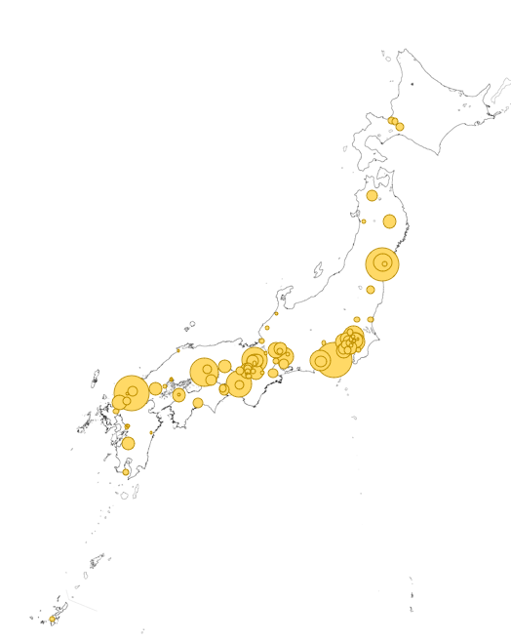
Acknowledgement
96 participating centers (Top 10 enrollers)
Teine Keijinkai Hospital
Megumino Hospital
Hokko Memorial Hospital
Hirosaki University Hospital
Iwate Medical University Hospital
Nakadori General Hospital
Sendai Kousei Hospital
Sendai Cardiovascular Center
Tohoku Medical and Pharmaceutical University Hospital
Hoshi General Hospital
Jichi Medical University Hospital
Mito Saiseikai General Hospital
Kawaguchi Cardiovascular and Respiratory Hospital
Mashiko Hospital
Ageo Central General Hospital
Kimitsu Central Hospital
Mitsui Memorial Hospital
Toranomon Hospital
Showa University Koto Toyosu Hospital
Juntendo University Hospital
Juntendo University Urayasu Hospital
Edogawa Hospital
Kawakita General Hospital
Sakakibara Heart Institute
Tokyo Metropolitan Tama Medical Center
Minamino Cardiovascular Hospital
Higashiyamato Hospital
St.Marianna University School of Medicine Hospital
Yokohama Rosai Hospital
Showa University Fujigaoka Hospital
Yokohama City University Medical Center
Fujisawa City Hospital
Kitasato University Hospital
Hiratsuka Kyosai Hospital
Tokai University Hospital
University of Yamanashi Hospital
Japanese Red Cross Wakayama Medical Center
Wakayama Medical University Hospital
Okayama Medical Center
Kurashiki Central Hospital
Hiroshima University Hospital
Hiroshima Prefectural Hospital
Shimane University Hospital
Iwakuni Medical Center
Tokuyama Central Hospital
Shimonoseki City Hospital
Tokushima University Hospital
Tokushima Red Cross Hospital
Kagawa Prefectural Central Hospital
Ehime Prefectural Central Hospital
Matsuyama Red Cross Hospital
Chikamori Hospital
Kokura Memorial Hospital
University of Occupational and Environmental Health Hospital
Saiseikai Fukuoka General Hospital
Iizuka Hospital
Saga University Hospital
Kumamoto University Hospital
Saiseikai Kumamoto Hospital
Japanese Red Cross Kumamoto Hospital
Hitoyoshi Medical Center
Miyazaki Prefectural Nobeoka Hospital
Ibusuki Medical Center
Urasoe General Hospital
Coordinating center
Research Institute for Production Development
Funded by
Abbott Medical Japan LLC
Kanazawa Cardiovascular Hospital
University of Fukui Hospital
Municipal Tsuruga Hospital
Gifu Prefectural General Medical Center
Ogaki Municipal Hospital
Juntendo University Shizuoka Hospital
Shizuoka General Hospital
Shizuoka Saiseikai General Hospital
Nagoya Daini Red Cross Hospital
Handa City Hospital
Ichinomiyanishi Hospital
Tosei General Hospital
Yokkaichi Hazu Medical Center
Matsusaka Chuo General Hospital
Nabari City Hospital
Otsu Red Cross Hospital
Hikone Municipal Hospital
Kyoto University Hospital
Uji Tokushukai Hospital
Kyoto Medical Center
Mitsubishi Kyoto Hospital
Kitano Hospital
Osaka Red Cross Hospital
Osaka General Medical Center
National Cerebral and Cardiovascular Center
Kindai University Hospital
Bellland General Hospital
Mimihara General Hospital
Kobe City Medical Center General Hospital
Tsukazaki Hospital
Kindai University Nara Hospital
Tenri Hospital
Notes:
96 PCI centers all over Japan participate in the current study. We really appreciate the contribution.
Special thanks to the coordinating center, the research institute for production development in Kyoto.
The study is funded by Abbott medical japan

Slide 8
Study Flow
STOPDAPT-2 ACS (NCT03462498)
Mar. 2018- Jun.2020
Eligible ACS patients
N=4056
STOPDAPT-2 (NCT02619760)
Dec. 2015- Dec.2017
Eligible ACS patients
N=2437
No Participation
N=1048 (26%)
No Participation
N=1276 (52%)
STOPDAPT-2 ACS
N=3008
ACS in STOPDAPT-2
N=1161
Randomized ACS patients
N=4169
1-month DAPT arm
N=2078
Stratified
by Center
12-month DAPT arm
N=2091
20 withdrew consent
13 withdrew consent
N=4136
1-month DAPT, ITT
N=2058
12-month DAPT, ITT
N=2078
1-year FU 99.3%
1-year FU 99.3%
Notes:
Between March 2018 and Jun 2020, we screened 4056 ACS patients and 1048 patients did not participate in the study from the judgement of physicians or refusal of patients. 3008 patients were newly enrolled as STOPDAPT-2 ACS.
Combined with 1161 ACS patients derived from STOPDAPT-2, total 4169 patients were enrolled and randomized.
After the exclusion of 33 patients who withdrew the consent, the final analytic population was 4136.
1-year follow up was achieved in over 99% of patients in both arm.

Slide 9
Baseline Clinical Characteristics
 | 1-month DAPT N=2058 | 12-month DAPT N=2078
Age, years | 67.0±11.9 | 66.6±11.9
Men | 79% | 79%
STEMI; NSTEMI; UA | 57%; 19%; 23% | 55%; 21%; 24%
Killip 4 | 3.4% | 3.1%
ECMO; Impella; IABP | 0.3%; 0.1%; 4.1% | 0.3%; 0.1%; 3.1%
Diabetes | 30% | 30%
Severe CKD (eGFR<30ml/min/m²) | 3% | 3%
Prior MI | 6% | 5%
Prior PCI | 11% | 10%
CREDO-Kyoto thrombotic risk score
High; Intermediate; Low | 4%; 17%; 79% | 5%; 16%; 79%
CREDO-Kyoto bleeding risk score
High; Intermediate; Low | 4%; 20%; 77% | 3%; 19%; 78%
Notes:
Baseline characteristics were well balanced between the two groups.
The mean age was about 67 years old.
Exclusive ACS patients, and STEMI was about 57 or 55%.
Killip 4 presentation or Requirement of Mechanical support were about 3%
As for the CREDO-Kyoto thrombotic or bleeding risk scores, most patients were categorized into intermediate or low category.

Slide 10
Procedural Characteristics and Medications
 | 1-month DAPT N=2058 | 12-month DAPT N=2078
Staged Procedure | 14% | 15%
Radial approach only | 85% | 86%
N of target lesions | 1.27±0.60 | 1.28±0.59
Minimal stent diameter, mm | 3.01±0.51 | 3.02±0.50
Total stent length, mm | 34.3±22.6 | 34.6±23.5
Target of LMCA | 3% | 3%
Two or more target vessels | 17% | 19%
IVUS or OCT | 97% | 98%
ASA; 100mg/d | 99.9%; 98.6% | 99.9%; 98.4%
Clopidogrel | 52% | 53%
Prasugrel (3.75mg/day) | 48% | 47%
Statin; High-intensity statin | 96%; 35% | 97%; 34%
PPI | 91% | 93%
Notes:
Procedural characteristics and medications were also well balanced.
85% of patients were treated with radial approach alone
About 18% of patients have the two or more target vessels.
The usage of imaging device like IVUS or OCT were over 97%, similar with STOPDAPT-2.
As for medication at discharge, most patients receive the aspirin with 100mg/day
Low-dose prasugrel 48%, and statin 96%, or proton-pump inhibitors 91%, these rates were higher than STOPDAPT-2

Slide 11
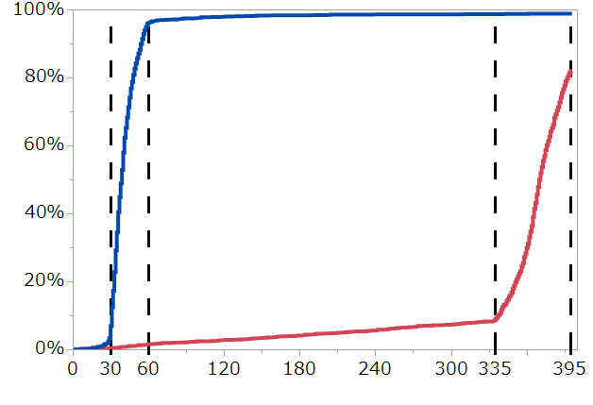
Persistent DAPT Discontinuation Rate
98.8%
96.1%
1-month DAPT
12-month DAPT
82.0%
Cumulative incidence
1.6%
8.8%
Days after index PCI
Number of patients on DAPT
1-month DAPT | 2058 | 1986 | 86 | 42 | 33 | 29 | 27 | 27 | 17
12-month DAPT | 2078 | 2070 | 2033 | 2004 | 1974 | 1941 | 1903 | 1879 | 299
Notes:
The persistent DAPT discontinuation rate,
At the 60-day, 96.1% patients in 1-month DAPT discontinued the DAPT and the majority moved into clopidogrel monotherapy.
On the other hand, only 8.8% of patients in 12-month DAPT discontinued the DAPT up to 1-year.
Therefore we can say that the study protocol was well followed by the participants.

Slide 12
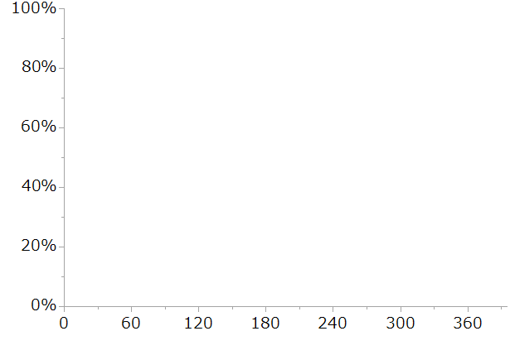
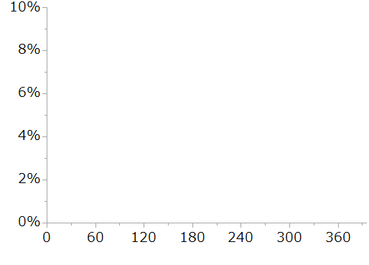
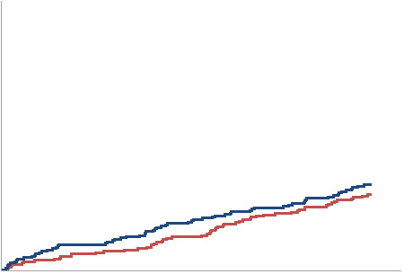
Primary Endpoint CV death/MI/ST/Stroke/TIMI major/minor bleeding
1-month DAPT
12-month DAPT
HR 1.14, (95%CI, 0.80-1.62)
P non-inferiority 0.06
Cumulative Incidence
3.20%
2.83%
30
30
Days after index PCI
No. at risk
12-month DAPT
1-month DAPT
No. at risk
12-month DAPT | 2078 | 2070 | 2055 | 2048 | 2036 | 2021 | 2010 | 1581
1-month DAPT | 2058 | 2047 | 2028 | 2021 | 2007 | 1993 | 1982 | 1606
Notes:
Here is the 1-year incidence of primary endpoint,
2.83% in 12-month DAPT and 3.20 in 1-month DAPT.
The hazard ratio was 1.14 with 95% confidential interval as the 0.80 to 1.62.
The upper limit was higher than the prespecified 1.5.
Then the noninferiority of 1-month DAPT was NOT met.

Slide 13
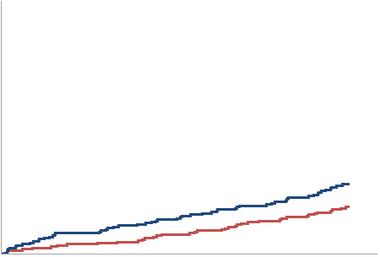
Major Secondary CV Endpoint CV death/MI/ST/Stroke
1-month DAPT
12-month DAPT
HR 1.50, (95%CI, 0.99-2.26)
Cumulative Incidence
2.76%
1.86%
30
30
Days after index PCI
No. at risk
12-month DAPT
1-month DAPT
No. at risk
12-month DAPT | 2078 | 2073 | 2059 | 2054 | 2046 | 2038 | 2028 | 1597
1-month DAPT | 2058 | 2049 | 2031 | 2024 | 2015 | 2002 | 1991 | 1614
Notes:
As for major secondary CV endpoint,
1.86% in 12-month DAPT and 2.76 in 1-month DAPT.
Hazard ratio was 1.50 with 0.99 to 2.26.

Slide 14
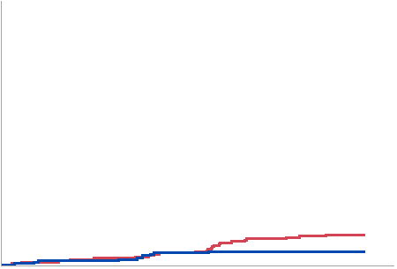
Major Secondary Bleeding Endpoint TIMI major/minor bleeding
1-month DAPT
12-month DAPT
HR 0.46, (95%CI, 0.23-0.94)
Cumulative Incidence
1.17%
0.54%
30
30
Days after index PCI
No. at risk
12-month DAPT
1-month DAPT
No. at risk
 | 2078 | 2073 | 2060 | 2054 | 2045 | 2033 | 2027 | 1603
 | 2058 | 2052 | 2041 | 2038 | 2030 | 2023 | 2015 | 1642
Notes:
Major secondary bleeding endpoint,
The incidence rates were 1.17% in 12-month DAPT and 0.54% in 1-month DAPT.
Hazard ratio was 0.46 with 0.23-0.94

Slide 15
Clinical Outcomes at 1 year
%
Hazard ratio (95%CI)
1.49
(0.83-2.67)
1.01
(0.42-2.43)
1.91
(1.06-3.44)
1.53 (0.43-5.43)
2.29
(0.70-7.42)
1.38
(0.63-3.00)
0.41
(0.20-0.83)
1.59
1.38
1.31
Cumulative Incidence
0.92
0.85
0.73
0.49
0.49
0.45
0.54
0.54
0.31
0.20
0.20
Death
CV death
MI
Large MI
(CKMB >=10*ULN)
Definite
ST
Any Stroke
BARC 3/5
Bleeding
Notes:
Each clinical outcomes at 1-year.
The incidence rate of all cause death was numerically higher in 1-month DAPT but that of cardiovascular cause was comparable.
The incidence of myocardial infarction was numerically higher in 1-month DAPT, but the large MI, definite stent thrombosis or any stroke was insignificant.
The reduction of bleeding events were also significant in BARC 3/5 criteria.

Slide 16
Comparison between STOPDAPT-2 and STOPDAPT-2 ACS
 | N of event/Total (incidence %) |  |  |  |  | HR (95%CI) | Post-hoc actual stat. power*
 | 1-month DAPT |  | 12-month DAPT
Primary endpoint
STOPDAPT-2 (N=3009) | 35/1500 | (2.37%) | 55/1509 | (3.72%) |  | 0.64 (0.42-0.98) | 77%
Present study (N=4136) | 65/2058 | (3.20%) | 58/2078 | (2.83%) |  | 1.14 (0.80-1.62) | 78%
Major secondary CV endpoint
STOPDAPT-2 | 29/1500 | (1.96%) | 37/1509 | (2.55%) |  | 0.79 (0.49-1.29) | 60%
Present study | 56/2058 | (2.76%) | 38/2078 | (1.86%) |  | 1.50 (0.99-2.26) | 60%
Major secondary Bleeding endpoint
STOPDAPT-2 | 6/1500 | (0.41%) | 23/1509 | (1.54%) |  | 0.26 (0.11-0.64) | 89%
Present study | 11/2058 | (0.54%) | 24/2078 | (1.17%) |  | 0.46 (0.23-0.94) | 60%
1-month DAPT better
12-month DAPT better
*Power calculated from actual event rate of 12-month DAPT group. Power for non-inferiority of 1-month DAPT with HR 1.5 in primary endpoint and major secondary CV endpoint, and power for superiority of 1-month DAPT in major secondary bleeding endpoint with observed risk reduction .
Notes:
Compared with the previously published STOPDAPT-2, the present study enrolling exclusively ACS patients was inconclusive for the primary endpoint.
If we compare the present study with the previously reported STOPDAPT-2 trial, the effects of clopidogrel monotherapy after 1-month DAPT relative to 12-month DAPT were directionally opposite for cardiovascular events.
One of the reasons for this apparently different effect for cardiovascular events might be the lower than anticipated event rate with a lack of adequate statistical power.
The reduction of bleeding event was consistent in both studies. However, considering the trend toward increase in cardiovascular events, the clopidogrel monotherapy may not be the optimal regimen after very short DAPT in ACS patients.

Slide 17
Limitations
Inconclusive for the primary endpoint (the net clinical benefit), and a trend toward increase in cardiovascular events with clopidogrel monotherapy is worrisome despite reduction in major bleeding.
Event rate lower than anticipated, rendering the present study underpowered.
Open label design
The various difference between Japan and US/Europe.
The balance of ischemic and bleeding risks
The usage of imaging device
Medication (Standard dose of prasugrel and ticagrelor are generally not used in Japan).
No assessment about the influence of CYP2C19 polymorphism.
Notes:
Limitations,

Slide 18
Conclusions
In ACS patients who underwent successful PCI using CoCr-EES, clopidogrel monotherapy after 1-month DAPT failed to attest the noninferiority to 12-month DAPT with aspirin and clopidogrel for the net clinical benefit with a trend toward increase in cardiovascular events despite reduction in major bleeding events.
Further investigations are needed to establish the optimal antiplatelet therapy after PCI in patients with ACS

