Slide 1
Impact of Ejection Fraction on
the Therapeutic Effect of
Omecamtiv Mecarbil in Patients
with Heart Failure and
Reduced Ejection Fraction:
A Secondary Analysis
From GALACTIC-HF
John R Teerlink,¹ Scott D Solomon,² Marco Metra,³
John JV McMurray,⁴ G Michael Felker,⁵ Rafael Diaz,⁶
Brain L Claggett,² Stephen B Heitner,⁷ Siddique
A Abbasi,⁸ Christopher E Kurtz,⁸ Fady I Malik⁷
on behalf of the GALACTIC-HF Investigators
¹San Francisco VAMC/ UCSF, San Francisco, CA; ²Brigham & Women's Hosp, Boston, MA; ³Univ of Brescia, Brescia, Italy; ⁴BHF Cardiovascular Res Ctr, Glasgow, United Kingdom; ⁵Duke Clinical Res Inst, Durham, NC; ⁶Rosario Inst of Cardiology, Rosario, Argentina; ⁷Cytokinetics Inc., South San Francisco, CA; ⁸Amgen Inc., Thousand Oaks, CA.

Slide 2





Disclosures
The authors thank the patients, study investigators, and trial committees
of GALACTIC-HF
Funded by Amgen, Inc., Cytokinetics, Inc., and Servier Laboratories
John R. Teerlink, MD, FACC, FAHA, FESC, FHFA, FHFSA, FRCP disclosures:
  Research Grant/ Consultant: Abbott, Amgen, Astra Zeneca, Bayer, Boehringer-Ingelheim, Bristol-Myers Squibb, Cytokinetics, EBR Sytems, LivaNova, Medtronic, Merck, Novartis, Servier
2

Slide 3
Background
Omecamtiv mecarbil (OM)¹ is a novel, selective cardiac myosin activator ("myotrope”²) that improves cardiac structure/function and decreases heart rate and NT-proBNP in patients with Heart Failure and reduced Ejection Fraction (HFrEF)^{3,4}
In the GALACTIC-HF trial,⁵ omecamtiv mecarbil improved the primary endpoint of heart failure events or cardiovascular death in patients with Heart Failure and reduced Ejection Fraction (EF ≤35%)
Analysis Question: Does the baseline Ejection Fraction (EF) modify the treatment effect of omecamtiv mecarbil?
¹Malik FI, et al. Science 2011;331:1439–43; ²Psotka MA, et al. J Am Coll Cardiol 2019;73:2345‒53;
³Teerlink JR, et al. Lancet 2016;388:2895–2903; ⁴Teerlink JR, et al. JACC Heart Fail 2020;8:329–40;
⁵Teerlink JR, et al. N Engl J Med 2021;384:105-116.

Slide 4
Trial Design
Hypothesis: Selectively improving cardiac function with the cardiac myosin activator, omecamtiv mecarbil, will improve clinical outcomes in patients with HFrEF
Screening:
Chronic HF, NYHA II-IV
LVEF ≤35%
Elevated BNP/ NTproBNP
Managed with Standard HF therapies
Currently hospitalized for HF (Inpatients)
OR
Urgent ED visit or hospitalization for HF within 1 year prior to screening (Outpatients)
SBP ≥85 mmHg;
eGFR ≥20 mL/min/1.73m²
Omecamtiv Mecarbil + Standard HF Therapy
Starting dose: 25 mg PO BID; Pharmacokinetic-guided dose selection
(25, 37.5 or 50 mg PO BID)
Randomization (1:1)
Stratification
Inpatient or outpatient
Region
End of Study
Placebo + SoC
Study Visits
D1
W2
W4
W6
W8
W12
W24
W36
W48
Q16W
Pharmacokinetic assessment
for dose adjustment
Multicenter, international, randomized, double-blind, placebo-controlled, event-driven Phase 3 study
Teerlink JR, et al. JACC Heart Fail 2020;8:329‒40.

Slide 5
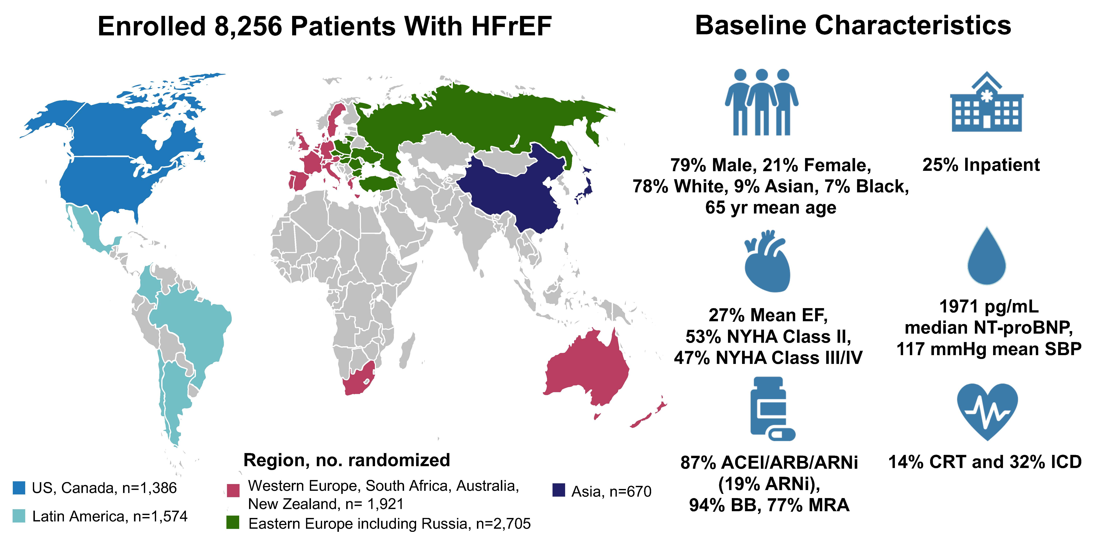
Baseline Characteristics
Only one patient lost-to-follow-up for vital status
Teerlink JR, et al. Eur J Heart Fail 2020;22:2160-2171.

Slide 6
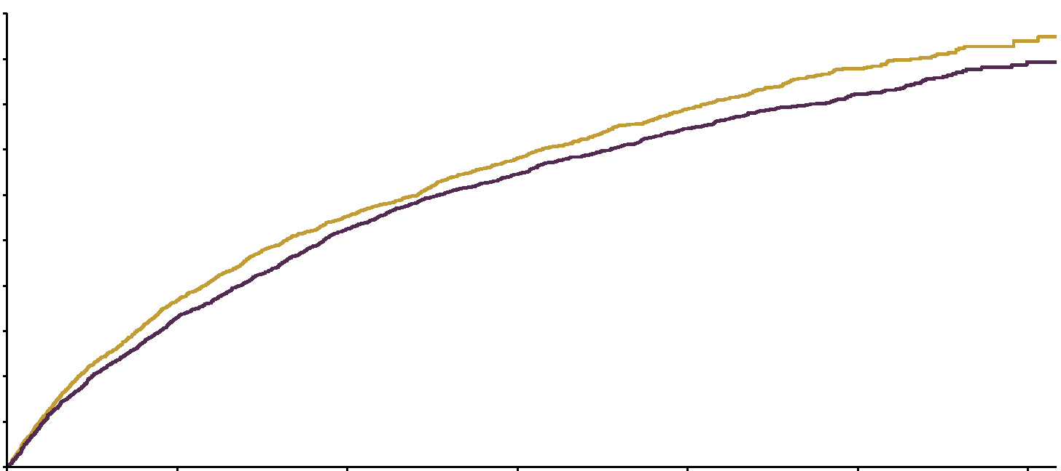
Primary Composite Endpoint
Time to First Heart Failure Event or Cardiovascular Death
Placebo
50
Hazard ratio = 0.92 (95% CI, 0.86–0.99) P = 0.0252
HR = 0.92 (95% CI, 0.86–0.99)
P = 0.025
40
Omecamtiv mecarbil
30
Cumulative incidence, %
20
10
0
0
6
12
18
24
30
36
Patients at risk, n
Months (30 days) since randomization
Placebo | 4112 | 3310 | 2889 | 2102 | 1349 | 647 | 141
Omecamtiv mecarbil | 4120 | 3391 | 2953 | 2158 | 1430 | 700 | 164
Teerlink JR, et al. N Engl J Med 2021;384:105-116.

Slide 7
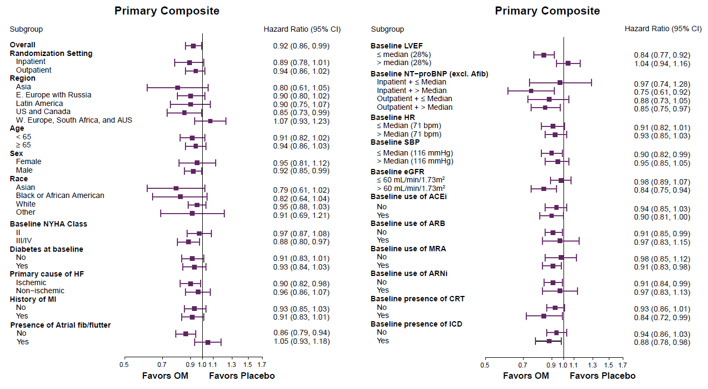
Primary Outcome: Subgroup Results
Baseline LVEF ≤ median (28%) > median (28%) |  | 0.84 (0.77, 0.92) 1.04 (0.94, 1.16)
Interaction P-value = 0.003
0.7
1.0
1.3
Teerlink JR, et al. N Engl J Med 2021;384:105-116.

Slide 8
Baseline Ejection Fraction
Ejection Fraction (EF) ≤35%
Most recent within 12 months prior to randomization
≥30 days after:
  Event likely to decrease EF (e.g., myocardial infarction, sepsis); or
  Intervention likely to increase EF (e.g., cardiac resynchronization therapy, coronary revascularization); or
  First ever presentation for HF.
>97% Baseline EFs from Echocardiograms
>70% Baseline EF’s ≤30%
EF Distribution

Slide 9
Baseline Characteristics by EF Quartile (1)
Demographics | Q1: EF ≤22% (N=2246) | … | Q4: EF ≥33% (N=1750) | P-Value
Age (years), mean±SD | 62.5 ± 12 |  | 66.4 ± 11 | <0.001
Sex, female, n (%) | 422 (19) |  | 421 (24) | <0.001
Race, n (%) |  |  |  | <0.001
Asian | 171 (8 ) |  | 136 (8)
Black | 243 (11) |  | 68 (4)
Other* | 200 (9 ) |  | 83 (5)
White | 1632 (73) |  | 1463 (84)
Region, n (%) |  |  |  | <0.001
Asia | 152 (7) |  | 130 (7)
Eastern Europe/ Russia | 476 (21) |  | 805 (46)
Latin and South America | 438 (20) |  | 268 (15)
US and Canada | 581 (26) |  | 205 (12)
Western Europe/ South Africa/ Australasia | 599 (27) |  | 342 (20)
Medical Conditions, n (%) | Q1: EF ≤22% (N=2246) | … | Q4: EF ≥33% (N=1750) | P-Value
Coronary artery disease | 1267 (56) |  | 1218 (70) | <0.001
Atrial Fib/ Flutter (Screen) | 547 (24) |  | 528 (30) | <0.001
Hypertension | 1431 (64) |  | 1367 (78) | <0.001
Type 2 diabetes mellitus | 869 (39) |  | 743 (43) | <0.001
Heart Failure History | Q1: EF ≤22% (N=2246) | … | Q4: EF ≥33% (N=1750) | P-Value
LVEF (%), median [Q1, Q3] | 20 [15, 20] |  | 34 [33, 35] | N/A
Time from last HF Hosp. (months; median [Q1,Q3] | 3.0 [1.6, 5.9] |  | 3.6 [1.6, 6.9] | 0.043
MAGGIC Score, median [Q1, Q3] | 25 [21, 30] |  | 21 [17, 25] | <0.001
NYHA III/IV, n (%) | 1086 (48) |  | 791 (45) | 0.016
Ischemic HF etiology, n (%) | 1033 (46) |  | 1088 (62) | <0.001
KCCQ TSS, median [Q1,Q3] | 69 [48, 88] |  | 69 [49, 85] | 0.77

Slide 10
Baseline Characteristics by EF Quartile (2)
Vitals and Laboratory Parameters | Q1: EF ≤22% (N=2246) | … | Q4: EF ≥33% (N=1750) | P-Value
Body mass index (kg/m²), mean (SD) | 27.9 (6.3) |  | 29.1 (6.1) | <0.001
SBP (mmHg), mean (SD) | 112 (15) |  | 121 (14) | <0.001
Heart rate (beats/min), mean (SD) | 74 (12) |  | 72 (12) | <0.001
NT-proBNP (pg/mL), median [Q1-Q3] | 2524 [1250, 5296] |  | 1615 [755, 3245] | <0.001
hsTnI (ng/L), median [Q3] | 31 [58] |  | 23 [43] | <0.001
eGFR (mL/min/1.73m²), median [Q1,Q3] | 59 [44, 74] |  | 58 [45, 74] | 0.72
Medications and Cardiac Devices, n (%) | Q1: EF ≤22% (N=2246) | … | Q4: EF ≥33% (N=1750) | P-Value
ACEi, ARB or ARNi | 1900 (85) |  | 1539 (88) | <0.001
ARNi | 534 (24) |  | 248 (14) | <0.001
BB | 2086 (93) |  | 1655 (95) | 0.022
MRA | 1715 (76) |  | 1305 (75) | 0.10
(ACEi, ARB, or ARNi) + MRA + BB | 1413 (63) |  | 1114 (64) | 0.37
Digitalis Glycosides | 450 (20) |  | 251 (14) | <0.001
SGLT2 Inhibitors | 64 (3) |  | 43 (3) | 0.19
Ivabradine | 172 (8) |  | 90 (5) | <0.001
Cardiac Resynchronization Therapy | 454 (20) |  | 152 (9) | <0.001
Implantable Cardioverter Defibrillator | 972 (43) |  | 363 (21) | <0.001

Slide 11
Incidence of Primary Composite Endpoint in Treatment Groups by Baseline Ejection Fraction
Placebo

Slide 12
Incidence of Primary Composite Endpoint in Treatment Groups by Baseline Ejection Fraction

Slide 13
Incidence of Primary Composite Endpoint in Treatment Groups by Baseline Ejection Fraction
Treatment Effect

Slide 14
Absolute and Relative Treatment Effect of Omecamtiv Mecarbil Compared to Placebo on Primary Composite Endpoint
Incidence Rate Difference
Treatment Effect

Slide 15
Absolute and Relative Treatment Effect of Omecamtiv Mecarbil Compared to Placebo on Cardiovascular Death
Incidence Rate
Treatment Effect

Slide 16
Other Variables and Events of Interest
For Omecamtiv Mecarbil compared to Placebo:
No significant difference in Systolic BP,
Serum potassium, or Creatinine.
Heart rate was significantly, though minimally and similarly reduced in every EF quartile.
NT-proBNP progressively decreased
with decreasing EF.
Troponin was minimally increased in every EF quartile.
Serious Adverse Events and Adjudicated Arrhythmic and Ischemic Events were similar.
Treatment Difference at 24 Weeks (95% CI) | Q1: EF ≤22% (N=2246) | … | Q4: EF ≥33% (N=1750) | p-Value
Systolic BP (mmHg) | 0.9 (-0.4, 2.2) |  | -1.2 (-2.7, 0.2) | 0.038
Heart rate (bpm) | -1.6 (-2.5, -0.6) |  | -1.1 (-2.1, -0.1) | 0.62
Potassium (mmol/L) | 0.0 (-0.04, 0.05) |  | 0.0 (-0.03, 0.06) | 0.87
Creatinine (mg/dl) | 0.0 (-0.04, 0.02) |  | 0.0 (-0.01, 0.05) | 0.22
NT-proBNP (Ratio) | 0.78 (0.71, 0.85) |  | 0.97 (0.89, 1.06) | <0.001
Troponin I (Ratio) | 1.19 (1.11, 1.27) |  | 1.27 (1.18, 1.37) | 0.22
Troponin I (ng/L) | 5 (4, 6) |  | 3 (2, 4) | 0.055

Slide 17
Conclusions
In patients with HFrEF, omecamtiv mecarbil reduced the 1° composite outcome (first HF event or CV death)
The treatment effect of omecamtiv mecarbil increased with decreasing EF
There was no difference in Serious Adverse, Ischemic or Arrhythmic Events compared to Placebo across the range of EF
There was no adverse effect on blood pressure, heart rate, potassium homeostasis or renal function
Treatment Effect

Slide 18

Effect of Ejection Fraction on Clinical Outcomes in Patients treated with Omecamtiv Mecarbil in GALACTIC-HF
John R. Teerlink, MD, Rafael Diaz, MD, G. Michael Felker, MD,
John J.V. McMurray, MD, Marco Metra, MD, Scott D. Solomon, MD,
Tor Biering-Sørensen, MD, PHD, Michael Böhm, MD, Diana Bonderman, MD,
James C. Fang, MD, David E. Lanfear, MD, Mayanna Lund, MD,
Shin-ichi Momomura, MD, Eileen O'Meara, MD, Piotr Ponikowski, MD, PHD,
Jindrich Spinar, MD, PHD, Jose H. Flores-Arredondo, MD, Brian L. Claggett, PHD, Stephen B. Heitner, MD, Stuart Kupfer, MD, Siddique A. Abbasi, MD,
Fady I. Malik, MD, PHD, on behalf of the GALACTIC-HF Investigators
DOI: https://doi.org/10.1016/j.jacc.2021.04.065

Slide 19
Acknowledgements
EXECUTIVE COMMITTEE: John R. Teerlink, MD (Chair); Rafael Díaz, MD; G. Michael Felker, MD, MHS; John J. V. McMurray, MD;
Marco Metra, MD; Scott D. Solomon, MD
DATA MONITORING COMMITTEE: Marvin A. Konstam, MD (Chair); Javed Butler, MD, MPH; Henry Dargie, MD; Joseph Massaro, PhD; Barry H. Greenberg, MD; James L. Januzzi, MD; Lawrence J. Lesko, PhD (Non-Voting Member); Jenica N. Upshaw, MD, MS (Non-Voting Member)
CLINICAL EVENT ADJUDICATION COMMITTEE: G. Michael Felker, MD, MHS (Co-Chair); Renato Lopes, MD, PhD (Co-Chair, Faculty Co-Director); W. Schuyler Jones, MD (Faculty Co-Director); Karen P. Alexander, MD; Sana M. Al-Khatib, MD, MHS; Robert W. Harrison, MD; J. Dedrick Jordan, MD, PhD; David F. Kong, MD; Robin Mathews, MD; Robert W. McGarrah, MD; Rajendra H. Metha, MD, MS; Chiara Melloni, MD, MHS; Thomas J. Povsic, MD, PhD; Shreyansh Shah, MBBS
SPONSOR LEADERSHIP: Fady I. Malik, MD, PhD; Christopher E. Kurtz, MD; Siddique Abbasi, MD, MSc; Beat Knusel, PhD; Thomas Hucko, MD; John Groarke, MBBCh, MPH, MSc; Narimon Honarpour, MD, PhD; Jason C. Legg, PhD; Lucie Sharpsten, PhD; Claire Varin, MD
INDEPENDENT STATISTICIAN: Brian Claggett, PhD
NATIONAL LEAD INVESTIGATORS: Kirkwood Adams, MD; Inder Anand, MD, PhD; Alexandra Arias Mendoza, MD; Tor Biering-Sørensen, MD; Michael Böhm, MD; Diana Bonderman, MD; John Cleland, MD; Ramon Corbalan Herreros, MD; Marisa Crespo Leiro, MD, PhD; Ulf Dahlstrom, MD, PhD; Rafael Diaz, MD; Luis Eduardo Echeverria, MD; James Fang, MD; Gerasimos Filippatos, MD; Candida Fonseca, MD, PhD; Eva Goncalvesova, MD, PhD; Assen Goudev, MD, PhD; Jonathan Howlett, MD; Lixin Jiang, MD, PhD; David Lanfear, MD, MS; Jing Li, MD; Mayanna Lund, MD; Peter MacDonald, MD, PhD; Viacheslav Mareev, MD, PhD; Marco Metra, MD; Shin-ichi Momomura, MD; Eileen O'Meara, MD; Alexander Parkhomenko, MD, PhD; Piotr Ponikowski, MD, PhD; Felix Ramires, MD, PhD; Pranas Serpytis, MD, PhD; Karen Sliwa, MD, PhD; Jindrich Spinar, MD, PhD; Thomas Suter, MD; Janos Tomcsanyi, MD, PhD; Hans Vandekerckhove, MD; Dragos Vinereanu, MD, PhD; Adriaan Voors, MD, PhD; Mehmet Birhan Yilmaz, MD; Faiez Zannad, MD, PhD
945 Site Investigators in 35 Countries!!

Slide 20
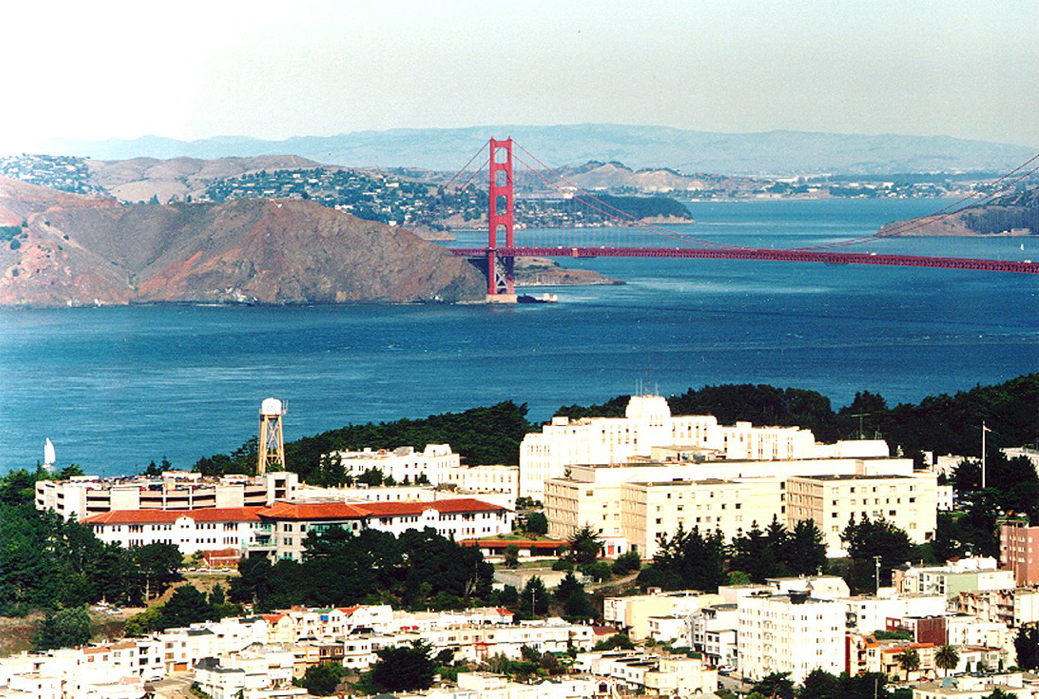
Thank you!
San Francisco Veterans Affairs Medical Center

