Slide 1
Late Breaking Clinical Trial
Effects of Interleukin-6 Inhibition with Ziltivekimab on Biomarkers of Inflammation and Thrombosis Among Patients at High Atherosclerotic Risk:
A Randomized, Double-Blind Phase 2 Trial
Paul Ridker, Matt Devalaraja, Florian Baeres, Mads Engelmann, G Kees Hovingh, Milana Ivkovic, Larry Lo, Douglas Kling, Pablo Pergola, Dominic Raj, Peter Libby, and Michael Davidson
on behalf of the RESCUE Investigators

Slide 2
Conflicts of Interest:
The RESCUE trial was supported by Corvidia and Novo Nordisk
Dr. Ridker has received investigator-initiated research grants from Kowa, Novartis, Pfizer, AstraZeneca, Amarin, NHLBI, NCI
Dr. Ridker has served as a consultant to Corvidia, Novo Nordisk, Inflazome, Novartis, Amgen, Merck, Jansen, Agepha, Flame, and CiviBio.
Dr. Ridker is listed as a co-inventor on patents related to the use of inflammatory biomarkers in CVD and diabetes that are no longer active.

Slide 3
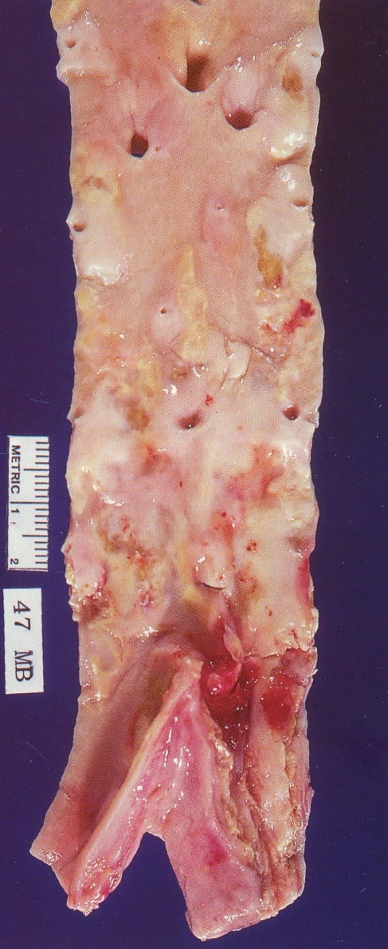
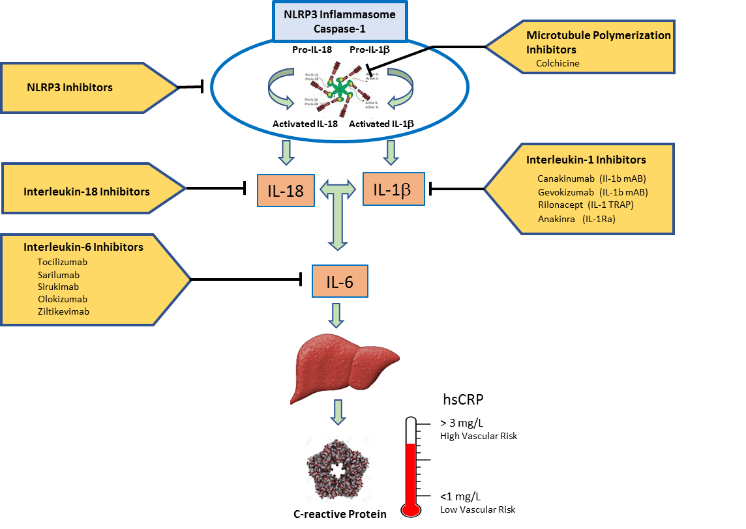
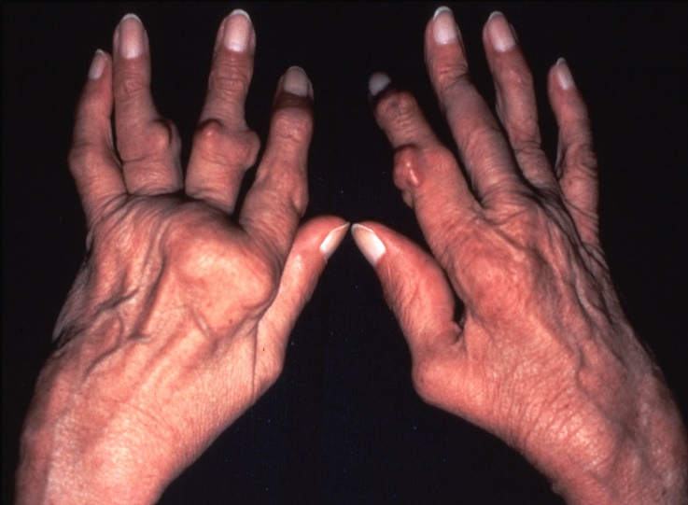
Moving Beyond Cholesterol:
Can Targeted Anti-Cytokine Therapy Reduce Cardiovascular Event Rates and Prolong Life?
Focus on the Interleukin-1 (IL-1β) to Interleukin-6 (IL-6) to CRP Pathway
Ridker PM. Circulation 2020;141:787-789

Slide 4
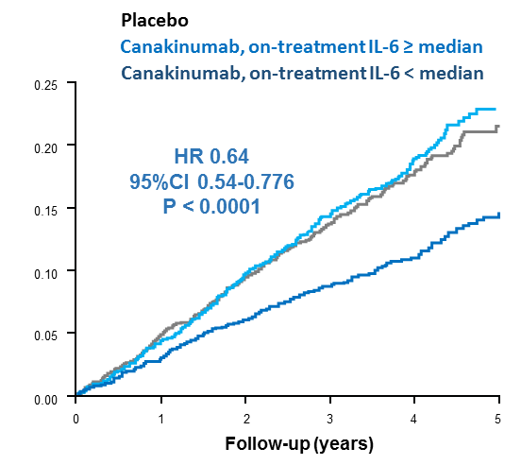
Anti-Cytokine Therapy for Chronic Stable Atherothrombosis
In 2017, the CANTOS trial demonstrated that inflammation inhibition targeting the central IL-1β to IL-6 to hsCRP pathway of innate immunity reduces cardiovascular event rates independent of LDL lowering.
NEJM 2017;377:1119-31
Moreover, in CANTOS, the magnitude of clinical benefit was directly related to the magnitude of downstream IL-6 reduction achieved by individual trial participants, suggesting that IL-6 may be the primary target for atheroprotection.
Lancet 2018;391:319-28; EHJ 2018;38:3499-3507
36 % RRR
among robust
IL-6 responders
EHJ 2018;38:3499-3507
Ridker PM, Rane M. Interleukin-6 Signaling and Anti-Interleukin-6 Therapeutics in Cardiovascular Disease
Circulation Research 2021

Slide 5
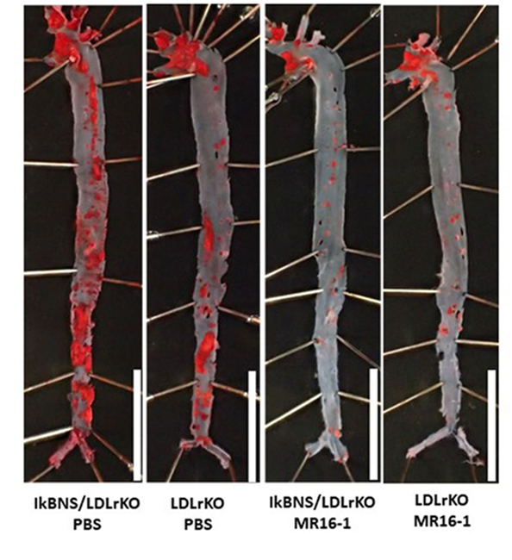
IL-6 and Chronic Stable Atherothrombosis : Experimental Findings
Pivotal cytokine of innate immunity and vascular biology:
Orchestrates hepatic synthesis of acute phase reactants
Activates endothelial cells, increased expression of ICAM,VCAM
Activates matrix metalloproteinases that weaken the fibrous cap
Promotes lymphocyte proliferation and differentiation
Increases coagulation, induction of monocyte TF expression
In murine intervention models:
Exogenous IL-6 increases fatty streak development
Murine anti-IL-6 receptor antibodies slow atherosclerotic progression
Akita et al, Front Cardiovasc Med 2017;4:84
Ridker PM, Rane M. Interleukin-6 Signaling and Anti-Interleukin-6 Therapeutics in Cardiovascular Disease
Circulation Research 2021

Slide 6
IL-6 and Chronic Stable Atherothrombosis : Human Translational Findings
Plasma levels of IL-6 and hsCRP predict cardiovascular risk with a magnitude of effect greater than that of LDL-C.
Mendelian Randomization studies indicate that genetic variants in the IL-6 receptor signaling pathway associate with lifelong risks of coronary heart disease suggesting that IL-6 is likely to be causal for atherosclerotic progression.
GWAS and PHEWAS data affirm a role of IL-6 signaling in multiple forms of atherosclerosis including myocardial infarction, peripheral arterial disease, and aortic aneurysm formation.
Ridker PM, Rane M. Interleukin-6 Signaling and Anti-Interleukin-6 Therapeutics in Cardiovascular Disease
Circulation Research 2021

Slide 7
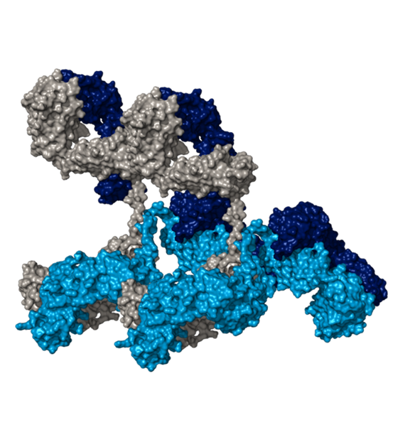
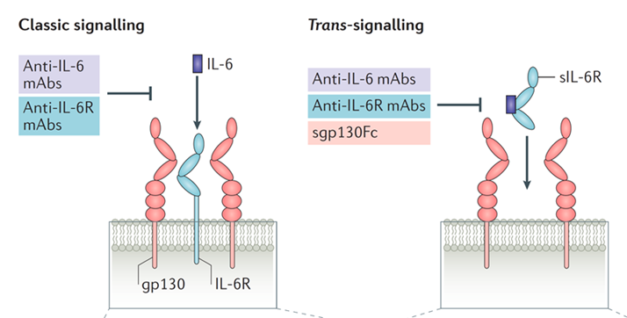
IL-6 and Chronic Stable Atherothrombosis : How to move forward?
Based on these observations, it has been hypothesized that direct inhibition of IL-6 might have the potential to maximize anti-inflammatory atherosclerotic benefit.
One agent under evaluation is ziltivekimab, a narrow spectrum fully human monoclonal antibody targeting the IL-6 ligand that is being developed specifically for atherosclerosis.
Ridker PM, Rane M. Interleukin-6 Signaling and Anti-Interleukin-6 Therapeutics in Cardiovascular Disease
Circulation Research 2021

Slide 8
IL-6 and Chronic Stable Atherothrombosis : How to move forward?
To address these issues, we conducted a randomized, double-blind, placebo-controlled phase 2 trial to evaluate the effects of ziltivekimab on multiple biomarkers of inflammation and thrombosis.
We focused on patients at high cardiovascular risk with chronic kidney disease (CKD) and elevated hsCRP, a group with considerable unmet clinical need where IL-6 levels correlate with severity of renal impairment as well as level of atherosclerotic risk.
Ridker PM, Rane M. Interleukin-6 Signaling and Anti-Interleukin-6 Therapeutics in Cardiovascular Disease
Circulation Research 2021

Slide 9
RESCUE : Trial Conduct and Participant Flow
Trial Conduct
June 17, 2019 -January 14, 2020
40 US clinical sites
264 participants randomized
SC placebo or
SC ziltivekimab 7.5, 15, 30 q 4 weeks
Major Inclusion Criteria
Age > 18 years
Stage 3 – 5 CKD
hsCRP > 2 mg/L
Major Exclusion Criteria
ANC < 2 x 10⁹ Platelet Count < 120 x 10⁹
Spot urine to creatinine ratio > 4
Active TB or
History of HIV, hepatitis B, hepatitis C
-
12 Week Primary Endpoint
24 Week Full Treatment and Safety Period
Primary Endpoint: Percent change in hsCRP from baseline to 12 weeks
Secondary Endpoints: Percent change in fibrinogen, haptoglobin, SAA, sPLA2, Lp(a), and lipid levels

Slide 10
RESCUE : Baseline Clinical Characteristics
 | Placebo (N=66) | Ziltivekimab 7.5mg (N=66) | Ziltivekimab 15mg (N=66) | Ziltivekimab 30mg (N=66) | All Participants (N = 264)
Age (years, median) | 66.0 | 70.0 | 65.5 | 68.0 | 68.0
Female, (%) | 44 | 48 | 55 | 48 | 49
BMI (kg/m² , median) | 35.9 | 32.7 | 34.4 | 34.8 | 34.4
Diabetes, (%) | 76 | 62 | 73 | 73 | 71
Hypertension, (%) | 94 | 91 | 91 | 91 | 92
ASCVD, (%) | 56 | 44 | 41 | 50 | 48
Statin Use, (%) | 68 | 67 | 68 | 68 | 68
CKD Stage, (%)
3a | 29 | 24 | 35 | 29 | 29
3b | 35 | 45 | 44 | 39 | 41
4 | 26 | 24 | 15 | 26 | 23
5 | 8 | 5 | 6 | 5 | 6
eGFR (ml/min/1.73m², median) | 38.0 | 35.3 | 37.3 | 37.2 | 36.8
hsCRP (mg/L, median) | 5.8 | 5.5 | 5.7 | 5.8 | 5.7
IL-6 (pg/ml, median) | 5.2 | 4.9 | 5.1 | 6.6 | 5.6

Slide 11
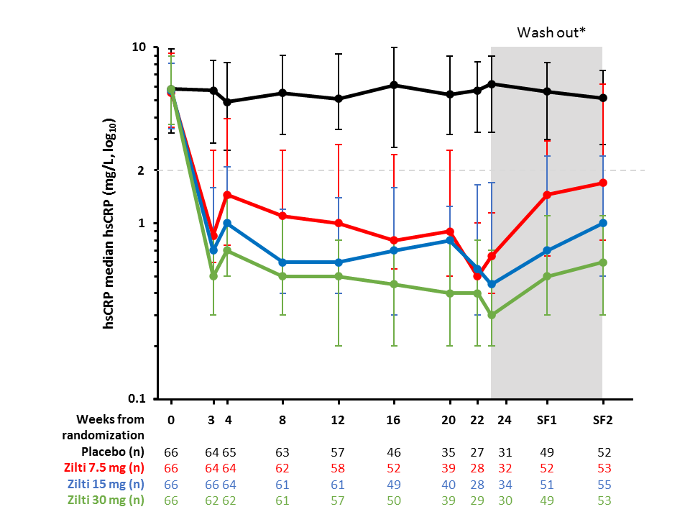
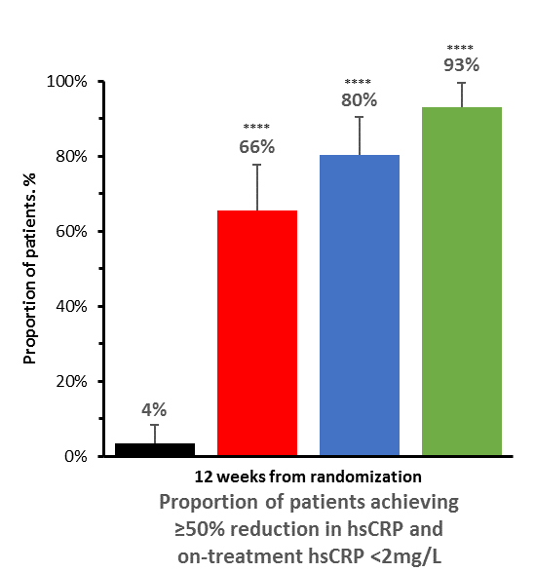

RESCUE: Primary Result – Change in hsCRP at 12 weeks
A
B
C
****
****
****
>50% reduction in hsCRP
and
on-treatment hsCRP < 2 mg/L
**** P< 0.001

Slide 12
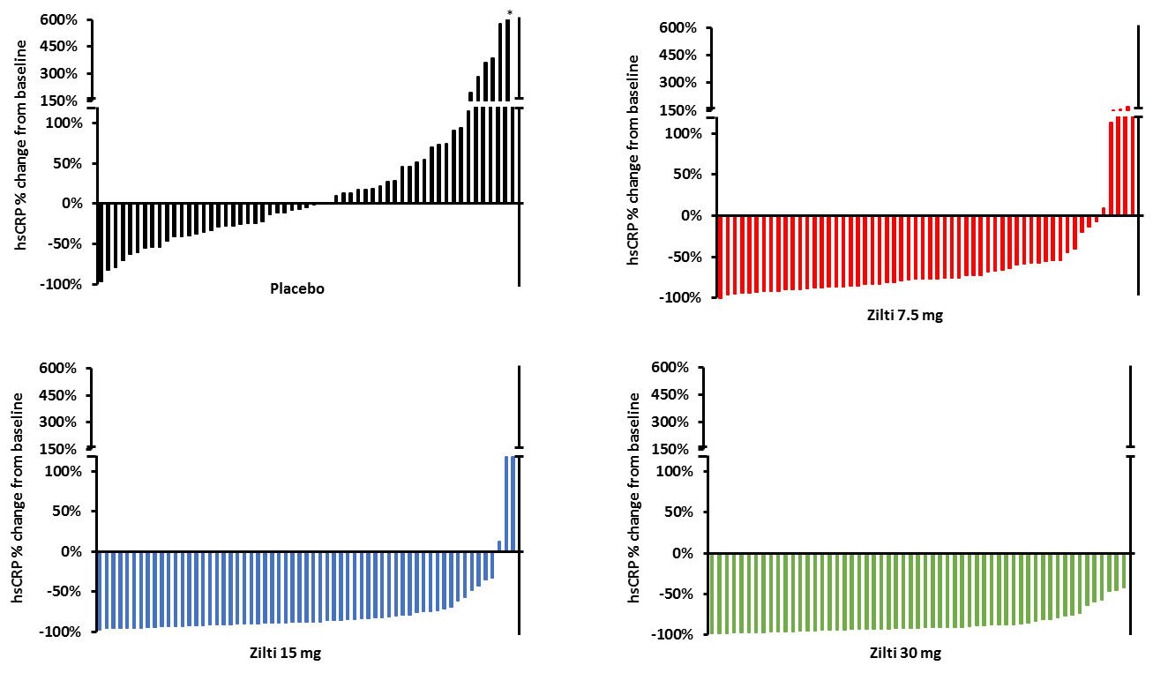
RESCUE: Waterfall Plots Demonstrate Dose-Dependent Effects of Ziltivekimab on Change in hsCRP
Placebo
Zilti 7.5 mg
Zilti 15 mg
Zilti 30 mg

Slide 13
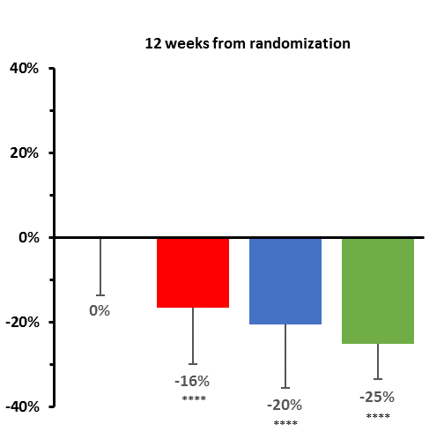
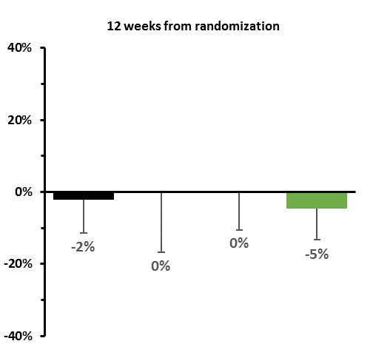
RESCUE: Secondary Biomarker Results
Fibrinogen
Haptoglobin
Serum Amyloid A
****
****
Placebo
****
****
Zilti 7.5 mg
****
Zilti 15 mg
****
Zilti 30 mg
****
****
****
Percent Change from Baseline to Week 12
sPLA2
Lipoprotein (a)
Apo B : Apo A Ratio
Figure 4D
****
****
****
**** P< 0.001

Slide 14
RESCUE : Safety Analysis
 | Placebo (N=65) | Ziltivekimab 7.5mg (N=65) | Ziltivekimab 15mg (N=66) | Ziltivekimab 30mg (N=65)
Serious injection-related reactions, % | 0 | 0 | 0 | 0
Any ALT or AST > 3x ULN, % | 0 | 0 | 0 | 0
Any serious infection, % | 5 | 11 | 5 | 3
Anaphylaxis, % | 0 | 0 | 0 | 0
Sustained neutropenia*, %
Grade 1 (<2000–1500 cells/mm³) | 2 | 2 | 3 | 2
Grade 2 (<1500–1000 cells/mm³) | 0 | 2 | 0 | 0
Grade 3 or 4 | 0 | 0 | 0 | 0
Sustained thrombocytopenia*, n (%)
Grade 1 (<100,000–75,000 cells/mm³) | 0 | 0 | 3 | 2
Grade 2, 3, or 4 | 0 | 0 | 0 | 0

Slide 15
RESCUE summary
Ziltivekimab, a novel IL-6 ligand inhibitor, markedly reduced multiple biomarkers of systemic inflammation and thrombosis known to promote the atherothrombotic process, including hsCRP, fibrinogen, SAA, sPLA2, and Lp(a).
The magnitude of change with ziltivekimab on hsCRP was nearly twice as large in RESCUE as that observed in the CANTOS trial of canakinumab where cardiovascular event rates were reduced by 15 to 20 percent.
The anti-inflammatory benefits of ziltivekimab were achieved with minimal evidence of bone marrow suppression, infectious risk, hepatic toxicity, or change in atherogenic lipid levels.
These phase II data suggest that ziltivekimab may be unique among currently available IL-6 inhibitors and strongly supports its use in future cardiovascular outcome trials.

Slide 16
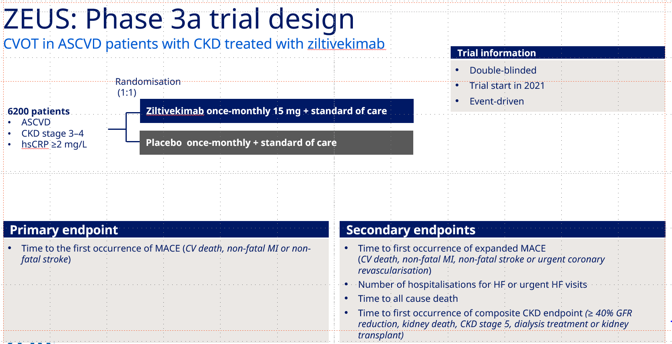
Ziltivekimab Cardiovascular Outcomes Study (ZEUS)
Why CKD with elevated hsCRP?
Large unmet need
Very high cardiovascular risk
Crucial biologic state
  LDL-C less relevant for outcomes
  Inflammation more relevant for outcomes
Colchicine is relatively contraindicated in CKD

Slide 17

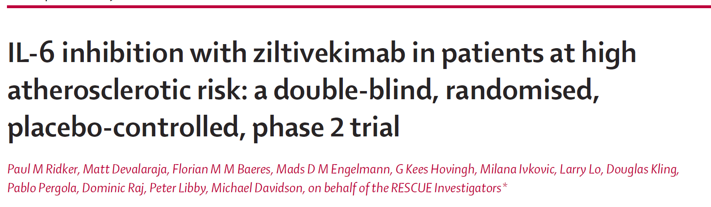
Lancet 2021 (on-line ACC)

