Slide 1
IMPACT-AFib Implementation of Stroke Prevention in Atrial Fibrillation
Tuesday, September 1st, 2020 – ESC Hotline
Sean D. Pokorney, MD, MBA
Assistant Professor of Medicine
Director of the Arrhythmia Core Laboratory
Duke Clinical Research Institute
Duke University
Durham, NC, United States

Slide 2
Funding and Trial Leadership
IMPACT-AFib was funded by a grant from the United States Food and Drug Administration
Co-Principal Investigators:
  Christopher Granger, MD
  Duke Clinical Research Institute
  Richard Platt, MD, MSc
  Department of Population Medicine, Harvard Medical School & Harvard Pilgrim Health Care Institute

Slide 3
Anticoagulation Prevents the Majority of Strokes
Warfarin compared
to control or placebo
Relative Risk Reduction
(95% CI)
NOAC compared
to warfarin
Relative Risk Reduction
(95% CI)
Trial
Trial
AFASAK I (1990)
SPAF I (1991)
BAATAF (1990)
CAFA (1991)
SPINAF (1992)
EAFT (1993)
Combined
RE-LY (2009)
ROCKET AF (2011)
ARISTOTLE (2011)
ENGAGE AF-TIMI 48
(2013)
Combined
100%
50%
0
−50%
−100%
50%
0
−50%
Favors warfarin
Favors placebo or control
Favors NOAC
Favors warfarin
RRR 64%
RRR 19%
Warfarin vs. Placebo or Control
(6 trials, total n=2,900)
Non-vitamin K antagonist Oral Anticoagulant (NOAC) vs. Warfarin
(4 trials, total n=71,683)
Hart R, et al. Ann Intern Med. 2007;146:857-867.
Ruff C, et al. Lancet. 2014;383:955–962.

Slide 4


FDA-Catalyst: Background
Medical Product
Safety
Surveillance
Queries
Results
Curated Distributed Data Using a Common
Data Model
Results
Execution
Randomized Clinical Trials

Slide 5
Study Design
    Patients
    Atrial fibrillation (AF) (two claims)
    CHA₂DS₂-VASc ≥ 2
    No admission for bleeding in prior 6 months
    Not prescribed anticoagulant in the prior 12 months
    Age ≥ 30 years
Randomize
~80,000 patients
    Aim to increase the use of oral anticoagulation (OAC) among patients with AF and risk of stroke
    Combined patient and provider level intervention
Control
Patient- + provider- level intervention
Primary comparison: difference in the proportion of patients with AF started on OAC over the course of the 12-month trial
Secondary outcomes: proportion of days covered with OAC prescription, number of patients on OAC at end of one year; admissions for stroke or bleeding; deaths (subset)

Slide 6











IMPACT-AFib Workgroup and Data Flow
Data Partners
Masked results from each data partner
Study specifications & Queries
Results
Performed meta-analysis
Identify eligible patients and providers
Perform intervention
Provide results
IMPACT-AFib Workgroup
Patient
representative
Representatives from each data partner

Slide 7
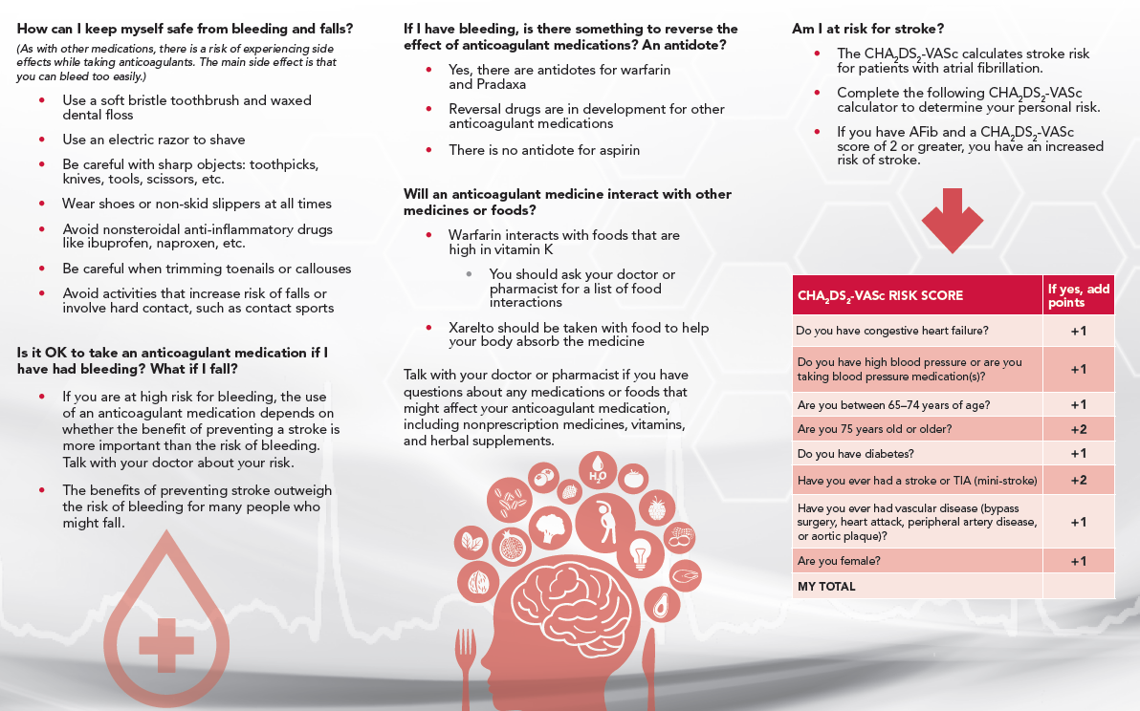
Patient Intervention: Patients Agent of Change

Slide 8
Statistical Methods
Patient-level data were maintained at each data partner and analyses were conducted via a distributed SAS programming code supplied by DCRI
Only aggregate summary statistics, point estimates, and 95% confidence intervals were shared with Harvard Pilgrim and DCRI
  Cumulative incidence rates were estimated using Kaplan Meier product limit
  Odds ratios were calculated using generalized estimating equations logistic regression model
  Hazard ratios were calculated using Cox proportional hazard models
Inverse-variance weighted average fixed-effects meta-analysis was used to aggregate the effect size from each data partner

Slide 9
CONSORT Diagram for 4 of 5 Data Partners
Total
Randomized
N=197,806
Randomized to
Early Intervention
Randomized to
Delayed Intervention
Randomized (met inclusion / exclusion criteria prior to knowing OAC status)
98,903
98,903
On OAC at randomization
66,608 (67.3%)
66,532 (67.3%)
Censored prior to follow-up: on OAC in updated data, disenrolled, not eligible for research)
8,749 (8.8%)
8,584 (8.7%)
Primary analysis for patients not on OAC (modified ITT)
23,546 (23.8%)
23,787 (24.1%)
Mean follow-up (days)
423.9 (132.2)
425.0 (135.9)

Slide 10
Patient Baseline Characteristics
 | Early Intervention N=23,546 | Delayed Intervention N=23,787
Age (years), Mean | 77.8 (9.7) | 77.9 (9.7)
≥ 75 years old | 14,589 (62.0%) | 14,688 (61.7%)
Female | 11,262 (47.8%) | 11,162 (46.9%)
CHA₂DS₂-VASc score, Mean | 4.53 (1.68) | 4.50 (1.65)
ATRIA Score ≥ 5 | 11,165 (47.4%) | 11,239 (47.3%)
History of Hospitalization for Bleeding | 4,409 (18.7%) | 4,481 (18.8%)

Slide 11
Primary Outcome: At Least One OAC Fill

Slide 12
Secondary Endpoints: Clinical Outcomes
**Meta-analyses were conducted using data from 2 sites.
*Meta-analyses were conducted using data from 3 sites.

Slide 13
Conclusions
Among a population with a guideline indication for OAC for stroke prevention with AF, there was no statistically significant difference in rates of OAC initiation at 1 year with a single education mailing
  Rates of OAC initiation were low (1 in 10)
  Numerically more patients initiated OAC early after mailing, raising question of whether multiple mailings or further contact may have been beneficial
It was feasible to identify, enroll, and obtain outcomes through this novel study design using the FDA-Catalyst Network
  Additional trials are needed to assess feasibility of patient consent and repeat patient interactions
The randomized design with a no intervention control arm through 1 year was critical to evaluate the intervention, given a nearly 10% increase in OAC use without intervention

Slide 14
Acknowledgements
Aetna: Cheryl McMahill-Walraven, Annemarie Kline, Daniel Knecht, Smita Bhatia
Clinical Trials Transformation Initiative: Sara Calvert, Jennifer Goldsack
Duke Clinical Research Institute: Christopher Granger, Hussein Al-Khalidi, Shuang Li, Wensheng He, Emily O’Brien, Jennifer Rymer, Sana Al-Khatib
DPM/HPHCI: Richard Platt, Noelle Cocoros, Meighan Rogers Driscoll, Crystal Garcia, Robert Jin, Hana Lipowicz
HealthCore: Kevin Haynes, Lauren Parlett
Humana: Vinit Nair, Thomas Harkins, Yunping Zhou
Optum: Nancy Lin
Patient Representative: Debbe McCall
U.S. Food & Drug Administration: Bob Temple, Jacqueline Corrigan-Curay, Dianne Paraoan, David Martin, Melissa Robb, Patrick Archdeacon

