Slide 1
Achieved Omega-3 Fatty Acid Levels and Major Adverse Cardiovascular Events
A Secondary Analysis of the STRENGTH Trial
Steven E. Nissen MD MACC
For the STRENGTH Trial Investigators
Disclosure
Clinical Trials: AbbVie, Amgen, AstraZeneca, Esperion, Eli Lilly, Novartis, Takeda, Resverlogix, Orexigen, Ethicon Endosurgery, Medtronic,The Medicines Company, and Pfizer.
Companies are directed to pay any honoraria, speaking or consulting fees directly to charity so that neither income nor a tax deduction is received.

Slide 2
Background
Several large clinical trials (ORIGIN n=12536, ASCEND n=15480, VITAL, n=25871) have shown no cardiovascular benefits from supplementation with omega-3 fatty acids.
Two recent trials, REDUCE-IT (n=8179) and STRENGTH (n=13078) studied higher doses of omega 3 fatty acids, but reported contradictory results:
REDUCE-IT reported a HR of 0.75
STRENGTH reported a HR of 0.99
These disparate results have generated considerable controversy with several alternative hypotheses proposed to explain the conflicting results.

Slide 3
Three Hypotheses to Explain Disparate Results
The mineral oil placebo used in REDUCE-IT increased LDL-C 10.9% and hsCRP 32.3%, raising concerns whether the favorable results were driven largely by mineral oil toxicity.
- STRENGTH used corn oil which exhibited neutral effects
REDUCE-IT used purified EPA to achieve moderately higher EPA levels compared with STRENGTH. Could higher achieved EPA levels explain the more favorable outcomes?
STRENGTH used a mixture of EPA and DHA. Could the DHA component have exactly counterbalanced the benefits of EPA, resulting in a precisely neutral outcome in STRENGTH?
The current study designed to examine the 2nd and 3rd hypotheses

Slide 4
STRENGTH Substudy Details
The STRENGTH study randomized 13,078 patients to omega-3 carboxylic acid (CA) vs. corn oil placebo.
The primary endpoint was a composite of CV death, non-fatal MI, non-fatal stroke, coronary revascularization, or unstable angina requiring hospitalization.
EPA and DHA levels were available in 10,382 patients measured 12 months after randomization.
The primary outcome measure for this substudy was the HR for the top tertile of achieved EPA and DHA levels in the omega-3 CA group compared with corn oil reference group.

Slide 5
Baseline Characteristics and Medication Use
 | Corn Oil | Omega 3 Carboxylic Acid (Tertiles of Achieved EPA)
 |  | Tertile 1 | Tertile 2 | Tertile 3
Age (years) | 62.5 | 61.2 | 62.1 | 64.2
Female gender | 34.9% | 36.5% | 29.6% | 36.6%
Body Mass Index (kg/m²) | 32.5 | 33.0 | 33.5 | 31.1
Established CV disease | 54.5% | 52.6% | 54.2% | 54.2%
Diabetes mellitus | 70.4% | 69.5% | 73.4% | 67.0%
Hypertension | 87.7% | 90.0% | 89.6% | 85.7%
High intensity statin use | 52.8% | 64.2% | 52.6% | 41.6%

Slide 6
Median Lipid Measurements after 12 Months
 | Corn Oil | Omega 3 Carboxylic Acid (Tertiles of Achieved EPA)
 |  | Tertile 1 | Tertile 2 | Tertile 3
LDL-C (mg/dL) | 75 | 76 | 71 | 82
HDL-C (mg/dL) | 37 | 37 | 37 | 38
Triglycerides (mg/L) | 235 | 198 | 177 | 198
Non-HDL-C (mg/dL) | 124 | 119 | 107 | 123
Apo B (mg/dL) | 56 | 56 | 52 | 57
hsCRP (mg/L) | 1.8 | 1.8 | 1.8 | 1.5

Slide 7
Median EPA and DHA Levels after 12 Months
 | Corn Oil | Omega 3 Carboxylic Acid (EPA and DHA Tertiles)
 |  | Tertile 1 | Tertile 2 | Tertile 3
Plasma EPA (μg/mL) | 19 | 30 | 90 | 151 (443% increase)
Plasma DHA (μg/mL) | 58 | 67 | 88 | 118 (68% increase)
RBC EPA (% of total) | 0.6% | 1.0% | 2.9% | 4.3%
RBC DHA (% of total) | 4.8% | 5.7% | 6.6% | 7.1%

Slide 8
Tertiles of Achieved EPA and Cardiovascular Outcome
Variable |  | Adjusted HR* | P value
Corn Oil | NA | 1.00 (reference) | NA
Achieved plasma EPA levels (µg/mL) | <62.4 | 0.99 | 0.95
 | 62.5-116.3 | 1.10 | 0.27
 | >116.4 | 0.98 (0.83-1.16) | 0.81
*Adjusted for baseline fatty acid levels, region, cardiovascular disease, age, sex, diabetes, creatinine, non–high-density lipoprotein cholesterol, high sensitivity C-reactive protein, antiplatelets agents, β Blockers, renin angiotensin inhibitors.

Slide 9
Tertiles of Achieved DHA and Cardiovascular Outcome
Variable |  | Adjusted HR* | P value
Corn Oil | NA | 1.00 (reference) | NA
Achieved plasma DHA levels (µg/mL) | <78.2 | 1.03 | 0.74
 | 78.3-105 | 1.03 | 0.74
 | >105.2 | 1.02 (0.86-1.20) | 0.85
*Adjusted for baseline fatty acid levels, region, cardiovascular disease, age, sex, diabetes, creatinine, non–high-density lipoprotein cholesterol, high sensitivity C-reactive protein, antiplatelets agents, β Blockers, renin angiotensin inhibitors.

Slide 10
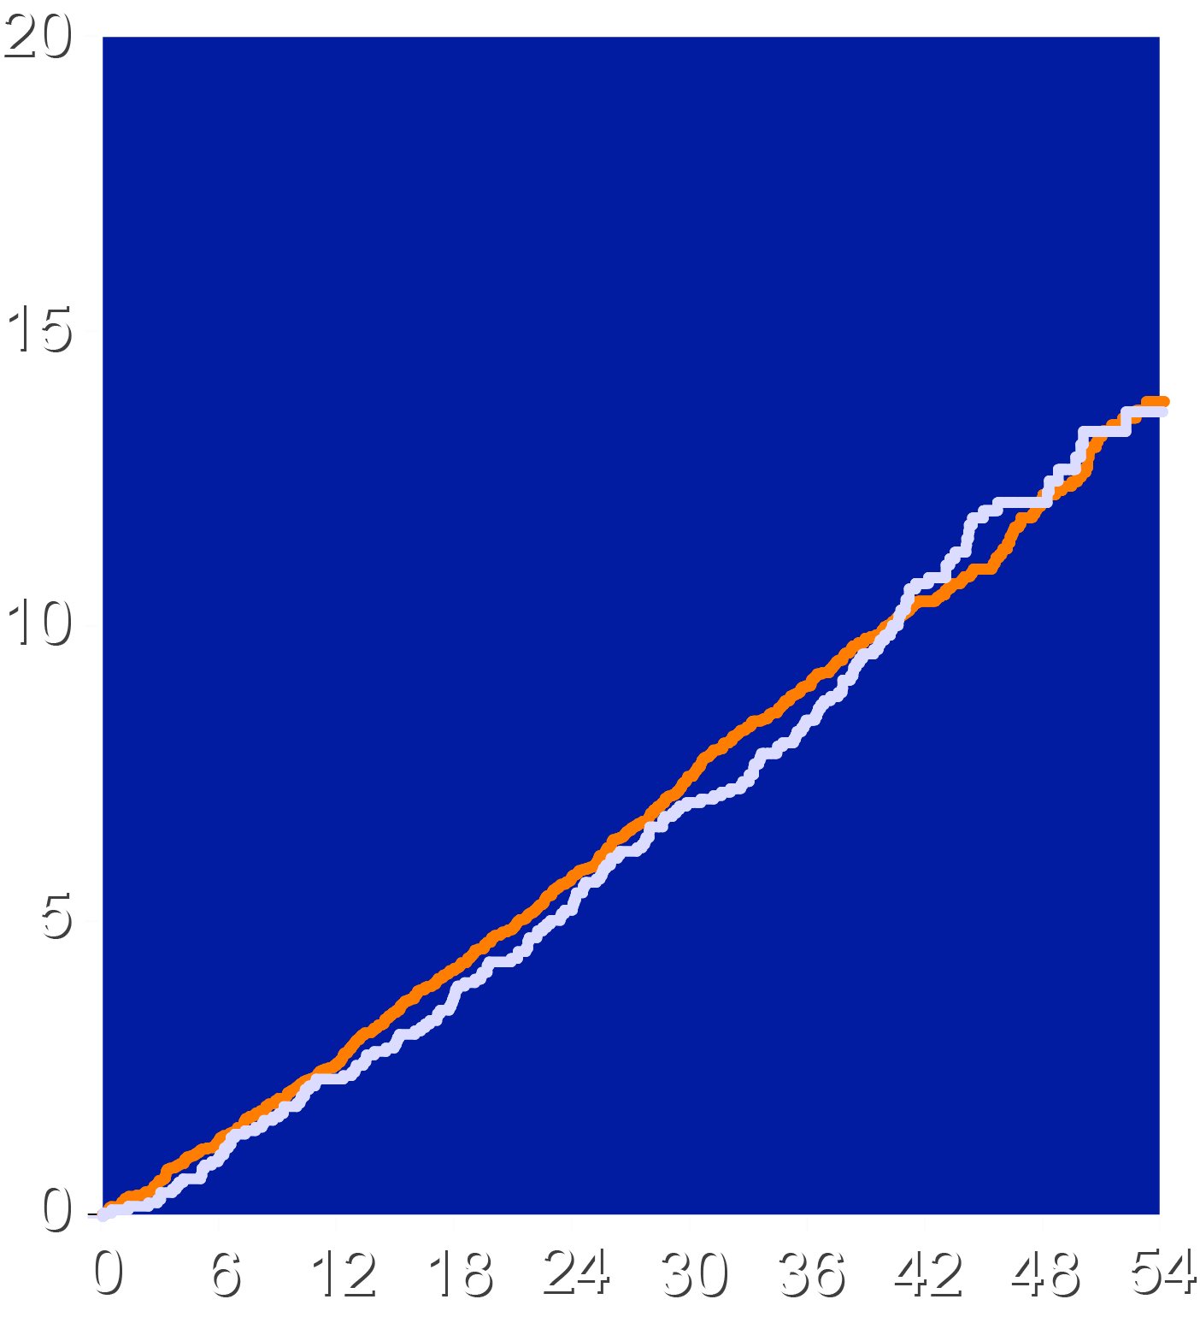
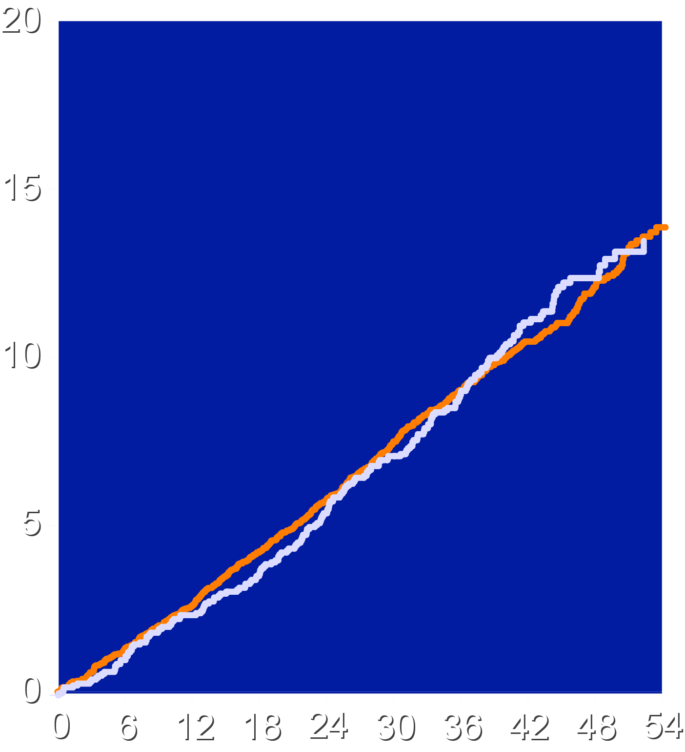
MACE: Top Tertile of Achieved EPA and DHA
Plasma EPA vs. Corn Oil
Plasma DHA vs. Corn Oil
Top Tertile EPA (>116 ug/mL)
Corn Oil Placebo
Top Tertile DHA (>105 ug/mL)
Corn Oil Placebo
HR = 0.98 95% CI (0.83 - 1.16)
p = 0.81
HR = 1.02
95% CI (0.86 - 1.20)
p = 0.85
Patients with Event (%)
Patients with Event (%)
Months since Randomization
Months since Randomization

Slide 11
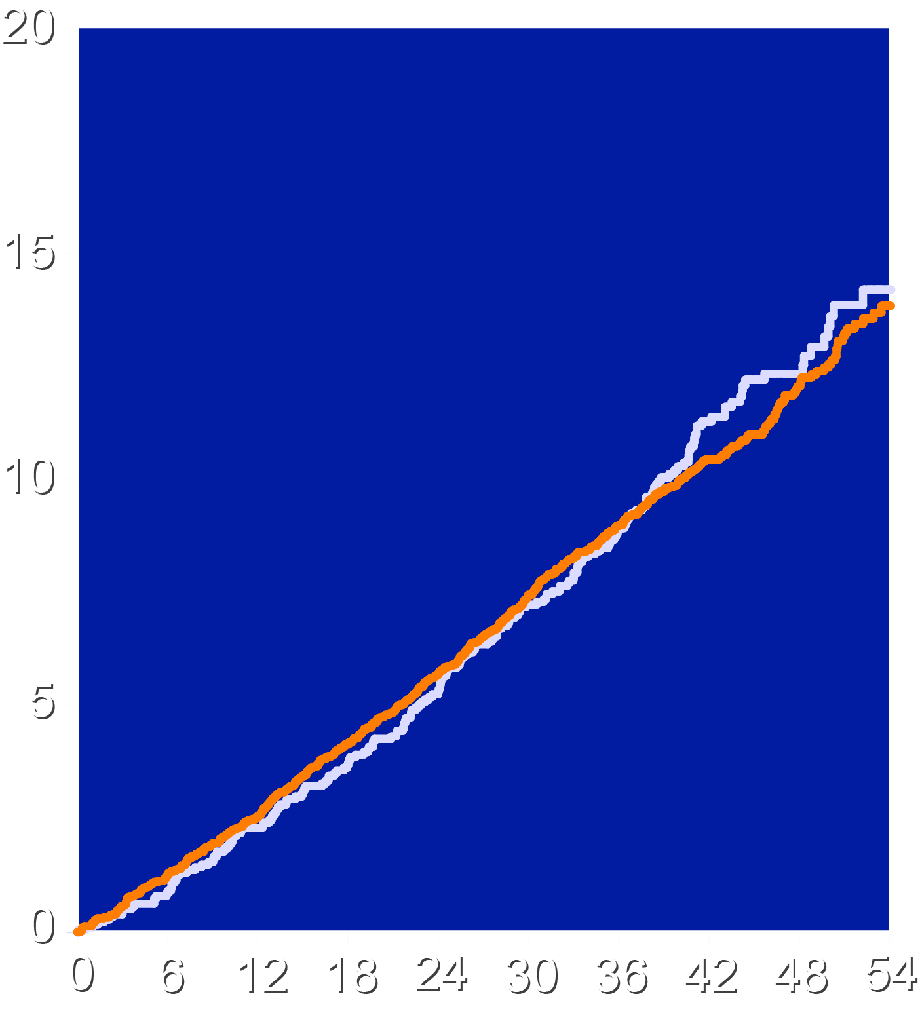
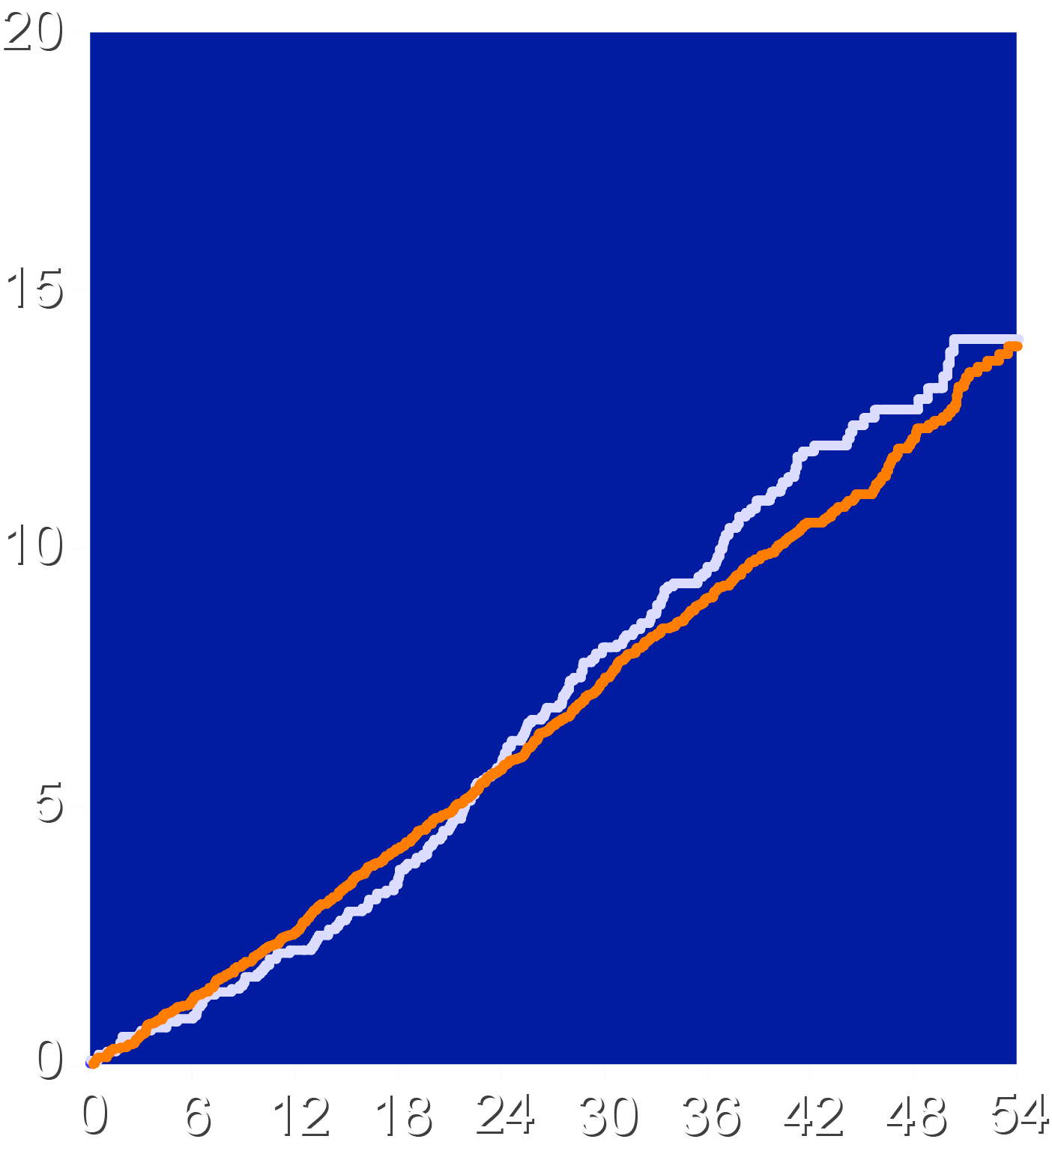
MACE: Top Tertile of Change in EPA and DHA
Change in Plasma EPA
Change in Plasma DHA
Top Tertile EPA (≥88.6 ug/mL)
Corn Oil Placebo
Top Tertile DHA (≥38.5 ug/mL)
Corn Oil Placebo
HR = 1.03 95% CI (0.88 - 1.21) p = 0.69
HR = 1.12 95% CI (0.96 - 1.32) p = 0.16
Patients with Event (%)
Patients with Event (%)
Months since Randomization
Months since Randomization

Slide 12
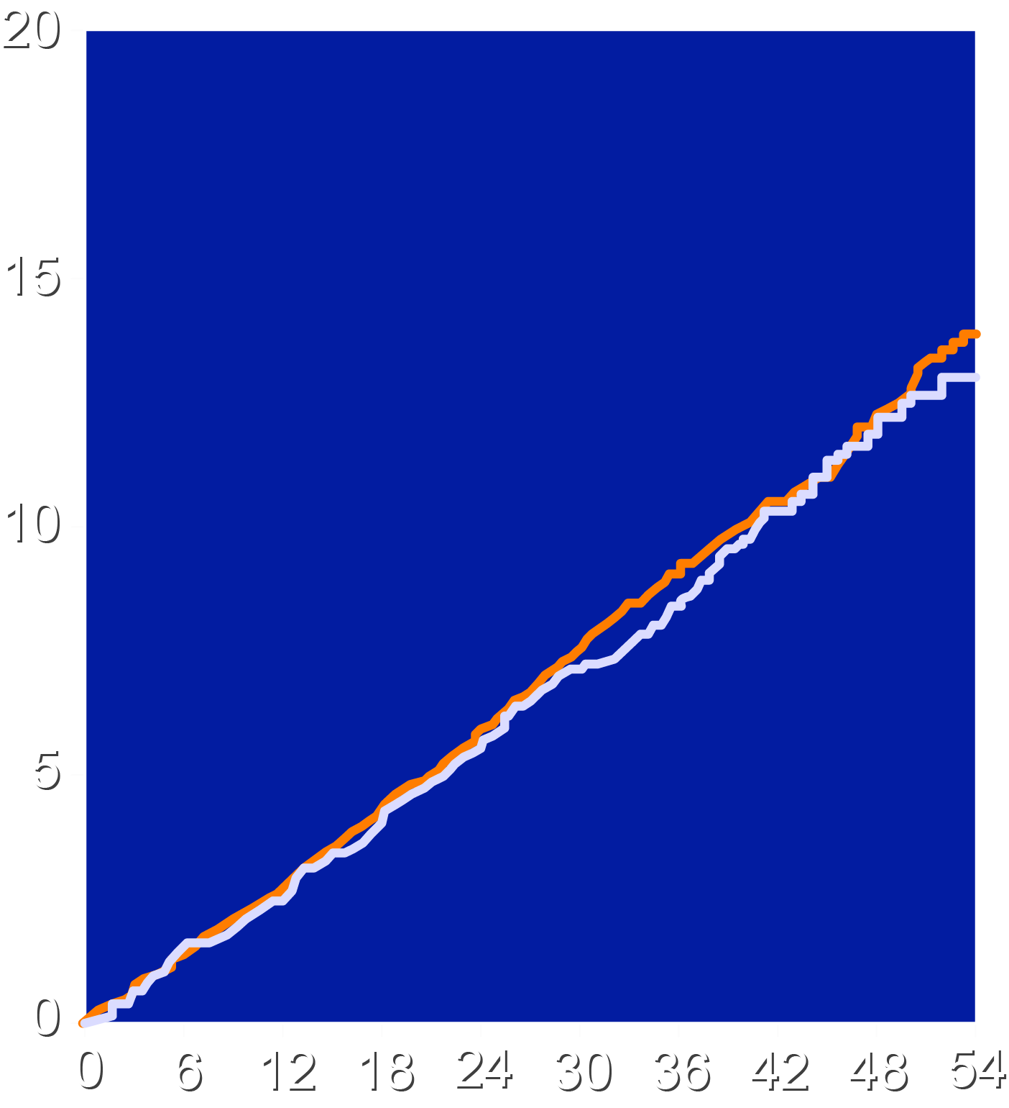
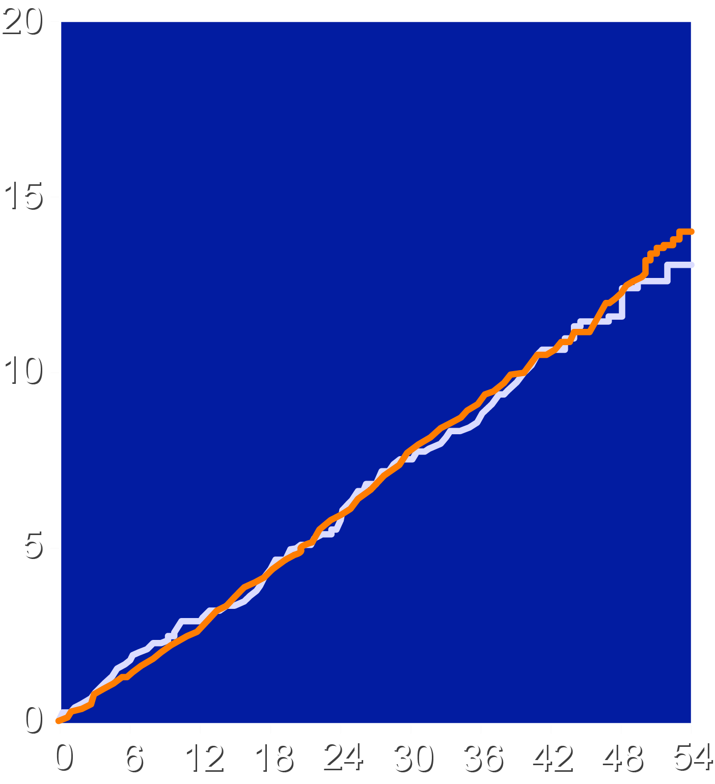
MACE: Top Tertile of Achieved RBC EPA and DHA
RBC EPA vs Corn Oil
RBC DHA vs Corn Oil
Top Tertile EPA (>3.57%)
Corn Oil Placebo
Top Tertile DHA (>7%)
Corn Oil Placebo
HR = 0.90 95% CI (0.76 - 1.07) p = 0.22
HR = 0.95 95% CI (0.76 - 1.17) p = 0.61
Patients with Event (%)
Patients with Event (%)
Months since Randomization
Months since Randomization

Slide 13
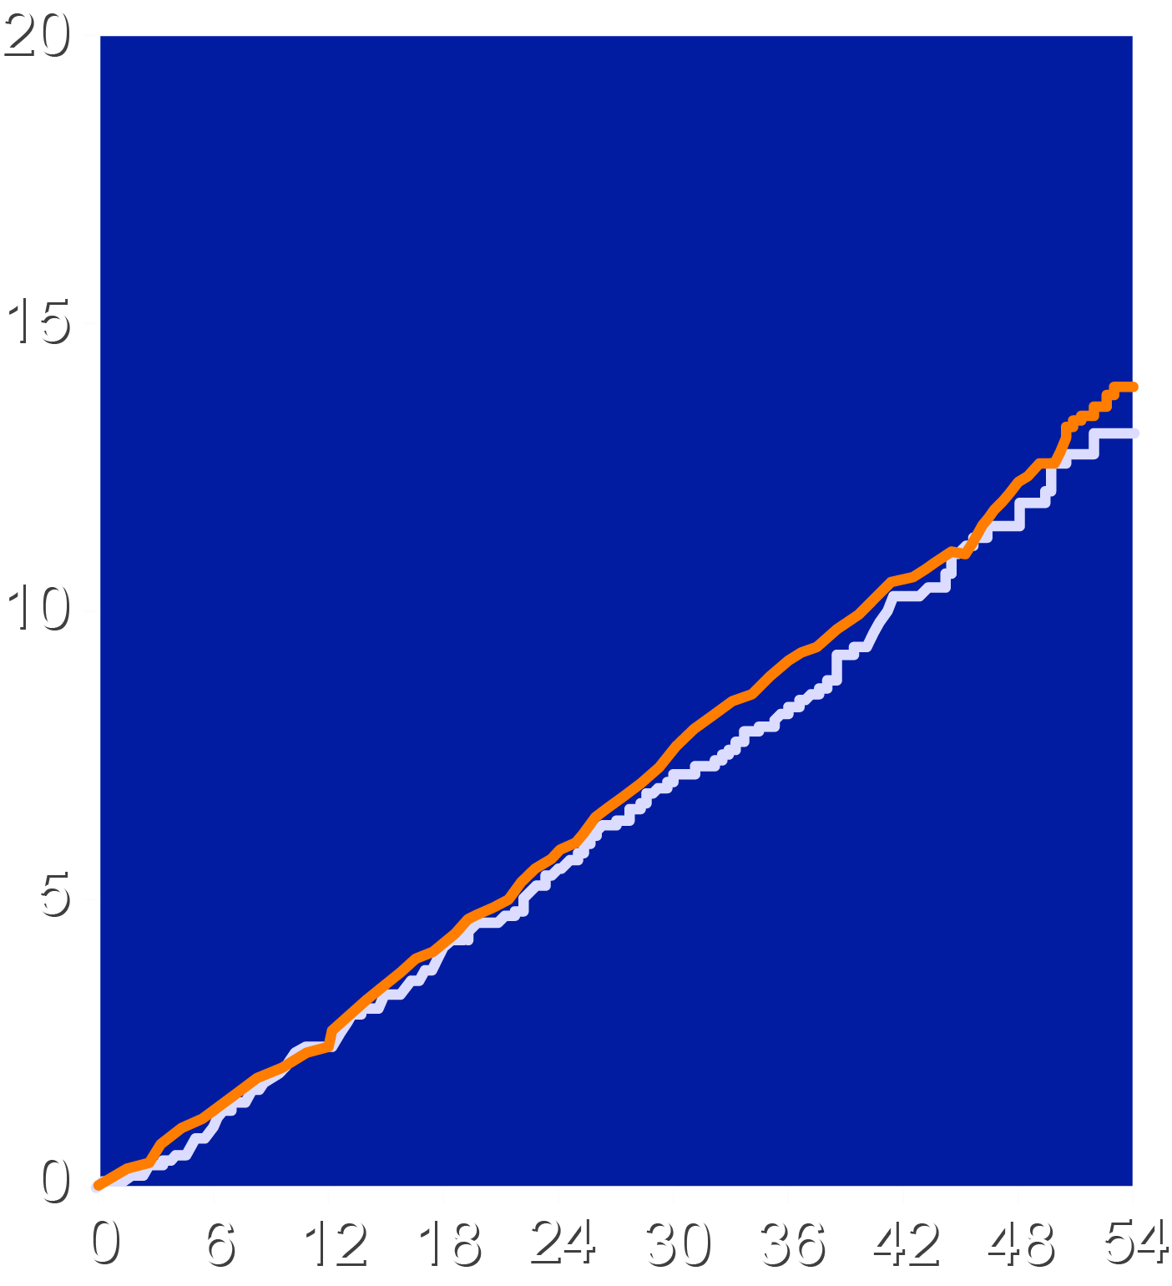
MACE: Top Tertile of Change in RBC EPA and DHA
RBC EPA vs Corn Oil
RBC DHA vs Corn Oil
Top Tertile EPA (>2.83%)
Corn Oil Placebo
Top Tertile DHA (>1.89%)
Corn Oil Placebo
HR = 0.92 95% CI (0.78 - 1.09) p = 0.32
HR = 0.96 95% CI (0.81 - 1.14) p = 0.67
Patients with Event (%)
Patients with Event (%)
Months since Randomization
Months since Randomization

Slide 14
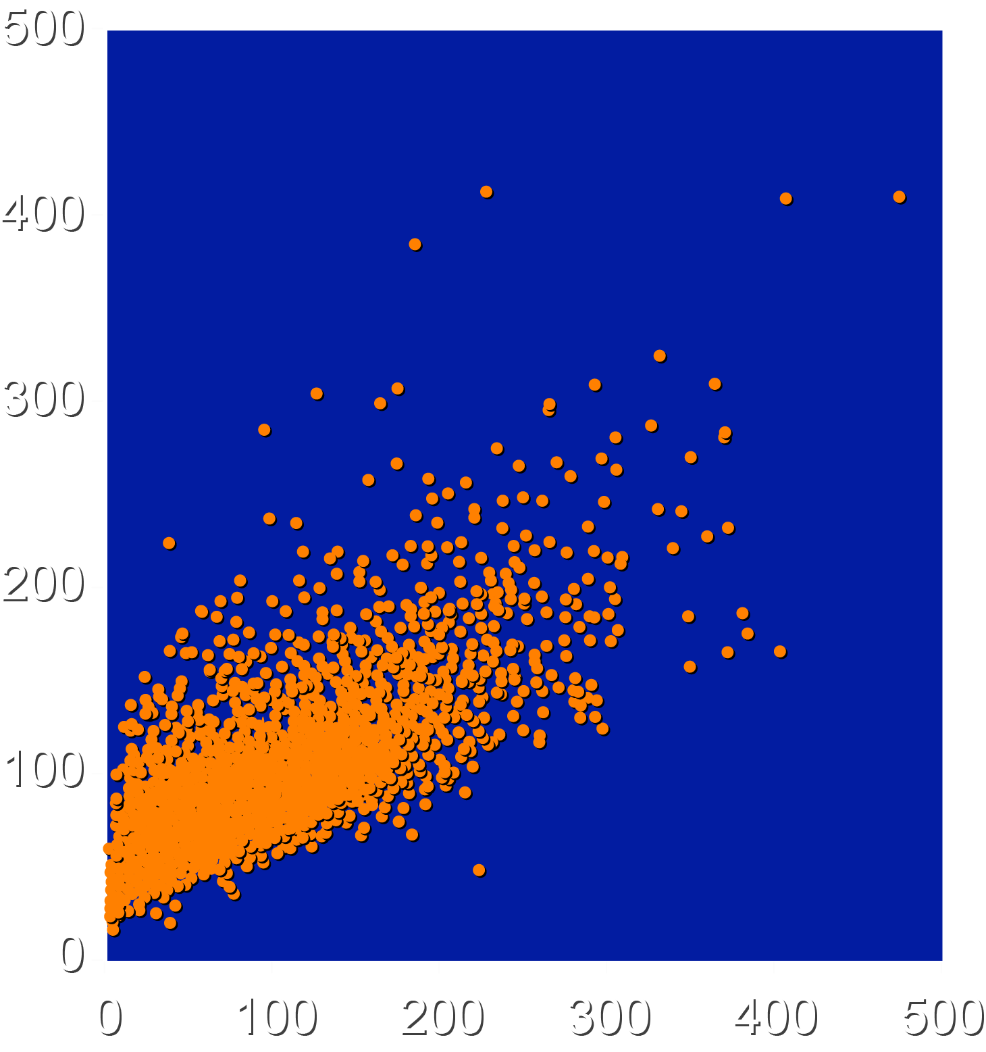
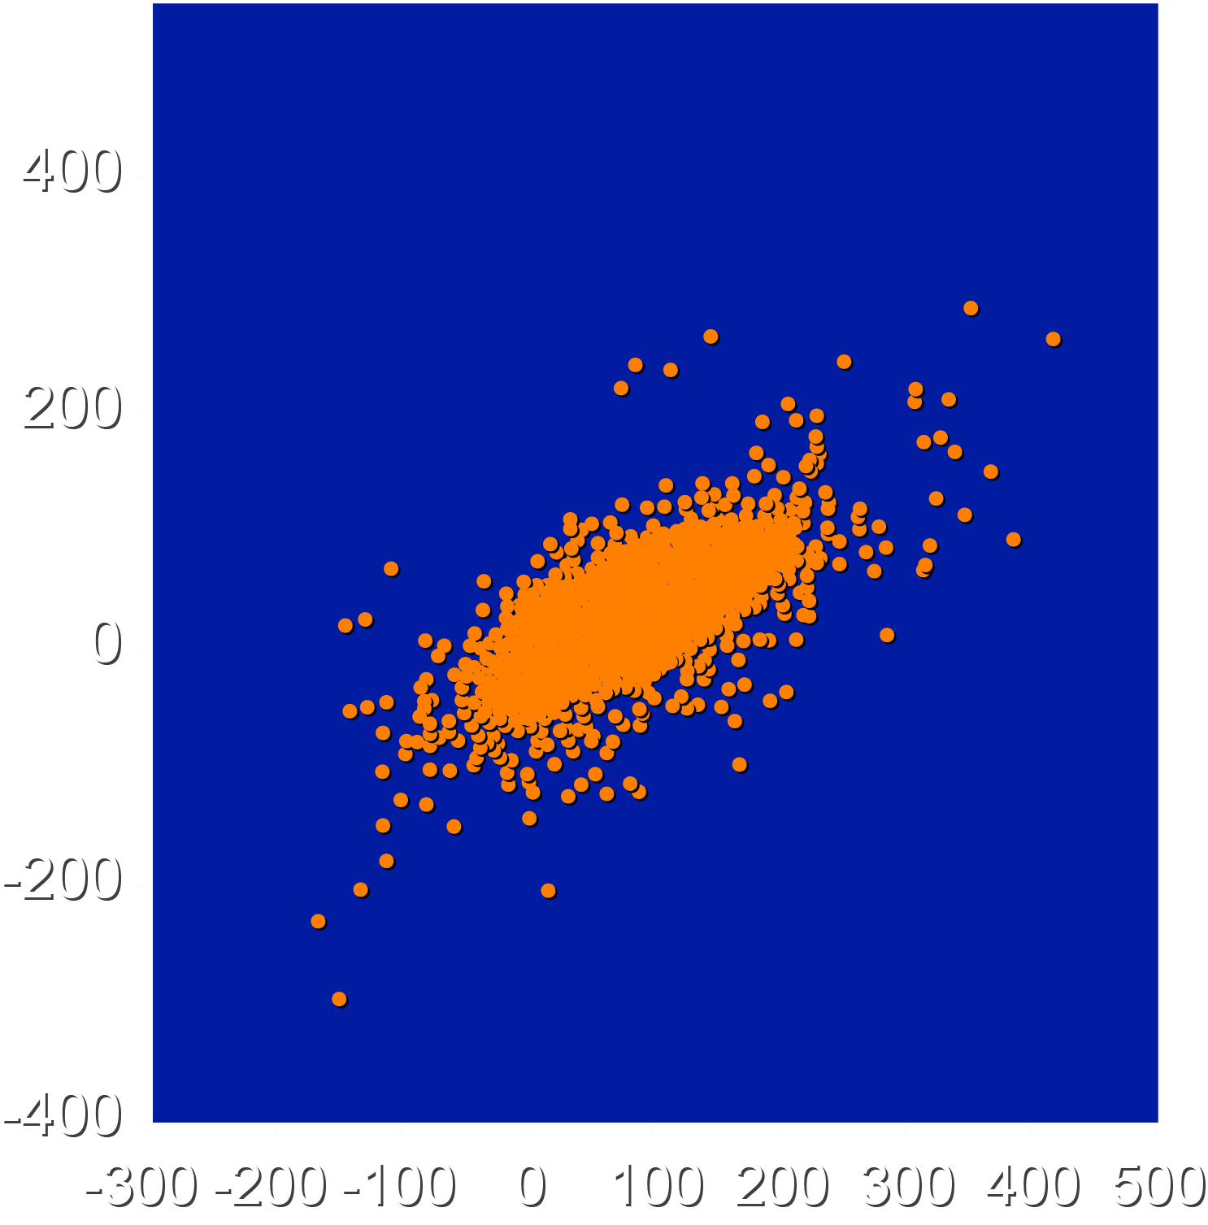
Correlation Between EPA and DHA Levels
Achieved EPA vs DHA
Change in EPA vs DHA
r² =0.55
r² =0.49
Month 12 Plasma DHA, ug/mL
Absolute Change in Plasma DHA, ug/mL
Month 12 Plasma EPA, ug/mL
Absolute Change in Plasma EPA, ug/mL

Slide 15
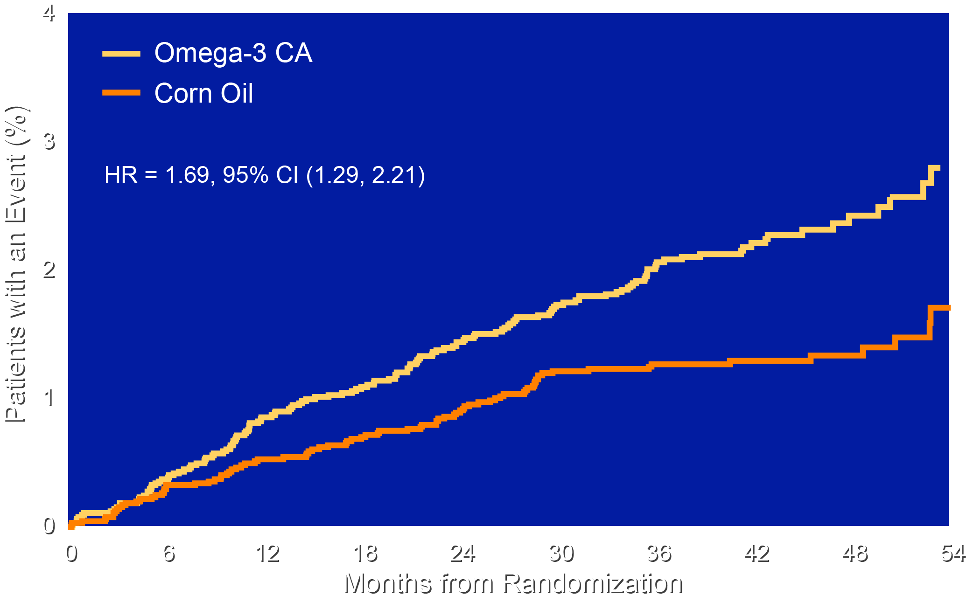
STRENGTH: Time to Onset of Atrial Fibrillation
HR = 1.69, 95% CI 1.29-2.21)

Slide 16
Limitations
This substudy represents a post hoc analysis that should be considered exploratory and hypothesis-generating.
Analysis by tertiles reduces statistical power since each group represents only 1/3 of the population (however, confidence intervals are reasonably narrow).
Imbalances in baseline characteristics can influence results. Although multivariable analysis was used, residual confounding is always a possibility.
There was a moderate correlation between EPA and DHA levels (r² = 0.49 to 0.55), which precludes completely independent assessment of these fatty acids and outcome.

Slide 17
Conclusions
Despite a 443% increase in EPA levels with omega-3 carboxylic acid, the top tertile was not associated with any benefit.
Despite a 68% increase, the top tertile of achieved DHA levels was not associated with harm.
These findings, in the context of increased risk of atrial fibrillation in omega-3 trials, cast uncertainty whether there is net benefit or harm with any omega-3 preparation.
Additional research is needed with trials designed to compare corn oil with mineral oil and to compare purified EPA with other formulations of omega- 3 fatty acids.

