Slide 1



Colchicine in Chronic Coronary Disease
Mark Nidorf, Aernoud Fiolet, Arend Mosterd, John Eikelboom,
Astrid Schut, Charley Budgeon, Jan Tijssen, Jan Hein Cornel, Peter Thompson
and the LoDoCo2 Investigators

Slide 2
Mark Nidorf has no declaration of interest

Slide 3
Background
CANTOS proved that the specific anti-inflammatory effect of canakinumab reduced the risk of cardiovascular events in high risk patients with coronary disease.¹
Colchicine has broad anti-inflammatory effects and is widely available.
COLCOT proved that colchicine reduced the risk of cardiovascular events in patients following a recent myocardial infarction.²
Evidence to support the routine use of colchicine for secondary prevention in patients with chronic coronary disease is limited.
1 - PM Ridker et al. 2017 NEJM
2 - JC Tardif et al. 2019 NEJM

Slide 4
Objective: To determine whether colchicine 0.5mg once daily prevents
cardiovascular events in patients with chronic coronary disease.
Design: Investigator‑initiated, double‑blind, placebo‑controlled, event‑driven trial.
Enrolment: Began in Australia (GenesisCare) in August 2014.
Expanded to The Netherlands, Dutch Network for Cardiovascular Research (WCN) in October 2016. Last enrolment: November 4, 2018.

Slide 5
Protocol
Patients aged 35 – 82 years with proven coronary disease Clinically stable >6 months
No advanced renal disease, heart failure or severe valvular heart disease
30-day open label run-in of colchicine 0.5mg daily
Tolerant, clinically stable and willing
Colchicine
Placebo
Planned to begin close-out 12 months after the last participant had been randomized*
* If 331 primary events had accrued – sufficient to detect a 30% effect of therapy with 90% power
Notes:
Those who consented had a 30-day open label run-in of colchicine 0.5mg daily

Slide 6
Primary end point
The composite of
Cardiovascular death
Myocardial infarction
Ischemic stroke
Ischemia-driven coronary revascularization

Slide 7
Secondary end points (ranked)
1. Cardiovascular death, Myocardial infarction or Ischemic stroke
2. Myocardial infarction or Ischemia-driven coronary revascularization
3. Cardiovascular death or Myocardial infarction
4. Ischemia-driven coronary revascularization
5. Myocardial infarction
6. Ischemic stroke
7. Death from any cause
8. Cardiovascular death

Slide 8
Enrolled
6528
91.3% Tolerated open label therapy
Randomized
Followed for a median of 29 months (12-64 months)
90.3% in each arm continued their trial medication
3.4% in each arm ceased due to perceived effects
5522
5521
Close-out
Began on December 4, 2019; Ended February 17, 2020
99.9% Final, end point status known
5521

Slide 9
Baseline characteristics
Colchicine Placebo
N=2762 N=2760
Age, years 65.8 +8.4 65.9 +8.7
Male 2305 (83.5) 2352 (85.9)
Risk Factors and History
Current Smoker 318 (11.5) 330 (12.0)
Hypertension 1421 (51.4) 1387 (50.3)
Diabetes 492 (17.8) 515 (18.7)
Prior Revascularization 2419 (83.4) 2468 (84.0)
Prior ACS 2323 (84.1) 2335 (84.6)
- Last ACS >24m 1570 (67.6) 1609 (68.9)

Slide 10
Medication use at baseline
Colchicine Placebo
N= 2762 N= 2760
Single anti-platelet therapy | 1849 | (66.9%) | 1852 | (67.1%)
Dual anti-platelet therapy | 638 | (23.1%) | 642 | (23.3%)
Anticoagulant | 342 | (12.4%) | 330 | (12.0%)
Statin | 2594 | (93.9%) | 2594 | (94.0%)
Any lipid lowering agent | 2670 | (96.7%) | 2665 | (96.6%)
Renin angiotensin inhibitor | 1995 | (72.2%) | 1965 | (71.2%)
Beta-blocker | 1692 | (61.3%) | 1735 | (62.9%)
Calcium-channel blocker | 633 | (22.9%) | 611 | (22.1%)

Slide 11
Primary end point
Cardiovascular death, Myocardial infarction, Ischemic stroke or
Ischemia-driven coronary revascularization
264/2760 had a primary event

Slide 12
Primary end point
Cardiovascular death, Myocardial infarction, Ischemic stroke or
Ischemia-driven coronary revascularization
264 placebo vs 187 colchicine

Slide 13
Key secondary end point
Cardiovascular death, Myocardial infarction or Ischemic stroke
157 placebo vs 115 colchicine

Slide 14
Ranked secondary end points
 | Colchicine (N = 2762) |  | Placebo (N = 2760) |  | Hazard Ratio (95% CI) |  | P Value
1. Cardiovascular death, Myocardial infarction, or Ischemic stroke | 115 | (4.2) | 157 | (5.7) | 0.72 | (0.57-0.92) | 0.007
2. Myocardial infarction or Ischemia-driven coronary revascularization | 155 | (5.6) | 224 | (8.1) | 0.67 | (0.55-0.83) | <0.001
3. Cardiovascular death or Myocardial infarction | 100 | (3.6) | 138 | (5.0) | 0.71 | (0.55-0.92) | 0.010
4. Ischemia-driven coronary revascularization | 135 | (4.9) | 177 | (6.4) | 0.75 | (0.60-0.94) | 0.012
5. Myocardial infarction | 83 | (3.0) | 116 | (4.2) | 0.70 | (0.53-0.93) | 0.014
6. Ischemic stroke | 16 | (0.6) | 24 | (0.9) | 0.66 | (0.35-1.25) | 0.198
7. Death from any cause | 73 | (2.6) | 60 | (2.2) | 1.21 | (0.86-1.71)
8. Cardiovascular death | 20 | (0.7) | 25 | (0.9) | 0.80 | (0.44-1.44)

Slide 15
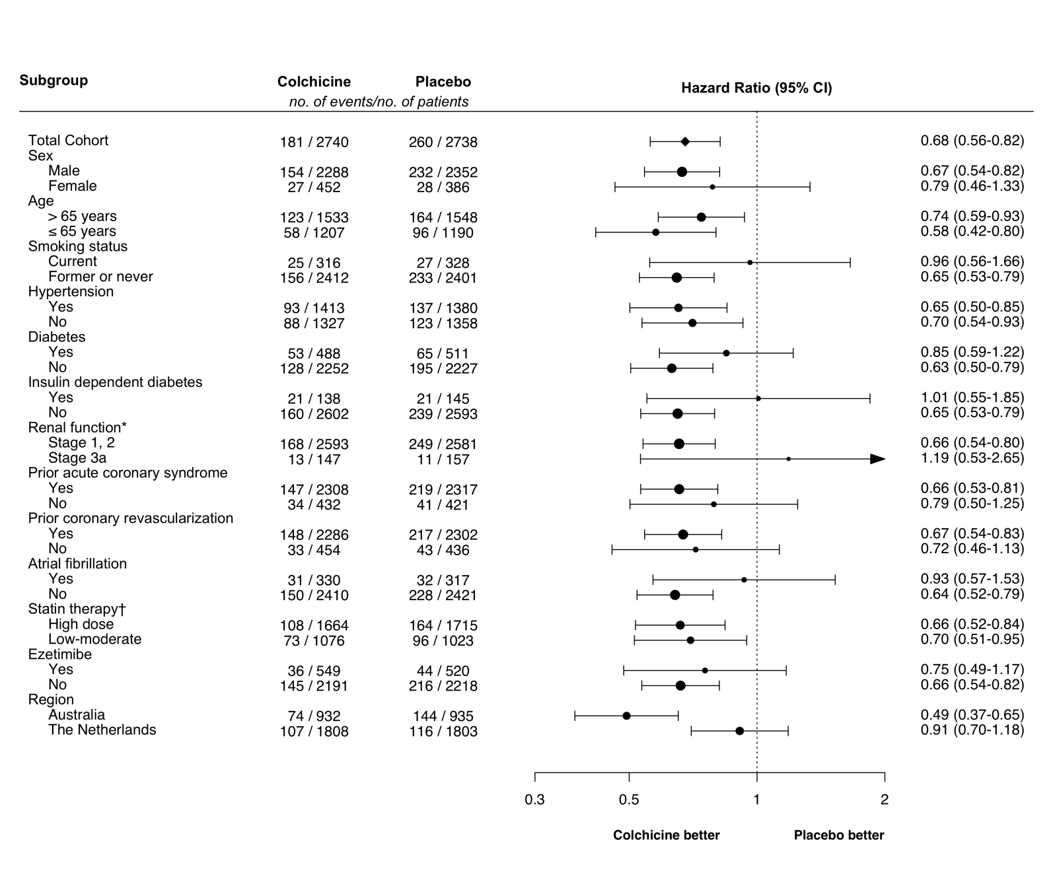
Prespecified sub-groups

Slide 16
Serious adverse events
 | Colchicine |  | Placebo
 | (N = 2762) |  | (N = 2760)
Non-cardiovascular death | 53 | (1.9) | 35 | (1.3)
Diagnosis of new cancer | 120 | (4.3) | 122 | (4.4)
Hospitalization for infection | 137 | (5.0) | 144 | (5.2)
Hospitalization for pneumonia | 46 | (1.7) | 55 | (2.0)
Hospitalization for gastro-intestinal reason | 53 | (1.9) | 50 | (1.8)
Neutropenia 3(0.1) 3(0.1)
Myotoxicity 4(0.1) 3(0.1)

Slide 17
Summary
In patients with chronic coronary disease, low-dose colchicine
Reduced the risk of;
- The primary composite end point
Cardiovascular death, myocardial infarction, ischemic stroke or ischemia-driven coronary revascularization.
- Key secondary composite end points
Cardiovascular death, myocardial infarction or ischemic stroke.
- Individual secondary end points
Myocardial infarction & Ischemia-driven coronary revascularization.
… with broadly consistent effects across a range of clinical subgroups
Was well tolerated and appeared safe
The incidence of premature discontinuation & serious adverse events were both low & equivalent to placebo.

Slide 18
Conclusion
LoDoCo2 provides strong evidence to support repurposing colchicine for routine secondary prevention in patients with chronic coronary disease.

Slide 19
We would like to acknowledge
Every participant in the trial
Our co-investigators
Tjerk S.J. Opstal, Salem H.K. The, Xiao-Fang Xu, Mark A. Ireland, Timo Lenderink, Donald Latchem, Pieter Hoogslag, Jeroen Schaap, Anastazia Jerzewski, Peter Nierop, Alan Whelan, Randall Hendriks, Henk Swart, Aaf F.M. Kuijper, Maarten W.J. van Hessen, Pradyot Saklani, Isabel Tan, Angus G Thompson, Allison Morton, Chris Judkins, Willem A. Bax, Maurits Dirksen, Marco M.W. Alings, Graeme J. Hankey
The trial coordinators
Trial monitors and staff from GenesisCare and the Heart and Vascular Research Institute of Sir Charles Gairdner Hospital Perth WA, including Penny Buczec, Denny Craig, Karen Doherty, Louise Nidorf, and Karen Youl, and from the Dutch Network for Cardiovascular Research (WCN), including Marjelle van Leeuwen as project manager, Ingrid Groenenberg and Glentino Rodriguez for data management, Erik Stroes, Max Silvis, & Tim de Vries for medical review, Petra Bunschoten & Wendy Tousain for site monitoring
Organizational support
The National Health Medical Research Council of Australia, The Sir Charles Gairdner Research Advisory Committee Grant,
The Withering Foundation The Netherlands, The Netherlands Heart Foundation, The Netherlands Organization for Health Research and Development, and The Dutch Pharma consortium; Teva, Disphar and Tiofarma.
Both the active and placebo tablets were supplied at no cost by; Tiofarma in The Netherlands and Aspen Pharmacare in Australia
Neither the funders nor pharma had any role in the design of the study, the collection or management of the data, the statistical analyses, or presentation of the results
an investigator-initiated trial, of an old drug in an ancient disease
Notes:
….we received for this investigator-initiated trial of an old drug in an ancient disease

Slide 20
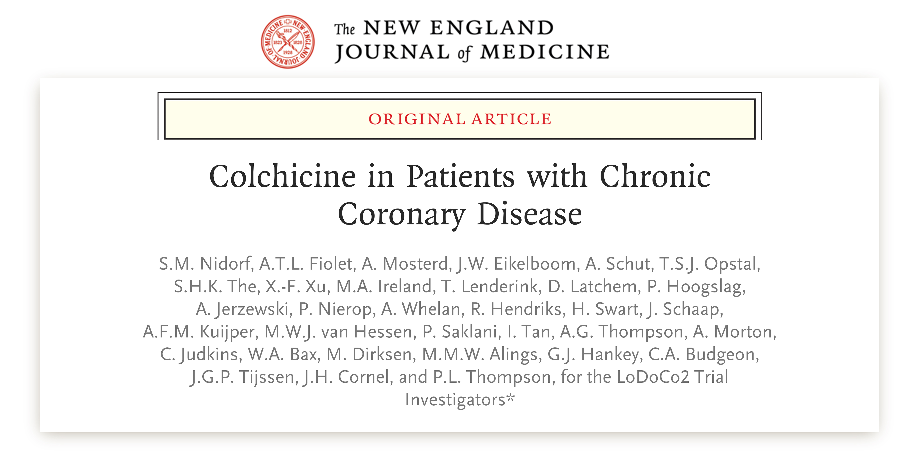
Research Publication
“ Authors Name”
Article Name
JOURNAL NAME ,
Volume XX, Issue XX, Date , Page Ref
https://doi.org/XXX/yyj/zzzz

