Slide 1

Acute Alcohol Consumption and Discrete Atrial Fibrillation Events
1 R01 HL158825-01
The HOLIDAY (HOw ALcohol InDuces Atrial TachYarrhythmias) Monitors Study
Gregory M Marcus, MD, MAS, Eric Vittinghoff, PhD, Isaac R Whitman, MD, Sean Joyce, Vivian Yang, Gregory Nah, MA, Edward P Gerstenfeld, MD, Joshua D. Moss, MD, Randall J. Lee, MD, PhD, Byron K. Lee, MD, Zian H. Tseng, MD, MAS, Vasanth Vedantham, MD, PhD, Jeffrey E Olgin, MD, Melvin M Scheinman, MD, Henry Hsia, MD, Rachel Gladstone, Shannon Fan, Emily Lee, Christina Fang, Kelsey Ogomori, BA, Robin Fatch, Judith A Hahn, PhD
5/5/2021
Notes:
Thank you. It is my pleasure to present what we refer to as the HOLIDAY monitors study

Slide 2
Disclosures
Research
  NIH (NIBIB, NCI, NHLBI)
  PCORI
  TRDRP
  Medtronic
  Eight Sleep
  Baylis
Consulting
  InCarda Therapeutics
  Johnson and Johnson
Equity
  InCarda Therapeutics (as co-founder)
Notes:
Here are my disclosures

Slide 3
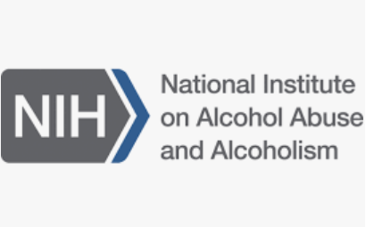
Funding
  R01AA022222
Notes:
This study was funded by an R01 from the NIAAA

Slide 4
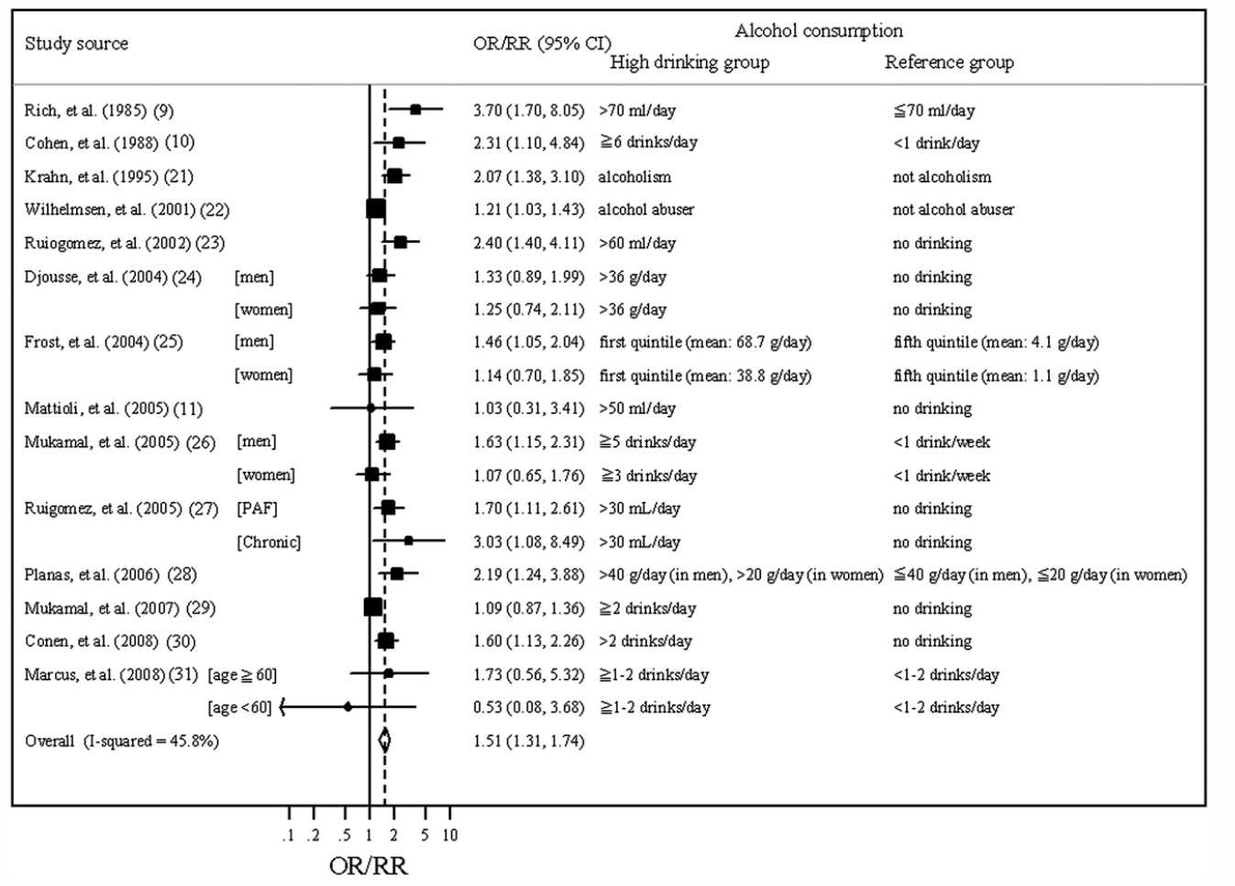
Kodama et al. J Am Coll Cardiol 2011
Notes:
As nicely shown in this important meta-analysis, it is now fairly well-established from large epidemiolgical studies that those who drink more alcohol tend to experience a higher risk of eventually developing a diagnosis of atrial fibrillation

Slide 5

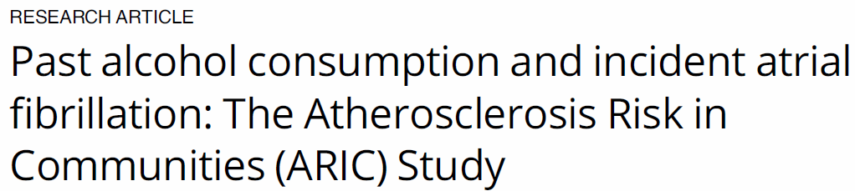
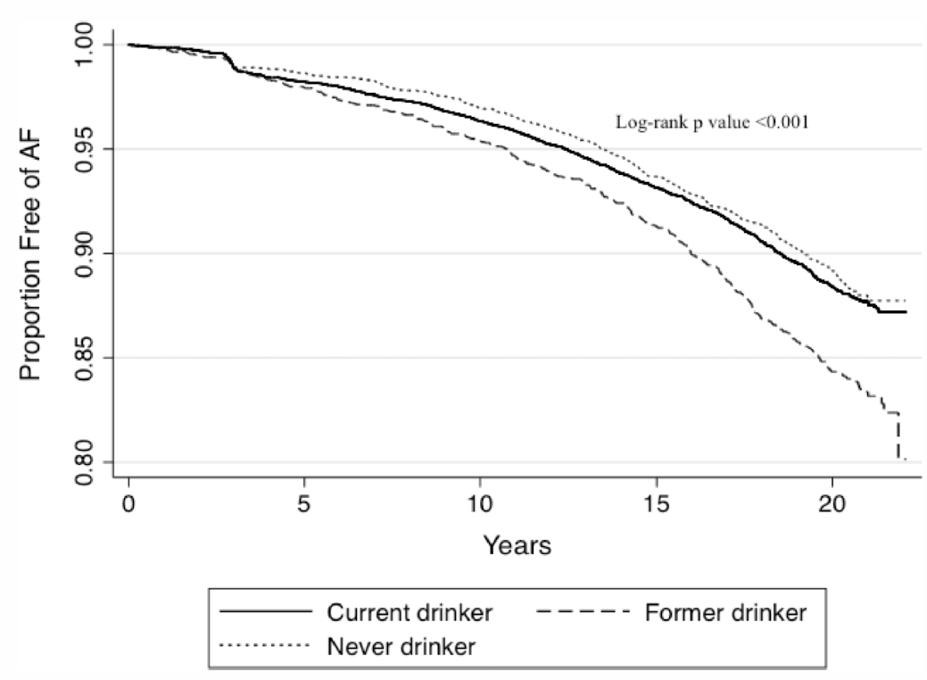
Notes:
This begs the question as to whether those relationships are fixed, such that the cat is already out of the bag, or dynamic. We demonstrated in an observational study that alcohol cessation was associated with a lower risk of Afib;.

Slide 6
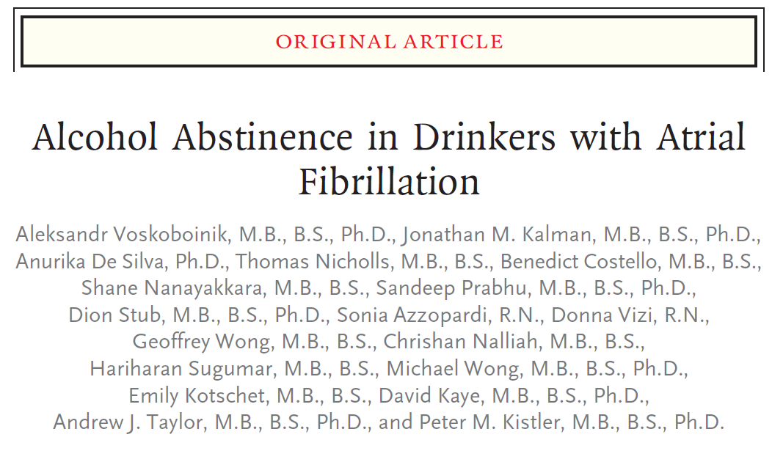
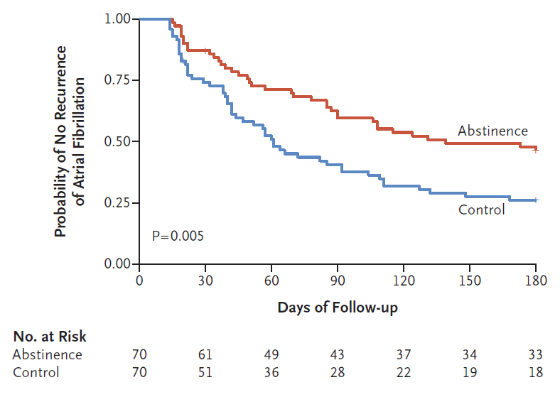
N Engl J Med 2020
………………
Notes:
Following on this, Drs. Voskoboinik and Kistler recently demonstrated that random assignment to instructions to avoid alcohol leads to a reduction in AF burden and recurrence.

Slide 7
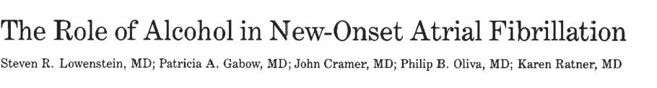
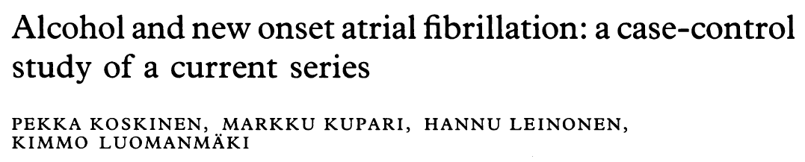

Original Descriptors Focused on Acute Effects: The “Holiday Heart Syndrome”
Small case series relying on self-reported alcohol consumption
Notes:
But all of these studies focused on chronic effects between tendencies to drink in the longterm and the development of atrial fibrillation, while in fact the first description of the alcohol-atrial fibrillation relationship stemmed from small case series of patients reporting an acute relationship, or the HOLIDAY heart syndrome, where alcohol consumption was shortly therafter followed by a discrete Afib event.

Slide 8
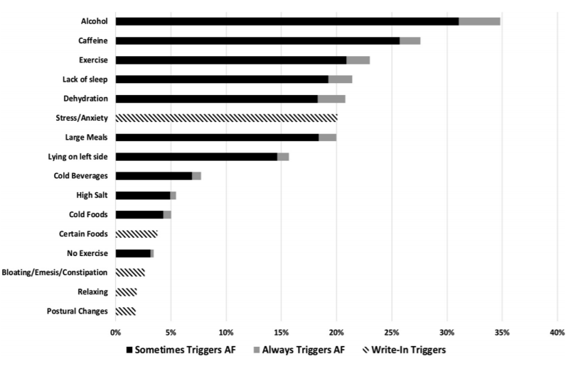
N=957
Groh CA….Marcus GM. Heart Rhythm 2019
Notes:
Indeed, when we ask our patients, as in this study where we queried nearly a thousand of our Health eHEart participants with Afib, they tell us that alcohol is the most common trigger for an AF episode

Slide 9
Could patients be mistaken?
Because alcohol is so commonly consumed, such observations are prone to an “availability heuristic,”¹ where recent exposures might naturally, and yet potentially erroneously, be inferred as causal.
1. Tversky A, Kahneman D. Science 1974
Notes:
Could these reports be mistaken? Because alcohol is so ubiquitous, it’s possible people are prone to what Kahneman and Tversky called an availability heuristics, where recent exposures are naturally and yet potentially erroneously inferred as caual for a particular outcome

Slide 10
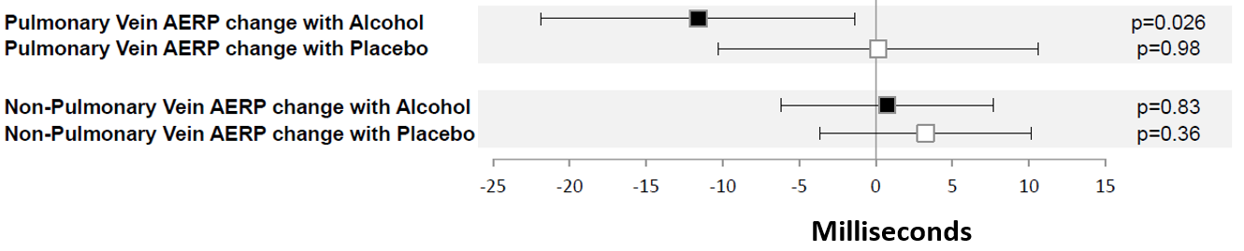
Biological Plausibility
Atrial fibrillation patients randomly assigned to an alcohol infusion titrated to 0.08% breath alcohol concentration versus double-blinded, volume, and osmolality-matched placebo infusion.
No differences in AF inducibility were observed in this study of near-immediate alcohol-related effects.
Marcus GM et al. JACC Clin Electrophysiol 2021
Notes:
But there is biological plausibility as we recently showed in this randomized trial comparing AF patients infused with IV alcohol titrated to 0.08% blood alcohol concentreaion versus a double-blinded volume and osmolality-matched placebo. We found that random assignment to alcochol was associated with a significant reduction in the atrial effective refractory periods in the pulmonary veins, an electrical change expected to render the atria more prone to fibrillate. Interestingly, we failed to observe any differences in AF inducibility, suggesting there may yet be delayed effects after alcohol exposure that are important.

Slide 11
Hypotheses
The timing and occurrence of an atrial fibrillation episode is not due to random chance alone
Acute alcohol consumption heightens the risk for a discrete atrial fibrillation episode
Notes:
We therefore sought to test the hypothesis that the timing and occurrence of an atrial fibrillation episode is not due to random chance alone. And that specifically acute alocohl consumption heightens the risk for a discrete atrial fibrillation episode.

Slide 12
Methods
We enrolled 100 consenting paroxysmal atrial fibrillation patients at least 21 years of age who consumed at least one alcoholic drink per month.
  With no plans to change management in the next 4 weeks
  No evidence of substance or alcohol use disorders (using chart review and the AUDIT-C questionnaire)

Slide 13
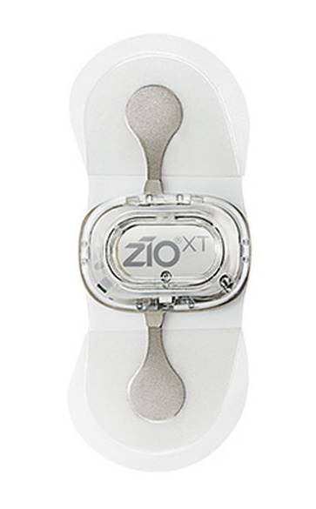
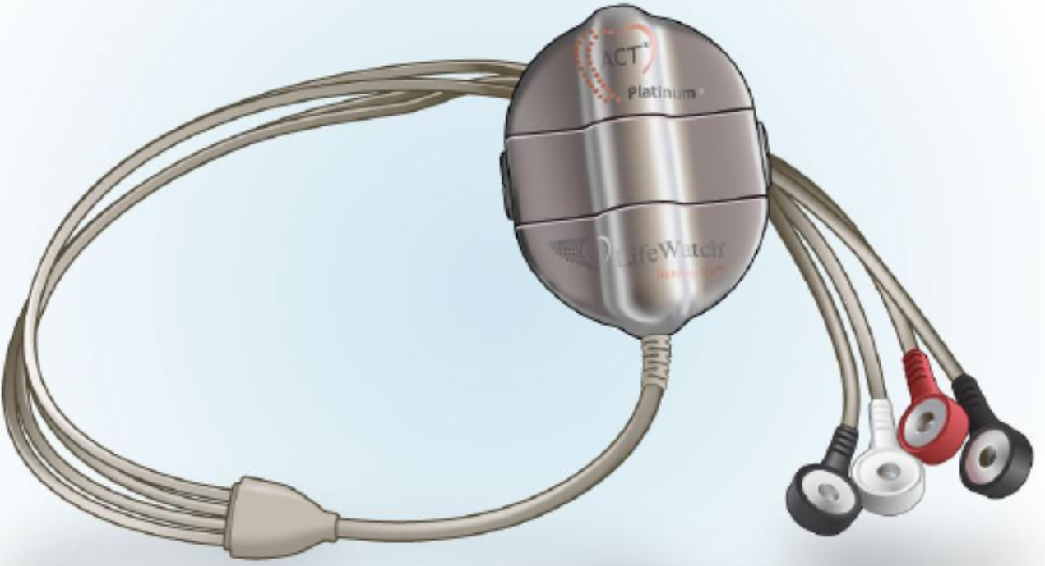
Methods
1 month of Wearable continuous ECG monitoring was obtained using:
  Lifewatch (Lifewatch, Rosemount, Ill) ACT monitor in the first 27 participants
  Two successive Zio patches (iRhythm, San Francisco, CA) in the remining 73 participants

Slide 14
Methods
Using these continuously worn ECG monitors:
  The timing of every AF episode lasting at least 30 seconds was determined
Participants were instructed to press a patient activator button on the ECG monitor only and every time they had a standard alcoholic drink.
  Providing a time stamp for each drink
  A standard drink was defined as a glass of wine, 12 ounce can/ bottle of beer, or a shot of hard liquor/ spirits

Slide 15

Methods
For passive continuous alcohol monitoring, participants were fit with a transdermal alcohol sensor placed around the ankle, the Secure Continuous Remote Alcohol Monitor (SCRAM, Highlands Ranch, CO).
  These devices achieve optimal sensitivity when ≥2 drinks are consumed on one occasion
  A “UCSF Cardiology” sticker was applied to mitigate concern regarding stigma

Slide 16
Methods
Participants returned for in-person visits at two and four weeks to assure compliance with devices and place new devices (such as the second Zio patch) if needed.
During those visits, a finger-stick blood spot was collected for phosphatidylethanol testing (PEth, United States Drug Testing Laboratories, Des Plaines, Illinois).
  PEth is a byproduct of ethanol metabolism indicative of alcohol consumption within the previous 21 days.
  Optimal sensitivity is achieved with binge drinking.

Slide 17
Statistical Analyses
We employed a case-crossover analysis among all participants that exhibited at least one atrial fibrillation episode during the monitoring period.
The associations of having an AF episode with alcoholic consumption was estimated using conditional logistic models adjusting for day of week of the event.
  The exact time of the first AF episode was compared to the same time on non-AF days
  The initial “look-back” period for self-reported drinking events was set to 4 hours based on the median time estimated by participants
  As the transdermal sensor ascertains alcohol levels only every 30 minutes and may exhibit delayed effects, the look-back time for those events was set to 12 hours

Slide 18
Results
Participants wore the ECG monitor a median of 27 days (IQR 15-28), with 90% wearing it more than 21 days.
Real-time recordings of alcohol consumption revealed a median of 19 drinks (IQR 10-38) on a median 12 (IQR 7-21) different days.
56 participant exhibited at least one atrial fibrillation episode.
Atrial fibrillation occurred on a median of 5 (IQR 2.5-12.5) different days.

Slide 19
Notes:
Differences in characteristics between those that did and did not exhibit any AF are shown. Participants were generally middle-aged, the majority were white males, about a half had hypertension and a third had other cariodvacular comorbidities. Antiarrhythmic drug use was rare.

Slide 20
Adjusting for study week and taking repeated measures within individuals into account, every additional participant activation-based drinking event was associated with a 23% greater odds of a positive PEth (OR 1.23, 95% CI 1.09-1.39, p<0.001).
The Spearman correlation between real-time recordings of alcohol consumption and daily areas under the curve for SCRAM-detected events was 0.52 (p<0.001).
Notes:
The real-time participant activations using the buttons on the ECG monitor correlated well with the PEth results and the alcohol sensor-based results.

Slide 21
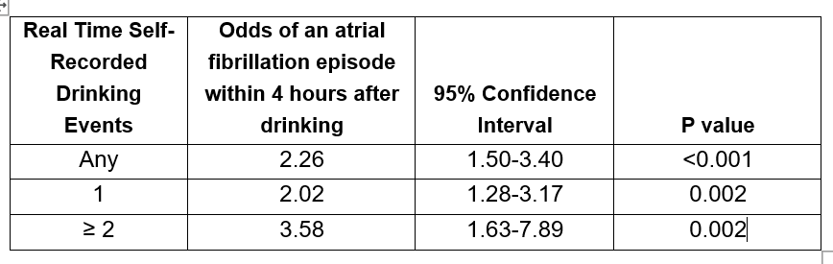
Results: real time self-reported events
Alcohol consumption as a predictor of subsequent discrete atrial fibrillation episodes
Odds ratios are adjusted for day of the week
Notes:
Any alcoholic drink determined by the real-time participant activation was associated with a more than two-fold greater odds of an AF event in the next 4 hours. There was a dose response relationship, such that consuming two or more drinks was associated with a greater than 3.5 fold greater odds of an AF event.

Slide 22
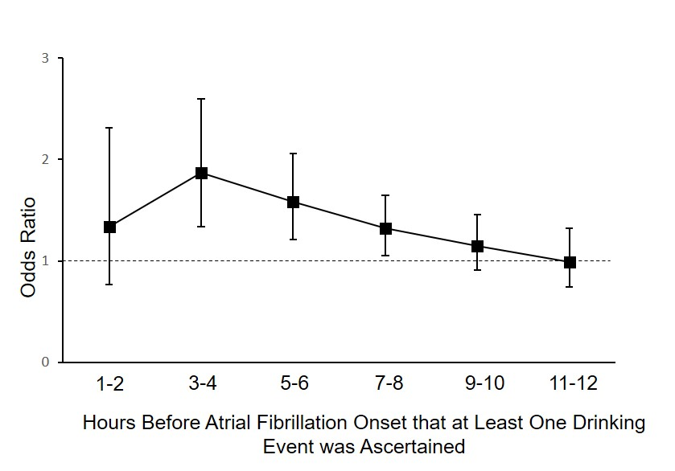
Results: timing of events
Notes:
In terms of the timing of this relationship, the highest risk occurred at 3-4 hours after alcohol consumption but significant effects lasted until almost 9 hours later.

Slide 23
Results: transdermal alcohol sensor
Every 0.1% increase in the inferred peak blood alcohol concentration in the last 12 hours was associated with a 38% greater odds of an atrial fibrillation episode (OR 1.38, 95% CI 1.04-1.83, p=0.024).
The total area under the curve of alcohol exposure in the past 12 hours was also associated with a heightened risk for an atrial fibrillation episode:
  Odds ratio of 1.14 (95% CI 1.06-1.22) per 4.7% increase in alcohol exposure, p<0.001).
No threshold effects were observed.

Slide 24
Strengths and Limitations
The case-crossover mitigates against confounding as the same individuals served as cases and controls.
We cannot exclude the possibility that some concomitant behavior or exposure that occurred with alcohol consumption was a causal factor.
  Only 1 participant in the analysis smoked
  Caffeine unlikely to be consumed at the same time
Poor sleep may occur due to alcohol consumption and lead to atrial fibrillation.
  Poor sleep in this circumstance would then serve as a mediator (along the causal pathway) rather than a confounder

Slide 25
Conclusions
Alcohol consumption appears to heighten the risk that a discrete atrial fibrillation event will occur.
This relationship exhibits a delayed effect of several hours.
No clear or consistent threshold of alcohol required was observed.
  With evidence that even one drink may heighten the risk

Slide 26
Conclusions
These data suggest that the probability a particular atrial fibrillation event will occur is not simply due to random chance.
A common behavior, alcohol consumption, is a modifiable exposure that may empower patients to influence the risk of an atrial fibrillation event.
These findings suggest understanding other acute triggers of atrial fibrillation may be a fruitful field of investigation.

Slide 27
Thank You

