Slide 1


Closure of Iatrogenic Atrial Septal Defects Following Transcatheter Mitral Valve Repair –
The Randomized MITHRAS Trial
Philipp Lurz, Matthias Unterhuber, Karl-Philipp Rommel, Karl-Patrik Kresoja,
Tobias Kister, Christian Besler, Karl Fengler, Marcus Sandri, Ingo Daehnert,
Maximilian von Roeder, Stephan Blazek, Holger Thiele
Heart Center Leipzig at University of Leipzig
Notes:
Thank you for the introduction and thank very much for the opportunity to present our results of MITHRAS trial in this outstanding session.

Slide 2
Disclosure Statement of Financial Interest
Speaker’s Name: Philipp Lurz
Within the past 12 months, I or my spouse/partner have had a financial interest/arrangement or affiliation with the organization(s) listed below
Affiliation/Financial Relationship Company
Institutional Grant/Research Support ReCor, Occlutech, Edwards Lifesciences
Consulting Fees to Institution Abbott, ReCor, Occlutech, Edwards Lifesciences, Medtronic
Personal Fees None
Major Stock Shareholder/Equity None
Royalty Income None
Ownership/Founder None
Intellectual Property Rights None
Notes:
These are my disclosure.

Slide 3
Background
Transcatheter therapies for mitral regurgitation (TMVR) require transseptal access to left atrium.
Persistent iatrogenic atrial septal defect (iASD) in 24-50% of patients.
iASD with left-to-right shunting associated with right heart volume overload and mortality.
In contrast, creation of an iASD linked to improved hemodynamics and is investigated in large-scale clinical trials in patients with heart failure
Notes:
2
Transcatheter therapies to treat mitral regurgitation commonly requires transseptal access to the left atrium
After these interventions, a persistent iatrogenic atrial septal defect is found in 24%-50% of patients
Now importantly, a persistent iatrogenic ASD with relevant left to right shunting is associated right heart volume overload and also increased risk for mortality.
In contrast, creation of an iASD is linked to improved hemodynamics, and this concept is currently investigated in large-scale clinical trials in patients with heart failure

Slide 4
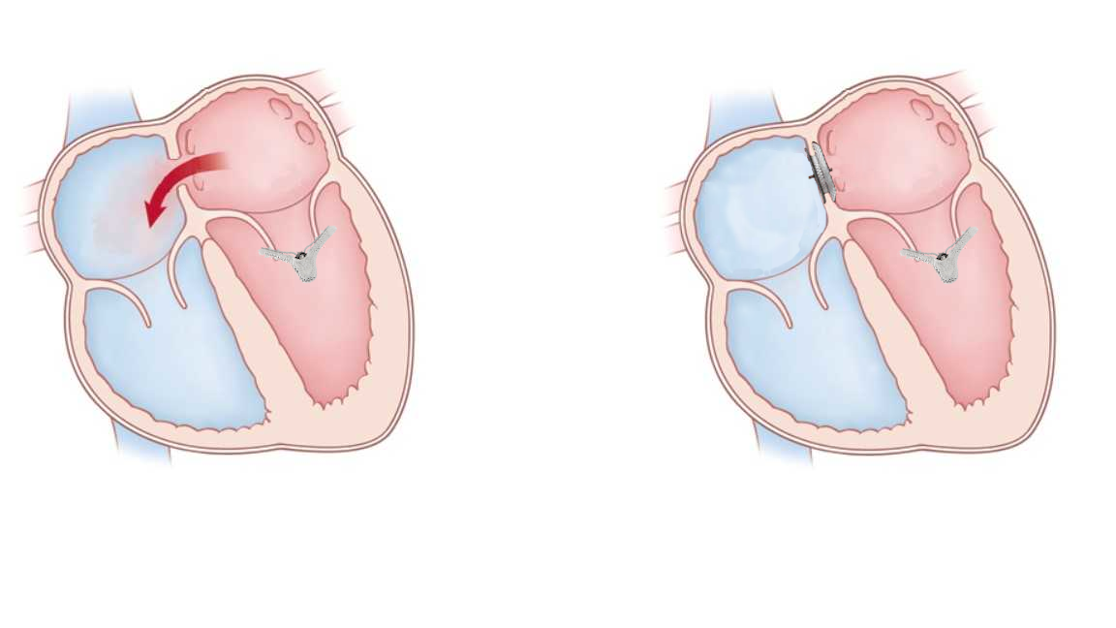
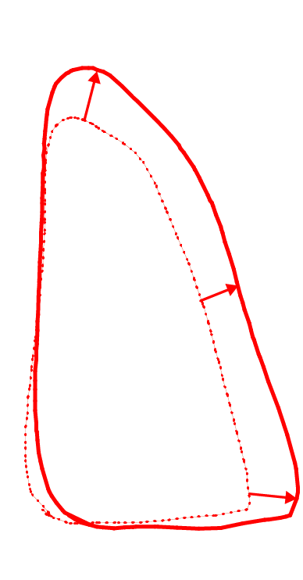
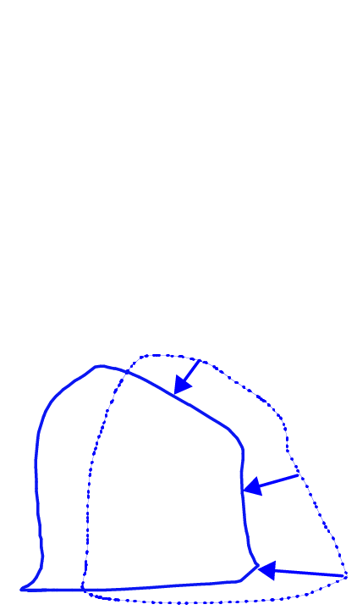
Interventional closure of
iatrogenic atrial septal defect
Pressure volume loop tracing during occlusion
Hemodynamic implications
of iASD closure
Left ventricle
Post ASD occluder
Pre ASD occluder
Right ventricle
Post ASD occluder
Pre ASD occluder
Pressure
Pressure
Volume
Volume
RV volume overload, LV underfilling
Reduced LV output
Unfavorable ventricular interaction
Heart failure symptoms
Volume shift from RV to LV, stable LVEDP
Reduced RV and incresaed LV output
Favorable ventricular interaction
Reduction in heart failure symptoms
von Roeder et al., Eur Heart J, 2016 Nov 1;37(41):3153.
Notes:
We previously have shown that interventional closure of iASD can improve hemodynamics. Acquisition of pressure volume loops demonstrated reduced RV volume overload with a leftward shift of the pressure volume relation. At the same time, LV filling increases and equally left ventricular output. Importantly, LV filling pressure and right ventricular systolic pressures remained stable, suggesting that iASD closure can be beneficial.

Slide 5
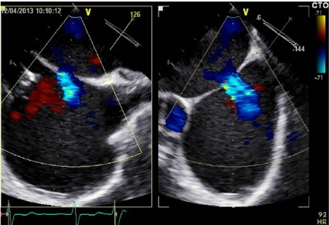
Objective
Interventional closure
Conservative treatment
Persistent iASD
Given the controversy and lack of recommendations in the setting of a persistent iASD with relevant left-to-right shunting following TMVR, we investigated whether the closure of a TMVR induced iASD is superior to conservative treatment in a randomized controlled trial.
Notes:
4
Given the controversy and lack of any recommendations in the setting of a persistent iASD with relevant left-to-right shunting following transcatheter mitral valve repair, we investigated whether the closure of an transcatheter mitral valve repair induced iASD is superior to conservative treatment in a randomized controlled trial.

Slide 6
Study Design – Inclusion/Exclusion
Design
Transcatheter mitral valve repair (TMVR) – 95% MitraClip
TTE and TEE assessment 1-month post TMVR
Design: Prospective, single-center, investigator initiated, unblinded randomized trial
Population: Patients with persistent iASD and relevant L-R-shunting (Qp:Qs ≥1.3) 1- month post transcatheter mitral valve repair
Primary endpoint: I2T analysis: group difference of change in 6-minute walking distance (6MWT) at 5 months
Powered to detect a 55 m difference in 6MWT between treatment groups with 80% power, α=0.05
iASD and L-R-shunting with Qp:QS ≥1.3
Exclusion of intraatrial shunting before TMVR, no TMVR success
Randomization
Interventional
iASD closure
(n=40)
Conservative treatment
(n=40)
Comparative cohort:
no iASD
(n=235)
Primary endpoint @ 5 months
change in 6MWT
Clinical FU: mortality + HF hospitalization
Notes:
The study was design as a prospective, single-center, investigator initiated, unblinded randomized trial with a 1 to1 randomization to either interventional iASD closure or conservative treatment.
Key inclusion criterion was a persistent left to right shunting with a Qp:Qs ratio equal or greater than 1.3 across the iASD on echocardiography 1-month post TMVR
The Primary endpoint was the group difference of change in 6-minute walking distance at 5 months follow-up and and this study was powered to detect a 55 meter difference between the 2 groups with 80% power and an alpha of 0.05
TMVR was performed using the MitraClip device in 95% of patients
Transthoracic and transesophageal echocardiography was performed 1 month post TMVR and the presence as well as significance of left to right shunting across the iASD determined
Excluded were patients with no relevant shunting or no TMVR success
Overall, 80 patients were randomized to interventional iASD closure or conservative treatment and treated accordingly
Secondary endpoints included mortality or heart failure hospitalization up to 1 year of follow-up.
In addition, 1-year clinical outcome of the 2 randomized cohorts were compared to a comparative cohort of 235 patients in whom no releavnt iASD was present 1-month post transcatheter mitral valve repair

Slide 7
01/2016 – 10/2019
TMVR (n=391)
Excluded (n=71)
• Enrollment in another study (n=5)
• Concomitant treatment of aortic valve (n=2)
• iASD occlusion during TMVR (n=18)
• Patients deceased (n=17)
• Follow-up in referral hospital (n=25)
• Lost to follow-up (n=4)
Study Flow
1 month post TMVR
Assessed for iASD (n=320)
Relevant iASD (n=85)
No relevant iASD (n=235)
Excluded (n=5)
• Declined to participate
Enrollment
Randomized MITHRAS cohort (n=80)
Allocation
iASD closure
(n=40)
Conservative therapy (n=40)
Standard care (n=235)
No iASD cohort
5 month follow-Up
Lost to follow-up (n=0)
Lost to follow-up (n=0)
6MWT in n=36
1 death, 1 declined, 2 acute heart failure
6MWT in n=37
1 death , 2 acute heart failure
Analysis
11 month follow-Up
Lost to follow-up (n=0)
Lost to follow-up (n=0)
Lost to follow-up (n=0)
Analysis
Analyzed for hospitali-zation/mortality (n=40)
Analyzed for hospitali-zation/mortality (n=40)
Analyzed for hospitali-zation/mortality (n=235)
Notes:
This slide summarizes the subject flow, for 80 patients enrolled we screened 320 patients 1 month post TMVR, 85 patients exhibited relevant left to right shunting across an iASD, of which only 5 declined participation. There was no loss to follow-up, the primary endpoint could be analyzed in 36 in the closure and 37 in the conservative treatment group, clinical follow-up at 1 year was 100% complete for both group and for 235 patients in the comparative group of patients without iASD 1 month post TMVR.

Slide 8
Baseline Characteristics I
 | iASD closure (n=40) | Conservative treatment (n=40)
Age, y | 77±9 | 76±10
Female sex, no. (%) | 16 (40) | 15 (38)
Diabetes, no. (%) | 16 (40) | 16 (40)
Hypertension, no. (%) | 38 (95) | 36 (90)
Hypercholesterolemia, no. (%) | 30 (75) | 31 (78)
Previous myocardial infarction, no. (%) | 13 (32) | 10 (25)
Previous coronary-artery bypass grafting, no. (%) | 6 (15) | 6 (15)
Previous stroke or transient ischemic attack, no. (%) | 3 (8) | 4 (10)
Peripheral vascular disease, no. (%) | 2 (5) | 4 (10)
Chronic obstructive pulmonary disease, no. (%) | 6 (15) | 6 (15)
History of atrial fibrillation of flutter, no. (%) | 29 (72) | 28 (70)
Body-mass index, kg/m² | 28±4 | 27±4
Creatinine clearance, ml/min | 63±29 | 59±24
Anemia, no. (%) | 20 (50) | 15 (38)
EuroScore II, | 4.9 (3.3-9.6) | 5.5 (2.6-7.6)
RV-lead, no. (%) | 16 (40) | 18 (45)
Single-chamber-ICD device, no. (%) | 8 (20) | 8 (20)
CRT-D device, no. (%) | 5 (12) | 4 (10)
NT-proBNP, ng/l | 3105 (1902-4134) | 3653 (1746-5848)
Peripheral edema, no. (%) | 20 (50) | 16 (40)
No relevant iASD (n=235) | p-value
77±8 | 0.12
110 (47) | 0.43
83 (35) | 0.75
215 (91) | 0.69
159 (68) | 0.34
43 (18) | 0.10
29 (12) | 0.83
15 (6) | 0.70
27 (11) | 0.46
28 (12) | 0.77
169 (72) | 0.97
27±5 | 0.35
60±25 | 0.87
94 (40) | 0.44
6.4 (3.9-9.6) | 0.15
83 (38) | 0.66
53 (23) | 0.89
23 (10) | 0.87
2205 (1160-4495) | 0.09
125 (53) | 0.47
Notes:
7
To the results, these are the baseline charateristics, patients were around 77 years of age an exhibited a typical risk profile for a TMVR population, signs of right heart failure were present in about 50% of patients,
Baseline charateristics were well balanced between the 2 treatment group.
In additon, there were no significant differences compared to the comparative group of patients without iASD.

Slide 9
Baseline Characteristics II
 | iASD closure (n=40) | Conservative treatment (n=40) | No relevant iASD (n=235) | p-value
NYHA class, no. (%) |  |  |  | 0.07
I | 4 (10) | 5 (12) | 13 (6)
II | 18 (45) | 21 (52) | 98 (42)
III | 17 (42) | 11 (28) | 115 (49)
IV | 1 (2) | 3 (8) | 9 (4)
Left ventricular ejection fraction, % | 38 ± 13 | 37 ± 19 | 47 ± 16 | <0.001
Left ventricular enddiastolic volume, ml | 147 (124 – 200) | 152 (121 – 206) | 132 (92 – 180) | 0.06
Left ventricular endsystolic volume, ml | 92 (63 – 130) | 96 (56 – 151) | 71 (38 – 121) | 0.009
Functional mitral regurgitation, n (%) | 25 (62) | 25 (62) | 67 (29) | <0.001
Qp:Qs | 1.5 (1.4–1.6) | 1.5 (1.3–1.6) | 1.0 (1.0-1.2) | <0.001
TAPSE, mm | 14 (12–17) | 16 (13–21) | 17 (15-21) | 0.01
Mitral valve mean gradient, mmHg | 4.0 (3.2–5.0) | 3.8 (2.6-4.5) | 4.0 (2.8-5.0) | 0.34
PAPs, mmHg | 47 ± 14 | 45 ± 14 | 39 ± 12 | 0.59
Mitral regurgitation grade, n (%)
0–I | 31 (78) | 31 (78) | 168 (71) | 0.35
II | 8 (20) | 8 (20) | 61 (26) | 0.25
III | 1 (2) | 1 (2) | 6 (3) | 0.97
IV | 0 (0) | 0 (0) | 0 (0) | 1.00
Tricuspid regurgitation grade, n (%)
0–I | 19 (48) | 22 (55) | 103 (44) | 0.13
II | 15 (38) | 12 (30) | 58 (25) | 0.45
>II | 6 (15) | 6 (15) | 74 (31) | 0.11
Notes:
8
About half of patients were in NYHA class I or II in all 3 groups with no significant differences.
Patients in the randomized cohort had a significantly lower left ventricular ejection fraction, 37%, as compared to the comparative cohort with 47%.
Also, randomized patients had a higher incidence of functional mitral regurigtation prior to TMVR, and a slightly lower TAPSE.
Estimated PA pressures were around 45 mmHg.
Mean Qp:Qs in the randomized patients was 1.5.
Mild mitral regurgitation was present in around 75 % of patients, MR grade II° in about 20 %

Slide 10
Primary Endpoint
Group difference of change in 6-minute walking distance at 5 months
Notes:
Now to the results of the primary outcome: both in patients randomized to interventional iASD closure and in patients randomized to conservative treatment, there were no significant changes in 6 minute walking distance at 5 month follow-up. The difference of change between the 2 group was also non-significant.

Slide 11
Secondary Endpoints
at 5 months
 | iASD closure |  |  | Conservative treatment
 | Randomization | 5 months | Δ | Randomization | 5 months | Δ | p–value
NYHA class, no. (%) |  |  |  |  |  |  | 0.07
I | 4 (10) | 8 (20) | 4 | 5 (12) | 3 (8) | -2
II | 18 (45) | 20 (50) | 2 | 21 (52) | 22 (55) | 1
III | 17 (42) | 9 (22) | -8 | 11 (28) | 11 (28) | 0
IV | 1 (2) | 2 (5) | 1 | 3 (8) | 3 (8) | 0
NT-proBNP, pg/ml | 3105 (1902-4134) | 2259 (1648-4804) | -846 | 3653 (1746-5848) | 3374 (1394-6065) | -279 | 0.44
Peripheral edema, no. (%) | 20 (50) | 16 (40) | -4 | 16 (40) | 18 (46) | 2 | 0.26
Qp:Qs (IQR) | 1.5 (1.4–1.6) | 1.0 (1.0 – 1.0) | -0.5* | 1.5 (1.3–1.6) | 1.3 (1.1–1.5) | -0.2† | 0.02
Notes:
In addition, there were no significant differences between groups with repsect to changes in NYHA class, NTproBNP or incidence of peripheral edema.
The shunt estimated by Qp:Qs was reduced to 1 in all patiens in the iASD closure group. Interestingly, also in the consevative group, there was a significant reduction in Qp:Qs from 1.5 down to 1.3, so left to right shunting decreased in some patients even without iASD closure.

Slide 12
Combined Mortality and Rehospitalization - 1 Year
Kaplan-Meier analysis
No. at risk:
iASD closure:
40 40 40 36 35 33 32 31 31 31 30 30 28
Notes:
Here you can see the kaplan meier analysis for mortality and heart failure rehospitalization of patients with iASD closure

Slide 13
Combined Mortality and Rehospitalization - 1 Year
Kaplan-Meier analysis
p=ns
No. at risk:
iASD closure:
40 40 40 36 35 33 32 31 31 31 30 30 28
Conservative:
40 40 37 37 35 34 33 30 29 29 28 28 25
Notes:
With no diferences in event free survial between the 2 groups

Slide 14
Combined Mortality and Rehospitalization - 1 Year
Kaplan-Meier analysis
Hazard ratio per unit increase
p=ns
No. at risk:
iASD closure:
40 40 40 36 35 33 32 31 31 31 30 30 28
Conservative:
40 40 37 37 35 34 33 30 29 29 28 28 25
Notes:
Also, as depcited on the right, forrest plots did not reveal any subgroups of patients more likely to benefit form iASD clsoure. This included degree of iASD shunting, pulmonary pressures, gradient across the mitral valve, left ventricular ejection fraction and age.

Slide 15
Randomized vs. Comparative Cohort (no iASD)
Risk for Mortality and Rehospitalization
No. at risk:
iASD closure:
40 40 40 36 35 33 32 31 31 31 30 30 28
conservative treatment:
40 40 40 36 35 33 32 31 31 31 30 30 28
no relevant iASD:
235 232 224 220 215 212 210 206 202 199 197 196 194
Notes:
Finally, the risk for mortaly or heart failure hospitalization in patients with an iASD (shwon in blue and red), was significantly higher when compared to patients without relevant iASD following transcatheter mitral valve repair in the comparative cohort (as shwon in green), and this difference was driven by heart failure hospitalizations.

Slide 16
Randomized vs. Comparative Cohort (no iASD)
Risk for Mortality and Rehospitalization
No. at risk:
iASD closure:
40 40 40 36 35 33 32 31 31 31 30 30 28
conservative treatment:
40 40 40 36 35 33 32 31 31 31 30 30 28
no relevant iASD:
235 232 224 220 215 212 210 206 202 199 197 196 194

Slide 17
Limitations
Single-center and relatively small number of patients.
Randomization and analysis not stratified according to etiology of mitral regurgitation.
Results might vary depending on different degrees of RV dysfunction and volume overload as well as different left sided filling pressures.
Results might vary in specific subsets of patients.
Although mean Qp:Qs was 1.5, shunting volumes might have been to small to detect benefits of closure.
L-R shunting across iASD can decrease over time without interventional closure → inclusion and closure of iASD might have been too early to differentiate treatment benefits.

Slide 18
Summary
Interventional closure of iASD 1-month post transcatheter mitral valve repair was not superior to conservative treatment with regards to the primary endpoint 6-minute walking distance.
The results are corroborated by no difference in secondary endpoints such as heart failure symptoms or hospitalization and survival.
The presence of an iASD is associated with a higher rate of HF hospitalization irrespective of its management when compared to patients without relevant iASD following TMVR.

Slide 19
Conclusions
The presence of an iASD following transcatheter mitral valve interventions might be a prognostically relevant surrogate, but not necessarily causative for inferior outcomes.
Patients with a persistent iASD and relevant left-to-right shunting appear at higher risk with potential implications for surveillance and management other than interventional iASD closure.
iASD closure remains an individualized decision on case-by-case basis with no evidence in support of general recommendation to close.
Results of primary endpoint simultaneously published in Circulation

Slide 20

Thank You
philipp.lurz@medizin.uni-Leipzig.de

