Slide 1
Routine Pressure Wire Assessment Versus Conventional Angiography in the Management of Patients With Coronary Artery Disease:
The RIPCORD 2 Trial
Nick Curzen BM(Hons) PhD FRCP
Professor of Interventional Cardiology
Southampton, UK
On behalf of the RIPCORD2 Investigators
Stables R, Mullen L, Elguindy M, Nicholas Z, Aboul-Enien Y, Kemp I, O’Kane P, Hobson A, Johnson T, Khan S, Wheatcroft S, Garg S, Zaman A, Mamas MA, Nolan J, Jadhav S, Berry C, Watkins S, Hildick-Smith D, Gunn J, Conway D, Hoye A, Fazal I, Hanratty C, De Bruyne B.

Slide 3
Financial Disclosures
RIPCORD2 was funded by an unrestricted research grant from Boston Scientific Corp.
BSC had no role in the design, data collection, analysis or dissemination of the trial
The trial sponsor was University Hospital Southampton NHS Foundation Trust
NC reports:
Grants from Boston Scientific, HeartFlow, Beckmann Coulter
Speaker fees consultancy from Boston Scientific, Abbott, HeartFlow, Edwards
Travel sponsorship from Boston Scientific, Abbott, HeartFlow, Edwards, Biosensors

Slide 4
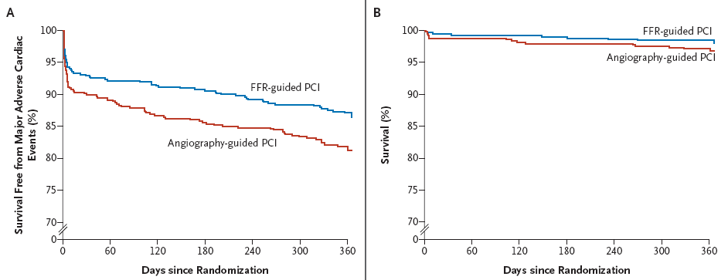
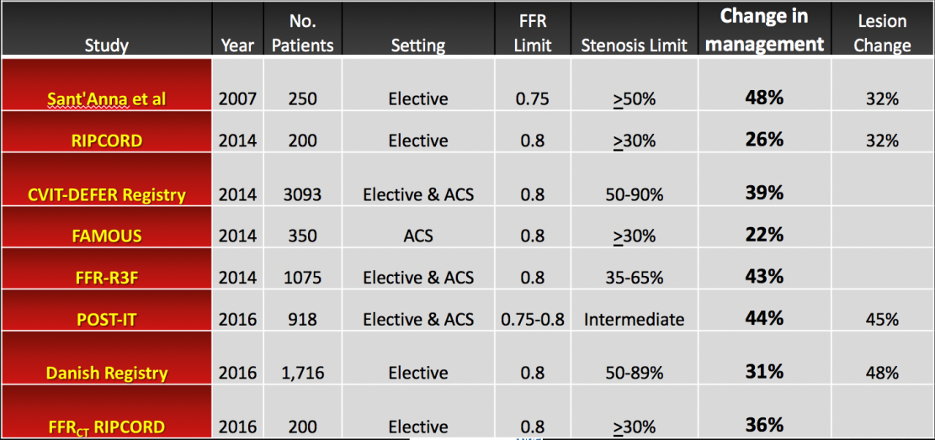
BACKGROUND
What we know about the clinical value of FFR
Randomised trials: FFR versus angio in patients committed to PCI
Observational Studies of effect of FFR
DEFER; FAME; FAME2
Less stent; less radiation & contrast

Slide 5
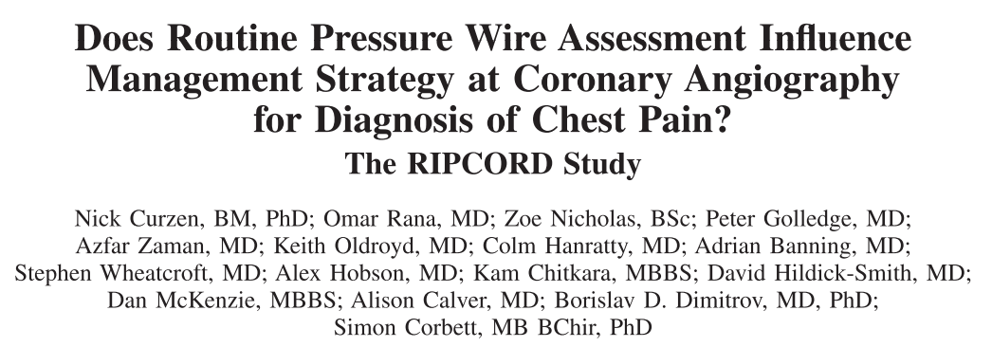
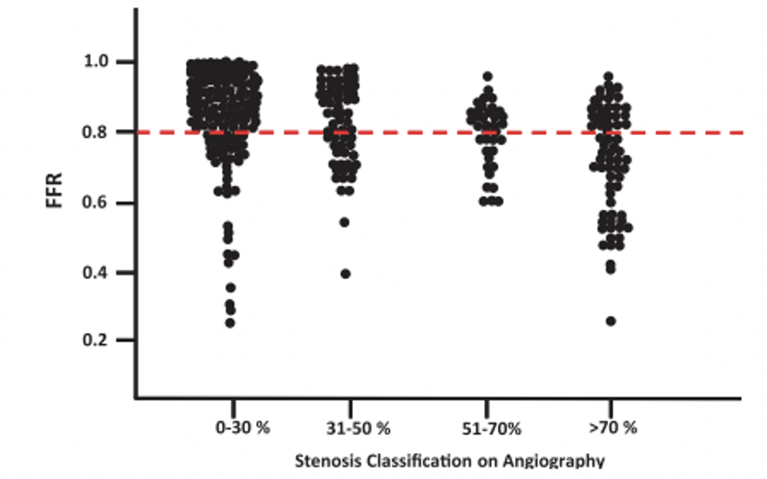
BACKGROUND
What we know about the clinical value of FFR
Discrepancy between angio & FFR in 32% of lesions
Change in management in 26% of cases

Slide 6
BACKGROUND
What we don’t know about the clinical value of FFR
Randomised comparison to assess the value of systematic FFR at the stage of the diagnostic angiogram
FUTURE trial: recruitment stopped early

Slide 7
HYPOTHESIS
That systematic, FFR-guided assessment of coronary artery disease would be superior,
in terms of resource utilisation & quality of life, to assessment by angiography alone
at the stage of diagnostic invasive coronary angiography (ICA).
Design
Open label, randomised, controlled, multicentre trial
Co-Primary Endpoints
-Primary Economic Endpoint: Total hospital costs at 12 months
-Primary Quality of Life: Quality of Life at 12 months
Power Calculations
Total Cost
We assumed an average baseline cost of £4615, & expected a wide standard deviation (£1850).
Sample size of 1030 subjects would provide 80% power at an alpha of 0.05, to detect an absolute change of 7%.
Because of expected non-parametric data, we increased the sample size to 1100.
QoL
In terms of the EQ-5D-5L data, we assumed a baseline mean (SD) score of 74.3 (16.7).
Evaluable data on 1040 patients would afford 80% power to detect an absolute difference of 3 points or 4% of the
observed value.

Slide 8
METHODS
1100 patients randomised in 17 UK centres
Scheduled to undergo diagnostic coronary angiography for either stable angina or non-ST elevation MI
Key Angiographic Inclusion Criterion
- Presence of potentially haemodynamically significant coronary disease defined as:
any stenosis >30% reduction in luminal diameter, by visual estimate, in at least one vessel (main or branch)
of sufficient calibre to permit the potential performance of PCI /CABG- approximately 2.25 mm diameter.
Randomisation
- After angiography and in cath lab
- Web-based
- Randomisation to either:
angiographic guidance alone [ANGIO ONLY] or
(b) FFR assessment of all epicardial vessels of a calibre that would be sufficient for stent or graft. [ANGIO+FFR]
- FFR not required for: CTOs – allocated FFR=0.5; vessels with < TIMI 3 flow
- i.c. or i.v. adenosine at operator discretion

Slide 9
METHODS
Management Plan
4 options: (1) OMT alone; (2) PCI; (3) CABG; (4) more information/further test required
12 month Follow Up
Co-Primary Endpoints
Total Hospital Costs: All hospital events (inpatient and outpatient attendances) including ED
Not including GP attendances or medication
Primary QoL Endpoint QoL using EuroQol EQ-5D-5L questionnaire (visual analogue scale)
Angina using CCS classification
Prespecified Secondary Endpoints
Clinical events at 12 months including:
all-cause mortality, stroke, myocardial infarction (MI) & unplanned revascularisation.

Slide 10
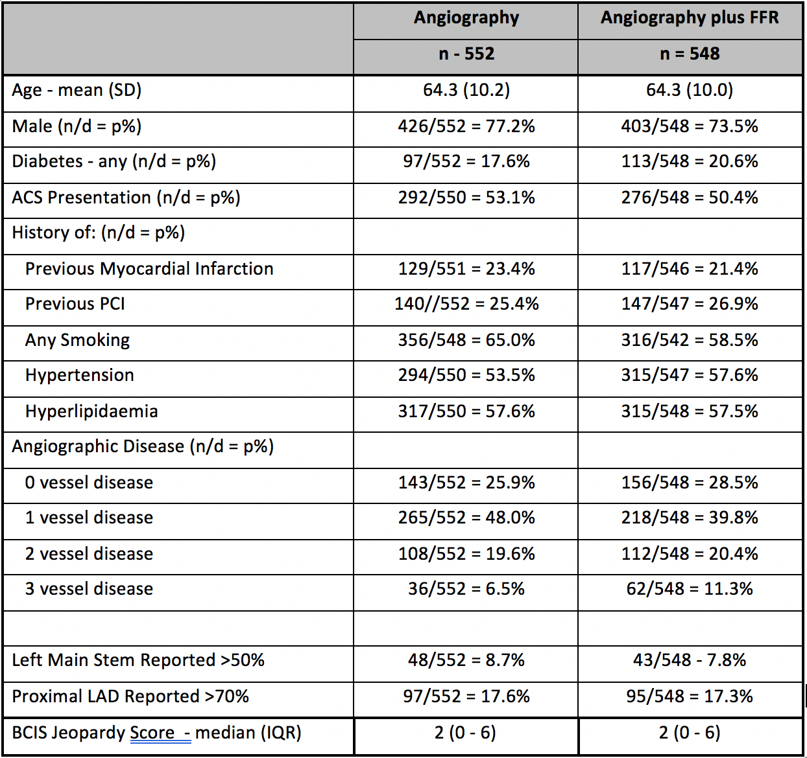
RESULTS
Patients undergoing diagnostic coronary angiography for stable angina or NSTEMI (n=1100)
ANGIOGRAPHY ALONE Group (n=552) Assessment & management decided
according to angiographic appearances only
ANGIOGRAPHY plus FFR Group (n=584) Assessment & management according to angiographic appearances + FFR of all arteries of
revascularisable calibre
Randomisation

Slide 11
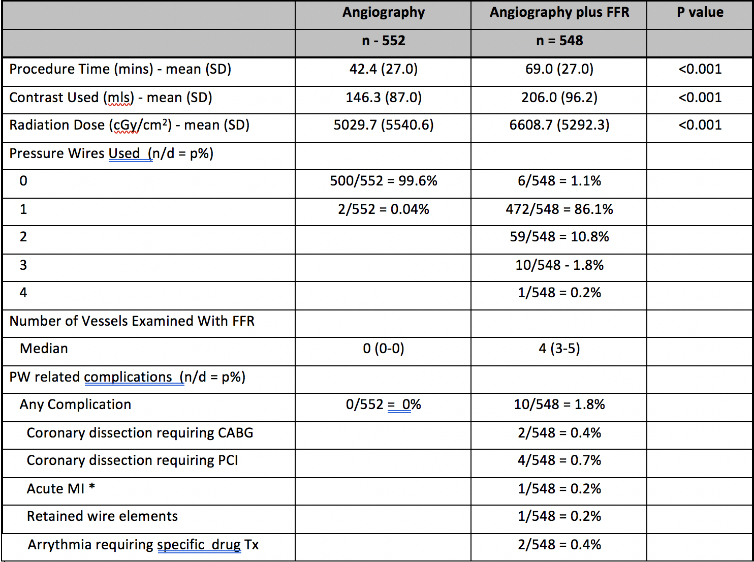
RESULTS
Procedure

Slide 12
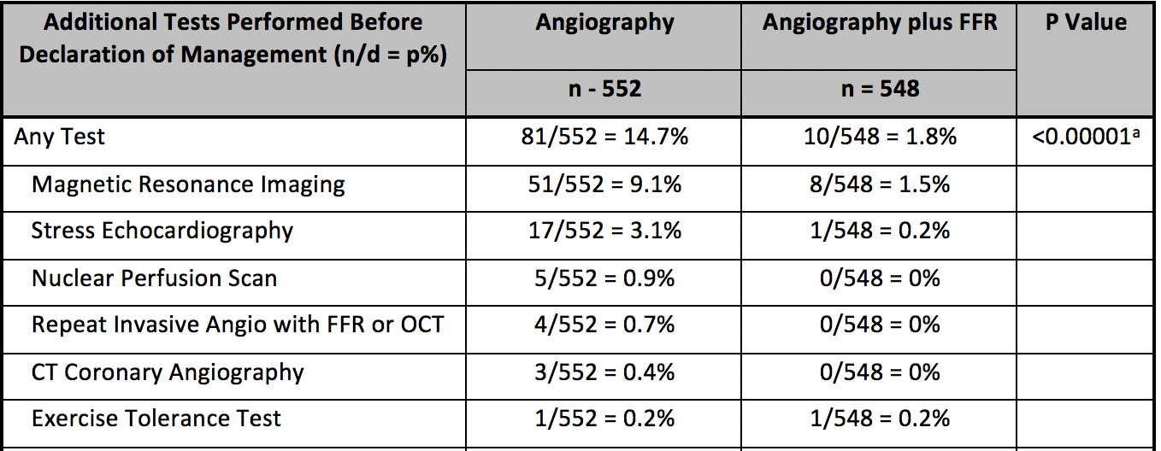
RESULTS
Management

Slide 13
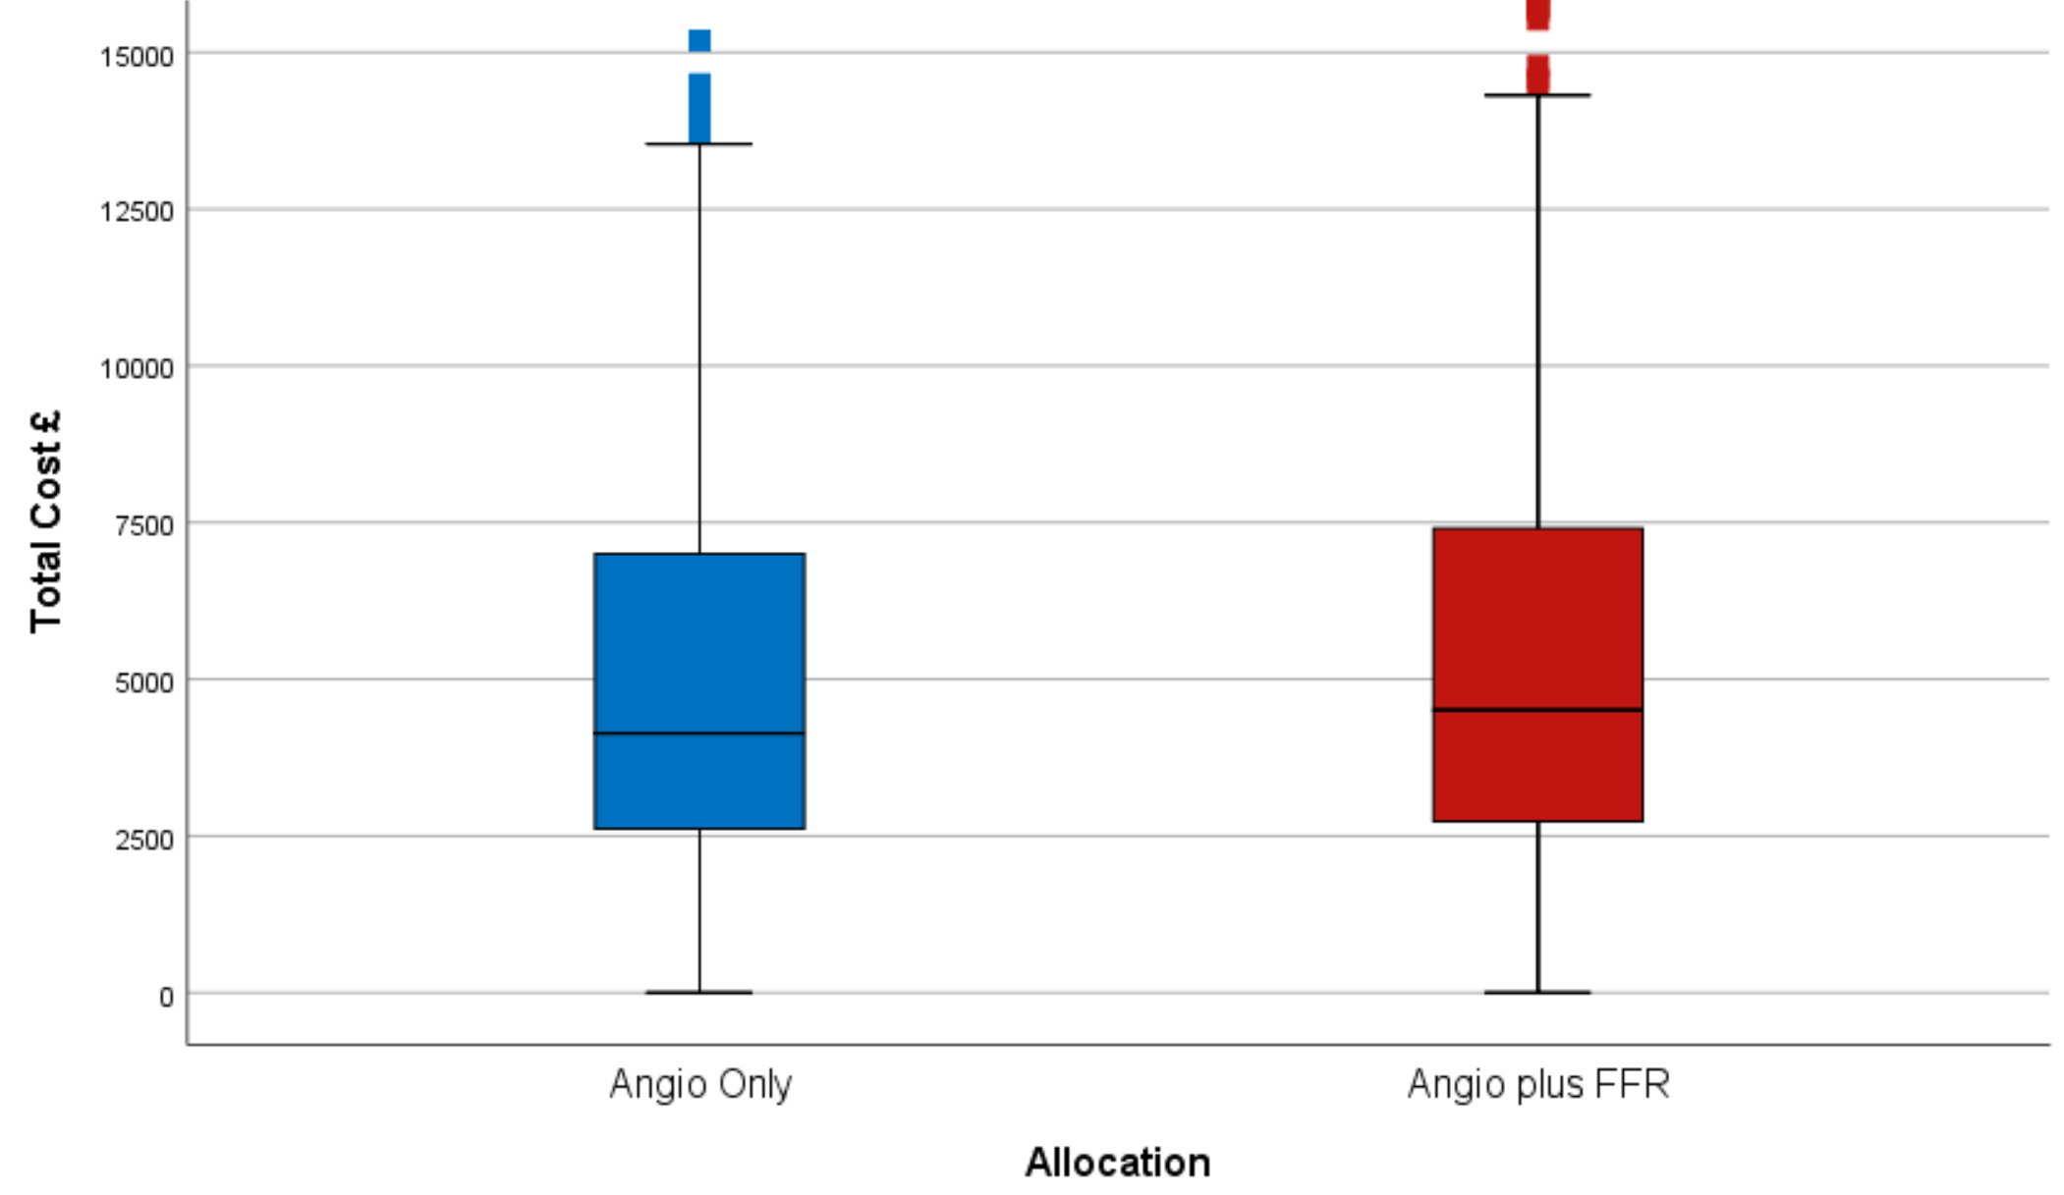
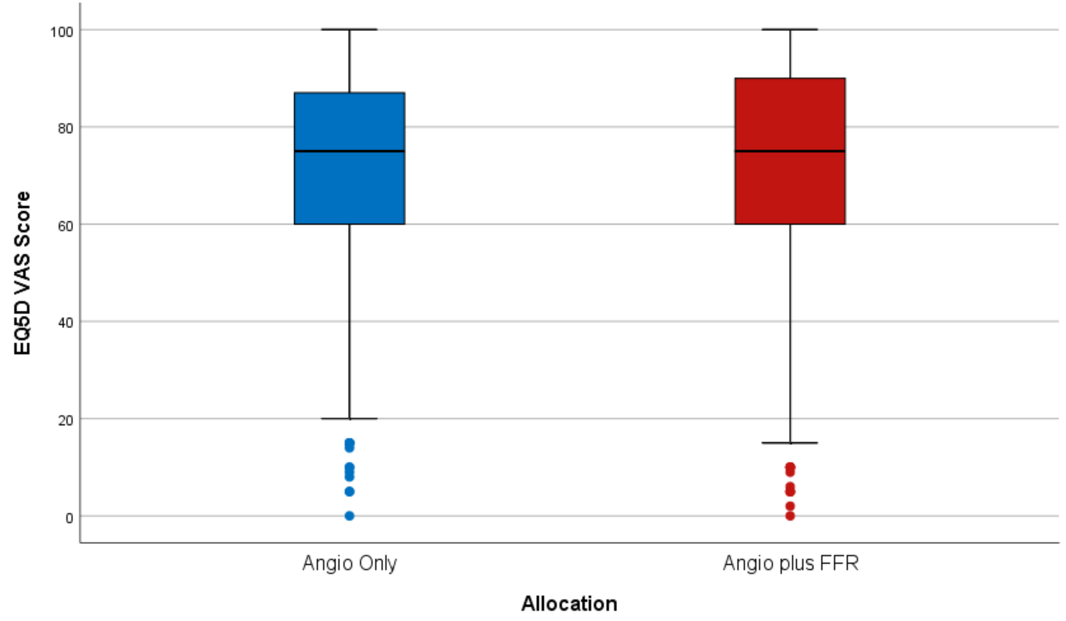
RESULTS
Primary Endpoints
Co-Primary Endpoint
Total Hospital Costs at
12 months (£)
Co-Primary Endpoint
Quality of Life
(EQ5d VAS)
p=0.137
p=0.88
Total Cost £
EQ5D VAS
ANGIO ONLY
ANGIO+FFR
ANGIO ONLY
ANGIO+FFR
£4136 (2613-7015)
£4510 (2721-7415)
75 (60-87)
75 (60-90)

Slide 14
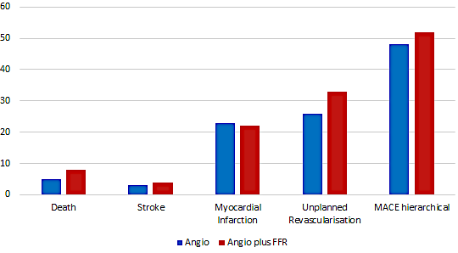
RESULTS
Secondary Endpoint
Clinical Events
p=0.64
TOTAL MACCE EVENTS
ANGIO ALONE 8.7% (48/552)
ANGIO+FFR. 9.5% (52/548)

Slide 15
CONCLUSION
Routine, systematic FFR assessment at the time of diagnostic angiography is cost neutral compared with angiographic guidance alone and is not associated with significant differences in QoL or angina status at 1 year
Nor did systematic FFR of all epicardial coronary vessels significantly alter the clinical event rate, or the distribution of management (OMT/PCI/CABG).
Systematic FFR was associated with longer procedure, more radiation + contrast, & more complications compared to angiography alone.
This strategy therefore has no overall advantage compared to angiography alone.

Slide 16
INTERPRETATION
RIPCORD2 is the first completed randomised trial of systematic FFR vs angio alone
at the stage of the diagnostic angiogram
It shows no overall advantage of this strategy in terms of cost, QoL, events or management
However, there is no direct information about the effect of FFR data on decision-making
FFR data are likely to have made an impact in individuals… but this cannot be detected in the
comparison of populations
It is likely that FFR is of most clinical value when targeted to specific patient groups
(eg those being considered for PCI with multivessel disease) rather than routinely

Slide 17
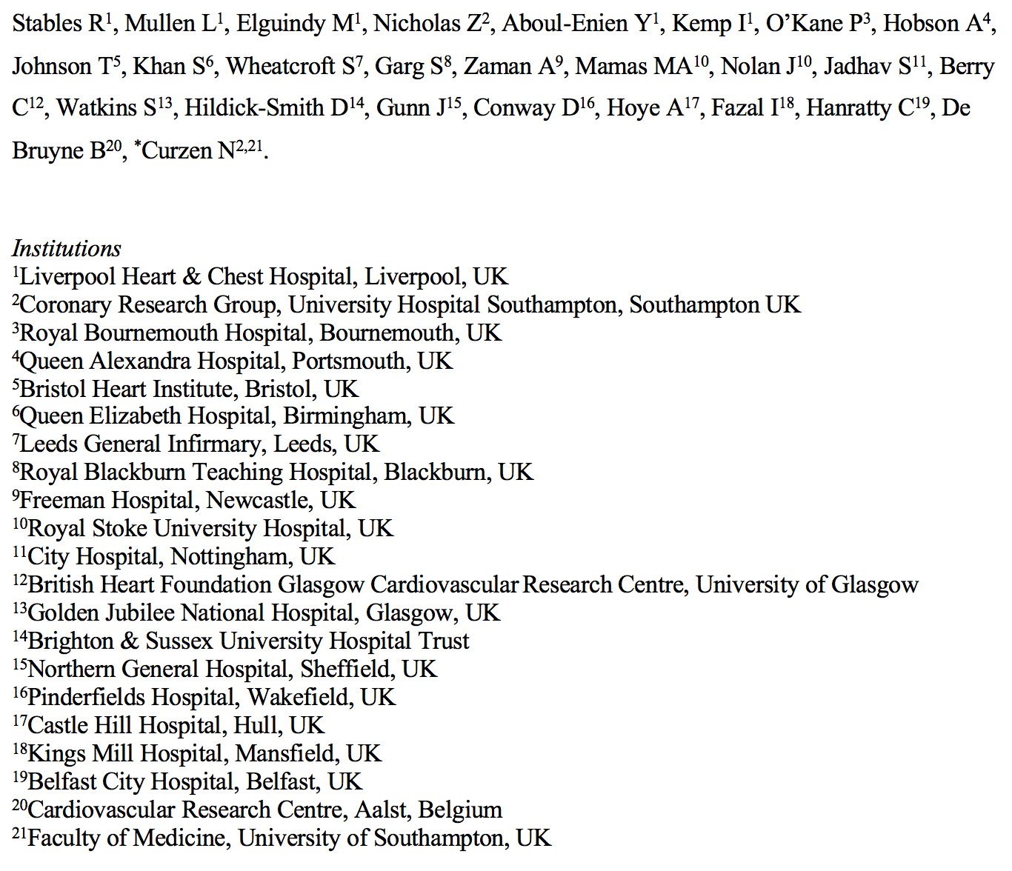
ACKNOWLEDGEMENTS
Coronary Research Group
Zoe Nicholas
Research & Development
Clinical Trials Unit

