Slide 1
Novel Healing-Targeted DES with Synchronized Antiproliferative Drug Delivery to Target Smooth Muscle Cell Proliferation after DES implantation in Coronary Artery Disease
Primary Results of the PIONEER III Trial
Alexandra Lansky, MD
Professor of Medicine, Section of Cardiology
Yale School of Medicine, New Haven, CT
Martin Leon, MD, Dean Kereiakes, MD, Andreas Baumbach, MD Shigeru Saito, MD, Stephan Windecker, MD
On Behalf of The PIONEER III
Executive Committee and Investigators

Slide 2
Disclosures
Speaker's name : Alexandra Lansky
Within the past 12 months, I have had a financial interest/arrangement or affiliation with the organization(s) listed below.
Affiliation/Financial Relationship
Grant/Research Support
Speaker/consulting fees
Major Stock Shareholder/Equity
Royalty Income
Ownership/Founder
Intellectual Property Rights
Other Financial Benefit
Astra Zeneca, Abiomed, Abbott Vascular, Bard, Boston Scientific, Biocardia, Biotronik, Cagent, Conformal, Gore, Intact Vascular, KeyStone Heart, Lifetech, Limflow, Medinol, Micell, Microport, Myocardia, Reva, Shockwave Medical, Surmodics, Trireme, Venus, Veryan Medical
Sinomed, Astra Zeneca, Abiomed, Microport, Trireme
None
None
None
None
None

Slide 3
Background
Polymer-based DES are associated with chronic inflammation and delayed vessel healing, which contribute to an annual 2-3% late DES failure and life-threatening stent thrombosis
Restoring a functional endothelium after DES implantation is fundamental to regaining vital vascular functions, minimizing the inflammatory response and regulating vascular smooth muscle cell proliferation¹
The Supreme DES (SINOMED, Tianjin, P.R. China) is a Healing-Targeted DES (HT-DES) that emphasizes early restoration of endothelial function via
Rapid drug delivery and polymer degradation, rather than the typical prolonged suppression of smooth muscle proliferation and polymer exposure
A biostable eG base layer that promotes endothelial migration and healing and protects the underlying metallic stent from chronic corrosion and ion leaching
¹Finn AV, Circulation. 2007;115:2435-41.

Slide 4
Supreme HT-DES Technology Overview
Topcoat
Biodegradable PLGA polymer coating containing sirolimus (~1.2 µg/mm² )
90% Drug elution by 28 days;
PLGA is resorbed in ~4-6 weeks
Base Layer
Ultra-thin permanent poly n-butyl methacrylate (PBMA) electro-grafted coating (eG Coating™) onto stent:
improves topcoat adhesion by interdigitation with PLGA;
accelerates migration of EC’s (vs BMS)
Bare Metal Stent
Thin-strut CoCr stent designed for deliverability and durability
Biodegradable PLGA
3-10 µm
INTERDIGITATION
eG Coating
200 nm
CoCr
80 µm

Slide 5
HT-DES Synchronizes Drug Release with Proliferation of Smooth Muscle Cell
Platelet Adherence
Leukocyte Aggregation
SMC Proliferation
Matrix Accumulation
66
100%
% Extent of Reaction
0
0.5
1
3
10
30
60
90
100
130
Time (days)
Concentration curve of Sirolimus from the Supreme DES stented vessel¹
Window of Healing
The peak value of sirolimus is at 20 days, post Supreme implantation
SMC proliferation is inhibited simultaneously
Endothelia cells are growing and healing with decreasing of drug
¹ Internal SINOMED Report, GLP Animal at AccelLab, Quebec, Canada, PK Analysis at BASi, West Lafayette, IN

Slide 6
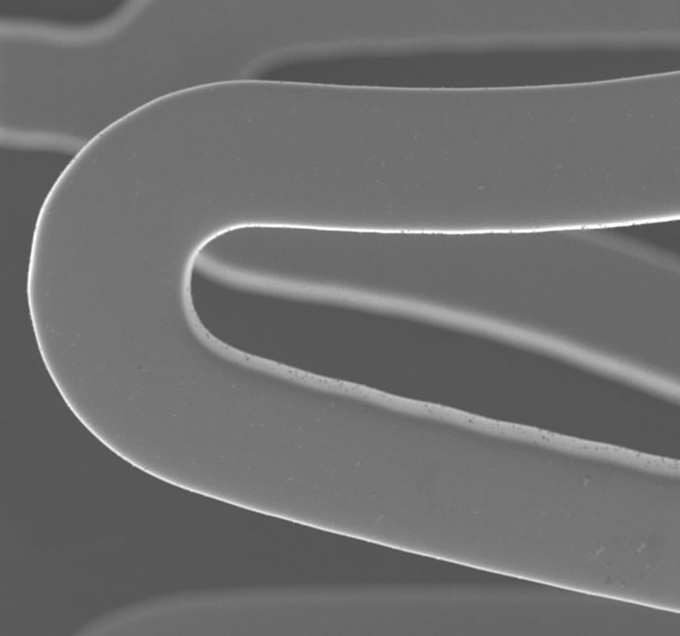
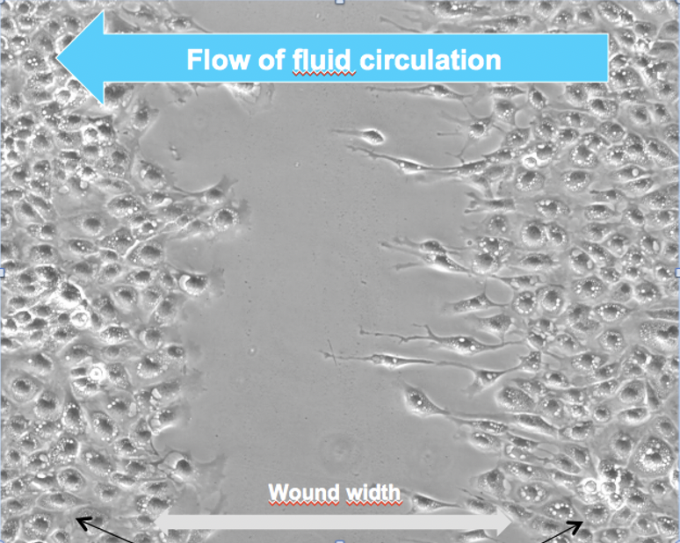
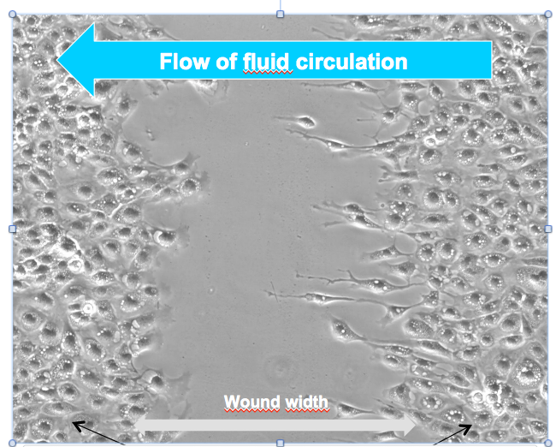
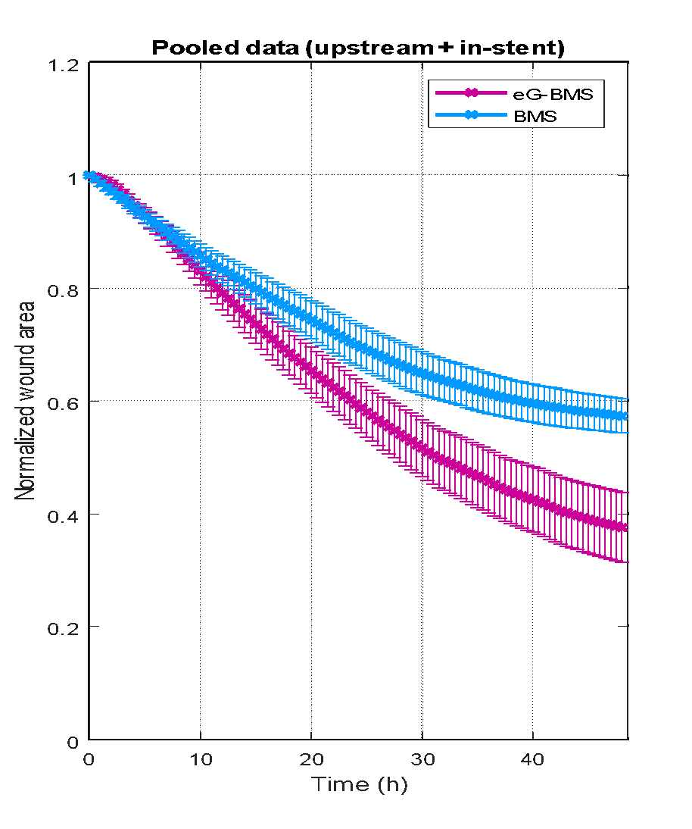
Healing Functions of the Electro-Grafted Coating (eG CoatingTM)
Wound width
BMS
eG Coating™
Time
Wound width
After PLGA resorption
eG™ base layer is inert and pro-healing¹
eG™ base layer is permanent and protects the underlying metal stent from corrosion and heavy metal ion release
Endothelial cells
High magnification microcopy shows EC migration and proliferation for eG Coating
¹Asano et al., Eurointervention, 14, e1306-e1315, 2020.

Slide 7
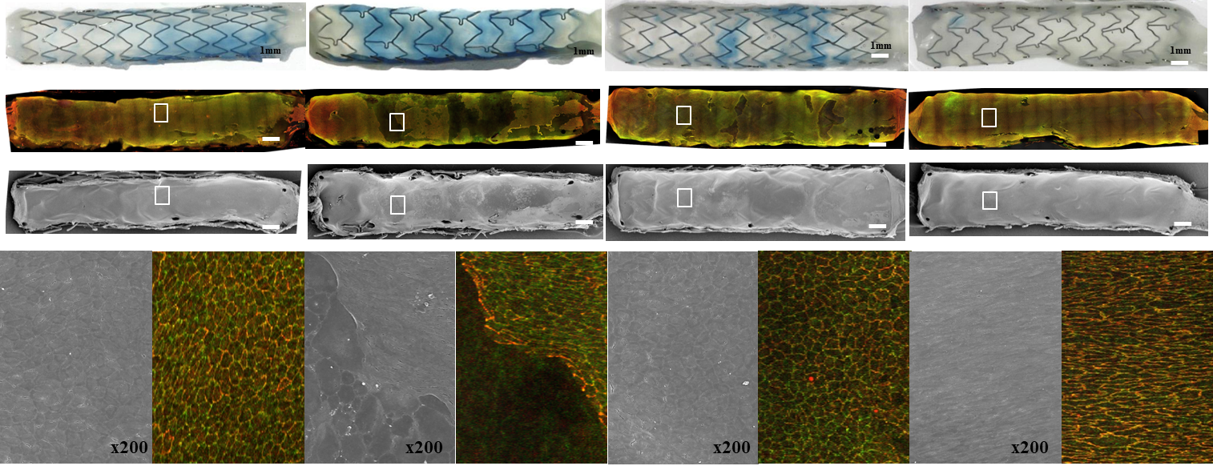
Restoration of the Endothelium Function at 90 days
Supreme HT
Xience
Synergy
Vision
Evans Blue Uptake (%)
EC Barrier Co-Localization (%)
Endothelial Coverage in SEM (%)
97.1
± 4.6
98.7
± 1.2
93.7
± 8.5
99.5
± 0.3
99.9
± 0.1
34.1
± 14.2
5.7
± 4.9
77.7
± 22.6
64.8
± 25.6
81.3
± 19.0
23.2
± 7.6
26.4
± 19.2
* p<0.05 vs Supreme, †p<0.05 vs Xience, ‡p<0.05 vs Synergy (generalized estimating equation)
Sakamoto A, Finn AV, Cardiovasc Revasc Med. 2020 Aug 13;S1553-8389(20)30481-4.
Notes:
7
In vivo animal study was conducted to examine the endothelial healing among the eG base layer coated stent (eG BuMA), fully loaded BuMA drug eluting stent (eG SES) and the first generation Cypher stent. The SEM images clearly showed that the eG BuMA and eG SES achieved complete endothelial coverage at 90 days in Rabbit model compared to the Cypher stent. eG base layer didn’t impair or even promote the endothelial coverage of the stents.

Slide 8
PIONEER III Trial Design
Subjects with CCS and ACS (no STEMI) Up to 3 de novo native lesions in up to 2 major vessels
RVD ≥ 2.25 to ≤ 4.0 mm, Length ≤ 31 mm
N = 1632
Supreme
(HT-DES)
n=1088
2:1 Randomization
74 sites (US, CAN, JP, EU)
Xience/Promus
(DP DES)
n=544
Primary Endpoint
Clinical F/U
30d
6mo
12mo
2yr
3yr
4yr
5yr
Angio Baseline
Primary Endpoint: TLF (DoCE) = Cardiac Death, Target Vessel MI, ID-TLR at 12mo
Powered Secondary Endpoints: TLF from 1-5 years by landmark analysis
Secondary Endpoints: Lesion, device success, TLF, TVF, TLR, MACE (all death, all MI*, any revascularization), Stent thrombosis (ARC defined) at each F/U time point
*Third universal MI definition
ClinicalTrials.gov Identifier: NCT02520180

Slide 9
Statistical Methods
Primary Endpoint
Non-inferiority test of TLF at 12 months
Estimated control TLF rate = 6.5% (derived from 14 DES trials, 13,833 patients)
Non-inferiority margin = 3.58% (preserves 60% of treatment effect of DES vs BMS)
One-sided type 1 error = 0.025
Expected attrition rate at 12 months = 5%
Power = 80%
N= 1632 (HT-DES=1088, DP-DES=544, 2:1 randomization)
Farrington-Manning test
Powered Secondary Endpoint
Test of superiority of TLF between 1 to 5 years follow-up in a landmark analysis
Population:
Primary: Intention to treat population (ITT)
Secondary: Per protocol population

Slide 10
Study Organization
Executive Committee | Other Committees
Chair: M. Leon US PI: D. Kereiakes US Co-PI: A. Lansky EU PI: S. Windecker EU Co-PI: A. Baumbach Japan PI: S. Saito Members: P. Urban, M. Valgimigli, A. Kirtane | Cardiovascular Research Foundation Data Monitoring Committee Clinical Events Committee Yale Cardiovascular Research Global Project Management Angiographic Core Laboratory Publications Committee IQVIA Site Management, Monitoring

Slide 11
PIONEER III Contributing Centers
Europe
23 Sites
650 patients (40%)
North America
37 Sites US and Canada
816 patients (50%)
Japan
14 Sites
163 patients (10%)

Slide 12
Consort Diagram
Randomized
(N = 1629)
HT-DES
(N = 1086)
DP-DES
(N = 543)
 | Analysis Populations
N = 1086 | Intention to Treat | N = 543
N = 1068 | As Treated | N = 537
Died: 3
Withdrew: 1
LTFU: 0
Other:1
Died: 1
Withdrew: 0
LTFU: 0
Other:1
1062/1081
(98.2%)
30 Day Follow-Up
526/541
(97.2%
Died: 5
Withdrew: 6
LTFU: 1
Other: 1
Died: 2
Withdrew: 2
LTFU: 0
Other:1
1053/1073
(98.1%
6 Month Follow-Up
520/538
(96.7%)
Died: 6
Withdrew: 7
LTFU: 3
Other:1
Died: 7
Withdrew: 3
LTFU: 2
Other:1
1036/1069
(96.9%)
1 Year Follow-Up*
521/530
(98.3%)
Died: 7
Withdrew: 8
LTFU: 9
Other:1
Died: 9
Withdrew: 5
LTFU: 2
Other:1
*End of 1-year Visit Window
(365 Days + 30 Days from Randomization

Slide 13
Baseline Characteristics
 | HT-DES (N=1086) | DP-DES (N=543)
Age - years | 64.53 ± 9.83 | 63.93 ± 10.26
Female – (%) | 23.8 | 27.3
Smoker (current/previous) – (%) | 61.2 | 59.4
Diabetes Mellitus – (%) | 30.5 | 30.1
Hypertension – (%) | 74.2 | 69.9
Hypercholesterolemia – (%) | 77.1 | 76.2
Previous MI - (%) | 17.4 | 18.6
Previous PCI - (%) | 28.0 | 30.6
Multi Vessel disease - (%) | 27.4 | 30.8
Previous CABG - (%) | 4.9 | 4.2
Previous Stroke - (%) | 4.2 | 3.5
Renal Insufficiency - (%) | 7.9 | 7.9

Slide 14
Procedure Characteristics
 | HT-DES (N=1086 pts; 1304 lesions) | DP-DES (N=543 pts; 677 lesions)
Radial/Brachial Access - (%) | 81.5 | 79.6
FFR Performed – (%) | 7.5 | 8.1
IVUS Performed – (%) | 15.3 | 14.8
Target Vessels treated per patient | 1.11 ± 0.32 | 1.14 ± 0.34
>2 vessels treated - (%) | 11.2 | 13.7
Target lesions per patient | 1.2 ± 0.5 | 1.3 ± 0.5
2 Target lesions - (%) | 15.8 | 19.2
3 Target lesions - (%) | 2.3 | 3.0
Number of stents per patient# | 1.2 ± 0.6 | 1.3 ± 0.6
Stented Lesion Length, mm | 20.81 ± 8.17 | 20.44 ± 7.94
B2/C Lesion*- (%) | 67 | 65
Reference Diameter* - mm | 2.78 ± 0.44 | 2.79 ± 0.44
Baseline Diameter Stenosis* % | 66.6 ± 13.0 | 66.4 ± 13.0
Baseline Lesion Length* mm | 15.3 ± 7.6 | 14.8 ± 7.0
Final In-Stent Diameter Stenosis* % | 8.4 ± 4.6 | 8.0 ± 4.7
Final Segment DS* % | 9.9 ± 4.5 | 9.8 ± 4.3
# p=0.02; * Angiographic Core Lab assessed by QCA

Slide 15
Device Performance
 | HT-DES (N=1086) | DP-DES (N=543) | P Value
Lesion Success - (%) | 99.7 | 99.5 | 0.62
Device Success - (%) | 97.3 | 98.8 | 0.07
Absence of Device Success – N (%) | 34 (2.7) | 8 (1.2) | 0.07
Device Implanted Outside Target- (N) | 1 | 2 | 0.16
Other DES Implanted After a Failed Assigned DES - (N) | 24 | 3 | 0.20
Other DES Implanted After Successful Assigned DES - (N) | 9 | 2 | 0.91
Residual Stenosis ≥ 30% - (N) | 1 | 1 | 0.38
Lesion success: <30% DS of the target lesion by QCA
Device success: lesion success with assigned device
DAPT Compliance: 99.1% Post procedure and 83% at 12 months
Chang et al. Position Statement for device success in PCI: EuroInt 2020;15:1190

Slide 16
TLF at 12 months (ITT)
Primary Endpoint | HT-DES (N = 1088 Patients) | DP-DES (N = 543 Patients) | Difference (95% CI) | One Sided 95% Upper Confidence Boundary | Non-inferiority Margin | P-value² ^{For non-inferiority}
TLF at 365 days | 5.4% (57/1057) | 5.1% (27/532) | 0.32% (-1.87%,2.5%) | 2.5% | 3.58% | 0.002
Non-inferior
-2.0
-1.0
0.0
1.0
2.0
3.0
4.0
5.0
6.0
7.0
8.0 %
Zone of non-inferiority
Pre-specified margin = 3.58%
Upper one-sided 95% CI
Primary non-inferiority endpoint met

Slide 17
Primary Endpoint (ITT)
HT-DES
DP-DES
10
HR: 1.05 [95% CI: 0.67, 1.66]
8
P-Value = 0.82
6
5.3%
Target Lesion Failure (%)
5.0%
4
2
0
0
3
6
9
12
Time in Months
Number at risk:
HT DES
1,086
1,042
1,031
1,010
759
DP DES
543
518
511
507
378

Slide 18
Secondary Endpoints (ITT)
p = 0.45
p = 0.06
p = 0.18
All rates based on KM estimates

Slide 19
Composite Secondary Endpoints
Cardiac Death or Target Vessel MI
HT-DES
DP-DES
10
%
HR: 0.76 [95% CI: 0.46, 1.25]
8
P-Value = 0.27
6
4.6%
4
3.5%
2
p = 0.82
p = 0.87
0
0
3
6
9
12
Time in Months
Number at risk:
HT DES
1,086
1,045
1,038
1,025
775
DP DES
543
518
512
508
379
All rates based on KM estimates

Slide 20
Stent Thrombosis (ITT)
All ST
p = 0.48
p = 0.22
Definite ST
Probable/Possible ST
All rates based on KM estimates

Slide 21
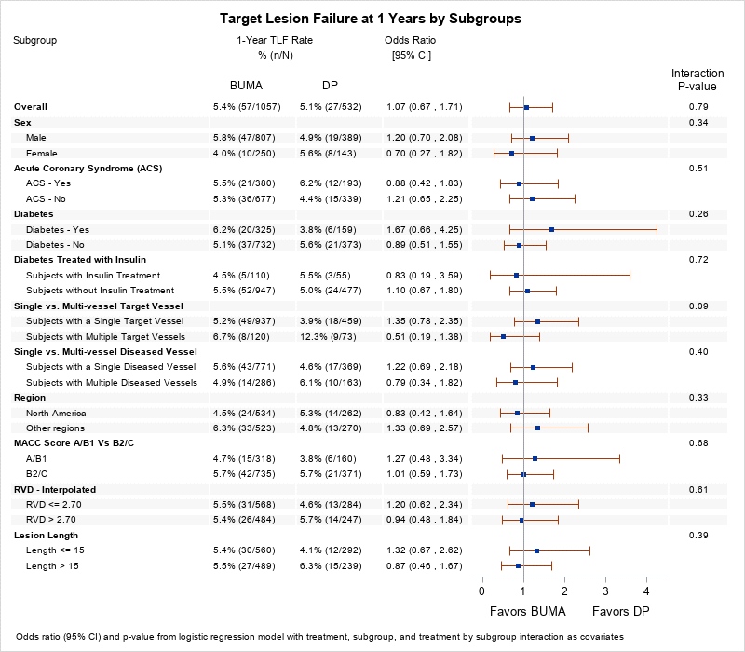
Pre-specified Subgroup Analyses
HT-DES
DP-DES
Favors HT-DES
Favors DP-DES
Target lesion failure (TLF) at 12 months: cardiac death, TV-MI, or clinically-driven target lesion revascularization (TLR)

Slide 22
Limitations
The trial was not powered for superiority at 12-months. Differences in outcomes will be assessed in a powered landmark analysis from 1-5 years.
TLR rates were lower than previously reported (1%) in the control group and ID TLR was not significantly different. Caution should be used when comparing low frequency events that were not powered.
This was not an all comers study (STEMI, CTO, LM were excluded) limiting generalizability of results to all patients.

Slide 23
Conclusions
Among patients with acute and chronic coronary syndromes undergoing PCI, the novel Healing-Targeted DES was as safe and effective as the standard DP-DES
Safety measures of CV Death+TV MI and late ST numerically favor HT-DES compared to DP-DES
Whether these early safety measures with HT-DES therapy differentiate into significant clinical benefit in the longer-term will be assessed at 5 years follow-up

